Slide 1
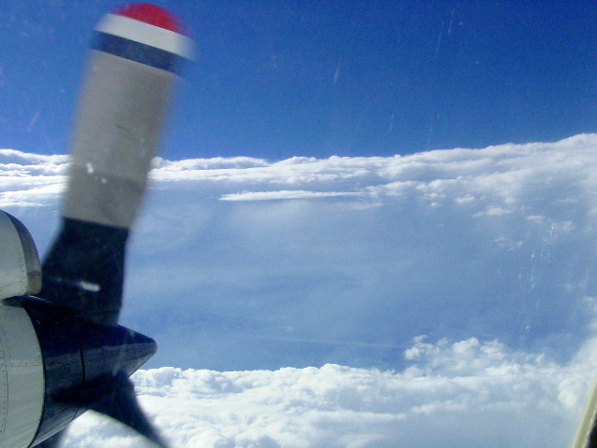
Tropical Storm Karl (2016) Debrief
Rob Rogers – HFP Director

Slide 2
Agenda for Karl debrief
Overview of missions
a. IFEX
2. Logistics
a. Staffing (airborne and ground-based)
b. Communications, including social media
c. Safety
d. Administrative
e. Suggestions for me
f. Other comments, etc
3. Science summary
a. motivation for RAPX
b. LPS summaries

Slide 3
Overview and accomplishments of Karl missions
Long-lived system over western Atlantic basin
Slow intensification, nearly reached hurricane intensity
SHIPS guidance indicated favorable (low shear, high SST) environment for intensification, RI was considered a reasonable possibility despite dry air
RAPX missions flown, combination P-3 and G-IV (7 P-3, 4 G-IV)
1 ET mission flown with G-IV
Coordinated legs with GH during 2 P-3 missions

Slide 4
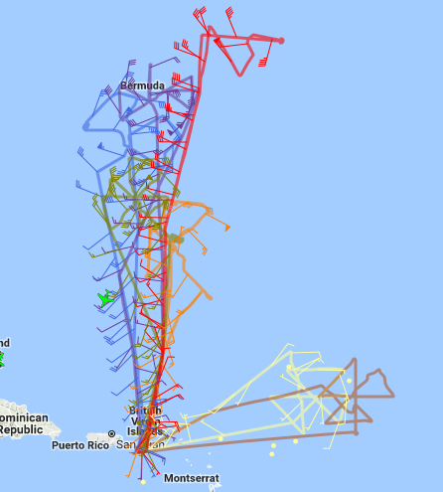
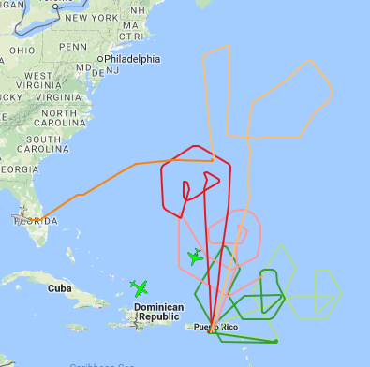
Karl missions: P-3 and G-IV
7 P-3, 5 G-IV missions flown
System struggled with continued moderate SW, then SE shear
Dry air persistent on S side of storm
Began missions when it was a TS, downgraded to TD, put missions on hold
Resumed missions when it reobtained TS status
Reached 60 kt surface winds during RAPX missions, never reached hurricane status
Novel sampling strategy with P-3 and G-IV missions
146 HRD drops released for RAPX, 20 for ET; ~15 IR sonde/BT combos
P-3 flight tracks
G-IV flight tracks
ET pattern

Slide 5
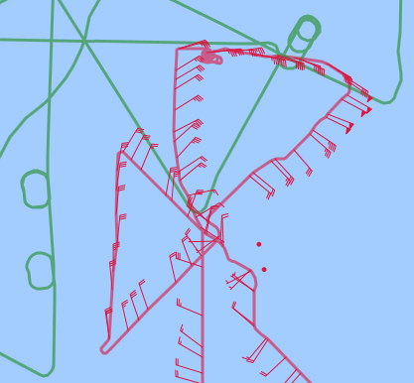
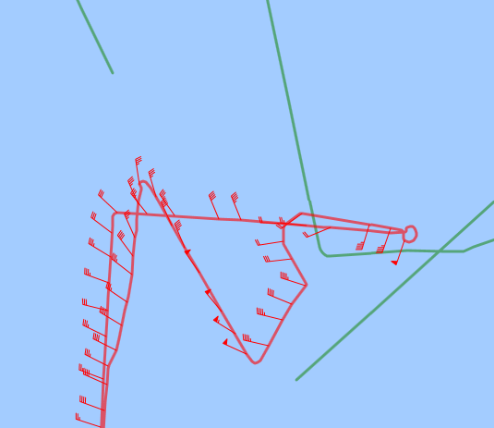
Coordination between P-3 and GH
Coordinated legs on 9/22, 9/24
Vertically stacked for portions of legs
  E-W leg on 9/22
  NW-SE, E-W legs on 9/24
Problem with GH not appearing on MTS during coordination legs on 9/24
September 22
September 24

Slide 6
Logistics
a. Staffing (airborne and ground-based)
b. Communications, including social media
c. Safety
d. Administrative
e. Suggestions for me
f. Other comments, etc

Slide 7
Science overview
Why did we fly these missions?
  Favorable environment, at least as diagnosed and predicted by SHIPS
  Storm looked to have a reasonable chance to intensify substantially, potentially RI
Science questions
  What is importance of thermodynamic environment near storm, especially on upshear side?
  How does precipitation structure respond to this environment?
  How does vortex intensify (or not intensify)?

Slide 8
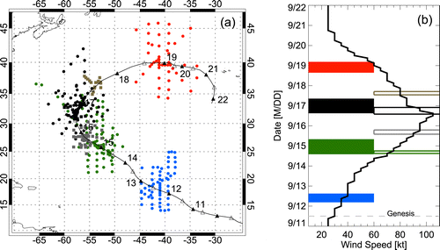
Case of Edouard (2014)
Earth-relative dropsonde locations and sampling times
Zawislak et al. 2016

Slide 9
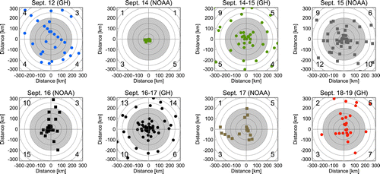
Case of Edouard (2014)
Distribution of dropsondes relative to the shear vector (pointing up)
Zawislak et al. 2016
Sampled over several days by P-3, G-IV, GH
Flights before, during RI, at end when steady-state
Focus on thermodynamic environment (RH) upshear

Slide 10
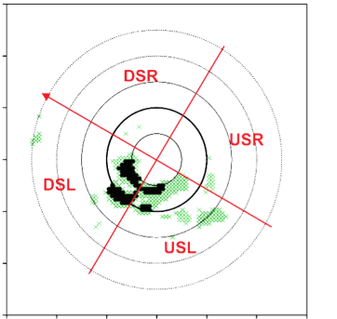
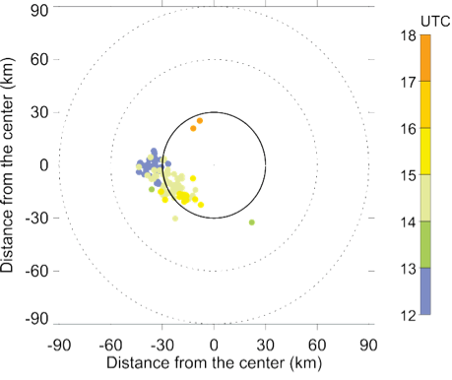
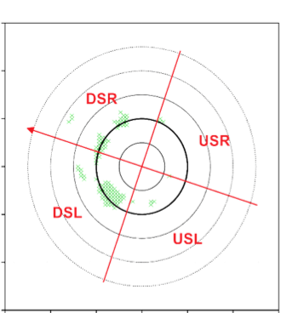
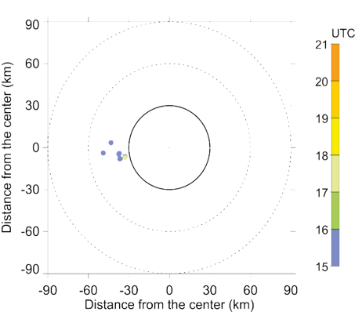
Case of Edouard (2014)
Locations of strong updrafts and lightning for Edouard (2014)
Strong 8-16 km updrafts
Lightning flashes from WWLLN
90
> 3 m/s
> 5 m/s
60
DSR
Distance from the center (km)
shear
shear
30
USR
14 September
(RI)
0
RMW
DSL
-30
-60
USL
-90
-90
-60
-30
0
30
60
90
Distance from the center (km)
90
> 3 m/s
> 5 m/s
60
DSR
Distance from the center (km)
30
shear
shear
USR
16 September
(SS)
0
RMW
-30
DSL
-60
USL
-90
-90
-60
-30
0
30
60
90
Rogers et al. 2016
Distance from the center (km)
14 Sept (RI): Strongest updrafts DSL, USL; Lightning flashes begin DSL, rotate toward USL and inside RMW
16 Sept (SS): Limited strong updrafts and lightning mostly DSL

Slide 11
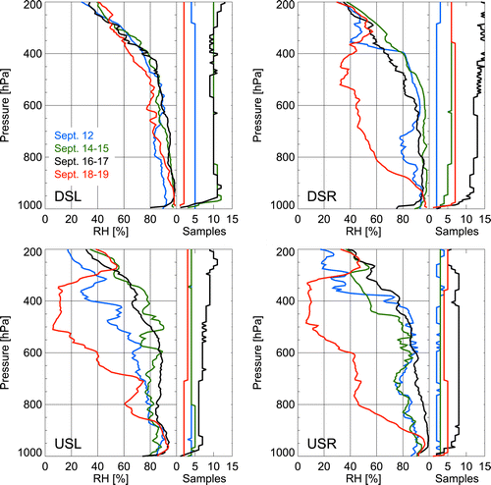
Case of Edouard (2014)
RH profiles stratified by day and shear-relative quadrant
downshear
Pre-RI
RI
SS
Weak
upshear
Zawislak et al. 2016
Focus on blue, green, black curves -- moist downshear during RI, SS
Dry USL pre-RI, moistened by time of RI -- what caused that moistening?
Was that crucial to observed greater distribution of deep convection USL this day?

Slide 12
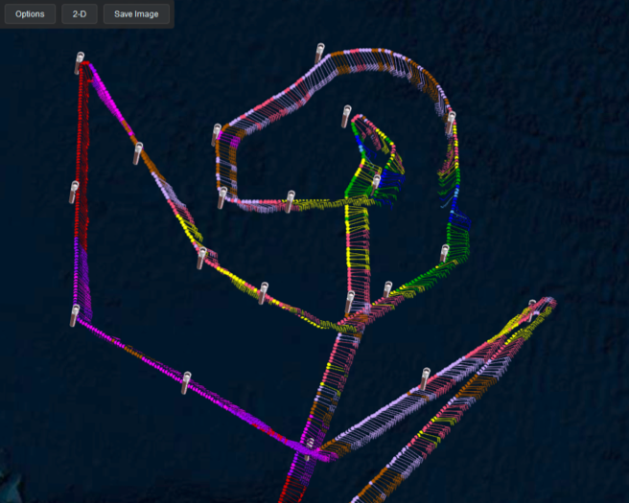
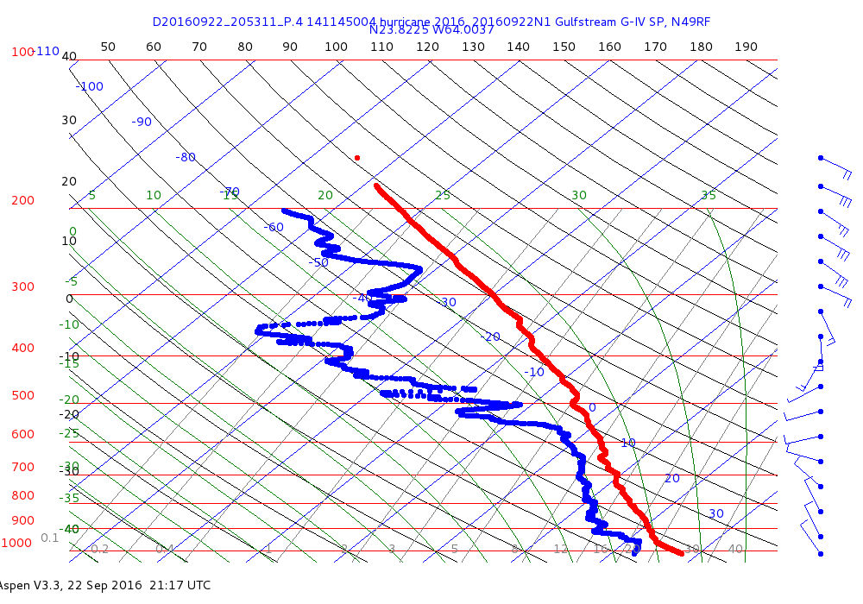
Karl (2016)
Provides opportunity to examine potential importance of upshear thermodynamics in another case
Ability to use G-IV to target upshear environment crucial to these missions
9/22 2053 UTC upshear drop
What was importance of dry air upshear to Karl’s inability to intensify significantly?

Slide 13
LPS summaries
Chronology of flights
160920N1 G-IV 1:30PM Sept 20
160920I1 P-3 2:00PM Sept 20
160921I1 P-3 2:00AM Sept 21
160921N1 G-IV 1:30PM Sept 21
160922N1 G-IV 1:30PM Sept 22
160922I1 P-3 2:00PM Sept 22
160923I1 P-3 2:00AM Sept 23
160923N1 G-IV 1:30PM Sept 23
160923I2 P-3 2:00PM Sept 23
160924I1 P-3 2:00AM Sept 24
160924N1 G-IV 1:30PM Sept 24
160924I2 P-3 2:00PM Sept 24

Slide 14
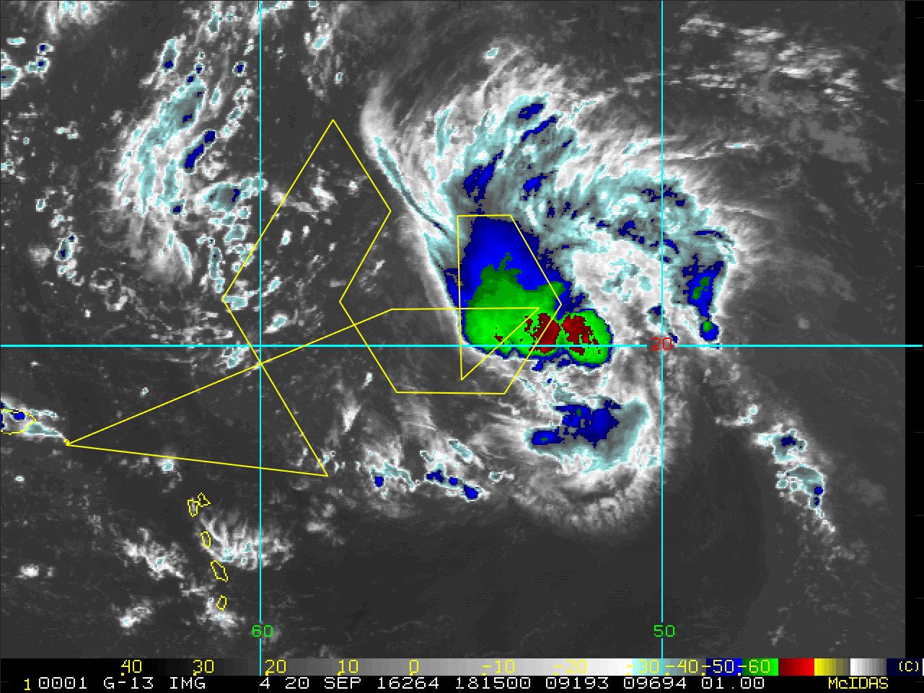
160920N1 (LPS: Aksoy)
Planned Flight Track and Actual Dropsondes
(13 Planned + 4 Extra)
Planned flight track
Actual dropsonde locations
Extra dropsonde locations

Slide 15
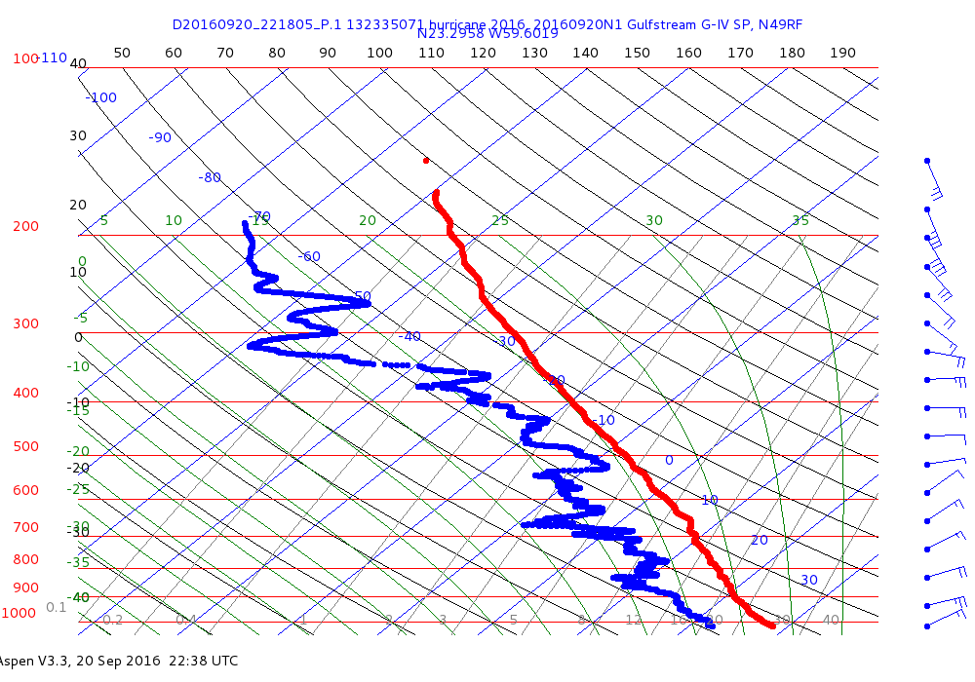
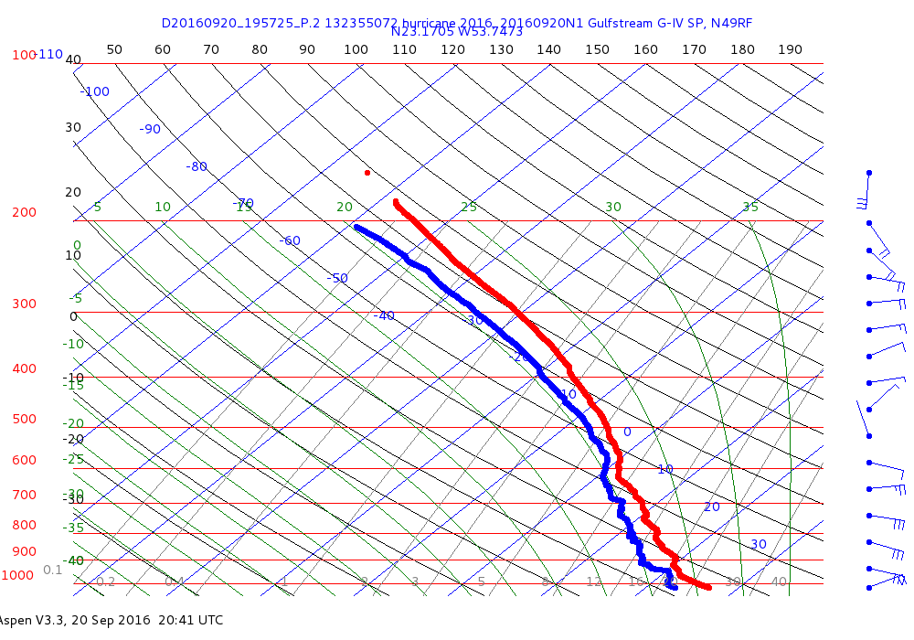
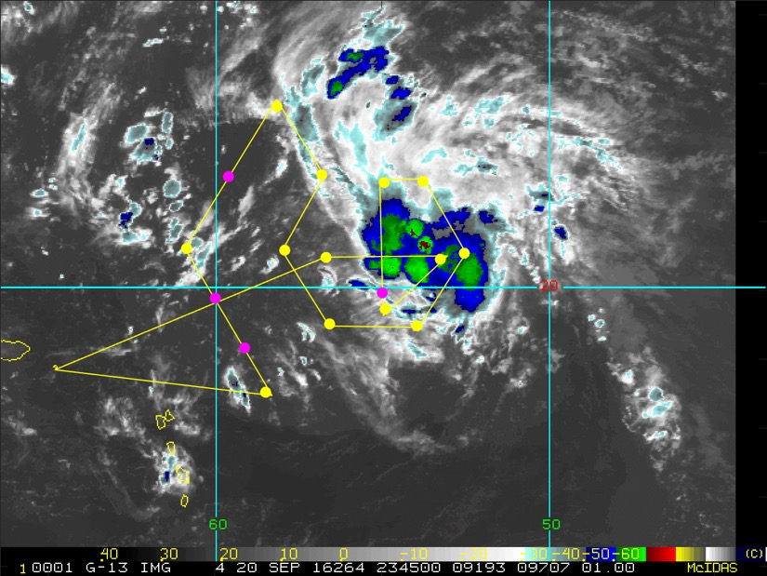
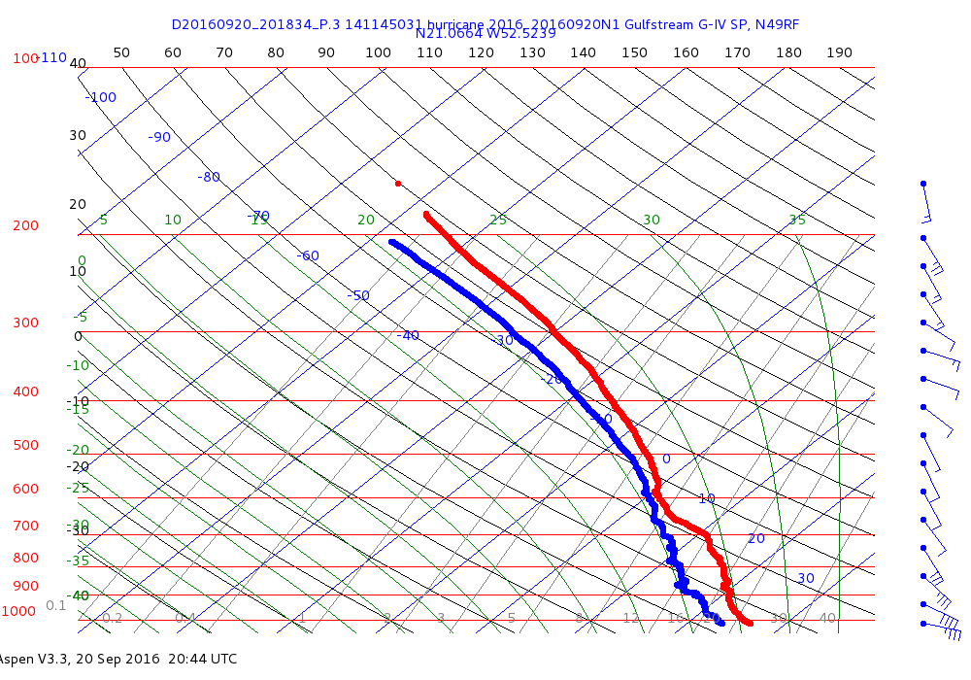
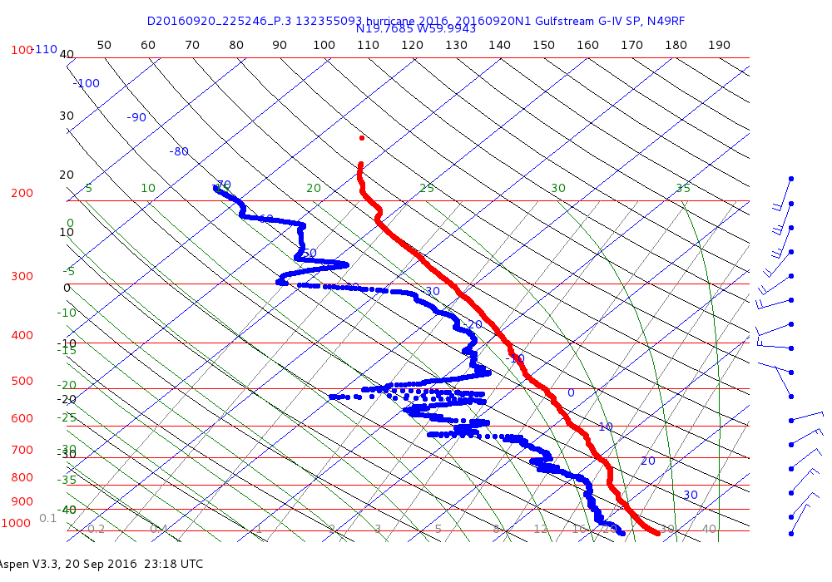
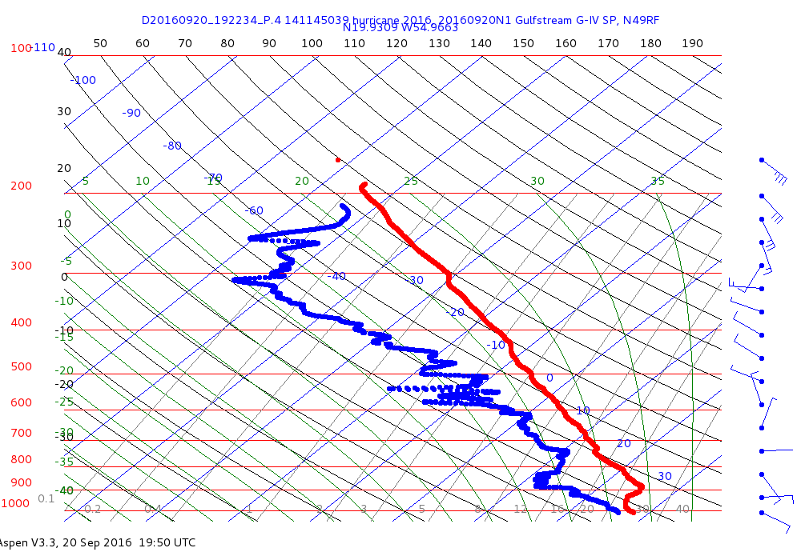
Sample Skew-T Diagrams
“Center Drop”

Slide 16
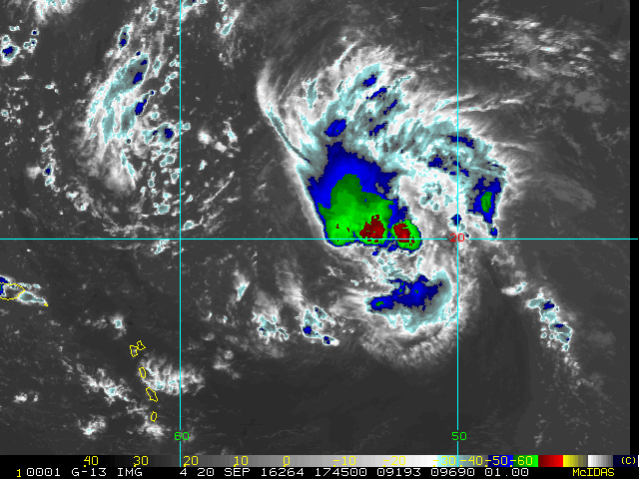
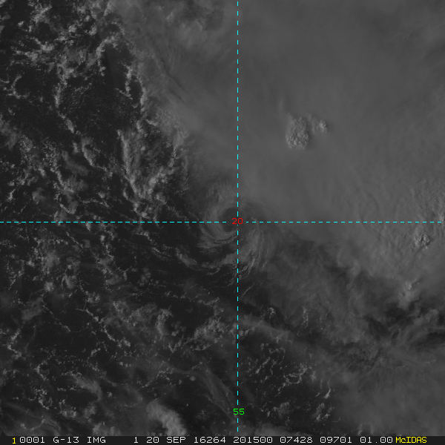
Mission 20160920I1 (RAPX)
LPS: Bucci Radar: Klotz/Gamache Drops: Christophersen
NHC Intensity: 40kts
Motion: ~15kts W
Shear: SSW @ 15 kts

Slide 17
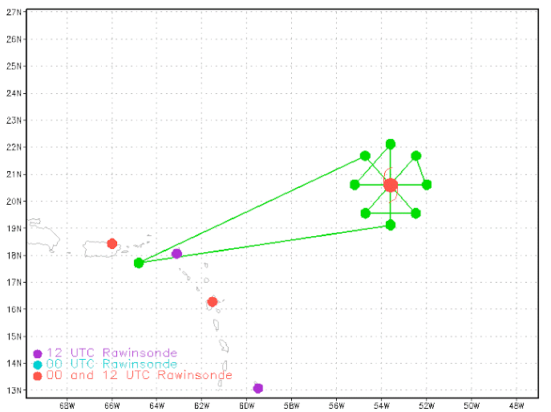
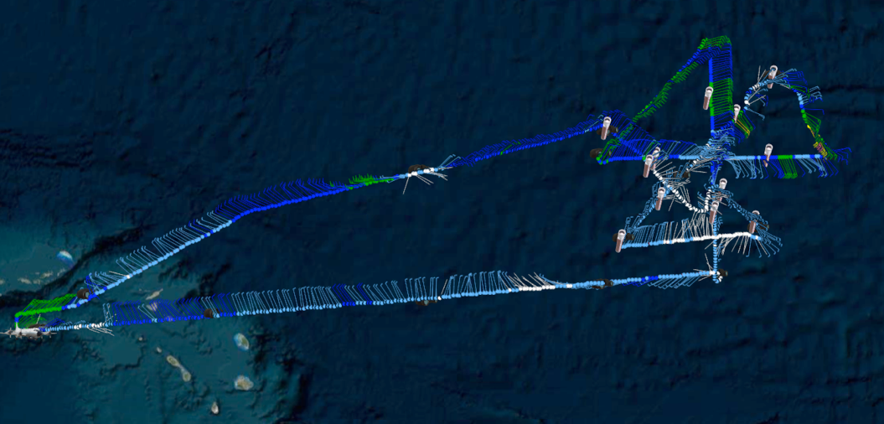
Mission 20160920I1 (RAPX)
LPS: Bucci Radar: Klotz/Gamache Drops: Christophersen
FL Altitude: 10000 ft
Peak FL: 25kts
Peak SFMR: 34kts

Slide 18
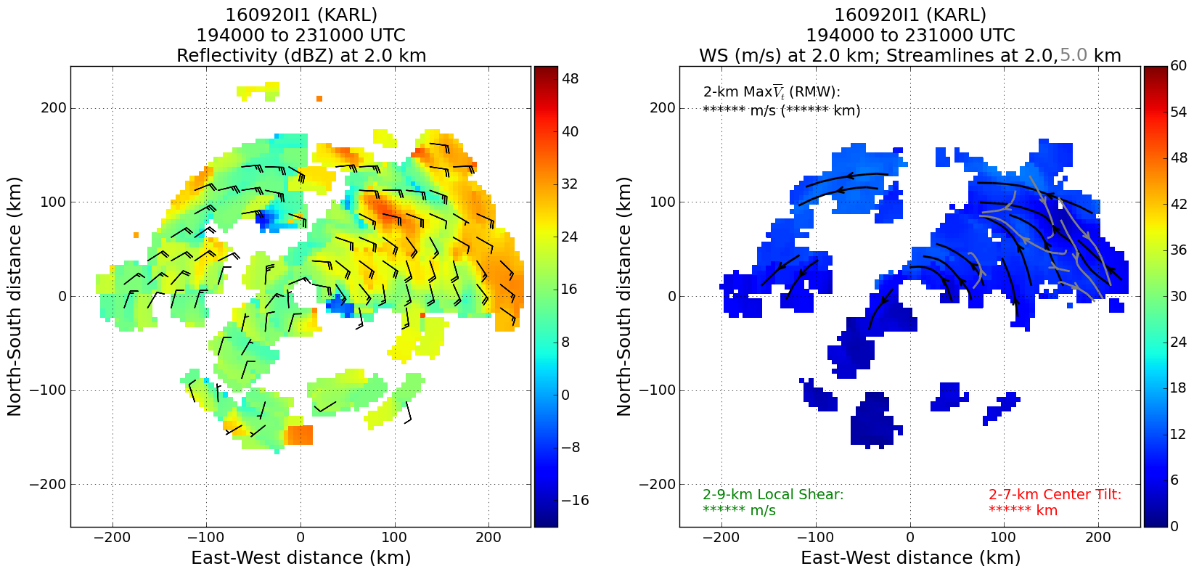
Radar Analyses: 4 Drops: 14 (1 bad) Highest Echo Tops: 16km
Problems: None

Slide 19
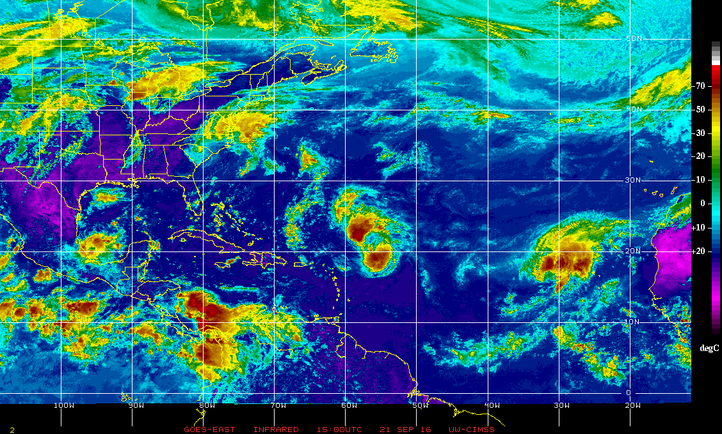
20160921I1
LPS (Jun Zhang), Radar (Paul Reasor), Sonde (Brittany Dahl)

Slide 20
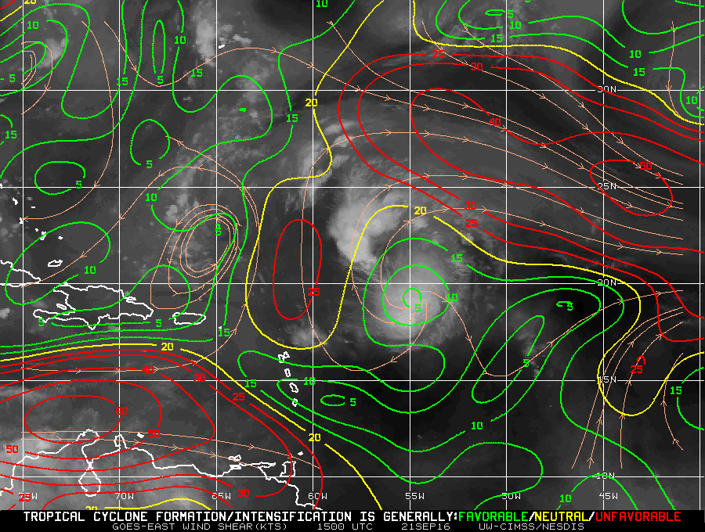
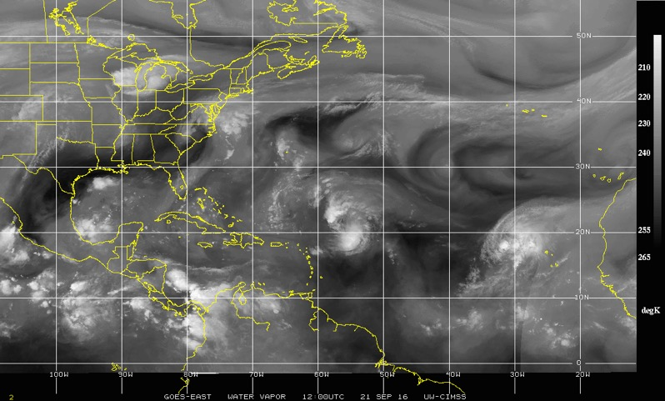
20160921I1
LPS (Jun Zhang), Radar (Paul Reasor), Sonde (Brittany Dahl)
Deep layer shear
Water vapor

Slide 21
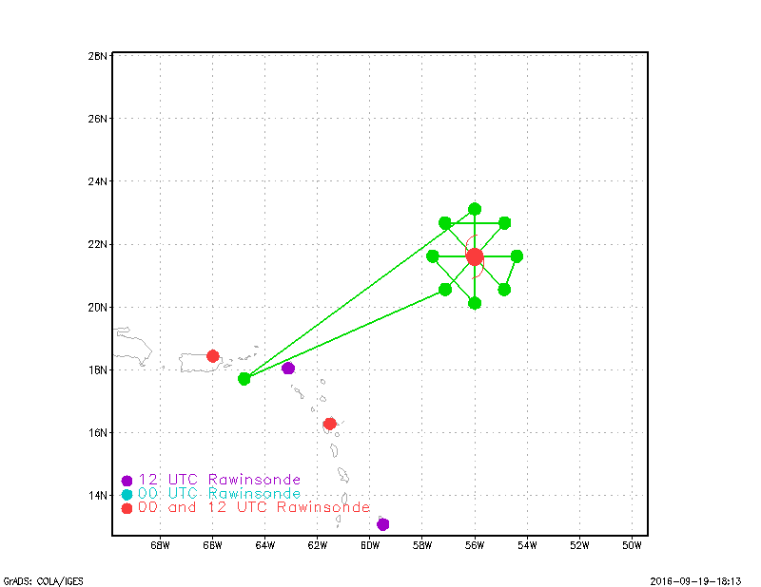
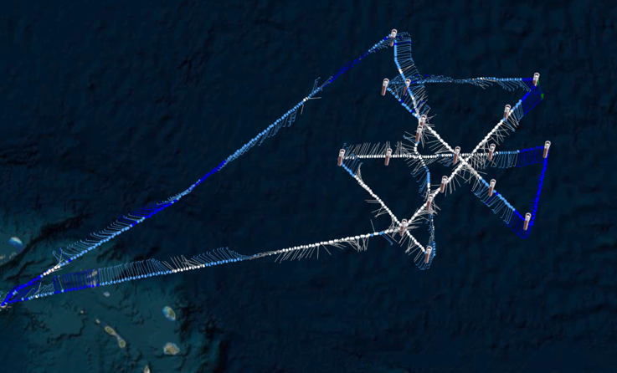
20160921I1
LPS (Jun Zhang), Radar (Paul Reasor), Sonde (Brittany Dahl)
RAPX mission: No problem with radar software, everything was smooth for the first 2 AM flight (seat-belt light wasn’t on all the time during the mission), 18 sondes, 4 Doppler radar passes, maximum surface wind ~ 40 kts.

Slide 22
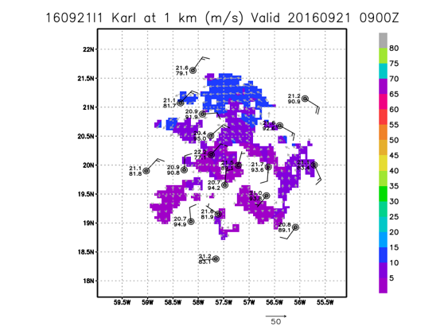
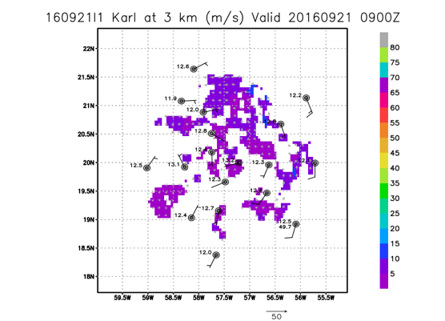
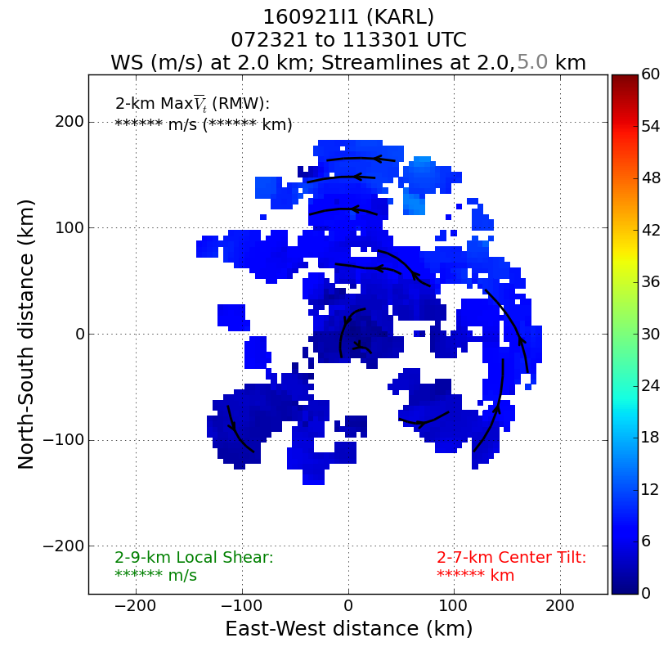
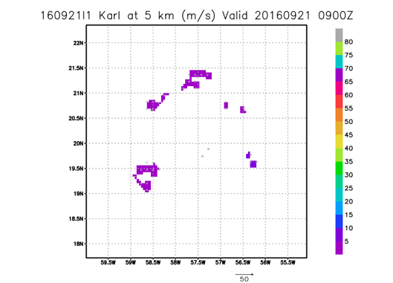
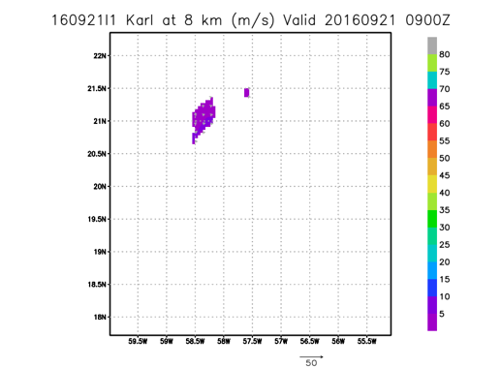
Shallow vortex, not much scatter at 5 km altitude. Tilt analysis may not be meaningful at this stage.
Storm became tropical depression after our mission. Two P3 missions following this mission were cancelled.

Slide 23
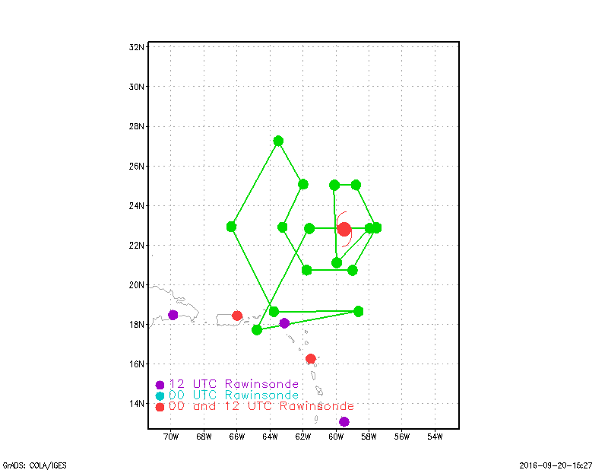
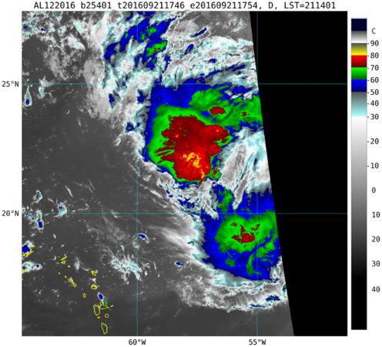
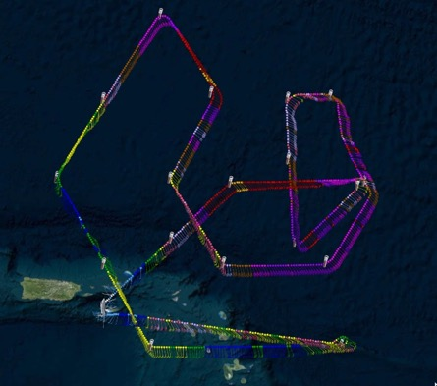
Karl (160921n1)
Vmax= 30 kt SFC P= 1007 mb @21z
Planned
1754 Z (CIRA)
Actual
Takeoff~ 1700Z and landing ~0010z
Notes:
Actual Track shifted ~1.8 deg south of original planned track
18 drops made (4 added) and all 18 were good drops and were transmitted
Leg between drops 5 and 6 and 6 and 7 truncated somewhat to west due to convection

Slide 24
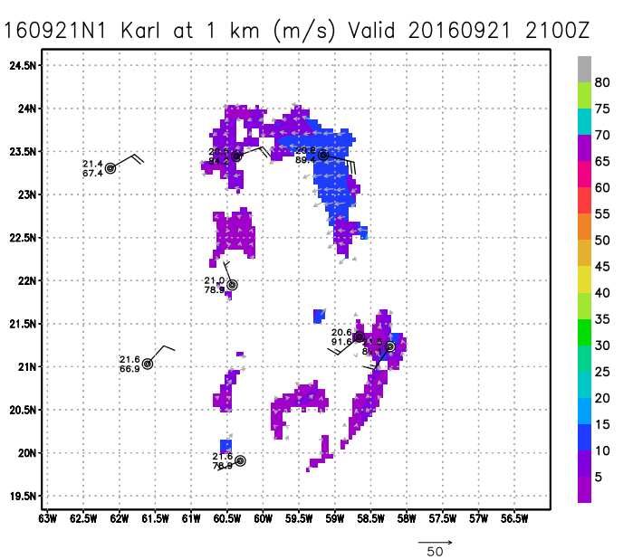
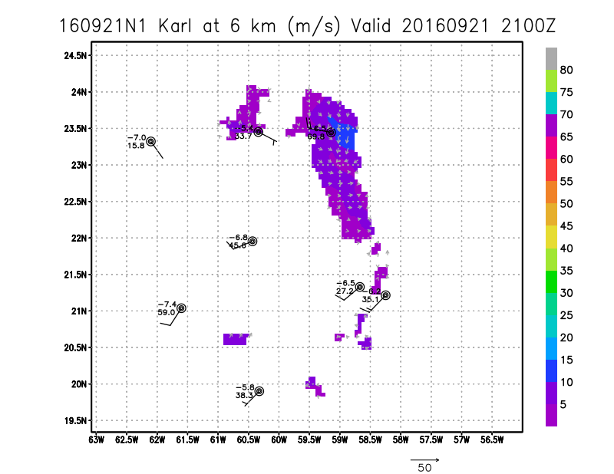
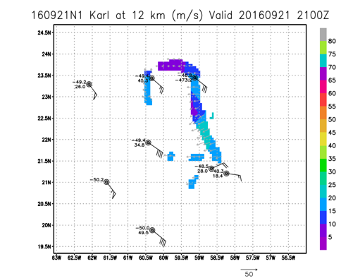
Karl 160921n1 Plots
(Sim Aberson)
Hui Christophersen
On-board dropsonde
processor/LPS
1. 0 KM
6. 0 KM
12.0 KM

Slide 25
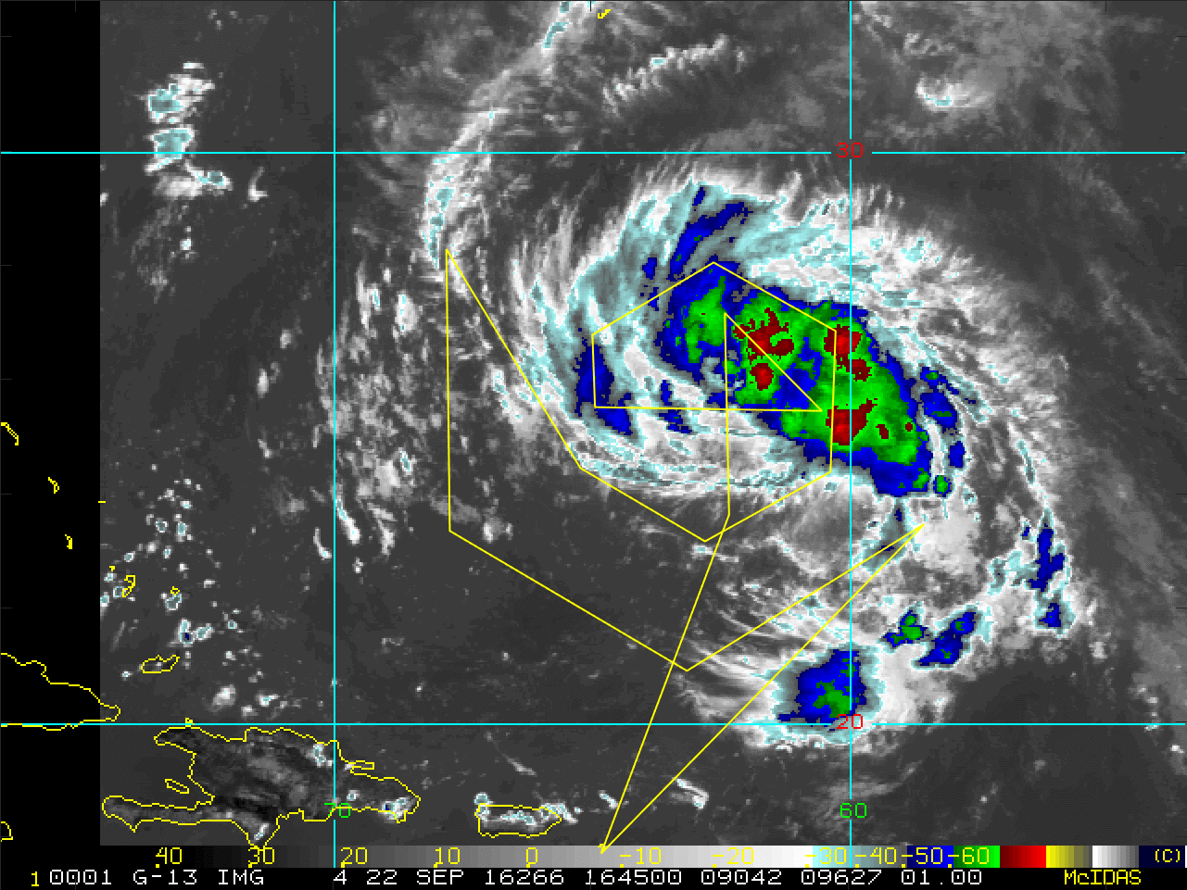
160922N1 (LPS: Aksoy)
Planned Flight Track and Actual Dropsondes
(14 Planned – 1 Skipped + 7 Extra)
Planned flight track
Actual dropsonde locations
Extra dropsonde locations

Slide 26
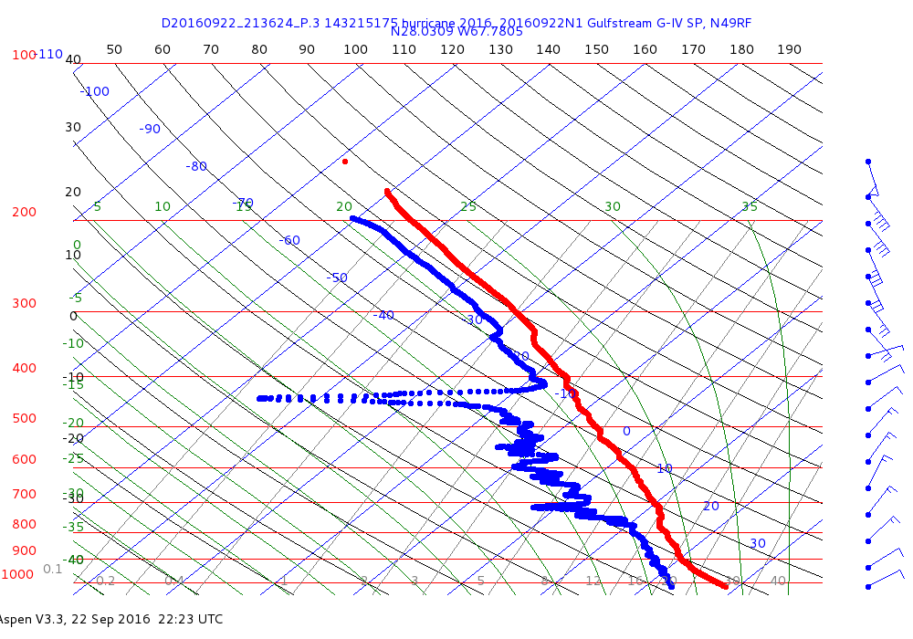
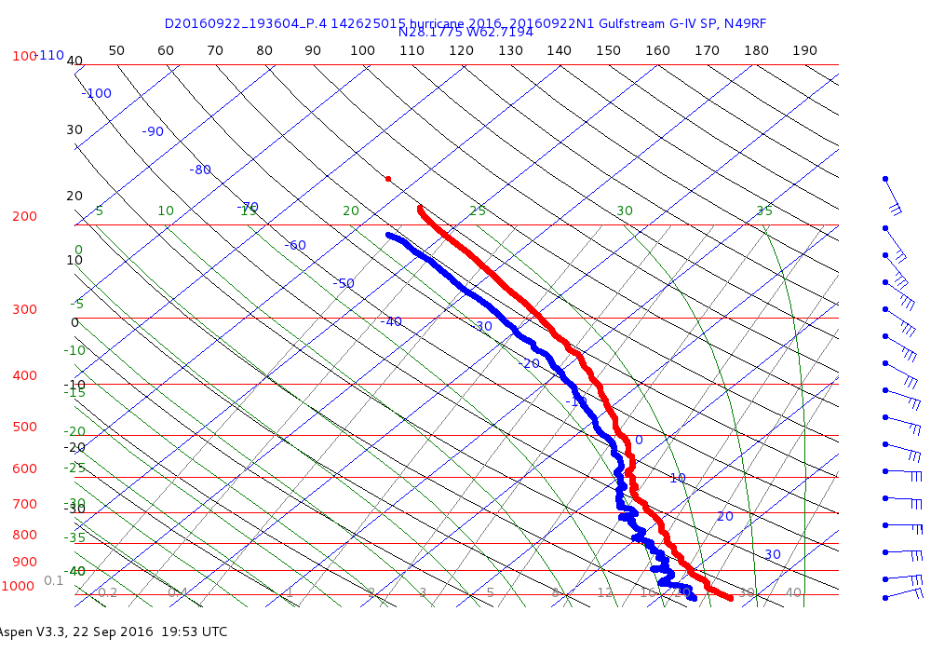
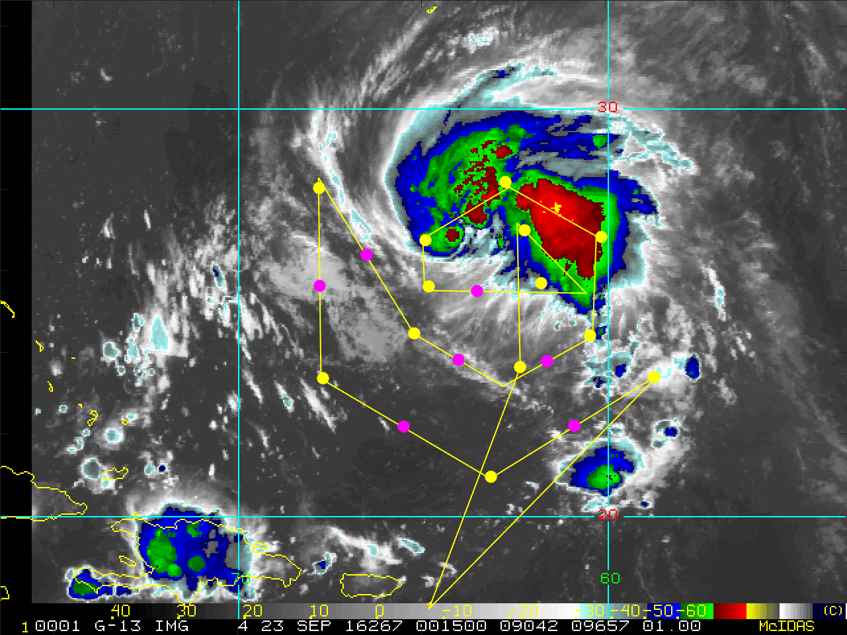
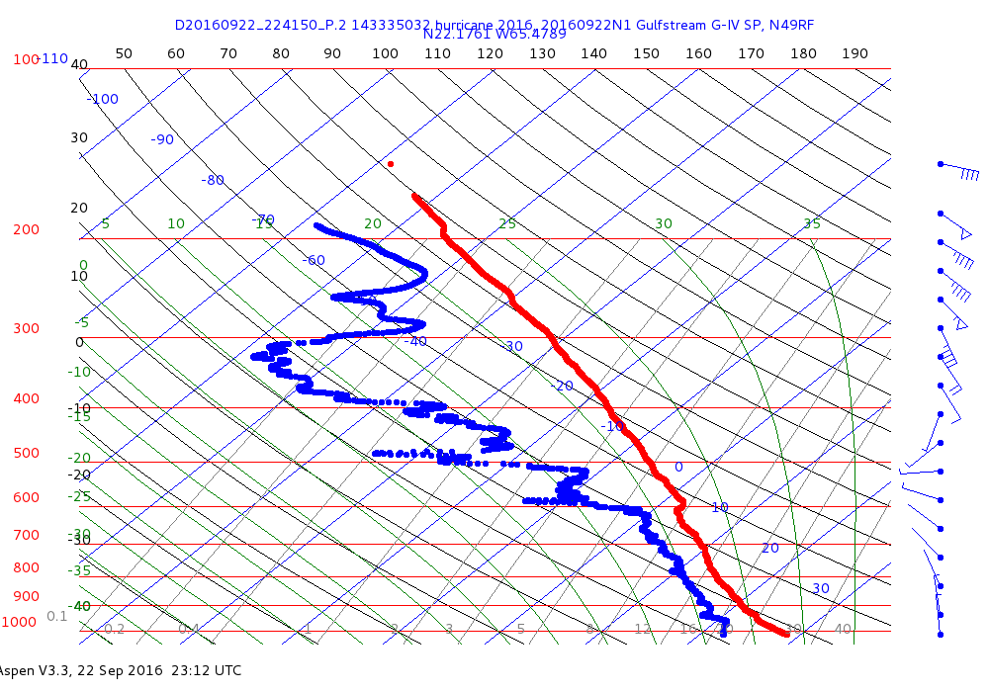
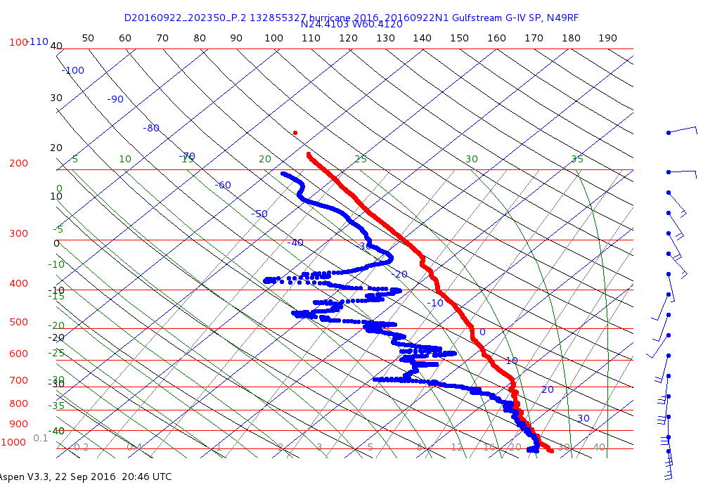
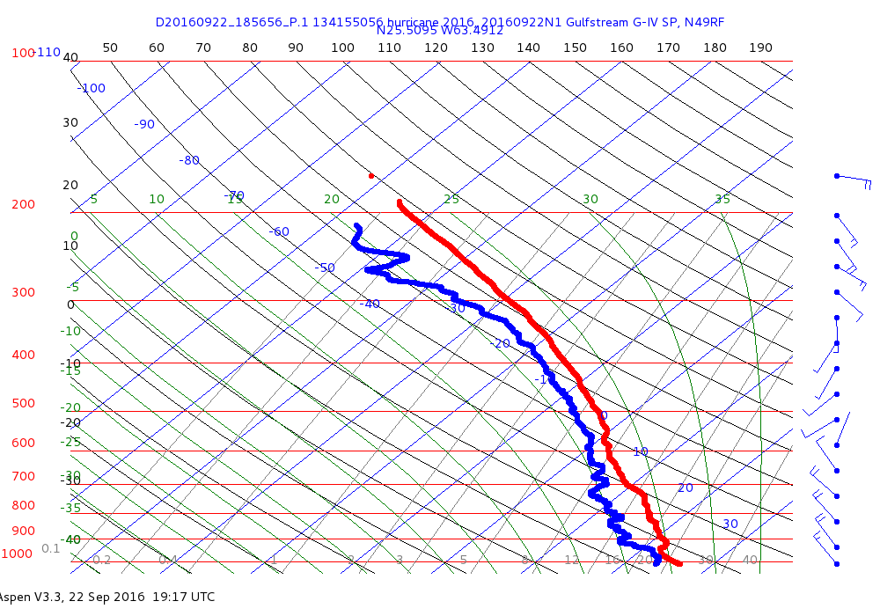
Sample Skew-T Diagrams
“Center Drop”

Slide 27

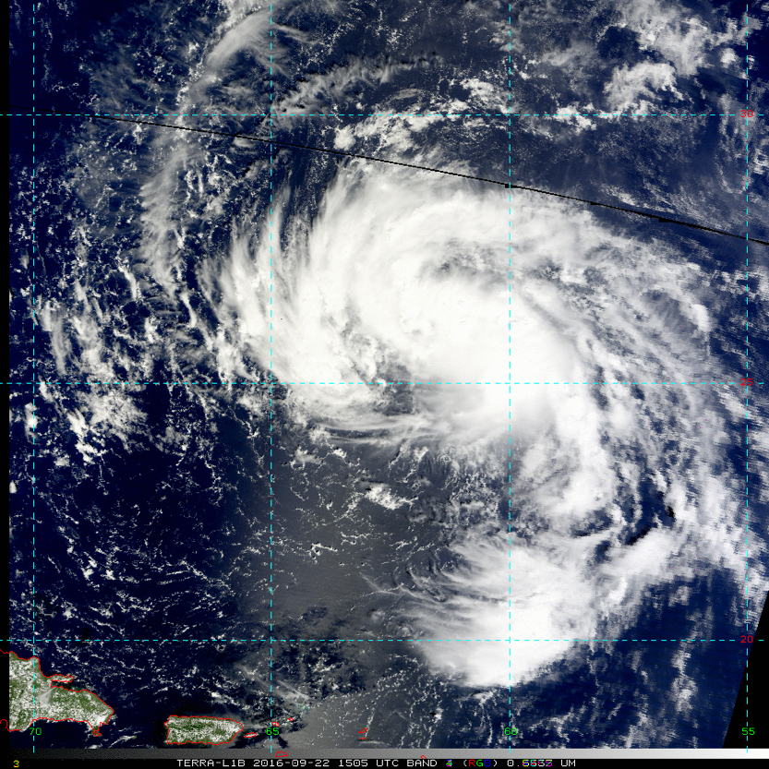
Mission 20160922I1 (RAPX)
LPS: Bucci Radar: Klotz/Gamache Drops: Christophersen
NHC Intensity: 30kts
Motion: ~17kts NW
Shear: SE @ 15-25 kts

Slide 28


Mission 20160922I1 (RAPX)
LPS: Bucci Radar: Klotz/Gamache Drops: Christophersen
FL Altitude: 8000 ft
Peak FL: 54kts
Peak SFMR: 34kts

Slide 29

Radar Analyses: 3 Drops: 12 Highest Echo Tops: 16km
Problems: AOC server was down -> Brad processed radar on plane
IWRAP cooling fan caused smoke -> No communications about flight status can leave place before the AC gives the okay

Slide 30

20160923I1
LPS (Jun Zhang), Radar (Paul Reasor), Sonde (Brittany Dahl)

Slide 31


20160923I1
LPS (Jun Zhang), Radar (Paul Reasor), Sonde (Brittany Dahl)
Deep layer shear
Water vapor

Slide 32


20160923I1
LPS (Jun Zhang), Radar (Paul Reasor), Sonde (Brittany Dahl)
RAPX mission: Overall successful mission. No problem with radar software, 4 Doppler radar passes, 18 sondes (NHC center sondes), maximum surface wind ~ 55 kts. Coordinated with Global Hawk (GH) mission scientist to do an over pass on the E-W leg. Conducted boundary layer stepped descent module during the downwind leg at SE quadrant before meeting with GH.
Problems: Needed to coordinate with Airforce aircraft at IP. Computer screen got stuck for both flight director’s and LPS’ computers for ~20 minutes.

Slide 33





Storm was developing as the vortex became deeper than a day ago. Vortex tilt was small indicating the storm may intensify during our flight.
The outflow was struggling to develop which may be due to high shear.

Slide 34



Karl(160923N1) Vmax_55-kt SFC P= 990mb @20z
Planned
Actual
Takeoff~1710z and landing ~00z
Notes:
Actual track shifted southward a bit with fewer drops requested
12 drops planned and 11 were made with 9/11 good and 2 terminating @ 850-900mb (All Transmitted) Leg from drop 5 to 6 not flown due to need to divert due to convection
MTS site down ~ 30 minutes during flight

Slide 35



Karl 160923n1 plots
(Sim Aberson)
1.0 KM
6.0 KM
12.0 km

Slide 36


Mission 20160923I2 (RAPX)
LPS: Bucci Radar: Klotz/Gamache Drops: Christophersen
NHC Intensity: 50kts
Motion: ~10kts N
Shear: SE @ 10-15 kts

Slide 37


Mission 20160923I2 (RAPX)
LPS: Bucci Radar: Klotz/Gamache Drops: Christophersen
FL Altitude: 8000 ft
Peak FL: 67kts
Peak SFMR: 57kts

Slide 38

Radar Analyses: 3 Drops: 13 (5 IR sondes) BTs: 7 (1 failed)
Highest Echo Tops: 17km
Modules: High Incidence SFMR circles (3 @ 45°, 30° and 15°)
Problems: Sensor on externally mounted BT failed
Initially scattered BT readings (due to turning?)

Slide 39

20160924I1
LPS (Jun Zhang), Radar ground (Paul Reasor), Sonde (Brittany Dahl)

Slide 40


20160924I1
LPS (Jun Zhang), Radar ground (Paul Reasor), Sonde (Brittany Dahl)
Deep layer shear
Water vapor

Slide 41


20160924I1
LPS (Jun Zhang), Radar ground (Paul Reasor), Sonde (Brittany Dahl)
RAPX mission: Successful mission. No computer problem. Modified flight track in storm for IWRAP, coordinating with NESDIS group. Calibrated IRsonde, successfully dropped IRsondes in low-reflectivity regions. No problem with radar software. LPS was able to work with radar scientist on ground-based radar processing. 4 - 5 Doppler radar passes, 15 sondes (NHC center sondes, 6 IR-BT pairs), maximum surface wind ~ 50 kts, maximum flight level wind ~ 63 kts on the east side of the storm. Still no hurricane penny! ☺

Slide 42





Karl was under transition to be extra-tropical cyclone. Vortex tilt was not large. The vortex was shallower than that one day before. The wind field became broader than before.
Storm maintained nearly steady state and slightly weakened during our flight.

Slide 43


Mission 20160924I2 (ET)
LPS: Bucci Radar: Klotz/Gamache Drops: Christophersen
NHC Intensity: 55kts
Motion: ~16kts NE
Shear: NE @ 30-40 kts

Slide 44


Mission 20160924I2 (ET)
LPS: Bucci Radar: Klotz/Gamache Drops: Christophersen
FL Altitude: 7000 ft
Peak FL: 59kts
Peak SFMR: 46kts

Slide 45

Radar Analyses: 2 Drops: 4 (all IR sondes) BTs: 4
Highest Echo Tops: 18 km
Partial Modules: High Incidence SFMR circles (1 @ 15°)
Problems/Challenges: Coordinating GH instrument comparison
Conflicting research objectives

Slide 46
Unprecedented coverage for ET case. Combined with earlier missions and later NAWDEX flights, this is something we have been trying to do for 12 years.

