Slide 1
Comparison of G-IV and P-3 TDR Analyses from Gabrielle (2013)
Paul Reasor and John Gamache
Questions to consider as we approach this season:
Does the G-IV TDR yield wind and reflectivity analyses in TCs similar to that from the P-3 TDR?
How does the spatial coverage of TDR data by the G-IV compare with that from the P-3?
Evaluate TDR inter-comparison data collected in the remnants of Gabrielle (2013)

Slide 2
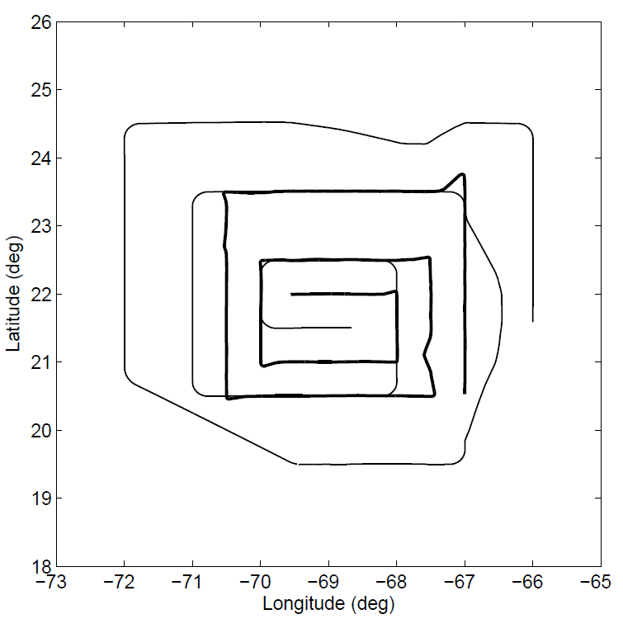
130907H1 & 130907N1
Leg A
1717 UTC (P-3); 1728 UTC (G-IV)
Leg A
Leg B
1831 UTC (P-3); 1822 UTC (G-IV)
Leg C
Leg C
1627 UTC (P-3); 1701 UTC (G-IV)
Leg B

Slide 3
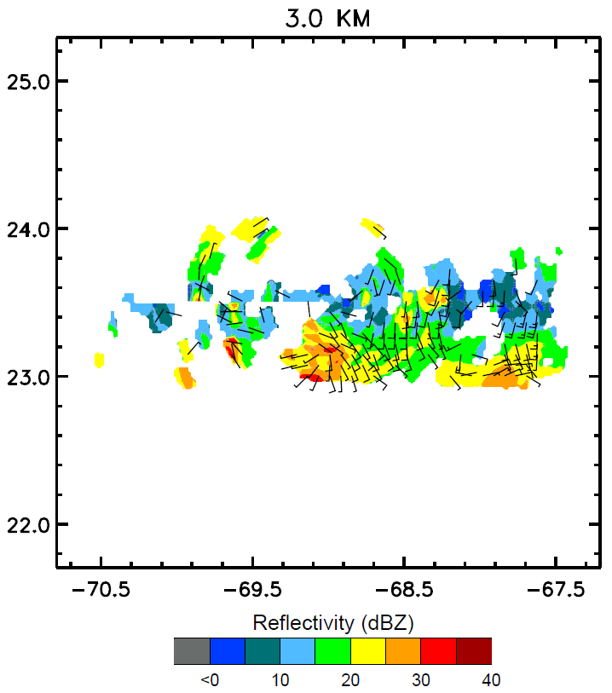
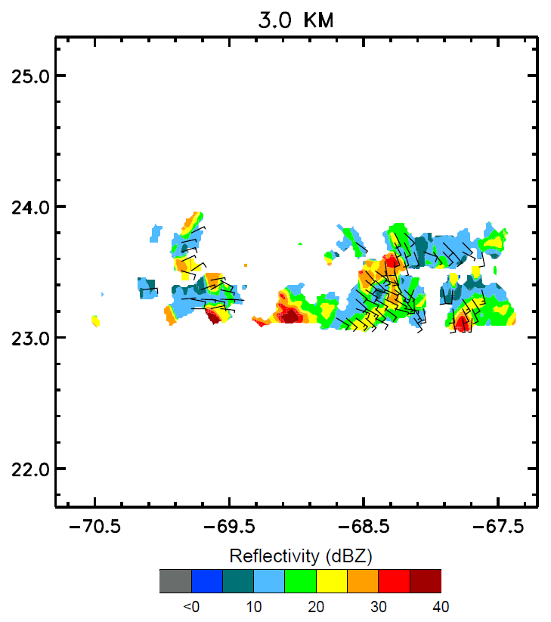
Leg A
P-3
G-IV

Slide 4
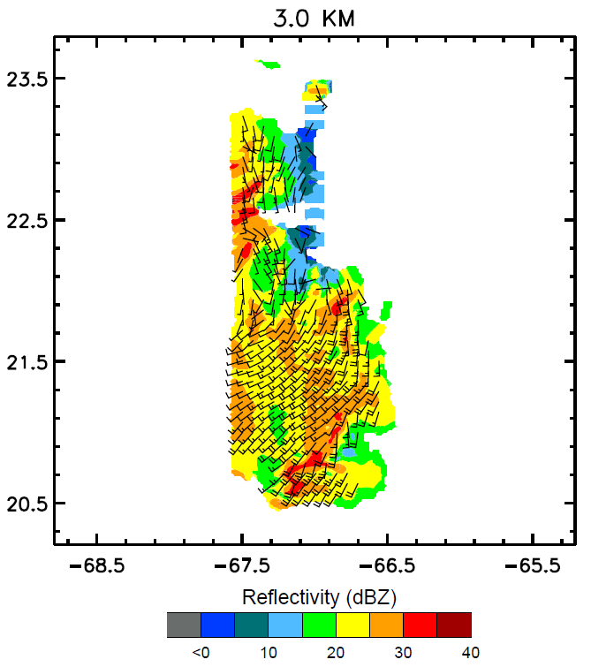
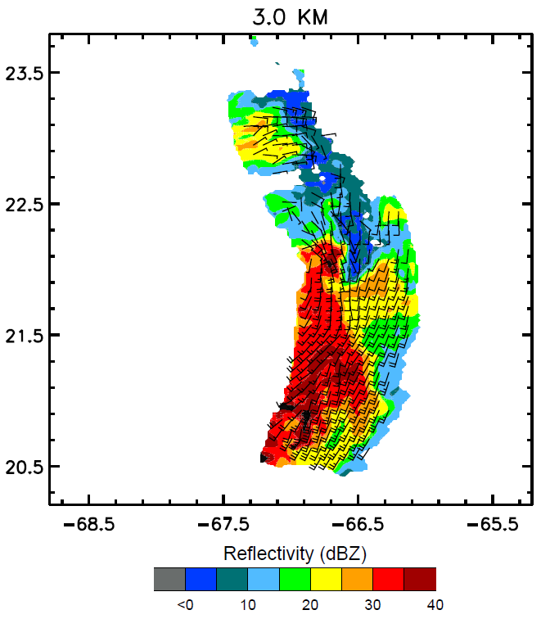
Leg C
P-3
G-IV

Slide 5
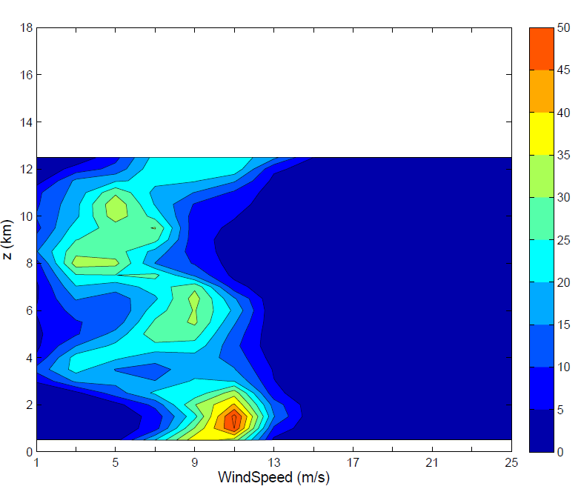
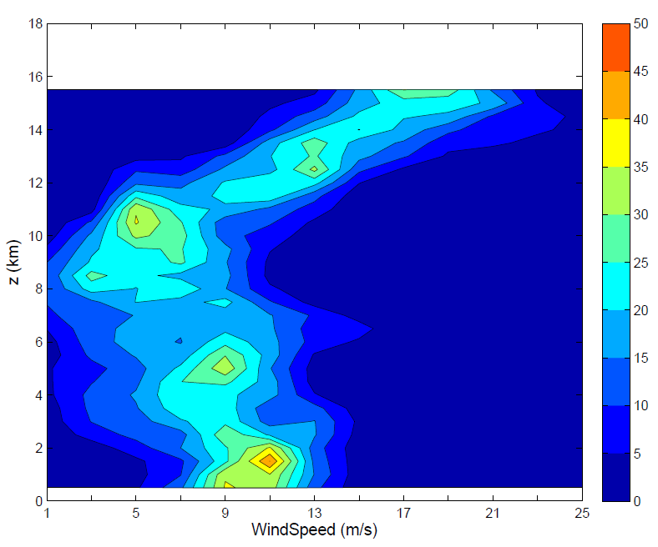
Leg C
P-3
G-IV
%
%
CFAD: Windspeed

Slide 6
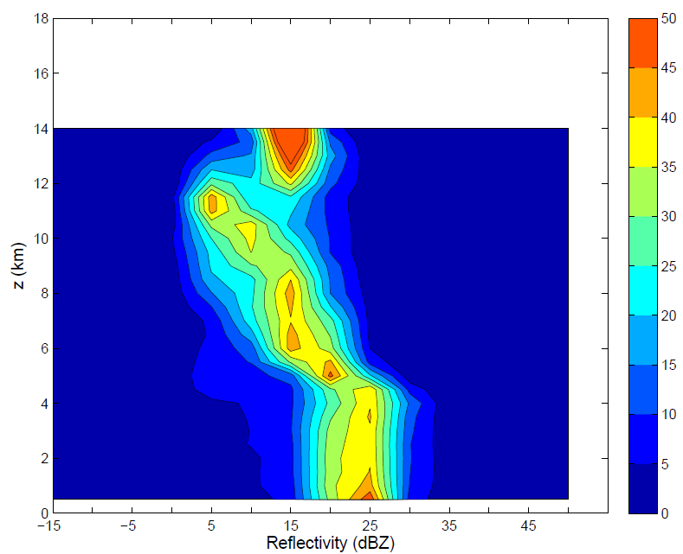
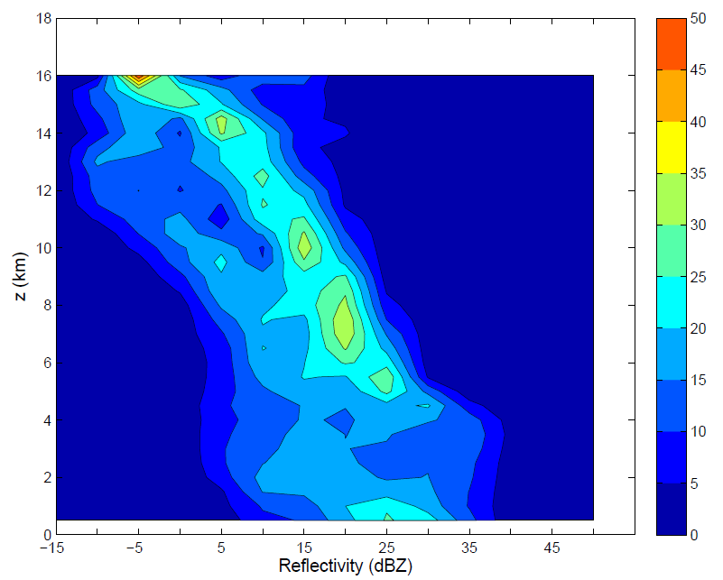
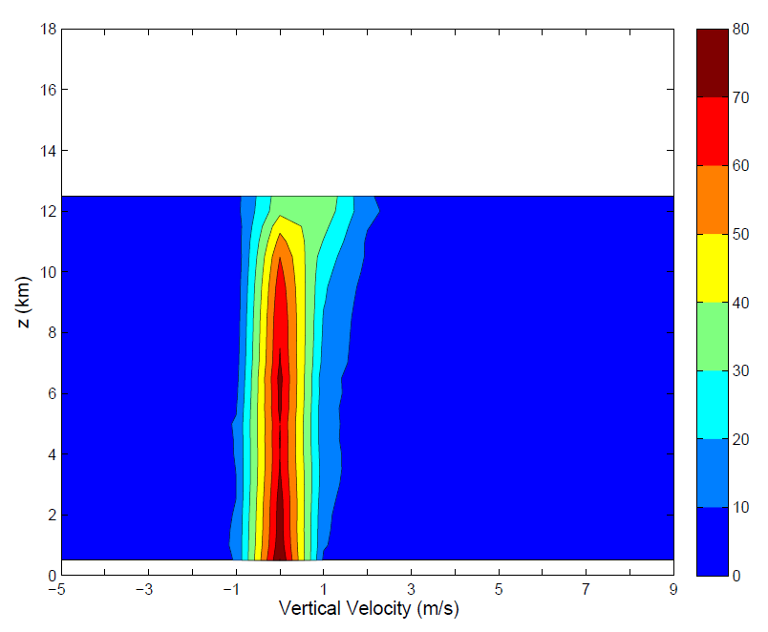
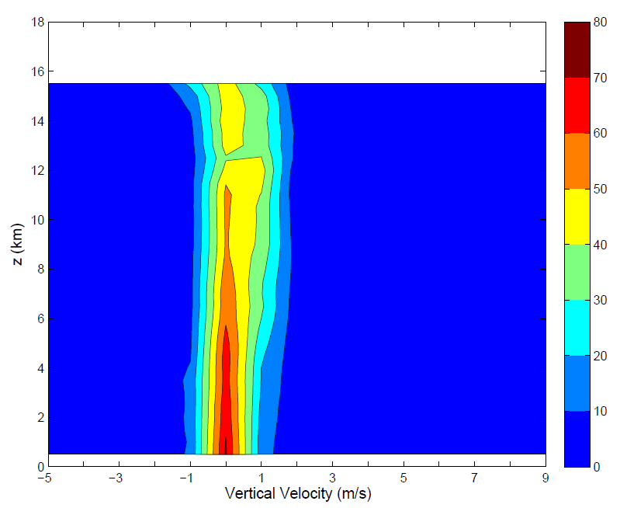
Leg C
P-3
G-IV
dBZ
W

