Slide 1
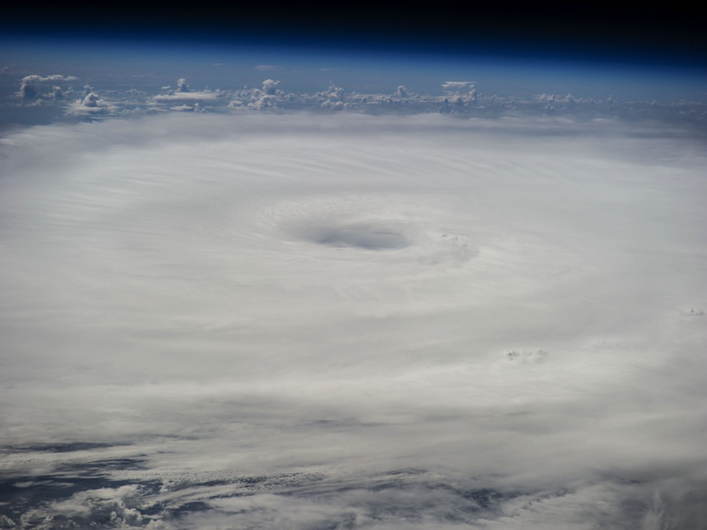
Hurricane Edouard: 11-19 September
De-brief
Miami, Fl; Boulder, Co
1 October 2014

Slide 2
Brief overview of all missions
Joe Cione

Slide 3

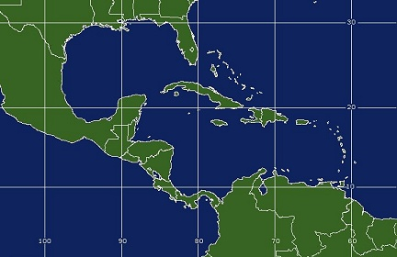




Deployment locations (STX; BDA)
BDA
STX

Slide 4
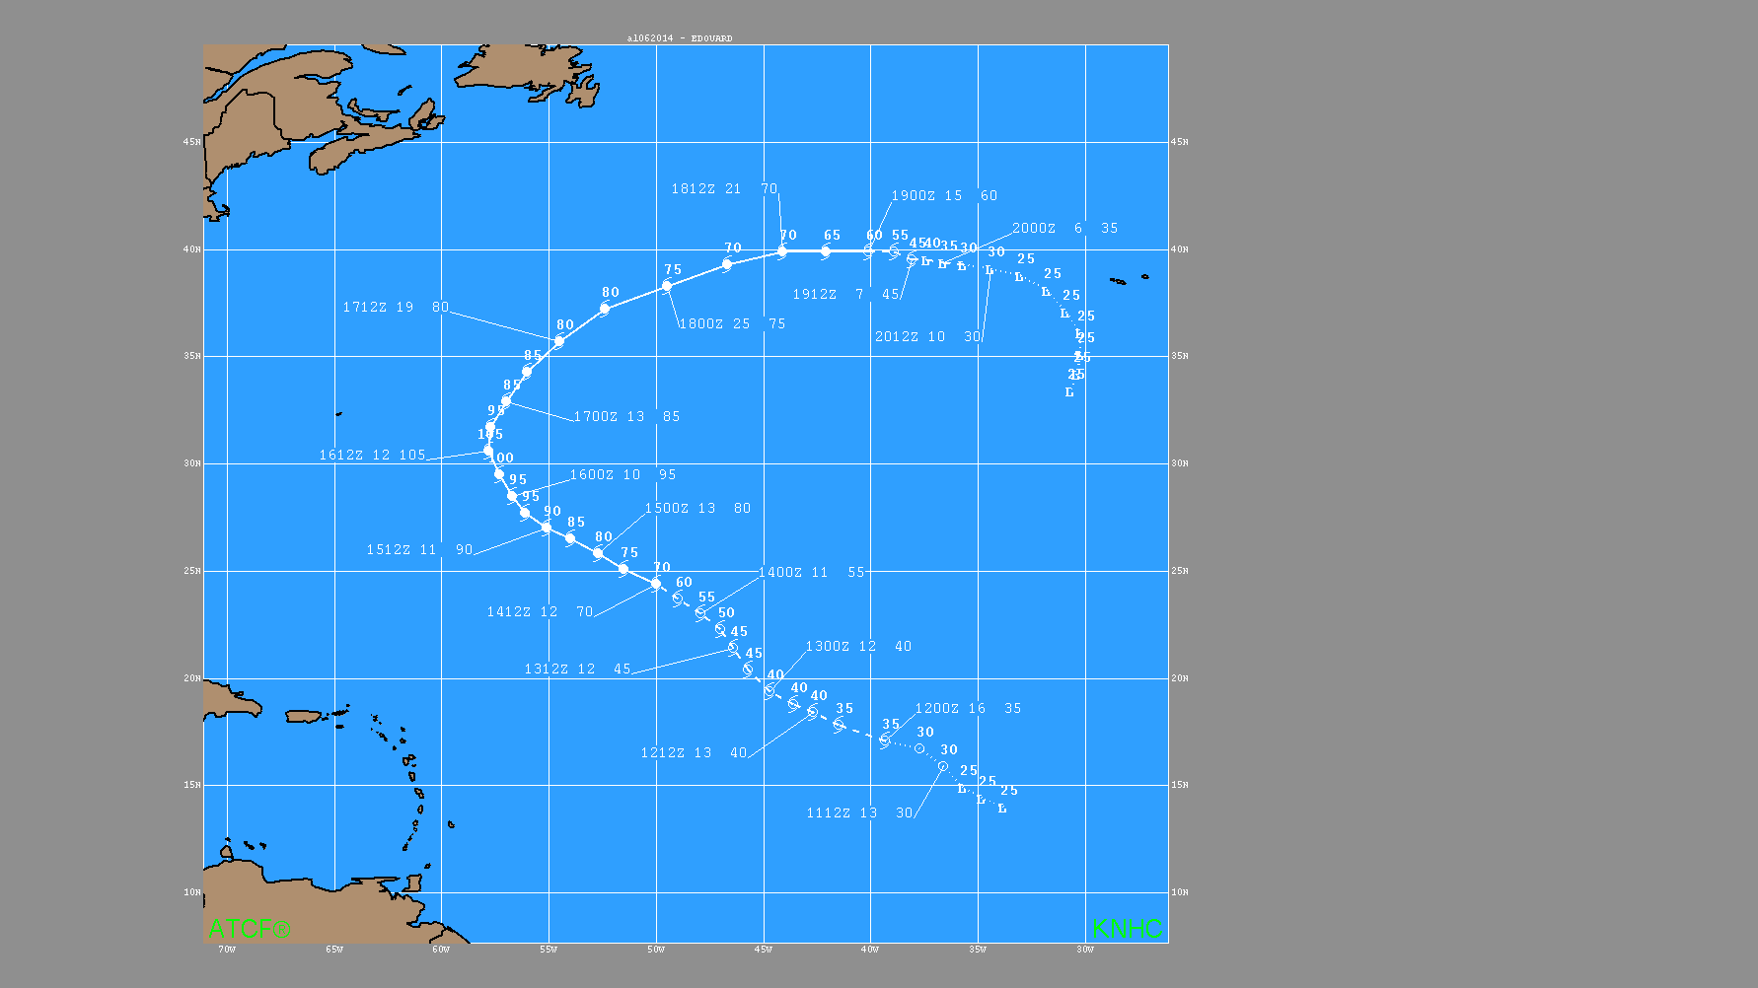
‘Operational’ Best Track for Edouard

Slide 5
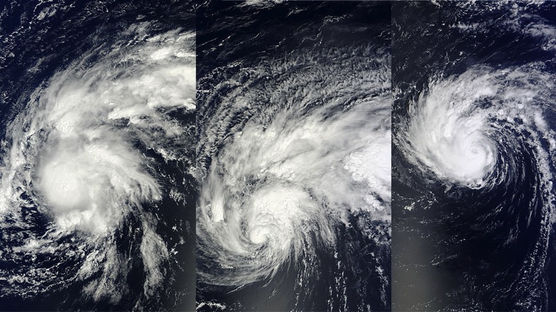



“Assets in Edouard”:
A daily breakdown – 11-14 September
43 Pre-Storm Ocean Survey on 11th and 12th…
14th Ocean Winds (1st In-storm pattern)…
11/12 TS
13 TS
14 H (15z)


Slide 6
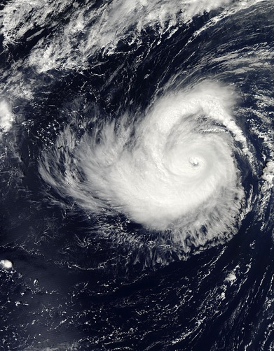
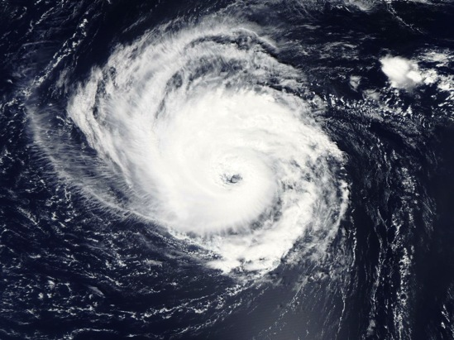




“Assets in Edouard”:
A daily breakdown – 15-16 September
Sept. 16th: 1st Successful air-deployed UAS mission into a hurricane (Coyote)
15 H
16 MH

Slide 7
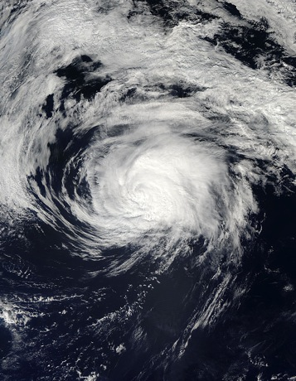





“Assets in Edouard”:
A daily breakdown – 17-19 September
2nd Successful Coyote mission on the 17th
GH solo in the storm (18-19)…
43 Ocean glider survey in the Caribbean (19)
17 H
18-19 H


Slide 8
Overview of Doppler radar composites from P3 flights
Sim Abserson

Slide 9
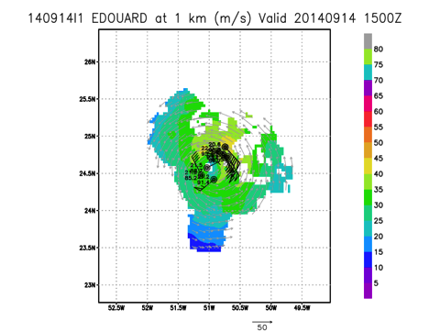
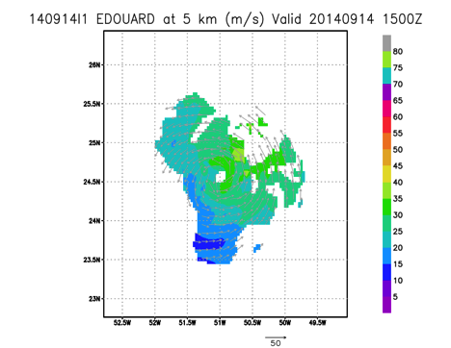
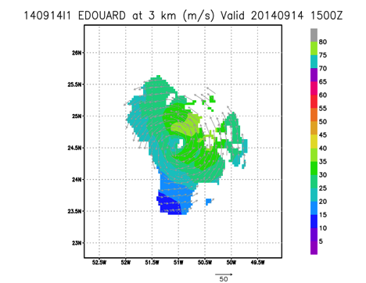
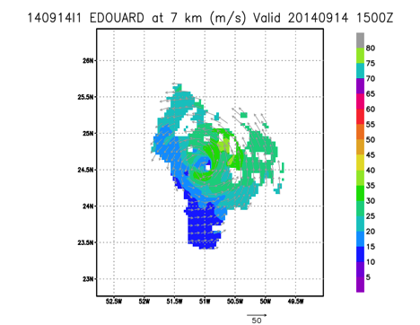

Slide 10
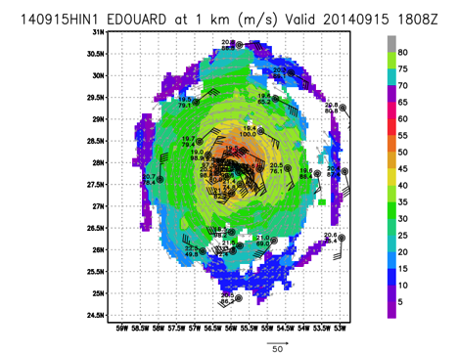
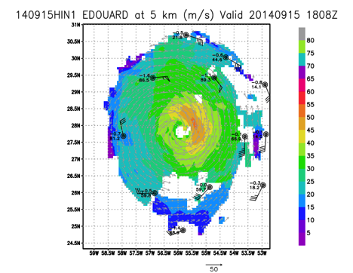
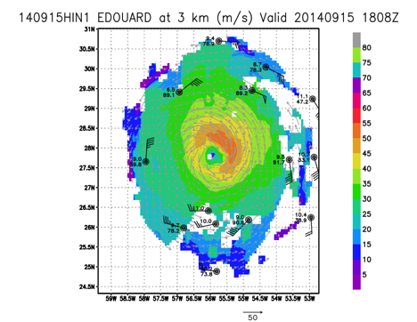
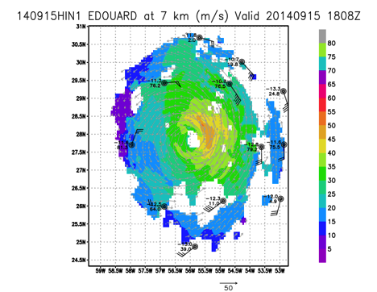

Slide 11
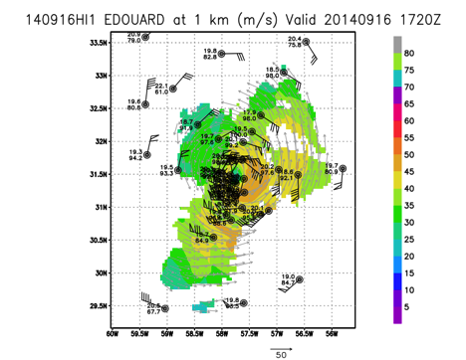
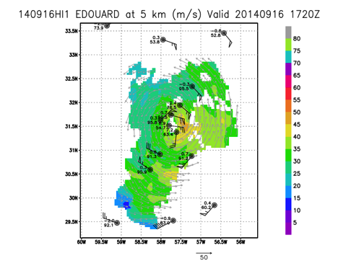
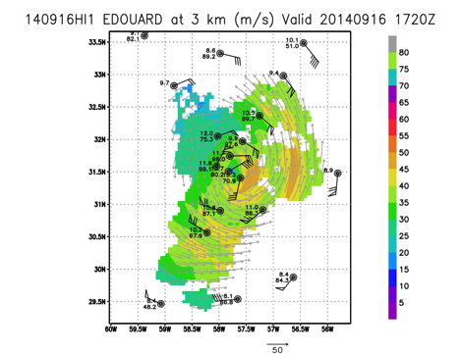
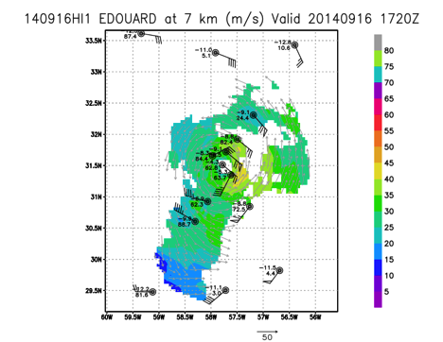

Slide 12
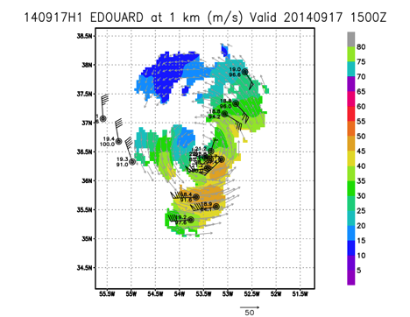
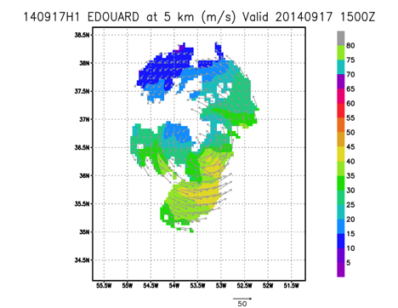

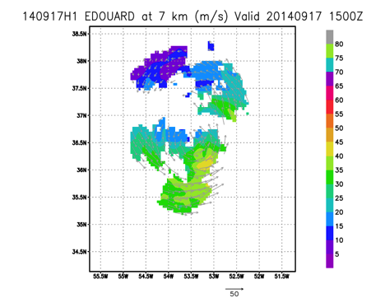

Slide 13
Pre-storm ocean and ocean winds
Eric Uhlhorn

Slide 14
Summary
Seven flights (not incl. repos) over 10 days
Three in-storm flights (09/14,15,16)
One pre-storm (12) and one post-storm ocean flight (17)
Two ocean glider inter-comparison missions (11,19)
One flight coordinated with N42RF and N49RF (15)
161 ocean expendables dropped
  106 AXBT
  37 AXCP
  18 AXCTD
43 sondes deployed (18 IR)
XX TDR analyses generated (Sim)

Slide 15
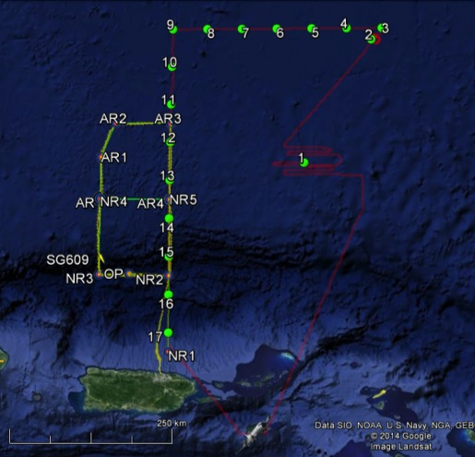
20140911I1
Ocean Winds and north ocean glider inter-comparison
17 AXBTs
2 Sondes
HI-SFMR low-wind module
HI-SFMR
Sat. overpass
Glider SG609 track

Slide 16
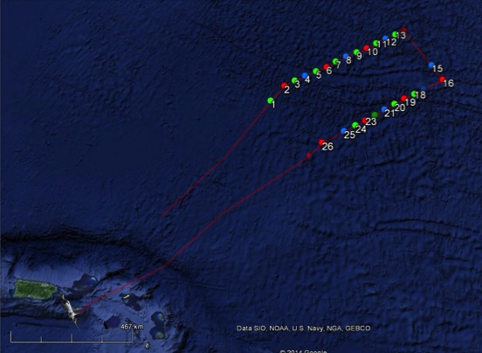
20140912I1 – Pre-storm ocean
26 ocean probes
  8 BT
  11 CP
  7 CTD
3 days prior to storm
7.5 hrs
TS Edouard 35 kts/1005 mslp

Slide 17
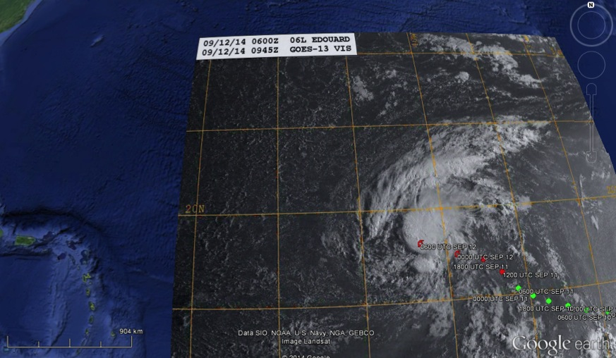
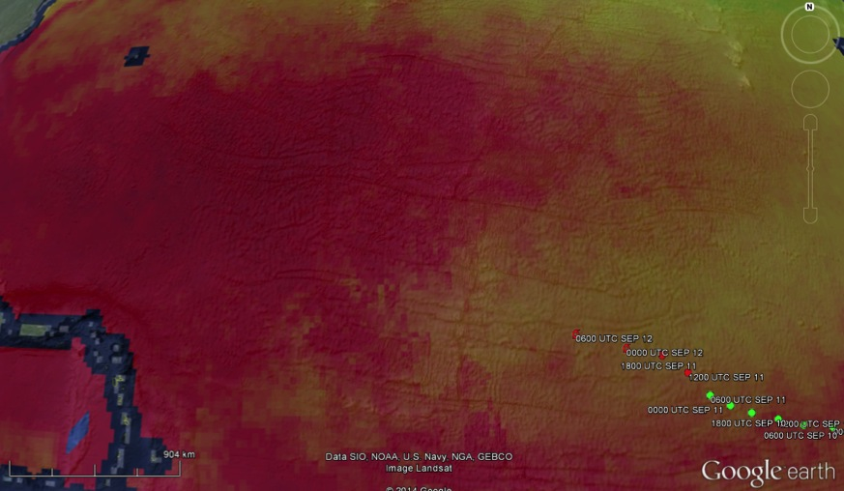
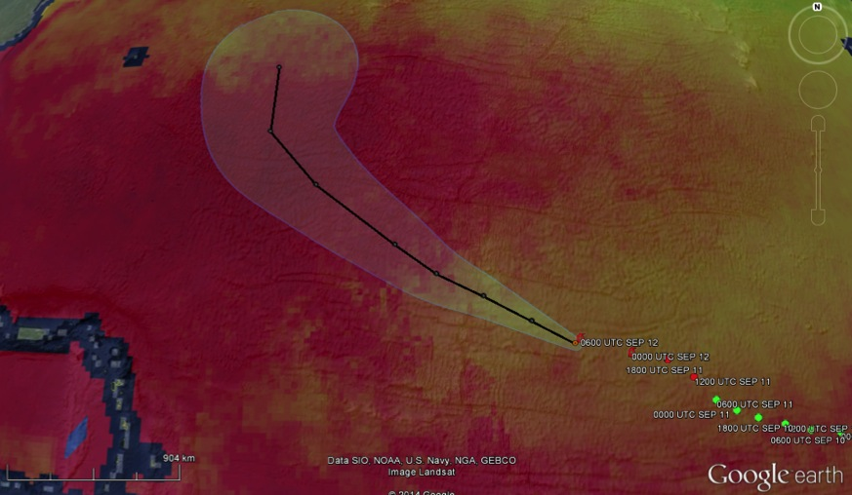

20140912I1 – Pre-storm ocean
09/16 0600Z 70 kts
09/15 0600Z 60 kts
~800 nmi

Slide 18
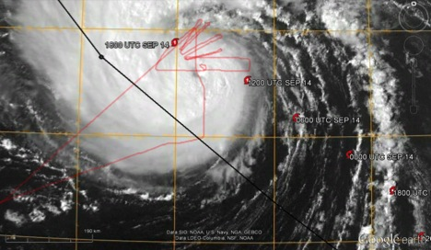
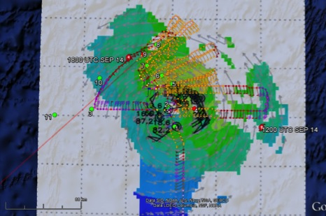
20140914I1 – Ocean Winds
75 kts/982 mb mslp
4(?) sondes
11 ocean probes
  9 BT
  2 CP
No RT TDR analyses
9 hours

Slide 19
Model evaluation experiment
20140915H1
Jason Dunion

Slide 20
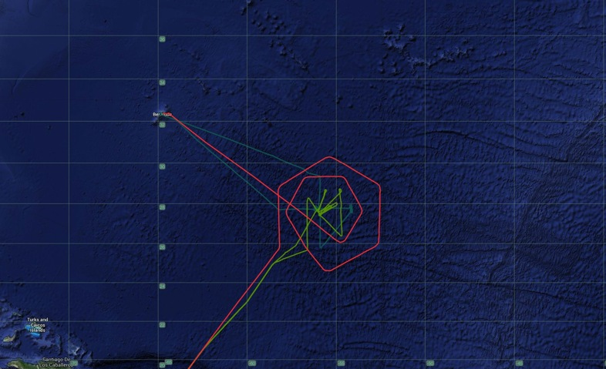
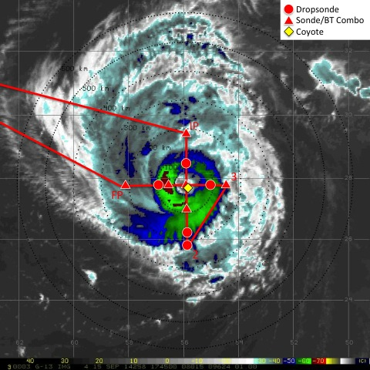
20140815H1
Hurricane Edouard
Model Evaluation Experiment
NOAA-42
NOAA-43
NOAA-49
Take-off 1408 UTC (Bermuda); Landing 2054 UTC (Bermuda)
14 GPS dropsondes; 8 AXBTs
Coyote (#1) launched during final E-W pass through eye
1 Radar Analysis (E-W final pass)

Slide 21
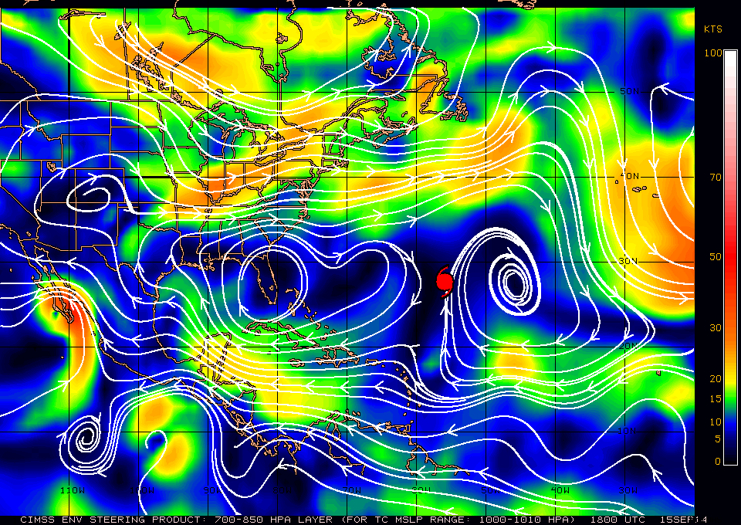
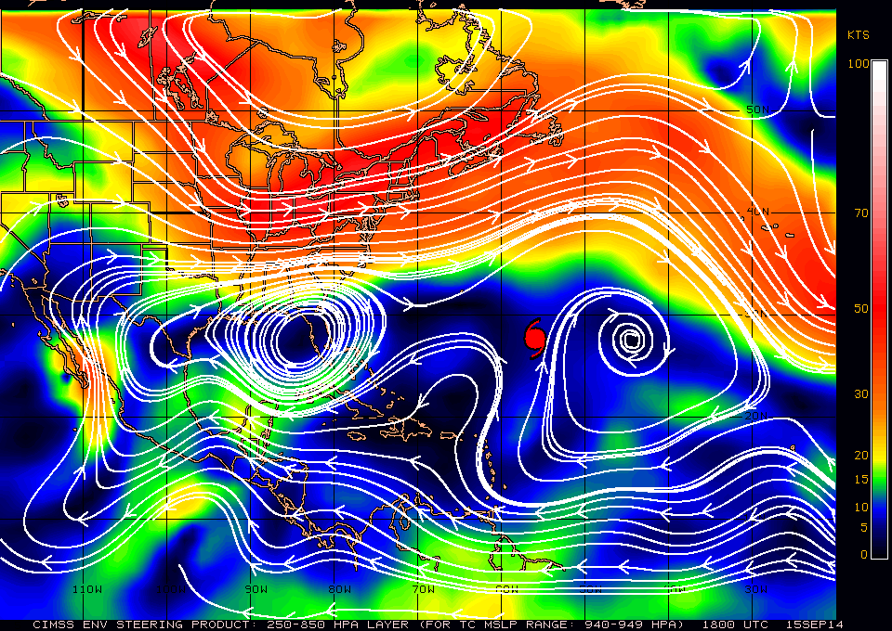
Hurricane Edouard: 15 Sept 2014:
CIMSS Deep Layer Mean Steering

Slide 22
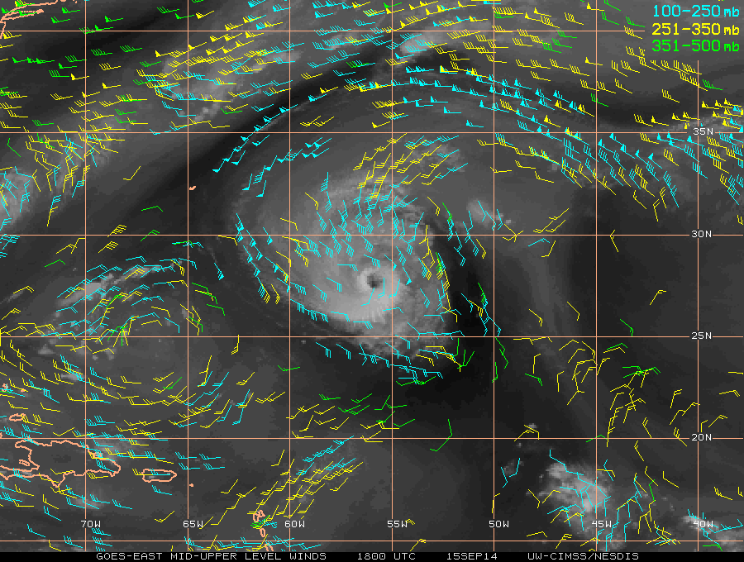
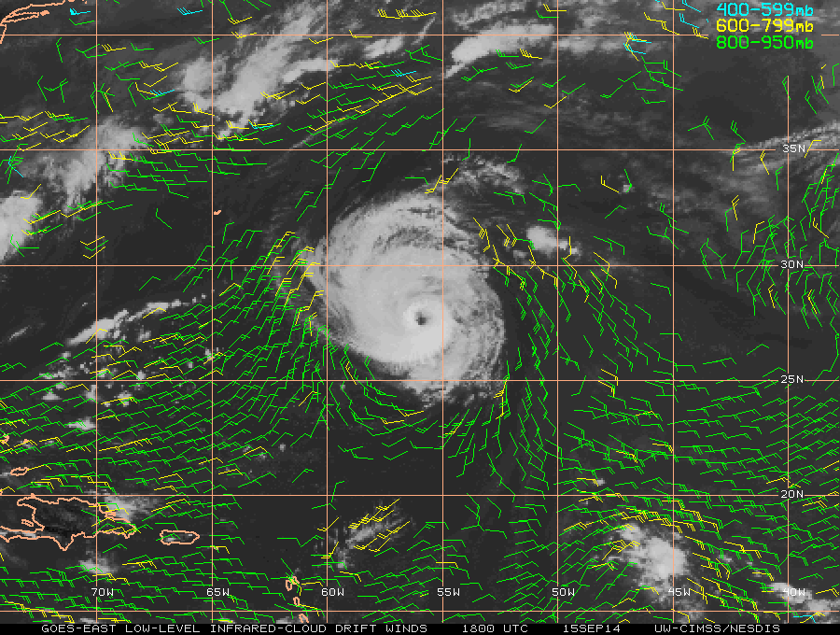
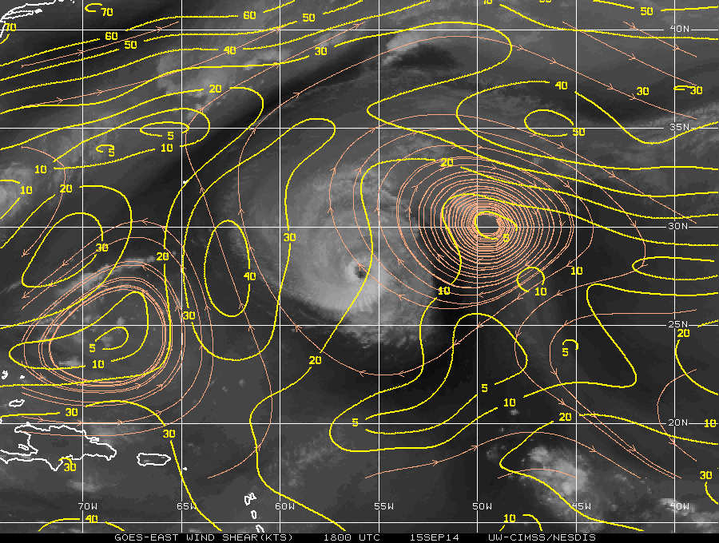
Hurricane Edouard: 15 Sept 2014:
CIMSS AMVs and Vertical Shear

Slide 23
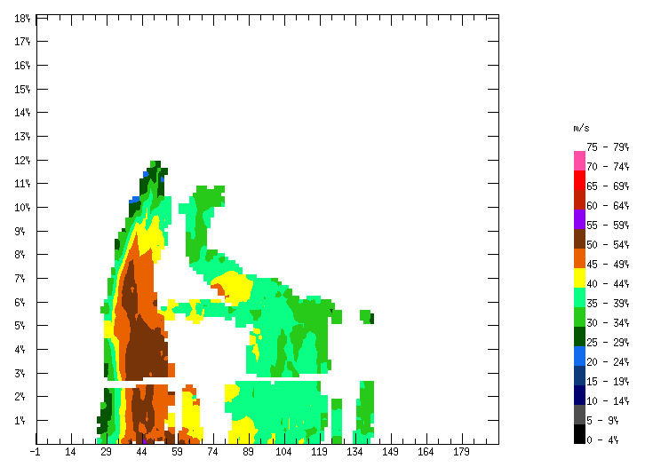
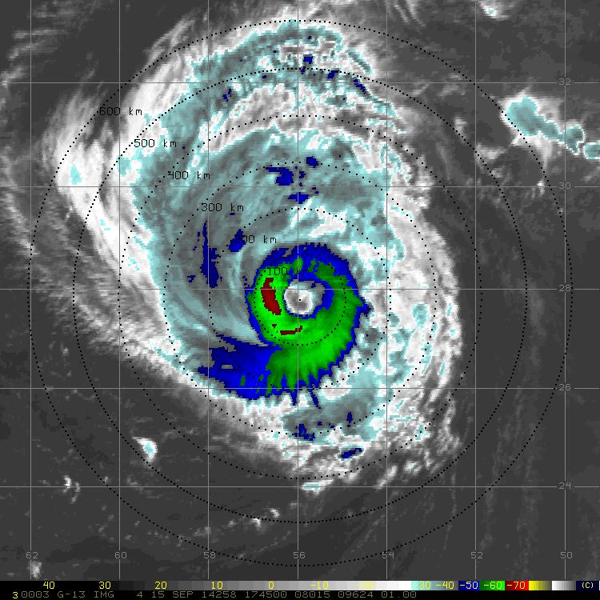
Hurricane Edouard: 15 Sept 2014:
Radar Cross-Section

Slide 24
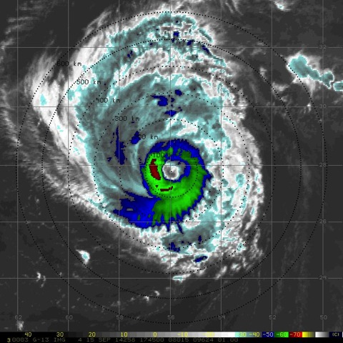
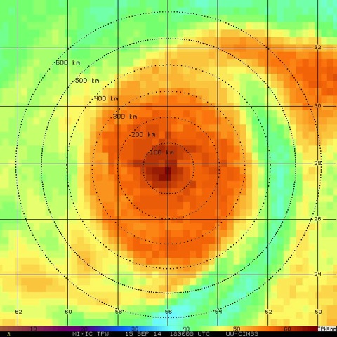
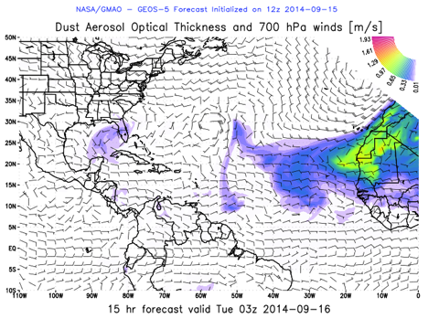
Hurricane Edouard: 15 Sept 2014
GOES Infrared
CIMSS MIMIC TPW
X

Slide 25
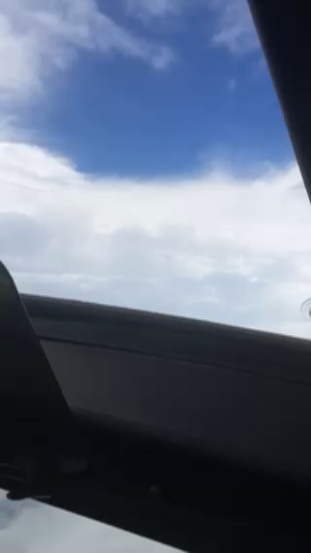
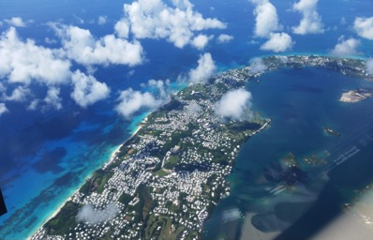
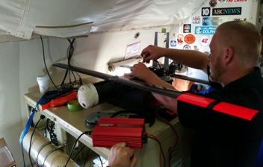
Summary
Coordination with NOAA-43 was poor
-NOAA-43 was delayed inbound E-W for Coyote eye launch
Radar software hung up during the 1st pass and was not transmitted in real-time
-John G. is troubleshooting
Coyote (#1) lost comms and never recovered

Slide 26
Model evaluation experiment
20140915I1
Eric Uhlhorn

Slide 27
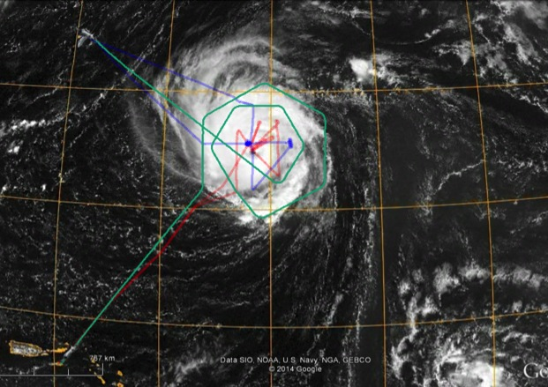
20140915I – Multi-aircraft MEEx
19 sondes (15 IR)
12 BTs
5 TDR analyses
8 hours STX-STX
N42RF
N49RF
N43RF

Slide 28
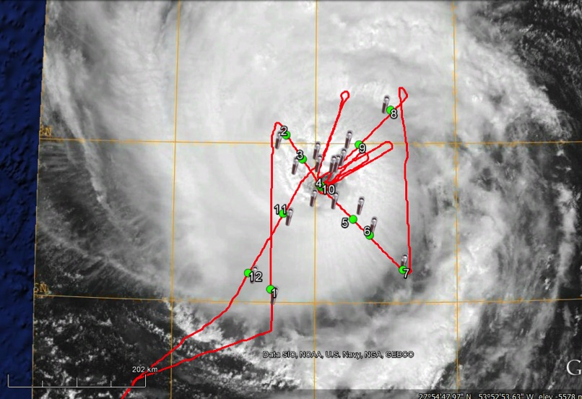
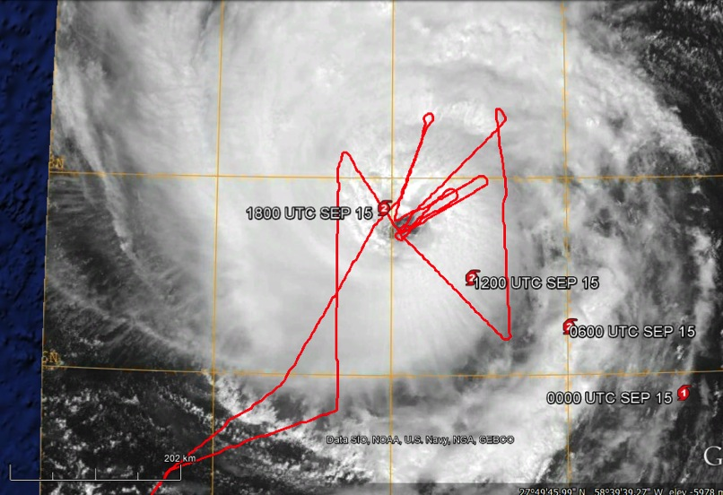


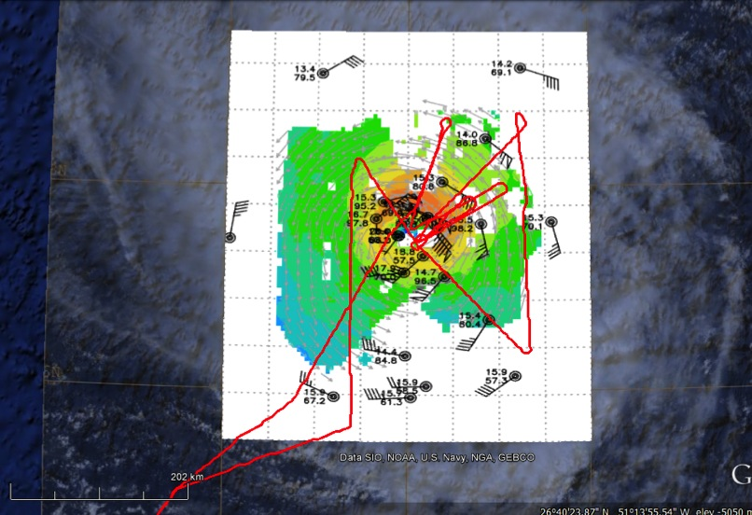
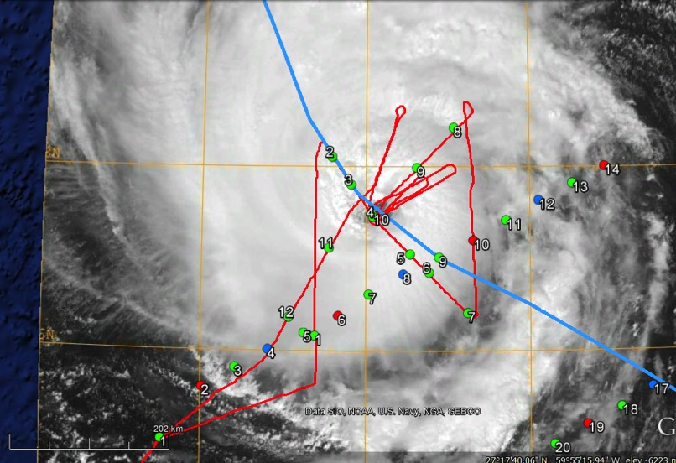
20140915I -- MEEx

Slide 29
HS3 GH operations
20140914-15
Robert Rogers

Slide 30
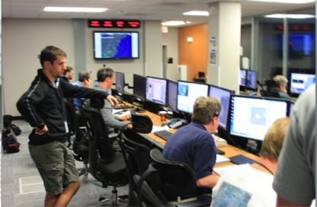

AV-6 mission into Hurricane Edouard on September 14-15
“Hybrid” pattern consisting of an environmental lawnmower survey pattern with N-S oriented legs (outflow sampling) and a storm-relative pattern
Storm was intensifying over the course of the ~24-h mission, possible RI, as some deep convection near center
  Mission concurrent with N43 Ocean Winds flight
  Take-off 1102 UTC 9/14; landing 1050 UTC 9/15; 80 dropsondes released
“mission control”
AV-6 on runway at Wallops

Slide 31

AV-6 mission into Hurricane Edouard on September 16-17
Flight plan for AV-6 flight 9/14-9/15
survey pattern
storm sampling

Slide 32

Aircraft sampling Edouard during 9/14
AV-6
N43

Slide 33


Dry air surrounding system
Very dry air on SW side of system. Lightning continues to fire along elongated
rainband bordering between the dry slot and possible dusty layer to the SW. Red area indicates dust AOT from GEOS-5.
lightning flashes

Slide 34


Re-establishment of eye
Cloud top heights at 1820 UTC > 50-52,000 ft, WV at 1815 UTC. Indicates eye is attempting to clear again, convective tops are axisymmetrizing around the center. Convection seems to be becoming more symmetric.
Cloud top heights (1000’s ft)
GOES WV

Slide 35

Re-establishment of eye
Cloud Physics Lidar
CPL at 21 UTC showing the break in the clouds corresponding with the eye.

Slide 36


Eye/eyewall drops
2054 UTC
2103 UTC
in eyewall most of fall
started in eye, got caught in N eyewall
- later dropsondes reported sea-level pressures of 969-970 hPa while splashing in eyewall, suggesting MSLP ~960 hPa – Rapid intensification?

Slide 37
Model evaluation experiment
20140915N1
Altug Aksoy

Slide 38

14915N1 (LPS: Aksoy)
Planned Flight Track and Actual Dropsondes
Planned flight track and
dropsonde locations
Actual dropsonde locations
16
Extra dropsonde locations
1
12 Planned dropsondes
4 Extra dropsondes
16 Total dropsondes (All successful)

Slide 39







140915N1 (LPS: Aksoy)
Situational Awareness
16Z Visible Satellite
16Z IR4 Satellite
16Z TPW Image
18:05Z
15:04Z
15:40Z
17:36Z

Slide 40


140915N1 (LPS: Aksoy)
Were We Able To Sample The Diurnal Pulse?
16Z 6-h IR Trend
19Z 6-h IR Trend
Drops within 1.5 h prior to 16Z
Drops within 1.5 h prior to 19Z

Slide 41
Model evaluation experiment
20140916H1
Jason Dunion

Slide 42



20140816H1
Hurricane Edouard
Model Evaluation Experiment
NOAA-42
NOAA-43
GH (AV-6)
Take-off 1252 UTC (Bermuda); Landing 1853 UTC (Bermuda)
23 GPS dropsondes; 11 AXBTs
Coyote (#2) launched during initial W-E pass through eye
3 Radar Analysis

Slide 43


Hurricane Edouard: 16 Sept 2014:
CIMSS Deep Layer Mean Steering

Slide 44



Hurricane Edouard: 16 Sept 2014:
CIMSS AMVs and Vertical Shear

Slide 45










Hurricane Edouard: 16 Sept 2014
GOES VIS
TC Diurnal Cycle Imagery

Slide 46




Hurricane Edouard: 16 Sept 2014
GOES VIS
GPS Dropsonde Skew-t
----- 20.9ºC; 52% RH -----
26.5ºC; 66% RH ----
27.7ºC; 71% RH -------
----- 24.6ºC ---------- 79.1% RH
26.9ºC; 71% RH -----

Slide 47



Hurricane Edouard: 16 Sept 2014
GOES Infrared
CIMSS MIMIC TPW
X

Slide 48




Summary
Successful Coyote (#2) eye launch
2-3 GPS dropwindsondes: “cursed”
NOAA-42/43 coordination improved
Negotiated “Hurricane Hunter Rate” at Grotto Bay (50%)
-savings to NOAA ~25K

Slide 49






















Hurricane Edouard: 17 Sept 2014
TC Diurnal Cycle

Slide 50
Coyote UAS
20140916H1
Joe Cione

Slide 51
Hurricane Edouard
Coyote Eye/Eyewall Mission
September 16th 2014
De-brief
Miami, Fl; Boulder, Co
1 October 2014

Slide 52

First air-deployed UAS mission into a hurricane (a major one at that!)
When: 1432Z September 16th 2014
Where: Deployed into Major Hurricane Edouard’s eye (then eyewall)
Deployment aircraft: NOAA WP-3D Orion (42)
UAS flight duration: 28 minutes
Minimum Altitude: 896m
Maximum Wind Speed: 100kt @971m (in SW eyewall) Platform record!

Slide 53

SUAVE experiment conducted…

Slide 54
Coyote UAS in Edouard’s eye…and eyewall..
~10kt SE in eye; Max 100kt in SW eyewall (Δt~15 min!)

Slide 55



Coyote UAS in Edouard’s eye… and eyewall..
Visible and IR (1445Z Sept 16th)
Angle of Satellite image distorts co-location of Coyote in Edouard’s eye…After losing communications via satellite and the P-3, @ ~1454Z the UAS climbs and -tries- to get back into eye…Did it ever make it ?

Slide 56
Ocean winds
20140916I1
Sim Abserson

Slide 57


20140916I
Double eyewall, none of the passes in strong convection

Slide 58
NESDIS Ocean Winds Experiment
Hurricane Edouard
Provided the first opportunity in 3 years (since we started collecting cross-polarized radar data with IWRAP) to sample winds above category 1 strength
  Data will support the follow-on ASCAT design for Europe’s EPS-SG program (follow-on polar satellite program to METOP)
  Goal is to characterize cross-pol performance in high winds
The Edouard flights provided AMSR2 under flight opportunities in support of product validation

Slide 59
NESDIS Ocean Winds Experiment
Hurricane Edouard
Higher wind and rain areas targeted
Data collected
  GPS dropsondes mostly targeting radii of max minds
  AXBT for SST tie down points
  IWRAP data (C-band and Ku-band, co- and x-pol)
  SFMR

Slide 60
Model evaluation experiment
20140917H1
Evan Kalina

Slide 61


NOAA 42 SEPT 17 2014
Hurricane Edouard
Mission Plan
COYOTE DEPLOYMENT
TO STUDY TC INFLOW
T/O: 11Z
LAND: 19Z
GENERAL DROP STRATEGY:
SONDE + BT at corners, eyewall, and eye
SONDE at midpoints
Image credit: Jason Dunion
VMAX 80 kt, MSLP 958 mb
Exhibited double eyewall structure throughout the mission

Slide 62

NOAA 42
SEPT 17 2014
EDOUARD
MODIS
1640Z
1250 nm
1000 nm
1420Z
1341Z
750 nm
1638Z
1617Z
1316Z
500 nm
1259Z
250 nm
T/O: 1110Z
LAND: 1919Z
Coyote Launch/Splash
Center Fix
Sonde
Sonde + BT
Total expendables: 17 sondes (1 bad) and 8 BTs

Slide 63
Coyote UAS
2014091671
Joe Cione

Slide 64
Hurricane Edouard
Coyote Inflow Mission
September 17th 2014
De-brief
Miami, Fl; Boulder, Co
1 October 2014

Slide 65
Record duration Coyote UAS mission!
Thermodynamic and kinematic radial profile within the boundary layer of Hurricane Edouard
When: 1507Z September 17th 2014
Where: Deployed along a boundary layer inflow channel into Hurricane Edouard
Deployment aircraft: NOAA WP-3D Orion (42)
UAS flight duration: 68 minutes (platform record!)
Minimum (controlled) Altitude: 400m
Maximum Wind Speed: 53kt @6m

Slide 66

SUAVE experiment conducted…

Slide 67
Coyote UAS inflow module in Edouard…
Evidence of high frequency variations in radial temperature, winds
Bonus: Splash SST!

Slide 68

Coyote UAS radial trek toward’s Edouard’s center
Visible and IR (1515Z Sept 17th)
Coyote UAS didn’t quite get to the outermost (concentric) eyewall…
…But did make it through some banding as it headed radially inward

Slide 69
HS3 GH operations
20140916-17
Robert Rogers

Slide 70

AV-6 mission into Hurricane Edouard on September 16-17
Two primary objectives:
  Sample storm at multiple azimuths around center, high radial resolution
  Sample structure of jet to north of storm that may have been impacting upper-level outflow
  Storm was a mature, briefly Cat-3 hurricane; stadium effect
  Mission concurrent with 42 Coyote, 43 Ocean Winds flights
  Take-off 1240 UTC 9/16; landing 1121 UTC 9/17; 85 dropsondes released
Flight plan for AV-6 flight 9/16-9/17
jet sampling
storm sampling

Slide 71

Aircraft sampling Edouard during 9/16
AV-6
N42
N43

Slide 72


Inner-core dropsonde strategy for AV-6 flight 9/16-9/17
Sonde distribution (centered at 00z30 8/30/10) in Earl (2010) from Montgomery et al. (2014) and Rogers et al. (2014)
Sonde pattern in Eduoard
Schematic of inner-core dropsondes (red dots) in storm-relative and RMW-relative framework. RMW assumed to be 14 nm (based on VDM from NOAA42 earlier in day).

Slide 73



Eye pass from ~55,000 ft
Edge of cirrus shield at 1650 UTC
Skew-T from N-W eyewall
Skew-T from eye-SE eyewall

Slide 74



Eye pass from ~55,000 ft
S-HIS cloud-top pressure in the eye
Scanning-HIS shows warmer temperatures in the eye
AV6 track
warm anomaly
N42 track
Slope of eyewall cloud
CPL cloud edge in the eye

Slide 75
Post-storm ocean
20140917I1
Eric Uhlhorn

Slide 76

20140917I1 – Post-storm ocean
~1.5 IP after storm
38 ocean probes
  15 BT
  17 CP
  6 CTD
HI-SFMR low-wind/large swell

Slide 77




20140917I1 – Post-storm ocean

Slide 78

20140919I1 – South glider inter-comparison/Caribbean survey/North Brazil Current Ring Experiment
55 ocean probes
  41 BT
  8 CP
  6 CTD
5 sondes (3 IR)
Glider SG610 track

Slide 79

AXBT
AXCP
AXCTD
GPSsonde

Slide 80
Drops
Flight Conditions
54/55 planned drops
  40/41 AXBTs (All Ch 16)
  8 AXCPs (2 Ch 12 & 6 Ch16)
  6 AXCTDs (3 Ch 14 & 3 Ch 16)
Success Rates
  88% AXBTs (37/40)
  93% AXCPs (7/8)
  100% AXCTDs (6/6)
ALT – 8000’
GSPD – 230-240 kts
IAS – 210 kts
Flight time ~ 8hrs
Distance ~ 1874 nm

Slide 81

Thermal Structure of Ring Core

Slide 82

Thermal Structure of Ring Core

Slide 83
Media
Erica Rule and David Hall

Slide 84



Coyote Communications
Erica Rule (AOML) and David Hall (OMAO)
Highlights:
  Great teamwork (AOML/OAR/OMAO/NOAA), communication despite dynamic situation
  Advance communication strategy (rollout, timing & key points)
  Web features following Coyote progress posted on AOML and OAR websites, with social media highlights from AOML, HRD, AOC, OAR, NOAA
  Positive coverage for project and NOAA (AP, Weather Channel, CBC, Business Insider)
  Favorable weather/operational environment for photography, videography
  Supportive local community in Bermuda (airport, FBO, BWS, etc.)

Slide 85


Coyote Communications
Erica Rule (AOML) and David Hall (OMAO)
Challenges:
  Uncertainty about deployment location and date
  Unfamiliarity with operating environment on the ground (e.g., airport rules)
  Internet connectivity issues
  Last-minute VIP tours
  Remote coordination of media interviews
Statistics:
  From OAR Web feature and social media:
    FB reach was over 5,200 / over 1,000 hits to the short link, and 78 retweets
    Twitter reach: 600,000
  From AOML Web feature and social media:
    Over 700 hits to the short links, and
    24 retweets,
    Twitter reach: 200,000

Slide 86
Open Disucussion
All

Slide 87
- Overall: how did things go, issues, concerns, lessons learned (MARKS/CIONE/REASOR/MURILLO)
Ground based 49 LPS: (how did things go, issues, concerns, lessons learned) (AKSOY/?)
Ground based radar support: (how did things go, issues, concerns, lessons learned) (GAMACHE/?)
Wallops: Overall how did things go, issues, concerns, lessons learned (MBLACK/ROGERS/SELLWOOD)
Travel: concerns, admin issues (CALDERON)
Other issues not covered above (ALL)

Slide 88
Suggestions from the Model Physics Evaluation and Improvement Workshop
Joe Cione

Slide 89
Model Physics Evaluation and Improvement Workshop
(Boulder, Co Aug 7-8, 2014)
Possible Model Physics Evaluation and Improvement Opportunities?
A. Warm core structure – Lead: Jason D.; (Jun Z.)
Desired measurements – environmental p, T, q; inner core p, T, q
Minimum measurement accuracy requirements – N/A
Platforms/Instr – dropsondes, globalhawk HAMSR, globalhawk scanning HIS, future uplooking radiometer
Time of day – N/A
Mission frequency – At least once per day; more frequently for RI
Radial/azimuthal coverage – For enviro, 400 km or greater, for core, 150 km or less
Flight level – GH 55-60k ft, G4 41-45k ft, WB-57 60-65k ft

Slide 90
Model Physics Evaluation and Improvement Workshop
(Boulder, Co Aug 7-8, 2014)
Possible Model Physics Evaluation and Improvement Opportunities?
B. Radial profile of rainfall – Lead: Chris F.
Desired measurements – reflectivity (precipitation)
Minimum measurement accuracy requirements – 1 dBZ
Platforms/Instr – P-3 TDR, P-3 Cloud micro package, Ku-band WSRA, C-band SFMR, G4 TDR and SFMR, Globalhawk HIWRAP, GH HIRAD
Time of day – N/A
Mission frequency – At least twice per day
Radial/azimuthal coverage – Fly rotated fig. 4 pattern, standard leg lengths (coverage out to at least 200 km)

Slide 91
Model Physics Evaluation and Improvement Workshop
(Boulder, Co Aug 7-8, 2014)
Possible Model Physics Evaluation and Improvement Opportunities?
C. LWC radial profile – Lead Bao; (Evan K.), (Ferrier)
Desired measurements – Droplet spectra and concentration, ice-water discrimination, frozen hydrometeor characteristics, fall speed
Minimum measurement accuracy requirements –
Platforms/Instr – P-3 TDR (nadir/VI mode scanning), P-3 Cloud micro package, P-3 HIRAP, G4 TDR, Globalhawk HIWRAP
Time of day – N/A
Mission frequency – At least twice per day
Radial/azimuthal coverage – Fly rotated fig. 4 pattern, standard leg lengths (coverage out to at least 200 km)
Flight level – GH 55-60k ft, G4 41-45k ft, P-3 8-12k ft

Slide 92
Model Physics Evaluation and Improvement Workshop
(Boulder, Co Aug 7-8, 2014)
Possible Model Physics Evaluation and Improvement Opportunities?
D. TPW – Lead Bao; (Ferrier), (Evan K.)
Desired measurements – integrated water vapor
Minimum measurement accuracy requirements – 1mm
Platforms/Instr –GH HAMSR (as well as satellite sensors: SSMI, SSMI/S, AMSR2), G4/GH/WB-57 dropsondes
Time of day – N/A
Mission frequency – 1-2x/day
Radial/azimuthal coverage – Fly rotated fig. 4 pattern or lawn mower patterns; radial coverage out to ~400 km)
Flight level – GH 55-60k ft, G4 41-45k ft, WB-57 60-65k ft

Slide 93
Model Physics Evaluation and Improvement Workshop
(Boulder, Co Aug 7-8, 2014)
Possible Model Physics Evaluation and Improvement Opportunities?
F. Ocean Initial Structure – Leads: Eric U., George H.; (Benjamin)
Desired measurements – T, S, V
Minimum measurement accuracy requirements
Platforms/Instr – Profiling floats, gliders, airborne profiles (XBT, XCTD, XCP) from P-3 and AF C-130, chained drifters, thermistor chains
Time of day – N/A
Mission frequency – 3 flights before, during, and after storm
Radial/azimuthal coverage – Prestorm: uncertainty forecast cone 2 days out
Flight level – P-3 5k ft for XCP and XCTD

Slide 94
Model Physics Evaluation and Improvement Workshop
(Boulder, Co Aug 7-8, 2014)
Possible Model Physics Evaluation and Improvement Opportunities?
G. Ocean Core Structure – Leads: George H., Eric U.; (Benjamin)
Desired measurements – T, S, V, surface winds/waves
Minimum measurement accuracy requirements
Platforms/Instr – Profiling floats, gliders, airborne profiles (XBT, XCTD, XCP) from P-3 and AF C-130, chained drifters, thermistor chains, P-3 dropsondes
Time of day – N/A
Mission frequency – within 3 RMW
Radial/azimuthal coverage – Typical Fig. 4 pattern
Flight level – P-3 8-10k ft

Slide 95
Model Physics Evaluation and Improvement Workshop
(Boulder, Co Aug 7-8, 2014)
Possible Model Physics Evaluation and Improvement Opportunities?
G. Ocean Core Structure – Leads: George H., Eric U.; (Benjamin)
Desired measurements – T, S, V, surface winds/waves
Minimum measurement accuracy requirements
Platforms/Instr – Profiling floats, gliders, airborne profiles (XBT, XCTD, XCP) from P-3 and AF C-130, chained drifters, thermistor chains, P-3 dropsondes
Time of day – N/A
Mission frequency – within 3 RMW
Radial/azimuthal coverage – Typical Fig. 4 pattern
Flight level – P-3 8-10k ft

Slide 96
Model Physics Evaluation and Improvement Workshop
(Boulder, Co Aug 7-8, 2014)
Possible Model Physics Evaluation and Improvement Opportunities?
H. Near-Surface Observations – Lead: Joe C.; (Eric), (Bao), (Jun), (Evan K.)
Desired measurements – T, q, surface flux estimates, sea spray, BL/near surface vertical motion (w)
Minimum measurement accuracy requirements
Platforms/Instr – P3s, COYOTE, pending W-band radar, GPS dropsondes (P3s; GIV; WB-57; GH); (HIWRAP AV-6), XBTS, IR sondes
Time of day – 3:43.5
Mission frequency – Whenever feasible
Radial/azimuthal coverage – All 4 SR quads inside 400 km
Flight level – P-3 <= 10k ft, Coyote 100 m to BL top

Slide 97
Model Physics Evaluation and Improvement Workshop
(Boulder, Co Aug 7-8, 2014)
Possible Model Physics Evaluation and Improvement Opportunities?
I. Cirrus Canopy – Lead: Jason D.
Desired measurements – T, q, winds
Minimum measurement accuracy requirements
Platforms/Instr – G-IV (flight-level, dropsondes, TDR); GHs: AV-1 (HAMSR, HIWRAP), AV-6 (Cloud Physics Lidar, S-HIS, dropsondes); WB-57 (dropsondes)
Time of day – daytime (several hrs before local sunset) and near/after local sunset
Mission frequency – 1-2x/day
Radial/azimuthal coverage – inner core out to R=400-600 km
Flight level – G-IV (41-45K ft), GH (55-60K ft), WB-57 (60-65K ft)

Slide 98
Model Physics Evaluation and Improvement Workshop
(Boulder, Co Aug 7-8, 2014)
Possible Model Physics Evaluation and Improvement Opportunities?
J. Vertical Velocity Probability Distribution at various altitudes - ??
Desired measurements – winds (w)
Minimum measurement accuracy requirements
Platforms/Instr – G-IV (flight-level, dropsondes, TDR); GHs: AV-1 (HIWRAP), AV-6 (dropsondes); WB-57 (dropsondes)
Time of day – n/a
Mission frequency –
Radial/azimuthal coverage –
Flight level – G-IV (41-45K ft), GH (55-60K ft), WB-57 (60-65K ft)

