Slide 1
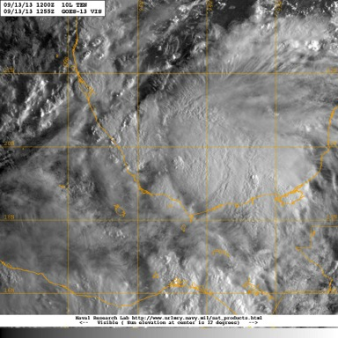
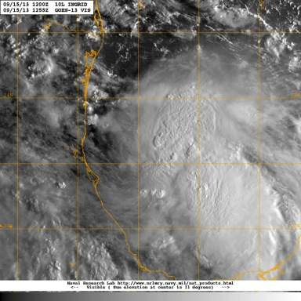
Hurricane Ingrid Debrief
13 Sept
15 Sept
Flight ops re-cap: 8 Total flight missions
62 Total flight hours; 147 GPSsondes; 51 AXBTs
September 26, 2013

Slide 2
Agenda
Missions Overview (Reasor)
Science Discussions
  G-IV: TDR (Gamache)
  N42: TDR (Rogers)
  N43: TDR/OW/Shear (Uhlhorn/Chang/Reasor)
NASA HS3 Coordination (Rogers/Dunion/Chang)
Additional Field Program Issues
HWIND/Modeling/HEDAS (Murillo/Zhang/Aksoy/Aberson)

Slide 3
Missions Overview
Purpose: Collect P-3 TDR data for assimilation into the operational HWRF model, and further test the G-IV TDR system and flight patterns.
Target: TD10/TS Ingrid on 13 Sept in the s. Bay of Campeche; Hurricane Ingrid (5PM) on 14 Sept; barely-Hurricane Ingrid on 15 Sept
Background: P34/93L moved off the w. Yucatan coast on 12 Sept with a 60% (80%) chance of development in 2 (5) days. A ‘go’ decision required the center to be far enough off the s. Bay of Campeche coastline.

Slide 4
Missions Overview
13 Sept: G-IV (9AM) circumnavigation pattern; N43 (2PM) figure-4 pattern
14 Sept: N42 (2AM) figure-4 pattern; G-IV (9AM) circumnavigation pattern; N43 (2PM) figure-4 and OW pattern
15 Sept: N42 (2AM) figure-4 pattern; G-IV (9AM) circumnavigation pattern; N43 (2PM) figure-4, circumnavigation, and OW pattern (recover in Corpus Christi, TX)

Slide 5
Missions Highlights
Scientifically interesting case of intensification from TD to Hurricane under sustained moderate westerly vertical wind shear.
13th
14th
15th

Slide 6
Missions Highlights
NOAA flights referenced in NHC discussions:
13 Sept (5PM): THE CENTRAL PRESSURE ESTIMATED FROM A DROPSONDE FROM THE NOAA G-IV JET EARLIER TODAY WAS 999 MB.
13 Sept (8PM): DATA FROM NOAA AND AIR FORCE RESERVE HURRICANE HUNTER AIRCRAFT INDICATE THAT INGRID HAS STRENGTHENED...AIRCRAFT DATA ALSO INDICATE THAT THE WIND FIELD HAS EXPANDED IN SIZE.
14 Sept (2PM): SATELLITE IMAGES AND INFORMATION FROM THE METEOROLOGIST ONBOARD THE NOAA JET SUGGEST THAT AN EYE COULD FORMING.
14 Sept (11PM): THE NOAA P-3 REPORTED SEVERAL SFMR WINDS IN THE 70-75 KT RANGE AFTER CORRECTING FOR THE INFLUENCE OF RAIN...AND DATA FROM TWO DROPSONDES NORTHEAST OF THE CENTER FROM THE NOAA AIRCRAFT ALSO SUGGEST SURFACE WINDS IN THE 70-75 KT RANGE...MICROWAVE IMAGERY SHOWED THE FORMATION OF A PARTIAL EYEWALL...WHICH WAS ALSO NOTED BY PERSONNEL ON THE NOAA AIRCRAFT.
15 Sept (11AM): NOAA AND AIR FORCE RESERVE AIRCRAFT JUST COMPLETED SEVERAL HOURS OF INVESTIGATION OF INGRID...AND FOUND LITTLE TO INDICATE THAT THE CYCLONE IS STILL A HURRICANE.
15 Sept (5PM): VISIBLE SATELLITE IMAGES AND DROPSONDE DATA FROM A NOAA G-IV MISSION INDICATE THAT THE CENTER OF INGRID REMAINS NEAR THE WESTERN EDGE OF THE DEEP CONVECTION DUE TO MODERATE WESTERLY SHEAR.
15 Sept (11PM): AROUND 21-22Z...A NOAA AIRCRAFT MEASURED A CENTRAL PRESSURE OF 987 MB.

Slide 7
Missions Highlights
G-IV and P-3 QC’d TDR data transmitted to the ground in real time
6-hourly TDR sampling of the TC core region between the N42 and N43 flights
G-IV circumnavigation pattern flown at 60, 90, and 120 nm radius (~4-8xRMW) from TC center
Ground-based sonde processing and TDR job file creation tested
TC-in-shear pattern tested during N43’s last flight

Slide 8
Science Discussions
G-IV TDR (Gamache)
N42 TDR (Rogers)
N43 TDR/Shear (Uhlhorn/Reasor)
Ocean Winds (Chang)

Slide 9
G-IV TDR in Ingrid
20130913N1, 20130914N1 and 20130915N1

Slide 10
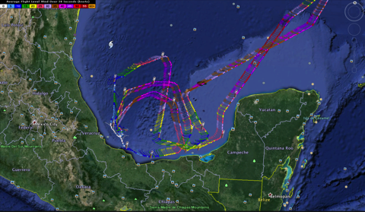
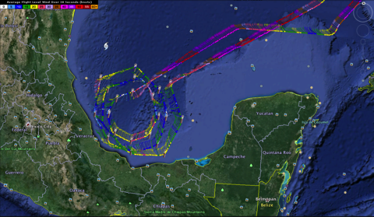
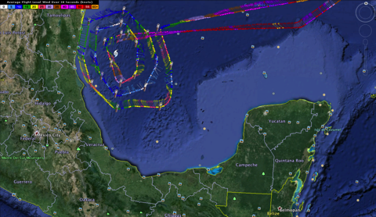
20130913N1
20130914N1
20130915N1

Slide 11
G-IV analyses during Ingrid
20130913N1-20130915N1
  Job files made by Gamache at home all 3 days (as well as for NOAA43)
  Job files accessed by NOAA 49
  Joe Greene ran analysis on 20130913N1 and 20130914N1, Alan Goldstein on 20130915N1
  Analyses and superobs sent in real time
  Timing problem between fore and aft continued to create artificial tilt in aft sweeps—seen in all three flights
  Data transferred successfully to EMC on all 5 missions (based upon AOC ftp site information)

Slide 12
G-IV analyses during Ingrid
20130914N1
  StartRawCopy (rsync) not run initially
  hrd49 froze up before last analysis finished and transmitted—as G-IV was on approach
20150915N1
  Decided not to start processing until first circle finished
  Processing not finished before landing—about 20 min on ground
  Gamache researching more parallel processing with Goldstein’s collaboration

Slide 13
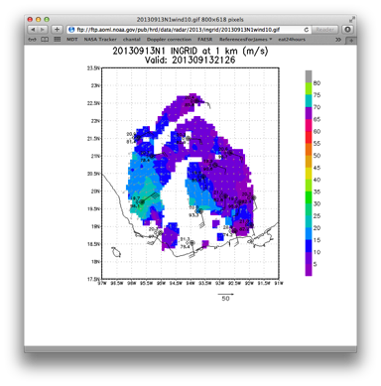
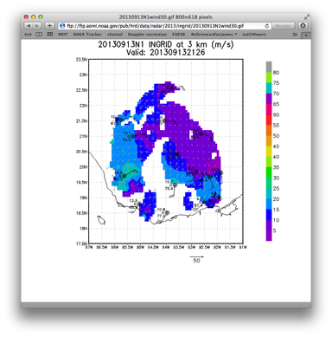
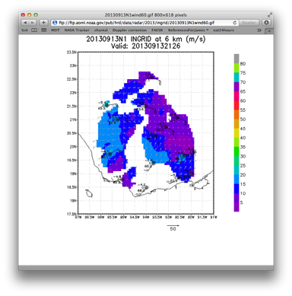
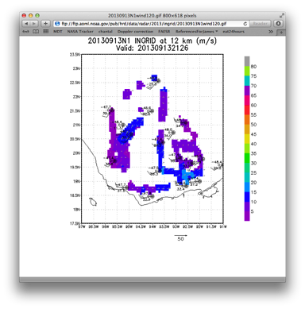

Slide 14
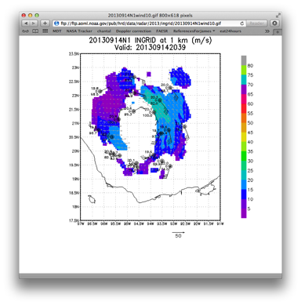
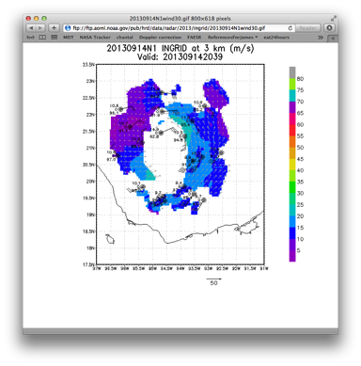
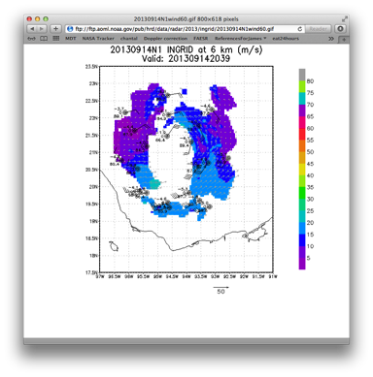
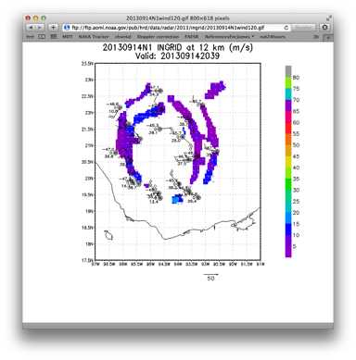

Slide 15
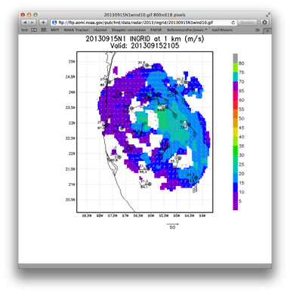
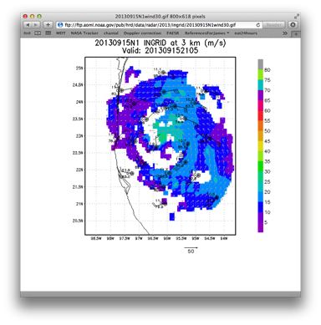
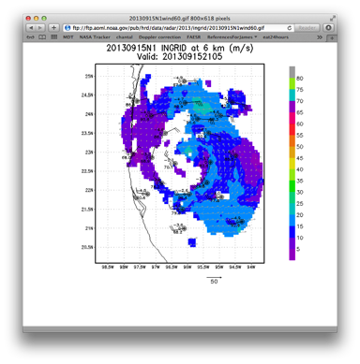
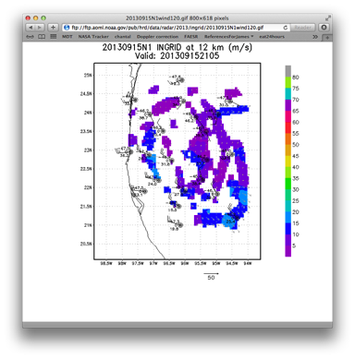

Slide 16
Takeaway points
Remote jobfile creation works—but could be sped up to require less ground-aircraft interaction—Alan suggested AOC learning jobfile_display
Either analysis must be faster or can’t do whole large-circle analyses..maybe both—G-IV is a challenge—twice the data in same amount of time and returns to base 30-40% faster.
Progress happening on java jobfile_display so others without linux can set up jobs on the ground.
G-IV TDR angle problems continue—still being addressed by King Air subcontractor.

Slide 17
N42 in Ingrid
20130914H1, 20130915H1

Slide 18
NOAA Flight 130914H1
Tropical Storm Ingrid
LPS: R. Rogers
Radar: H. Chen
Dropsonde, AXBT: J. Zhang
MISSION GOALS
TDR/RAPX mission into T.S. Ingrid
MISSION SUMMARY
storm getting better organized
deep convection on northeast side of storm; mostly stratiform on southwest side
wind asymmetry rotates between 1 and 7 km
vortex nearly vertically aligned
MSLP measurements ~989 hPa, peak SFMR winds ~60 kt
11 sondes and 10 AXBT’s dropped

Slide 19
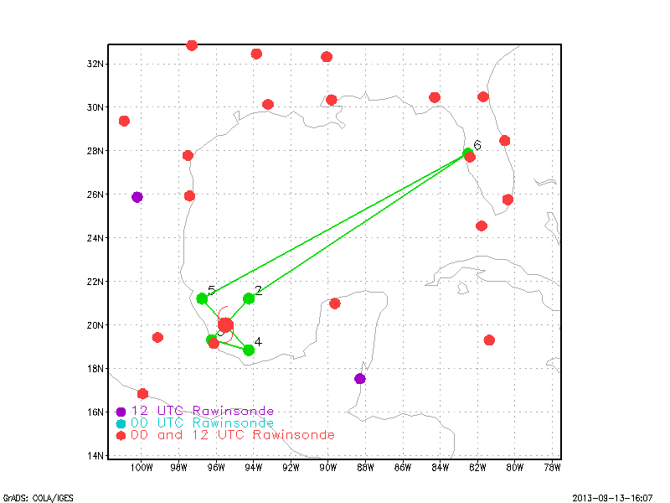
Proposed flight track for 130914H1

Slide 20
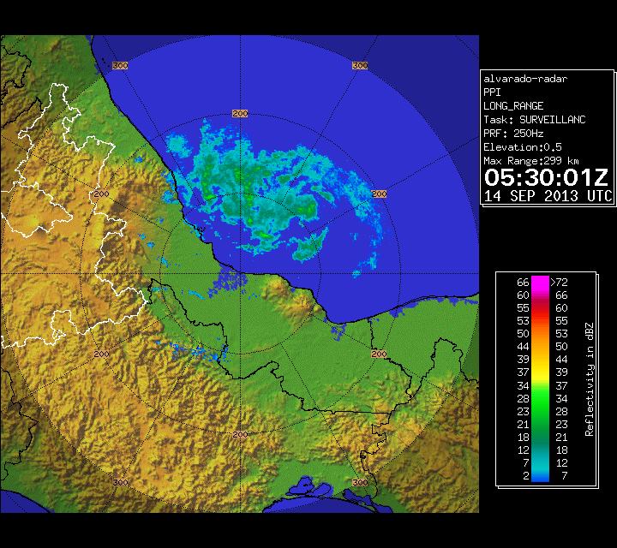
Long-range radar image (dBZ) from Alvarado radar site valid 0530 UTC Sept 14

Slide 21
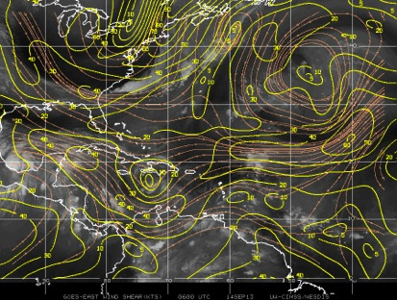
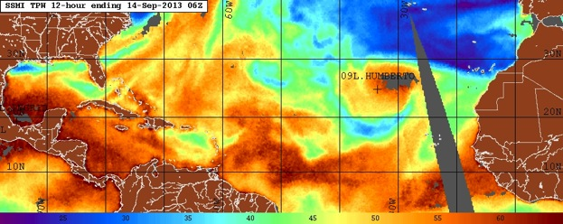
Environmental conditions at time of take-off
850-200 hPa vertical shear (kt) valid 06 UTC Sept. 14
SSMI Total Precipitable Water (mm) valid 06 UTC Sept. 14

Slide 22
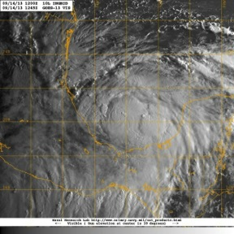
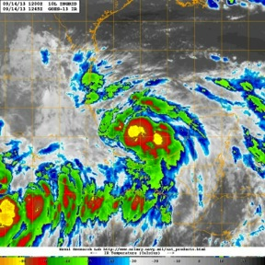
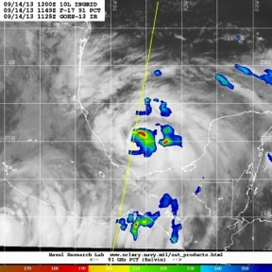
Satellite imagery during mission
Visible at 1245 UTC
Infrared at 1245 UTC
91 GHz MW at 1149 UTC

Slide 23
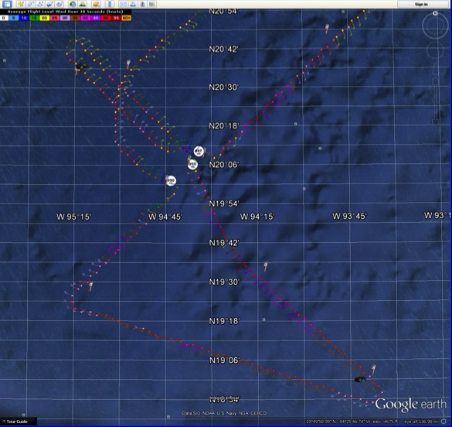
Actual flight track for 130914H1

Slide 24
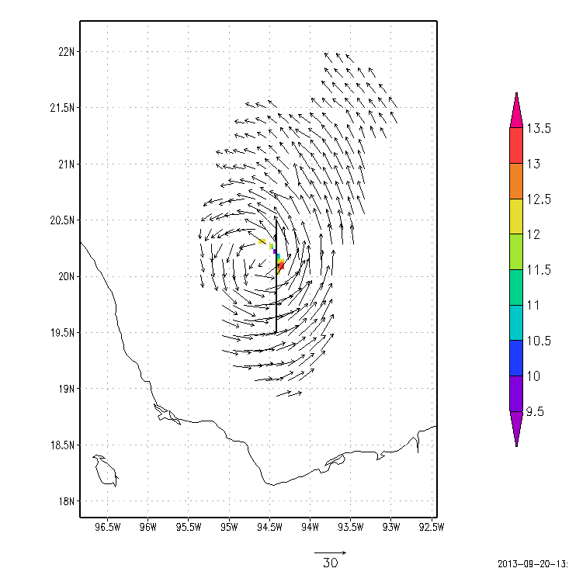
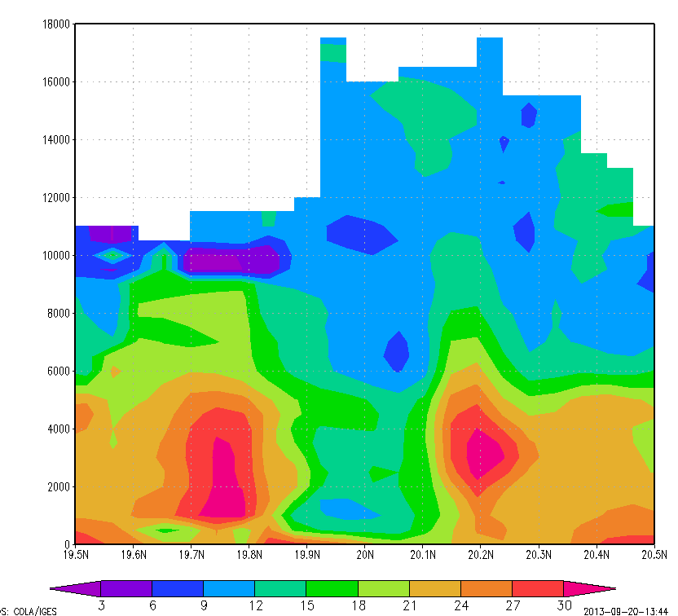
Locations of deep convection
2-km winds (m/s) and
16-km reflectivity (dBZ)
reflectivity (dBZ)
B
height (m)
A
A
B

Slide 25
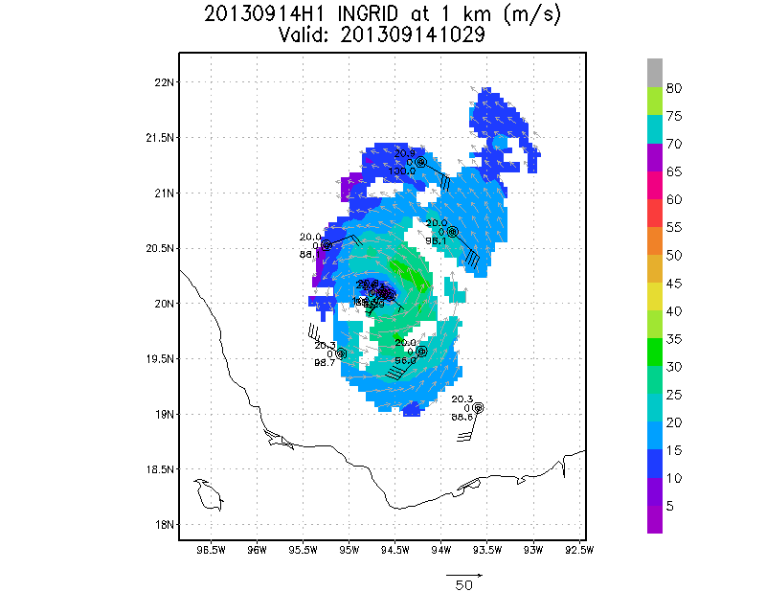
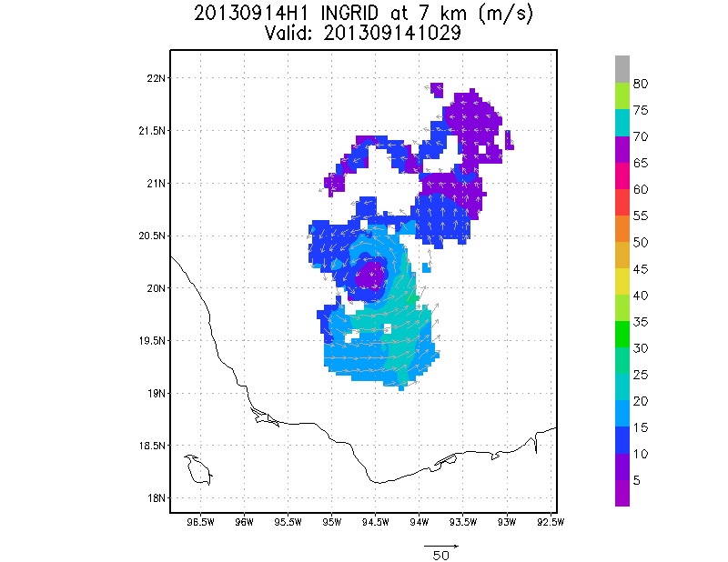
Doppler-derived winds and drops
1 km
7 km

Slide 26
NOAA Flight 130915H1
Hurricane Ingrid
LPS: R. Rogers
Radar: H. Chen
Dropsonde, AXBT: J. Zhang
MISSION GOALS
TDR/RAPX mission into Hurricane Ingrid
MISSION SUMMARY
storm showing classic shear structure
precipitation only on one side – the east, or downshear side
open eyewall on the right side of the shear, spiral band wrapping through the downshear side
vigorous convection only in upwind portion of the spiral band, and limited amount in northern eyewall
peak SFMR winds ~65-70 kt on northeast side, pronounced across-storm asymmetry
radar shows tilt of ~30-40 km toward northeast between 2 and 8 km
17 sondes and 10 AXBT’s dropped

Slide 27
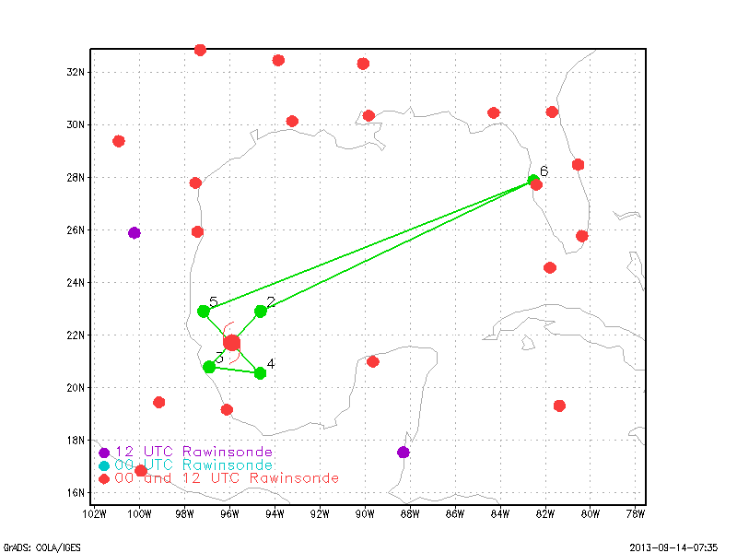
Proposed flight track for 130915H1

Slide 28
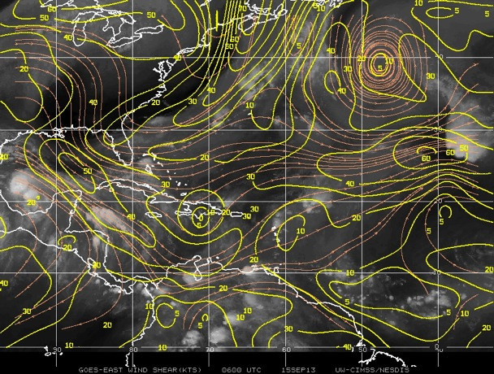
Environmental conditions at time of take-off
850-200 hPa vertical shear (kt) valid 06 UTC Sept. 15

Slide 29
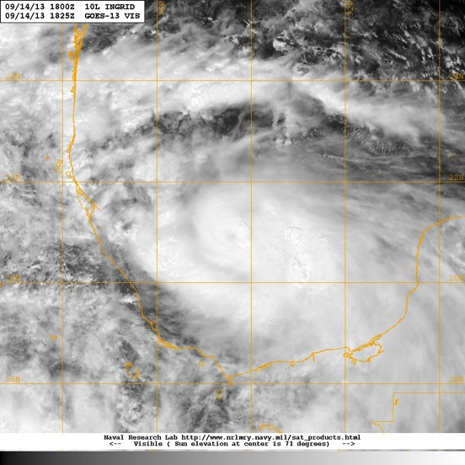
Satellite imagery prior to mission
attempted eye formation?

Slide 30
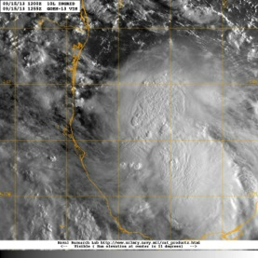
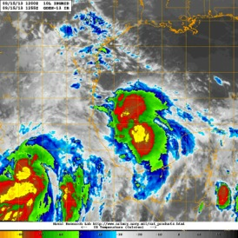
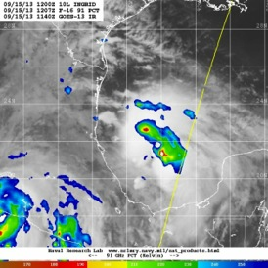
Satellite imagery during mission
Visible at 1255 UTC
Infrared at 1255 UTC
91 GHz MW at 1207 UTC

Slide 31
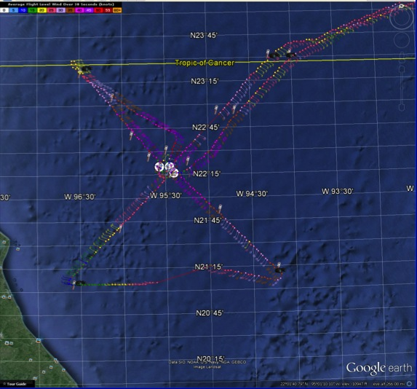
Actual flight track for 130915H1

Slide 32
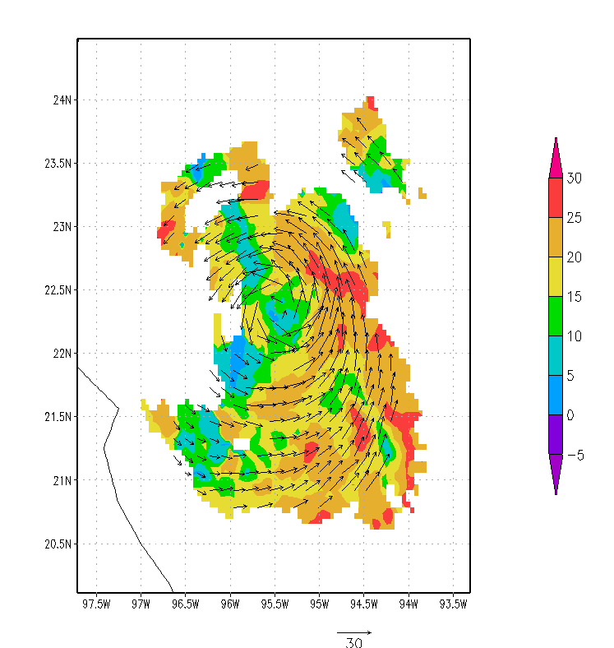
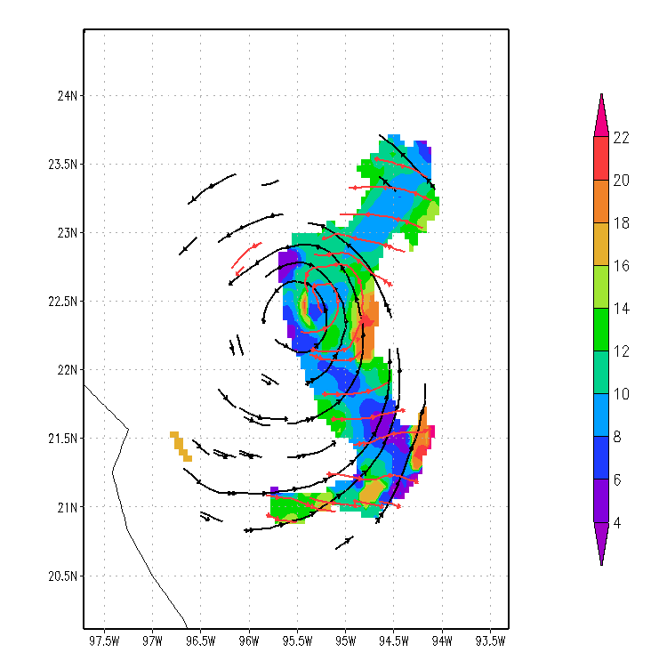
Reflectivity and Doppler-derived winds
Reflectivity at 4 km (dBZ) and wind vectors at 2 km (m/s)
Reflectivity at 10 km (dBZ) and 2-km winds (black) and 8-km winds (red)

Slide 33
N43 in Ingrid
20130913I1, 20130914I1 and 20130915I1

Slide 34
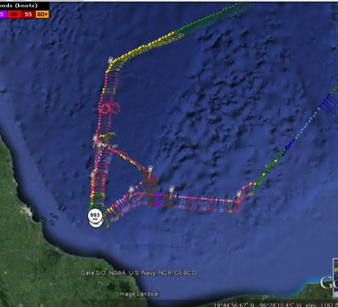
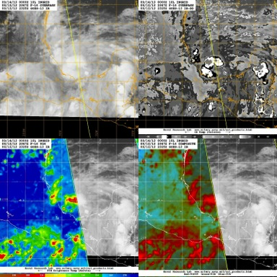
TS Ingrid - 20130913I1
10 Sondes
10 AXBTs
W/S legs cut due to proximity to Mexico

Slide 35
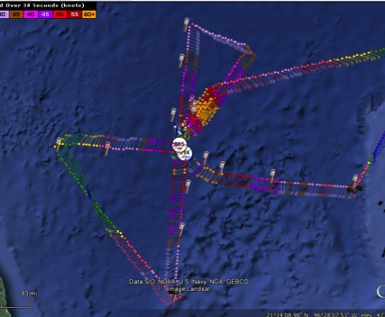
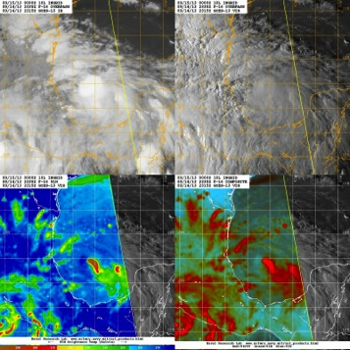
H Ingrid - 20130914I1
17 Sondes
10 AXBTs
Figure-4, Ocean Winds racetracks
5 penetrations

Slide 36
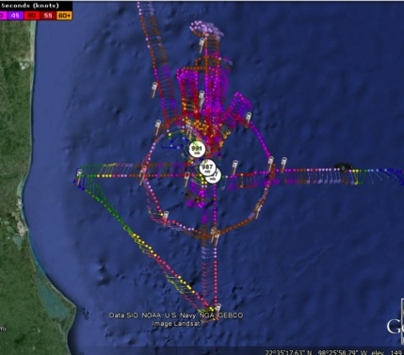
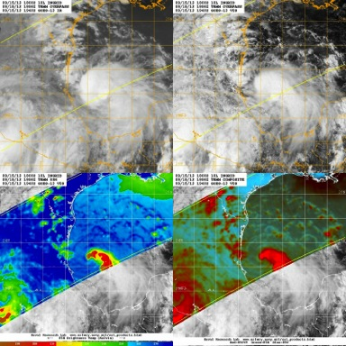
H Ingrid - 20130915I1
26 Sondes
10 AXBTs
Figure-4, Circumnavigation at ~2RMW, Ocean Winds racetracks, coordination with AV-1 unsuccessful
7 penetrations

Slide 37
N43: TC in Shear (15 Sept)
Initial figure-4 helps define RMW and TC center
Circumnavigation pattern at 2xRMW yields another look at core wind/reflectivity and provides azi-height thermo. structure of PBL via sondes
G-IV data 6-h earlier provides larger-scale context
Hypothesis regarding TC weakening in shear: The shear-induced vortex tilt asymmetry outside the eyewall organizes convection there into a wave-1 pattern. Mid-level low-θ_{e} air is transported into the PBL via downdrafts (tied to the wave-1 convective asymmetry), and is then brought into the eyewall within the inflow layer.

Slide 38
Reflectivity
S

Slide 39
Vortex Tilt
2 KM
6 KM
S

Slide 40
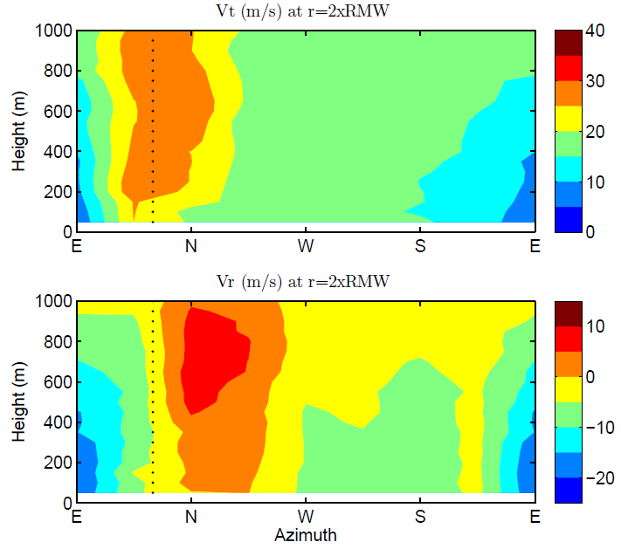
Sonde-based Azi-Height Vt and Vr
Vt
1 KM
Vr
1 KM

Slide 41
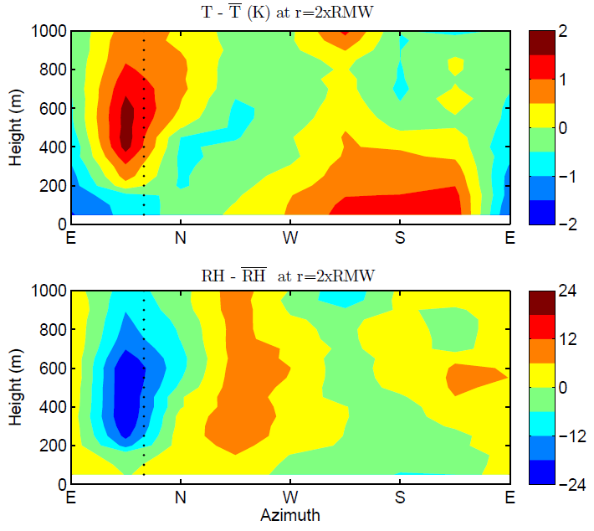
Sonde-based Azi-Height T’ and RH’
dBZ

Slide 42
NASA HS3 Coordination
13 Sept – AV6 cancelled
15 Sept – AV1 aborted in pattern ← N43 mission

Slide 43
Additional Issues
N42 TDR: jobfile_display window minimized when fields were clicked (temporary solution was to create job files on the ground)
Long ferries limited the time in pattern. Re-evaluate the decision not to recover in Corpus Christi on 13 Sept.
Others? [Or postpone until after HWIND/Modeling/HEDAS discussion...]

Slide 44
HWIND/Modeling/HEDAS

Slide 45
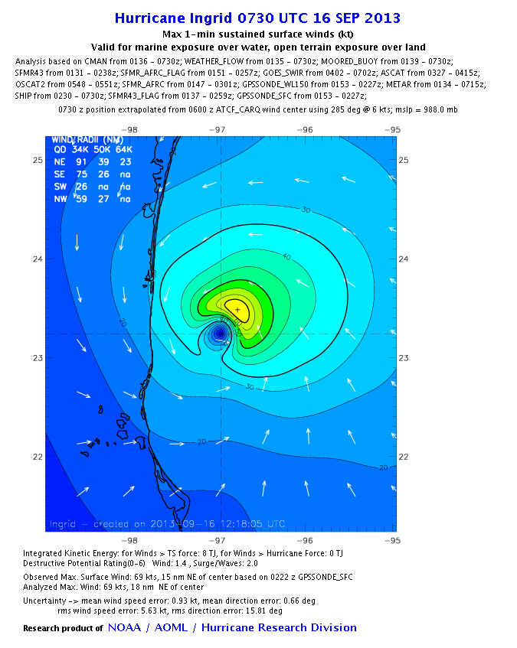
H*Wind during Ingrid
12 analysis from 9/12-16/13
33 analysis performed in 2013

Slide 46
HEDAS EXPERIMENTS - ASSIMILATED OBSERVATIONS
 |  | FLIGHT LEVEL |  |  |  | SFMR |  |  | Dropsondes |  |  |  |  | Doppler Superobs |  |  | Satellite AMVs | Satellite AIRS Retrievals | Satellite GPS-RO Retrievals
CASES | MISSIONS | P-3 | Air Force | G-IV | Total | P-3 | Air Force | Total | P-3 | Air Force | G-IV | HS-3 | Total | P-3 | G-IV | Total |  |  |  | Total
2013091218 | 302 | 0 | 816 | 0 | 816 | 0 | 166 | 166 | 0 | 0 | 0 | 0 | 0 | 0 | 0 | 0 | 804 | 1,586 | 31 | 3,403
2013091300 | 302 | 6 | 428 | 0 | 434 | 3 | 69 | 72 | 0 | 0 | 0 | 0 | 0 | 0 | 0 | 0 | 848 | 0 | 184 | 1,538
2013091312 | 304 | 0 | 1,778 | 0 | 1,778 | 0 | 357 | 357 | 0 | 13 | 0 | 0 | 13 | 0 | 0 | 0 | 1,261 | 0 | 195 | 3,604
2013091318 | 43, 49 | 432 | 0 | 1,108 | 1,540 | 103 | 0 | 103 | 0 | 0 | 1,075 | 0 | 1,075 | 0 | 15,554 | 15,554 | 1,534 | 669 | 163 | 20,638
2013091400 | 43, 304 | 1,194 | 1,691 | 0 | 2,885 | 311 | 245 | 556 | 157 | 18 | 0 | 0 | 175 | 20,372 | 0 | 20,372 | 1,067 | 0 | 0 | 25,055
2013091406 | 42 | 415 | 0 | 0 | 415 | 88 | 0 | 88 | 0 | 0 | 0 | 0 | 0 | 0 | 0 | 0 | 1,321 | 466 | 171 | 2,461
2013091412 | 42, 49, 307 | 1,546 | 1,808 | 204 | 3,558 | 391 | 353 | 744 | 226 | 84 | 80 | 0 | 390 | 26,089 | 2,071 | 28,160 | 1,527 | 0 | 364 | 34,743
2013091418 | 43, 49 | 704 | 0 | 943 | 1,647 | 175 | 0 | 175 | 122 | 0 | 1,124 | 0 | 1,246 | 8,513 | 8,272 | 16,785 | 2,027 | 1,891 | 5 | 23,776
2013091500 | 43, 304 | 1,476 | 1,904 | 0 | 3,380 | 350 | 446 | 796 | 191 | 31 | 0 | 0 | 222 | 10,683 | 0 | 10,683 | 1,883 | 0 | 0 | 16,964
2013091506 | 42, 307 | 643 | 0 | 0 | 643 | 172 | 0 | 172 | 102 | 0 | 0 | 0 | 102 | 5,889 | 0 | 5,889 | 1,511 | 3,471 | 0 | 11,788
2013091512 | 42, 49, 307 | 1,318 | 2,304 | 207 | 3,829 | 327 | 532 | 859 | 244 | 226 | 52 | 0 | 522 | 19,603 | 1,793 | 21,396 | 1,641 | 0 | 200 | 28,447
2013091518 | 43, 49 | 311 | 0 | 890 | 1,201 | 98 | 0 | 98 | 20 | 0 | 1,444 | 0 | 1,464 | 3,809 | 14,001 | 17,810 | 2,245 | 572 | 586 | 23,976
2013091600 | 43, 303 | 2,593 | 1,927 | 0 | 4,520 | 581 | 377 | 958 | 307 | 103 | 0 | 0 | 410 | 16,430 | 0 | 16,430 | 1,626 | 0 | 0 | 23,944
2013091612 | 303 | 0 | 1,366 | 0 | 1,366 | 0 | 323 | 323 | 0 | 22 | 0 | 0 | 22 | 0 | 0 | 0 | 1,326 | 0 | 204 | 3,241
 | Total | 10,638 | 14,022 | 3,352 | 28,012 | 2,599 | 2,868 | 5,467 | 1,369 | 497 | 3,775 | 0 | 5,641 | 111,388 | 41,691 | 153,079 | 20,621 | 8,655 | 2,103 | 223,578

Slide 47
HEDAS EXPERIMENTS - ASSIMILATED OBSERVATIONS
By Case
CASES | MISSIONS | Total
2013091218 | 302 | 3,403
2013091300 | 302 | 1,538
2013091312 | 304 | 3,604
2013091318 | 43, 49 | 20,638
2013091400 | 43, 304 | 25,055
2013091406 | 42 | 2,461
2013091412 | 42, 49, 307 | 34,743
2013091418 | 43, 49 | 23,776
2013091500 | 43, 304 | 16,964
2013091506 | 42, 307 | 11,788
2013091512 | 42, 49, 307 | 28,447
2013091518 | 43, 49 | 23,976
2013091600 | 43, 303 | 23,944
2013091612 | 303 | 3,241
 | Total | 223,578

Slide 48
HEDAS EXPERIMENTS - ASSIMILATED OBSERVATIONS
By Platform
PLATFORM
Flight Level | 28,012
SFMR | 5,467
Dropsondes | 5,641
Doppler Superobs | 153,079
Satellite AMVs | 20,621
Satellite AIRS Retrievals | 8,655
Satellite GPS-RO Retrievals | 2,103
Total | 223,578

Slide 49
HEDAS EXPERIMENTS - ASSIMILATED OBSERVATIONS
By Aircraft
AIRCRAFT
P-3 | 125,994
Air Force | 17,387
G-IV | 48,818
HS-3 | 0
AMV | 20,621
AIRS | 8,655
GPS-RO | 2,103
Total | 223,578

Slide 50
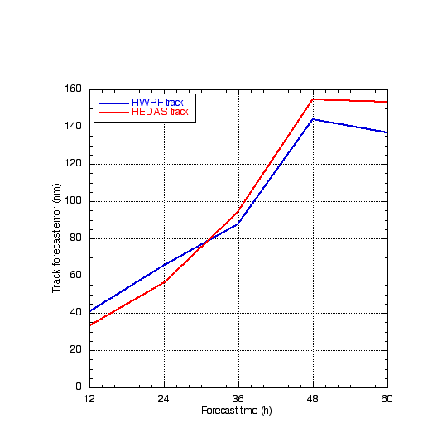
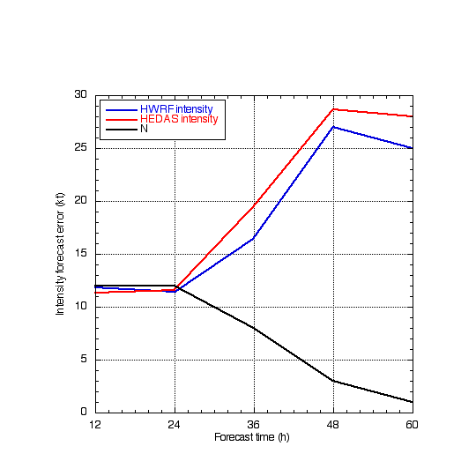
Ingrid only, including satellite data
HEDAS improved upon HWRF track forecasts 58% of the times
HEDAS improved upon HWRF intensity forecasts 43% of the times

Slide 51
Basin-wide HWRF Forecast Preliminary Evaluation
Prepared for HFP Hurricane Ingrid Debrief
Thursday, 26 October 2013

Slide 52
Ingrid Forecast Summary
Total forecasts: 19 (18Z 9/12-06Z 9/17)
Genesis forecast: 5 (00Z 9/09-00Z 9/12) (Forecast by NPS Montgomery’s group)
Good track forecast after 06Z 9/14
Good intensity forecast after 00Z 9/15

Slide 53
Ingrid Track Forecast Error
Absolute Error (NM)
Forecast (hour)
Forecast | 0h | 12h | 24h | 36h | 48h | 72h | 96h | 120h
CASE# | 17 | 16 | 15 | 12 | 11 | 7 | 1 | 0

Slide 54
2013 Track Forecast Error (Atlantic)
Absolute Error (NM)
Forecast (hour)
Forecast | 0h | 12h | 24h | 36h | 48h | 72h | 96h | 120h
CASE# | 98 | 82 | 70 | 58 | 48 | 29 | 15 | 17

Slide 55
Ingrid Intensity Forecast Error
Absolute Error (kt)
Forecast (hour)
Forecast | 0h | 12h | 24h | 36h | 48h | 72h | 96h | 120h
CASE# | 17 | 16 | 15 | 12 | 11 | 7 | 1 | 0

Slide 56
2013 Intensity Forecast Error (Atlantic)
Absolute Error (kt)
Forecast (hour)
Forecast | 0h | 12h | 24h | 36h | 48h | 72h | 96h | 120h
CASE# | 98 | 82 | 70 | 58 | 48 | 29 | 15 | 17

Slide 57
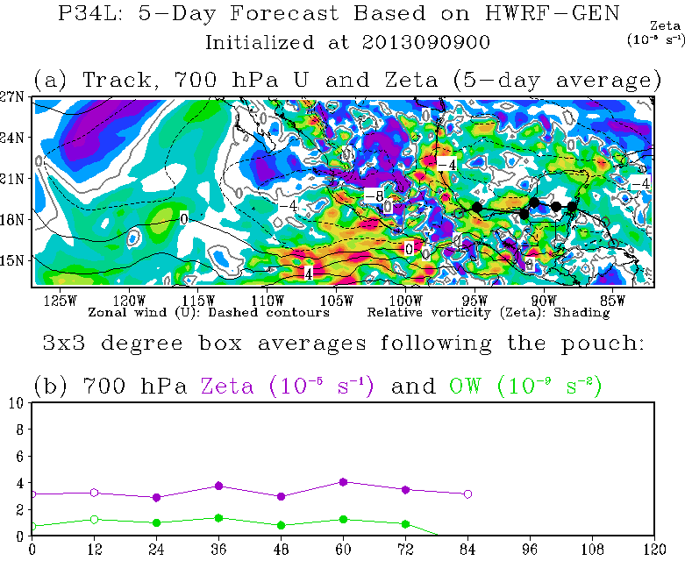

Genesis Forecast

Slide 58


Genesis Forecast

Slide 59

Genesis Forecast

Slide 60


Slide 61


Slide 62


Slide 63


