Slide 1
Analysis of the hurricane boundary layer kinematic structure using Doppler radar profiles :
Structure and dependence on intensity
Sylvie Lorsolo, Rob Rogers, Paul Reasor and John Gamache
Goal: Investigate the HBL structure in a composite framework to identify and better understand the intensification mechanisms in the boundary layer

Slide 2
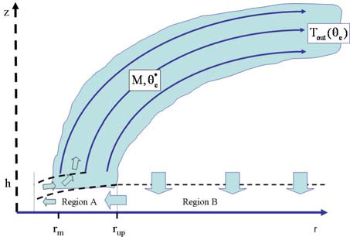
Assumptions and Motivation
  Smith et al. 2008:
    The intensification of the inner-core is a low-level process tied strongly to the dynamics of the HBL
    Intensification can be achieved if inward advection of angular momentum is strong enough to overcome angular momentum loss through friction
    So,
  In order the intensification mechanisms, the first step is to understand hurricane structure.
  The use of high-resolution data could provide better knowledge of smaller scale structure differences between TC of various intensities and help identify important processes that produce strong hurricanes.
  Better knowledge of HBL structure can also help better diagnose numerical models.
Notes:
Understanding why TCs of particular strength have a certain structure could provide some insights on what processes are at work.
A more detailed understanding of hurricane structure could, for instance, help diagnose why a model exhibiting an unrealistic structure did not capture the correct evolution of a TC.

Slide 3
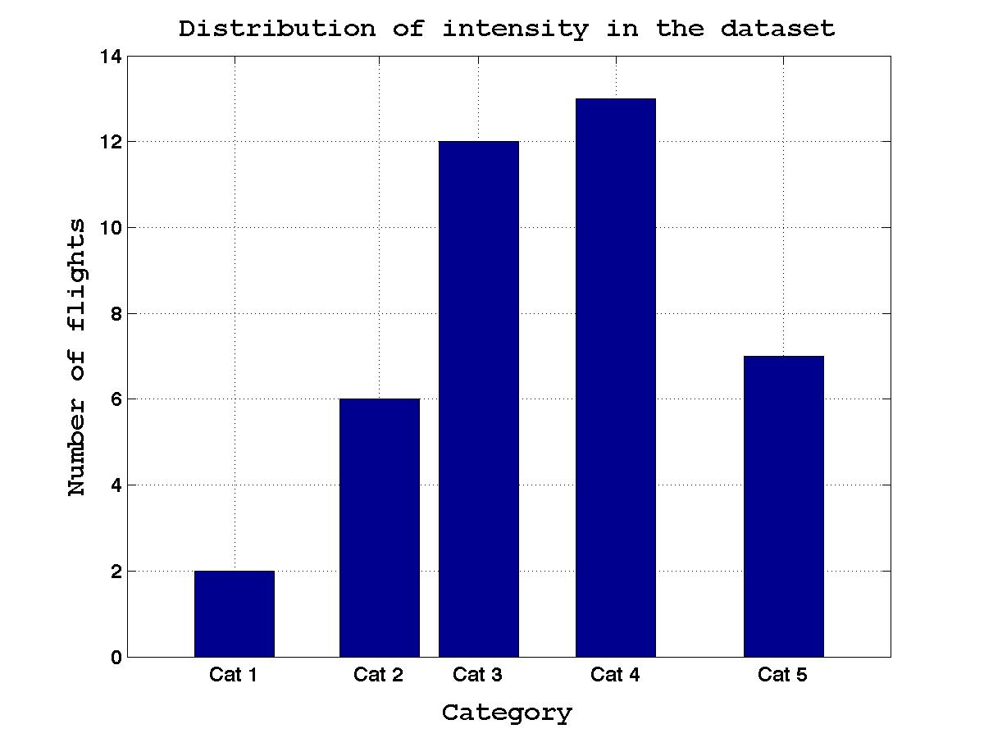
Database and intensity classification
Storm names | Number of Flights
Guillermo 97 | 2
Isabel 03 | 3
Fabian 03 | 2
Frances 04 | 6
Ivan 04 | 10
Jeanne 04 | 3
Katrina 05 | 1
Rita 05 | 4
Felix 07 | 3
Paloma 08 | 1
Earl 10 | 6
11 Storms | 41
Weak Storms :
BT < 105
Strong Storms :
BT > 120
Number of strong storm cases: 18
Number of weak storm cases: 15

Slide 4
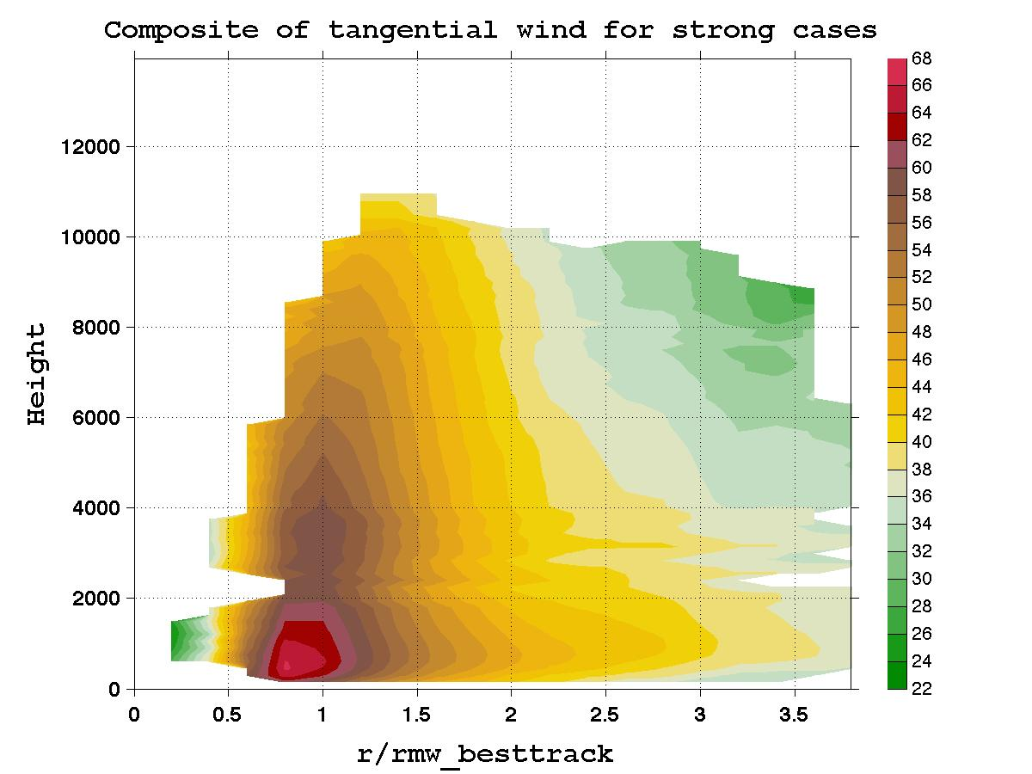
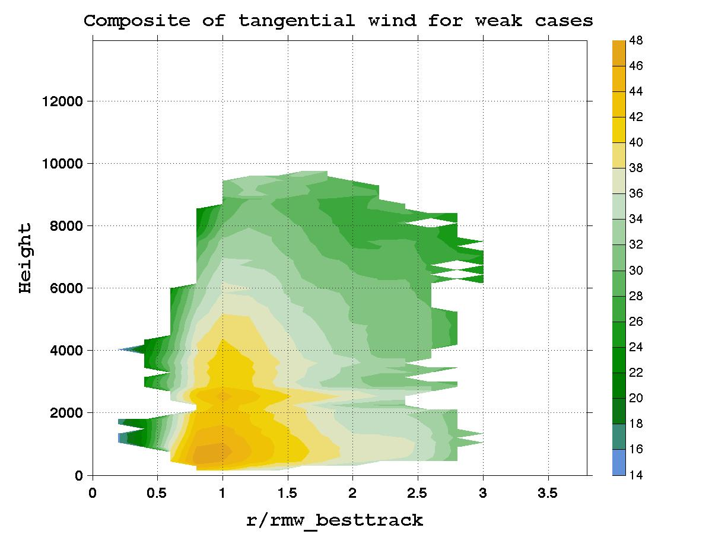
Composites

Slide 5
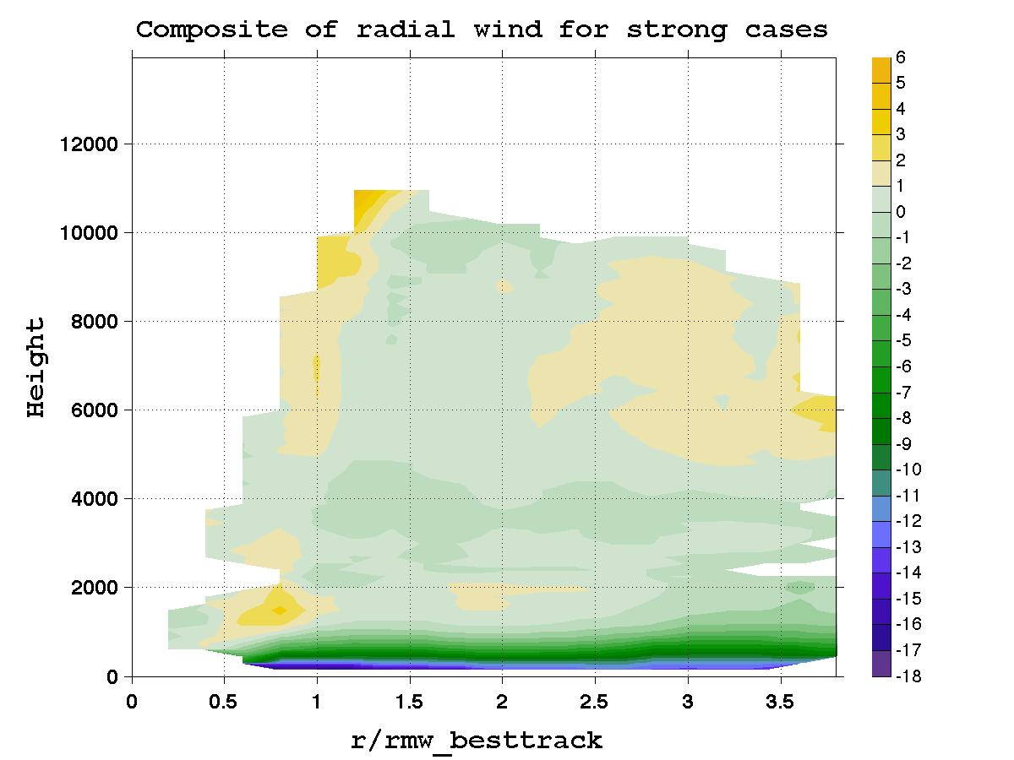
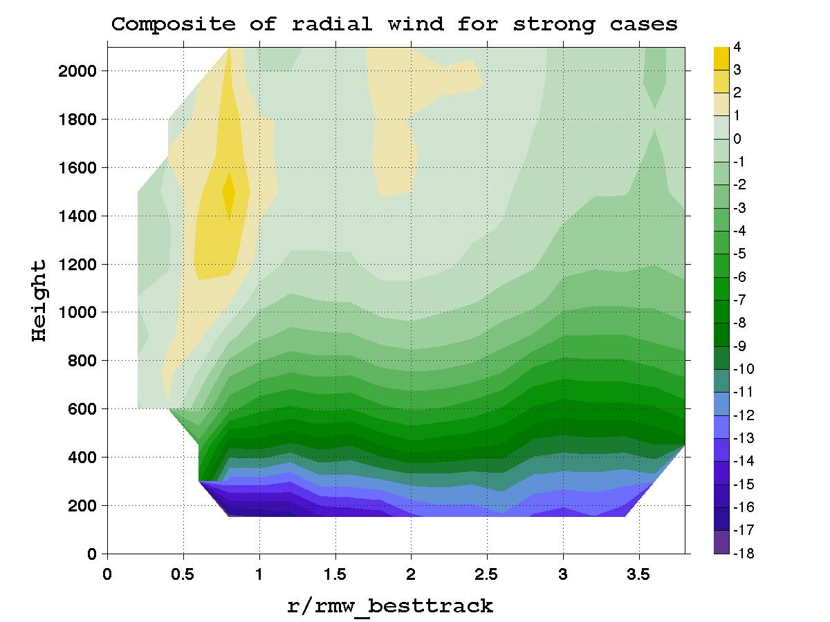
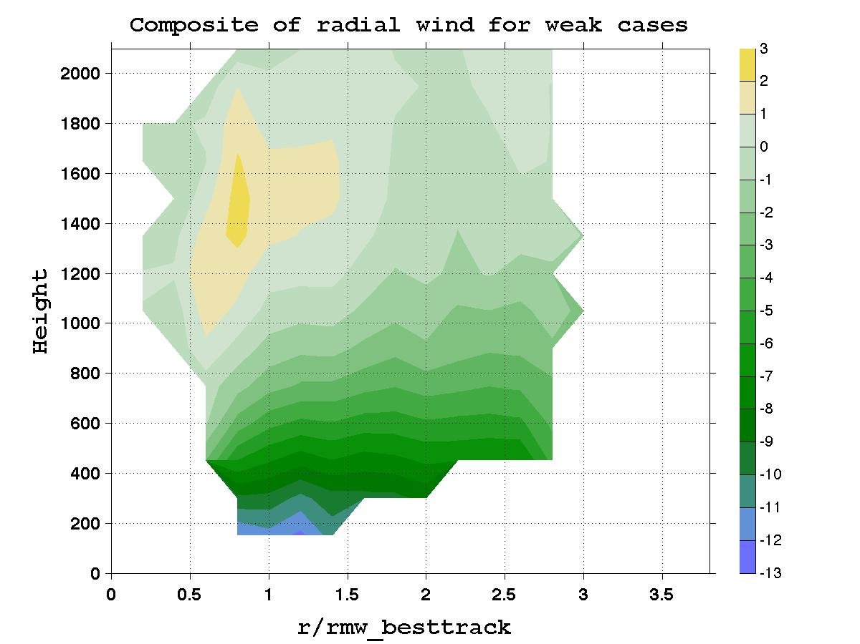
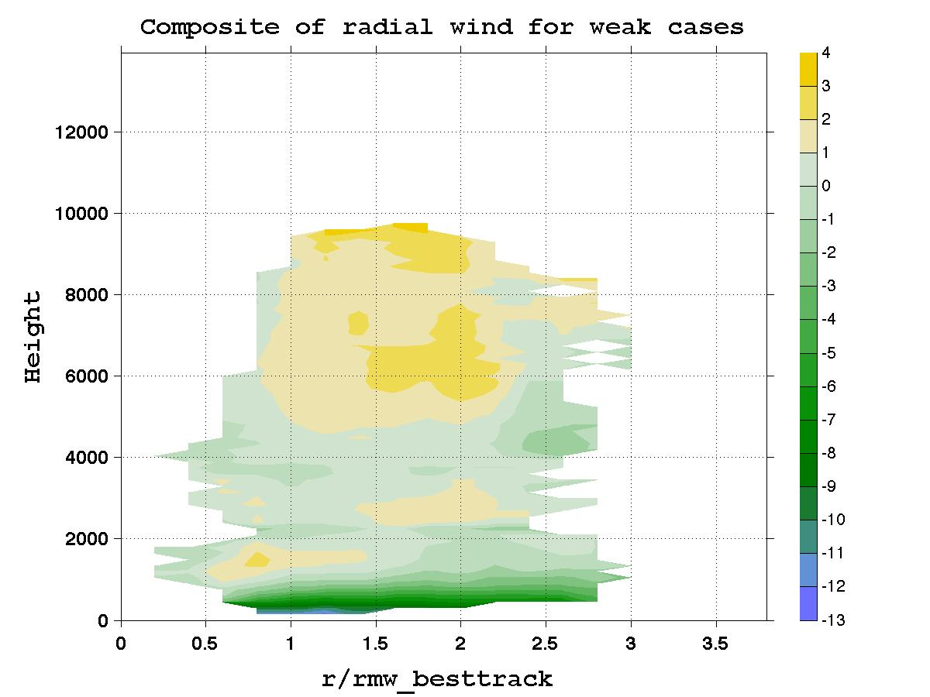
Composites
0.8 r* - 1.2r*
Region 1
2.4 r* - 2.8 r*
Region 2

Slide 6
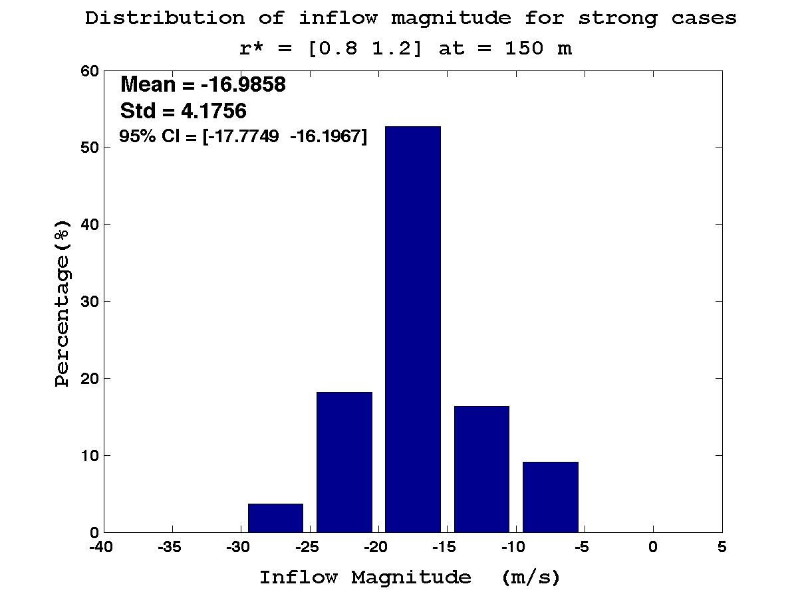
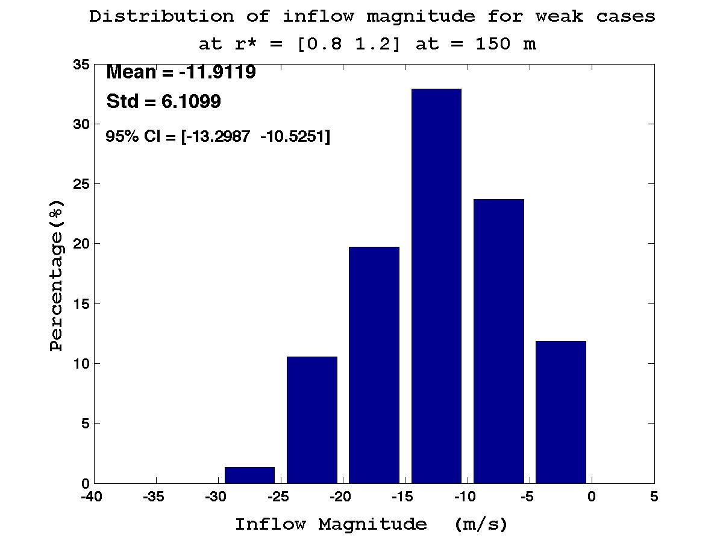
Inflow Magnitude
Inflow Magnitude at 150 m in region 1

Slide 7
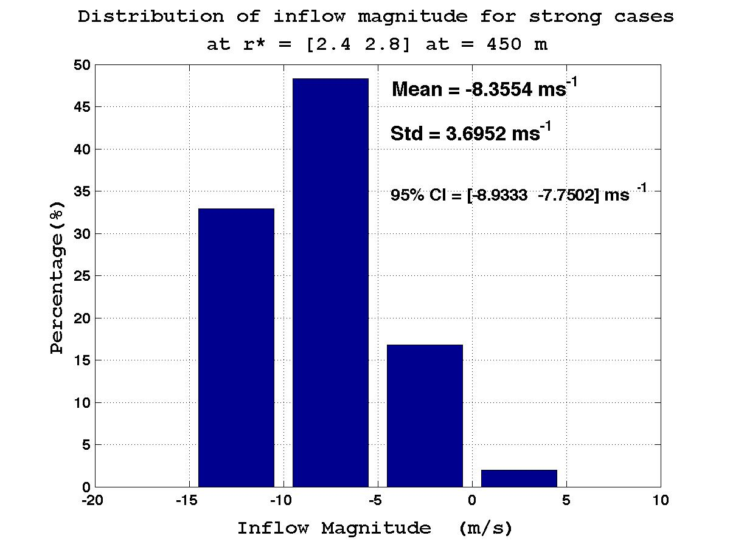
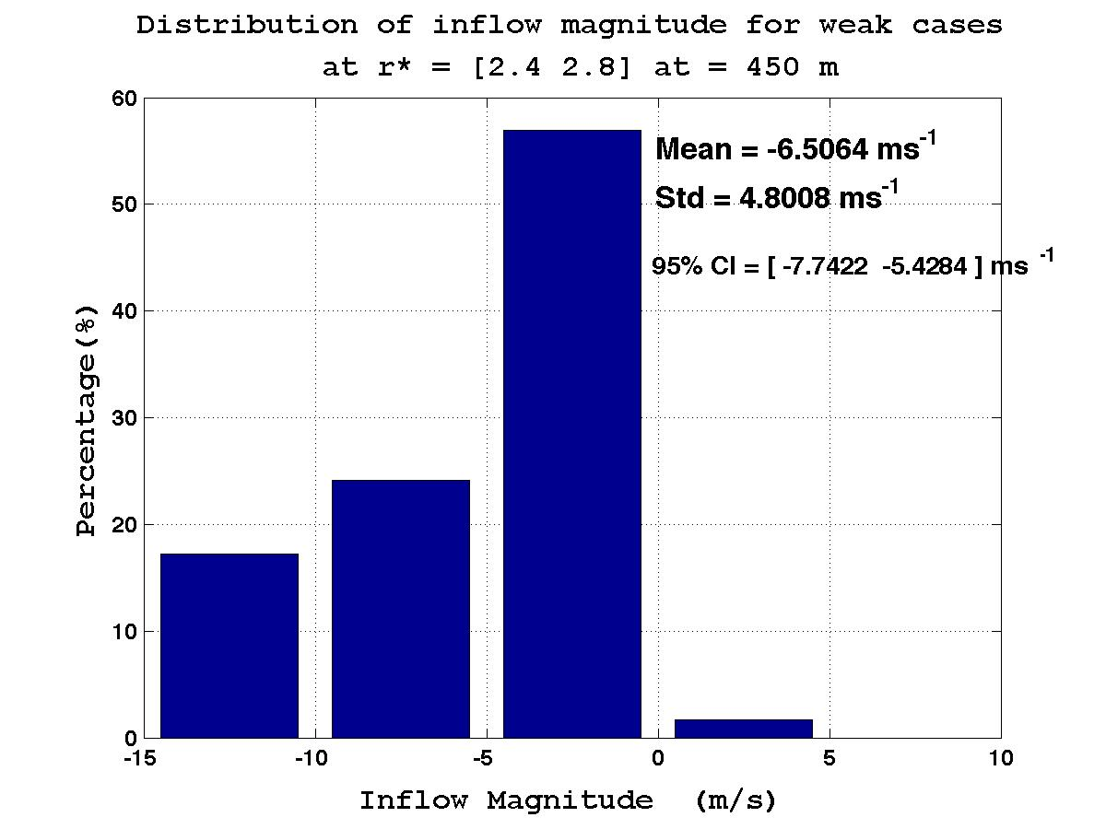
Inflow Magnitude
Inflow Magnitude at 450 m in region 2

Slide 8
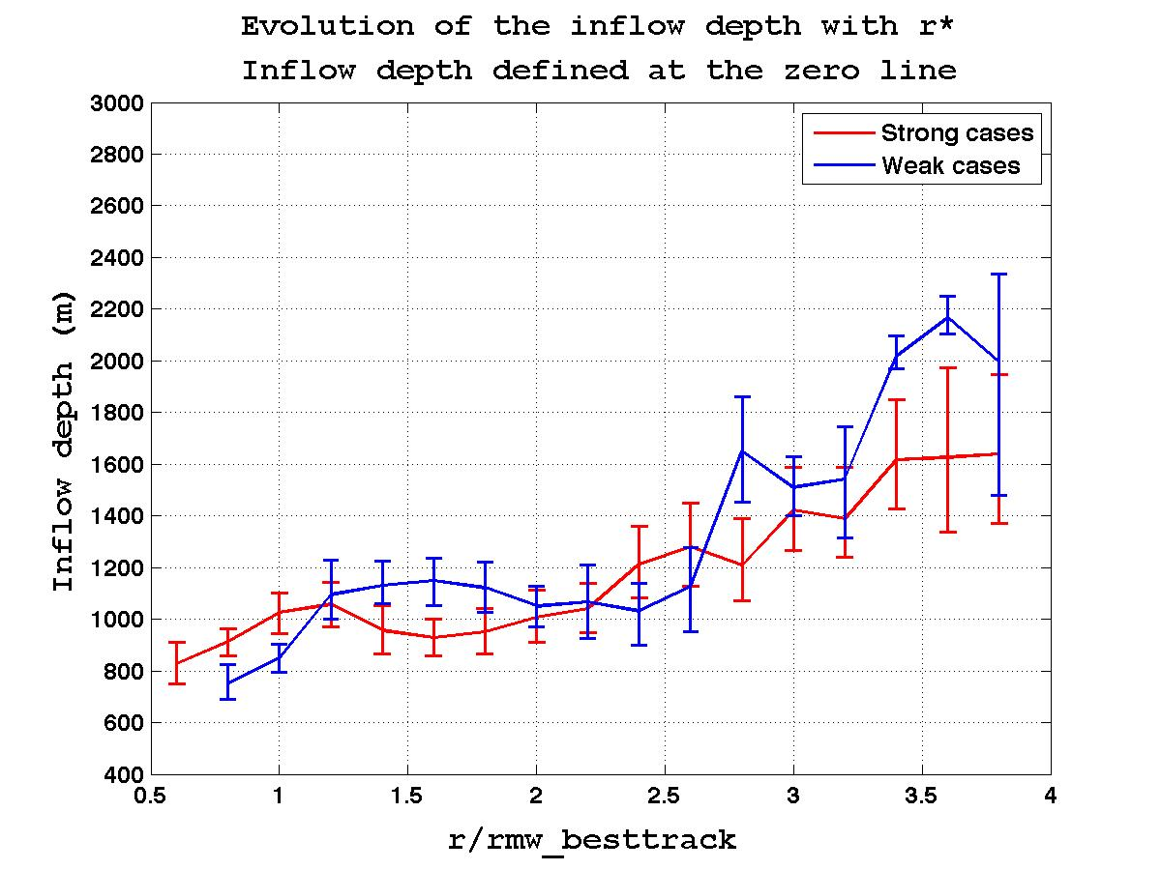
Inflow Depth

Slide 9
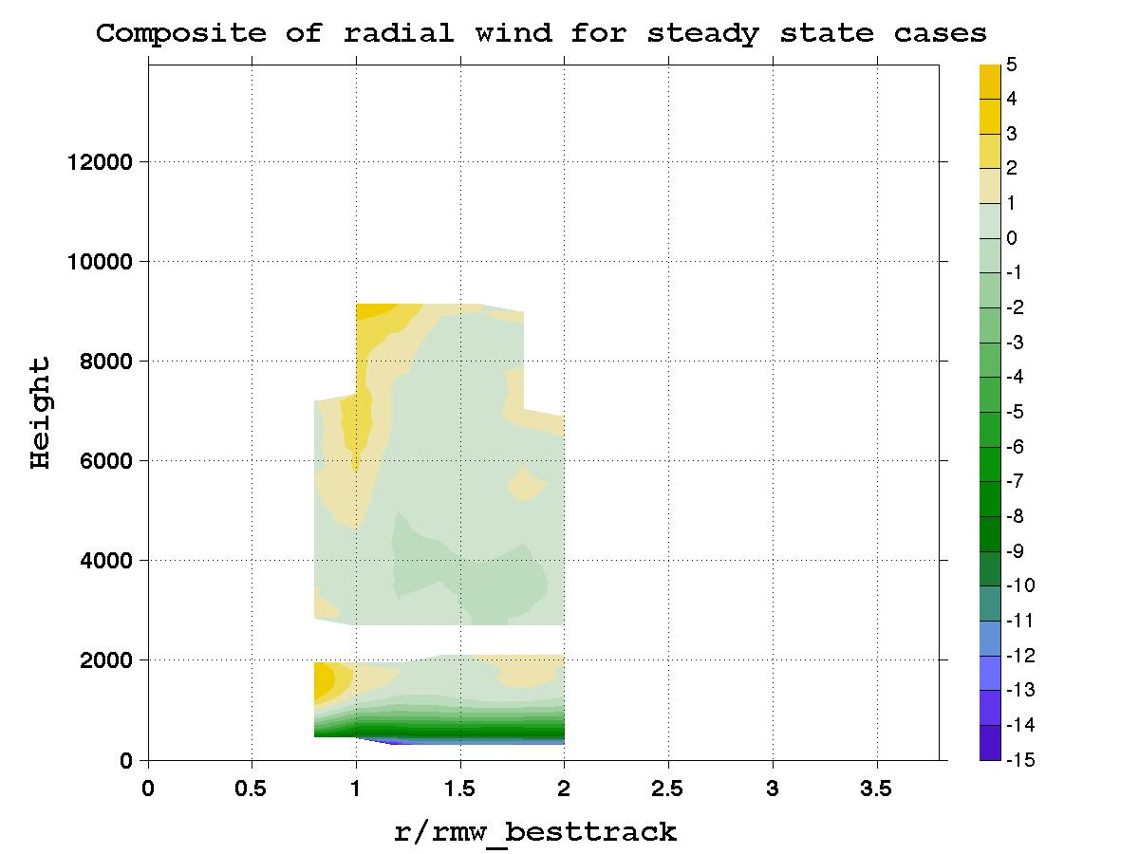
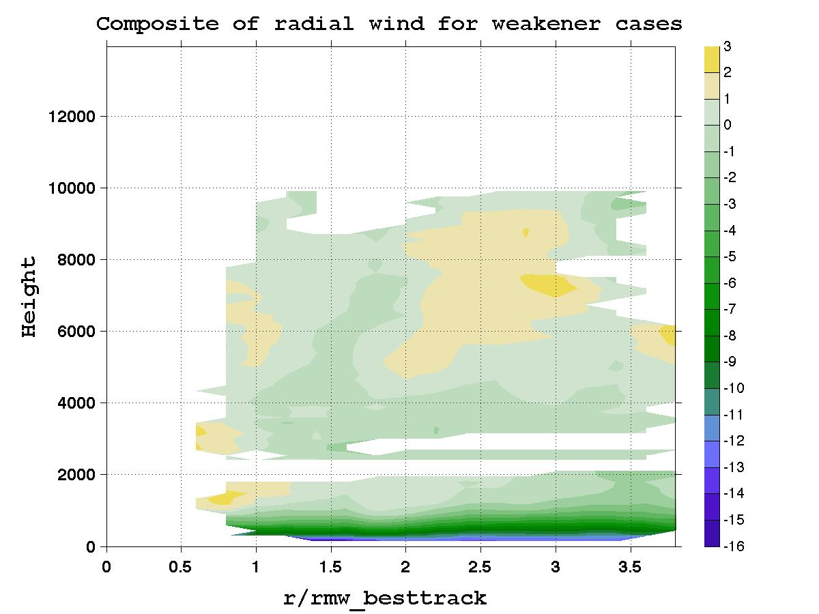
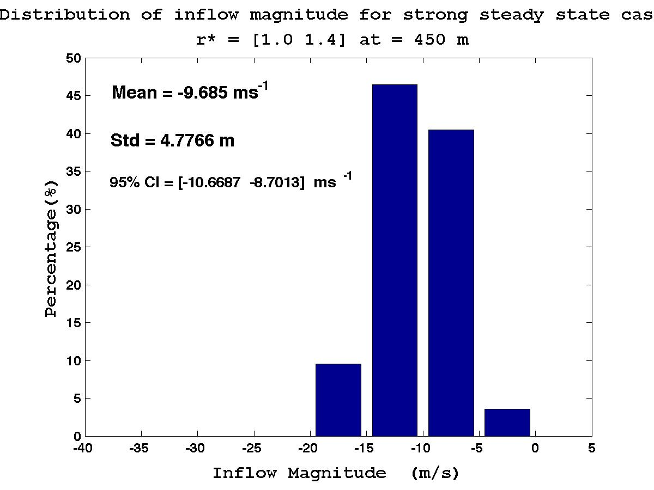
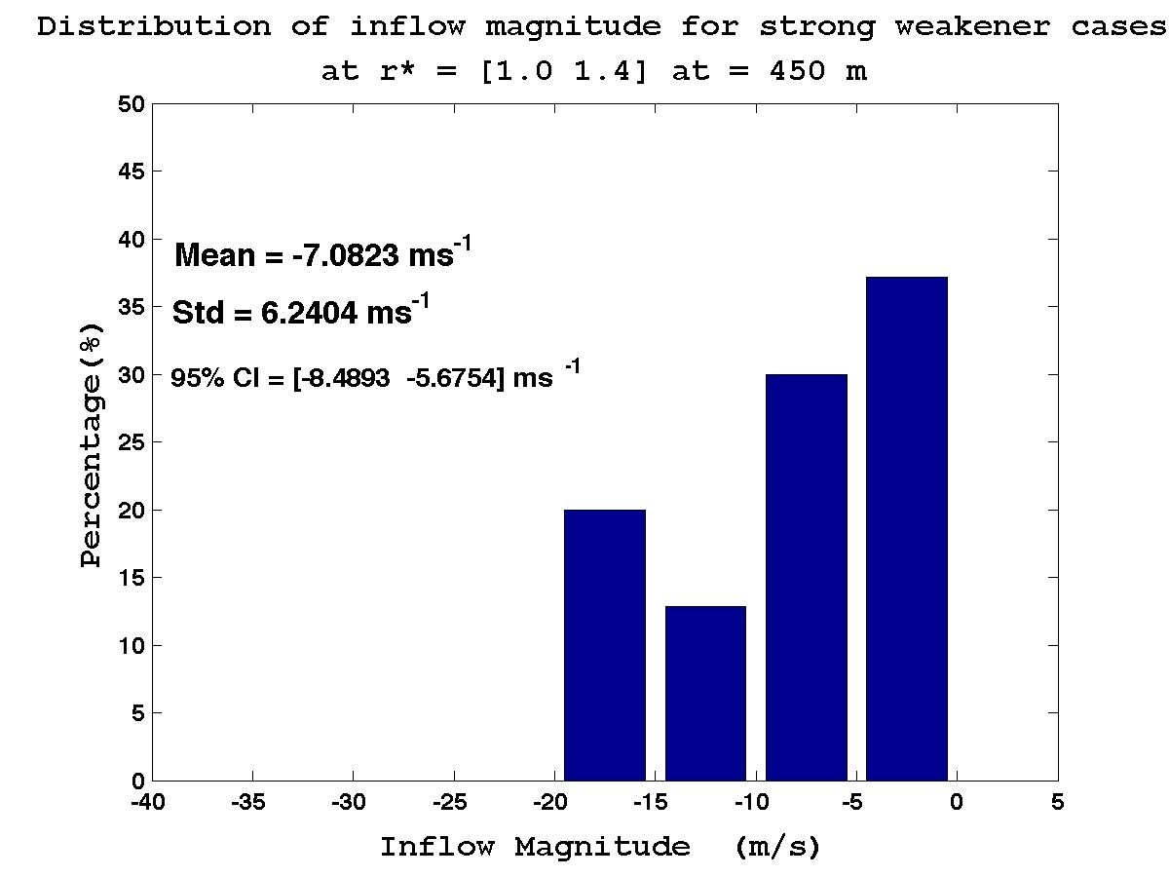
Strong steady state vs Weakeners
Mean intensity: 128 kt
Mean intensity: 137 kt

Slide 10
No significant difference in the inflow depth
Stronger inflow magnitude in stronger storms
Weakening storms seem to have a slightly weaker inflow magnitude even when slightly stronger
➔ Observations would confirm the argument that the inflow magnitude could determine how fast particle spin the intensification process (Smith and Thomsen 2009)
➔ Could these observations linked to the inflow angles?
➔ Observations (stronger inflow mangnitude while same inflow depth) suggest that there could be a stronger inward mass flux in the inflow layer

Slide 11
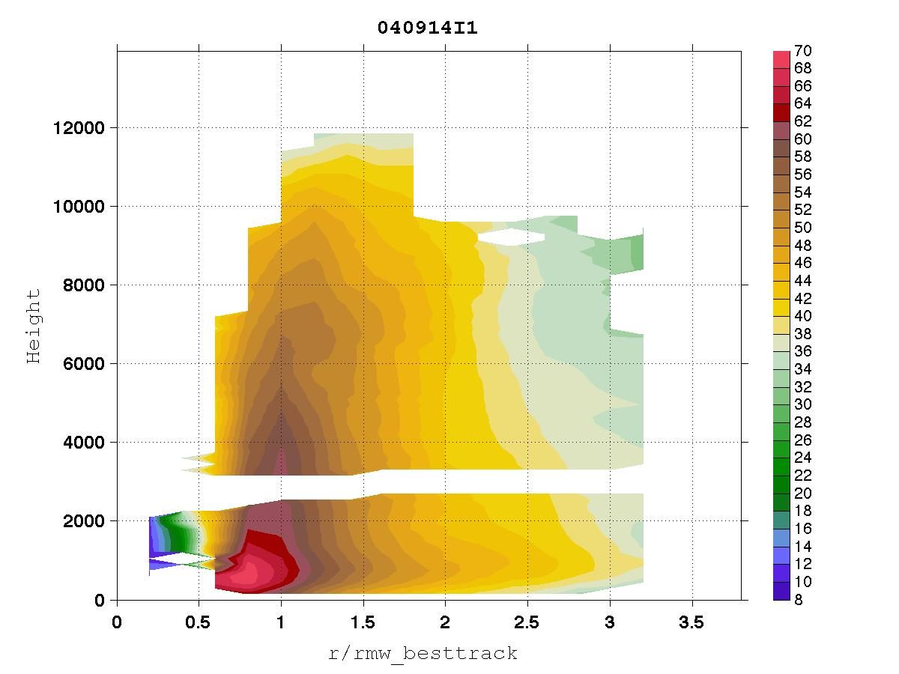
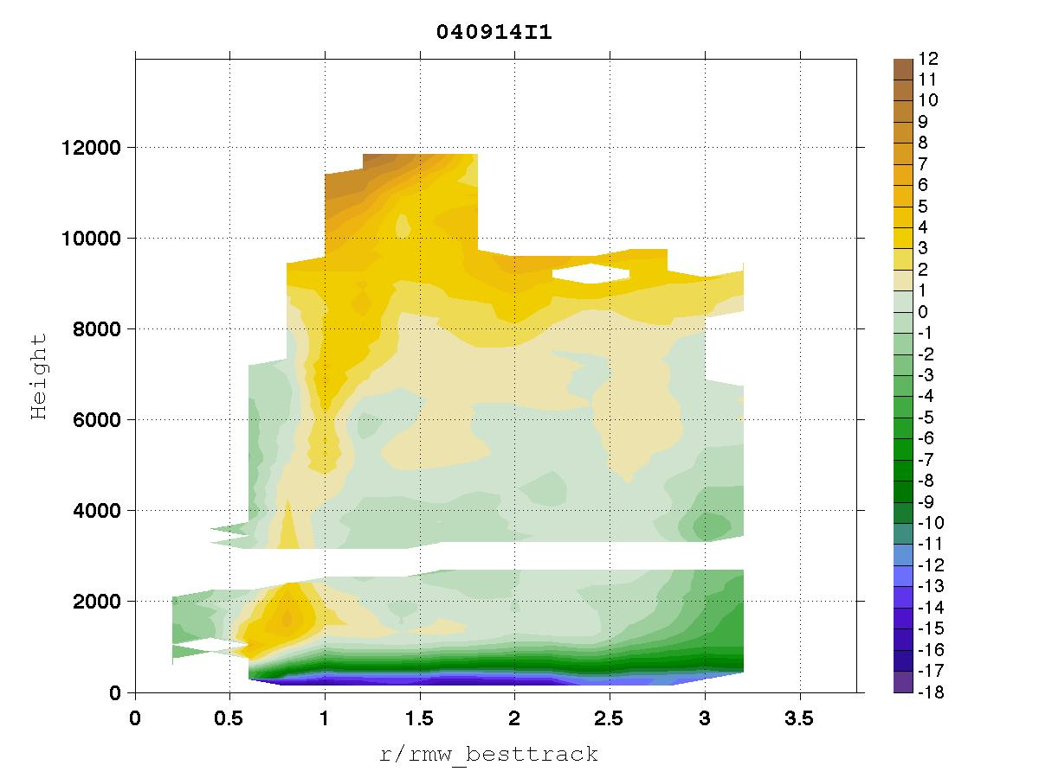
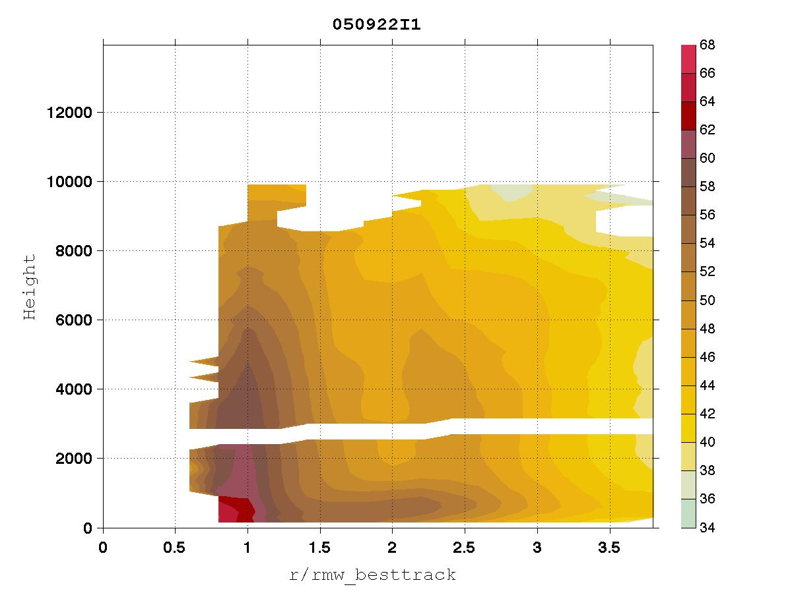
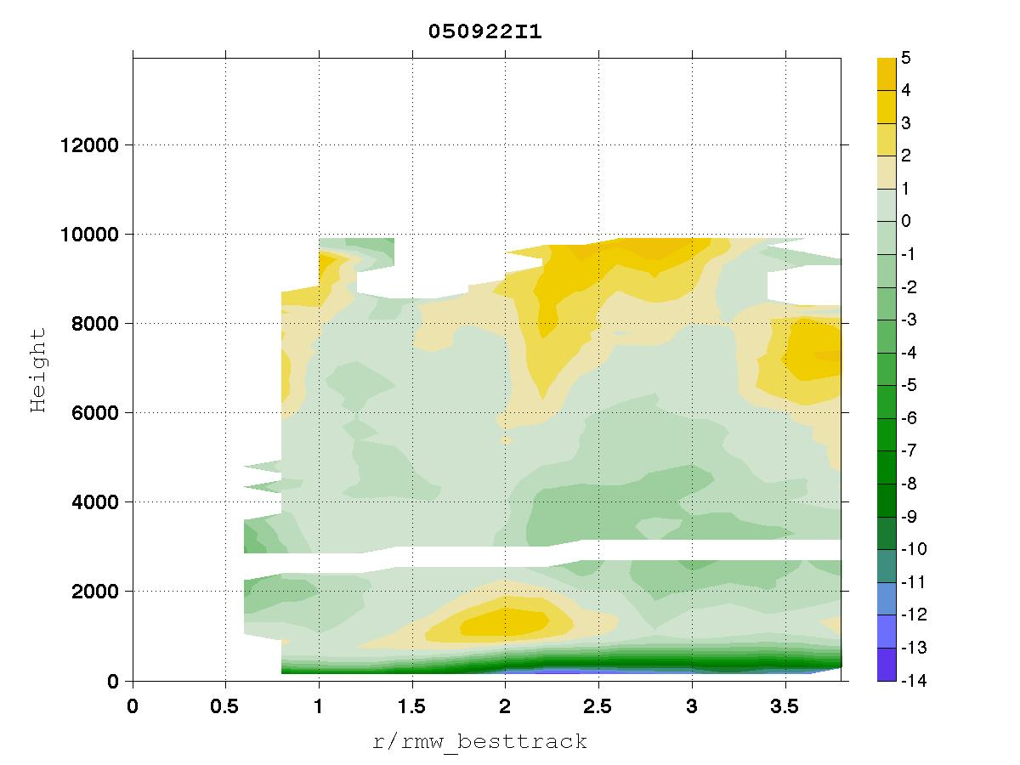
An example

Slide 12
Future Work
Outflow analysis
TKE analysis
Vertical Wind analysis
Further investigation of secondary eyewall cases
Angular momentum budget
Supergradient flow analysis*

