Slide 1
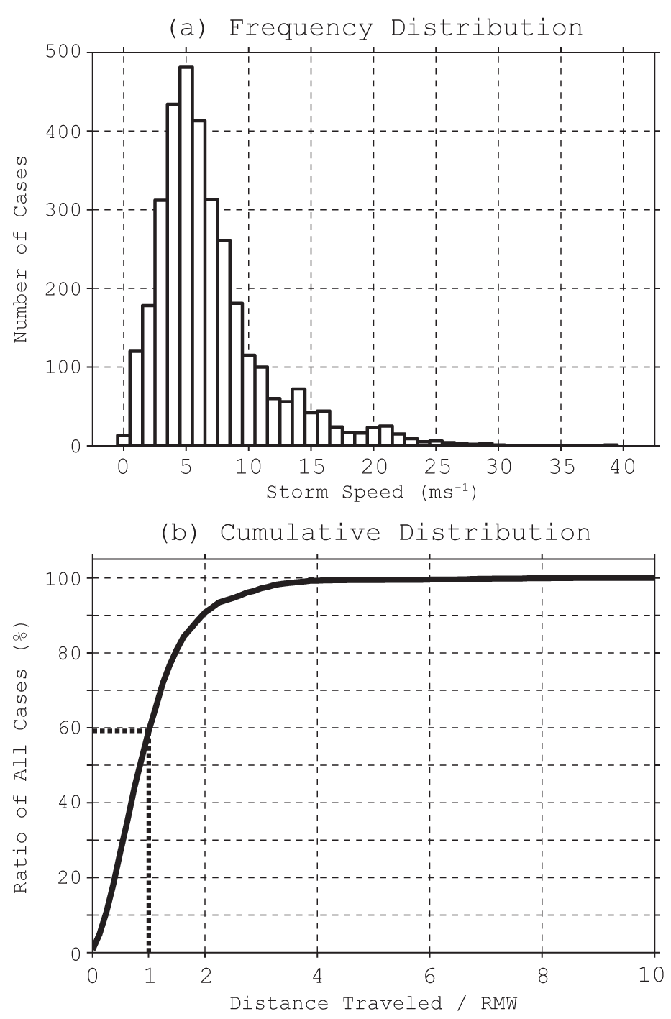
Storm-Relative Tropical Cyclone DA: Motivation (Aksoy 2012, MWR)
PDF of storm speed:
All 1970-2010 Atlantic tropical cyclones with
central pressure less than 990 hPa
CDF of distance traveled / RMW:
If storm speed is converted to distance using a
2-h possible separation between obs and ctr, and normalized by RMW
For ~40% of the TCs considered, DA would be carried out using observations that are more than 1 RMW apart!

Slide 2
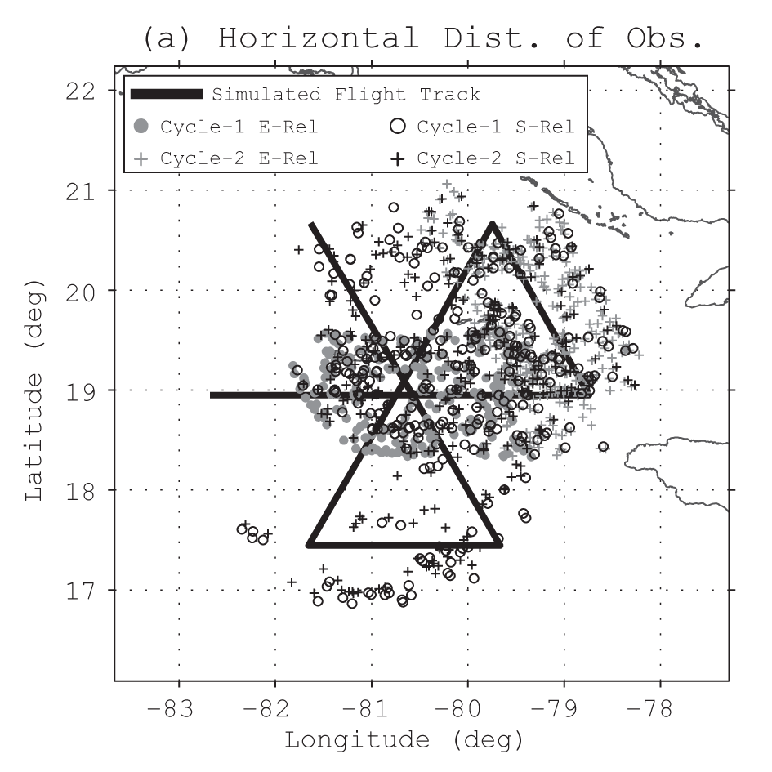
Horizontal Distribution of Observations: Earth-Relative vs. Storm-Relative
Cycle 2 - Downwind Leg:
Earth-relative:
Observations limited in
geographical location and
away from storm center
Storm-relative:
Observations more uniformly distributed around the vortex

Slide 3
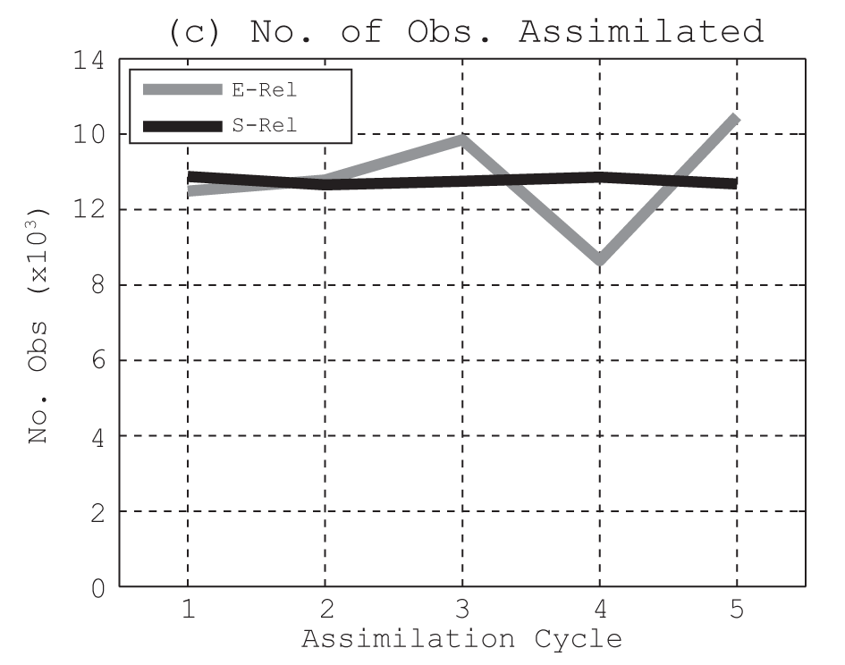
Number of Observations Assimilated per Assimilation Cycle: Earth-Relative vs. Storm-Relative
Storm-relative:
More uniform geographical distribution leads to better cycle-to-cycle number of observation consistency

Slide 4
Impact of Earth-Relative vs. Storm-Relative Processing of Observations: Preliminary Real-Data Results with 11 Earl (2010) Cases
Earth-relative processing:
Process observations in -3h to +3h window relative to synoptic time
Observations randomized within 1-h cycles
All aircraft observations within window processed
Storm-relative processing:
Process observations in -3h to +3h window relative to synoptic time
Randomly re-distribute all observations to -2h to +2h hourly cycles
Advect observations relative to the storm center of assimilation window
All aircraft observations within window processed

Slide 5
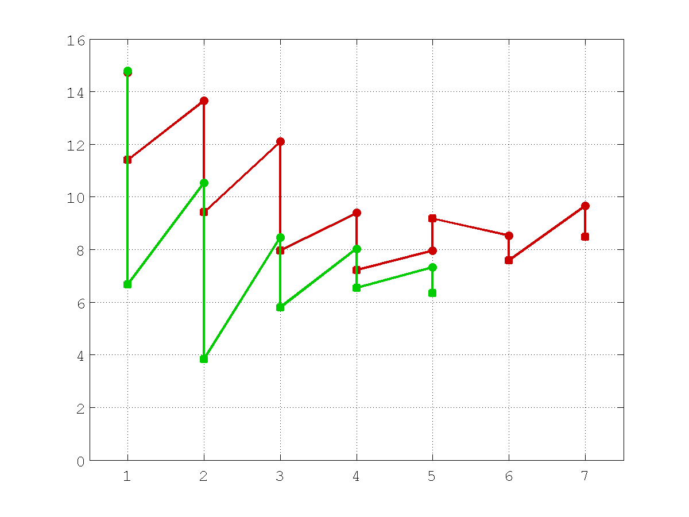
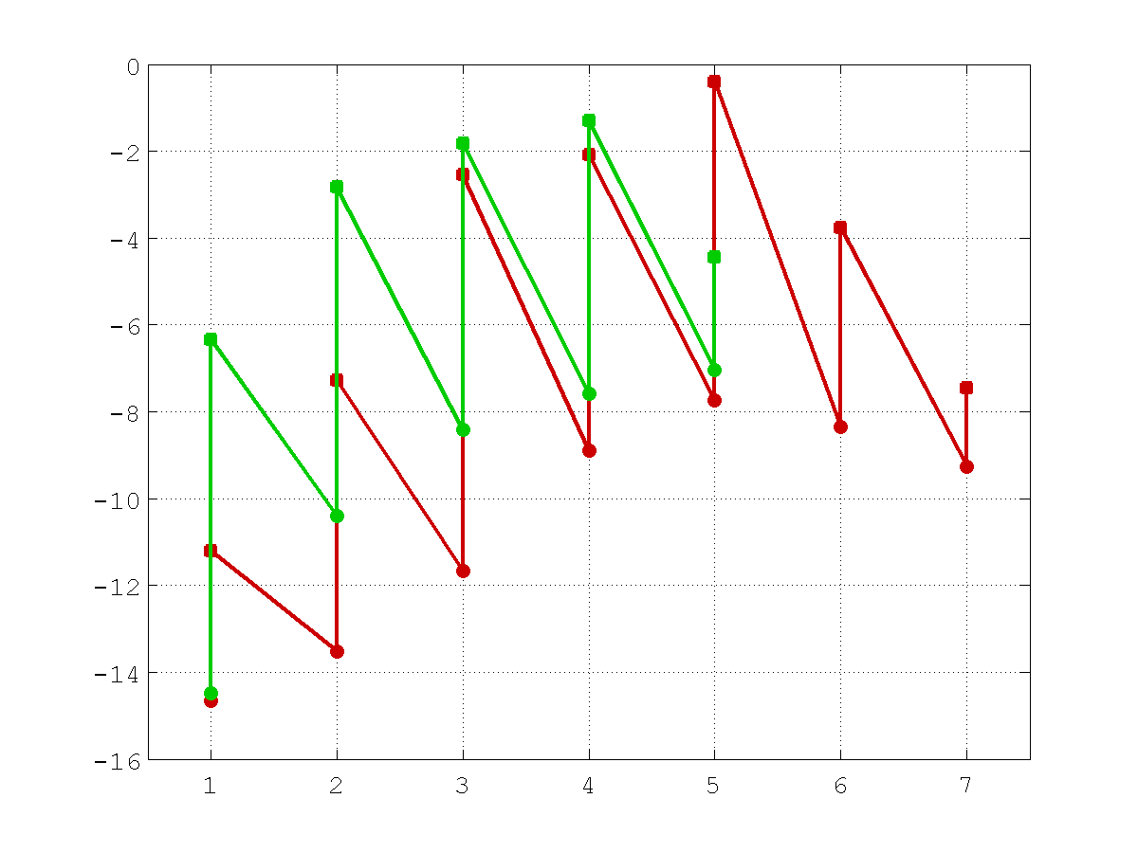
Impact of Earth-Relative vs. Storm-Relative Processing of Observations: Preliminary Real-Data Results with 11 Earl (2010) Cases
Intensity (m/s)
Absolute Error
Total Error (Bias)
Earth-relative (7 cycles)
Storm-relative (5 cycles)

Slide 6
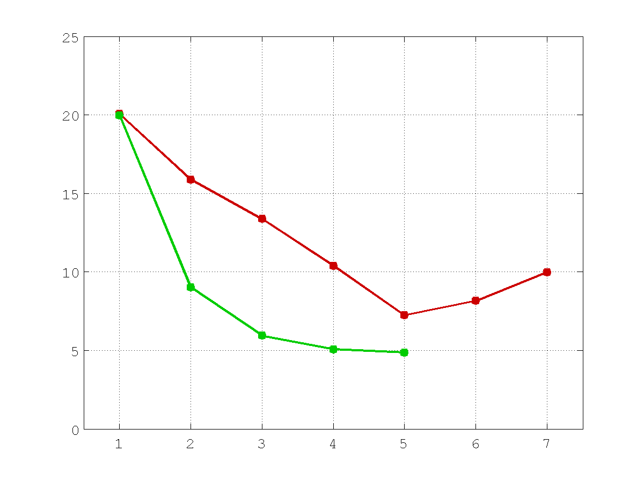
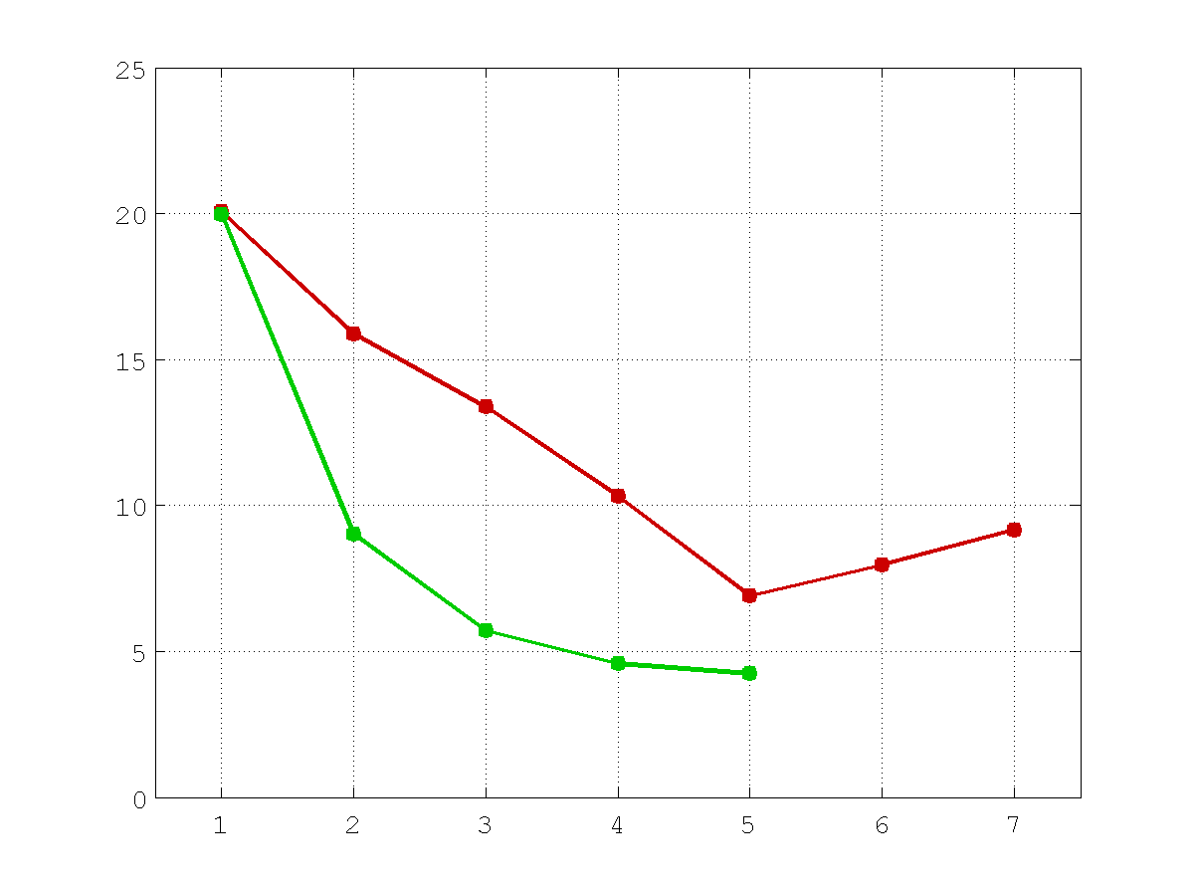
Impact of Earth-Relative vs. Storm-Relative Processing of Observations: Preliminary Real-Data Results with 11 Earl (2010) Cases
MSLP (hPa)
Absolute Error
Total Error (Bias)
Earth-relative (7 cycles)
Storm-relative (5 cycles)

Slide 7
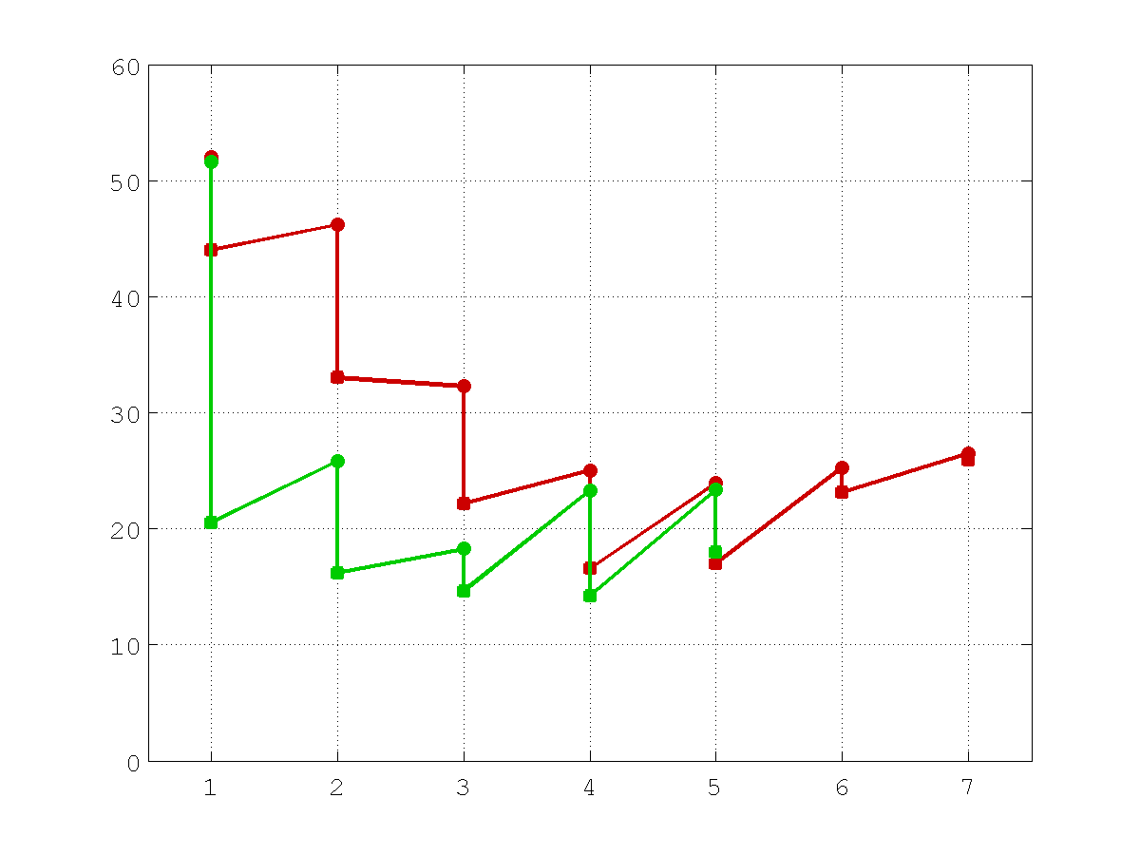
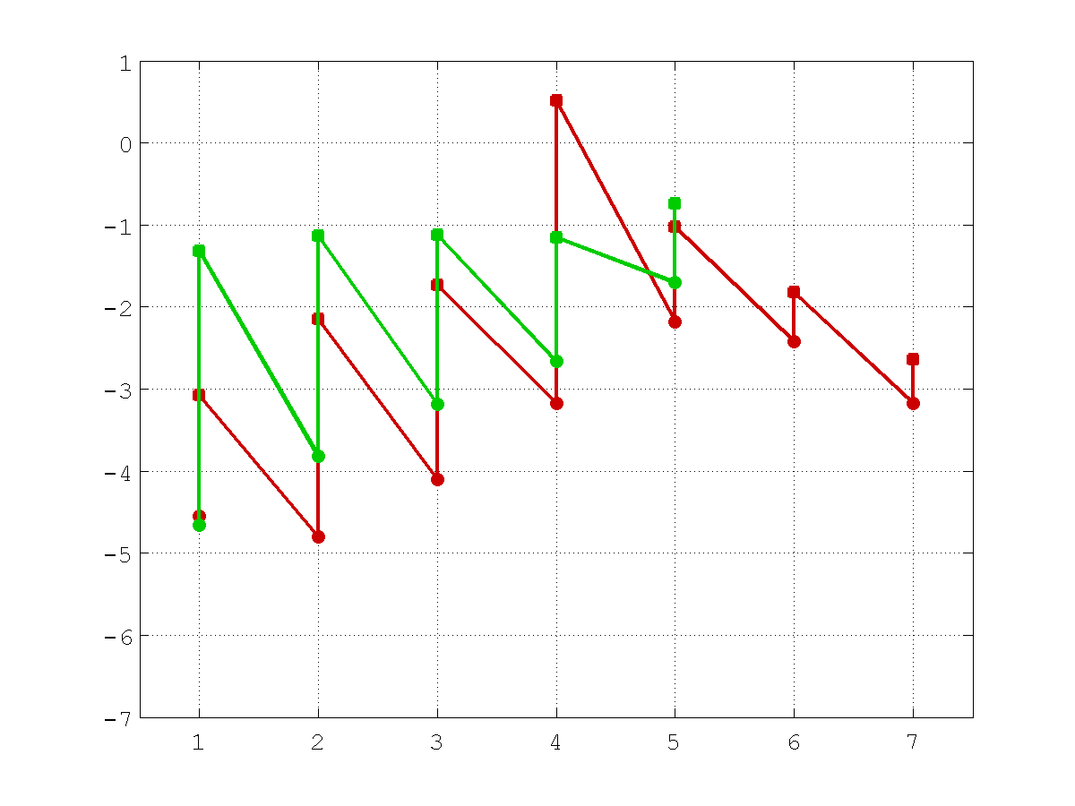
Impact of Earth-Relative vs. Storm-Relative Processing of Observations: Preliminary Real-Data Results with 11 Earl (2010) Cases
Max. Azim. Avg. Tangential Wind Speed (m/s)
Absolute Error
Total Error (Bias)
Earth-relative (7 cycles)
Storm-relative (5 cycles)

Slide 8
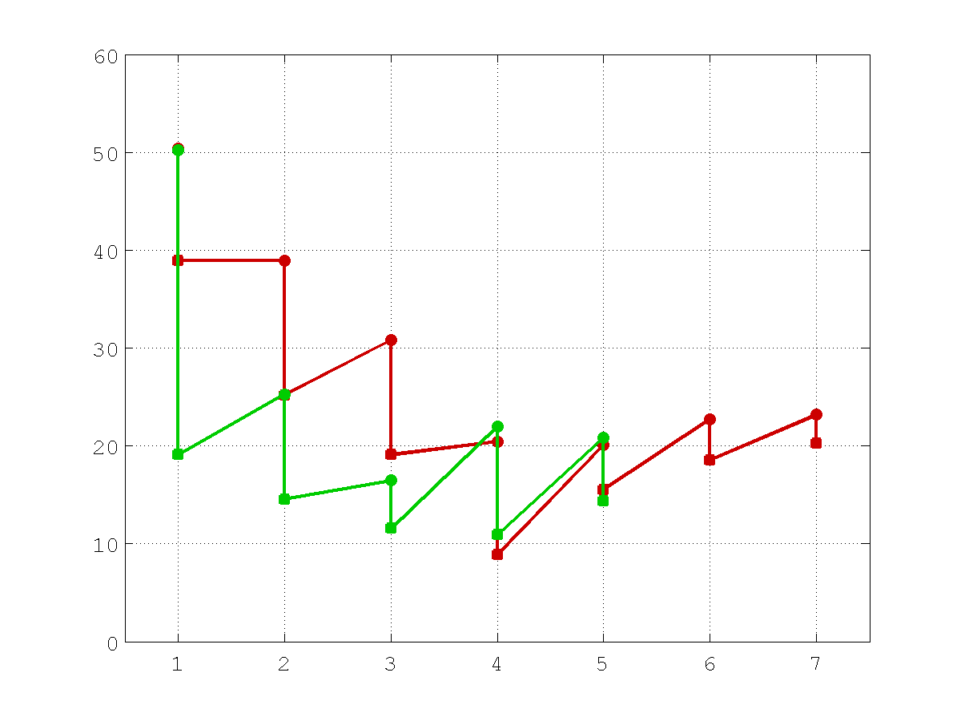
Impact of Earth-Relative vs. Storm-Relative Processing of Observations: Preliminary Real-Data Results with 11 Earl (2010) Cases
RMW (km)
Absolute Error
Total Error (Bias)
Earth-relative (7 cycles)
Storm-relative (5 cycles)

