Slide 1




Assimilation of Non-NOAA and Non-AF GPS Dropwindsonde Data into NOAA Numerical Models
Joint Hurricane Testbed Project update
PI: Sim Aberson NOAA/AOML/Hurricane Research Division
Presenter: Kathryn Sellwood UM/CIMAS and NOAA/AOML/HRD
JHT Points of Contact: M. Brennan, J. Franklin, C. Landsea, V. Tallapragada

Slide 2
Project Description addresses priority areas TPC/CPHC-1 (JTWC-1), TPC/CPHC-2 (JTWC-2), TPC/CPHC-5(JTWC-6), and EMC-1
Goal: Test the assimilation of dropwindsonde data from NASA and NSF aircraft that regularly participate in field programs.
OSE: produce GFS parallel runs that assimilate NASA and NSF dropwindsondes collected during the 2010 GRIP* and PREDICT** experiments
Product: 2 sets of forecasts cycled every 6 hours spanning the duration of the 2 experiments and diagnostics of data impact on TC track forecasts
Diagnostics: Comparison of track forecasts with operational GFS and NHC best track. Apply NCEP/EMC standard verifications for testing the impact of new data types in their data assimilation.
*NASA Genesis and Rapid Intensification Processes
**NOAA/NSF/NCAR Pre-Depression Investigation of Cloud systems in the Tropics

Slide 3
Motivation
GPS Dropwindesonde data from NOAA, U.S. Airforce and Taiwanese aircraft have been routinely assimilated into NOAA operational models since 1997
NASA and NSF aircraft regularly participate in observational field programs
NASA and NSF dropwindsonde data is not assimilated operationally into NCEP numerical models
Data is routinely and successfully assimilated into other global models
Observations are in data sparse locations
Instrument and data processing are identical
Small corrections to initial environment, even in remote locations capable of producing significant improvement in track forecasts (Aberson, 2011)

Slide 4
GFS Parallel Forecast 1
Date | Experiment | #of Drops | Cycles
20100815 | PREDICT | 9 | 0Z
20100817 | PREDICT | 20 | 12Z
20100818 | PREDICT + GRIP | 25 + 9 | 12Z, 18Z
20100821 | PREDICT | 17 | 12Z
20100823 | PREDICT | 12 | 12Z
20100824 | GRIP | 23 | 12Z, 18Z
Active Tropical Cyclones from August 15 through August 24, 2010
Atlantic W. Pacific E. Pacific
TD 5 (8/10 – 8/18) Mindulle ( 8/21 – 8/25) TD 8 (8/20 – 8/23)
Danielle (8/21 – 8/30) Frank(8/21 – 8/29)
Earl (8/25 – 9/04)

Slide 5
GFS Parallel Forecast 2
Date | Experiment | #of Drops | Cycles
20100829 | PREDICT | 20 | 12Z
20100830 | PREDICT + GRIP | 25 + 9 | 12Z, 18Z
20100831 | PREDICT | 17 | 12Z
20100901 | PREDICT | 12 | 12Z
20100902 | GRIP | 23 | 12Z, 18Z
20100903 | PREDICT + GRIP | 16 + 4 | 0Z, 18Z
20100905 | PREDICT | 22 | 12Z, 18Z
20100906 | PREDICT + GRIP | 18 + 3 | 12Z, 18Z
20100907 | PREDICT + GRIP | 19 + 7 | 12Z , 18Z
20100908 | Grip | 12 | 0Z
20100910 | PREDICT | 34 | 12Z, 18Z
20100911 | PREDICT | 22 | 18Z
20100912 | PREDICT + GRIP | 21 + 3 | 12Z, 18Z
20100913 | PREDICT + GRIP | 13 + 23 | 0Z, 12Z, 18Z
20100914 | PREDICT + GRIP | 18 + 18 | 0Z, 12Z, 18Z
20100915 | GRIP | 10 | 0Z
20100916 | GRIP | 12 | 28Z
20100917 | GRIP | 18 | 0Z, 18Z
20100920 | PREDICT | 18 | 12Z, 18Z
20100921 | PREDICT + GRIP | 21 + 10 | 12Z, 18Z
20100922 | PREDICT + GRIP | 15 + 22 | 0Z, 12Z, 18Z
20100924 | PREDICT | 15 | 12Z, 18Z
20100927 | PREDICT | 19 | 12Z, 18Z
20100928 | PREDICT | 16 | 12Z, 18Z
20100930 | PREDICT | 25 | 12Z, 18Z

Slide 6
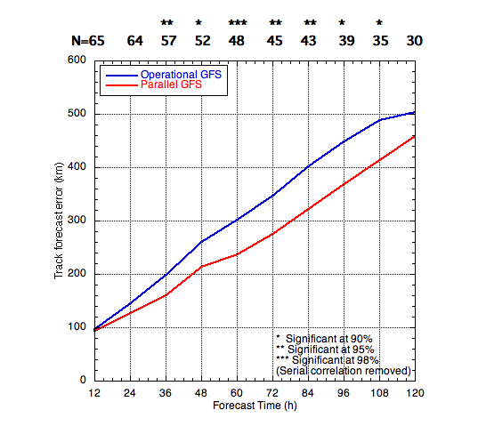
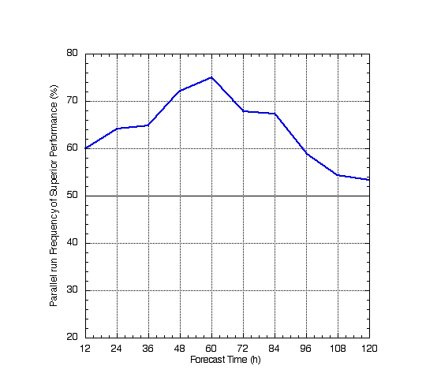
Preliminary Results
Track error and Frequency o f Superior performance for the 40 TC cases between
8/15 and 8/25 2010
Initial results indicate overall positive impact of additional dropwindsonde data out
to 5 days.
The forecasts that include the NASA and NSF data are superior to those that do not
more than 50% of the time.

Slide 7
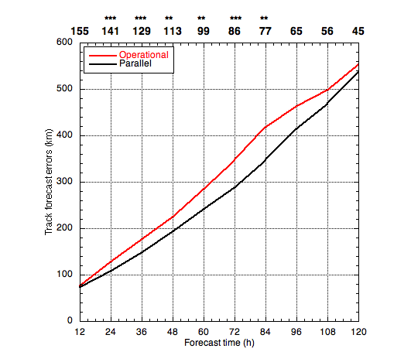
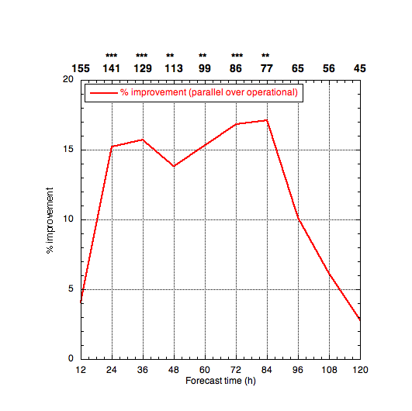
Including 8/29 – 9/04 cases
Track error Percent Improvement over operational GFS
Results are consistent with the addition of cases

Slide 8
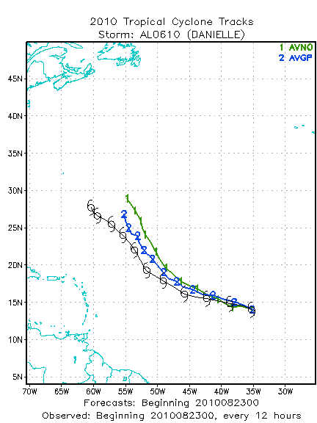
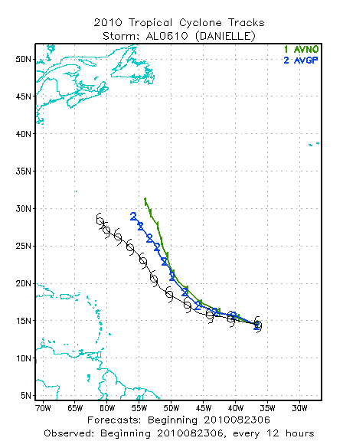
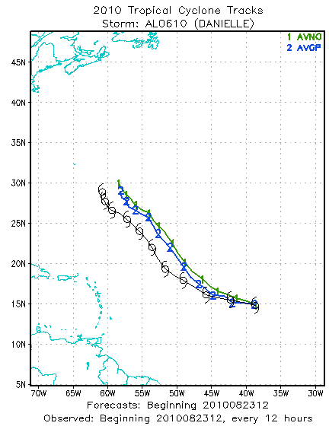
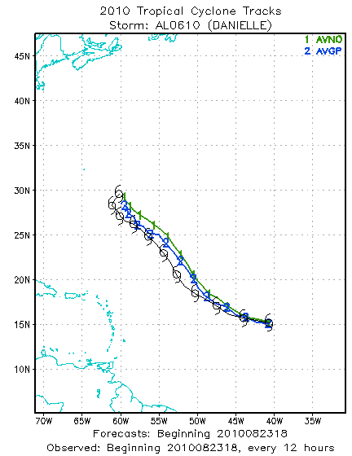
Hurricane Danielle
August 23, 2010
0Z 6Z 12Z 18Z
AVNO = control AVGP = NASA/NSF drops assimilated
3-5 day cross track forecast improved by addition of drops up to and including 8/21 12Z
Positive impact from drops assimilated 8/23 12Z for entire forecast.

Slide 9
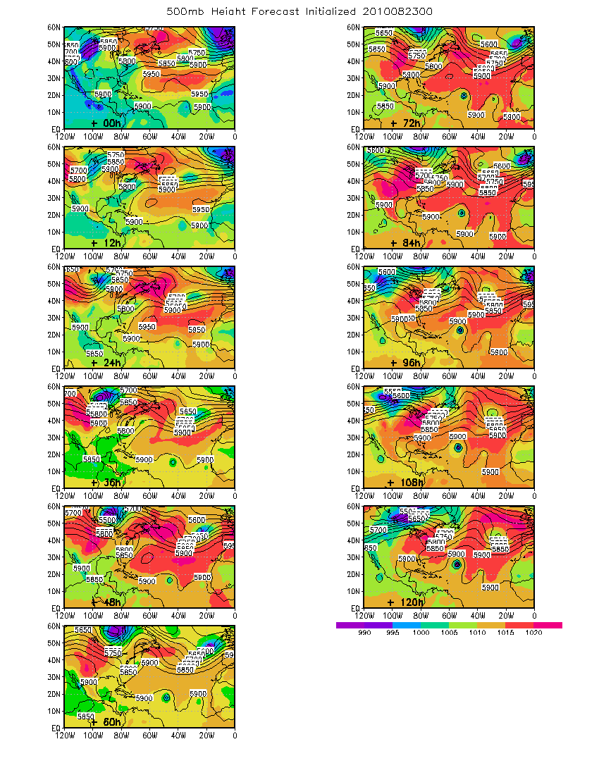
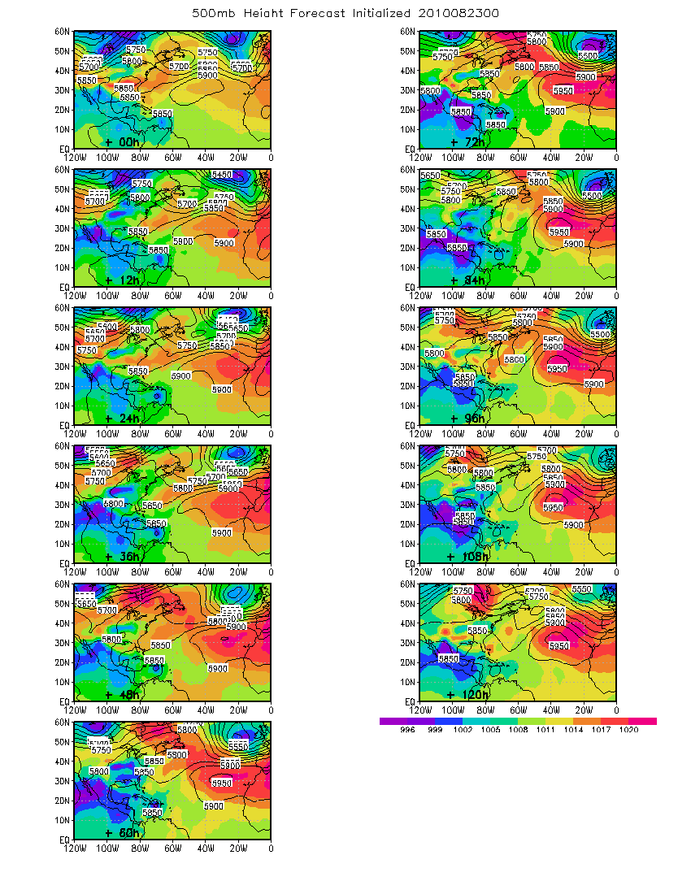
5 day Forecasts
MSLP and 500 mb height
with GRIP and PreDICT data assimilation Operational

Slide 10
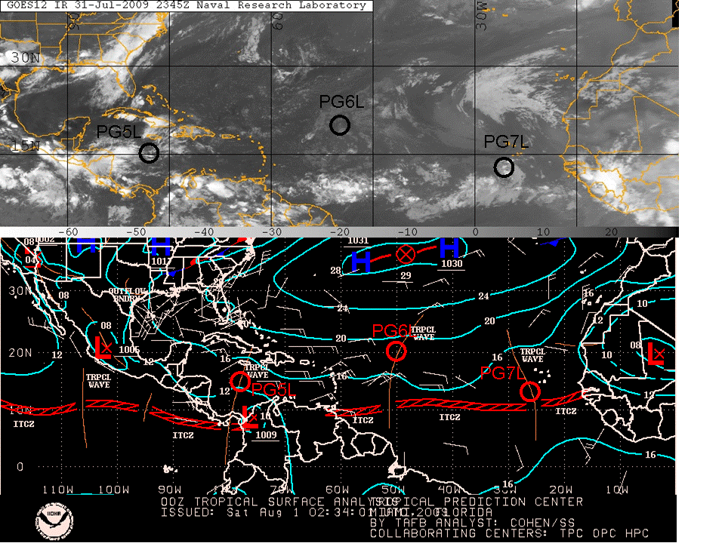
“Pouch” Tracking
(Dunkerton, Montgomery and Wang 2008)

Slide 11
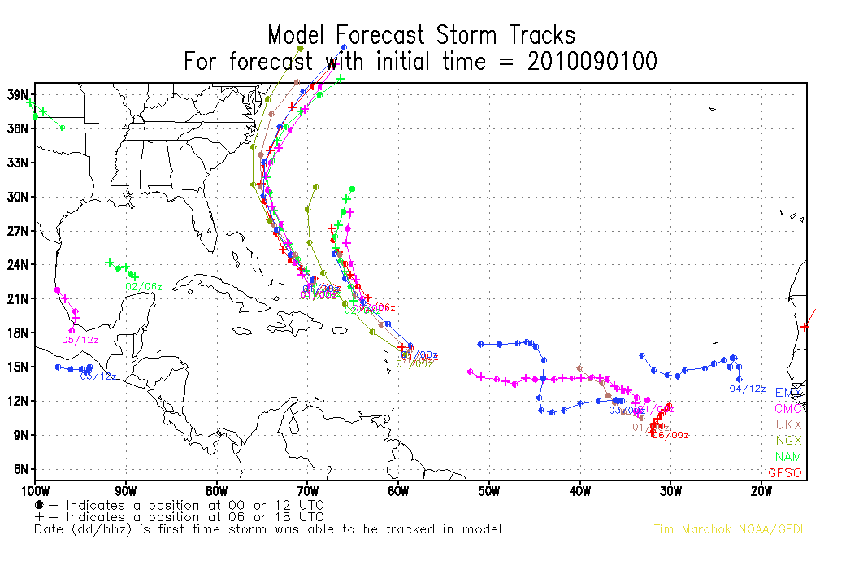
Tracker Product http://www.emc.ncep.noaa.gov/gmb/tpm/emchurr/tcgen/
GRIP and PreDICT dropwindesondes assimilated by ECMWF, UKMET and Canadian models

