Slide 1
Ana/Bill Debrief
3 September 2009

Slide 2
Summary
Date | A/C | T/O time | Flt ID | Mission | LPS | Radar | Dropsonde | Remarks | Summary
12 Aug | N43RF | ? | 090812I1 | Ferry
13 Aug | N49RF | ? | 090813N1 | Ferry
14 Aug | N49RF | 20Z | 090814N1 | Salex/Ana | Dunion |  | Sellwood |  | N
15 Aug | N43RF | 20Z | Canceled |  |  |  |  | Fuel line
15 Aug | N49RF | 20Z | 090815N1 | Salex/Ana | Aberson |  | Ananne |  | N
16 Aug | N43RF | 08Z | Canceled |  |  |  |  | Fuel line
16 Aug | N49RF | 08Z | Canceled |  |  |  |  | Useless
16 Aug | N43RF | 20Z | 090816I1 | Ana | Black, M. | Black, B. | Annane |  | Y
18 Aug | N43RF | 08Z | Canceled |  |  |  |  | Engine
18 Aug | N49RF | 08Z | 090818N1 | Bill | Dunion |  |  |  | N
18 Aug | N43RF | 20Z | 090818I1 | Bill | Cione | Gamache | Annane |  | Y
18 Aug | N49RF | 20Z | 090818N2 | Bill | Black, M. |  | Black, B. |  | Y
19 Aug | N43RF | 08Z | 090819I1 | Bill | Rogers | Murillo | Sellwood |  | N
19 Aug | N49RF | 08Z | 090819N1 | Bill | Dunion |  |  |  | N
19 Aug | N43RF | 20Z | 090819I2 | Bill | Cione | Gamache | Annane |  | Y
19 Aug | N49RF | 20Z | 090819N2 | Bill | Black, M. |  | Black, B. |  | N
20 Aug | N43RF | 08Z | 090820I1 | Bill | Rogers | Murillo | Sellwood |  | N
20 Aug | N49RF | 08Z | 090820N1 | Bill | Dunion |  |  |  | N
20 Aug | N43RF | 20Z | 090820I2 | Bill | Black, M. | Gamache | Annane |  | Y
20 Aug | N49RF | 1730Z | 090820N2 | Bill/NHC
21 Aug | N49RF | 1730Z | 090821N1 | Bill/NHC

Slide 3
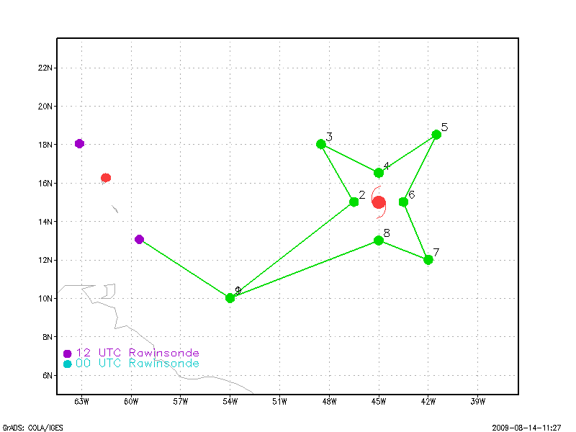
Ana 090814N1 - Dunion

Slide 4
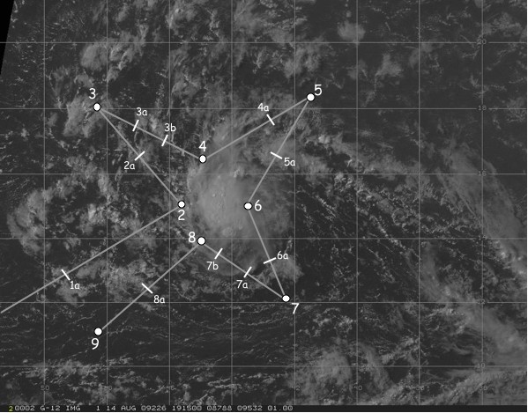
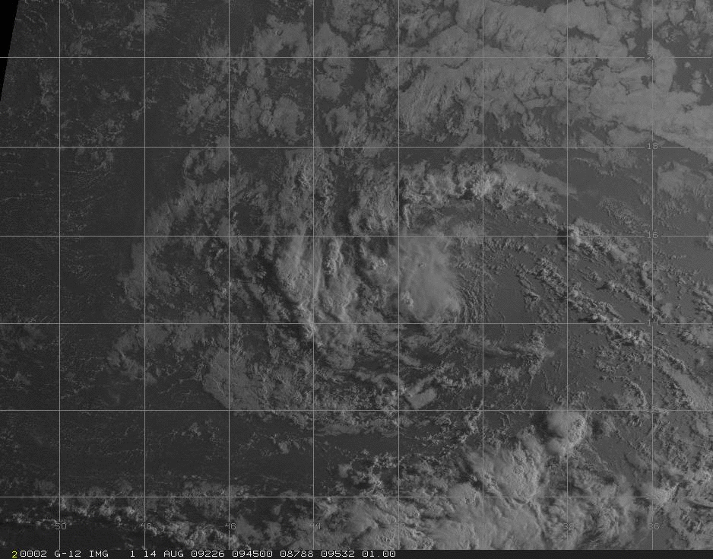
20080814N (G-IV)
“TD 2” (Ana)
Genesis Experiment/SALEX
Take-off 1958 UTC (Barbados)
7 hr 7 min mission
20 GPS dropsondes launched; 1 fastfall

Slide 5
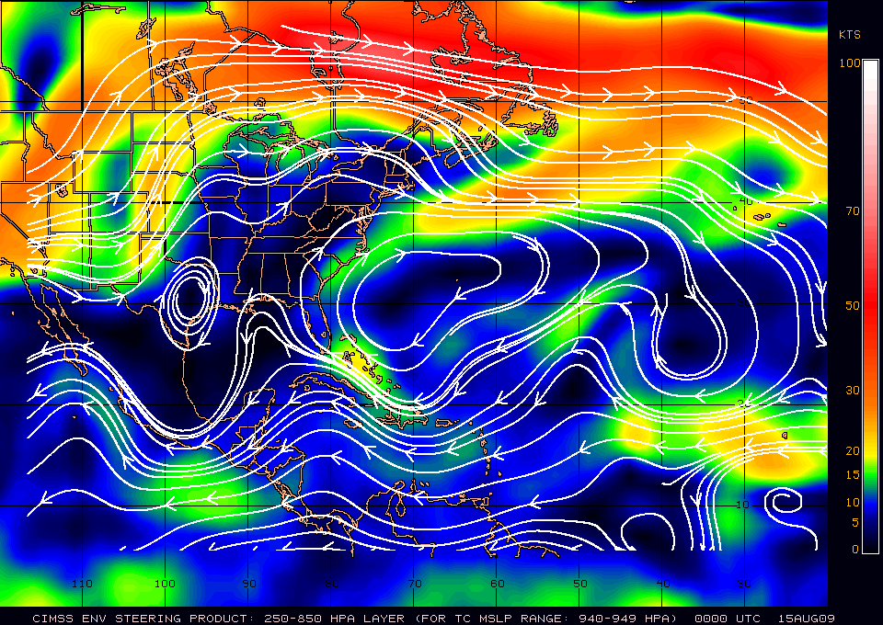
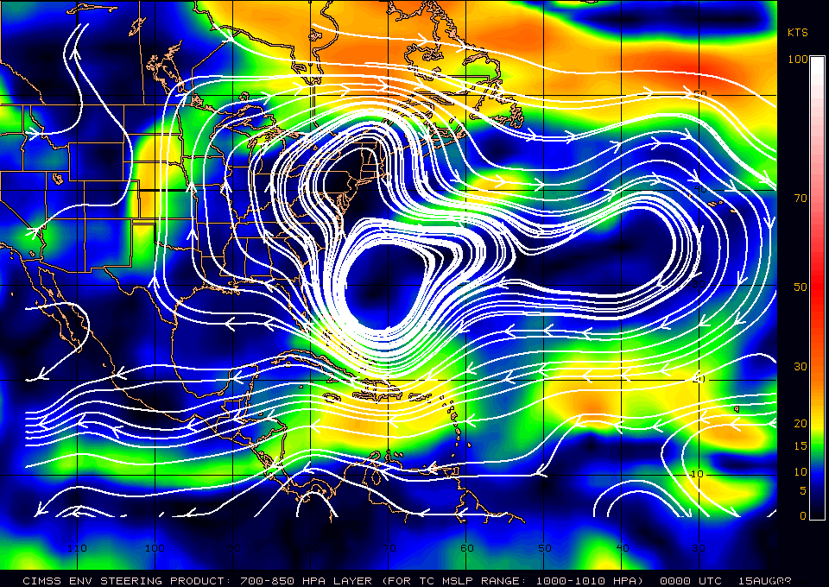
Deep Layer Steering
X
Notes:
-TD02: 270/13 kt
-general W/WSW flow

Slide 6
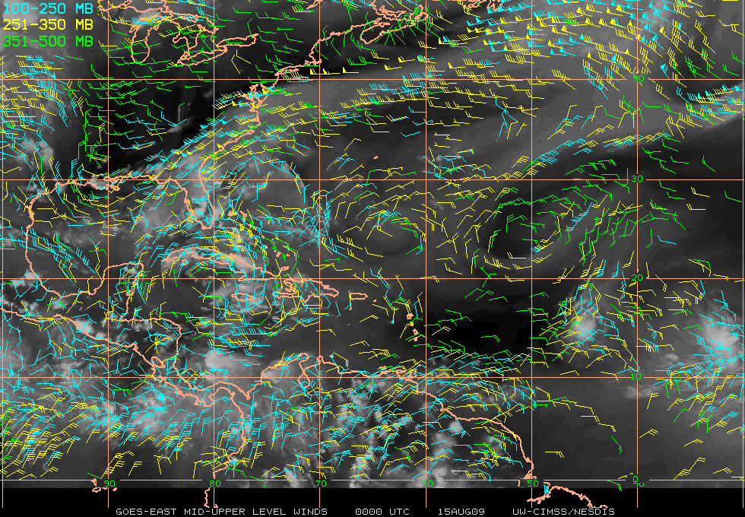
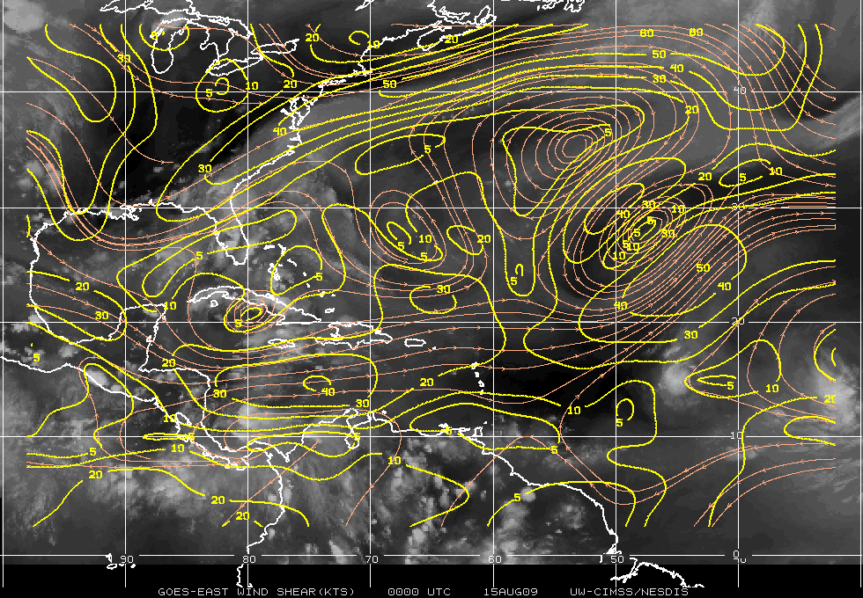
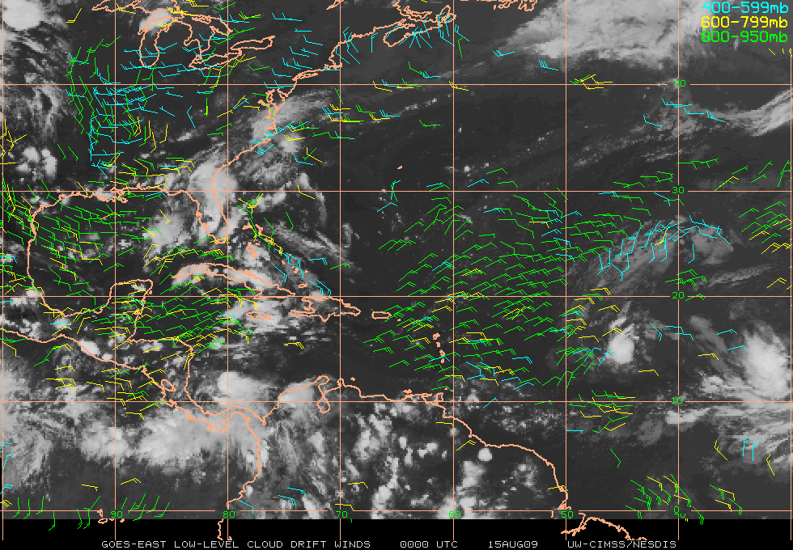
Vertical Shear/Satellite Winds
Notes:
-big N-S shear gradient
-strong AEJ to the north; enhanced N outflow from cold low to the NW

Slide 7
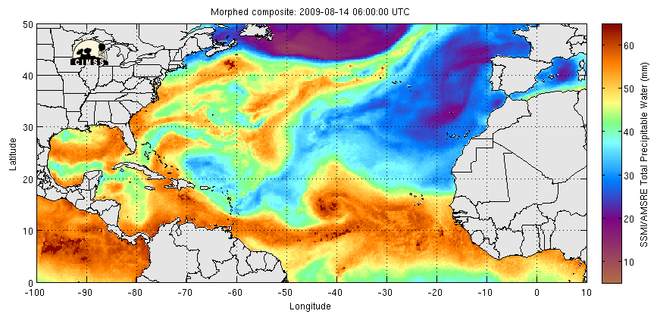
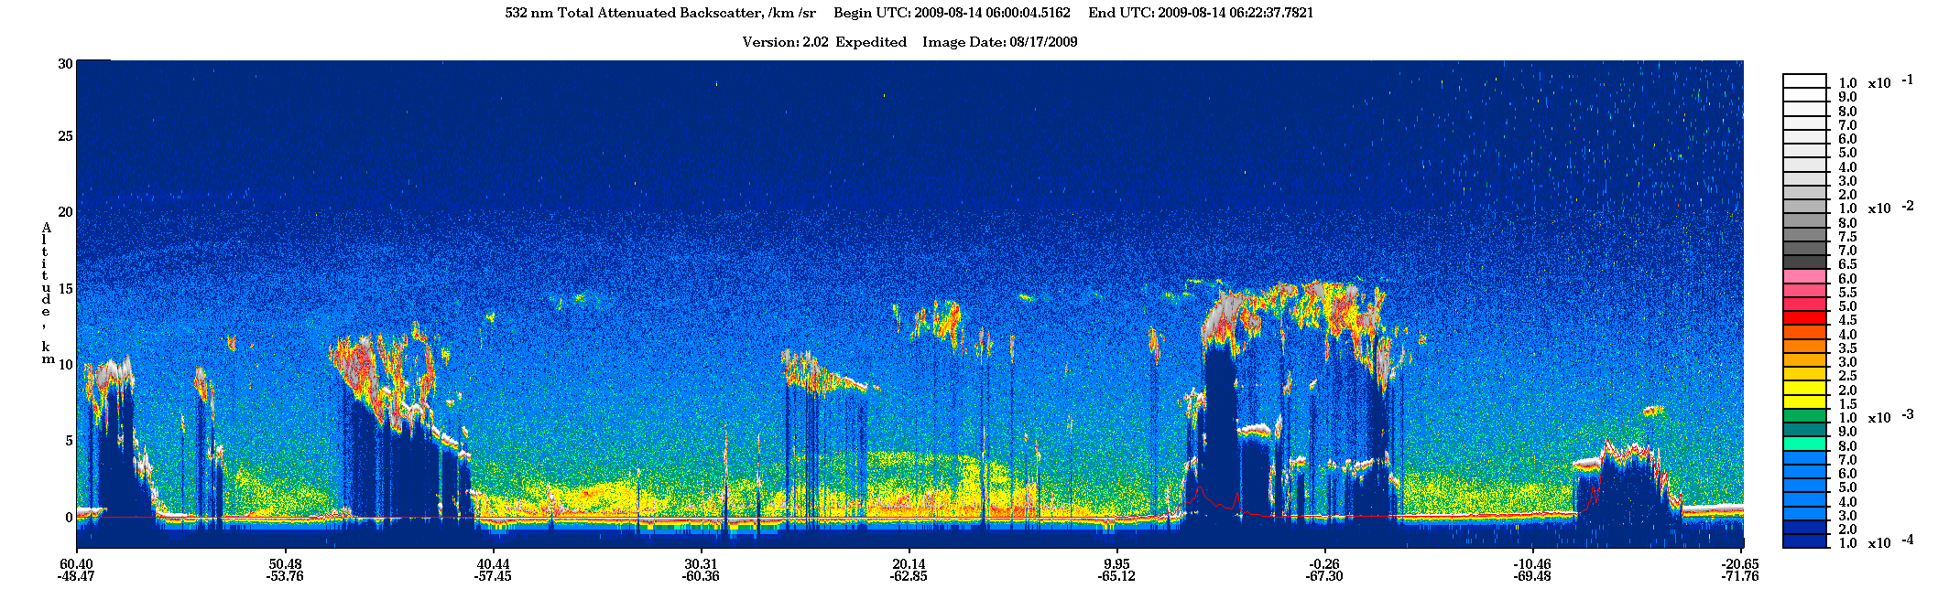
A
SAL
SAL+
subsidence
above
SAL
B
A
B
Saharan Dust

Slide 8
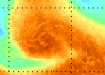
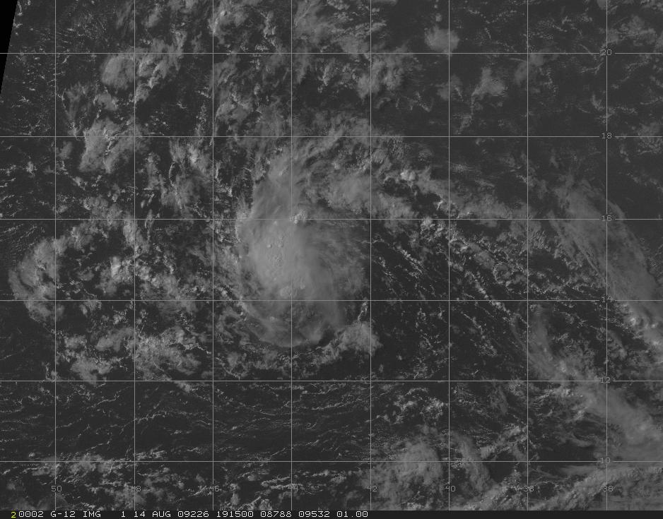
Saharan Air Layer
3
5
3a
4a
3b
4
2a
5a
6
2
8
6a
7b
1a
7a
8a
Saharan Air Layer
7
9

Slide 9
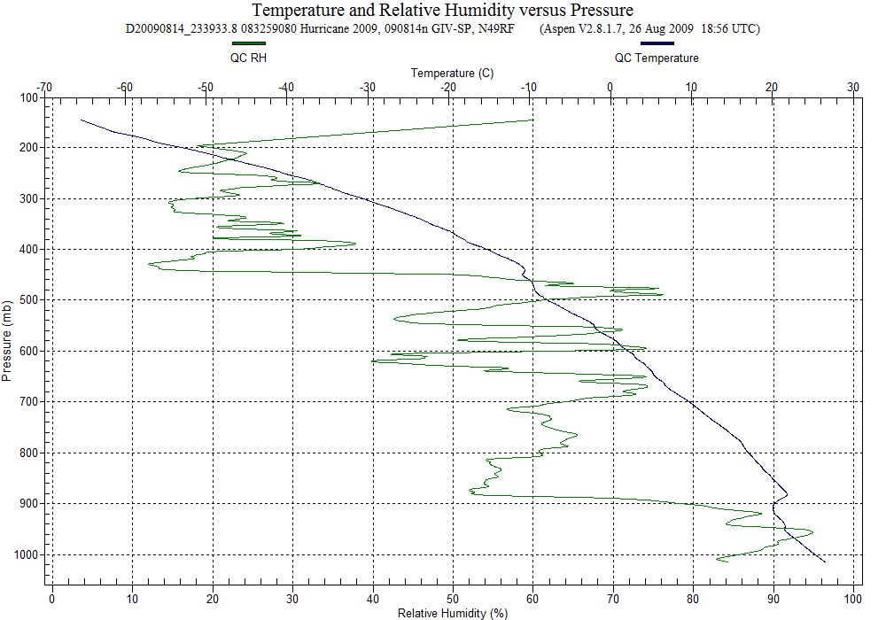
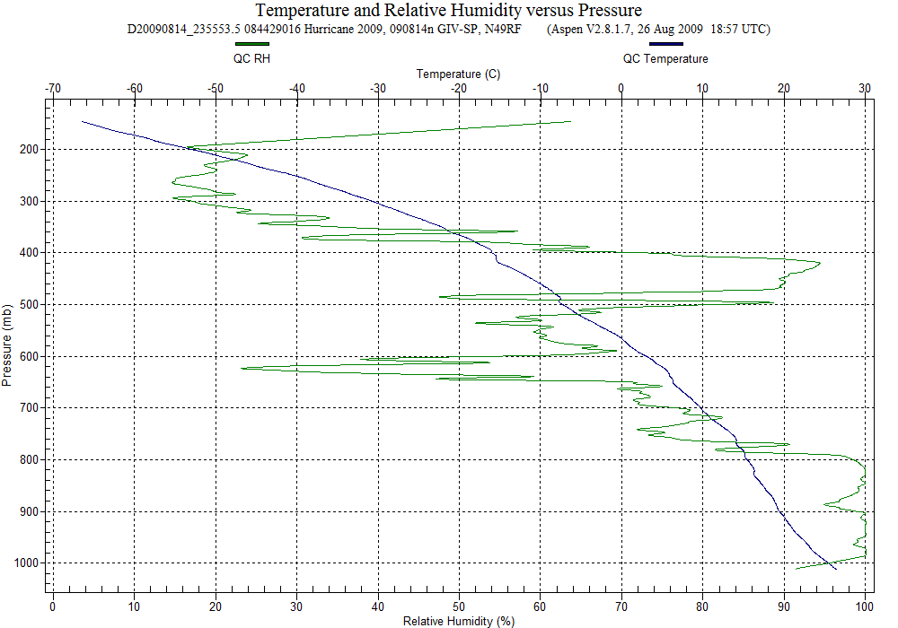
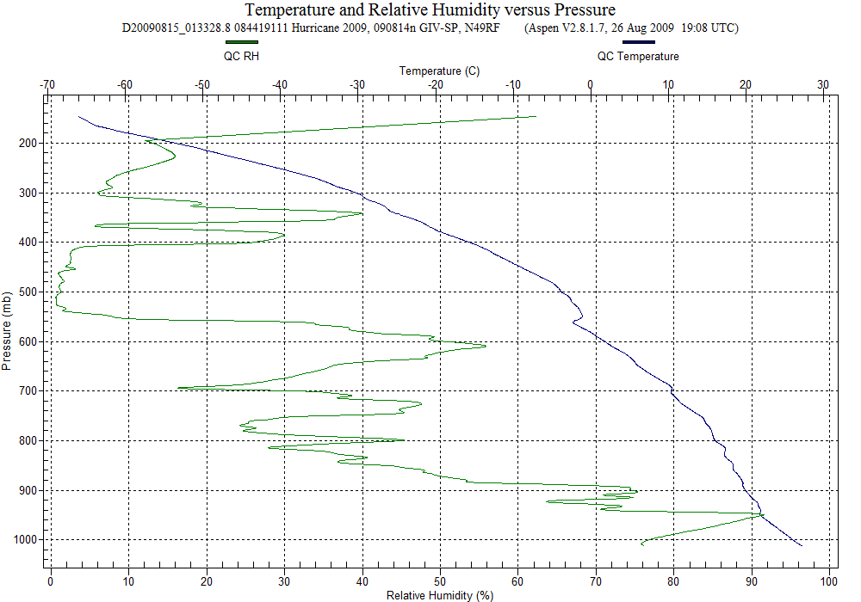
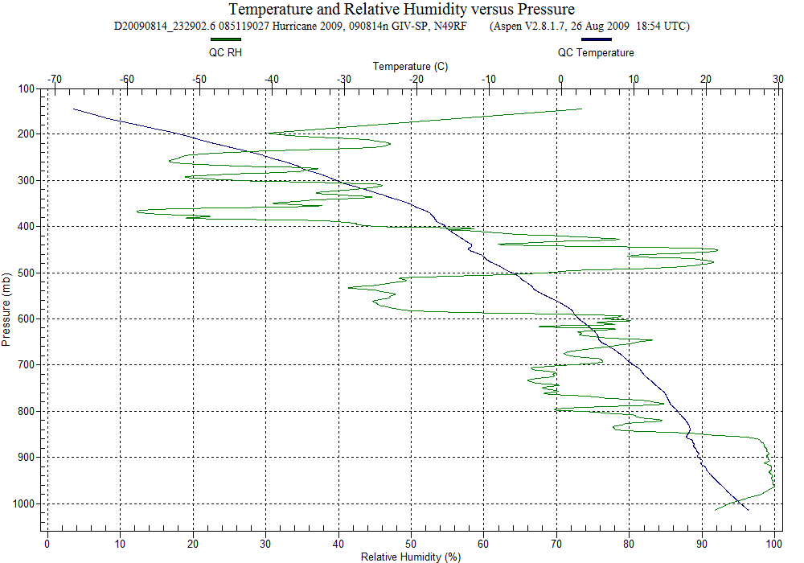
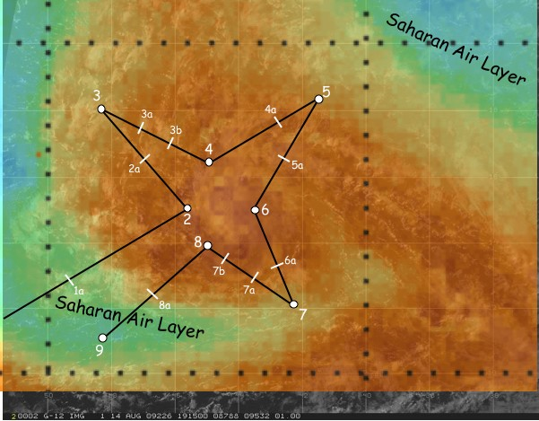
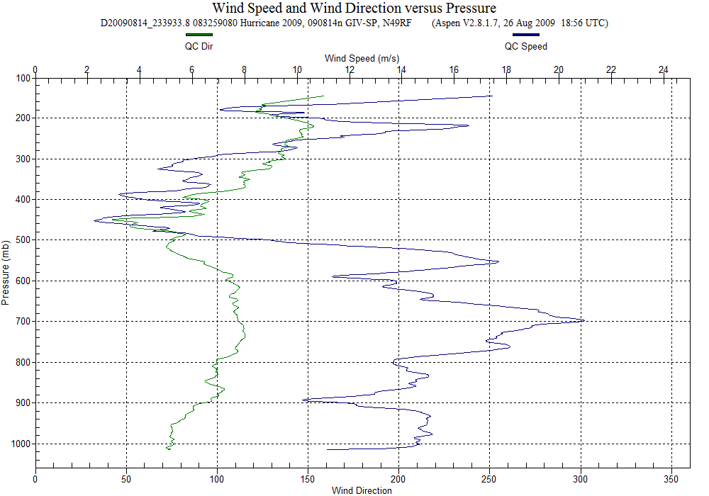
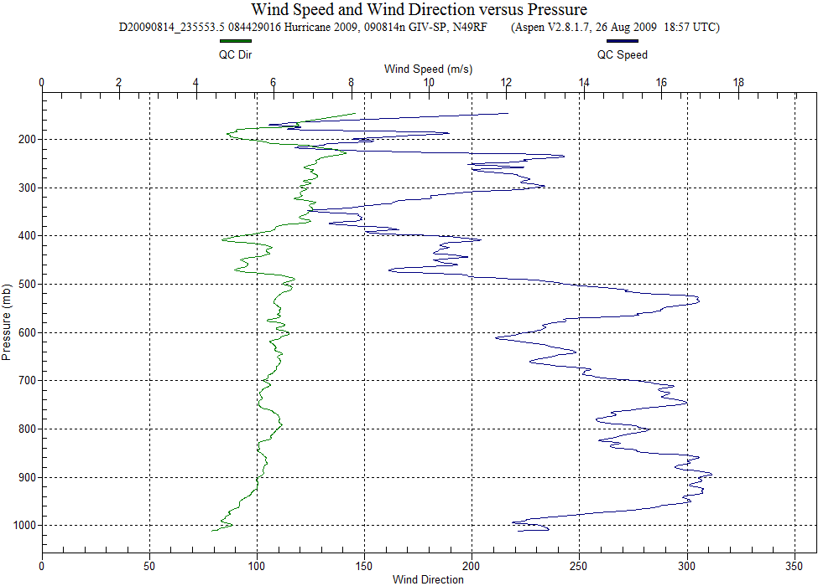
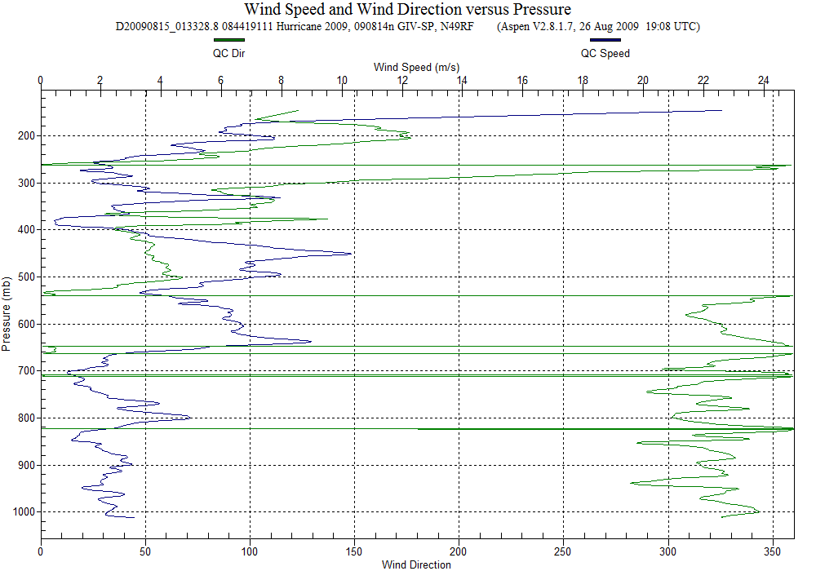
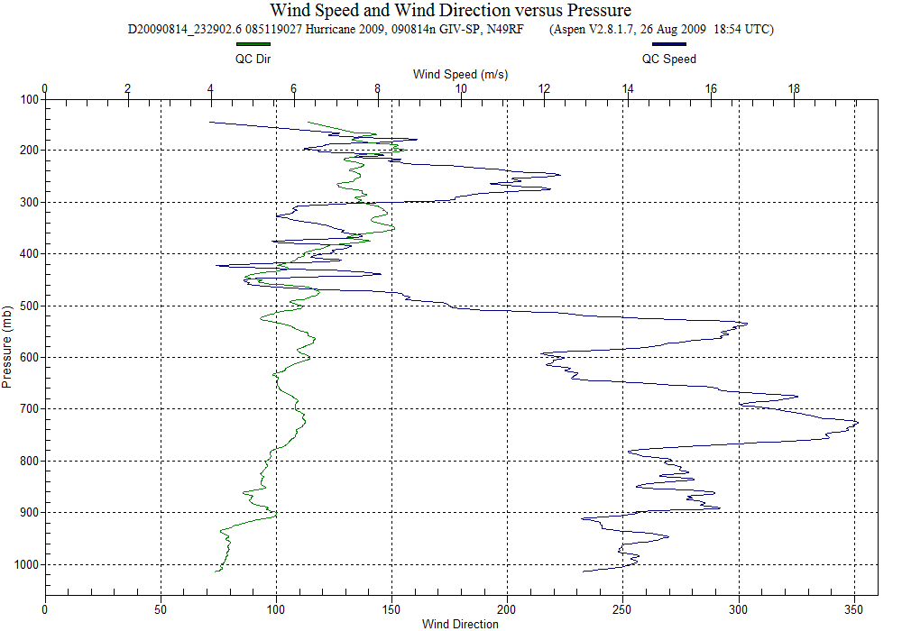
Mid-lat dry air/
subsidence
Dry air
intrusion
From SE?
Dry air working in from ESE
Dry air working in
from ESE
SAL
700 mb: 42 kt ESE jet
SAL intrusion:
NW around LLC
725 mb:42 kt ESE Jet
Notes:
-Calipso confirmed SAL outbreak; WV imagery confirmed dry air above that
-drops 6a and 7a also sampled dry air intrusion seen at 5a
-drop 9: SAL with mid-lat/subsidence overhead (notice Tinv at ~560 mb); SAL from NW via LLC; mid/upper dry air more N & NE

Slide 10
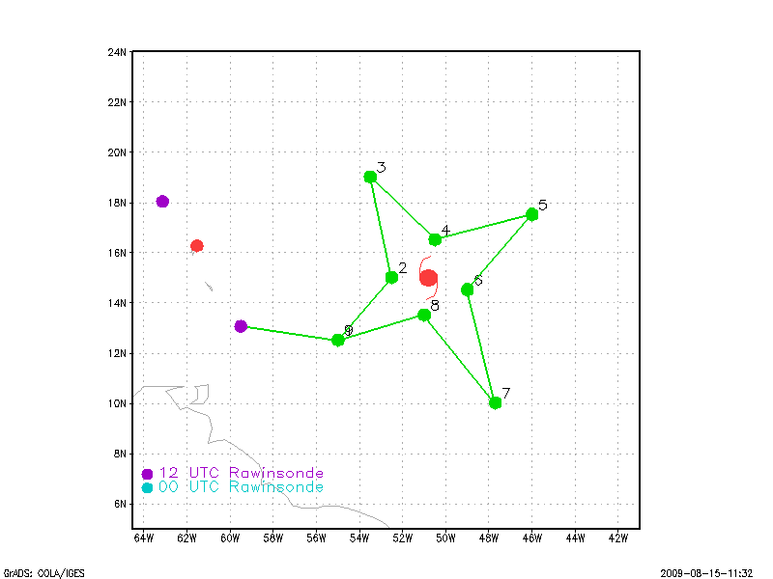
Ana 090815N1 - Aberson

Slide 11
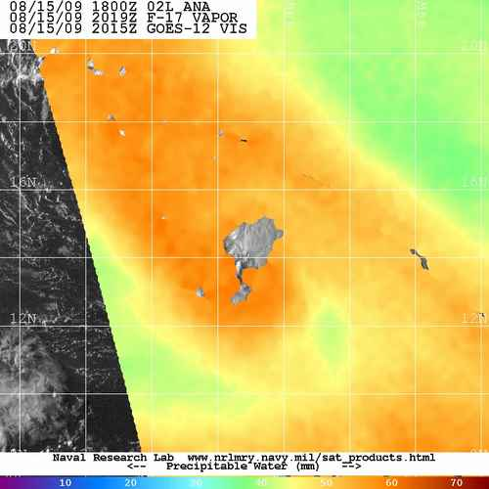
080915n G-IV mission

Slide 12
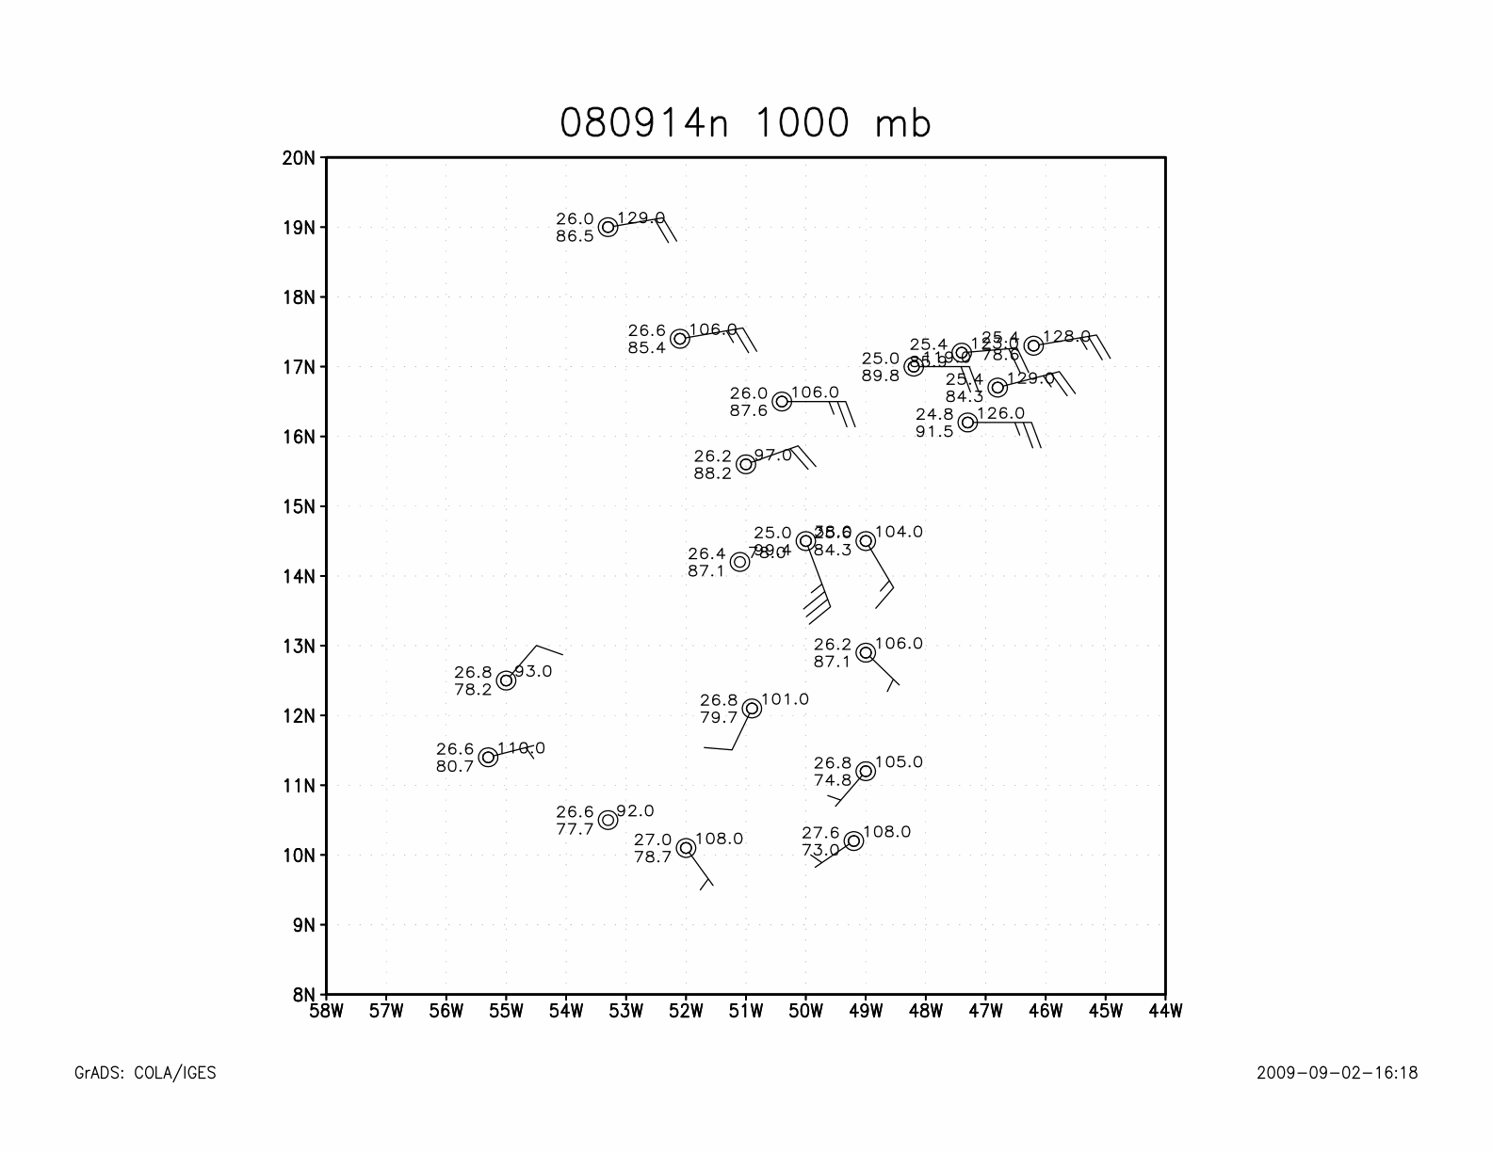
080915n G-IV mission

Slide 13
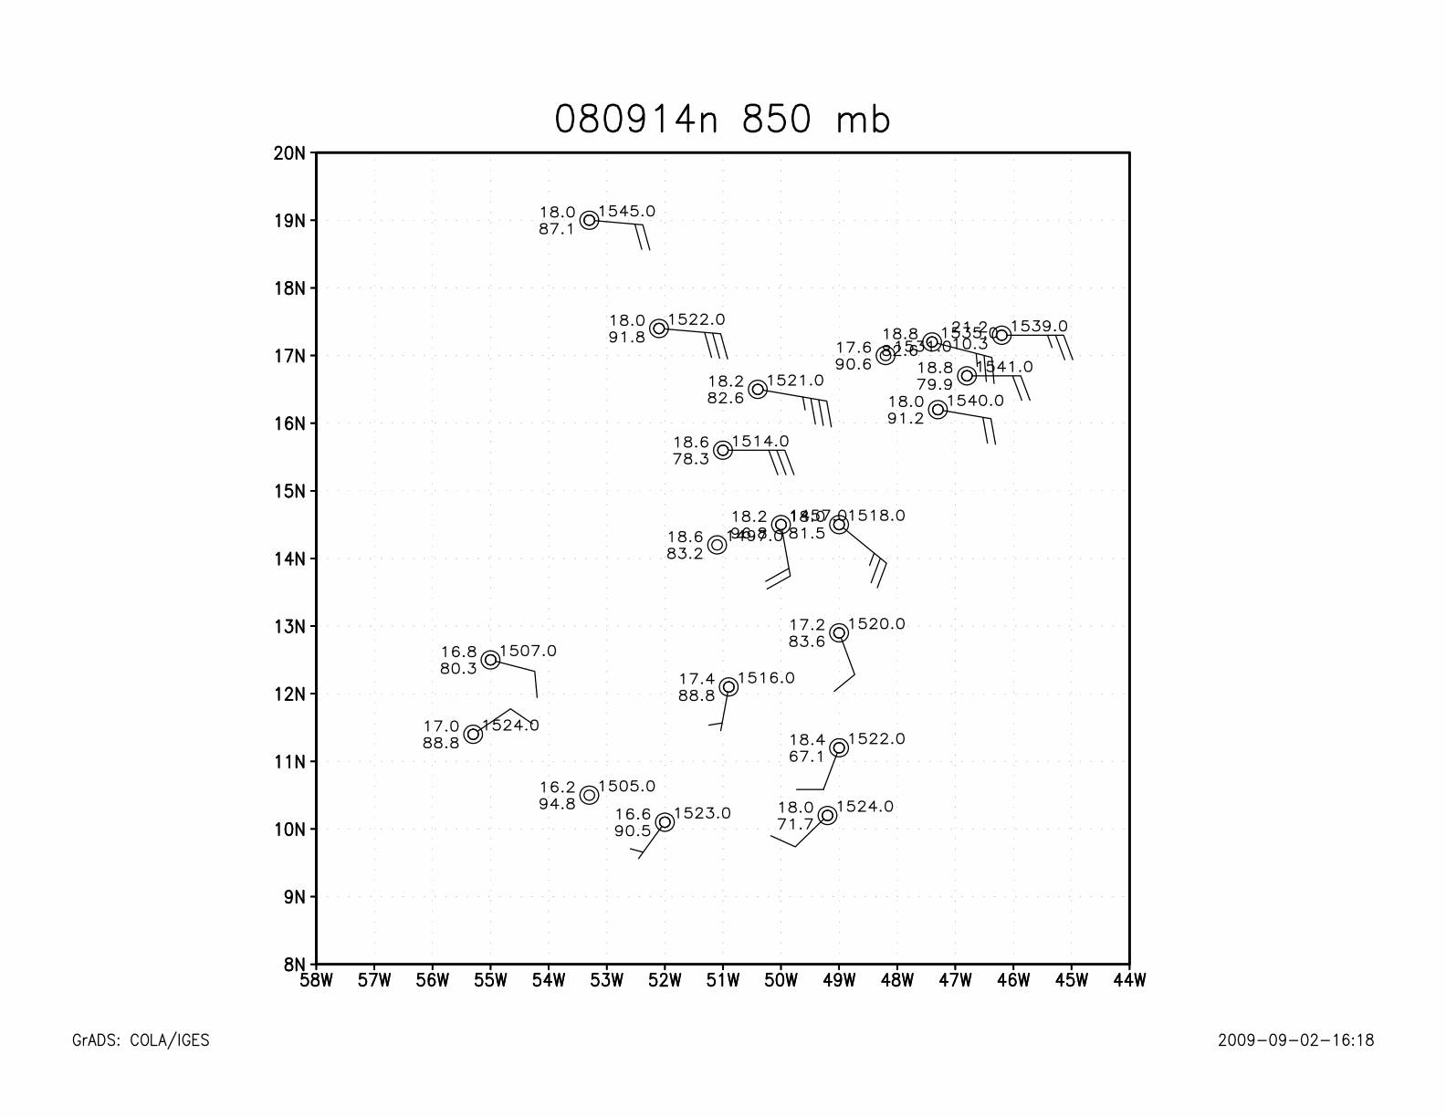

Slide 14
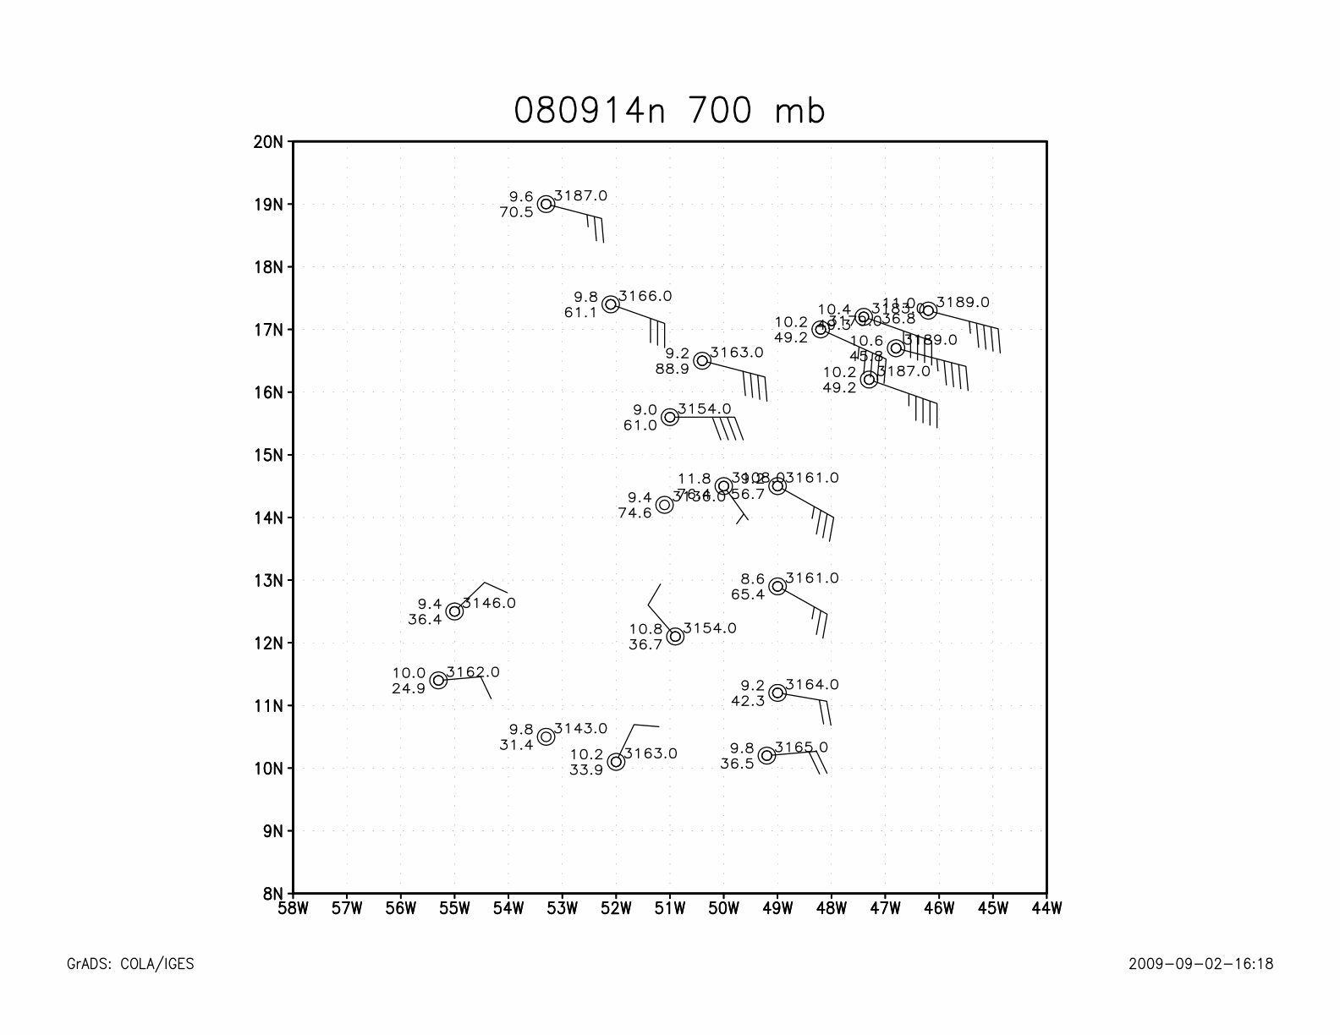
080915n G-IV mission

Slide 15
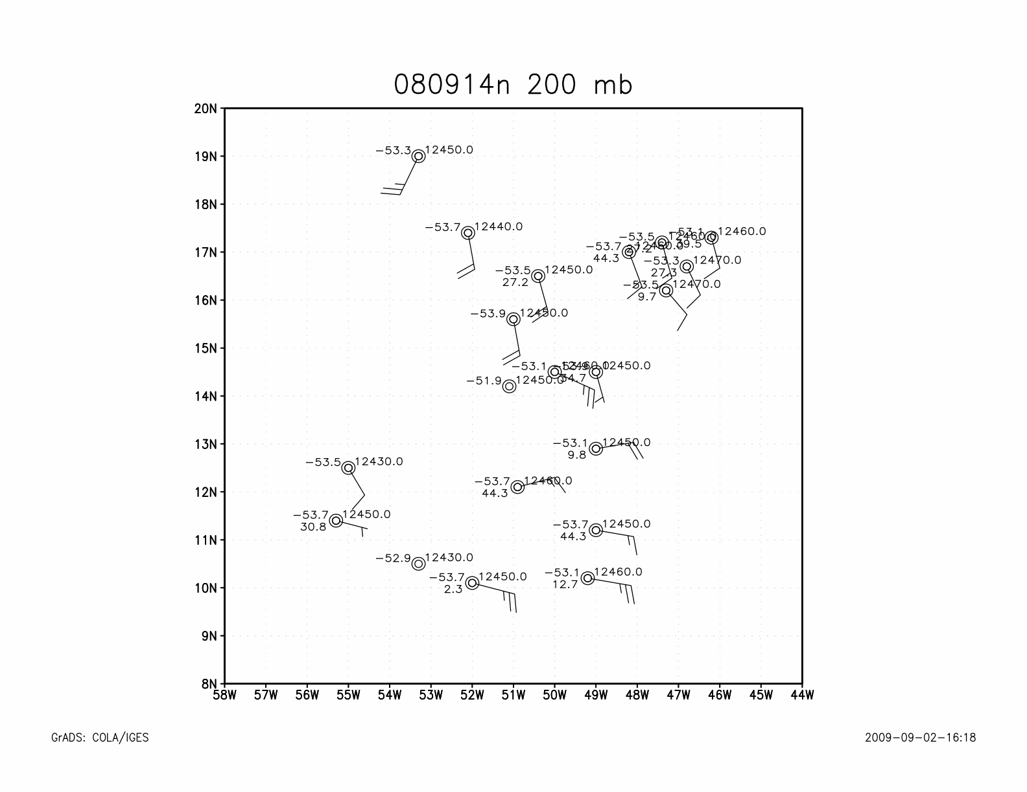
080915n G-IV mission

Slide 16
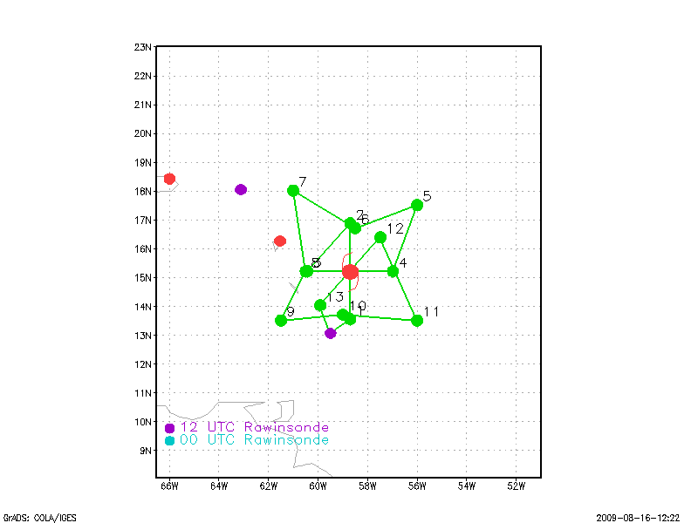
Ana 090816I1 – Black

Slide 17
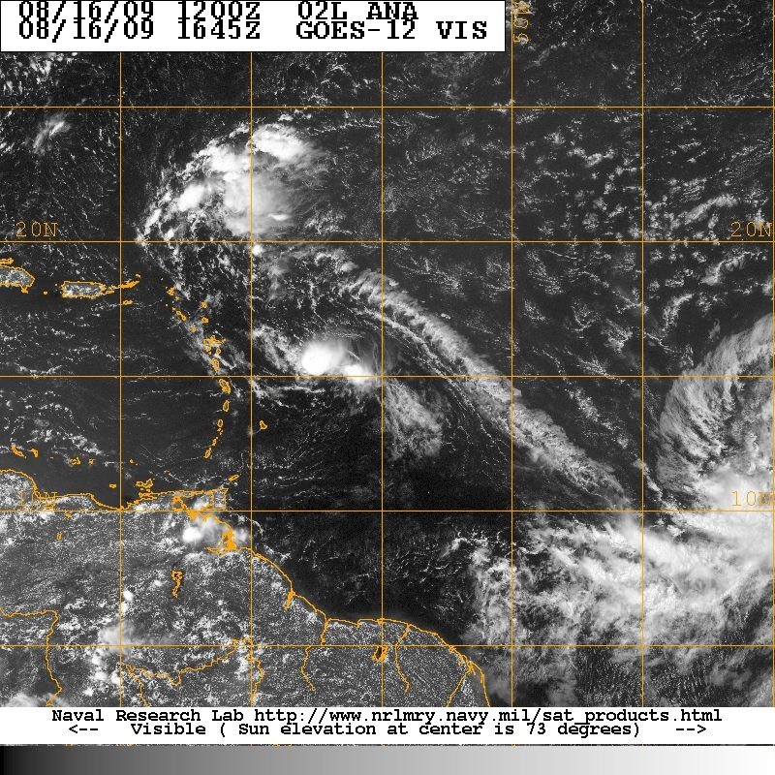
090816I ANA TDR/SALEX
35 kt TS?

Slide 18
090816I planned flight track

Slide 19
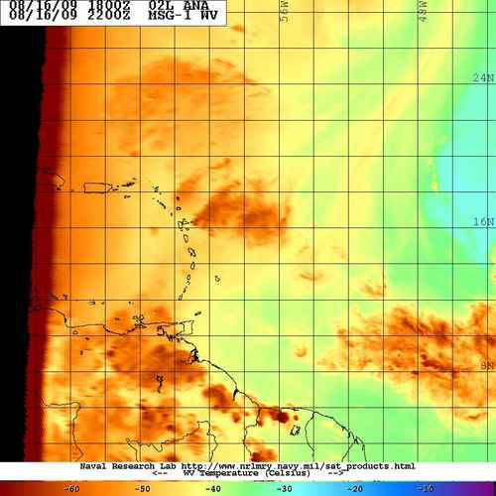
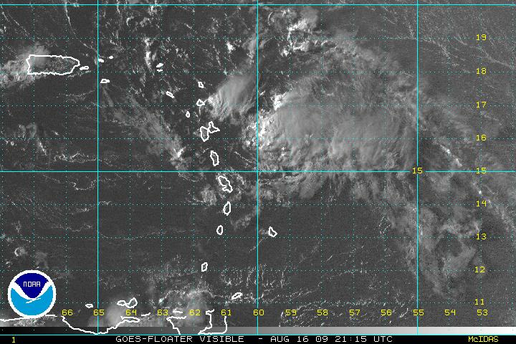
ANA: Limited convection, SW shear, and surrounded by moderately dry air

Slide 20
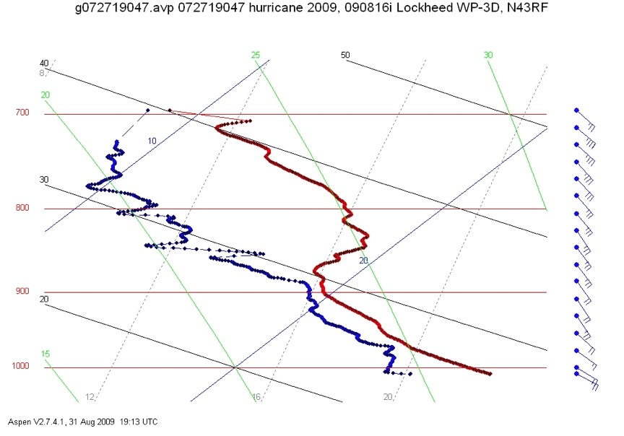
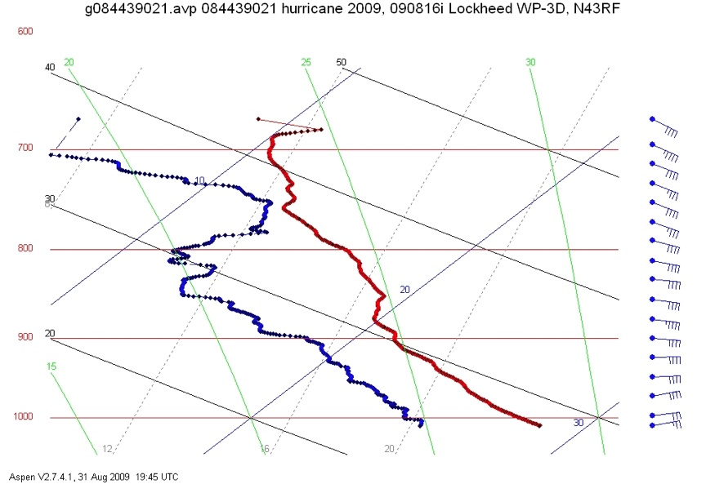
090816I skew-Ts
105 nmi east
135 nmi north

Slide 21
Notes on 080916I Ana mission:
No closed circulation at any level- from sondes, 2 Doppler analyses
Storm inhibited by shear and dry air?
What role did a low-level (700 mb) jet have?
Little distinction between air near the wave axis and in the environment

Slide 22
Bill 090818N1 - Dunion

Slide 23
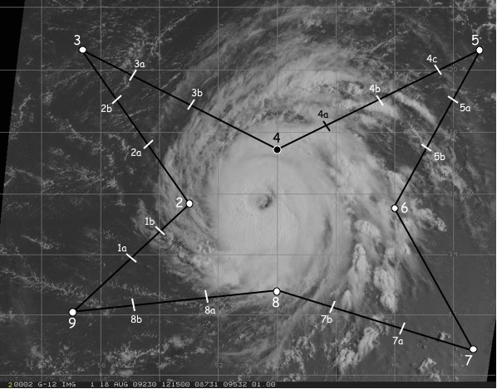
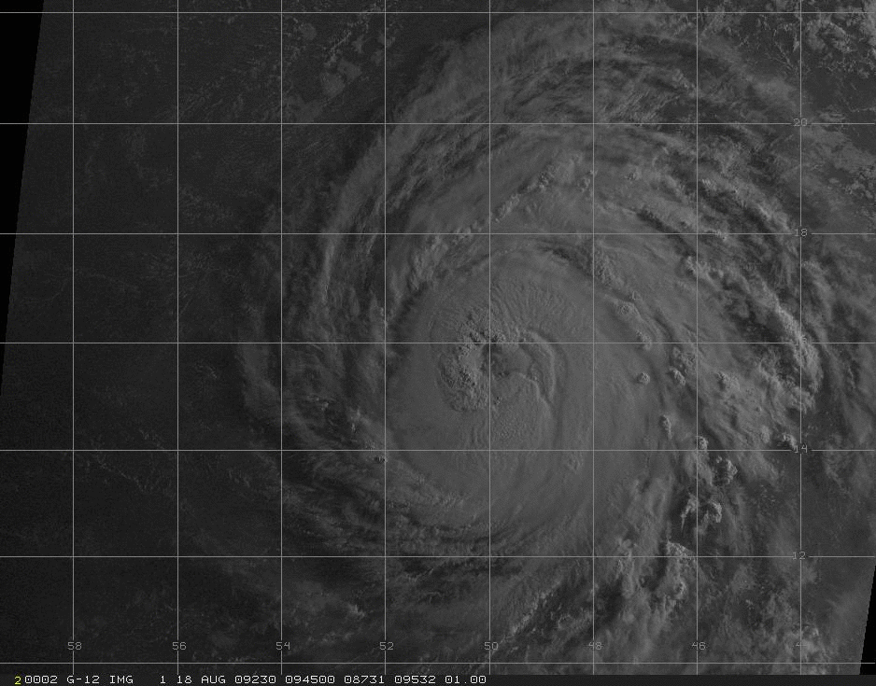
20080818N1 (G-IV)
Hurricane Bill
TDR/SALEX/RI
Take-off 0800 UTC (Barbados)
25 GPS dropsondes launched; All good
Intensity: 85 kt; Motion: 285/15 kt;

Slide 24
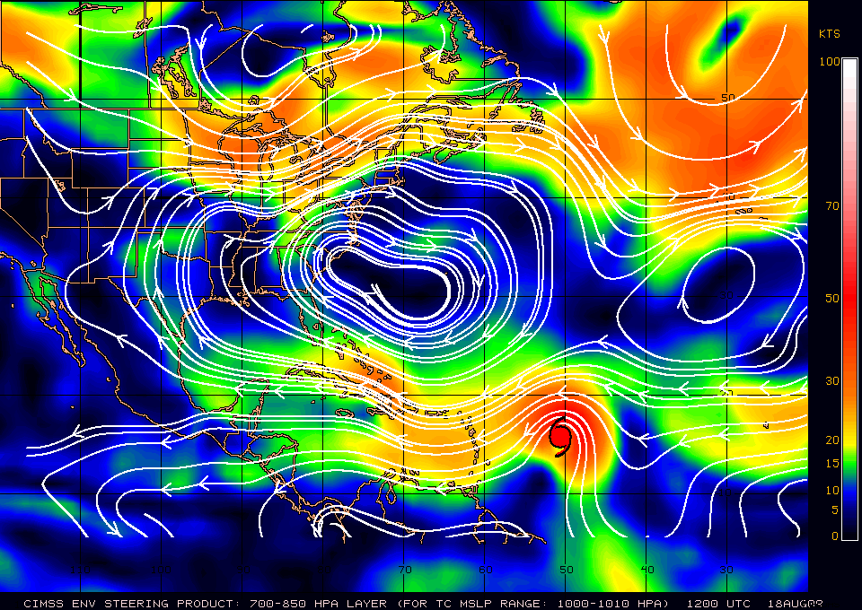
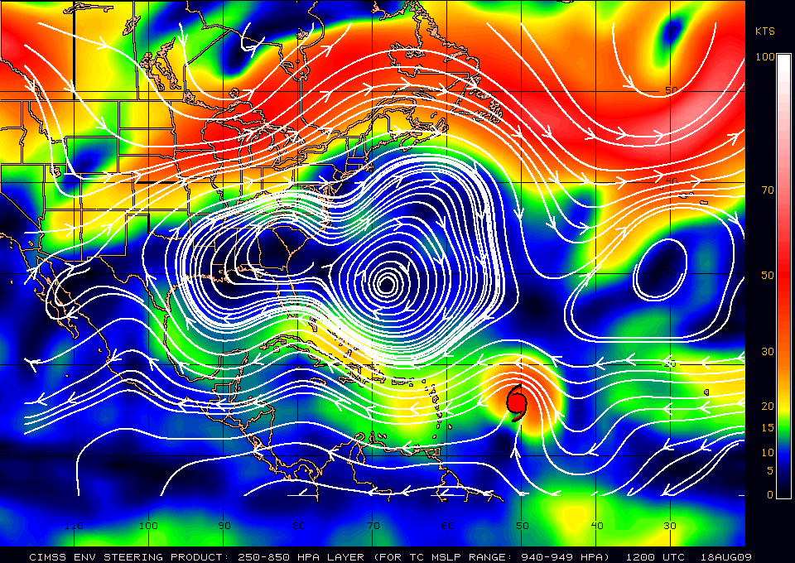
Deep Layer Steering
Notes:
-deep ridge steering Bill
-trough starting to dig over CONUS

Slide 25
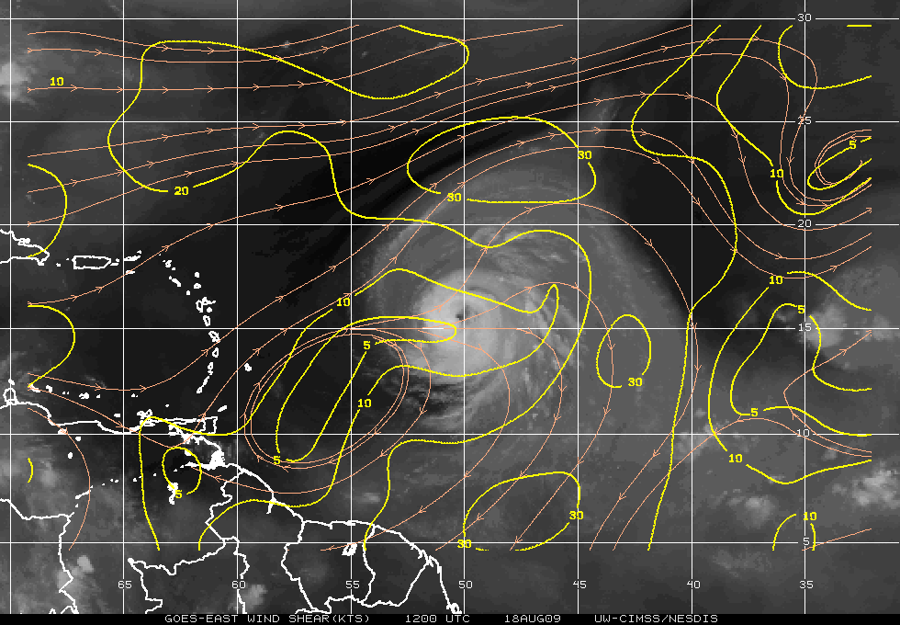
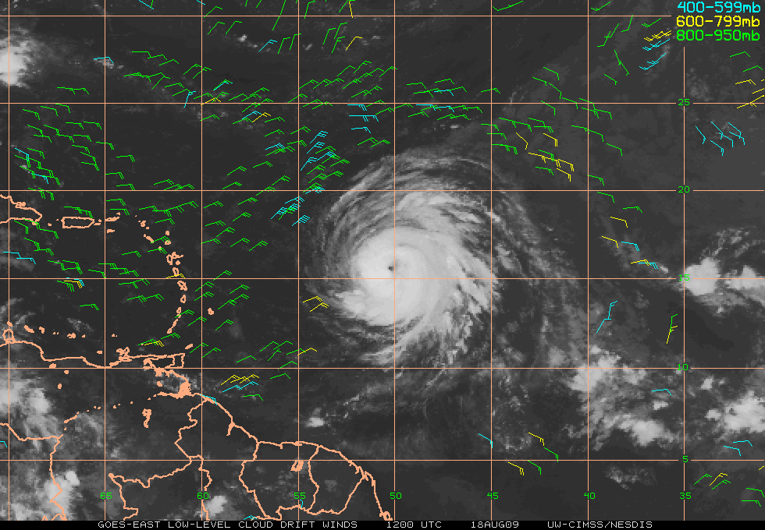
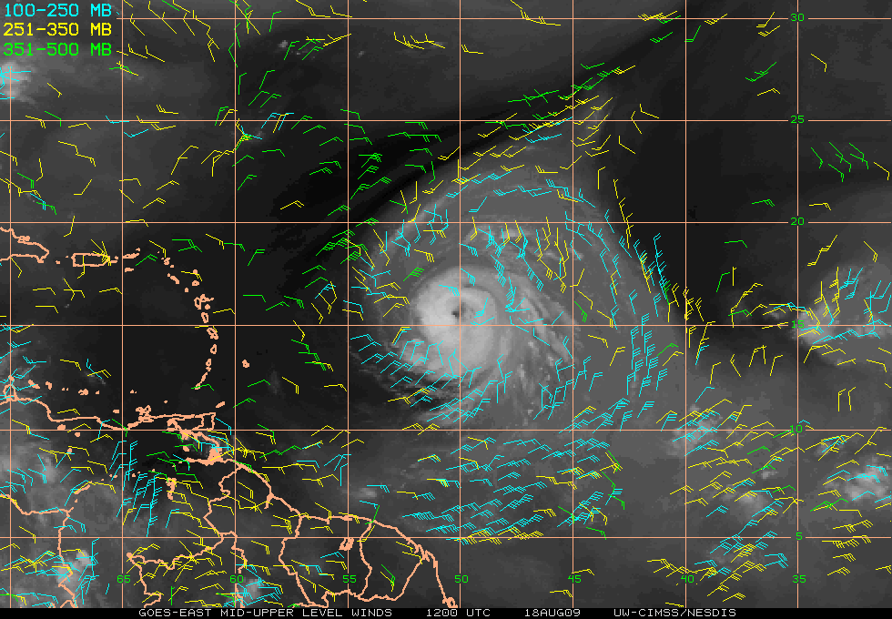
Vertical Shear/Satellite Winds
Notes:
-low shear (~5-10 kt)
-decent outflow all around

Slide 26
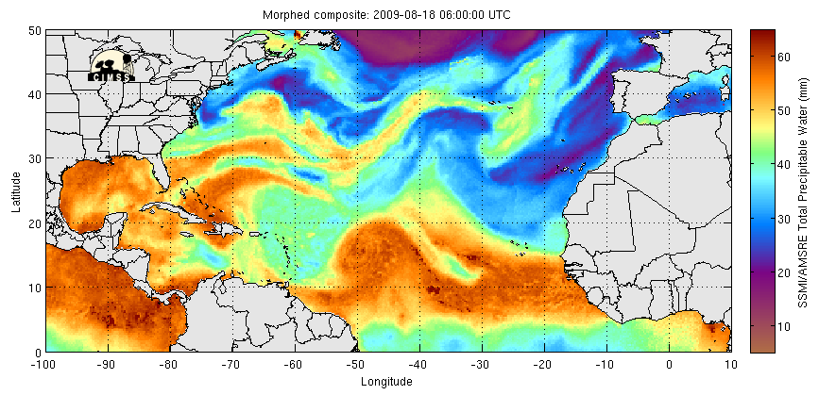
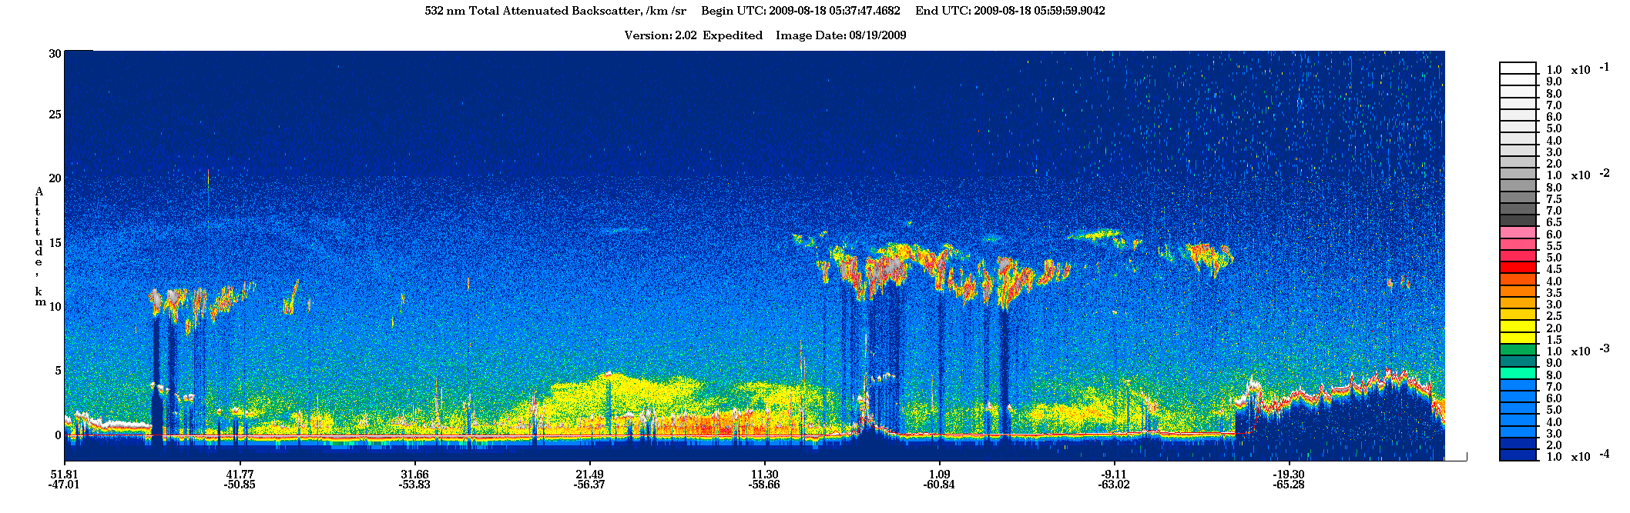
A
SAL+
subsidence
above
SAL
SAL
B
A
B
Saharan Dust

Slide 27
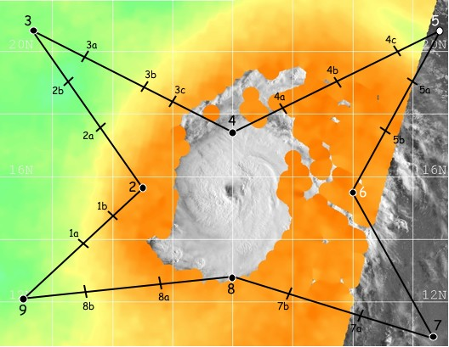
SSMIS TPW: 1105z
Drop 3c:
SAL: 4-4.5C Tinv 850 mb
20% RH 880 mb
42 kt NE jet 800 mb
Drops 4a/b/c:
SAL wedge 600-925 mb (widens SW-NE)
Drop 8:
Very dry <500 mb, variable below
Drops 1a & 1b:
SAL with 30 kt NE/ENE jet 600-750 mb
Drop 2a:
SAL: 4C Tinv (850 mb)
45-50 kt NE jet 750-800 mb
Notes:
-Calipso confirmed SAL outbreak; WV imagery confirmed dry air above that
-drops 6a and 7a also sampled dry air intrusion seen at 5a
-drop 9: SAL with mid-lat/subsidence overhead (notice Tinv at ~560 mb); SAL from NW via LLC; mid/upper dry air more N & NE

Slide 28
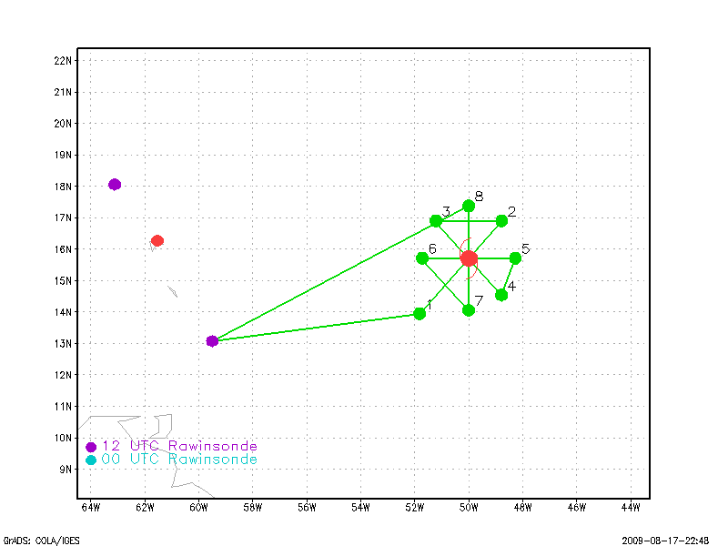
Bill 090818I1 - Cione

Slide 29
Hurricane Bill
HFIP Mission Summary
000818I1 Aircraft: N43RF
Scientific Crew:
Lead Project Scientist Joseph Cione
Radar Scientist John Gamache
Dropsonde Scientist Bachir Annane
Aircraft Crew:
Pilots Barry Choy, Mark Nelson, Cathy Martin
Flight Engineers Joe Klippel, Paul Darby
Navigators Tim Gallagher, Chris Sloan
Flight Director Jack Parrish, Rich Henning
Engineers Dana Naeher, Joe Bosko

Slide 30
Mission Brief:
Prior to the flight, the system of interest was classified by NHC as a category 2 hurricane situated in the eastern Atlantic. At takeoff (2000 UTC 18 August), Hurricane Bill had an estimated maximum intensity of 90kt, MSLP of 963mb and a center of circulation near 16.5N 52.3W. The planned mission of interest was a 3-penetration butterfly pattern that incorporated longer than usual 150mi legs. The goal was to have extended legs so as to better bridge the gap between Bill’s inner core and its larger surrounding environment (which was being sampled concurrently by NOAA 49). The flight track geometry for this mission is given in Figure 1. In addition to the basic pattern shown in figure 1 we also decided to do an eyewall/eye mixing module. This module was to be conducted between pt 1 and 2 during the first penetration. The planned module consisted of a figure 4 at 10kft followed by descent to 5000ft (3000ft radar). Once at this altitude circumnavigation of the eye was conducted at 3000ft agl followed by a rotated figure 4 while simultaneously climbing to 10kft. Total flight time was estimated at 8h. Follow-on missions at 12-hour intervals were planned with N43 and N49.

Slide 32
Mission Synopsis:
Takeoff was at 1959Z. Ferry altitude was 12kft. As Figure 1 illustrates, The IP for NOAA 43 required a NE heading in order to enter the storm from the south. The pattern for the 20 GPS sondes used was as follows. Drop at each 150nmi endpoint, at the 75 mile mid-point, and at the estimated RMW. Once through the eye the drop sequence was reversed (i.e. eyewall, mid point, endpoint). On legs 1-2 and 5-6 eye/center fix drops were also released. In addition, a complicated eyewall/eye module at altitudes ranging between 10kft and 5kft (3kft radar) altitude was conducted. After entering the eye on leg 1-2, we began the eyewall module. This included a figure 4 at 10kft followed by decent to 3kft radar at ehcich point we began full circumnavigation within the eye (w/ a 2mi P-3 eyewall separation maintained at all times). This module in my opinion needs to be modified and limited in application. More in the ‘problems’ section. As far as max winds, GPS (SFMR) max surface winds were observed in the NE eyewall at 95kts @10m (96kts). MSLP was ~960mb on leg 1-2 and fell to ~957 just before departure of the storm ~02Z 19 August. Throughout the storm there was evidence of dry air getting into the core circulation. The eyewall was precipitation-free on the south and southwest side. This is consistent with the water vapor imagery at the time that showed dry air just to the west of the core circulation (Figure 2). GPS sonde and radar observations from this flight confirm that some of this dry air was making its way into the core of the storm and had a direct impact on the subsequent eyewall precipitation pattern (or lack thereof) observed throughout the mission.

Slide 34
Problems:
The radar, flight-level, SFMR, and dropsonde systems for the most part all worked well on this flight. The only system blip was a 20 minute period towards the end of the flight where the radar screens froze up and had to be rebooted. All 20 dropsondes reported data throughout the drop and reached the surface. Both real time Doppler and Super-ob analyses were conducted and successfully sent off the plane in real time. In my opinion, the biggest ‘concern’ for this flight revolved around the eyewall module. I strongly recommend modifying the HFP such that this particular module is only conducted during daylight hours for intense hurricanes with clear eyewall/eye boundaries (i.e. ‘stadium eye’) at altitudes greater than 5000ft (radar).

Slide 35
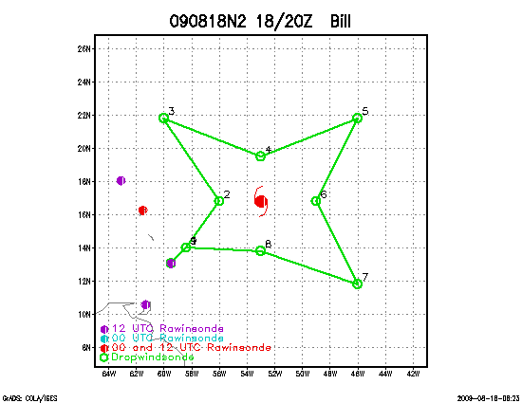
Bill 090818N2 - Black

Slide 36
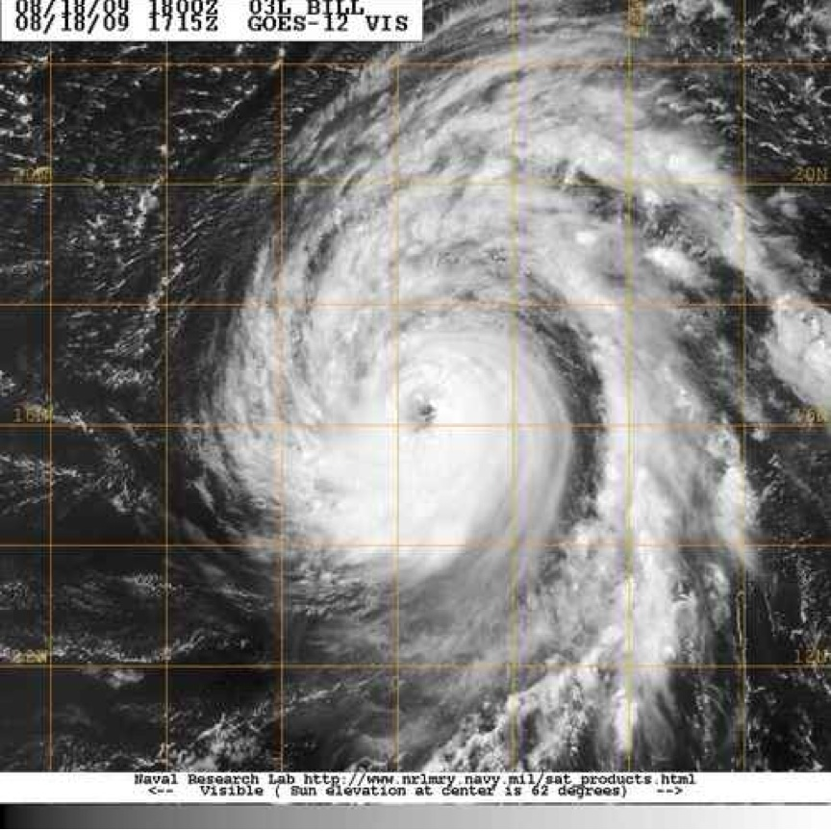
090818N2 BILL TDR/SALEX
90 KT, 963 mb

Slide 37
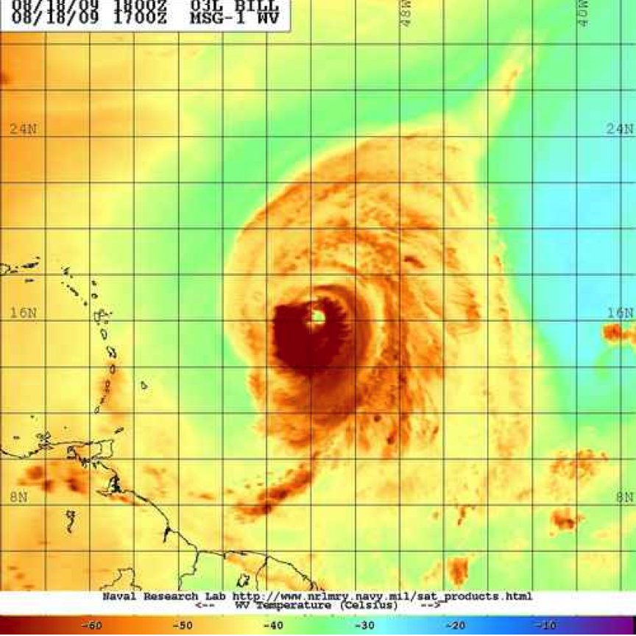
Bill was nearly surrounded by very dry air

Slide 38
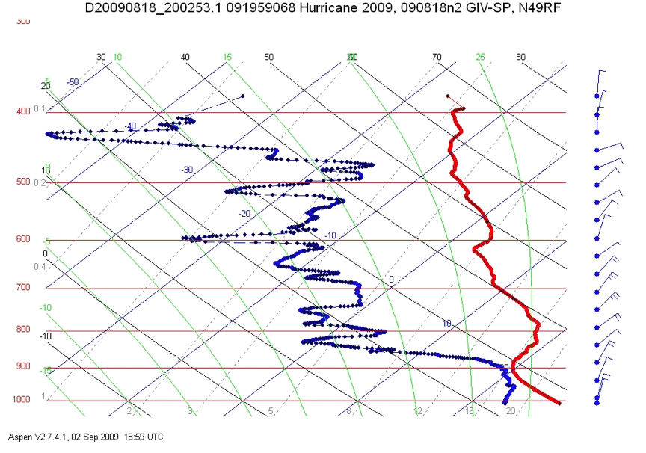
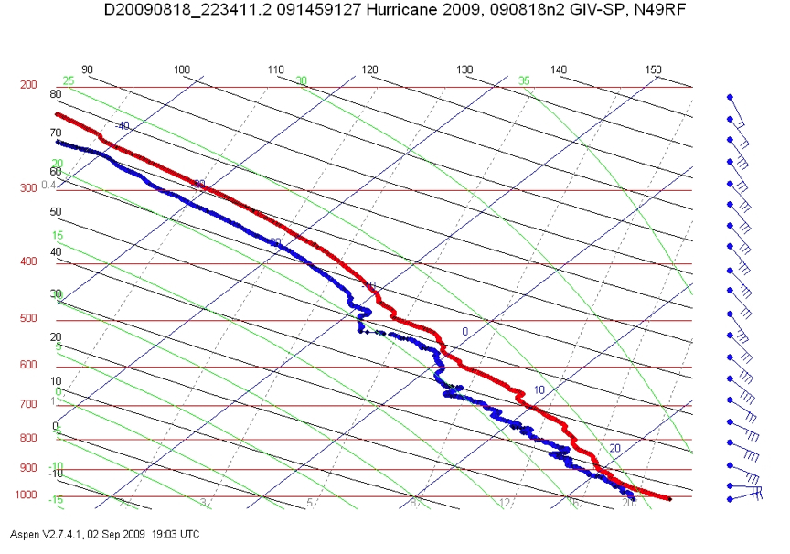
090818N2 sonde skew-Ts
105 nmi south
150 nmi north

Slide 39
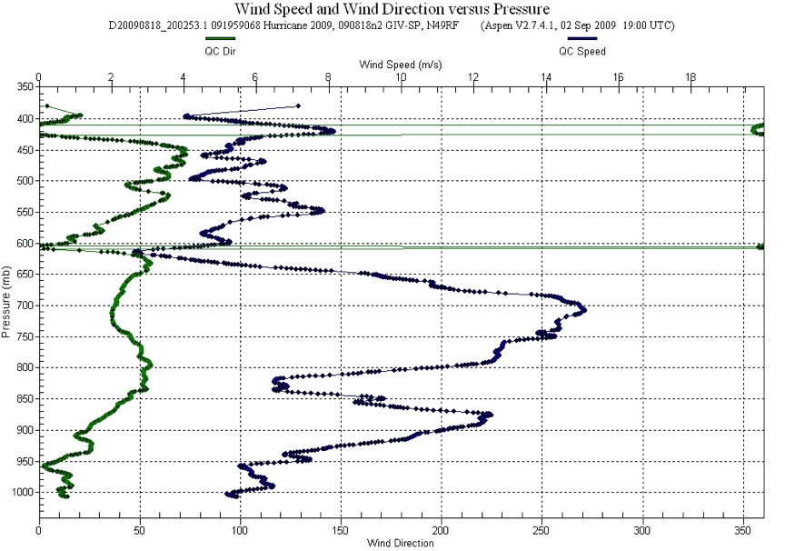

090818N2 sonde wind profiles
105 nmi south
150 nmi north

Slide 40
Notes on 080918N2 Bill mission:
Dry air on south and west side of storm
Low-level jet (700 mb) seen on west side
Nearby environment well-samples by sondes on G-IV - inner core by concurrent P3 mission
Unusually high number of fast fall sondes and ones with bad PTH

Slide 41
090819I1 - Rogers

Slide 42

GPS drop locations
Figure 1. Flight plan for 090819I1.

Slide 43


1600 UTC
Figure 2. Actual storm-relative flight track with flight-level winds overlain (barbs, kt) plotted over GOES infrared image valid 1600 UTC August 19.

Slide 44

Figure 3. 1-km GOES visible image valid 1345 UTC August 19.

Slide 45


1039Z Aug 19
(a)
1141Z Aug 19
(b)
Figure 4. Reflectivity (dBZ) measured from tail Doppler radar at 3 km altitude for radar legs centered at (a) 1039 UTC and (b) 1141 UTC August 19.

Slide 46



(a)
(b)
(c)
Figure 5. (a) CIMSS-derived upper-level cloud-drift vectors valid 0300 UTC August 19; (b) CIMSS-derived lower-level cloud-drift vectors valid 0300 UTC August 19; (c) CIMSS-derived 850-200 hPa vertical shear (kt) valid 0300 UTC August 19.

Slide 47


1039Z Aug 19
(a)
1141Z Aug 19
(b)
Figure 6. Wind speed (m/s) measured from tail Doppler radar at 1 km altitude for radar legs centered at (a) 1039 UTC and (b) 1141 UTC August 19.

Slide 48


(a)
(b)
Figure 7. (a) Peak flight-level (top number, kt) and SFMR (bottom number, kt) wind speed for each radial leg; (b) Ratio of peak SFMR to flight-level wind speeds for each radial leg.

Slide 49
090819I2 - Cione

Slide 50
Hurricane Bill
HFIP Mission Summary
000819I2 Aircraft: N43RF
Scientific Crew:
Lead Project Scientist Joseph Cione
Radar Scientist John Gamache
Dropsonde Scientist Bachir Annane
Aircraft Crew:
Pilots Barry Choy, Mark Nelson, Cathy Martin
Flight Engineers Joe Klippel, Paul Darby
Navigators Tim Gallagher, Chris Sloan
Flight Director Jack Parrish, Rich Henning
Engineers Dana Naeher, Joe Bosko

Slide 51
Mission Brief:
Prior to the flight, the system of interest was classified by NHC as a category 4 hurricane with maximum surface winds ~115kts. And MSLP 949mb. At takeoff (2000 UTC), Hurricane Bill’s center of circulation was ~19.5N 57.3W. The planned mission of interest was a 4-penetration butterfly pattern that incorporated l05mi legs. The goal was to maximize area coverage completely around the core of the storm. Similar to previous missions in Bill, NOAA 49 was concurrently sampling he large surrounding environment around the hurricane. The flight track geometry for both NOAA 49 and NOAA 43 is illustrated in Figure 1. Unlike the previous day NOAA 43 mission no eyewall/eye mixing module was to be conducted. Total flight time was approximately 8h. Follow-on missions at 12-hour intervals were planned with N43 and N49.

Slide 55
Other Interesting developments…
Besides this interesting development, there were other observations of note during this flight. As LPS, I did note that the (precipitation free) SW eyewall was radically different than the adjacent eyewall region found in the (strongest) NE quadrant. While significant kinematic differences existed (maximum surface winds in the SW eyewall ~80kts vs 120kt found in the NE) even more dramatic contrasts could be found with the thermodynamic structure illustrated associated with each of these eyewall regions In the SW, we found RH conditions relatively dry (85%) near the surface. This wasn’t overly surprising given the fact that it was precipitation free. However, saturation was never achieved anywhere in the sounding (max RH ~90% at 900mb). Even more noteworthy was that from 900 mb all the way up to 10kft flight level, RH linearly dropped off to a value ~60% RH. Again, this was a category 4 hurricane eyewall profile. In contrast the NE drop showed RH near 95% at the surface and saturation above that all the way up top 10Kft, both of which are typical and to be expected. Each drop was roughly separated by 50nmi. Incredible contrast over a very small distance for a mature category 4 storm. A tale of 2 hurricanes.

Slide 56
Problems:
The radar, flight-level, SFMR, and dropsonde systems worked well for most part of the mission. However, unlike previous flights the LF radar’s performance became less consistent. J. Gamache estimated that the radar system was down for ~30% of the flight. This situation would have to be monitored on future flights. The UPS failure mentioned earlier was rectified quickly once the visible smoke was detected by J Gamache. Initially we turned back to Barbados before the source of the smoke was positively identified by the flight crew. Once identified the crew determined it was safe to proceed with the mission. All 23 dropsondes reported data throughout the drop and reached the surface. Both real time Doppler and Super-ob analyses were conducted and successfully sent off the plane in real time.

Slide 57
Bill 090819N1 - Dunion

Slide 58


20080819N1 (G-IV)
Hurricane Bill
TDR/SALEX/RI
Take-off 0800 UTC (Barbados)
21 GPS dropsondes launched; 1 Fastfall
Intensity: 115 kt; Motion: 295/14 kt;

Slide 59


Deep Layer Steering
Notes:
-295/14 kt; 115 kt
-trough continuing to dig over CONUS; weakness developing in the ridge

Slide 60



Vertical Shear/Satellite Winds
Notes:
-Shear fairly low; 20 kt contour E of stormprobably a vortex removal issue (conv a bit skewed to the E relative to the center
Strong 25-30 kt low to mid-level flow (SAL)
-outflow now more restricted around W semicircle

Slide 61


A
SAL+
subsid
above
SAL
SAL
B
A
B
Saharan Dust

Slide 62

5
4b
3
3a
4a
3b
2b
4
5a
2a
2
6
1b
1a
6a
1
8
9
7a
7

Slide 63

5
3
4b
3a
4a
3b
2b
4
5a
2a
2
6
1b
1a
1
6a
1
8
9
7a
7

Slide 64

Drop 3:
SAL with dry air above
30-35 kt NE jet 925 mb
Drop 3b:
Dry wedge 600-950 mb
~60 kt ENE wind max 880 mb
Drop 5:
SAL 600-850 mb
1.5C Tinv at SAL base
30 kt E jet 600 mb
Drop 8:
strong SAL under CDO
35 kt SSW jet at 675 mb
Notes:
-Calipso confirmed SAL outbreak; WV imagery confirmed dry air above that
-drops 6a and 7a also sampled dry air intrusion seen at 5a
-drop 9: SAL with mid-lat/subsidence overhead (notice Tinv at ~560 mb); SAL from NW via LLC; mid/upper dry air more N & NE

Slide 65
090820I1 - Rogers

Slide 66

GPS drop locations
Figure 1. Flight plan for 090820I1.

Slide 67


1615 UTC
Figure 2. Actual storm-relative flight track with flight-level winds overlain (barbs, kt) plotted over GOES infrared image valid 1615UTC August 20.

Slide 68

Figure 3. 1-km GOES visible image valid 1615 UTC August 20.

Slide 69


(a)
(b)
Figure 4. (a) Peak flight-level (top number, kt) and SFMR (bottom number, kt) wind speed for each radial leg; (b) Ratio of peak SFMR to flight-level wind speeds for each radial leg.

Slide 70



(a)
(b)
(c)
Figure 5. (a) CIMSS-derived upper-level cloud-drift vectors valid 0300 UTC August 20; (b) CIMSS-derived lower-level cloud-drift vectors valid 0300 UTC August 20; (c) CIMSS-derived 850-200 hPa vertical shear (kt) valid 0300 UTC August 20.

Slide 71
Bill 090820N1 - Dunion

Slide 72


20080820N1 (G-IV)
Hurricane Bill
TDR/SALEX/RI
Take-off 0749 UTC (Barbados); 7 hr 20 min mission; “backwards”
26 GPS dropsondes launched; 3 Fastfalls
Intensity: 110 kt; Motion: 305/16 kt;
>50% of drops > no surface winds (090814n/090818n1/090819n1/090820n1

Slide 73


Deep Layer Steering
Notes:
-285/15 kt; 85 kt
-trough starting to dig over CONUS

Slide 74



Vertical Shear/Satellite Winds
Notes:
-Outflow a bit restricted on S & E sides; upper-level cyclonic…interesting
-high shear in SE quad looks real; drop 3 in SE:
-200 mb: 6.4 kt 240 deg 700 mb: 42 kt 160 deg 850 mb: 37 kt 173 deg
-200-850 shr: 35 kt 353 deg 200-700 shr: 41 kt 331 deg

Slide 75


A
SAL
SAL+subsidence
above
B
A
B
Saharan Dust

Slide 76










SAL intrusion
SAL intrusion?
(collocated with jet)
SAL intrusion >
Downdraft?
Hmmmm…..
46 kt SSE jet
86 kt SE jet
76 kt ENE jet
5 m/s downdraft
Notes:
-Calipso confirmed SAL outbreak; WV imagery confirmed dry air above that
-drops 6a and 7a also sampled dry air intrusion seen at 5a
-drop 9: SAL with mid-lat/subsidence overhead (notice Tinv at ~560 mb); SAL from NW via LLC; mid/upper dry air more N & NE

Slide 77
090820I2 – Black

Slide 78

090820I2 BILL SALEX
105 KT, 951 mb

Slide 79


090820I2_ Radar sytem was down but the G-IV and C-130(?) were sampling the environment

Slide 80

Flew a figure 4 with 105 nmi legs then used microwave imagery to circumnavigate dry slot outside of Bill’s eyewall

Slide 81

On ferry to Bill at 600 mb, SAL air clearly visible below us

Slide 82

090820I2 skew-T
~105 nmi west

Slide 83



Different imagery will give you a different interpretaion of storm structure

Slide 84
Notes on 080920I2 Bill mission:
Radar inoperative but sondes and flight-level data combined with G-IV and C-130 synoptic data could prove valuable
Was the dry air eroding the convection on Bill’s west side and weakening or limiting intensification?
Microwave imagery useful for mission planning and execution
Was the core of Bill protected by dry air intrusions

Slide 85
HWRF-X Runs

Slide 86


Slide 87


Slide 88


Slide 89
MGOC

