Slide 1

Sensitivity of Hurricane Intensity Forecast to Parameterizations in an Axisymmetric Model
Rosimar Ríos-Berríos
Significant Opportunities in Atmospheric Research and Science (SOARS) Fellow
Advisor
Tomislava Vukicevic
Co-Advisor
Marcus Van Lier-Walqui

Slide 2
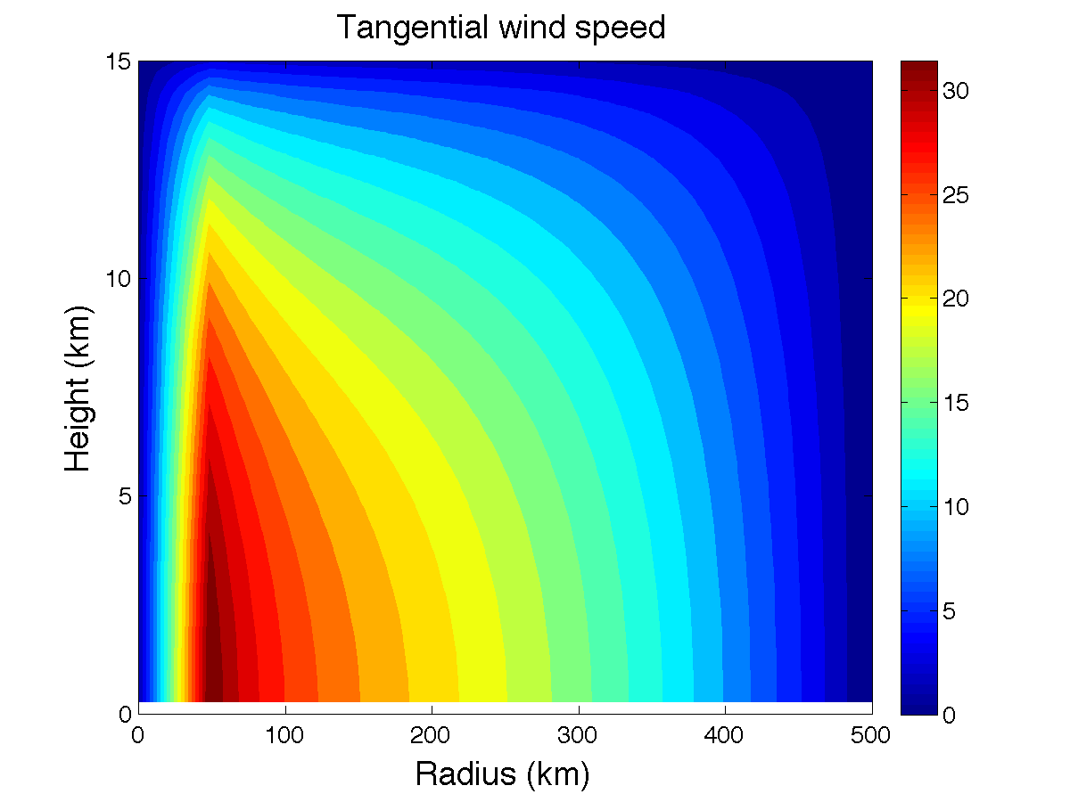
Model setup
Axisymmetric Simplified Pseudoadiabatic Entropy Conserving Hurricane Model (ASPECH 2.0; Tang and Emanuel 2012)
Resolution
  Radial: 4 to 10 km (grid stretching)
  Vertical: 0.5 to 0.8 km (grid stretching)
Initial conditions
  Vmax = 33 ms⁻¹ (at the surface)
  RMW = 50 km
  SST = 29ºC
  RH = 75% in the PBL
  70% above the PBL

Slide 3
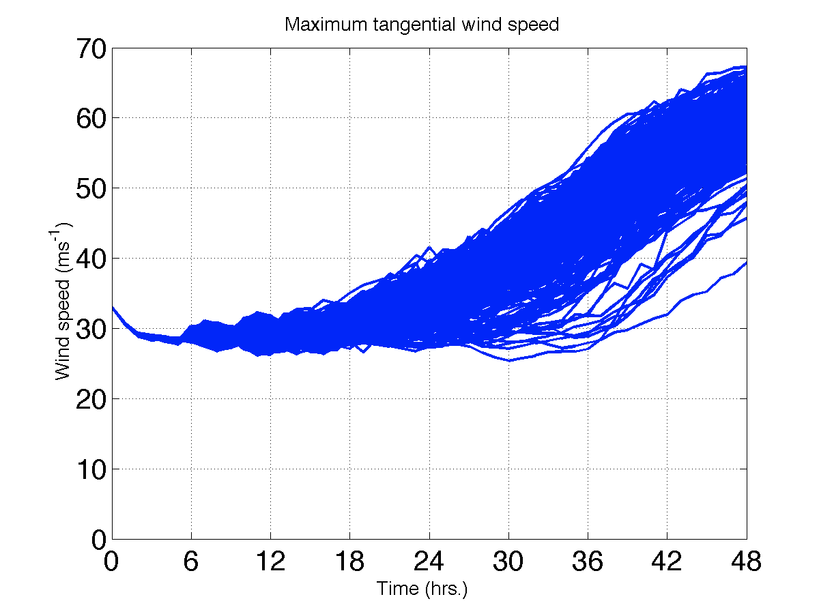
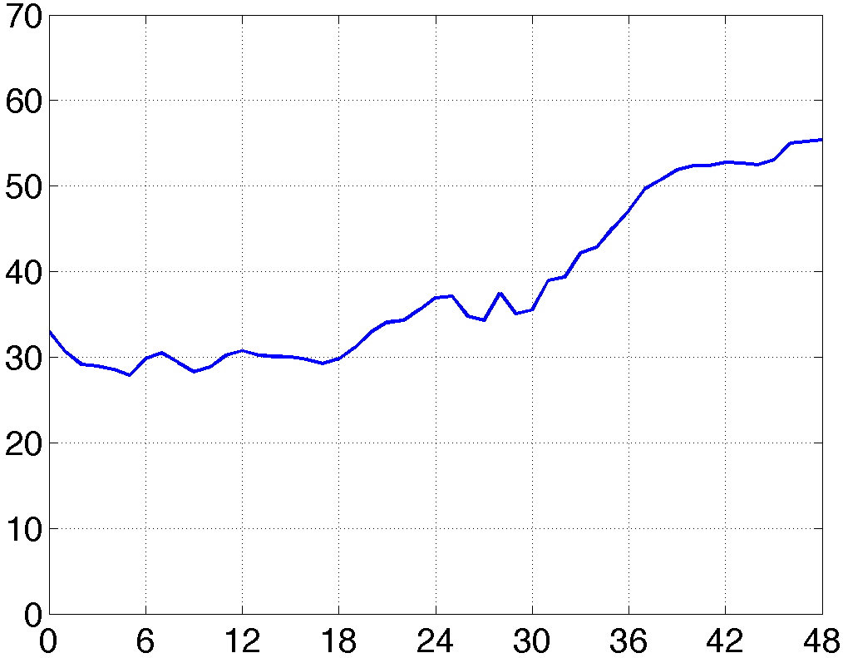
‘True’ or ‘observed’ run (no perturbations)

Slide 4
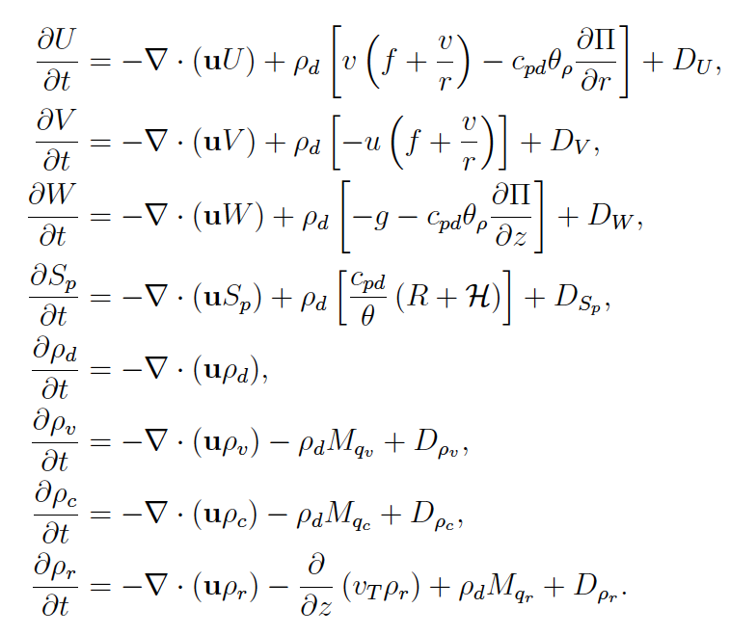
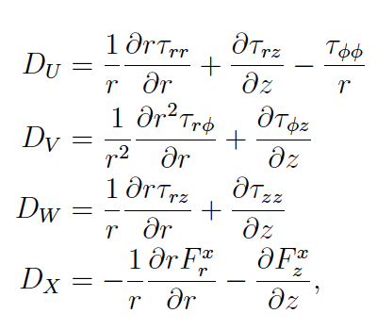
Model parameterizations
Horizontal and vertical mixing length
Other studies:
Bryan and Rotunno 2009, Bryan 2012
Kessler Microphysics
Tang and Emanuel (2012)

Slide 5
Experiments
Horizontal mixing length:
20 bins (750-1500m)
400 runs!
Microphysics:
M_{qv} = E-C → αM_{qv}
20 bins
(0.5 – 1.5)
Tang and Emanuel (2012)

Slide 6
Forward model observations

Slide 7
Inverse problem solution
(“brute force” method)
Start
Select observable
(e.g. max Vt)
Select fixed variable
(e.g. time)
Assume ‘observed’ value is normally distributed
Calculate convolution of obs and fwd obs pdfs
Integrate over observable
Assume each parameter (thus each measurement) is normally distributed
Vukicevic and Posselt (2008)

Slide 8
Observables
Maximum tangential wind speed at fixed time
Maximum change in tangential wind speed in 24 hrs (simulating RI)
Onset time for RI
RMW?
Precipitation efficiency?
Maximum vertical wind?
Something about the secondary circulation?

Slide 9
Preliminary results
Observable: maximum tangential wind speed

Slide 10
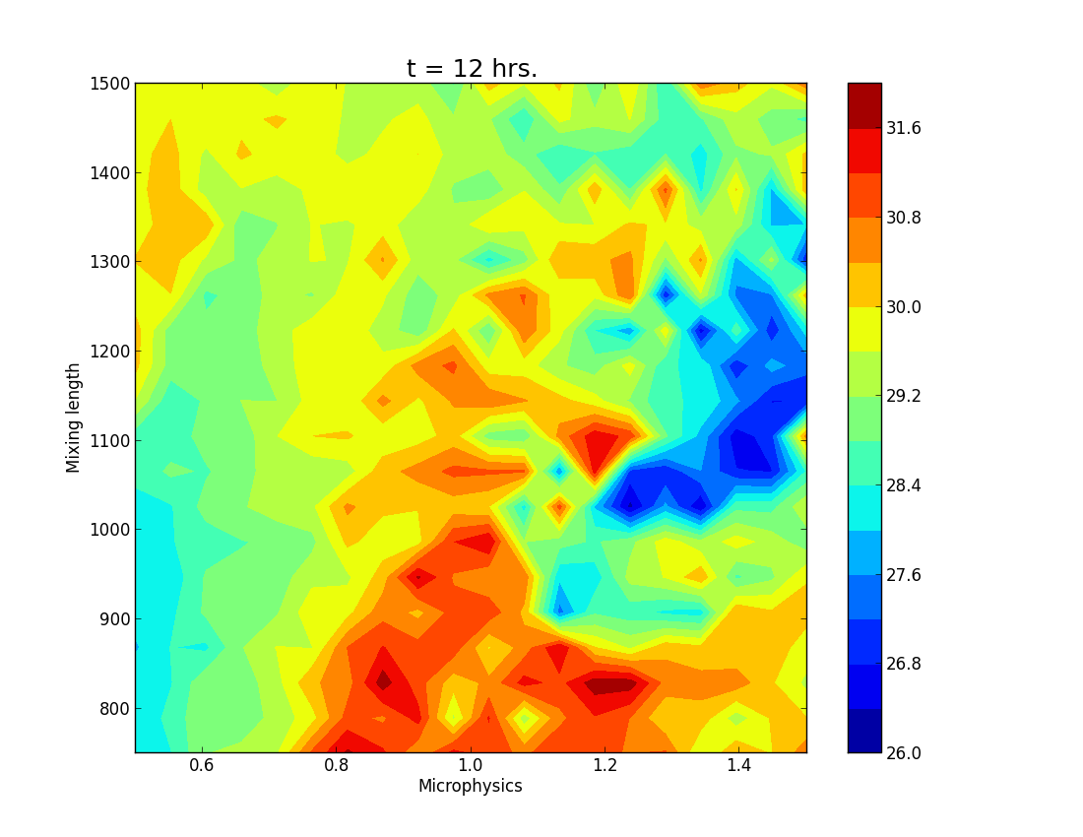
Maximum V_{t}

Slide 11
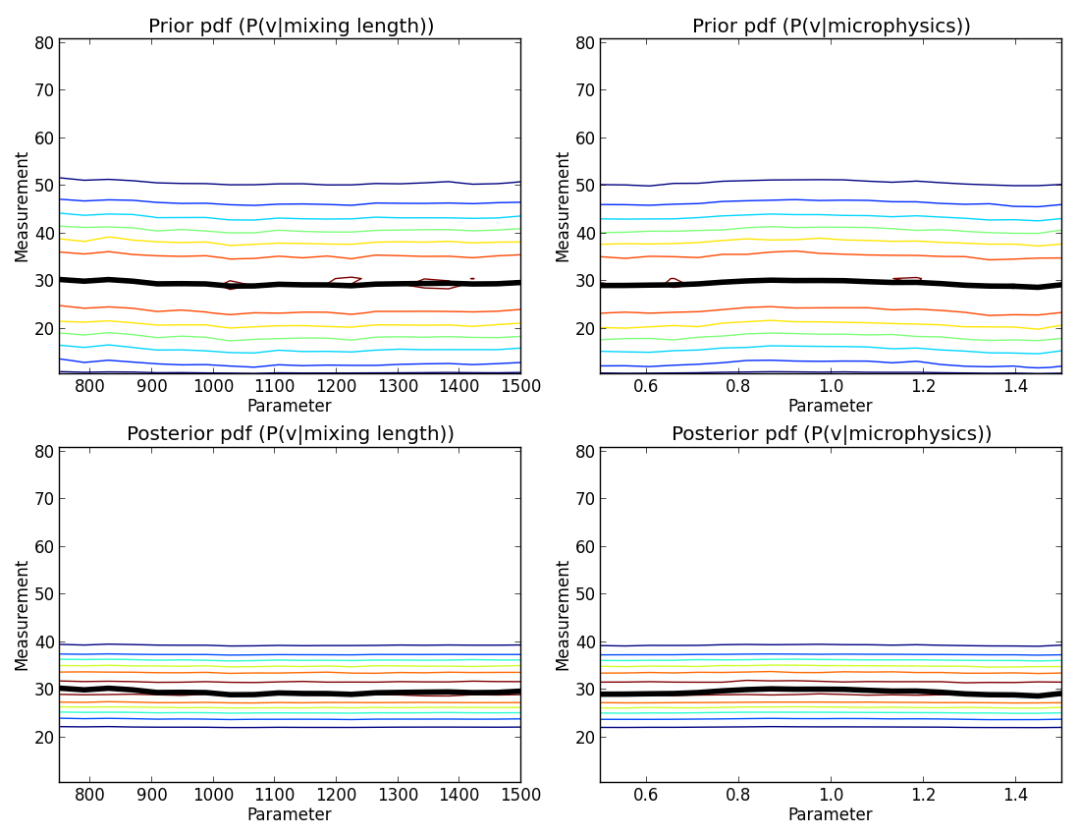
Conditional prior and posterior pdfs t = 12 hrs.
*black line represents the mean simulated measurement

Slide 12
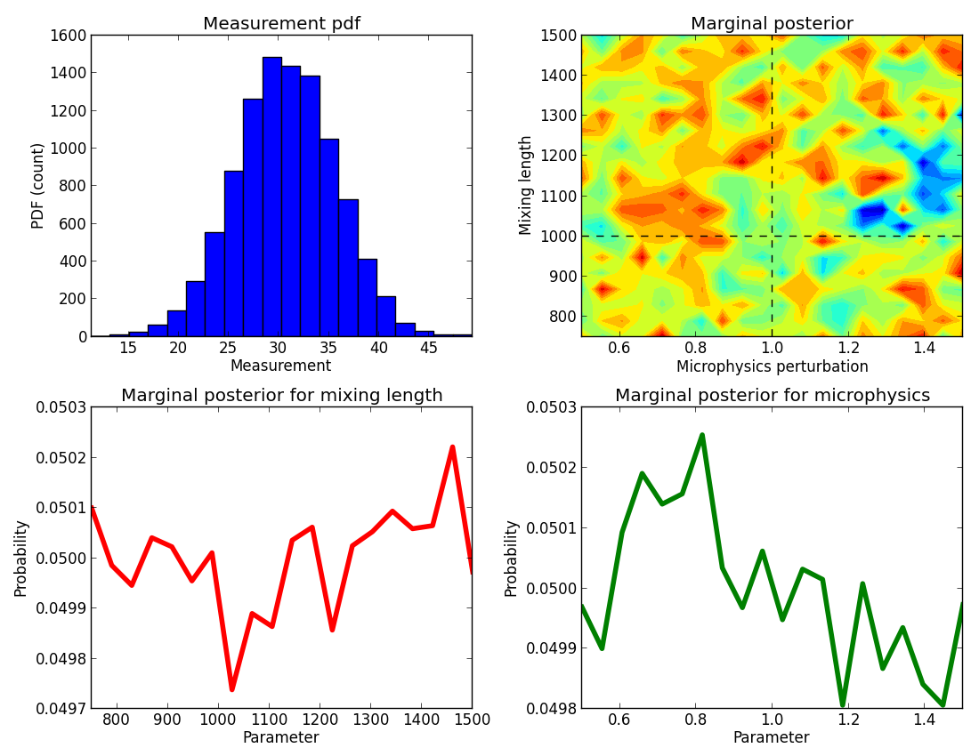
Observable pdf and marginal posteriors t = 12 hrs.
pdf(x,y)
P(V_{t_obs})
pdf(x)
pdf(y)

