Slide 1
Importance of Warm Core Processes on the Rapid Intensification of Hurricane Earl (2010)
Josh Alland
Iowa State University
Sundararaman Gopalakrishnan
Thiago Quirino
AOML/HRD

Slide 2
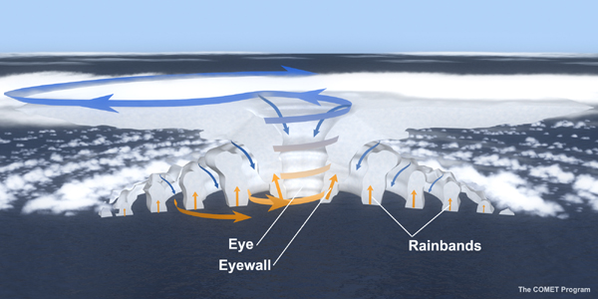
Introduction
Low-level convergence from inflow layer (Willoughby 1998) and low-level outflow from eye (Smith 1980) results in deep convection within eyewall.
Subsidence in eye combined with latent heat release from eyewall forms a warm core in mid- to upper- troposphere of eye (Zhang and Chen 2012).
Warm core is directly responsible for lowering the surface pressure in eye and strengthening storm (Zhang and Chen 2012).
outflow
outflow
15 km
downdraft
downdraft
updraft
Inflow
Inflow
1 km

Slide 3
Importance of Warm Core Structure
Warming aloft produces much lower surface pressure (Zhang and Chen 2012).
Upper-level warm core is more effective at strengthening tropical system.
P₂=P₁*EXP((z₂-z₁)/(R_{d}*T))
Hypotheses
Upper-level warming will produce much lower MSLPs.
A deeper warm core will produce much lower MSLPs as well.
Notes:
I looked at idealized parabolic warm cores,

Slide 4
Idealized Parabolic Warm Cores
a.
b.
c.
d.
Notes:
Fig. 2 a) Idealized parabolic warm core with a vertical depth from 6000 m to 16000 m, b) Vertical depth from 6000 m to 14000 m, c) Vertical depth from 6000m to 12000m, and d) Vertical depth from 10000 m to 16000m. Each parabola represents a different maximum temperature anomaly, with purple, light blue, orange, blue, red, and green corresponding to 18K, 16 K, 14 K, 12 K, 10 K, and 8 K, respectively. The resulting MSLP for each parabola is shown.

Slide 5
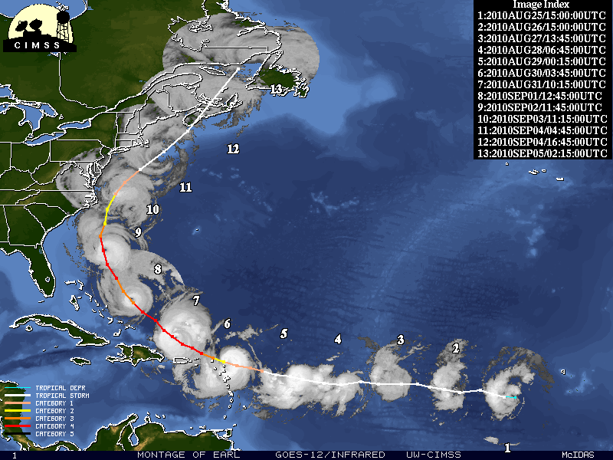
Hurricane Earl
1003 hPa to 927 hPa pressure drop (71 hPa) from Aug. 27th to Sept. 2nd (Cangialosi 2011).
Slow development at first due to shear (Danielle) and dry air (NHC real-time discussion).
RI due to decrease in shear and warmer sea surface temperatures, 28-29°C (Cangialosi 2011).
Courtesy of University of Wisconsin-Madison CIMSS
Cangialosi: 2011 http://www.nhc.noaa.gov/pdf/TCR-AL072010_Earl.pdf

Slide 6
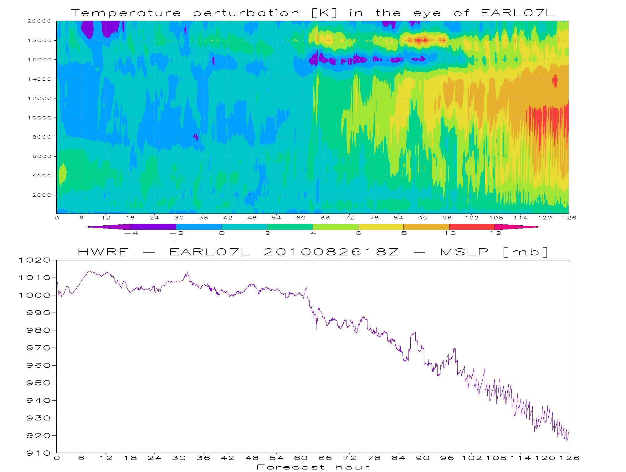
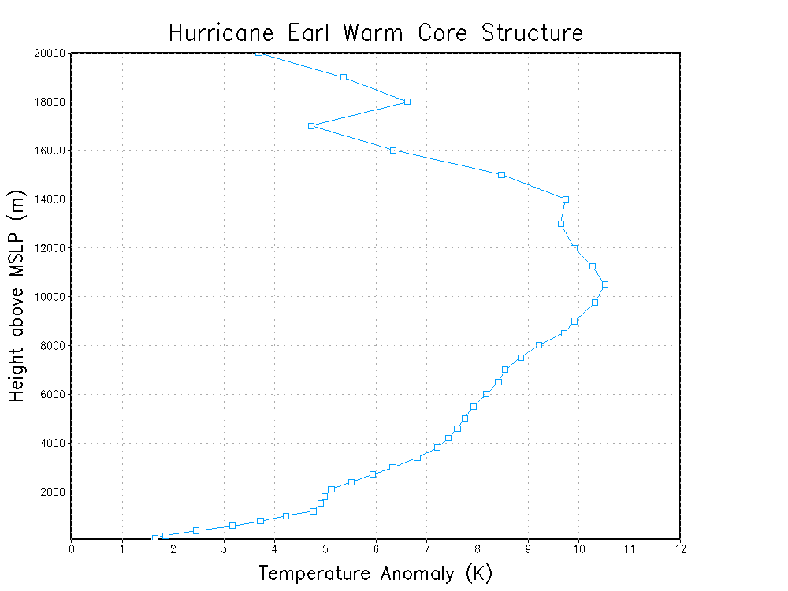
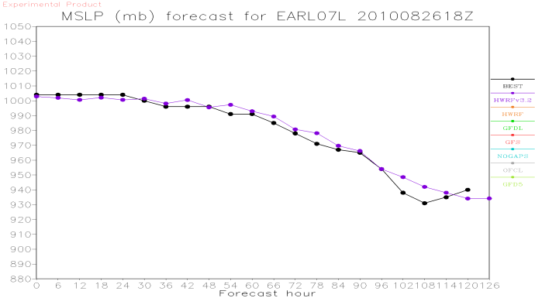
Earl’s Warm Core
Large depth of warm core produces MSLP of 921.86 hPa.
Simple hydrostatic balance produces MSLP similar to model MSLP.
Model is accurate for this forecast – model MSLP is close to observations.

Slide 7
Next Steps
Analyze individual plumes (using 1-minute data).
Understand how the model is intensifying Earl.
Questions
What is the structure of vertical motions within these plumes?
How are these plumes intensifying Earl??
Are strong or weak updrafts developing the warm core???
No solution yet, but en route to the modeled intensification process.
Could give insight into how hurricanes strengthen!
Notes:
Since the HWRF did a good job modeling this event

