Slide 1
Update 01/20
2. Assimilation using GSI a. perfect T,q,u,v profiles
b. perfect u,v profiles
c. perfect T profiles
d. perfect q profiles

Slide 2
Date | U,V | T | Q
05/08/01 6z | -1 | 0 | 1
05/08/01 12z | -1 | 1 | 0
05/08/01 18z | -1 | -1 | -1
05/08/02 00z | -1 | 1 | 0
05/08/02 6z | 1 | 1 | 1
05/08/02 12z | -1 | 1 | -1
05/08/02 18z | 1 | 1 | 1
05/08/03 00z | 1 | 1 | 1
05/08/03 6z | 1 | 1 | 1
05/08/03 12z | 1 | 1 | 1
05/08/03 18z | 1 | 1 | 1
05/08/04 00z | 1 | 1 | 1
05/08/04 06z | 1 | 1 | 1
05/08/04 12z | 1 | 1 | 1
05/08/04 18z | 1 | 1 | 1
05/08/05 00z | 0 | 1 | 1

Slide 3
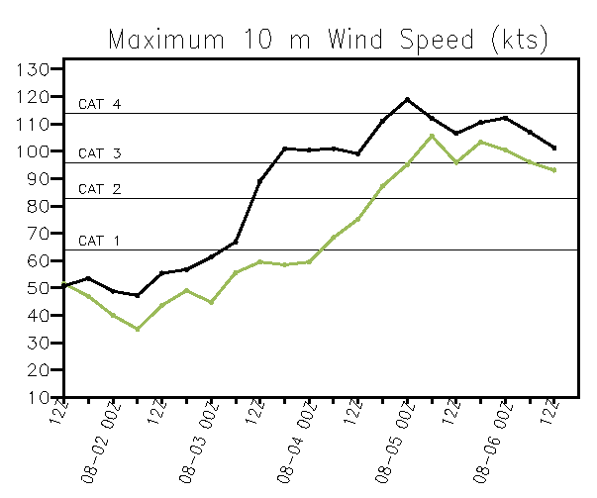
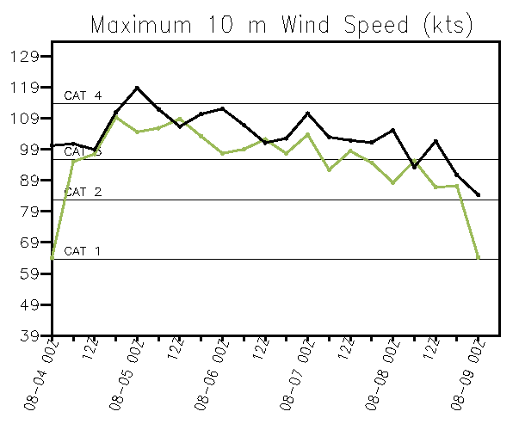
U,V assimilated
Q assimilated

