Slide 1
List of Spindown Experiments
1. perfect I: interpolation from NR, no DA (completed)
a. reduce and increase horizontal resolution in half
b. reduce and increase vertical resolution in half
2. assimilation using GSI, EnKF, and maybe HEDAS
a. perfect T,q,V profiles
b. perfect V profiles
c. perfect T profiles
d. perfect q profiles
e. ocean surface winds plus T profiles
3. Add realistic errors for dropsondes to 2(a)
4 a. Assimilate upper portion of profiles only.
b. Assimilate lower portion of profiles only.
5. Test different horizontal coverages (e.g using aircraft (including UAS) data)

Slide 2
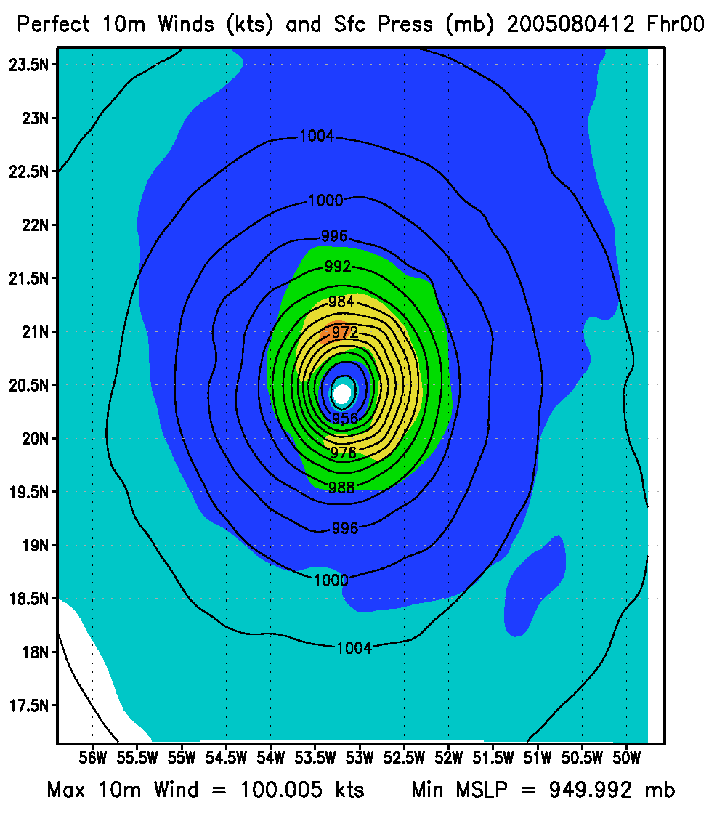
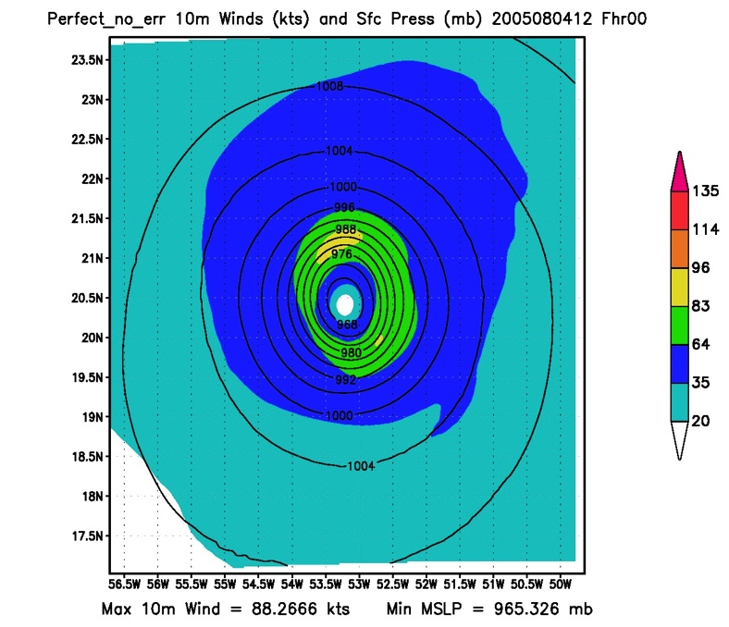
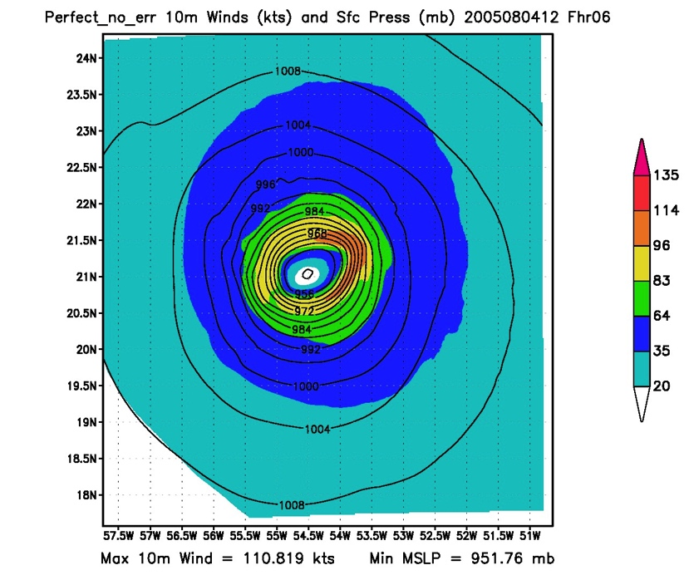
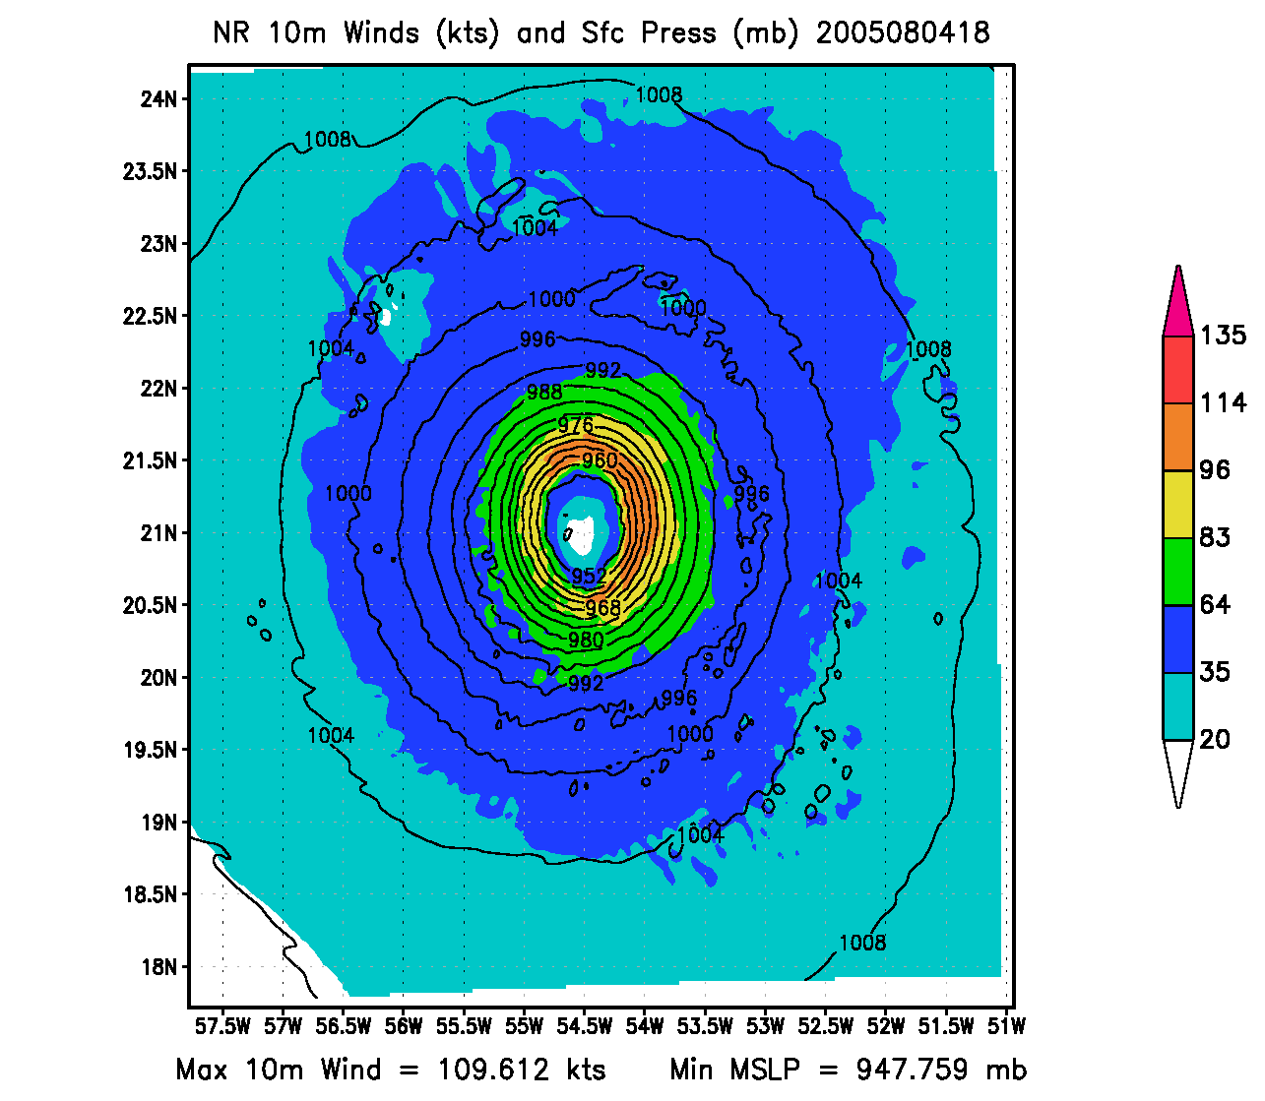
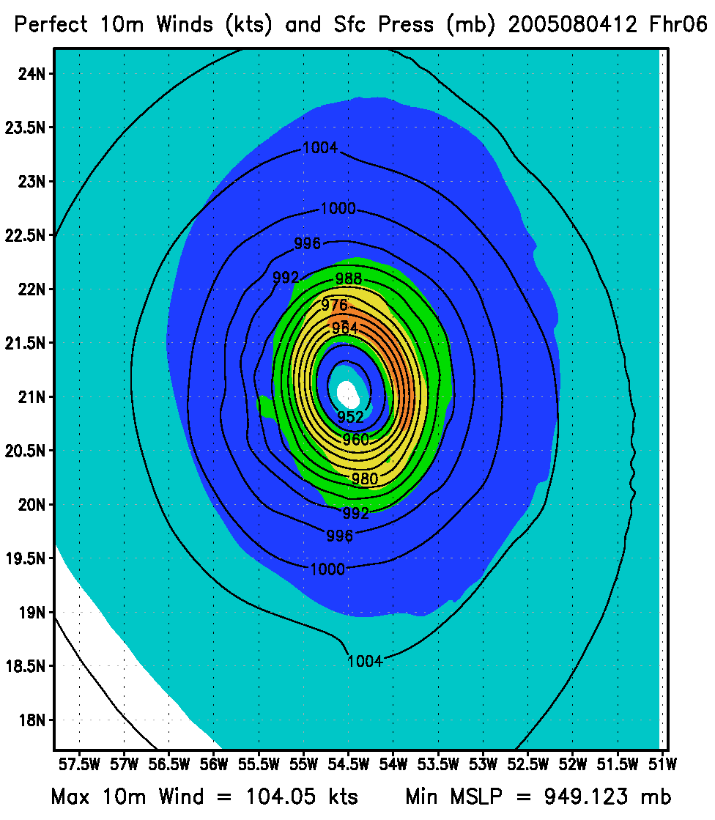
U,V,T, and Q with errors

Slide 3
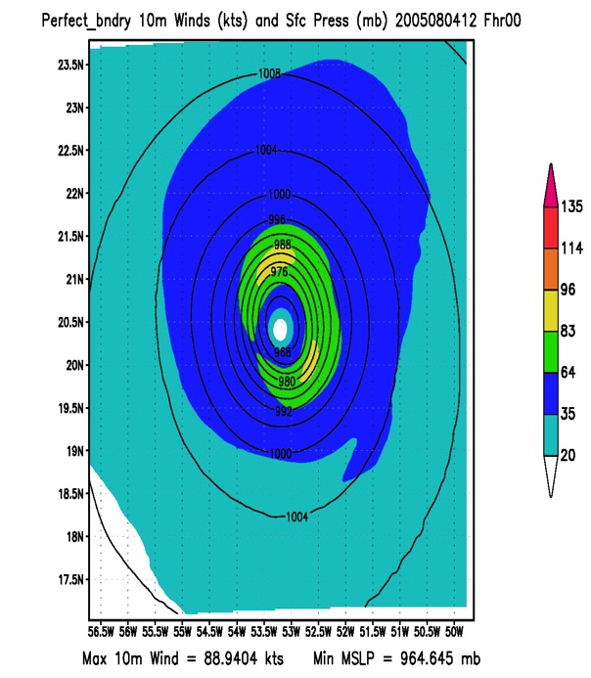
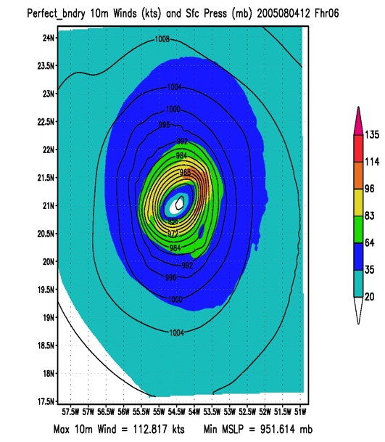
Different experiment configurations

