Slide 1
GSI Perfect D01 Experiment
Assimilate data from D01 of NR
Cycle from Aug 01 06Z to 09 00Z
24 hr forecast

Slide 2
TC stats on 05/08/04 at 12Z U,V only

Slide 3
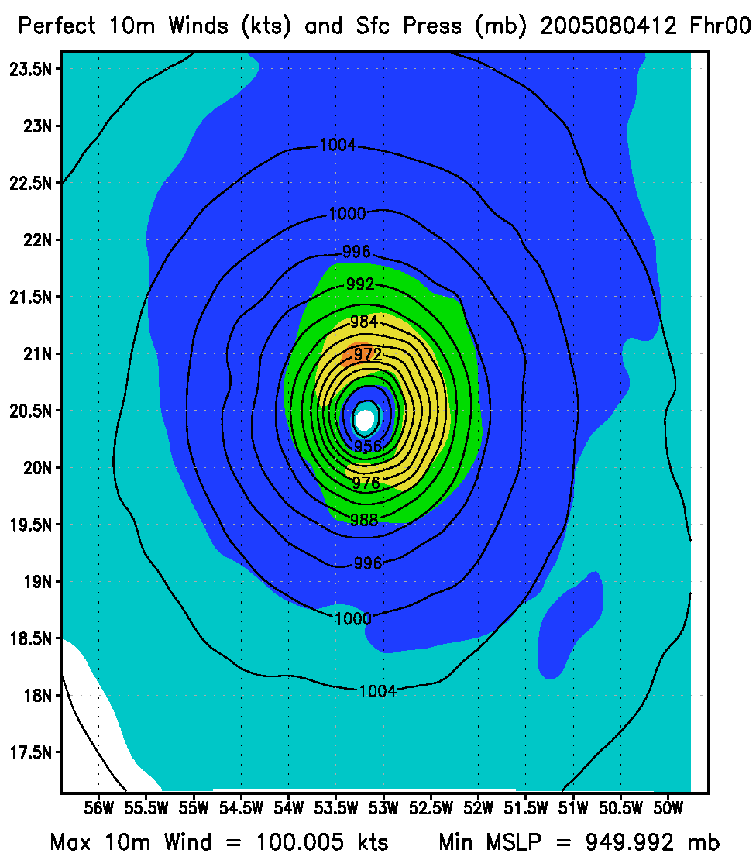
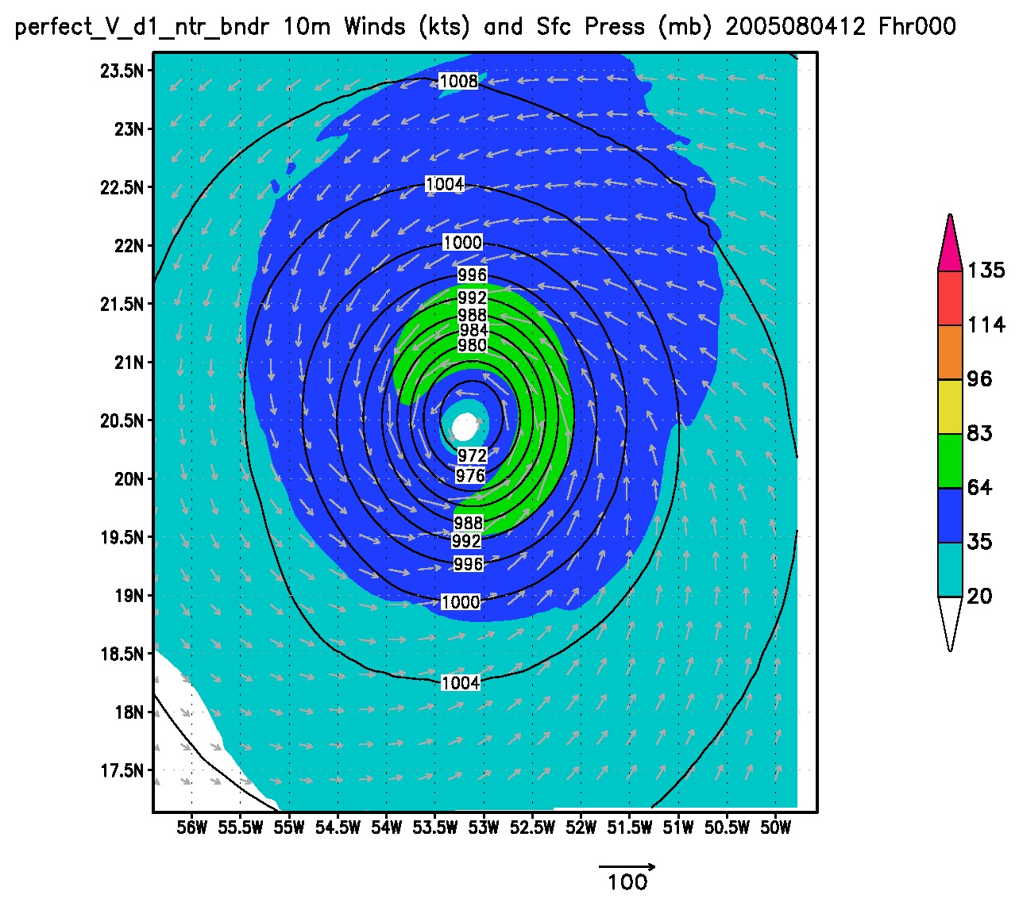
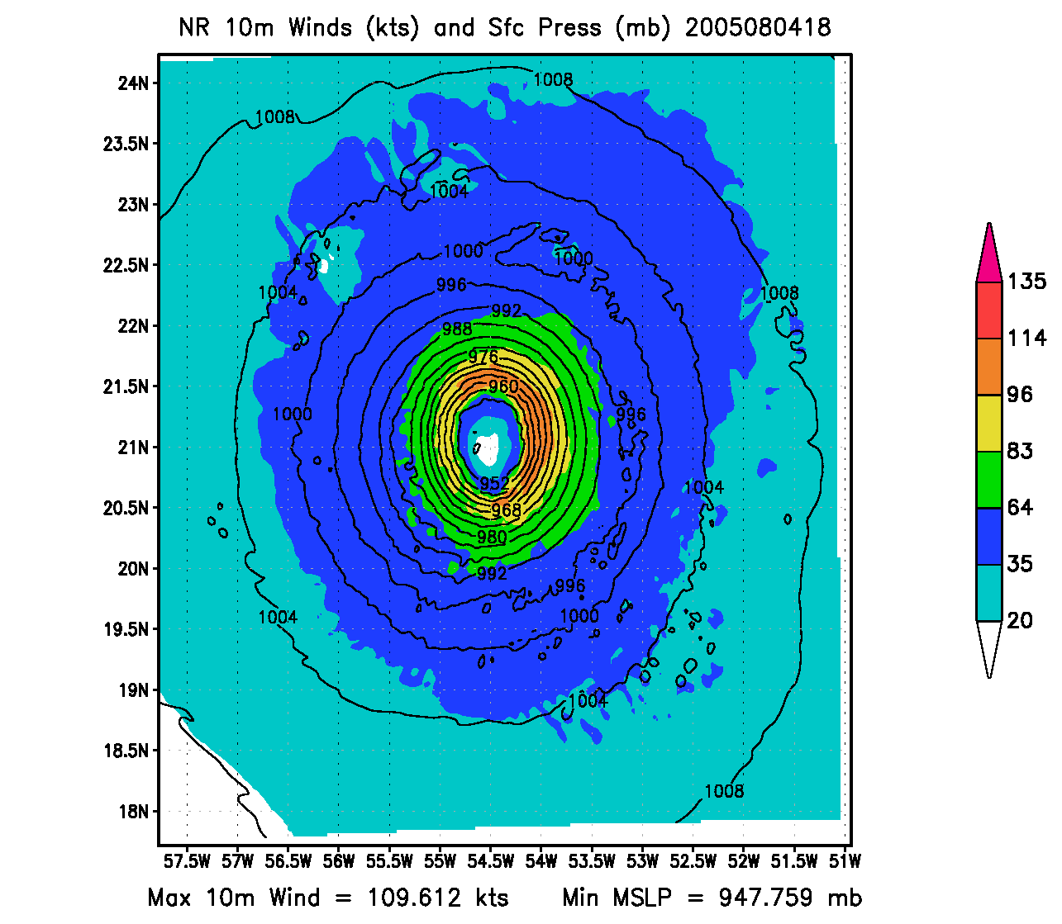
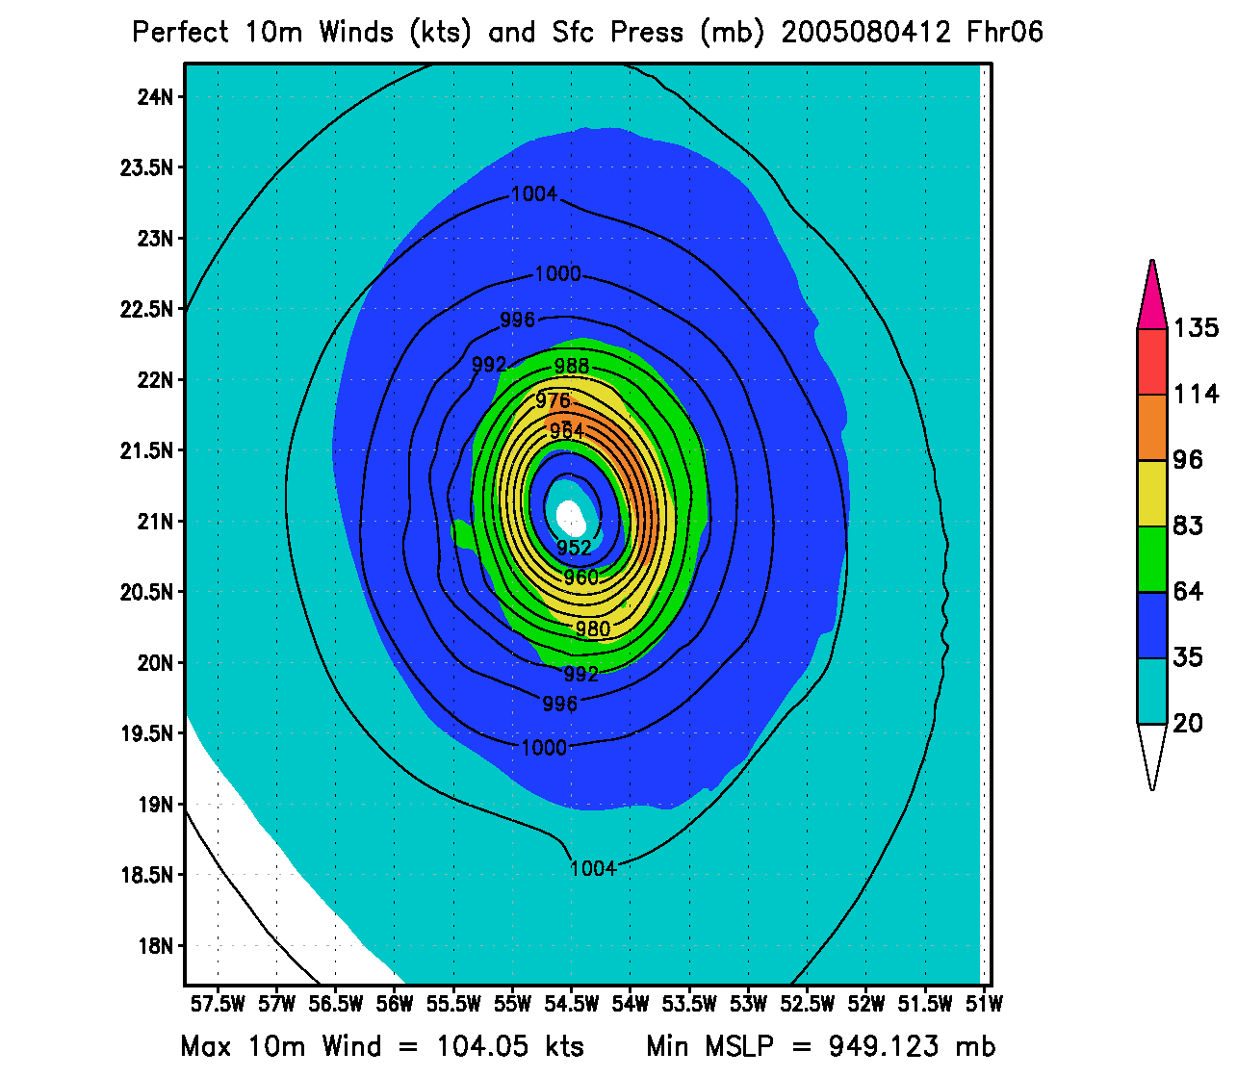
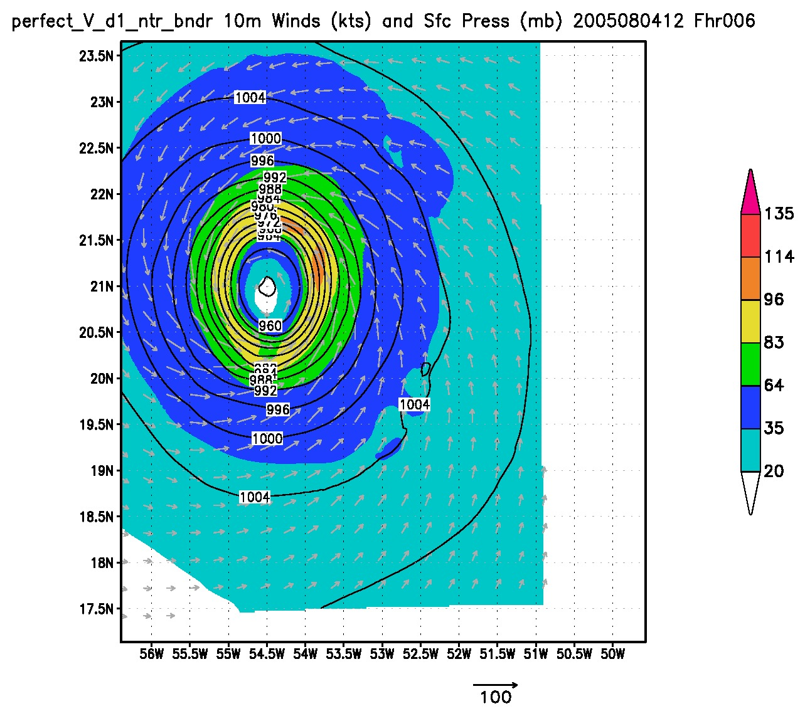
U,V only

Slide 4
TC stats on 05/08/04 at 12Z T only

Slide 5
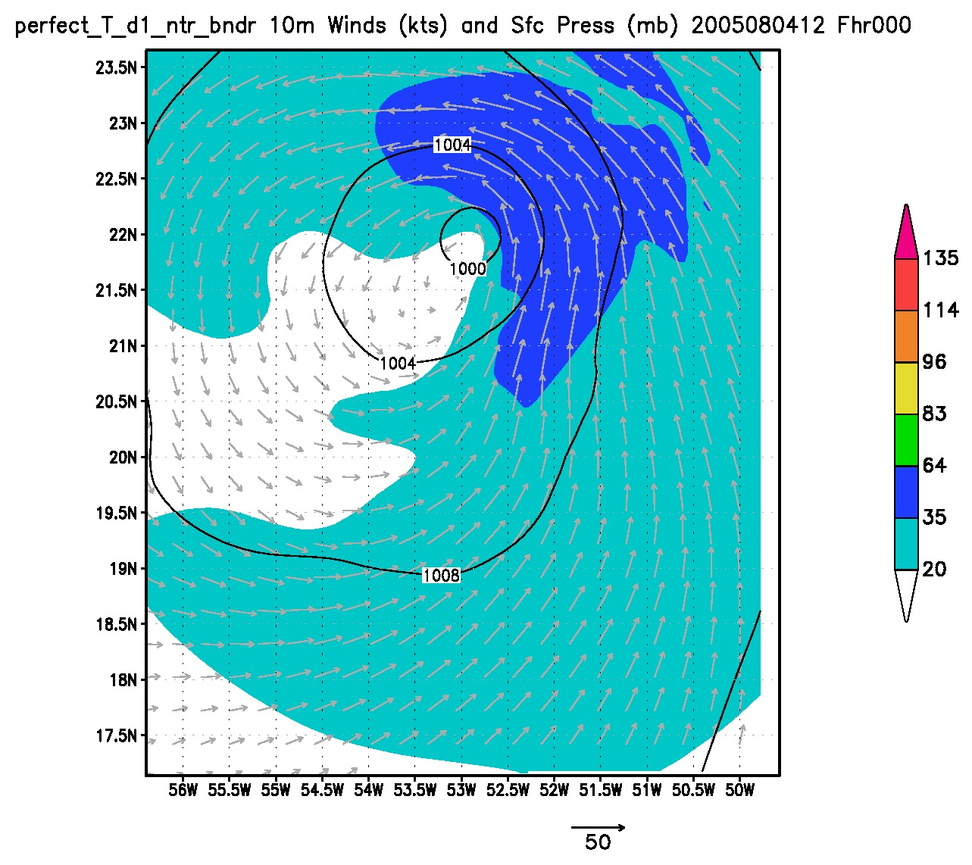
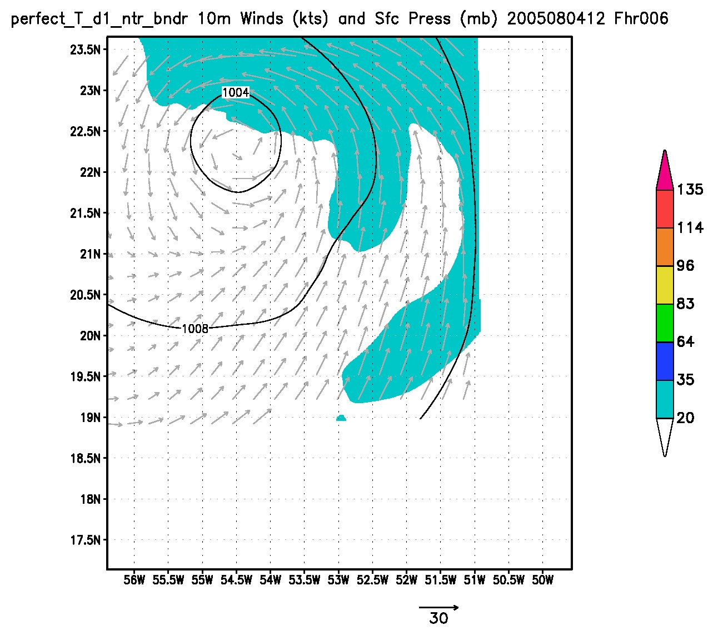
T only

Slide 6
TC stats on 05/08/04 at 12Z Q only

Slide 7
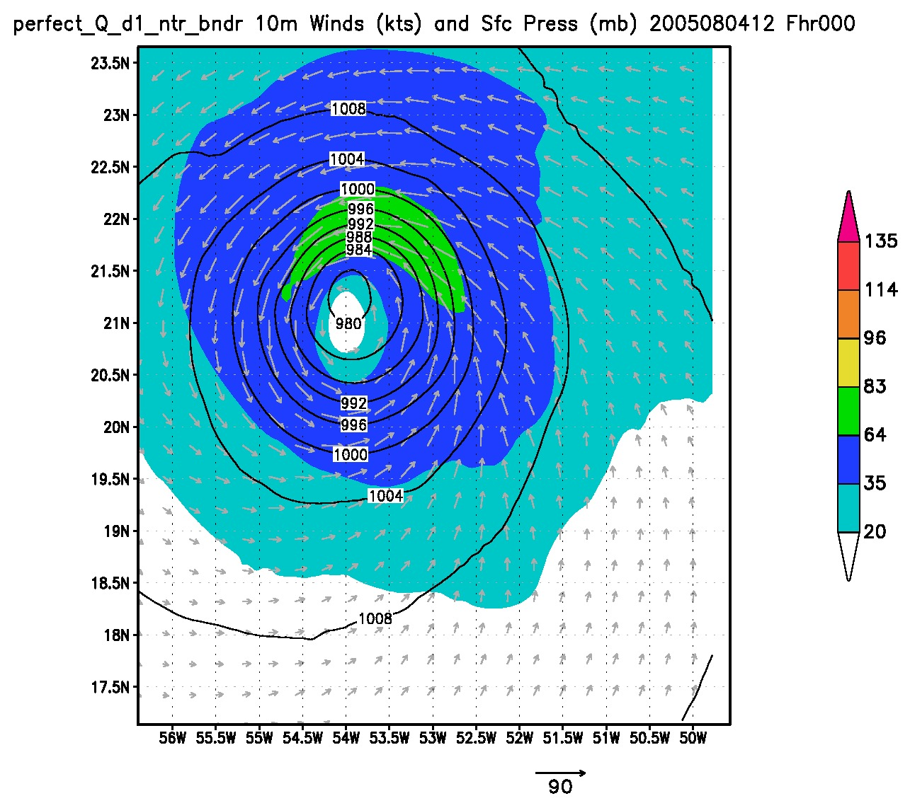
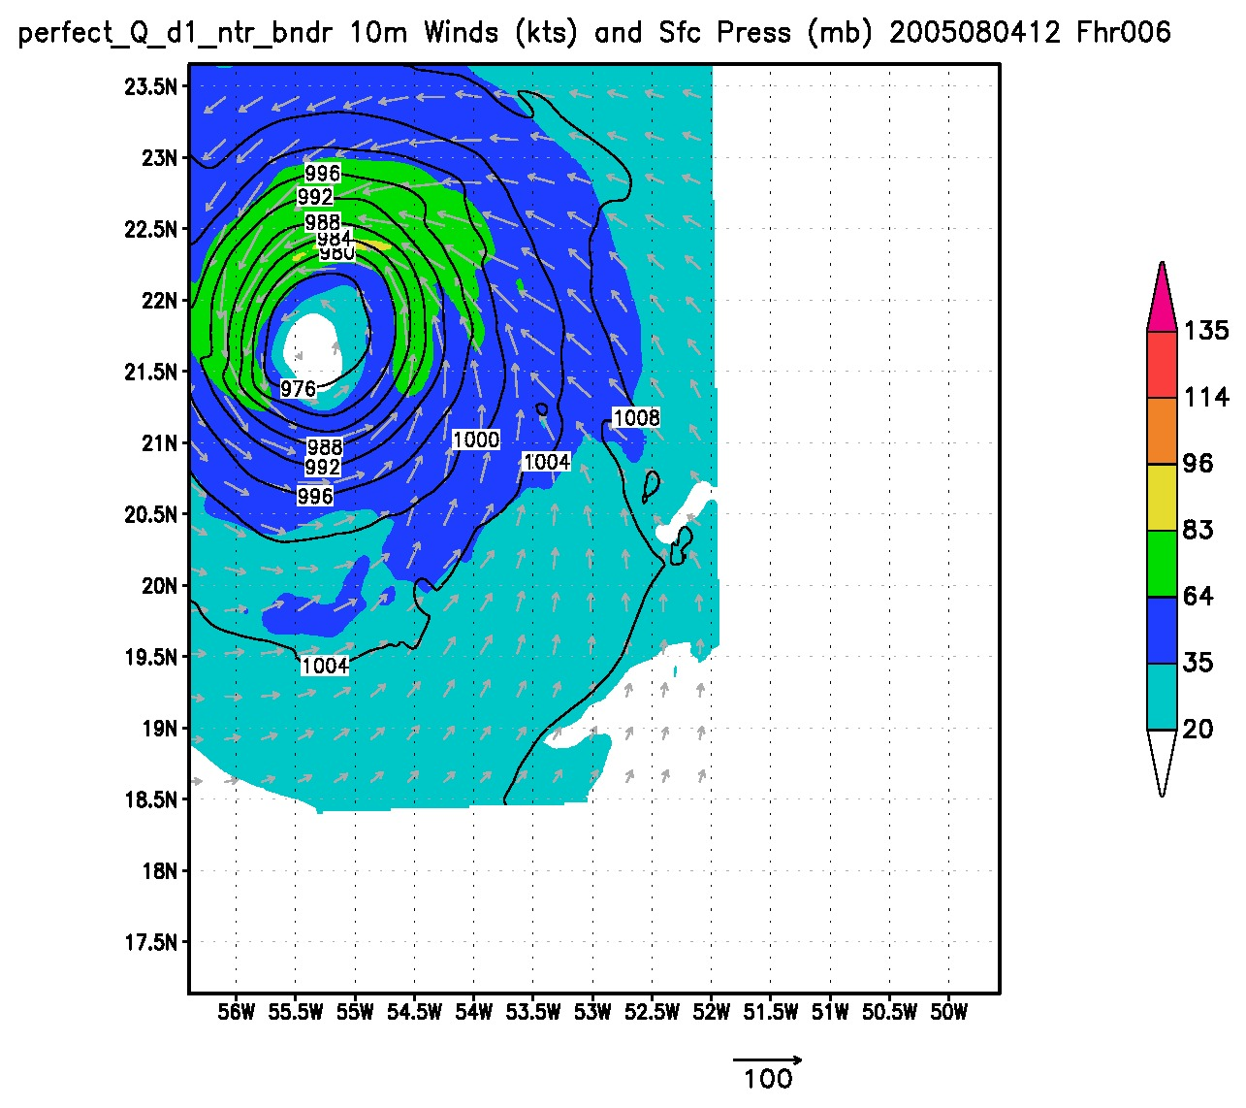
Q only

Slide 8
TC stats on 05/08/04 at 12Z U,V,T, and Q

Slide 9
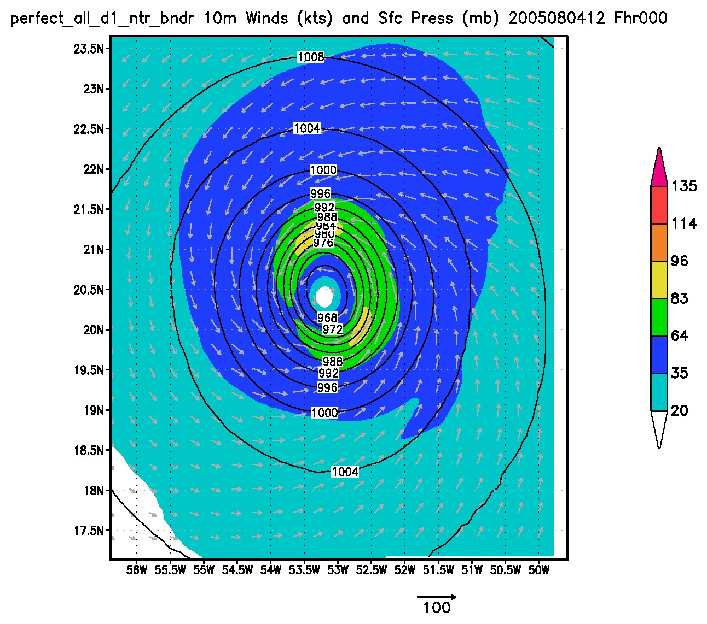
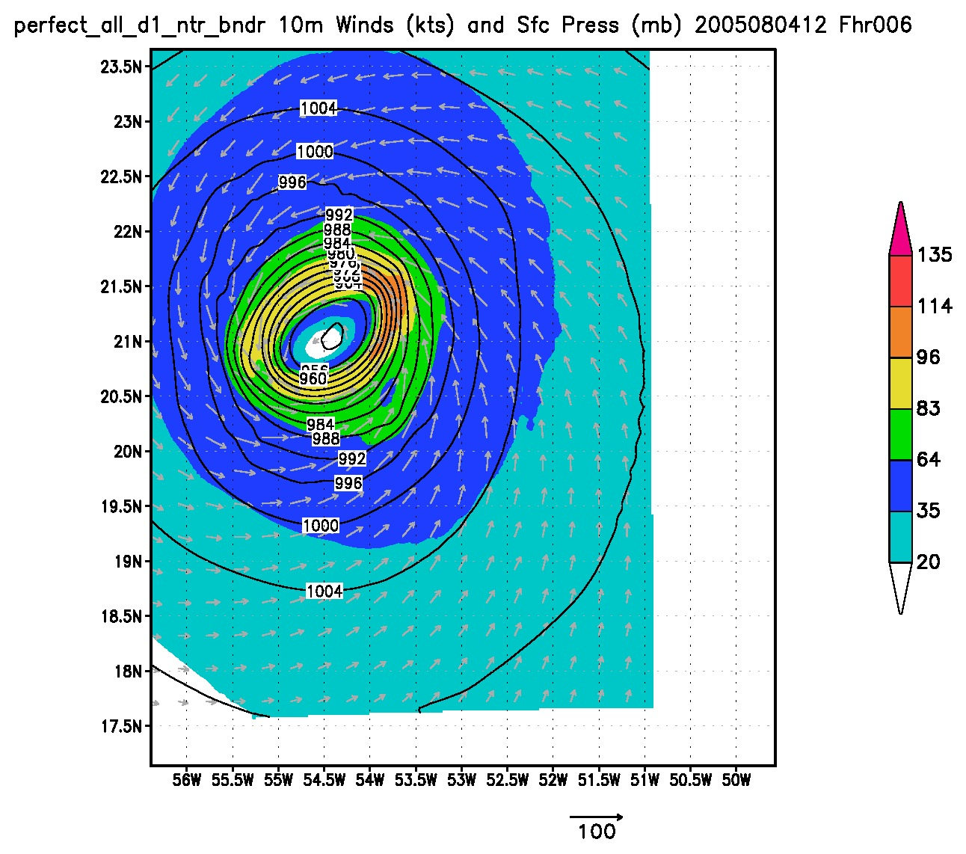
U,V,T, and Q

