Slide 1
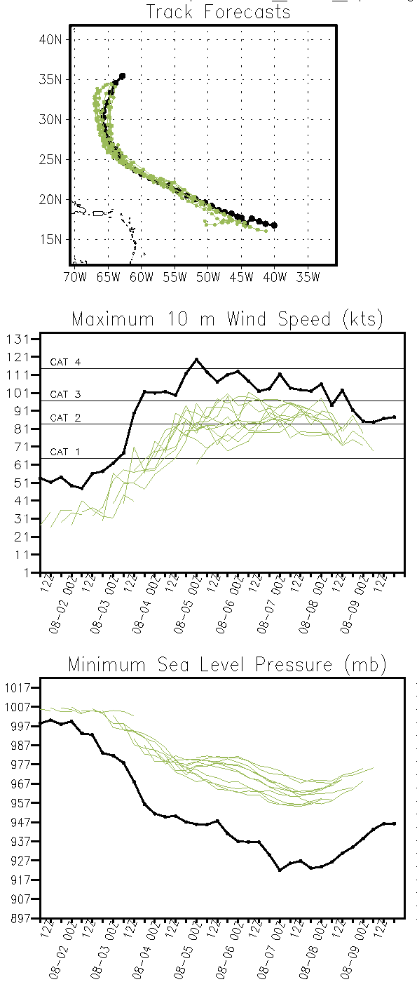
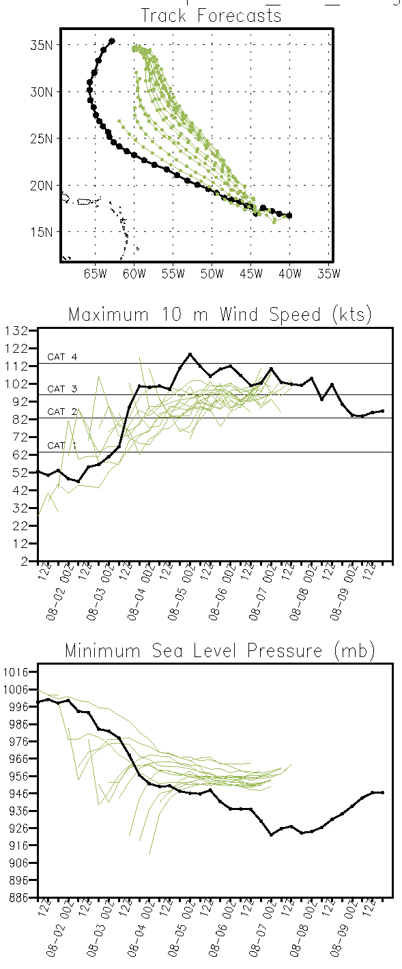
T and Q only (D04)
Q only (D04)
T only (D04)

Slide 2
TC stats (D04 only)

Slide 3
TC stats (D04 only)

Slide 4
TC stats (D04 only)

