Slide 1
Basin scale HWRF-GSI baseline experiments
Tomi Vukicevic
Bachir Annane, Sundararaman Gopalakrishnan, Xuejin Zhang and Thiago Quirino
AOML/HRD

Slide 2
Experiments
EXP1 : Cold start from GFS analysis every 6 h
EXP2 : No-cycling, GSI with HWRF background
  9h HWRF forecast from cold start
  GSI analysis centered at 6 h using HWRF background (different from operational configuration which uses GFS analysis background)
EXP3 : Partial cycling with refresh from GFS analysis every 24 h

Slide 3
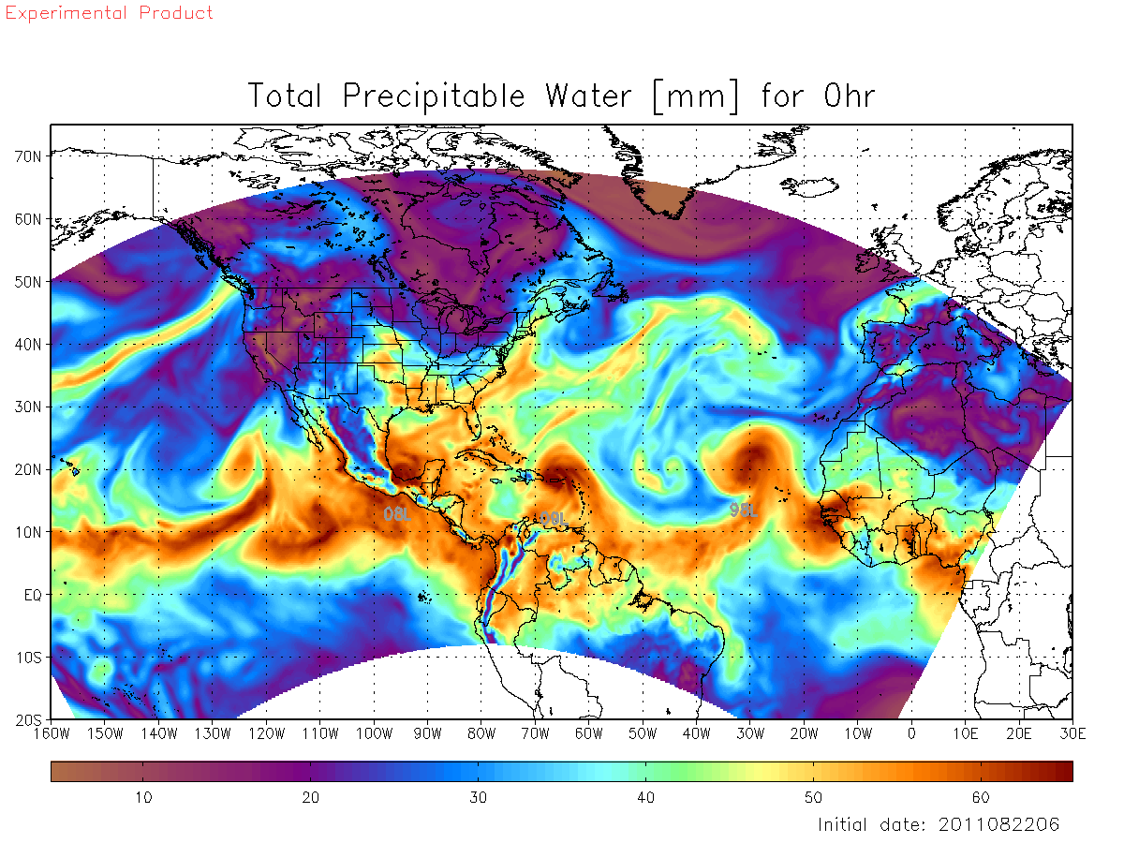
Configuration
Basin scale HWRF
  V3.4a (FY2012)
  https://svn-dtc-hwrf.cgd.ucar.edu/branches/hwrf-baseline-basinscale
  27 km, 61 Levels with 2 hPa top
GSI
  Latest version in repository
  All observations as in GFS
  HWRF restart data files are used
Period of experiments
  August 2011

Slide 4
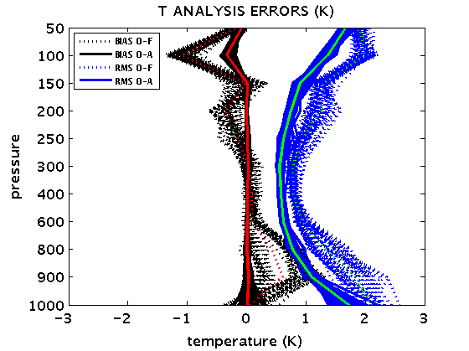
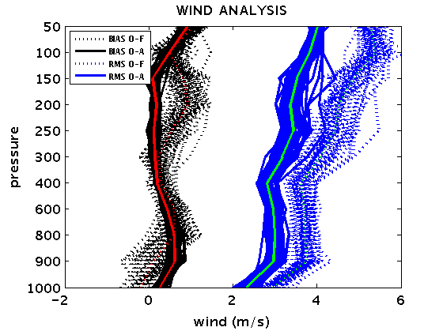
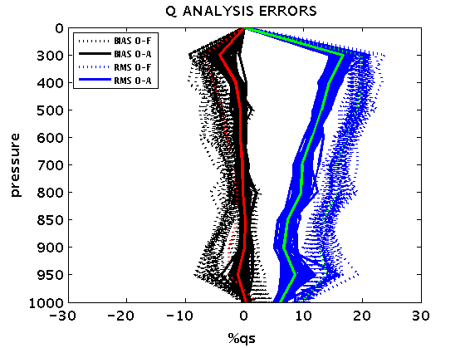
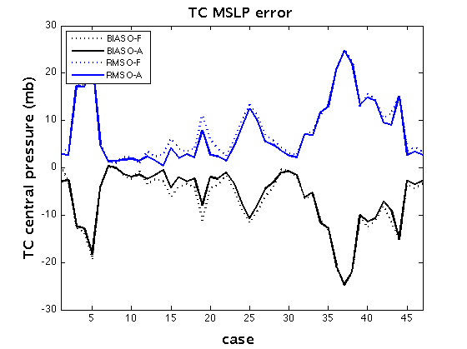
GSI analysis statistics: conventional data
EXP2 (no cycling)

Slide 5
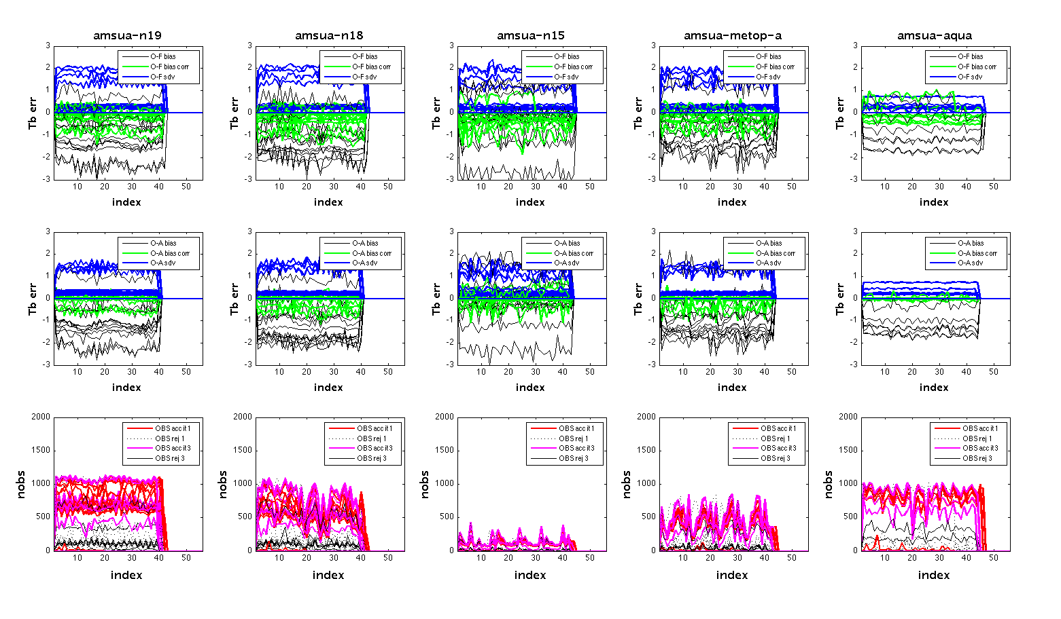
GSI analysis statistics: satellite data example AMSUA platforms
EXP2 (no cycling)
O-F
O-A

Slide 6
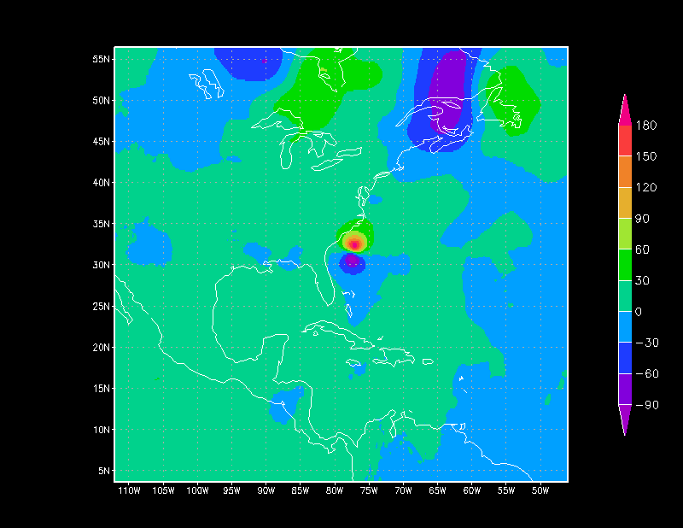

Verification against GFS analysis difference GFS-(HWRF-GSI)

Slide 7
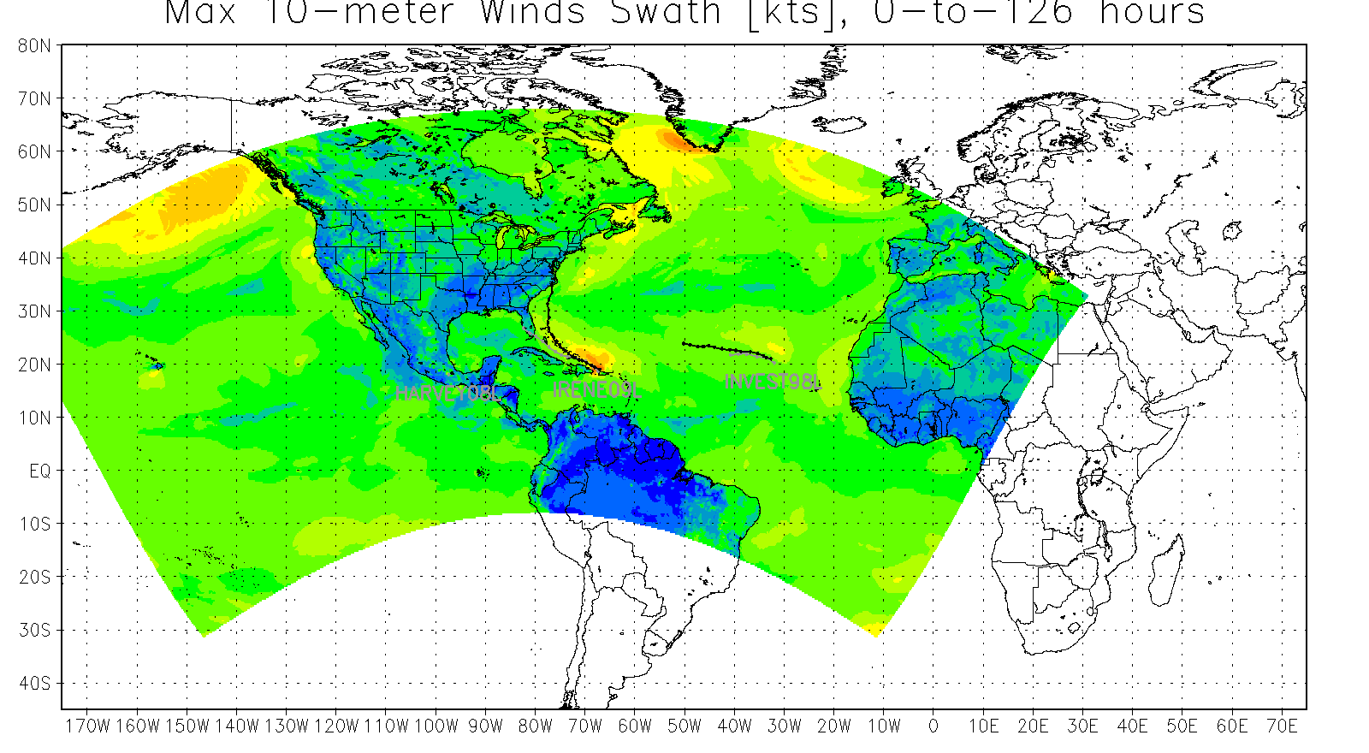
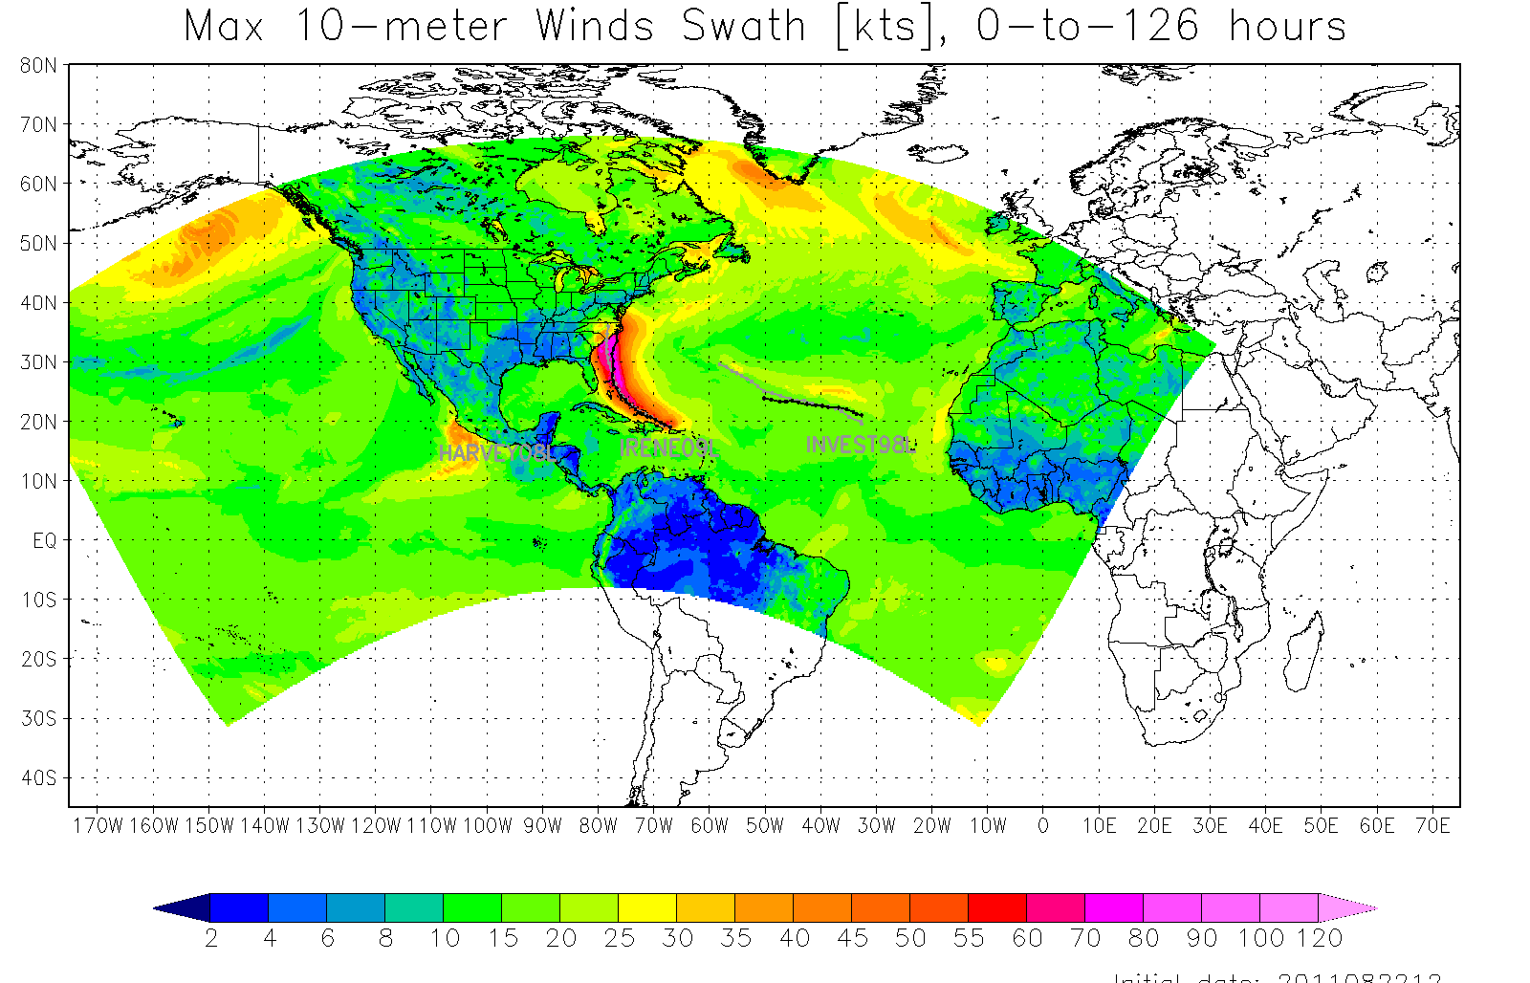
Forecast: Irene example
From HWRF-GSI analysis (no cycling)
Irene dissipated after 60 h
Cold start from GFS analysis
Good track forecast for Irene

Slide 8
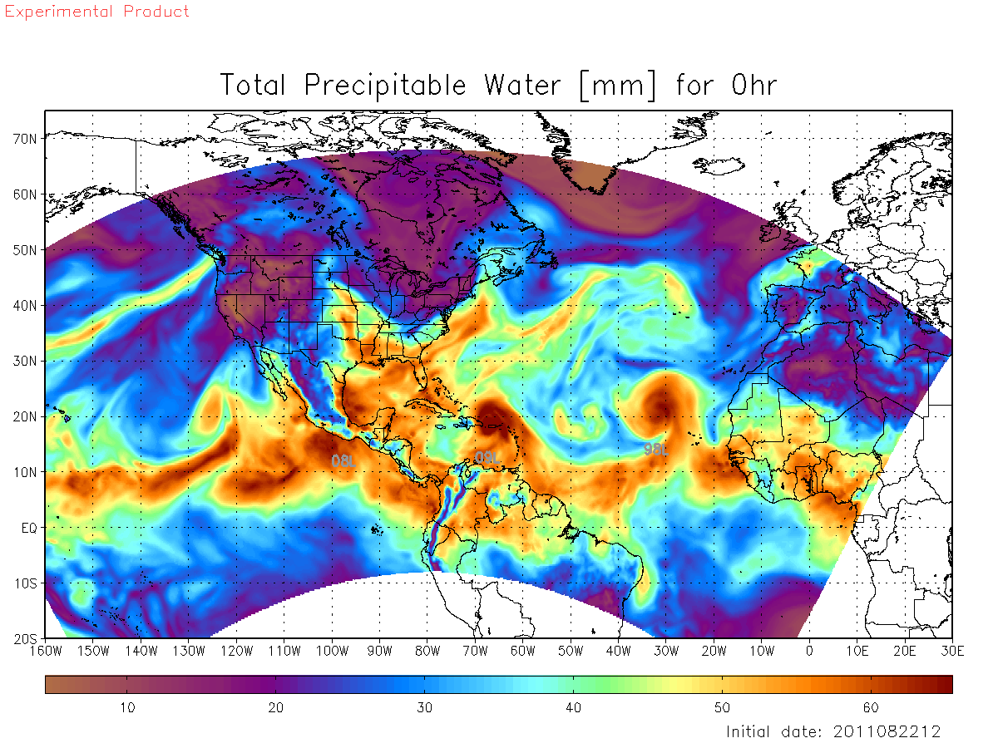
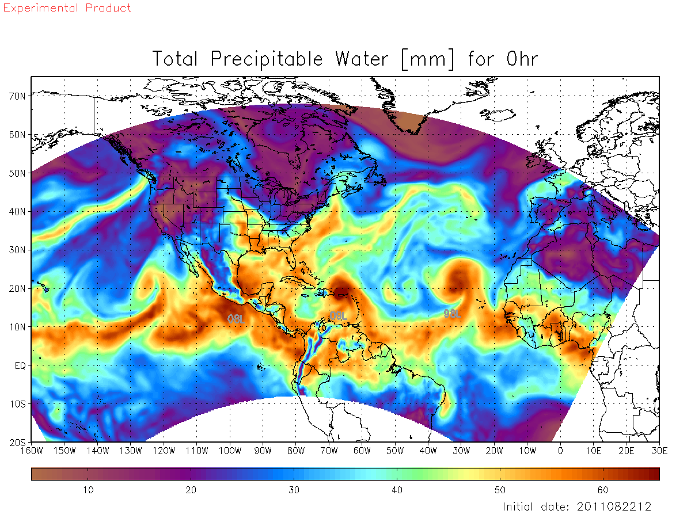
Forecast: Irene example
0 h
Initial HWRF-GSI analysis (no cycling)
Irene associated TPW max
Initial GFS analysis
Very similar TPW
For Irene and overall

Slide 9
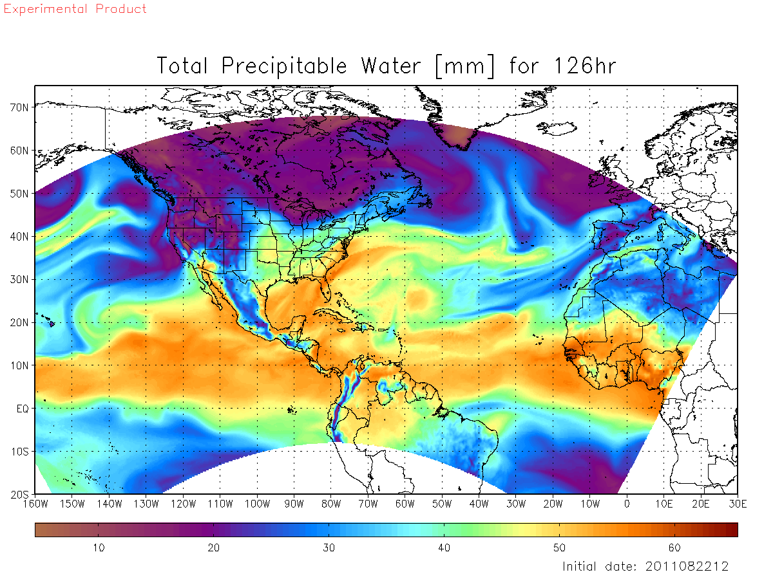
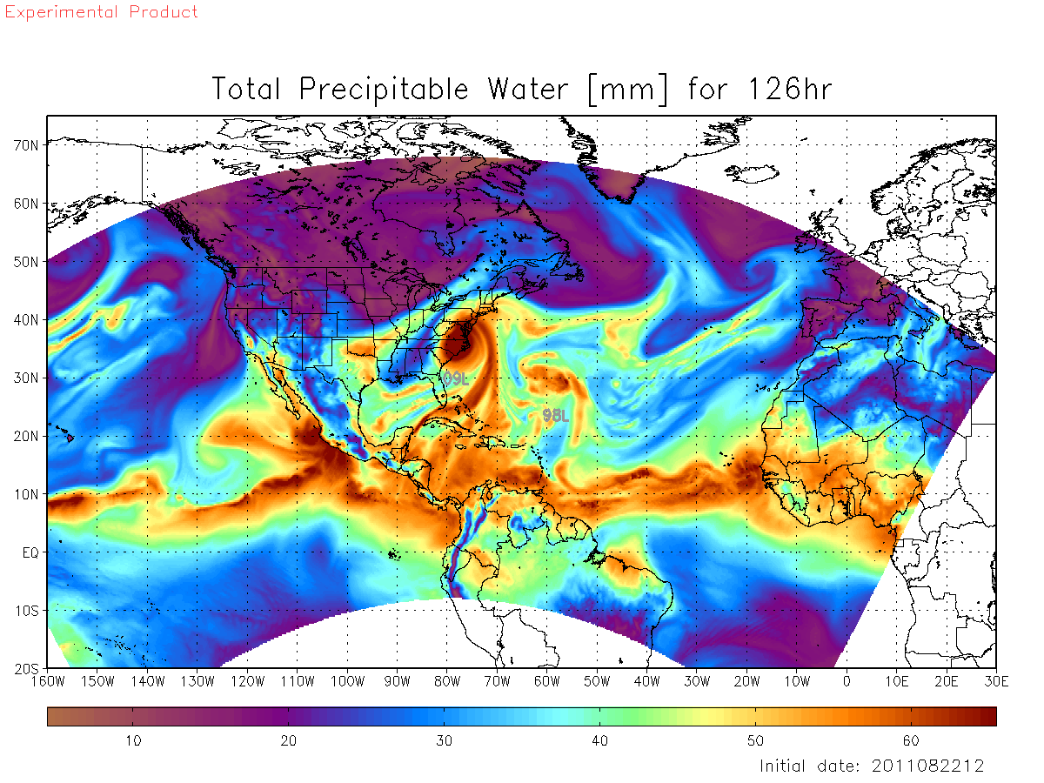
Forecast: Irene example
126 h
Initial HWRF-GSI analysis (no cycling)
Dried up tropics
Cold start from GFS analysis
Normal tropics with Irene

Slide 10

What is the cause of drying tendency?
Another experiment: HWRF-GSI without observations
126 h forecast from initial HWRF-GSI analysis (no cycling)
Dried up tropics
126 h forecast form new experiment
Still dried up tropics

Slide 11
What is the cause of drying tendency in the forecast?
Discussion
GSI analyses with HWRF background look good, thus it is unlikely that the analysis control fields are the cause
Experiment in which GSI was used but no observations were assimilated indicated that passing the background forecast data through GSI creates the problem . Not yet known where?
Vijay et al. recent forecast experiments using GSI (“accidental run”) also show TC spin-down bias. This suggests that the same problem may be occurring in the EMC configuration with GSI
Restart capability in HWRF was tested in forecast was shown to work properly

Slide 12
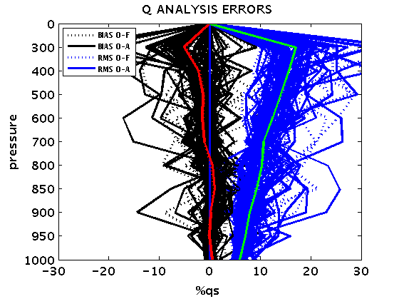
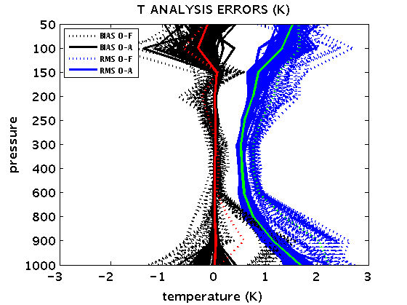
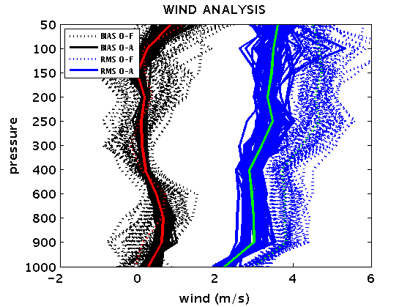
GSI cycling analysis statistics: conventional data
Confirms the existence of loss of moisture problem
No-cycling
cycling
cycling
cycling

Slide 13
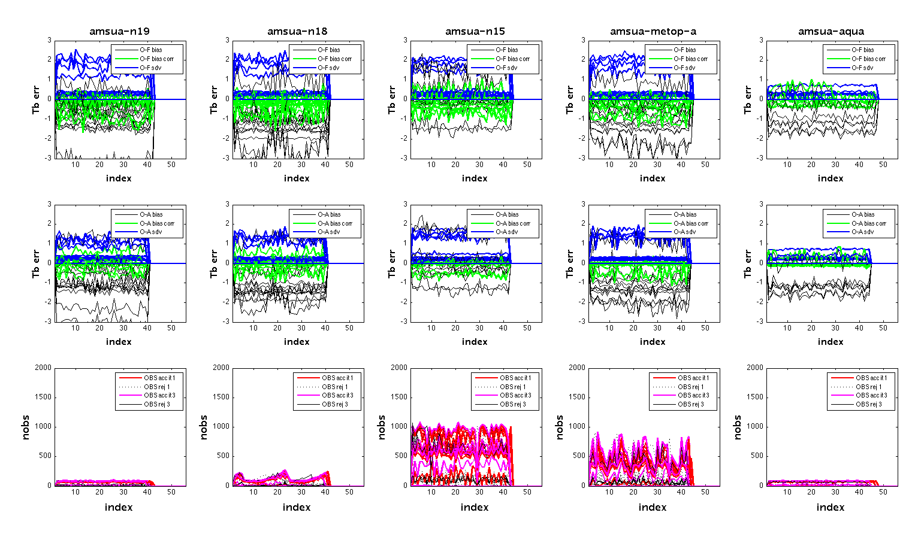
GSI cycled analysis statistics: satellite data example AMSUA platforms
EXP3 : cycling within 24 h interval)
O-F
O-A
Result suggests slightly more background bias in some channels

Slide 14
What next?
Find the bug
  Find out what data that are coming from HWRF are being changed by GSI, besides the analysis control fields
  Check whether GSI software is reading all the incoming data correctly
Repeat HWRF-GSI experiments after the bug fix

