Slide 1
Available Days
08/01 at 12Z
08/02 at 00Z,12Z, 18Z
08/03 at 00Z,12Z,18Z
08/04 at 00Z,12Z,18Z
08/05 at 00Z

Slide 2
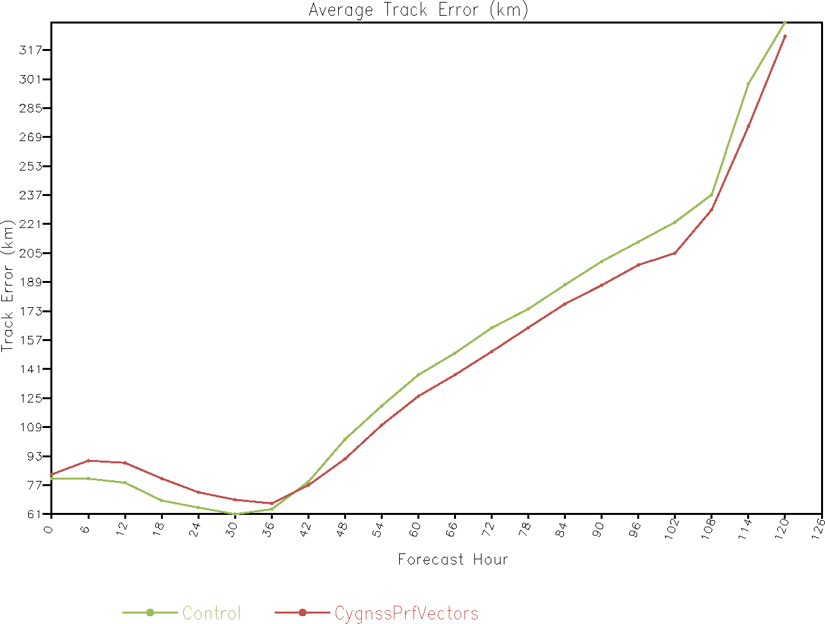
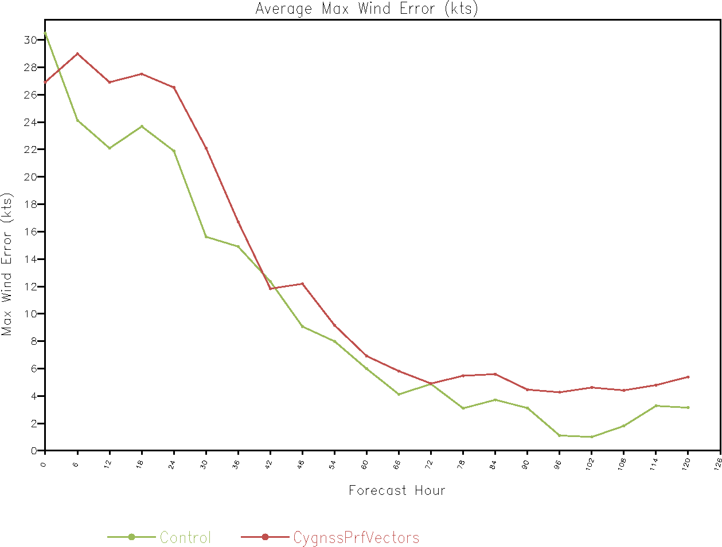
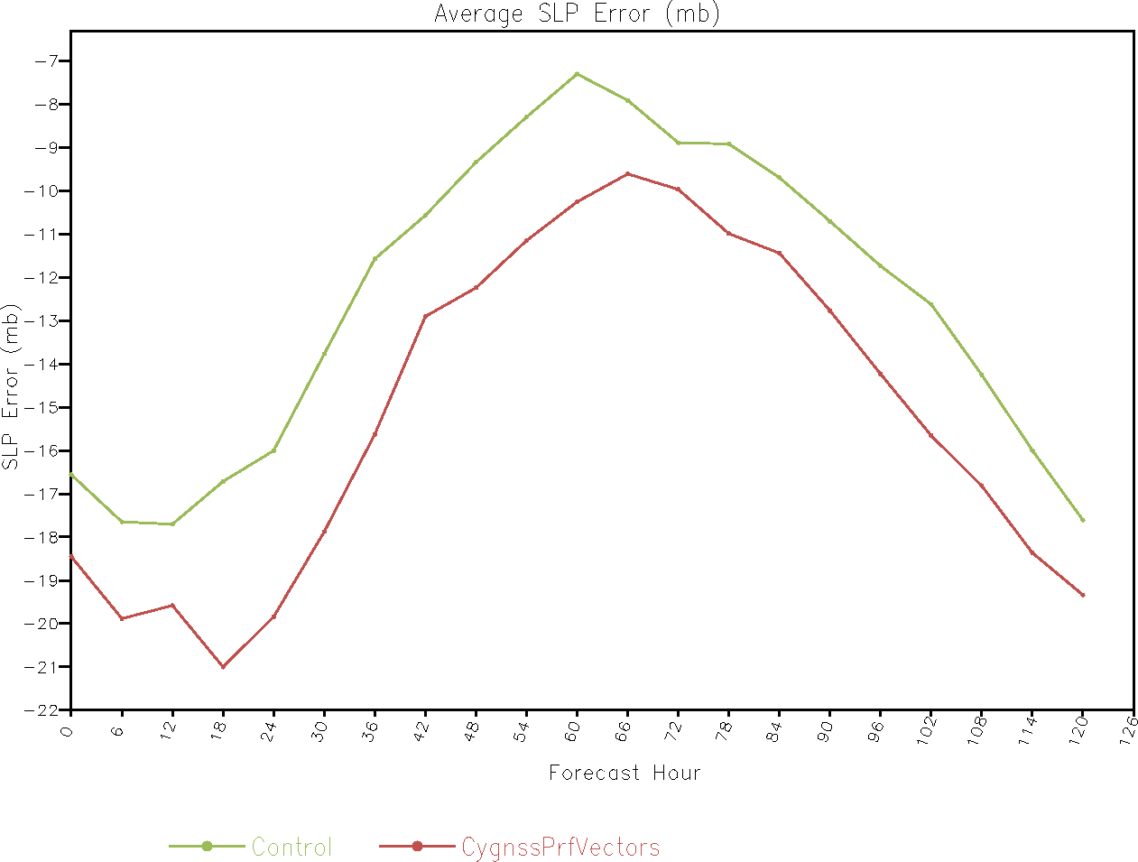

Slide 3
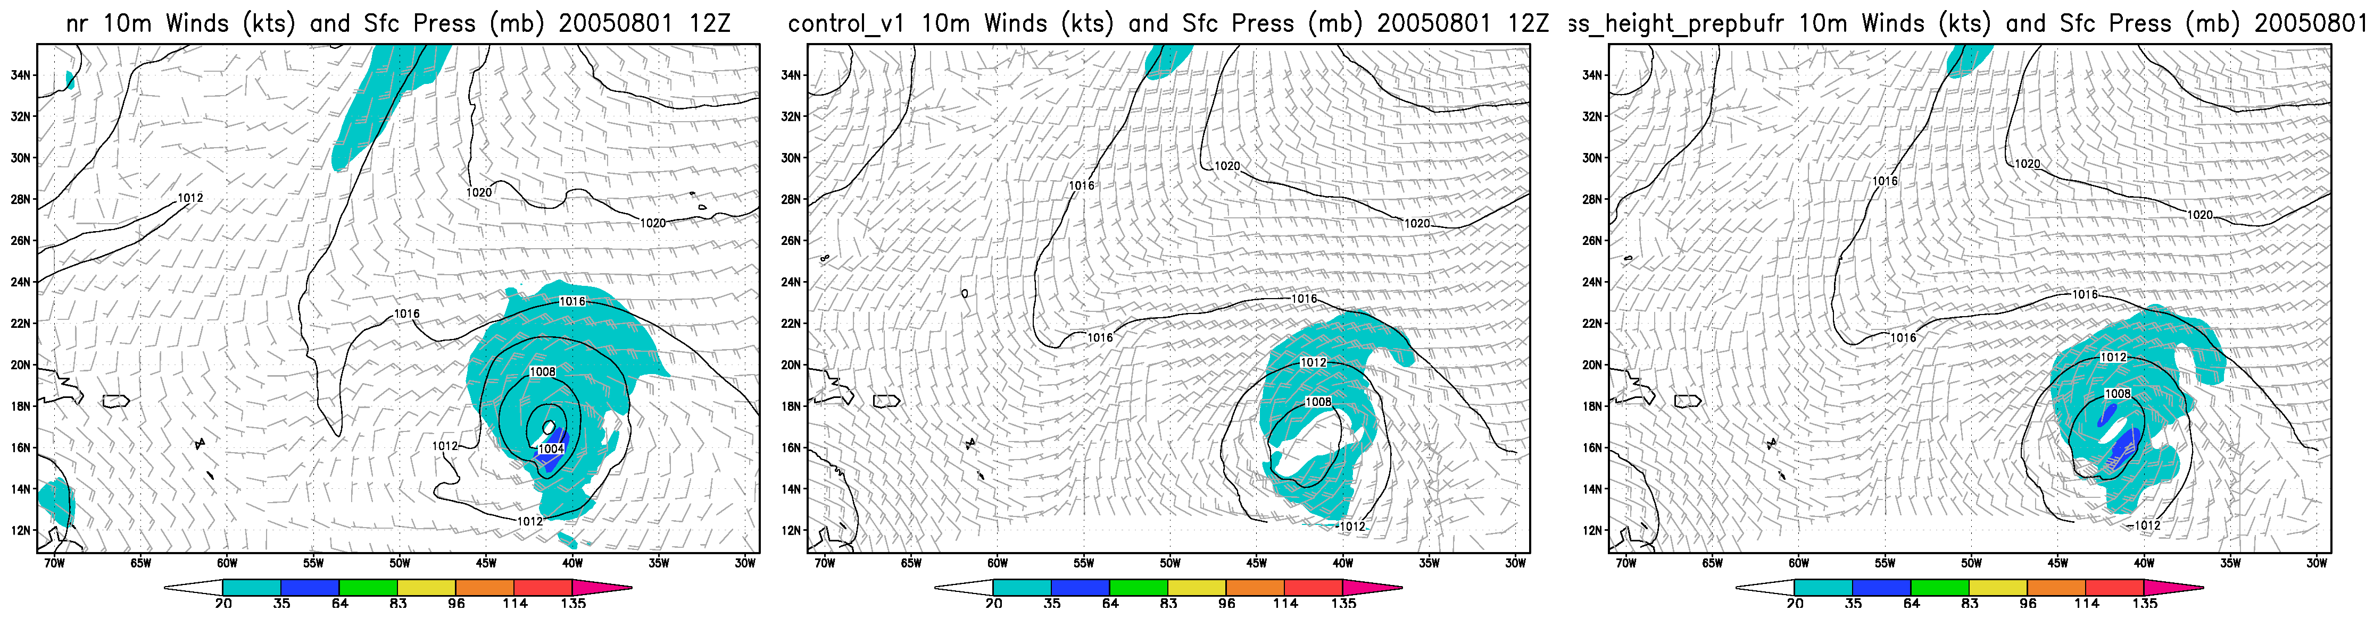

Slide 4
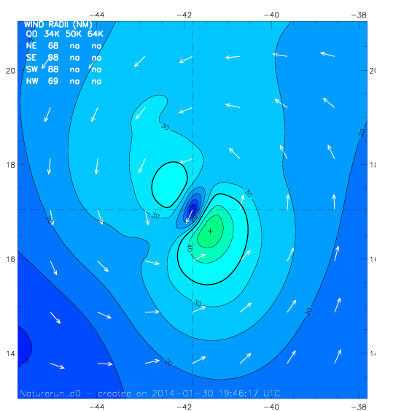
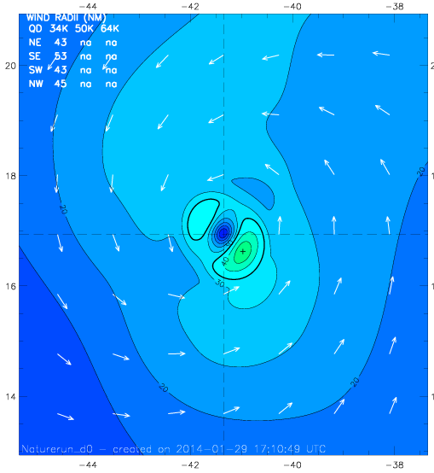
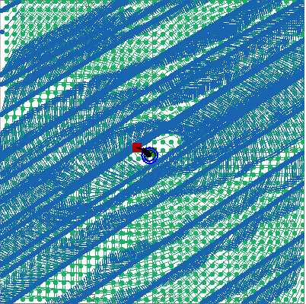
H*WIND Analyses on Aug 01, 2005 @ 12Z
b. H*WIND Perfect analysis from 9km Nature
c. H*WIND with perfect CYGNSS data
a. Nature
Max = 50 kts
TS force = 7 TJ
Max = 48 kts
TS force = 2 TJ
Mean: -0.12, RMS:4.02

Slide 5
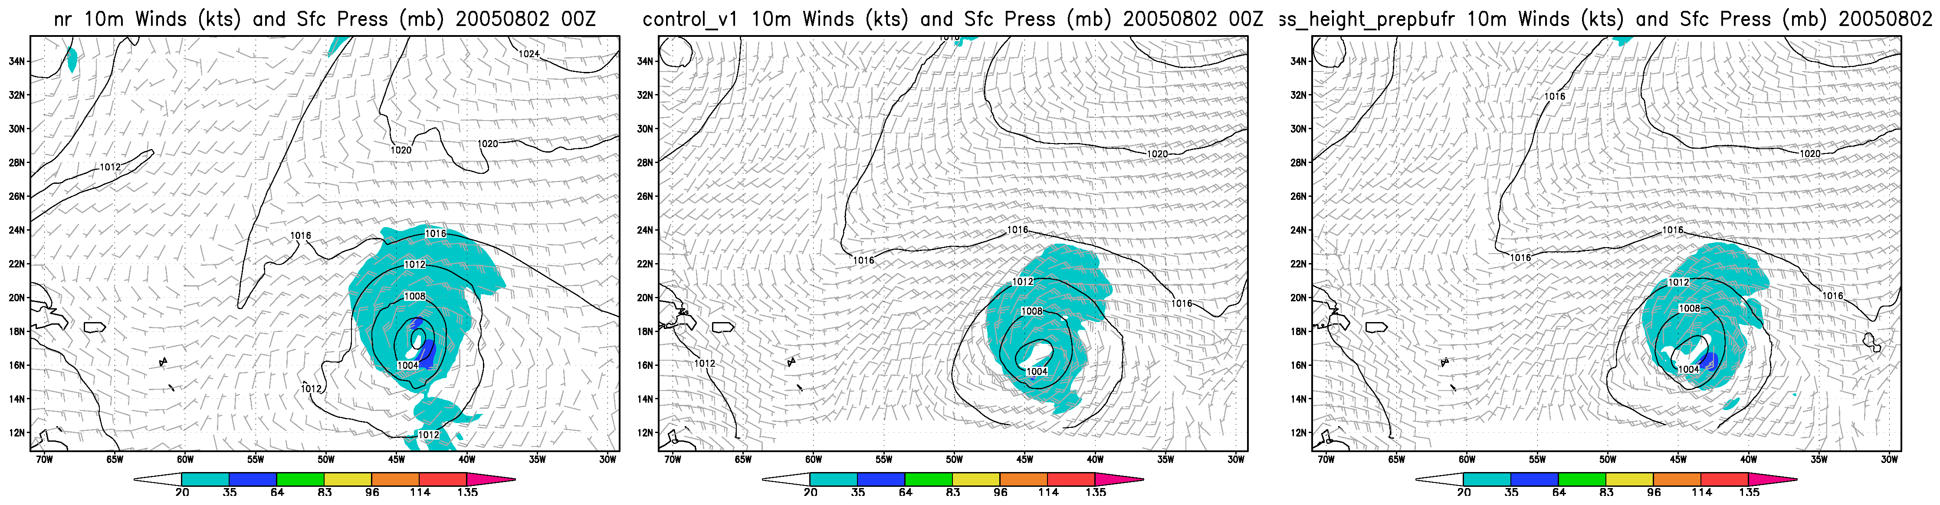
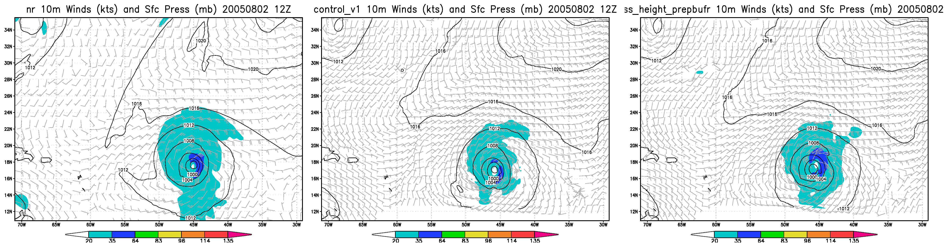
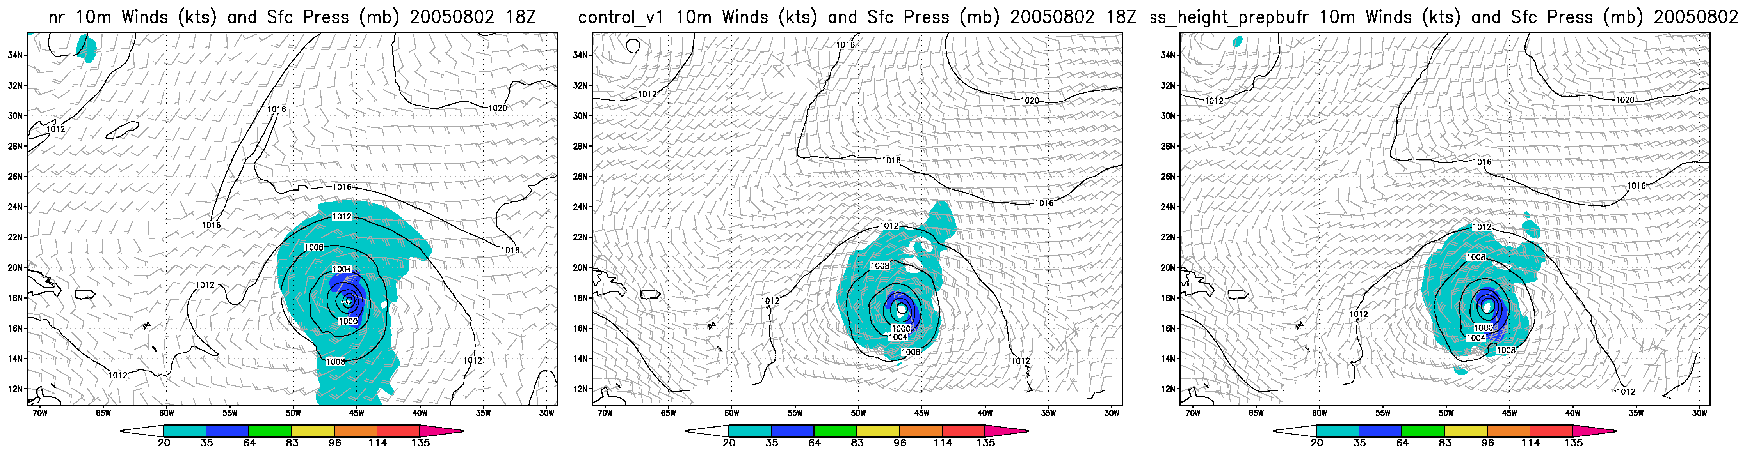

Slide 6
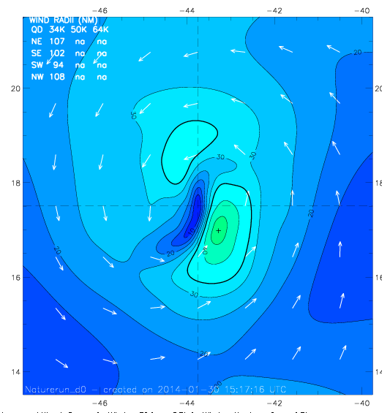
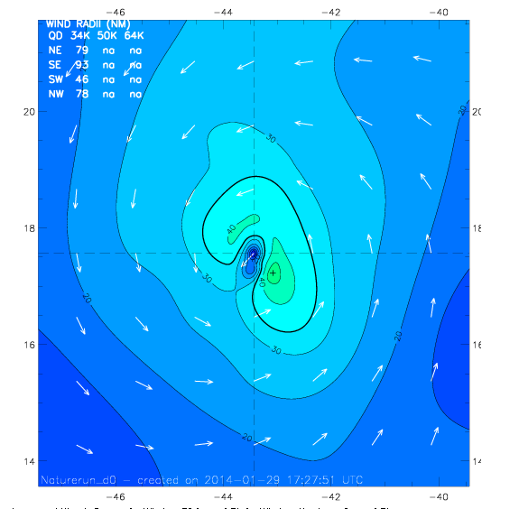
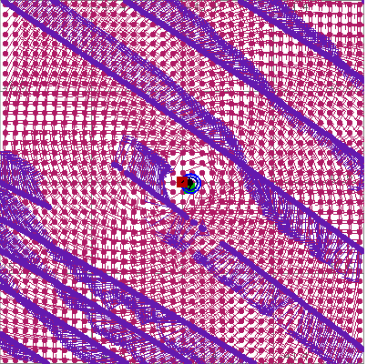
H*WIND Analyses on Aug 02, 2005 @ 00Z
a- Nature
b. H*WIND Perfect analysis from 9km Nature
c. H*WIND with perfect CYGNSS data
Max = 47 kts
TS force = 7 TJ
Max = 47 kts
TS force = 8 TJ
Mean:1.2, RMS:2.85

Slide 7
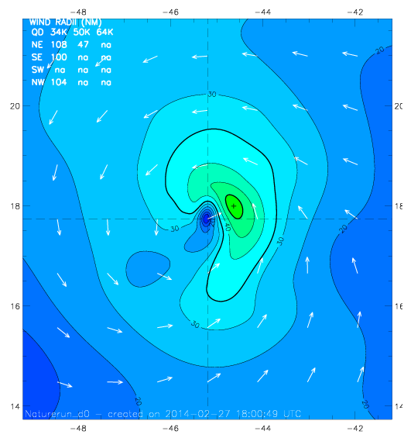
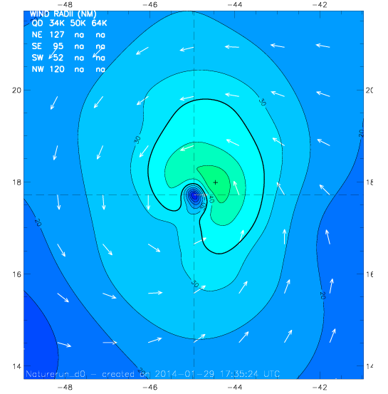
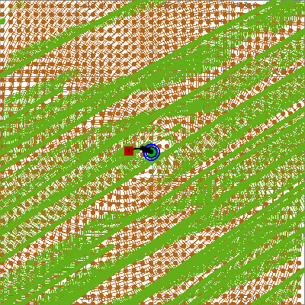
H*WIND Analyses on Aug 02, 2005 @ 12Z
a. Nature
b. H*WIND Perfect analysis from 9km Nature
c. H*WIND with perfect CYGNSS data
Max = 53 kts
TS force = 12 TJ
Max = 50 kts
TS force = 15 TJ
Mean: 0.93, RMS: 2.56

Slide 8
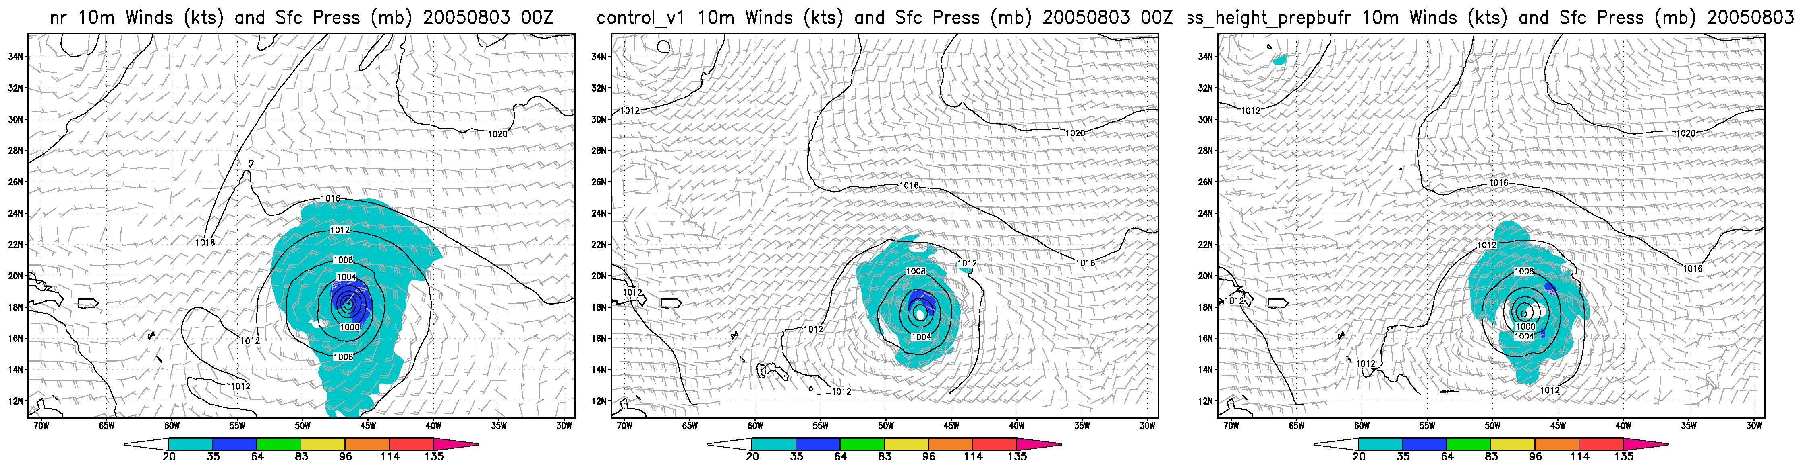
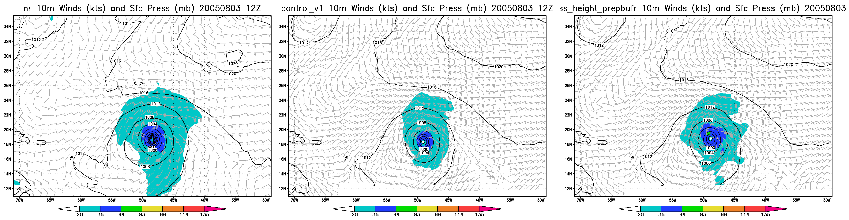
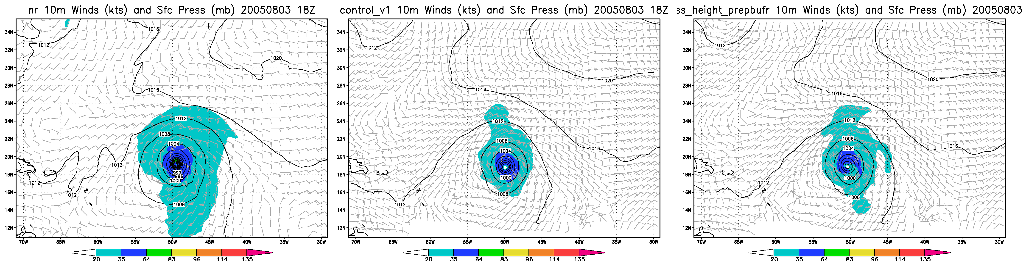

Slide 9
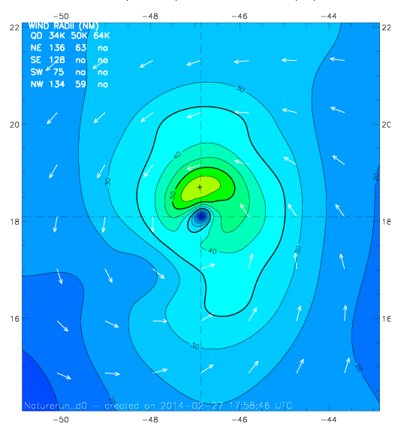
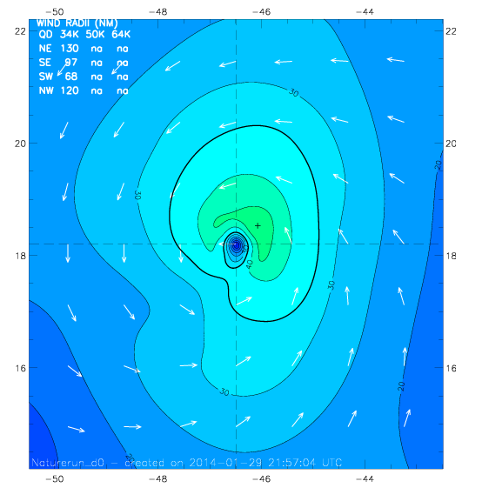
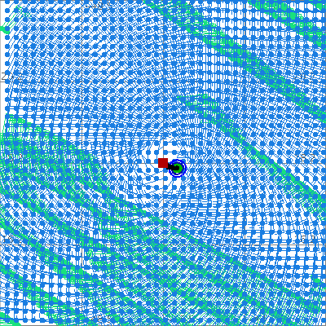
H*WIND Analyses on Aug 03, 2005 @ 00Z
a. Nature
b. H*WIND Perfect analysis from 9km Nature
c. H*WIND with dataperfect CYGNSS
Max = 59 kts
TS force = 26 TJ
Max = 50kts
TS force = 18 TJ
Mean: 1.61, RMS: 4.93

Slide 10
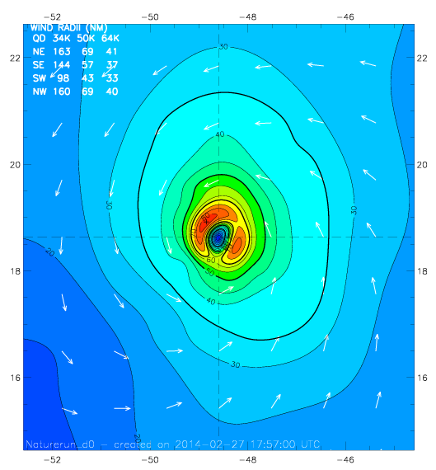
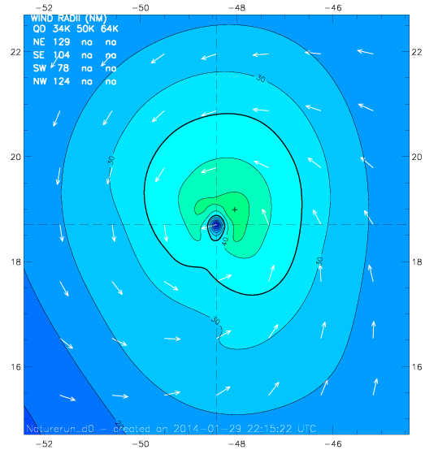
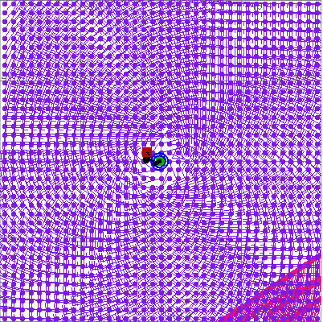
H*WIND Analyses on Aug 03, 2005 @ 12Z
a. Nature
b. H*WIND Perfect analysis from 9km Nature
c. H*WIND with perfect CYGNSS data
Max = 84 kts
TS force = 46 TJ
Max = 49 kts
TS force = 21 TJ
Mean: -0.12, RMS: 4.02

Slide 11
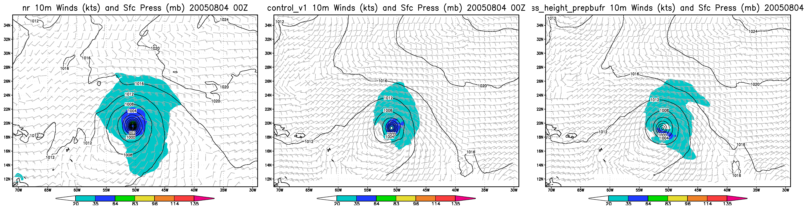
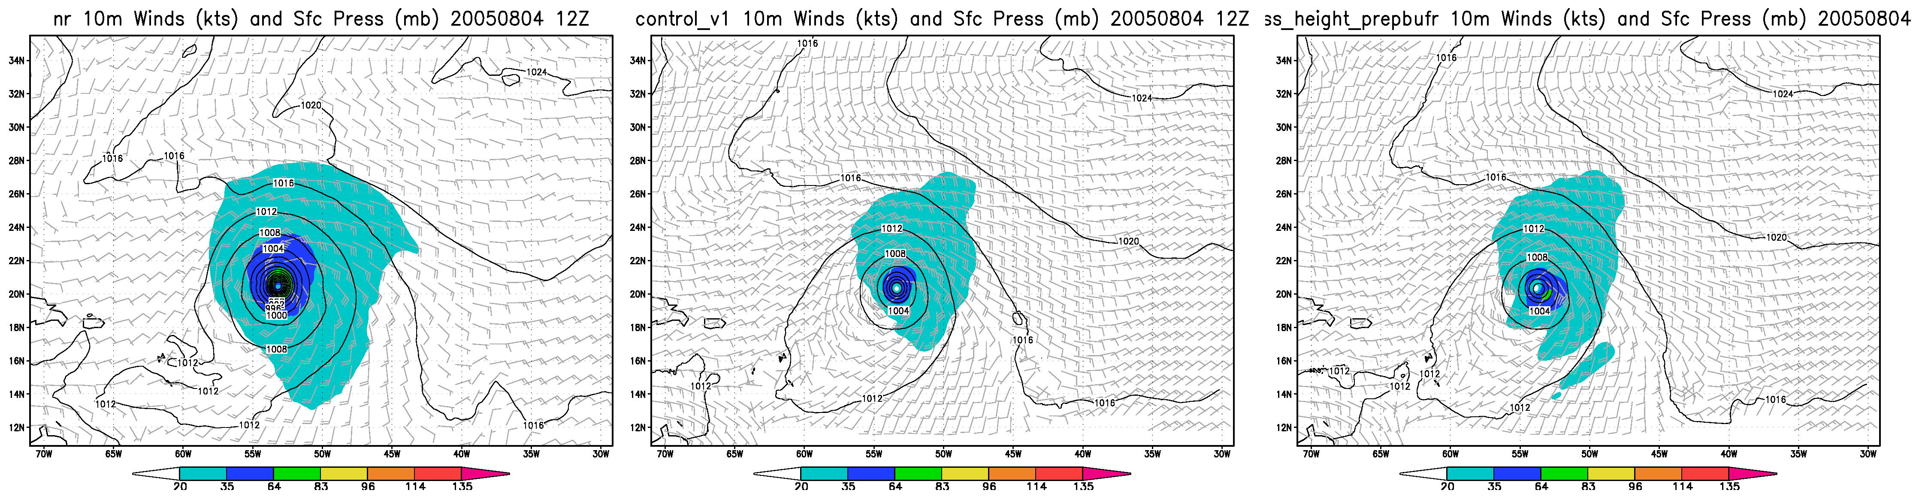
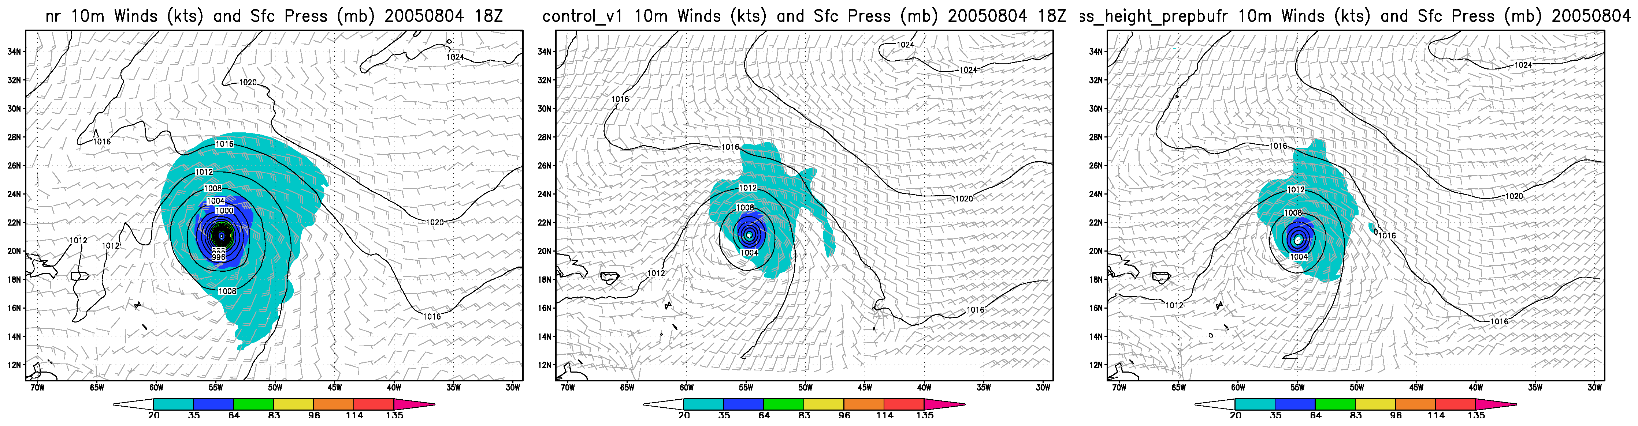

Slide 12
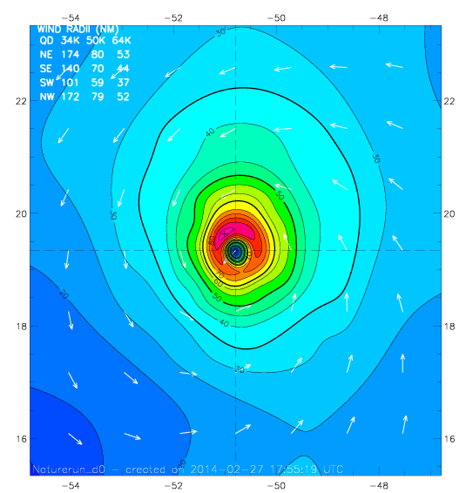
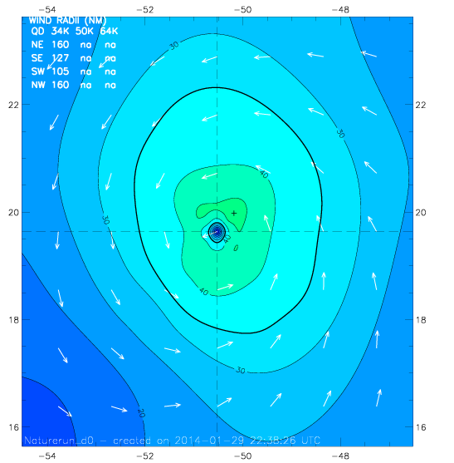
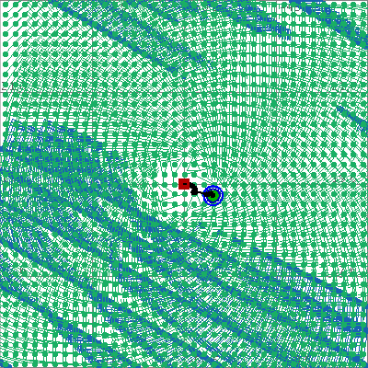
H*WIND Analyses on Aug 04, 2005 @ 00Z
a. Nature
b. H*WIND Perfect analysis from 9km Nature
c. H*WIND with perfect CYGNSS data
Max = 92 kts
TS force = 59 TJ
Max = 48 kts
TS force = 32 TJ
Mean: 0.72, RMS: 1.96

Slide 13
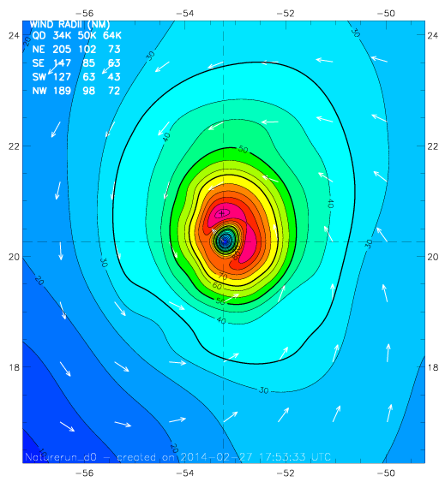
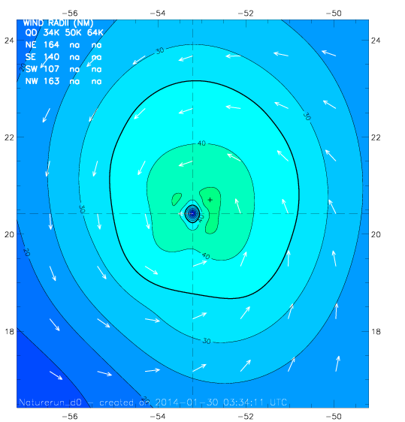
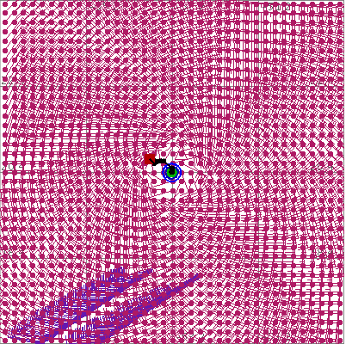
H*WIND Analyses on Aug 04, 2005 @ 12Z
a. Nature
b. H*WIND Perfect analysis from 9km Nature
c. H*WIND with perfect CYGNSS data
Max = 92 kts
TS force = 85 TJ
Max = 47 kts
TS force = 37 TJ
Mean: 0.62,RMS: 1.53

Slide 14
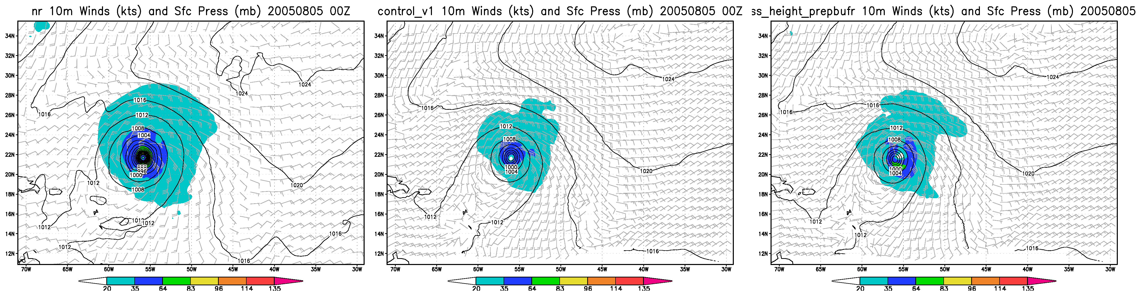

Slide 15
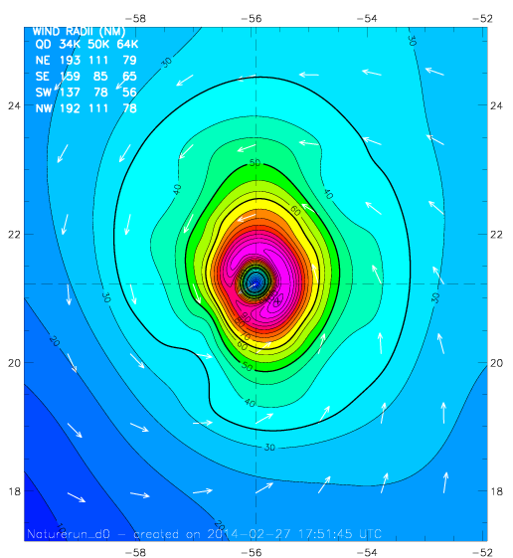
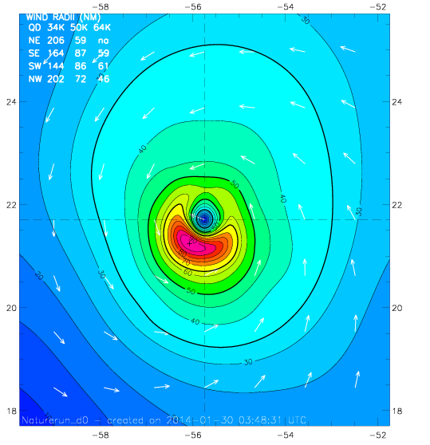
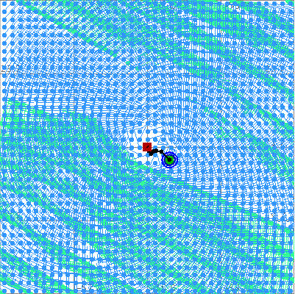
H*WIND Analyses on Aug 05, 2005 @ 00Z
b. H*WIND Perfect analysis from 9km Nature
c. H*WIND with perfect CYGNSS data
a. Nature
Max = 112 kts
TS force = 100 TJ
Max = 95 kts
TS force = 84 TJ
Mean: 2.0, RMS: 4.89

