Slide 1
Preliminary Results of CYGNSS Data Assimilation and Impact on Hurricane Forecasts

Slide 2
D01 Domain Average (10m wind)

Slide 3
D01 Domain Average (10m wind)

Slide 4
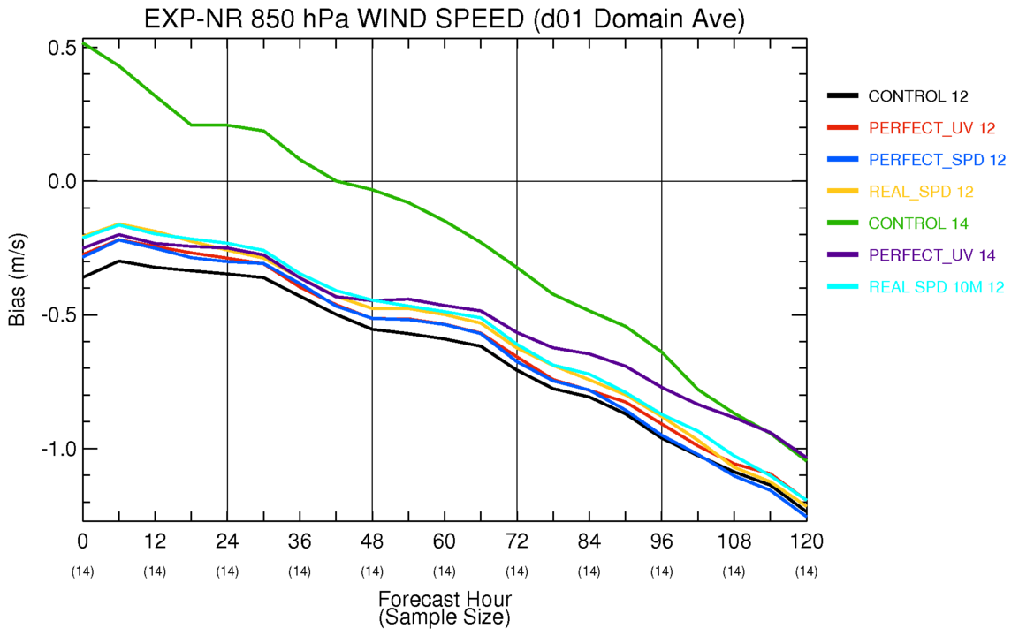
D01 Domain Average (850hPa wind)

Slide 5
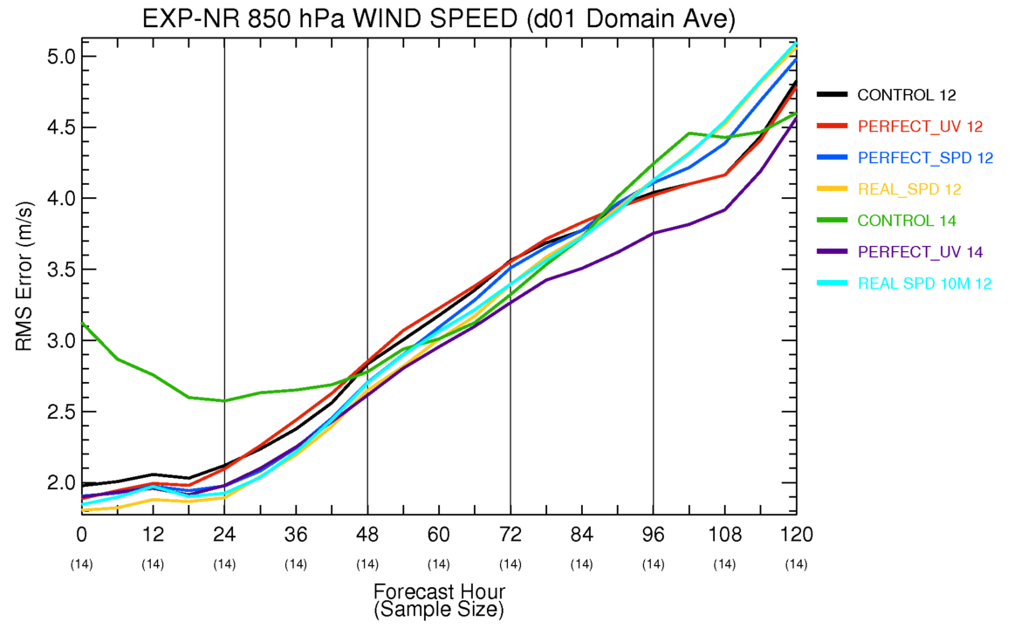
D01 Domain Average (850hPa wind)

Slide 6
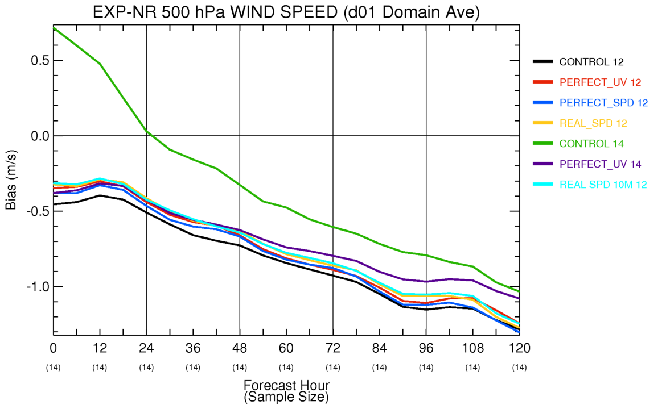
D01 Domain Average (500hPa wind)

Slide 7
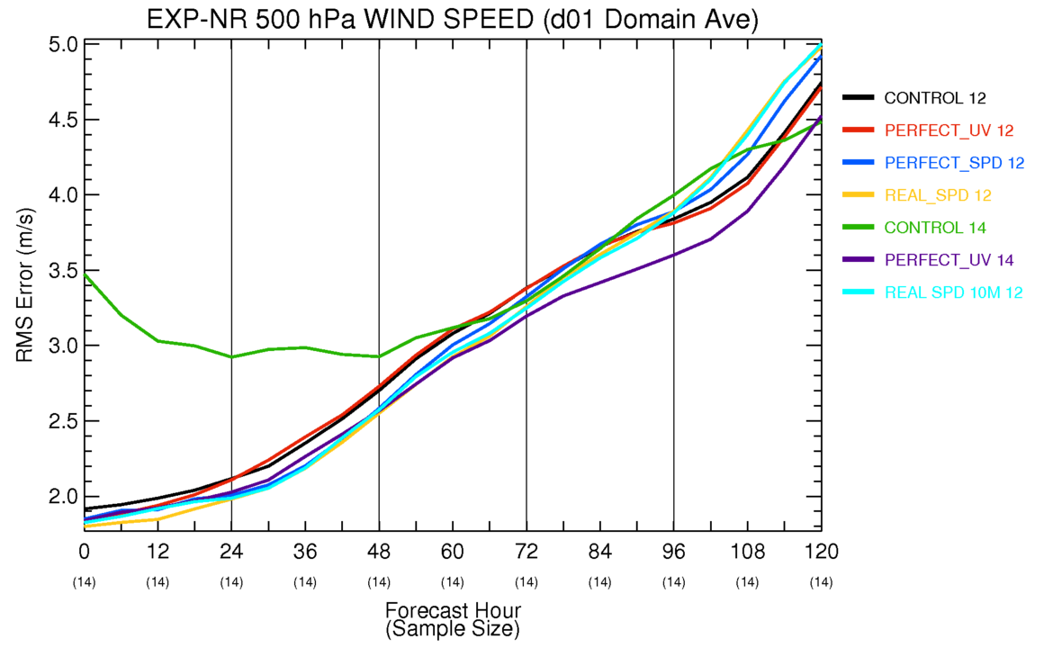
D01 Domain Average (500hPa wind)

Slide 8
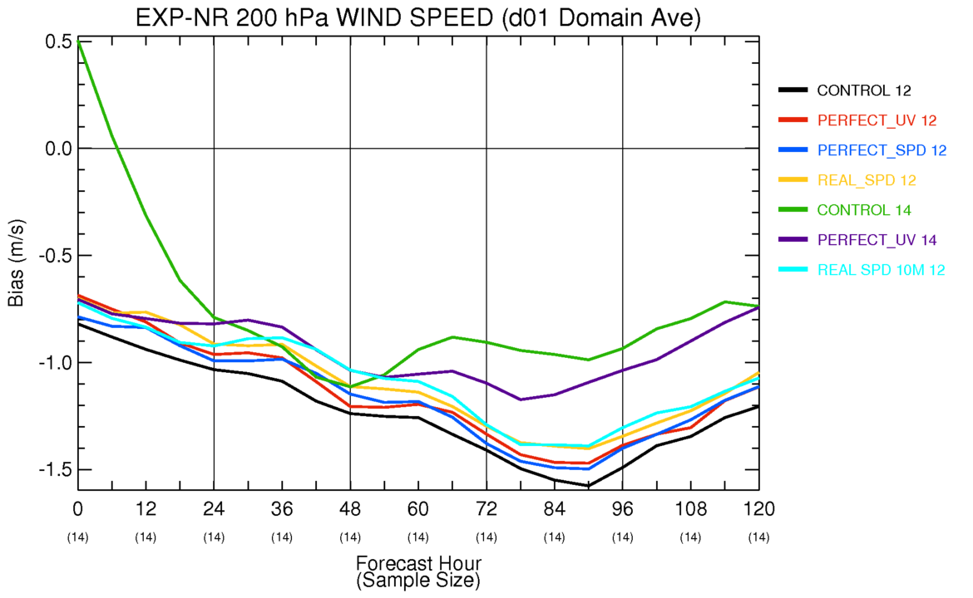
D01 Domain Average (200hPa wind)

Slide 9
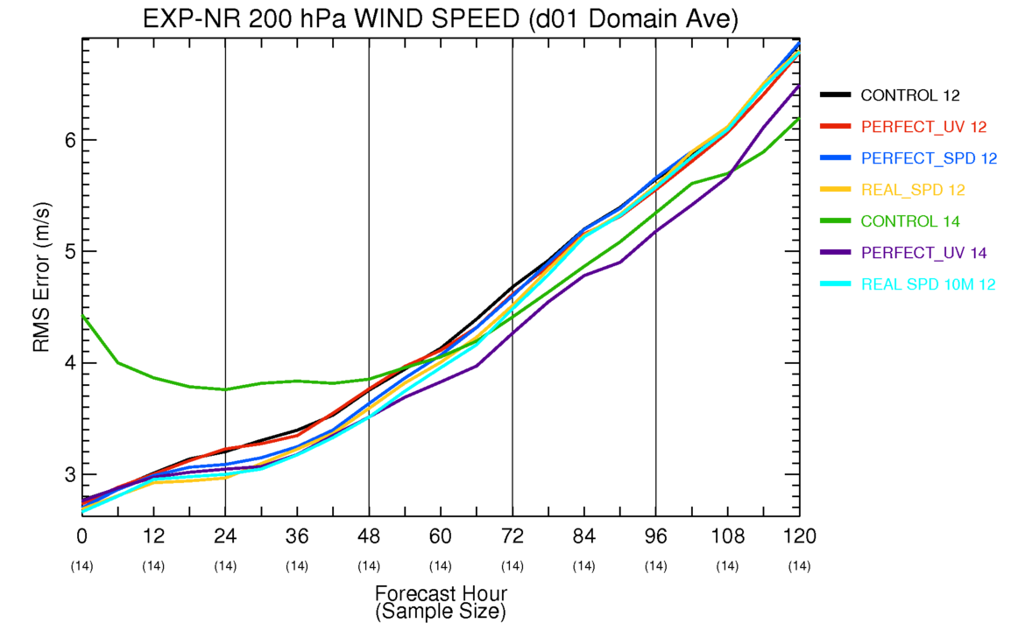
D01 Domain Average (200hPa wind)

Slide 10
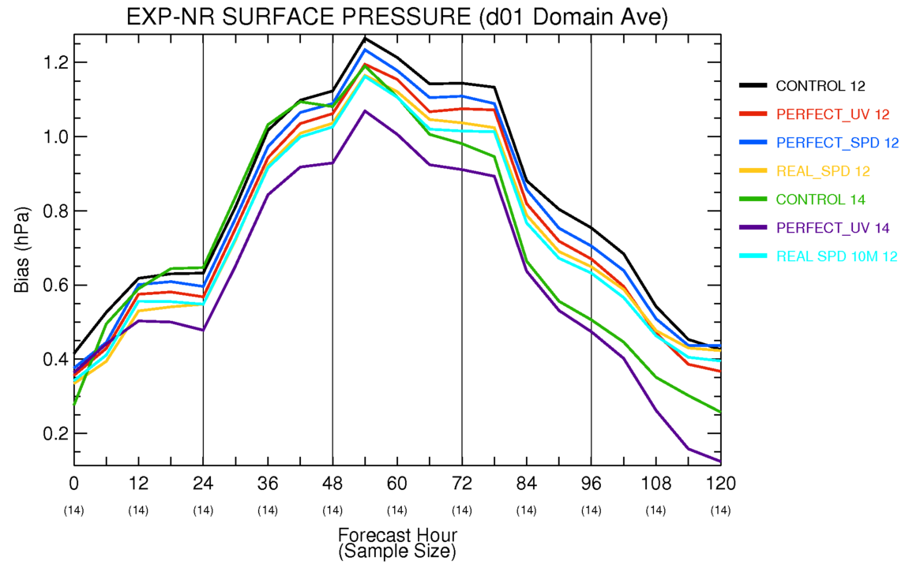
D01 Domain Average (sfc pressure)

Slide 11
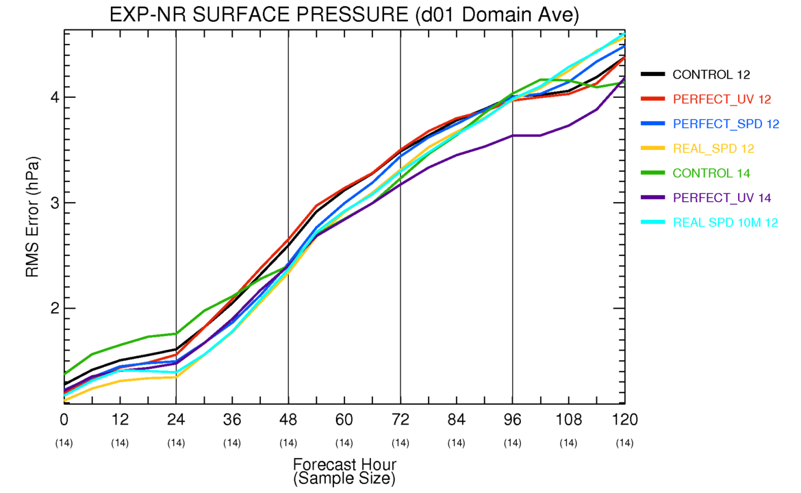
D01 Domain Average (sfc pressure)

Slide 12
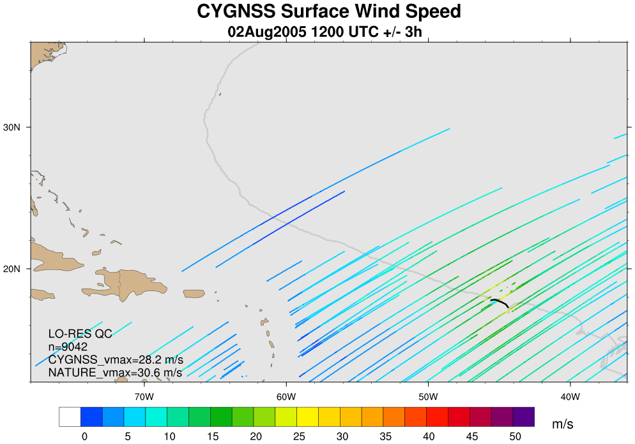
CYGNSS Coverage: 2Aug 12Z (+/-3h)

Slide 13
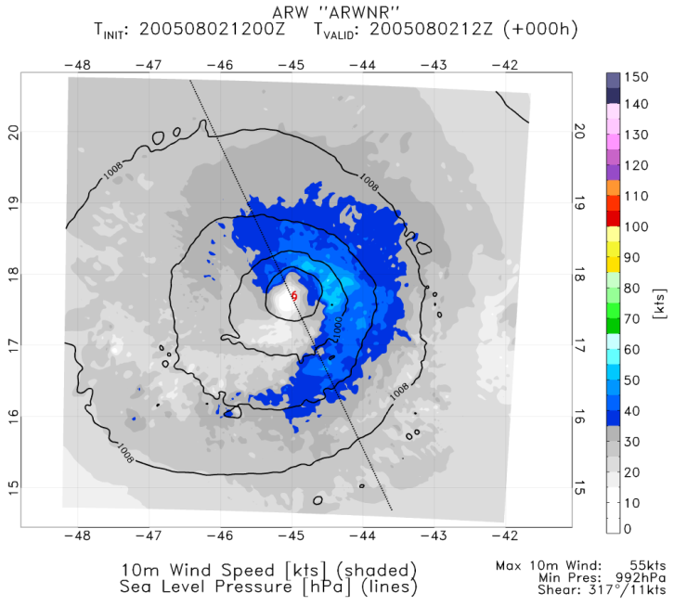
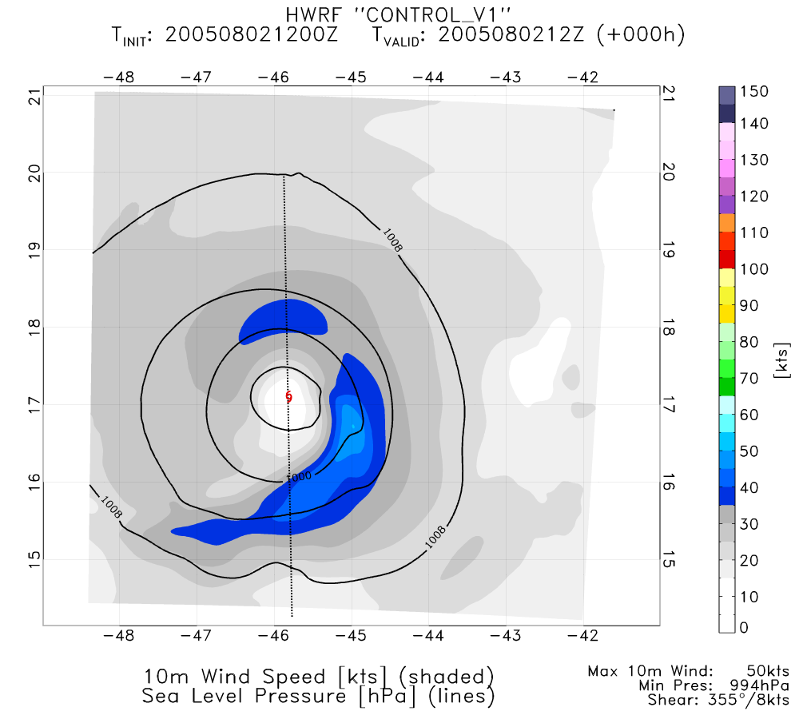
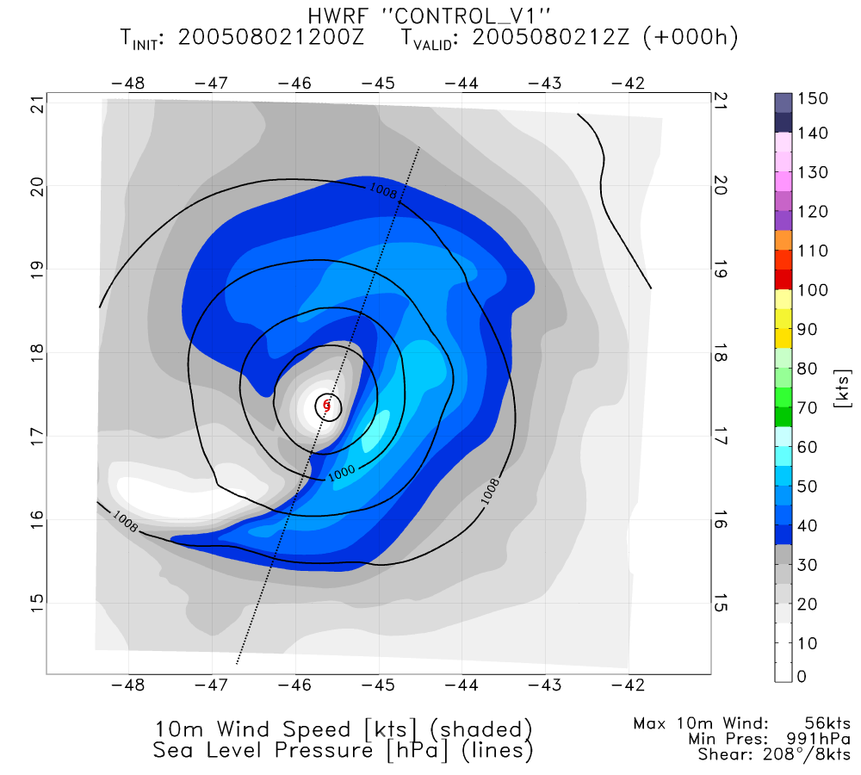
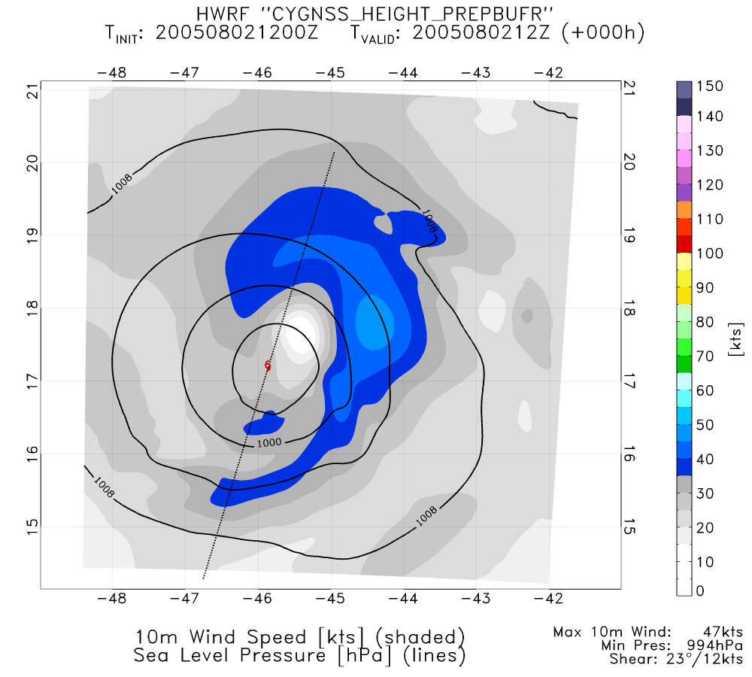
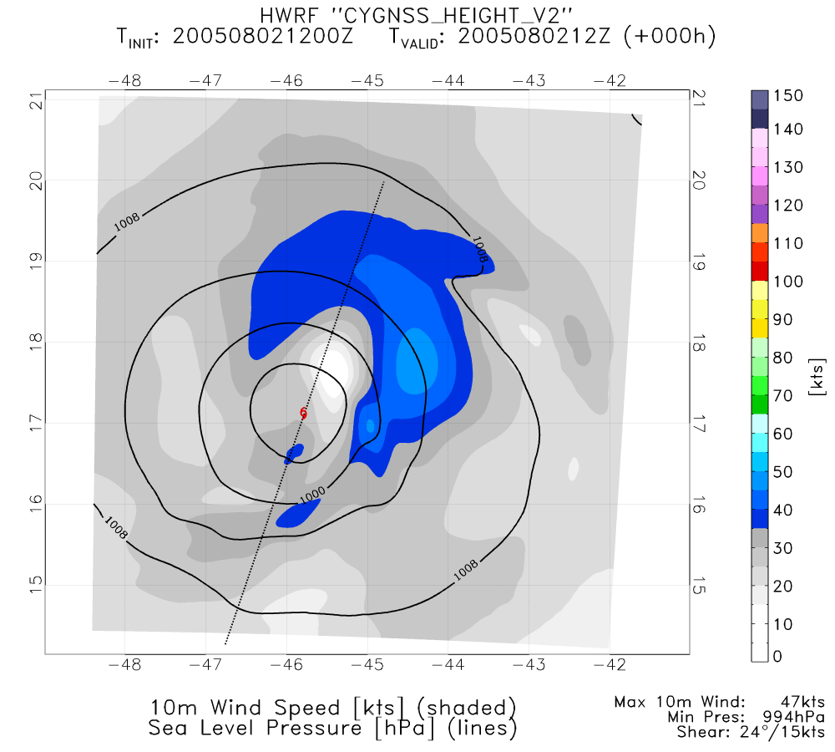
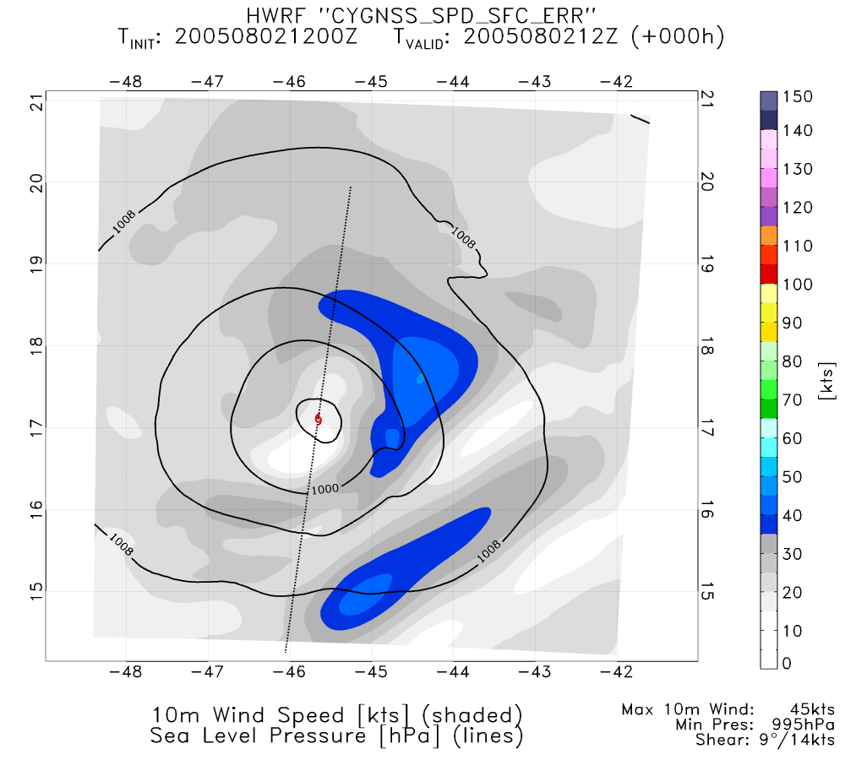
NATURE
CONTROL 12
CONTROL 14
PERFECT CYGNSS UV 12
PERFECT CYGNSS UV 14
REAL CYGNSS SPD 10m

Slide 14
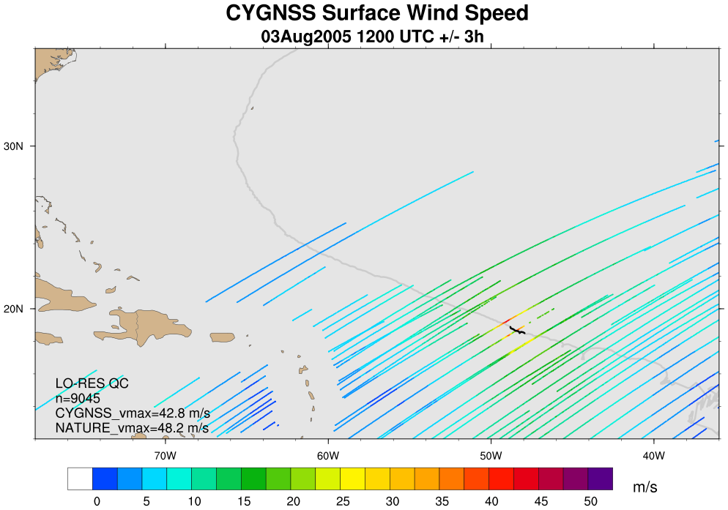
CYGNSS Coverage: 3Aug 12Z (+/- 3h)

Slide 15
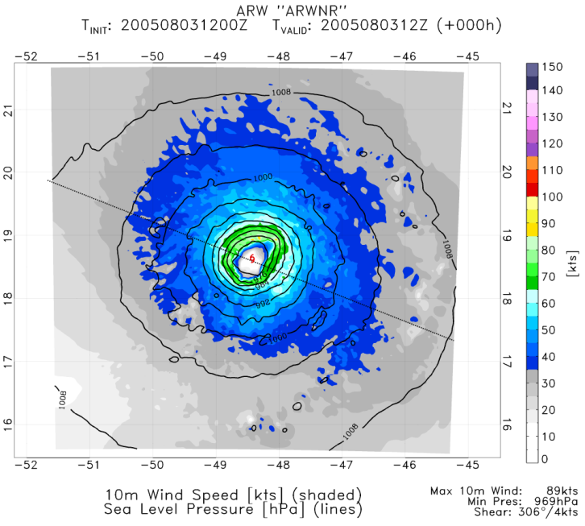
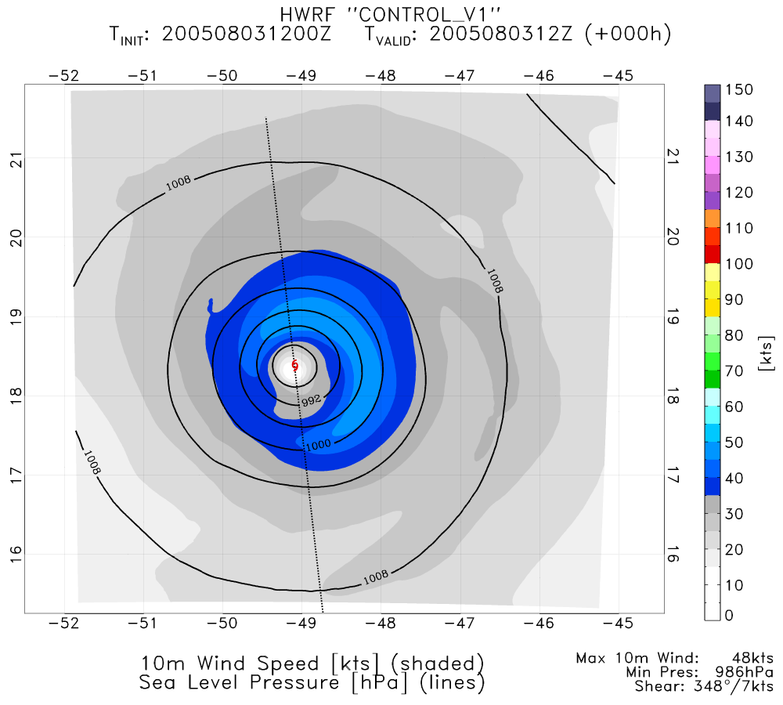
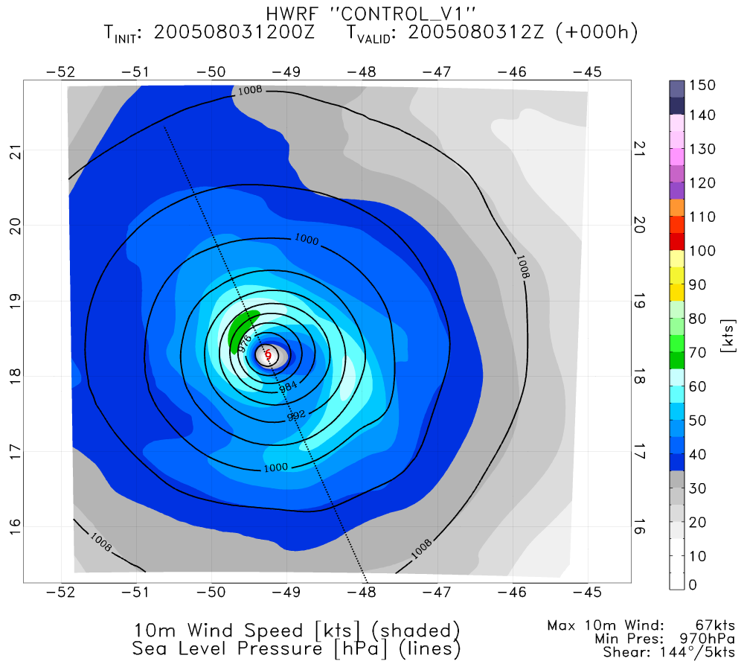
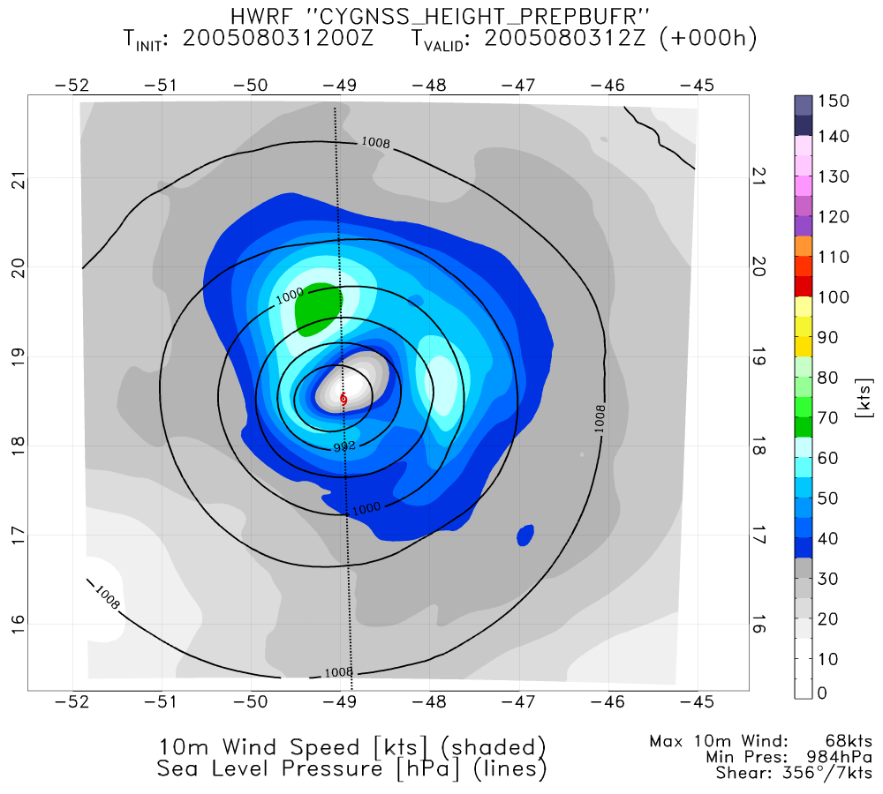
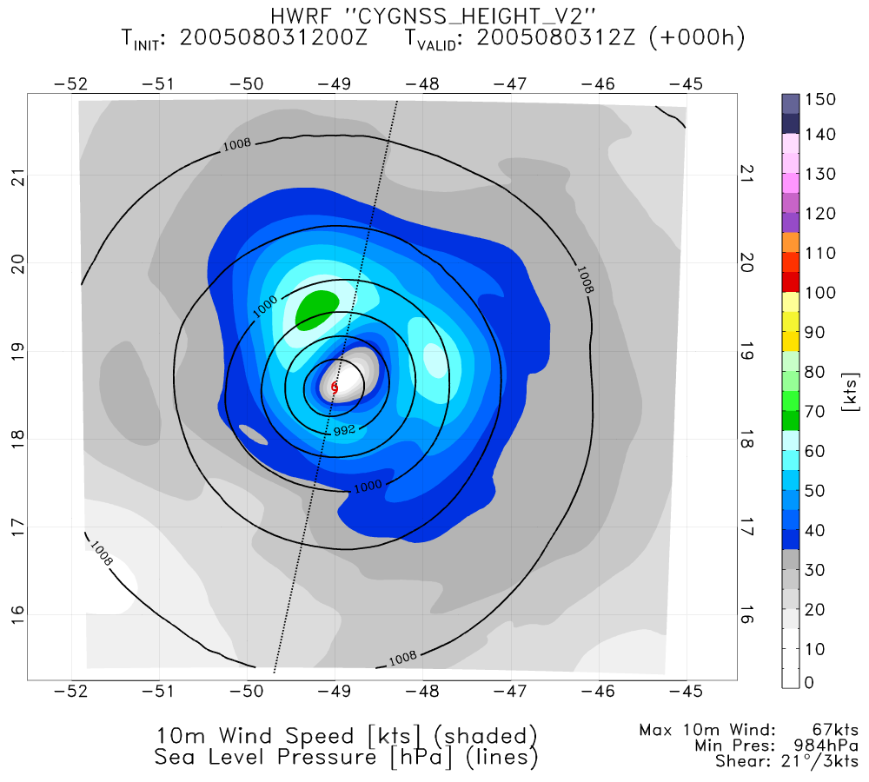
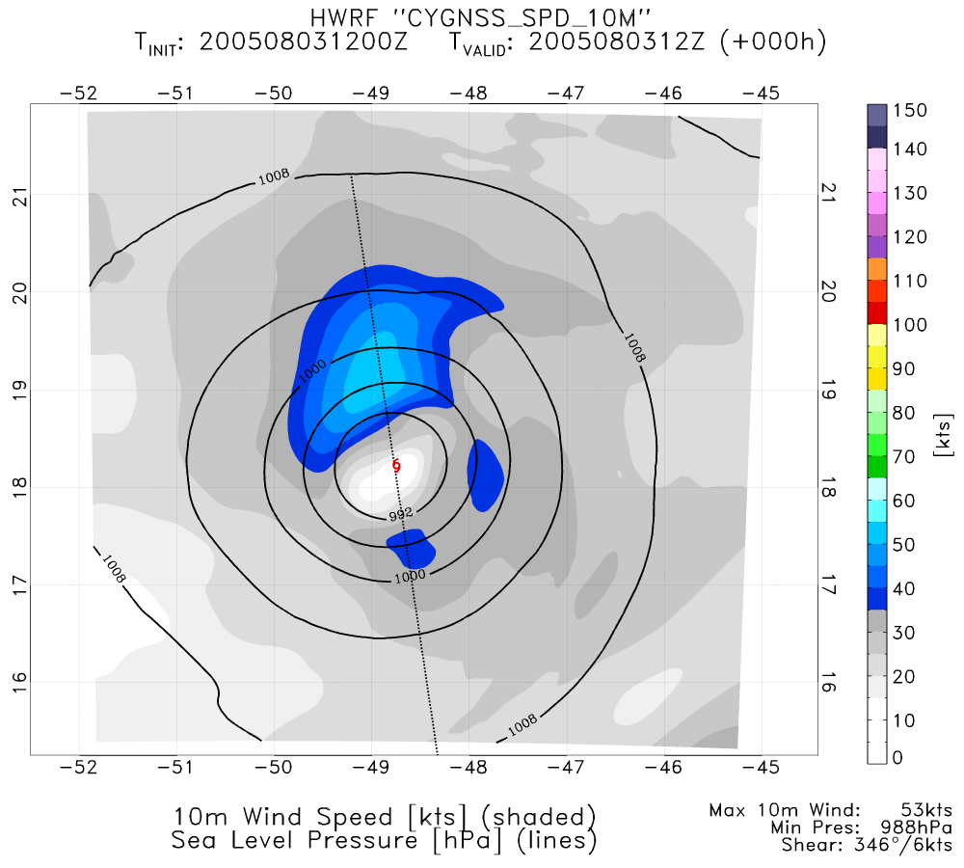
NATURE
CONTROL 12
CONTROL 14
PERFECT CYGNSS UV 12
PERFECT CYGNSS UV 14
REAL CYGNSS SPD 10M

Slide 16
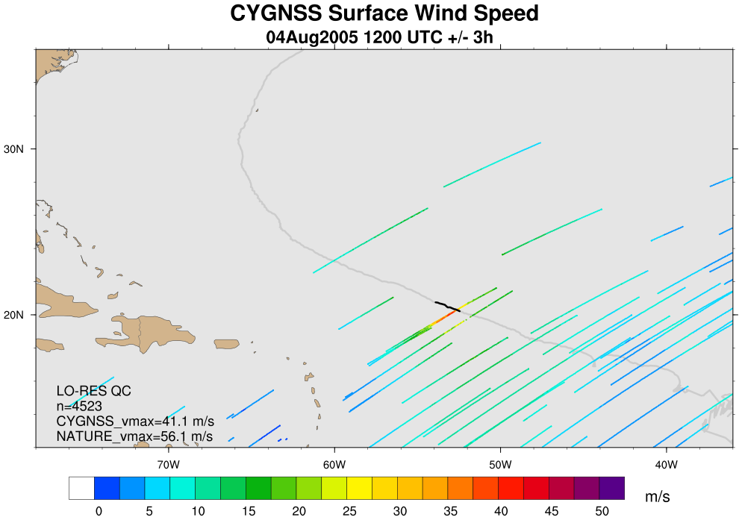
CYGNSS Coverage: 4Aug 12Z (+/- 3h)

Slide 17
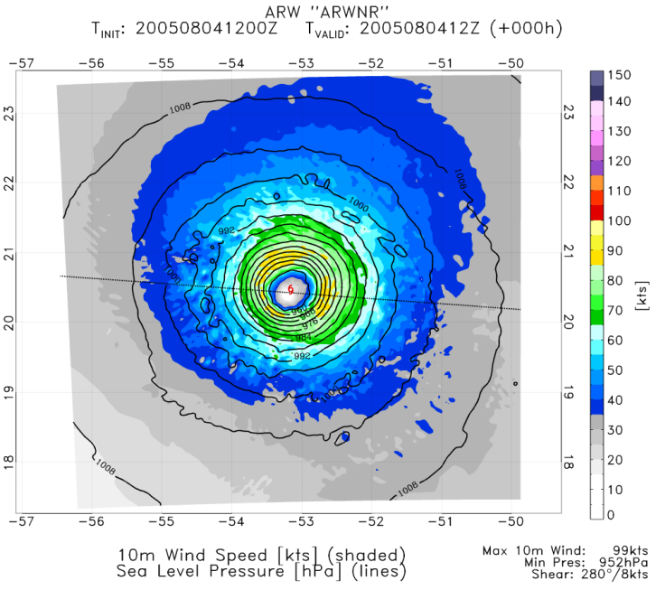
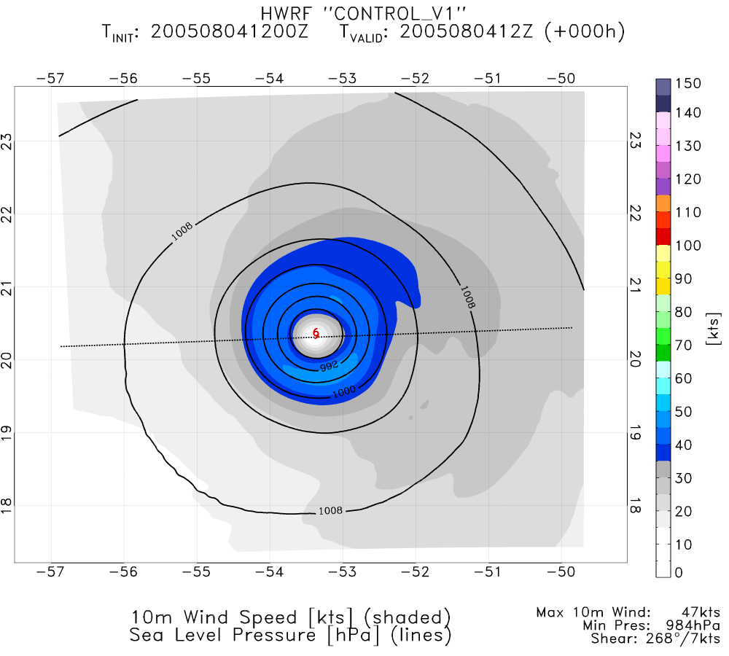
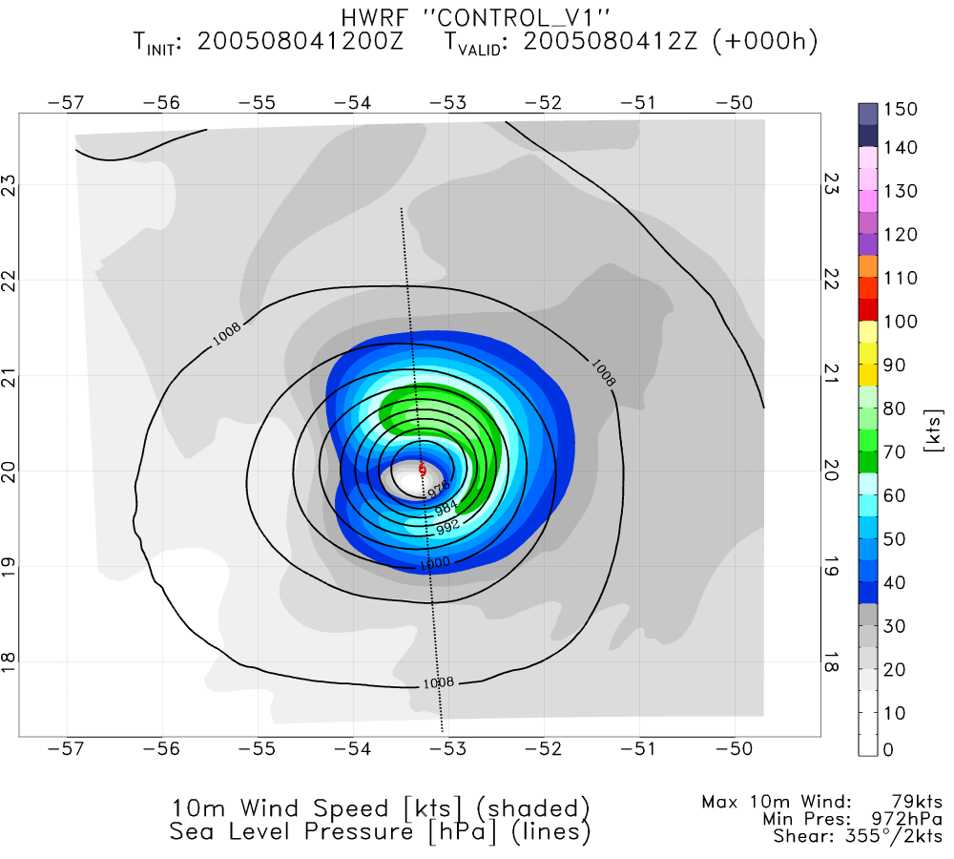
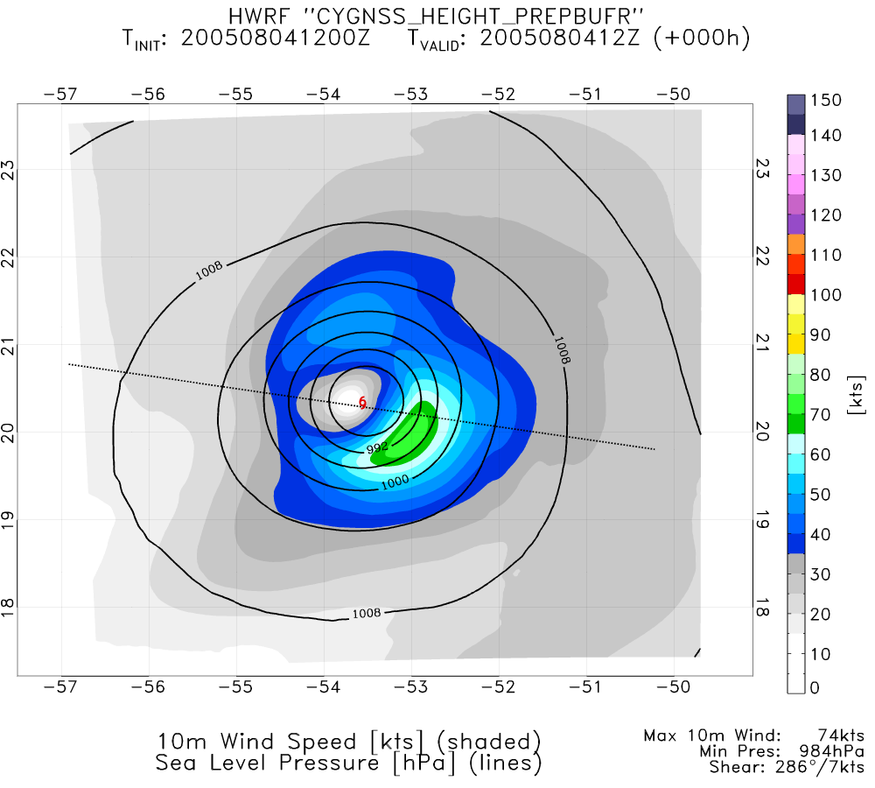
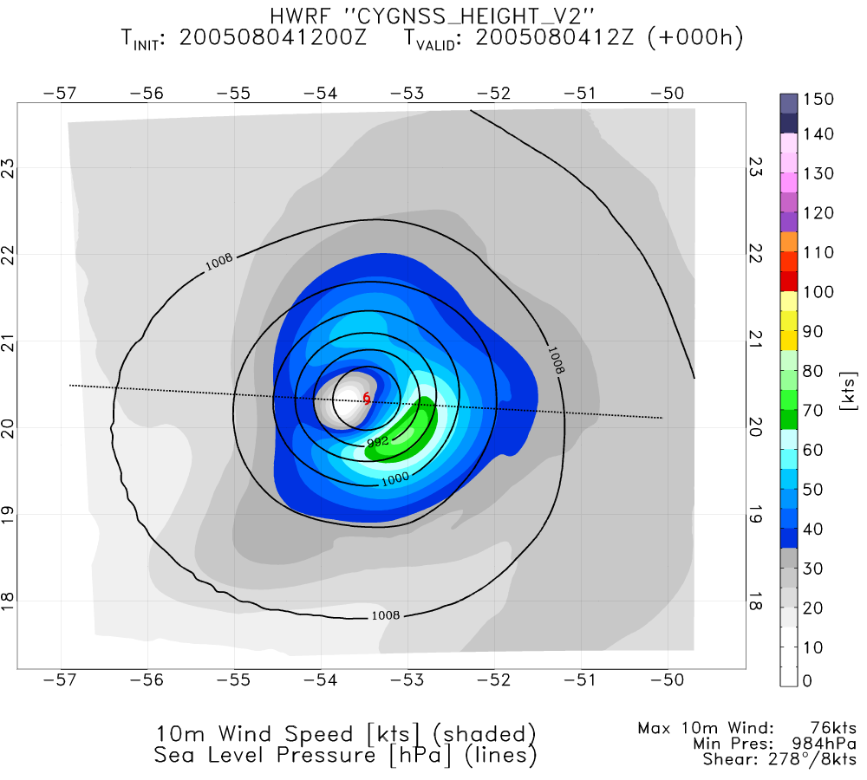
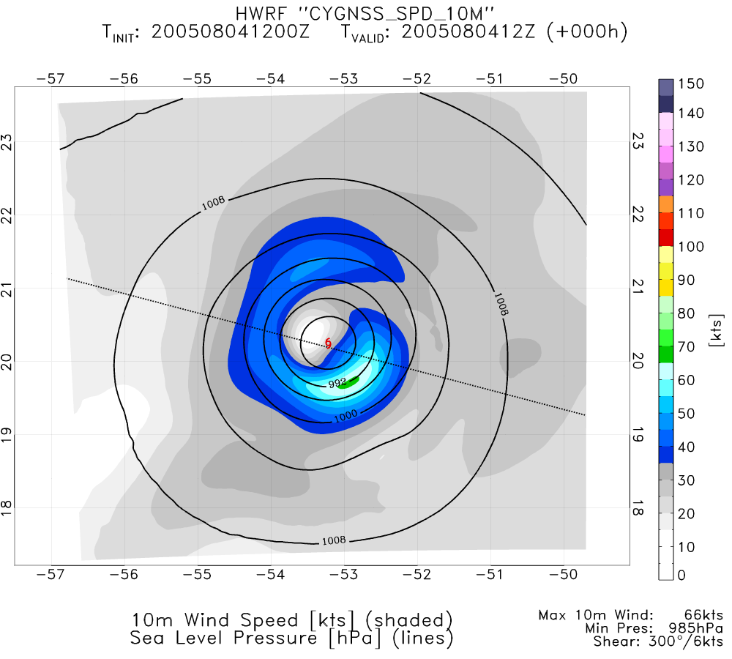
NATURE
CONTROL 12
CONTROL 14
PERFECT CYGNSS UV 12
PERFECT CYGNSS UV 14
REAL CYGNSS SPD 10M

