Slide 1
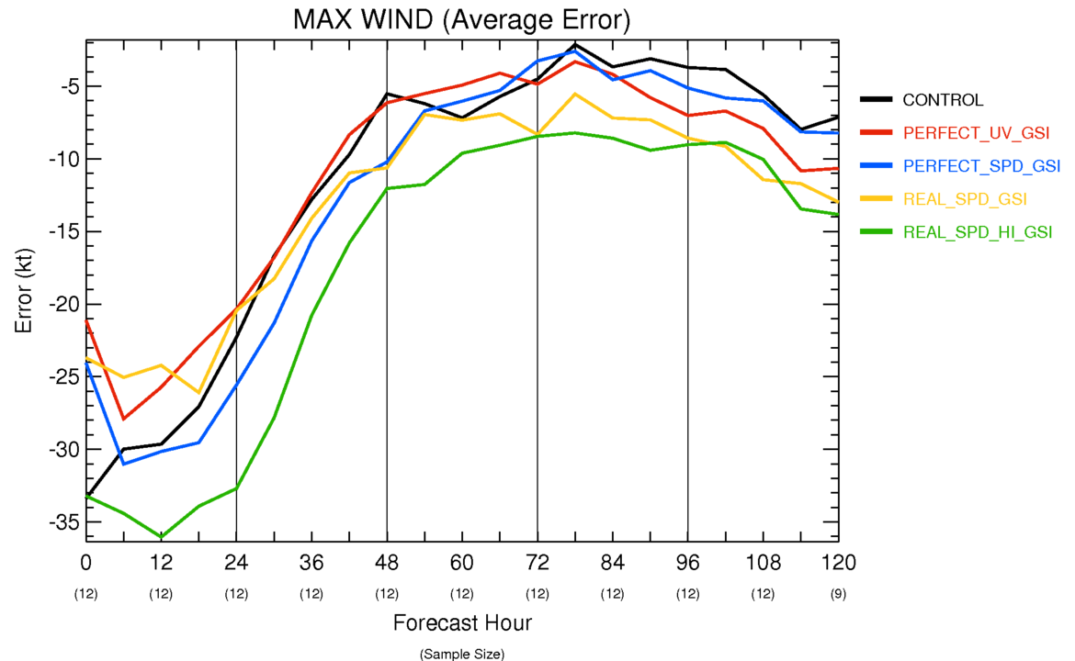
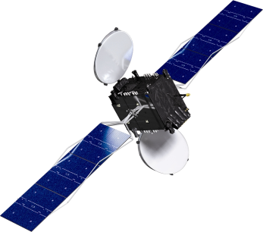
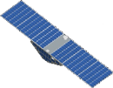
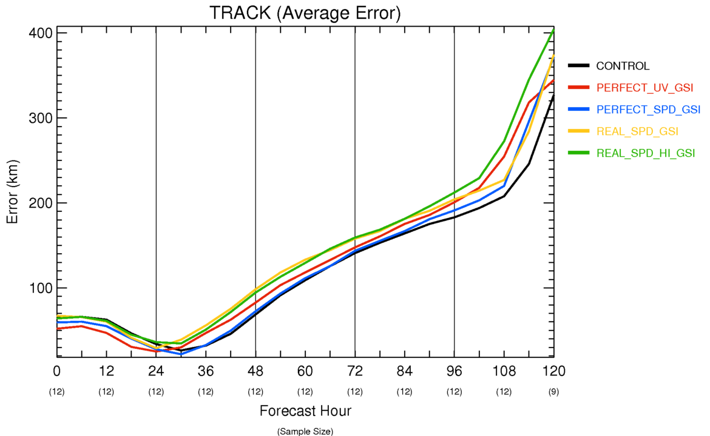
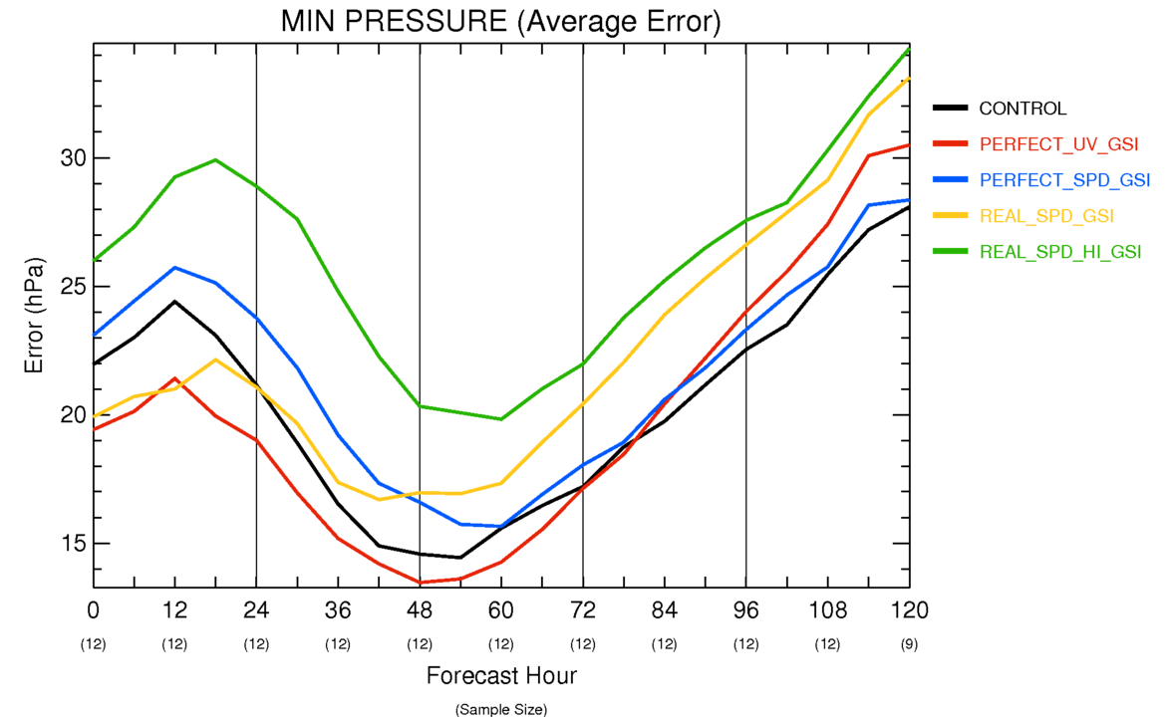
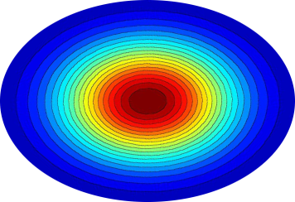
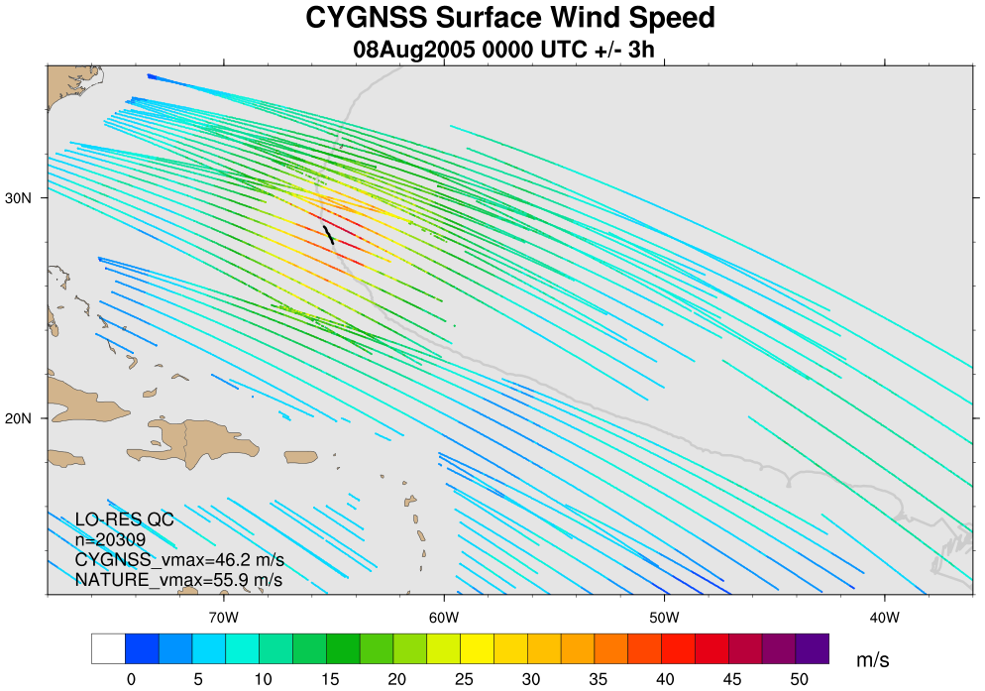
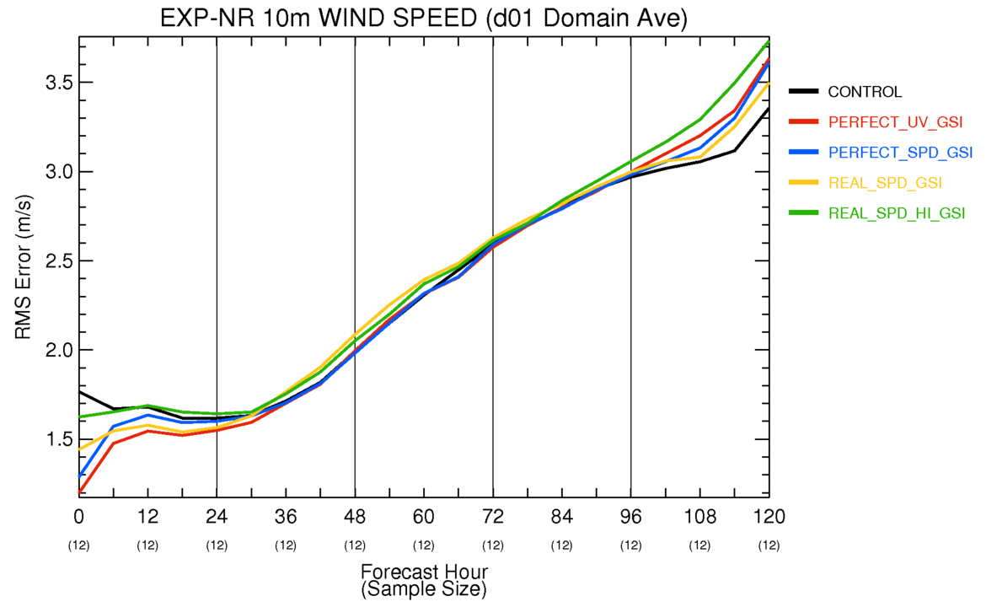
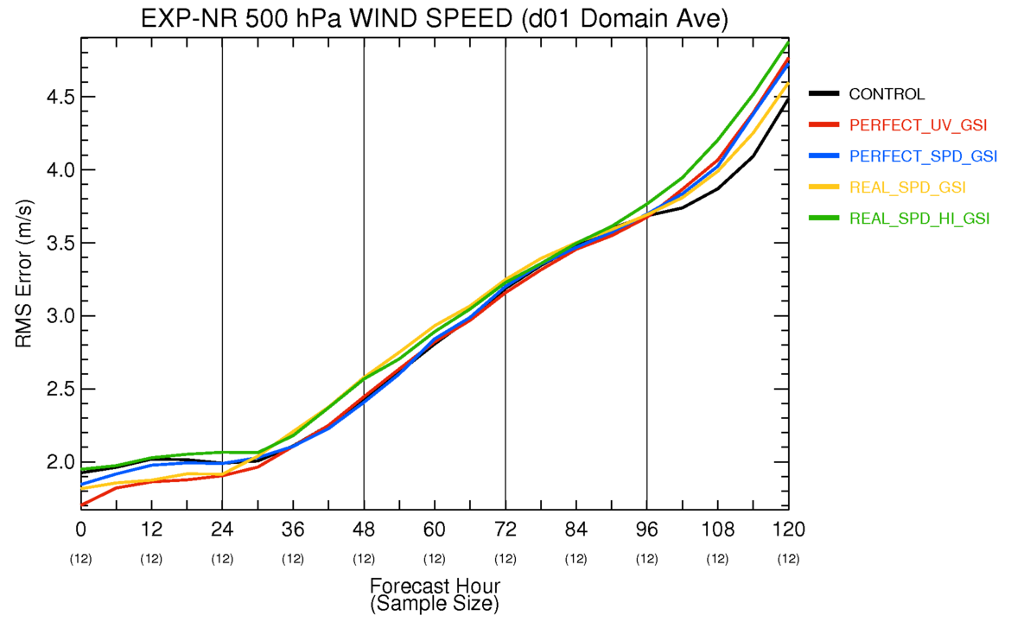
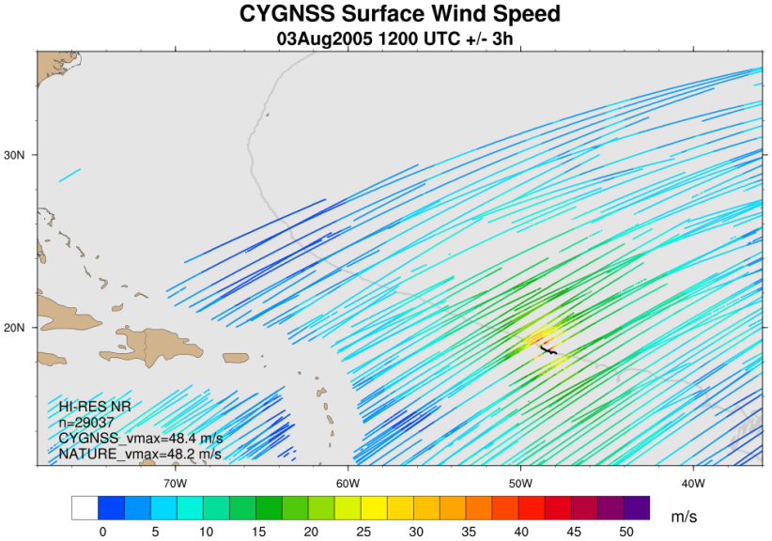
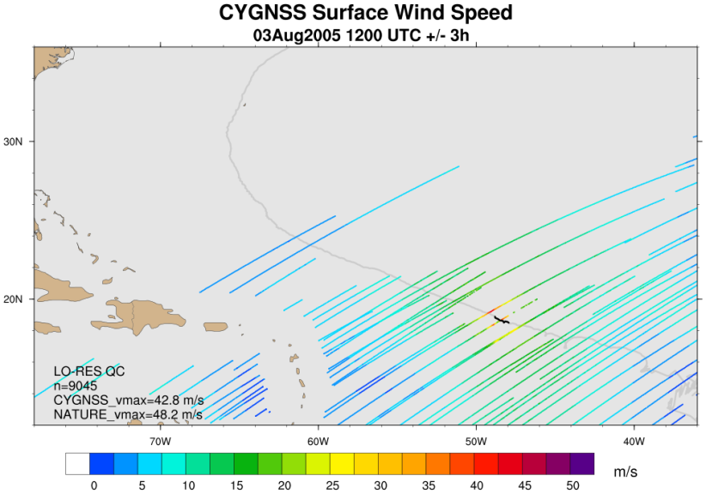
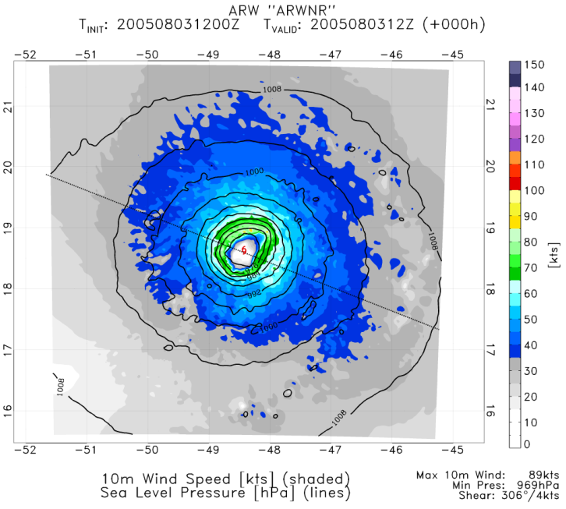
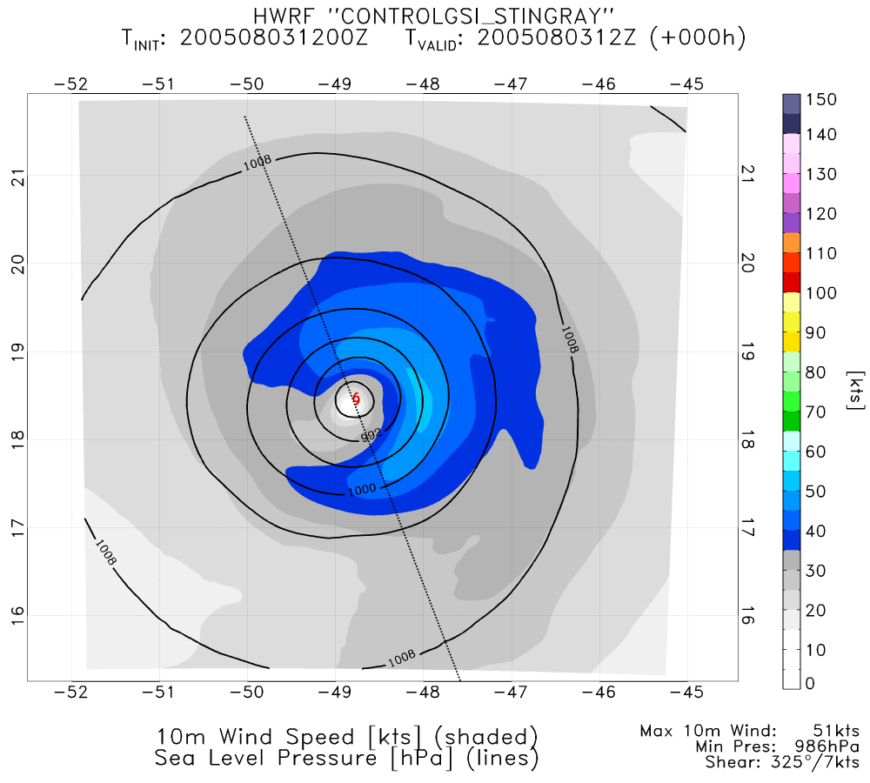
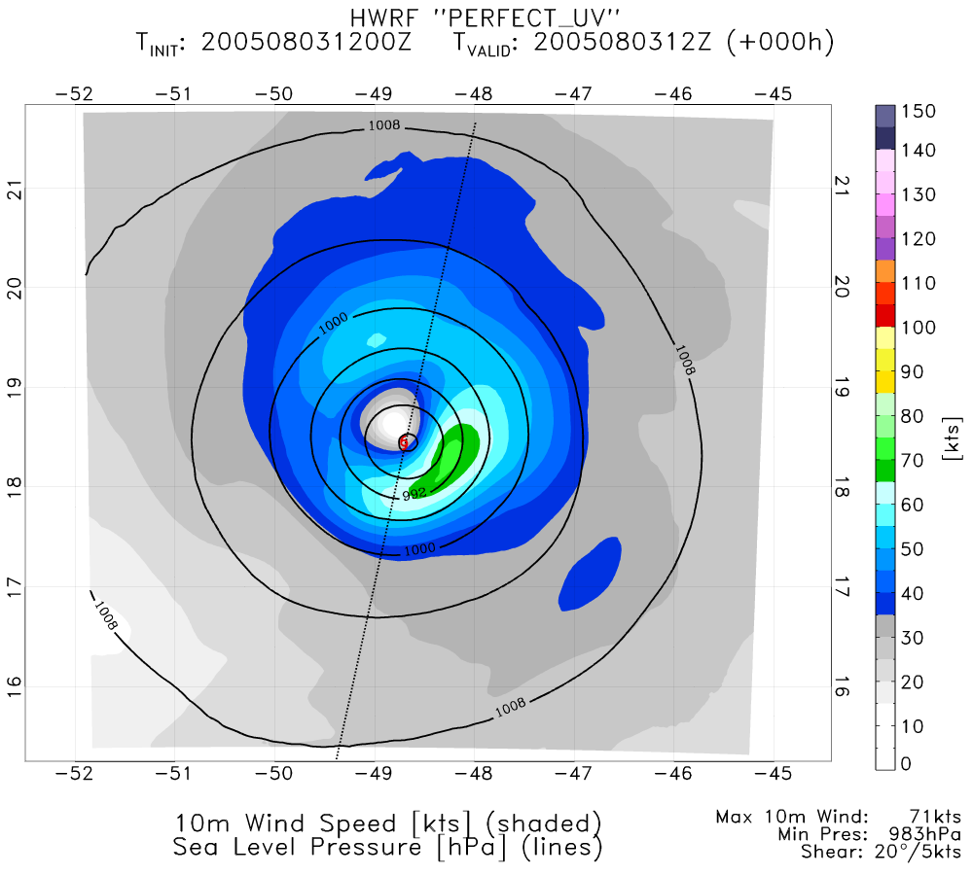
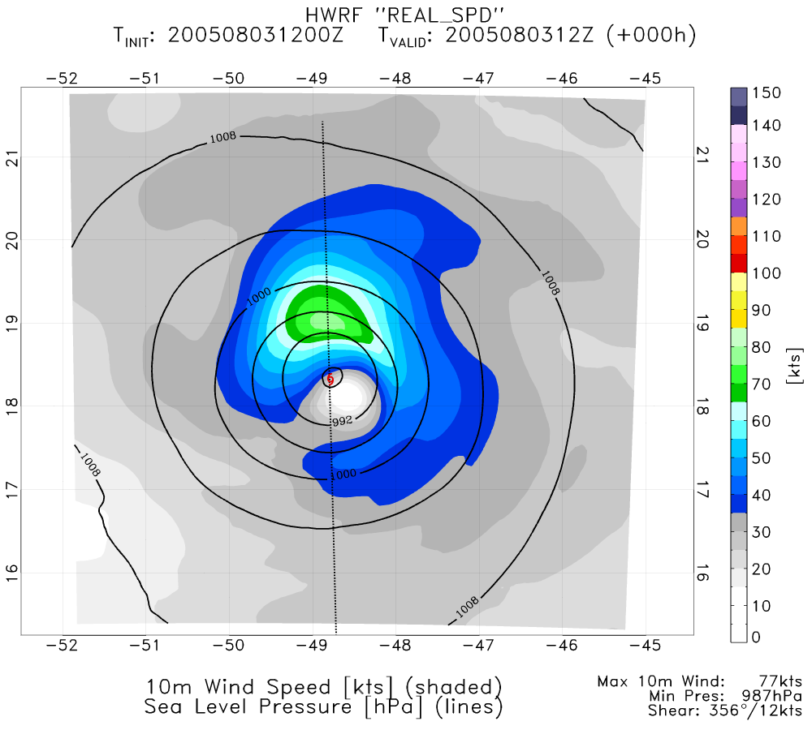
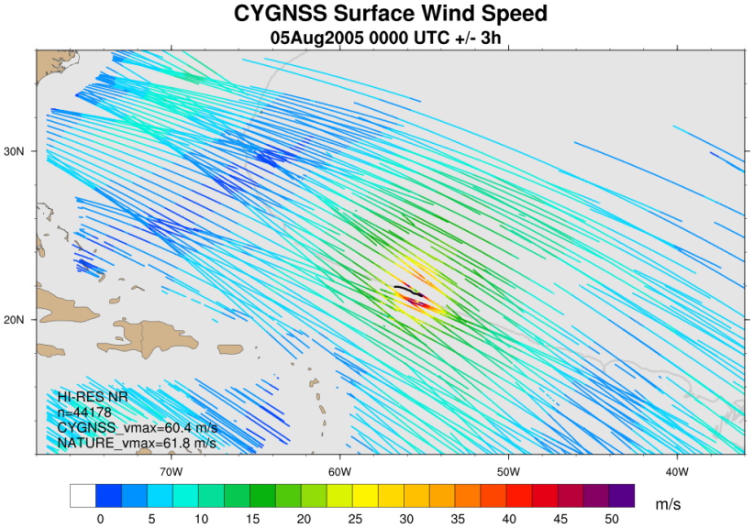
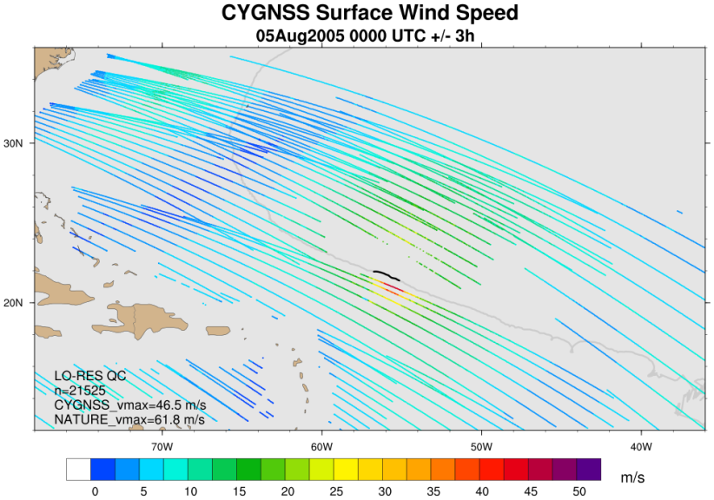
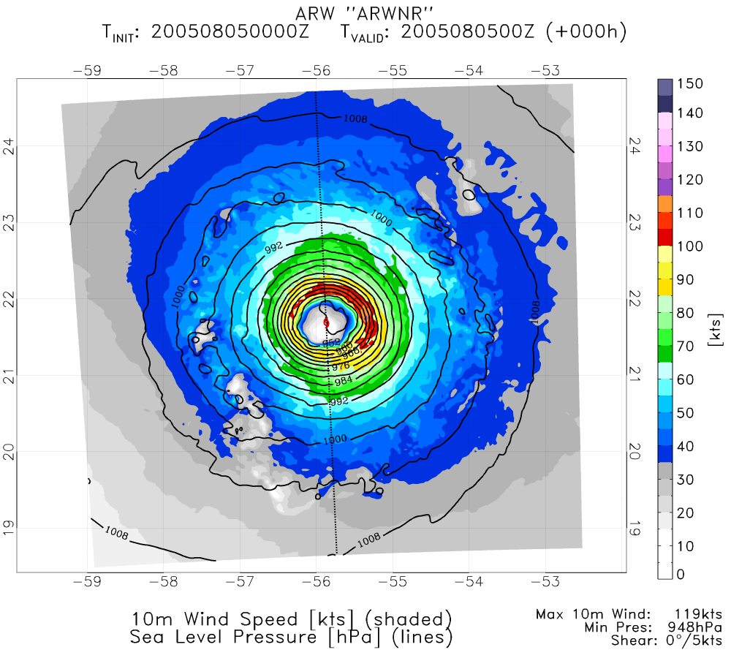
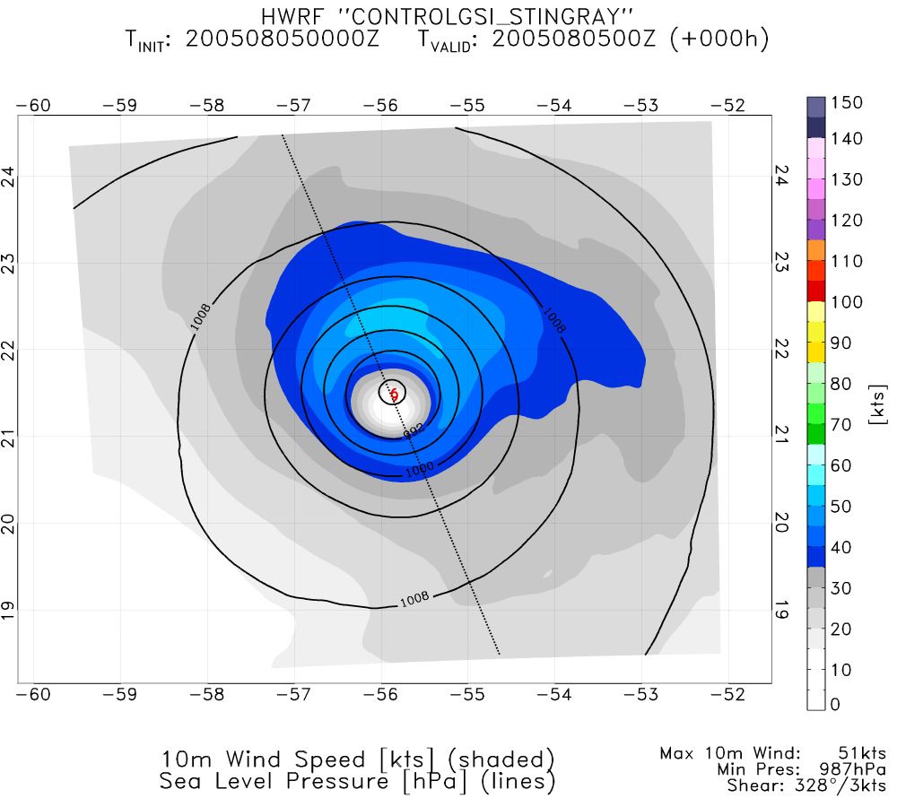
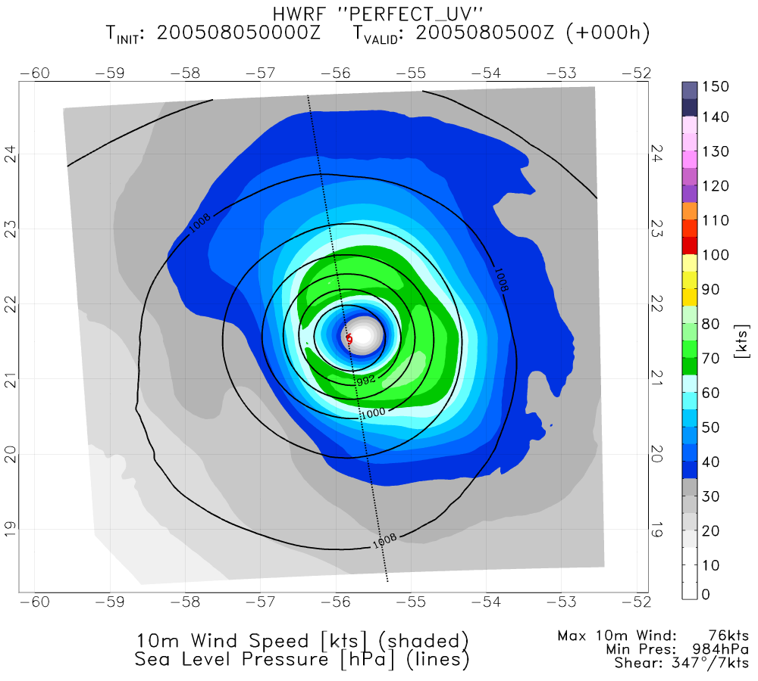
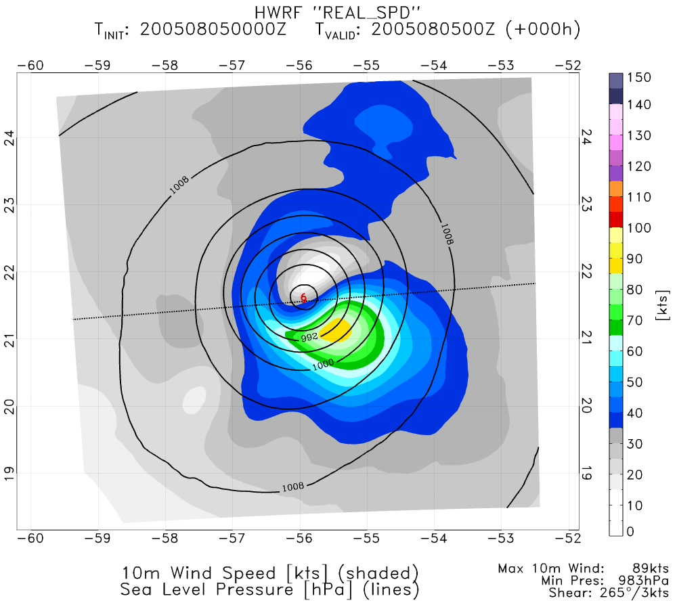
Impact of CYGNSS Data on Hurricane Analyses and
Forecasts in a Regional OSSE Framework
P238
Bachir Annane¹, Brian McNoldy², Javier Delgado¹, Lisa Bucci², Robert Atlas³, Sharanya Majumdar²
¹ Univ. of Miami/CIMAS and NOAA/AOML/HRD, Miami, FL
² Univ. of Miami/RSMAS, Miami, FL
³ NOAA/AOML, Miami, FL
Observational Data: CYGNSS
Experiments and Results
· Average Storm Errors
- Most impacts are realized in first 24h, and especially in analyses. Biggest improvement from “PERFECT_UV”, while “REAL_SPD_HI” negatively affects the results.
GPS
CYGNSS
· The Cyclone Global Navigation Satellite System (CYGNSS) is a NASA mission planned for launch in 2016 that consists of a constellation of 8 micro-satellites.
· These swan-sized satellites will receive signals reflected off the ocean by existing GPS satellites.
· Two synthetic CYGNSS datasets generated to span the WRF nature run.
- “low resolution”: ~25km effective footprint… nominal product
- “high resolution”: ~12km effective footprint… experimental product (much greater noise in the retrieval results in many dropped data points after quality control is applied)
· All experiments listed use identical configurations of GSI for data assimilation and HWRF for forecasts.
1) CONTROL: conventional data minus scatterometers
2) PERFECT_UV: CONTROL plus all available high-resolution CYGNSS data points; wind speed and direction are interpolated from WRF nature run and assumed to have zero error
3) PERFECT_SPD: CONTROL plus all available high-resolution CYGNSS data points; only wind speed is interpolated from WRF nature run and assumed to have zero error
4) REAL_SPD: CONTROL plus quality-controlled low-resolution CYGNSS data points; synthetic realistic wind speeds and errors are used
5) REAL_SPD_HI: CONTROL plus quality-controlled high-resolution CYGNSS data points; synthetic realistic wind speeds and errors are used
direct signal
scattered signal
specular point
Fig 1. Geometry of GPS-based quasi-specular surface scattering. The GPS direct signal provides location, timing, and frequency references, while the forward scattered signal contains ocean surface information.
· Scattered signal contains information on ocean surface roughness, from which a wind speed can be derived under precipitating conditions and with sensitivity beyond 70 m/s.
· Spatial and temporal coverage pro-vided by the 8-satellite constellation will be superior to ASCAT and OSCAT combined.
Fig 6. Average error over 12 cycles (first 4 are omitted to allow for model adjustment). Storm errors include track (left), peak surface wind (top right), and minimum surface pressure (bottom right).
· Large-scale ‘domain-averaged’ Errors
- Again, most improvement seen in first 24h, and especially in analyses.
- Improvements extend far beyond surface wind speed (not all fields are shown here, but include height, pressure, and temperature)
Fig 2. Example of synthetic CYGNSS data coverage over a 6-hour window. Colors correspond to retrieved wind speed.
· Storm Structure
- Addition of CYGNSS surface wind observations generally improves upon the CONTROL run (brings it closer to NATURE) in terms of symmetry, peak intensity, central pressure, and wind radii
OSSE Framework
The regional OSSE (Observing System Simulation Experiment) framework described here was developed at NOAA/AOML and UM/RSMAS and features a high-resolution regional nature run embedded within a lower-resolution global nature run. Simulated observations are generated and provided to a data assimilation scheme which provides analyses for a high-resolution regional forecast model.
· Nature Runs
- ECMWF: low-resolution T511 (~40km) “Joint OSSE Nature Run”
- WRF-ARW: high-resolution 27km regional domain with 9/3/1 km storm-following nests (v3.2.1)
· Data Assimilation Scheme
- GSI: Gridpoint Statistical Interpolation… a standard 3D variational assimilation scheme (v3.3). Analyses performed at 9km resolution.
· Forecast Model
- HWRF: the 2014 operational Hurricane-WRF model (v3.5). Parent domain has ~6km resolution, single storm-following nest has ~2km resolution.
DA and model cycling performed every 6 hours, each run producing a 5-day forecast, for total of 16 cycles.
Fig 7. RMS errors of winds averaged over entire outer “d01” domain at 10m (left) and 500 hPa (right). Results are similar for surface pressure, geopotential height, temperature, etc.
a) NATURE
b) CONTROL
c) PERFECT UV
d) REAL SPD
Summary
· Assimilation of CYGNSS data with GSI almost always improves hurricane intensity and track analyses
· Assimilation of CYGNSS data with GSI always improves large-scale analyses of wind, pressure, temperature, height, etc. from the surface through upper troposphere
· Assimilation of CYGNSS data can improve hurricane and synoptic field forecasts with HWRF in short lead times
· Higher-resolution but noisier data degrade analyses when compared to lower-resolution higher-quality data
· Adding directional information to the CYGNSS wind speeds improves hurricane analyses in GSI
· GSI analyses are very sensitive to the exact location of the observational data… symmetry and coverage affect the result
· The stronger a storm is in an analysis, the more severely the short-range forecast suffers from vortex spin-down and adjustment
· We have very few samples from one storm, so error statistics are not robust, but provide some guidance
ECMWF NATURE RUN
WRF NATURE RUN
observation
simulator
SYNTHETIC DATA
GSI
ANALYSIS
HWRF
FORECASTS
verification
background
VMAX: 89 kt, MSLP: 969 hPa
VMAX: 51 kt, MSLP: 986 hPa
VMAX: 71 kt, MSLP: 983 hPa
VMAX: 77 kt, MSLP: 997 hPa
Fig 3. Basic flow chart of the regional OSSE framework.
Fig 4. Examples of the 10m surface wind and pressure fields from the WRF nature run (a), and analyses from the CONTROL run (b), the PERFECT_UV run (c), and the REAL_SPD run (d) at 3 Aug 1200 UTC. Although not ideal, c) and d) are better analyses than that from the CONTROL run.
- However, due to the nature of GSI, if observation coverage is not symmetric in a TC, the analysis will suffer. This example is from 36 hours after the previous example.
a) NATURE
b) CONTROL
c) PERFECT UV
d) REAL SPD
Acknowledgements
Funding for this research is from NASA Award NNL13AQ00C. We would like to thank the CYGNSS Science Team, the NOAA Office of Weather and Air Quality, and the NOAA HFIP program for computing support.
VMAX: 119 kt, MSLP: 948 hPa
VMAX: 51 kt, MSLP: 987 hPa
VMAX: 76 kt, MSLP: 984 hPa
VMAX: 89 kt, MSLP: 983 hPa
Fig 5. Examples of the 10m surface wind and pressure fields from the WRF nature run (a), and analyses from the CONTROL run (b), the PERFECT_UV run (c), and the REAL_SPD run (d) at 5 Aug 0000 UTC. Asymmetric data coverage in REAL_SPD results in very lopsided vortex.
4-8 January 2015 • 19th IOAS-AOLS Conference • 95th AMS Annual Meeting • Phoenix, Arizona

