Slide 1
CYGNSS
YSLF Windspeed (DDMA)
V2.0 Beta Release
Low Wind Speed Case
Bachir Annane

Slide 2
Version 2 beta release Content
The L2 files include the YSLF windspeed data products, in addition to the FDS products.
There are two YSLF windspeed products, one retrieved from the DDMA observable and the other from the LES observable.
DDMA is more sensitive to windspeed and is better correlated with matchup windspeeds measured by the SFMR instrument on the P-3.
Several QC flags
Error values; -9999, 3, 4, 5, 6, 7
Spacecraft ID
others

Slide 3
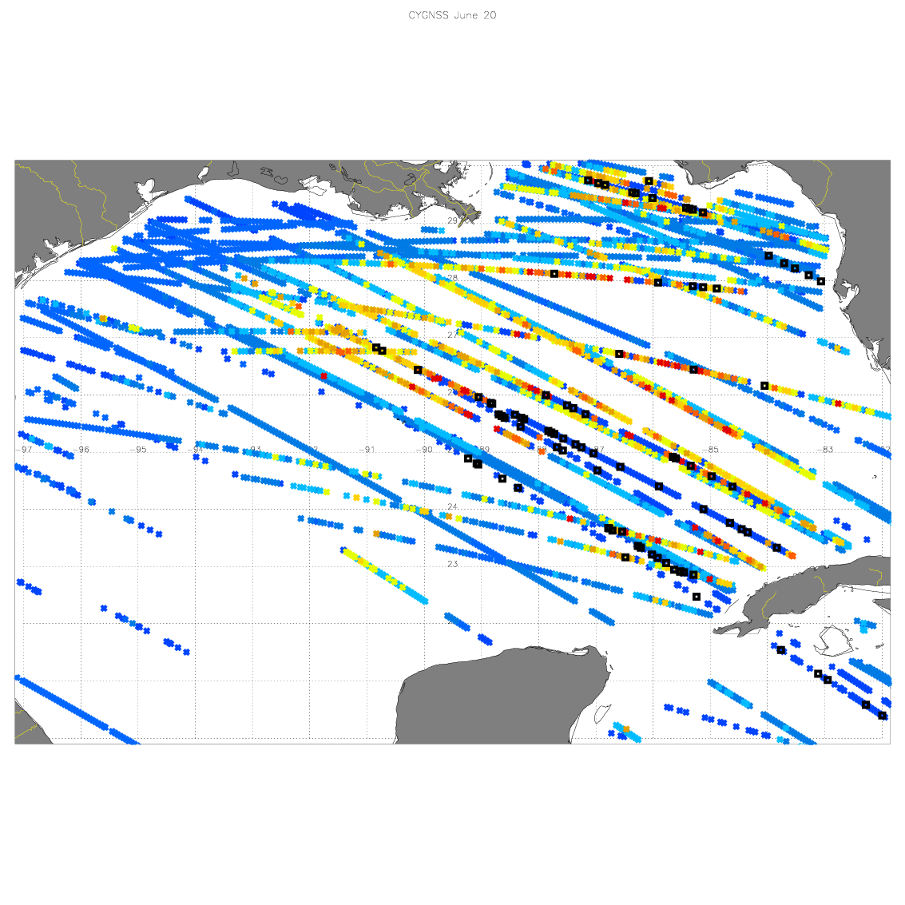
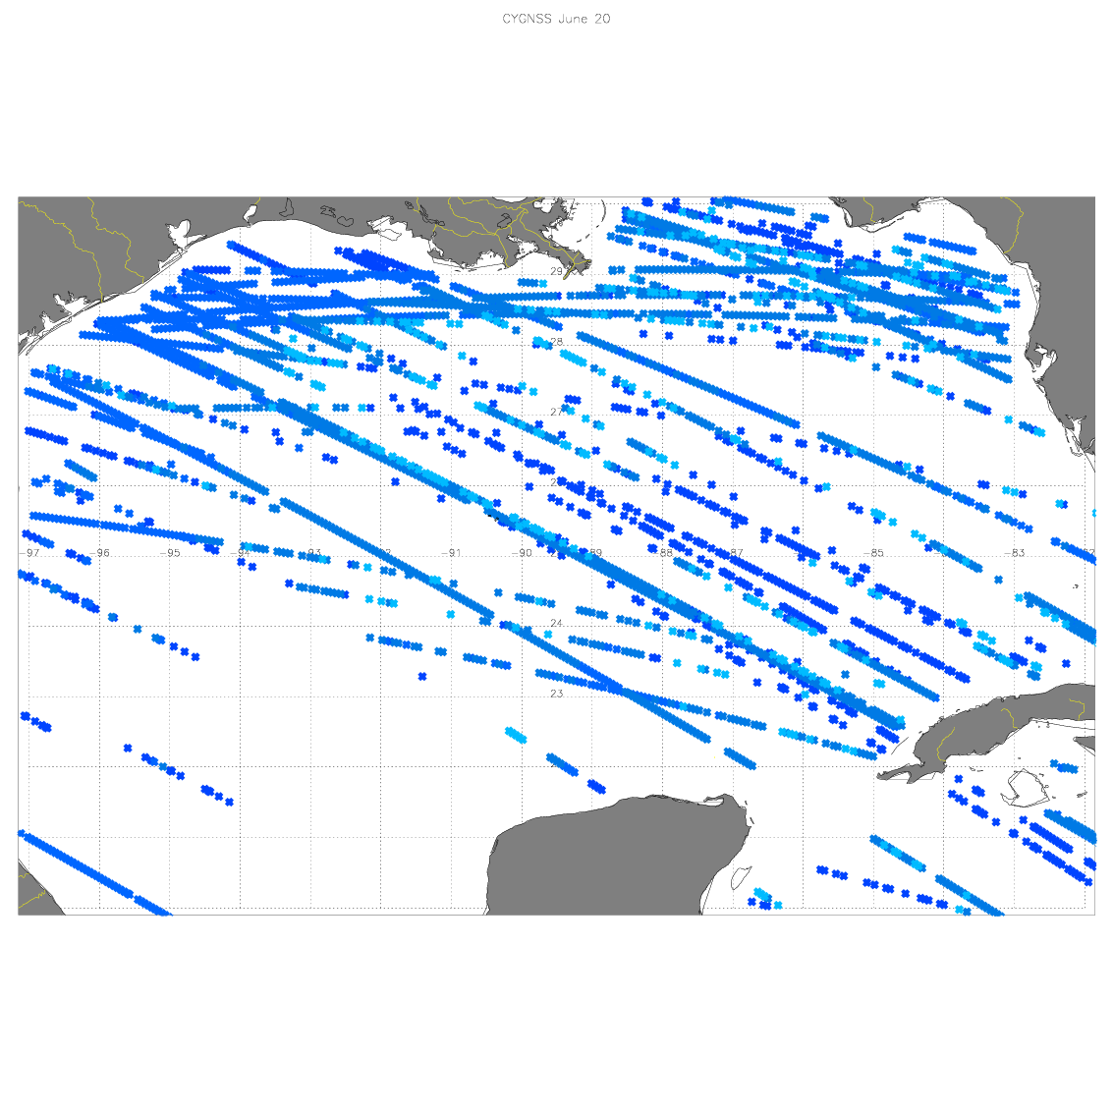
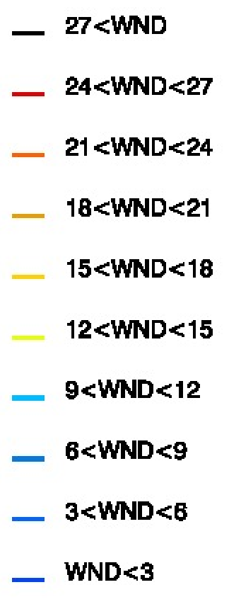
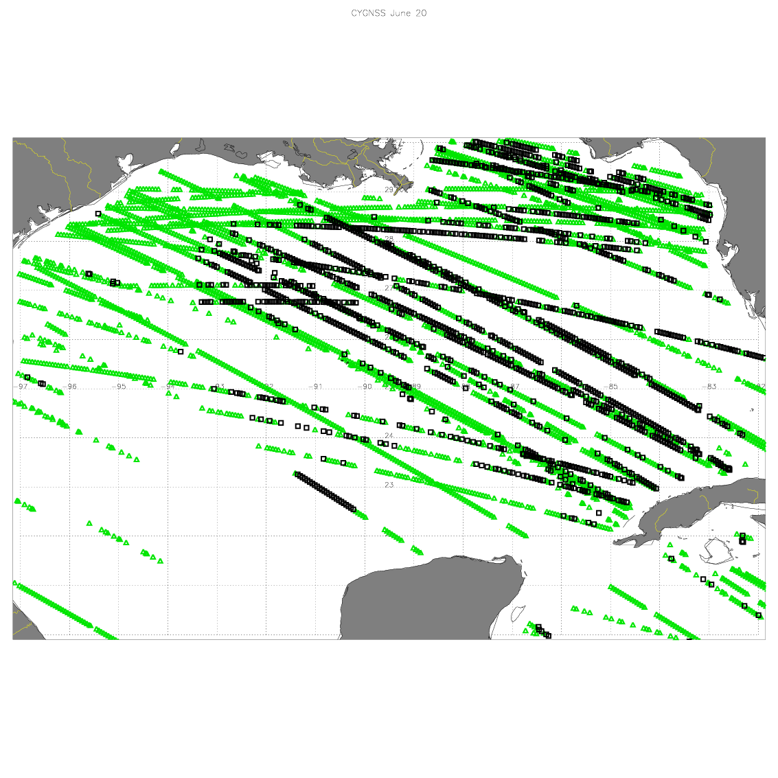
All Data
CYGNSS data 06/19 18Z-23:59Z AL03 [TD03]
All Data with Error=3 m/s
Errors
Error=3
Error>3
NHC MXWND: 35 KTS
HWRF MXWND: 35 KTS

Slide 4
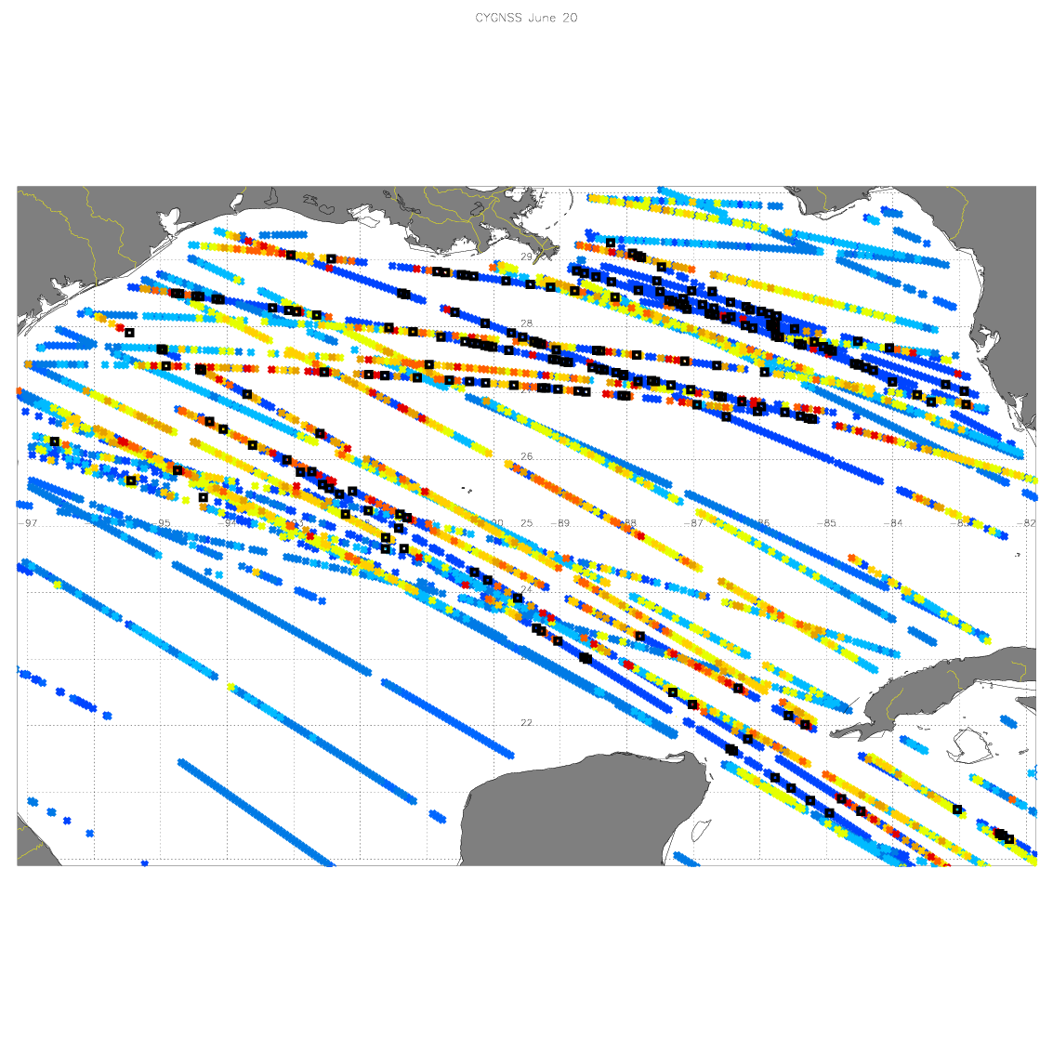
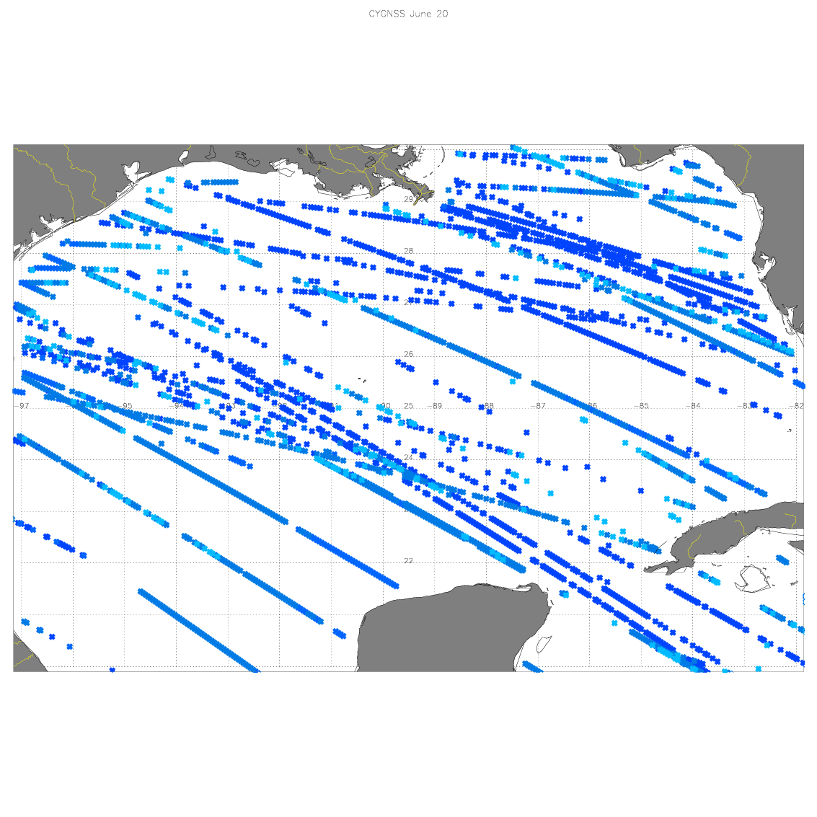
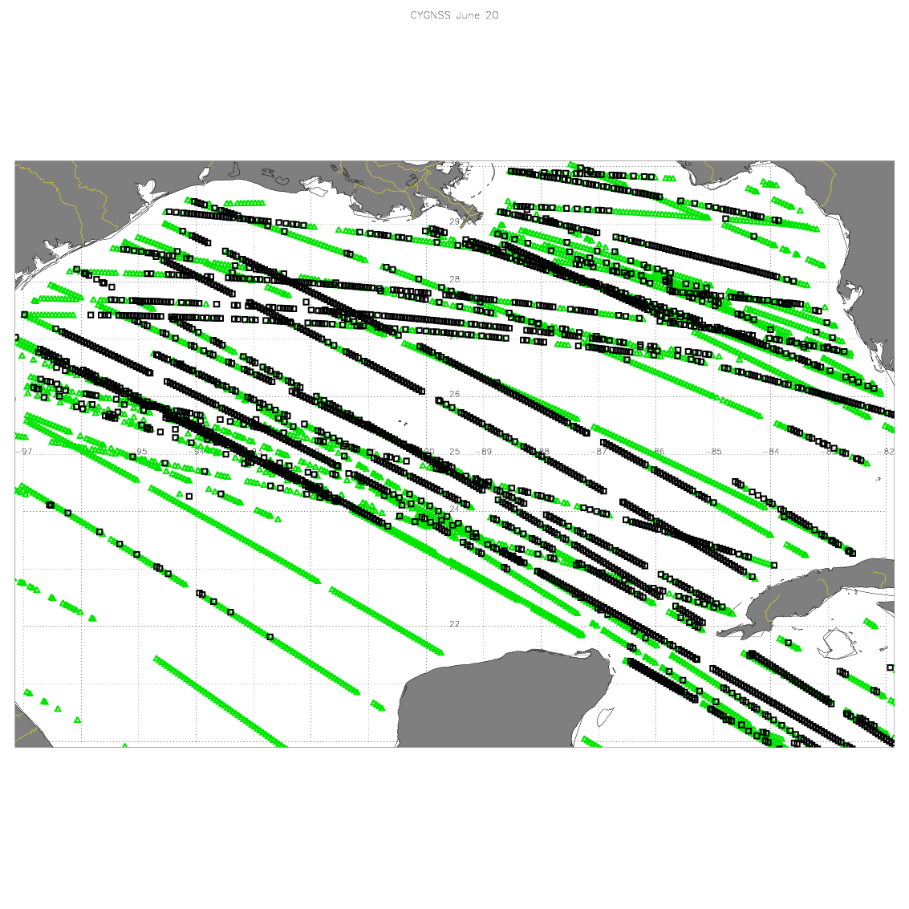
All Data
CYGNSS data 06/20 18Z-23:59Z AL03 [CINDY]
All Data with Error=3 m/s
Errors
NHC MXWND: 40 KTS
HWRF MXWND: 50 KTS
Error=3
Error>3

Slide 5
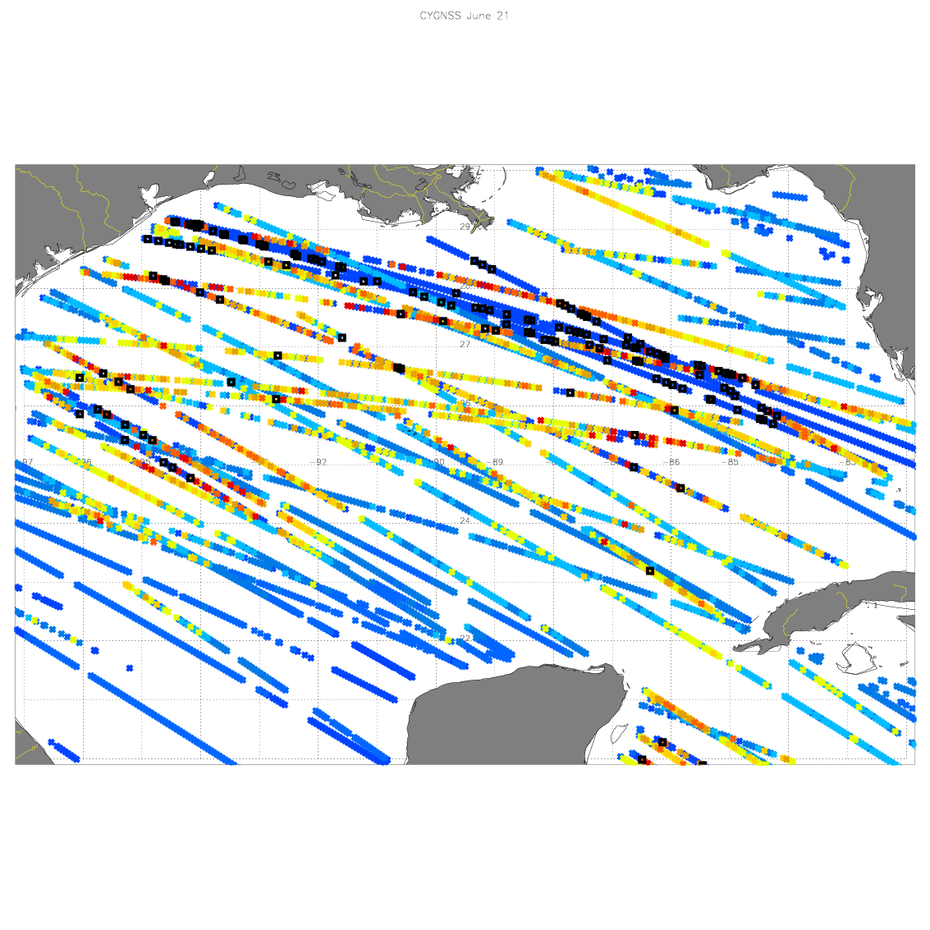
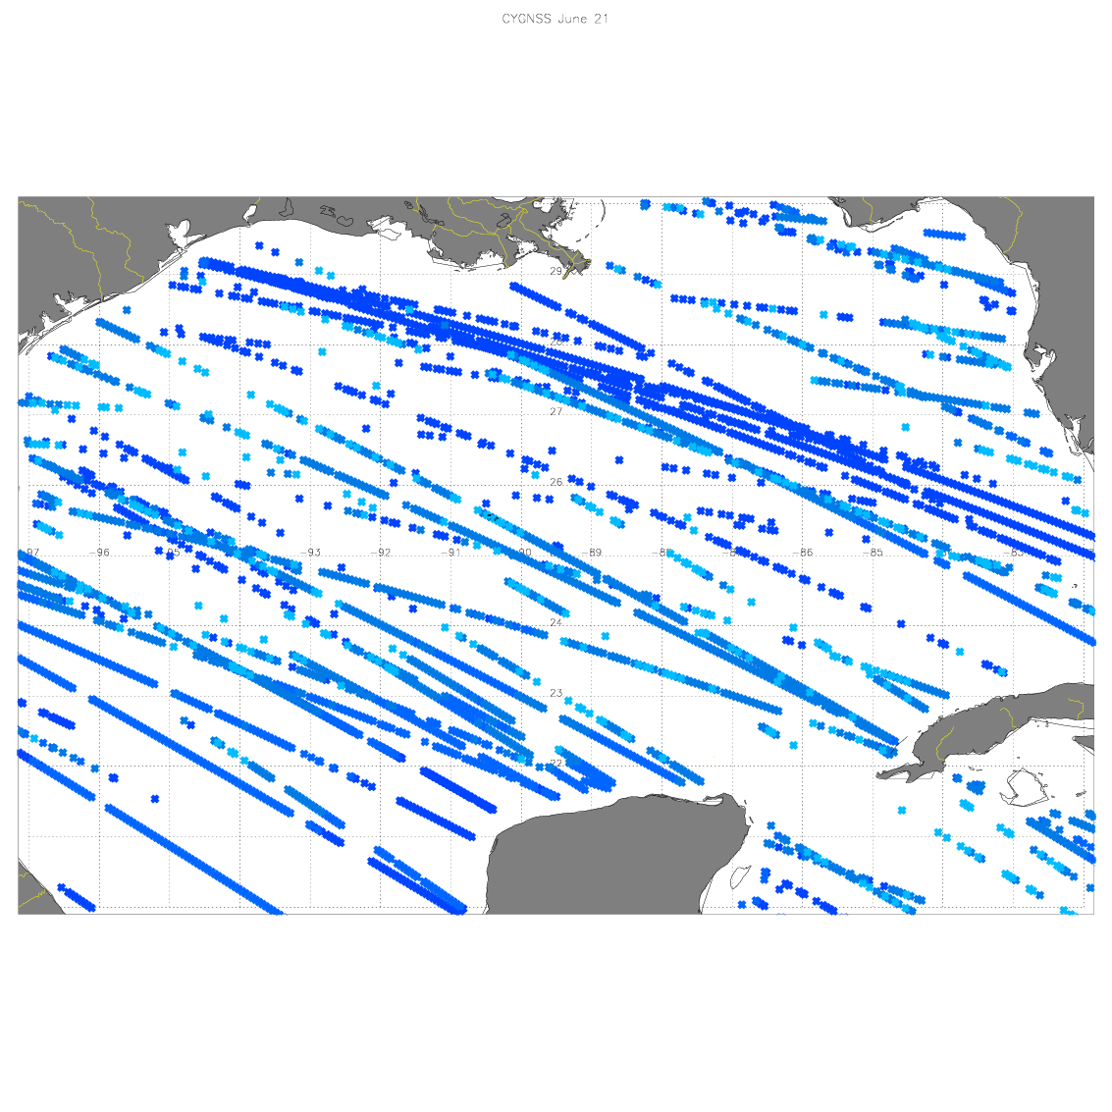
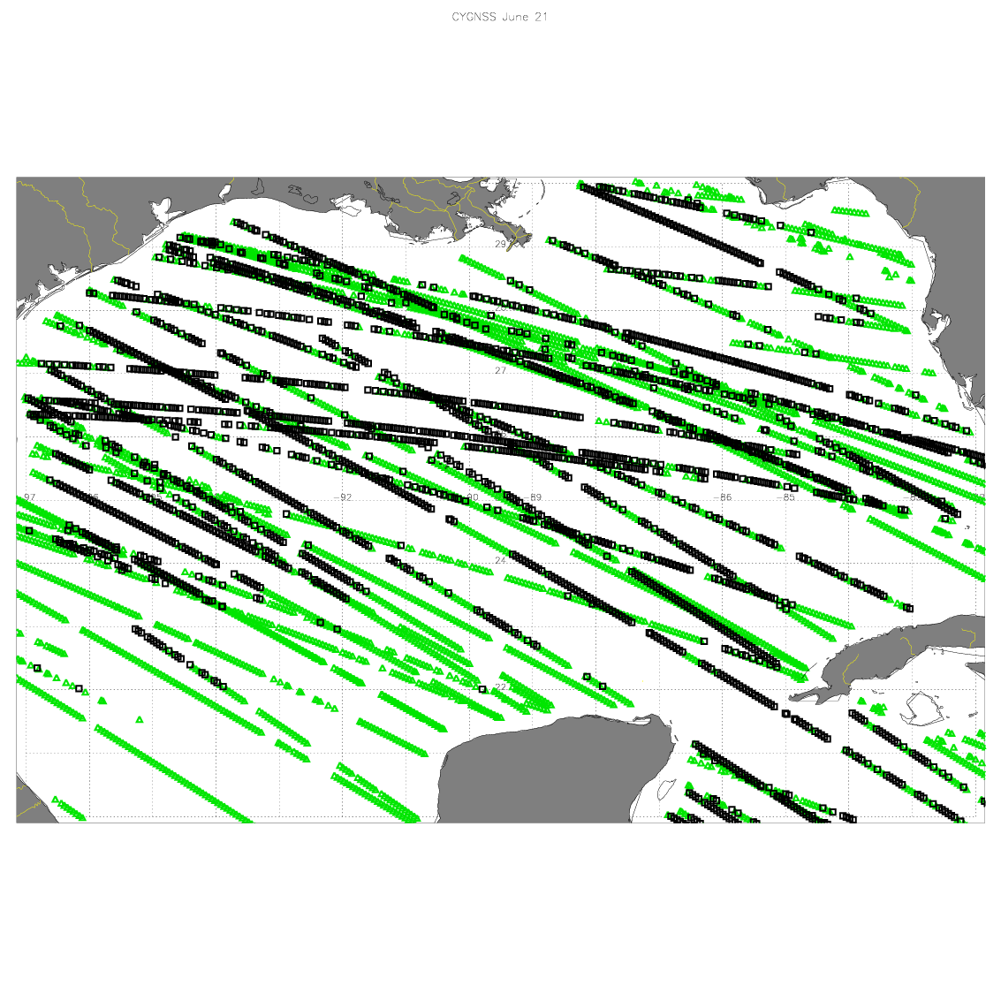
CYGNSS data 06/21 18Z-23:59Z AL03 [CINDY]
All Data
All Data with Error=3 m/s
Errors
Error=3
Error>3
NHC MXWND: 45 KTS
HWRF MXWND: 45 KTS

Slide 6
Dropsonde data (CPEX) 06/19 18Z-23:59Z AL03 [TD03]
20 drops
8 dropsondes with no surface observations
Min=9.58 m/s and max=18.21 m/s
CYGNSS values are on this interval [0,12]
NHC maximum wind is 18 m/s

Slide 7
Dropsonde data (CPEX) 06/20 18Z-23:59Z AL03 [CINDY]
16 drops
All drops are good
Min=0.53 m/s and max=17.60 m/s
CYGNSS values are on this interval [0,12]
NHC maximum wind is 20.57 m/s

Slide 8
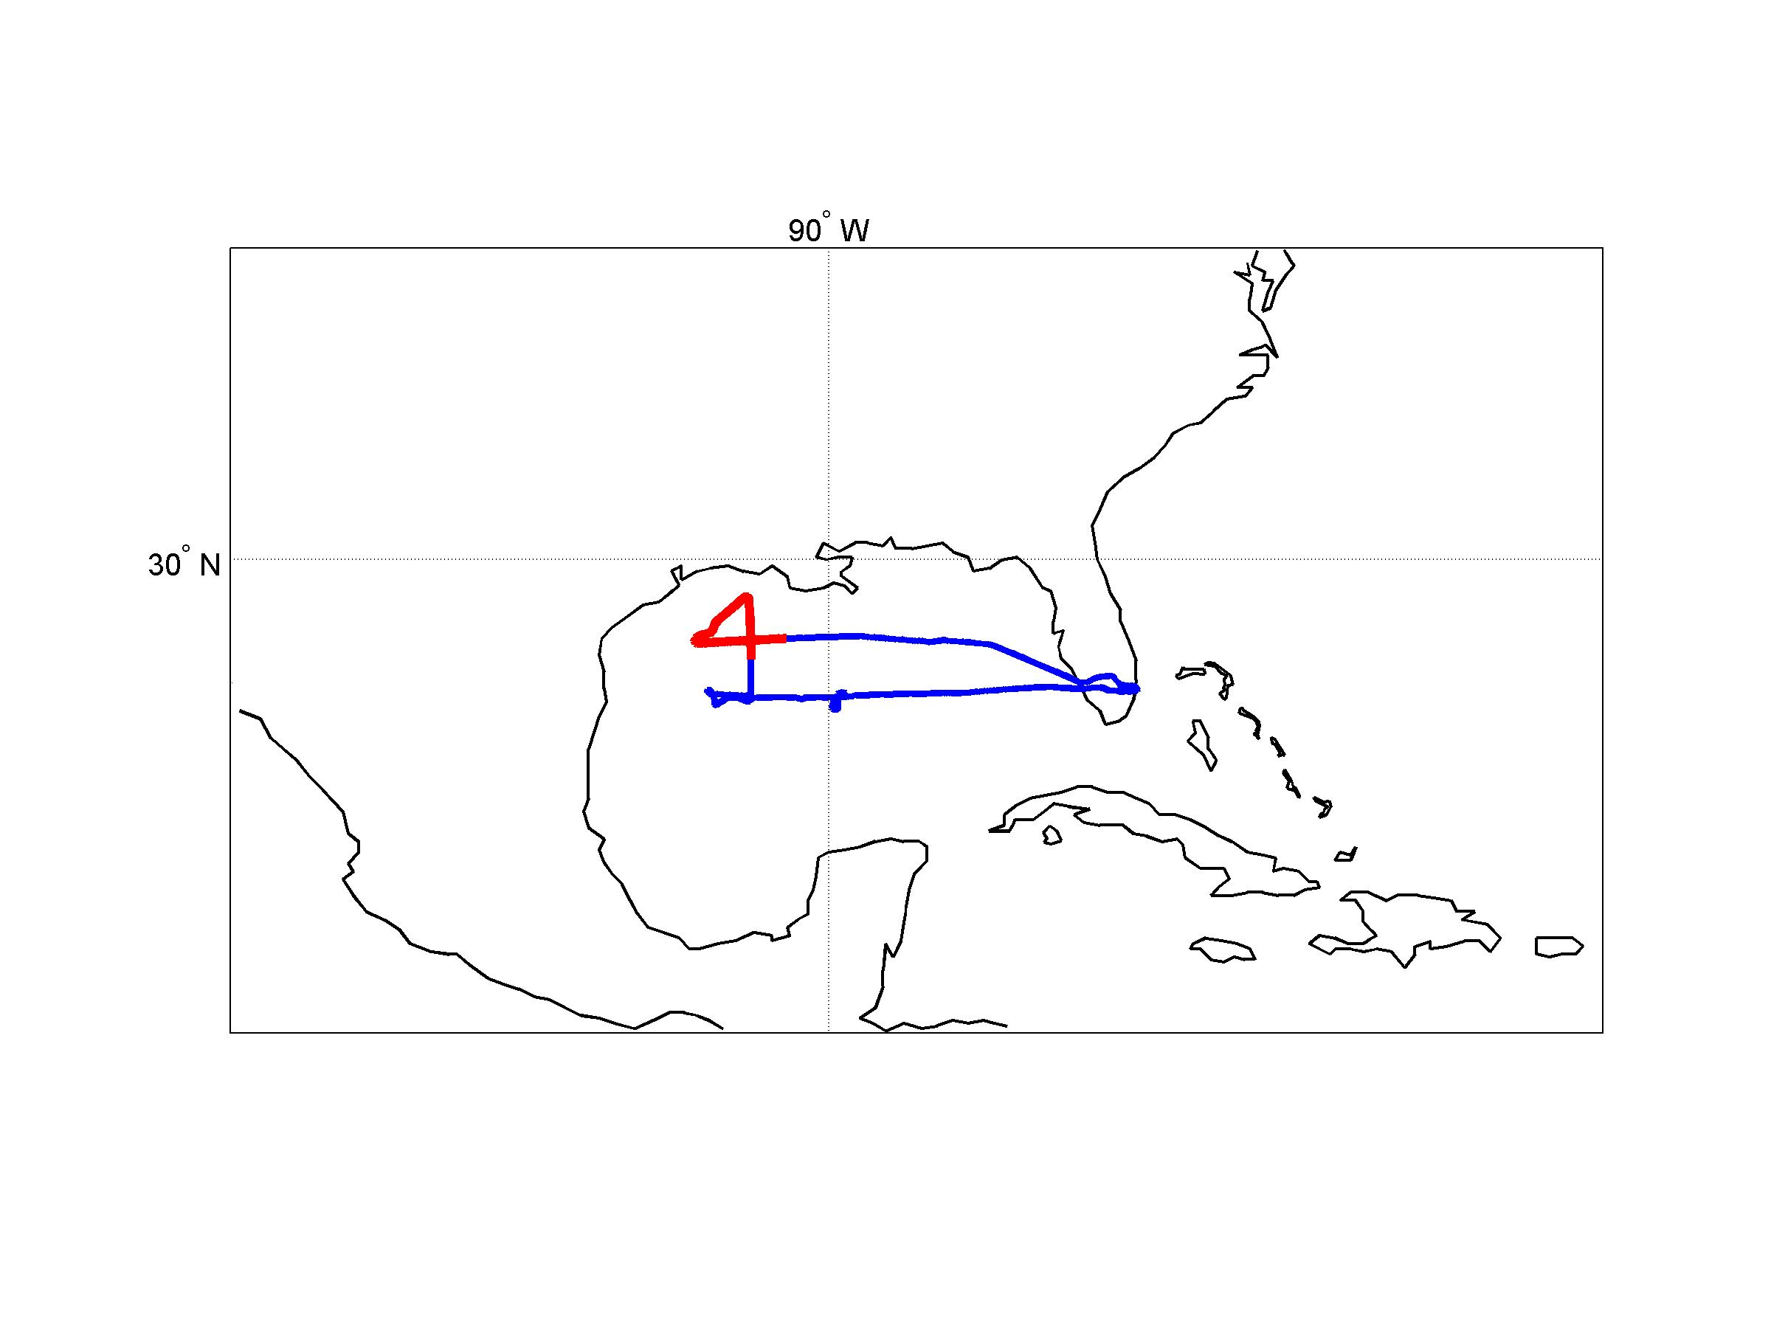
Dropsonde data (CPEX) 06/21 18Z-23:59Z AL03 [CINDY]
11 drops
2 dropsondes with no surface observations
Min=9.71 m/s and max=18.60 m/s
CYGNSS values are on this interval [0,12]
NHC maximum wind is 23.15 m/s

Slide 9
Gust factor 10 min mean to 1 min mean
In Literature the gust factors varies from 1.05 to 1.14.
Operationally 1.14 is used.
Day | Dropsonde data (m/s) | CYGNSS data with gust factor (m/s) | NHC max wind (m/s)
06/19 | [9.58 ,18.21] | [0,13.68] | 18
06/20 | [0.53 ,17.60] | [0,13.68] | 20.57
06/21 | [9.71 ,18.60] | [0,13.68] | 23.15

Slide 10
Steps for creating the prepbufr file
QC the data
Use the observation error
Apply the gust factor
Create prebufr file

Slide 11
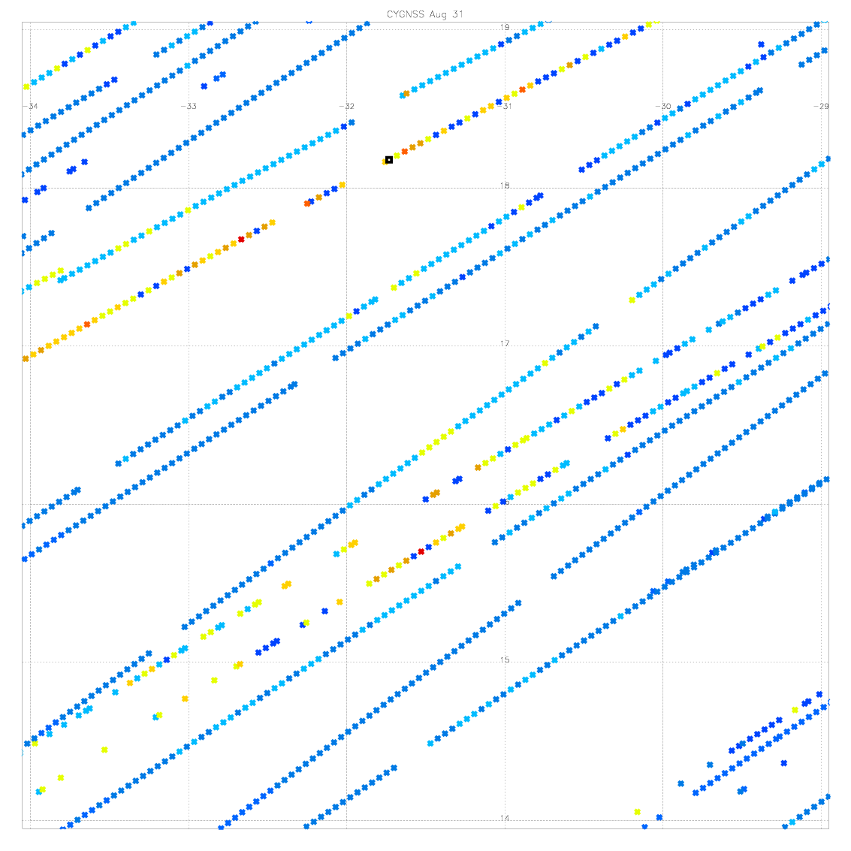
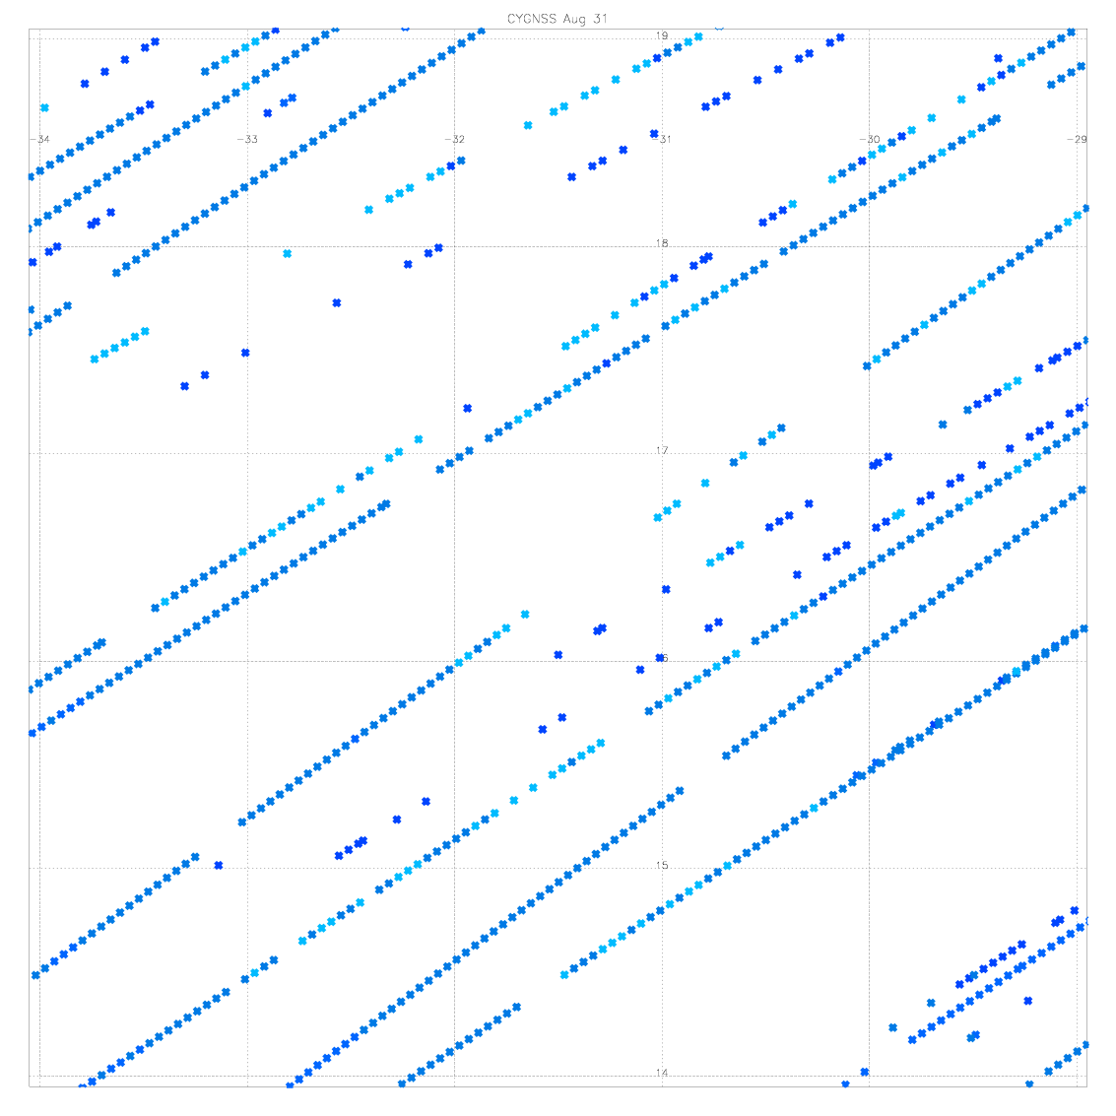
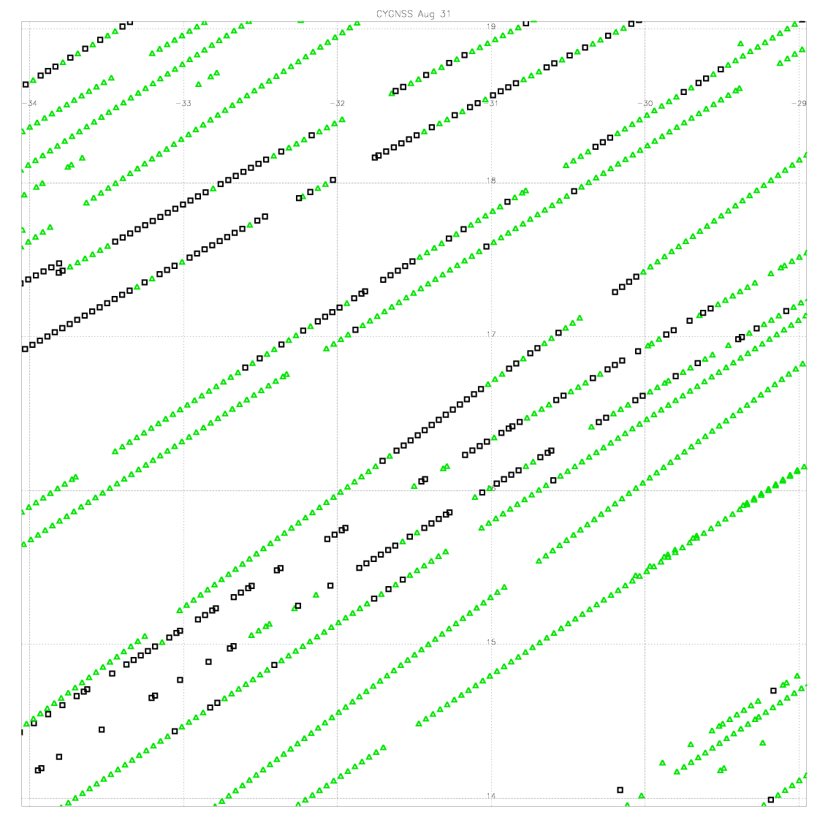
High wind speed case Irma 08/31 00z + - 3 hours
All Data
All Data with Error=3 m/s
NHC max winds ~28 m/s
Error=3
Error>3
Errors

Slide 12
Additional Slide

