Slide 1
HWRF CYGNSS Observing System Experiments (OSEs)
OSEs will focus on:
Poorly observed periods of TC lifecycles (genesis)
Poor operational HWRF forecasts
Four candidate hurricanes identified: Harvey, Irma, Katia, Maria
1-2 day forecasts of hurricane intensity/genesis are a focus (OSSE results)

Slide 2
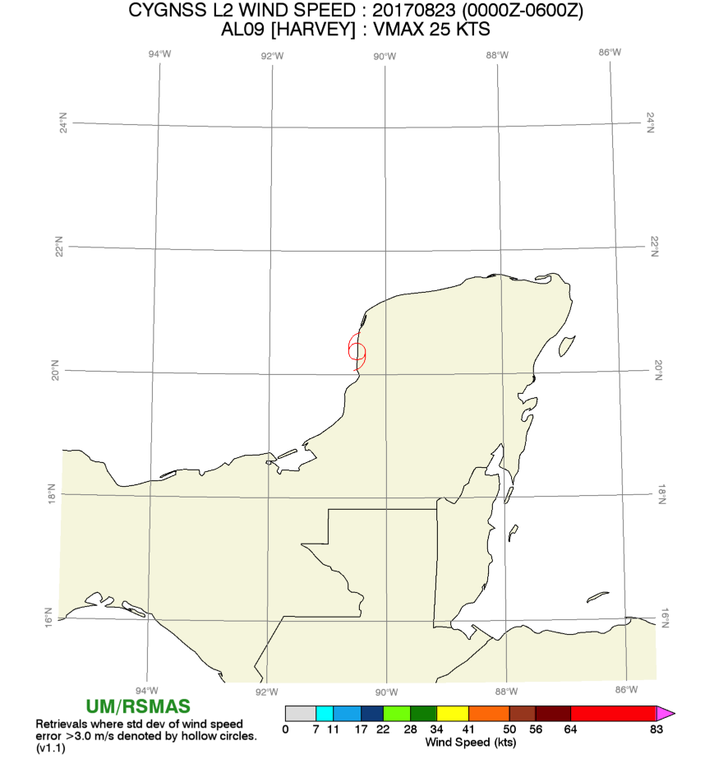
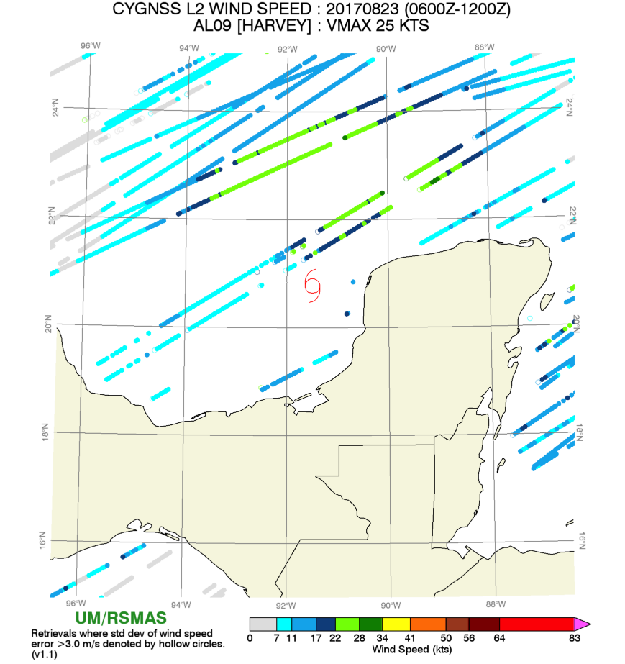
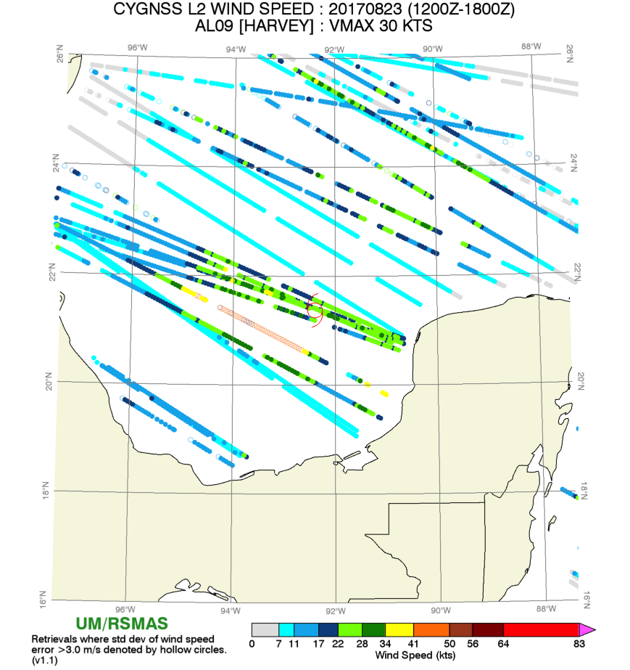
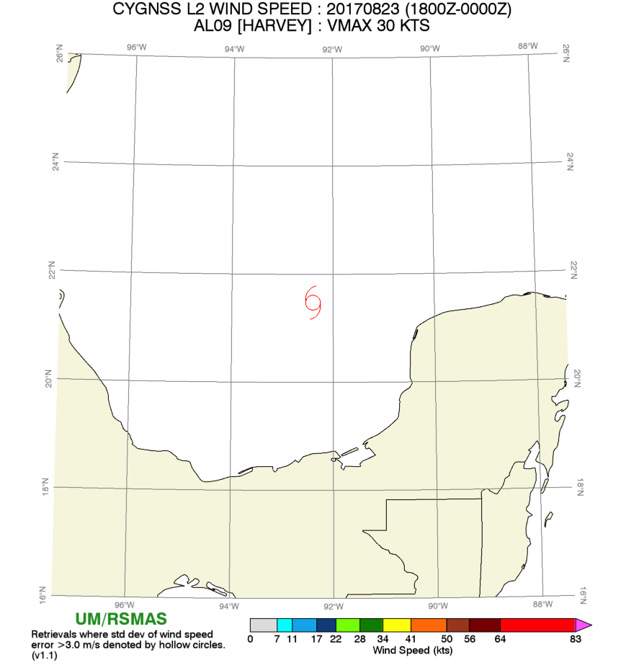
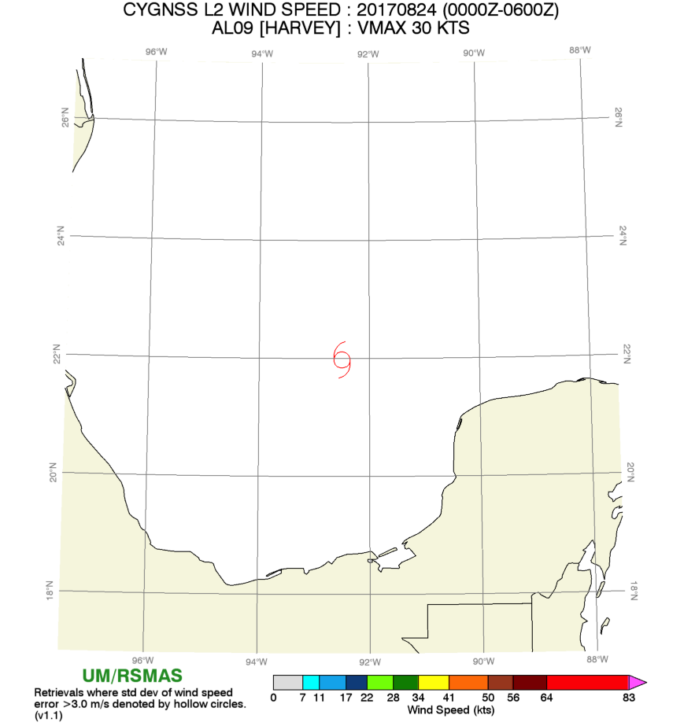
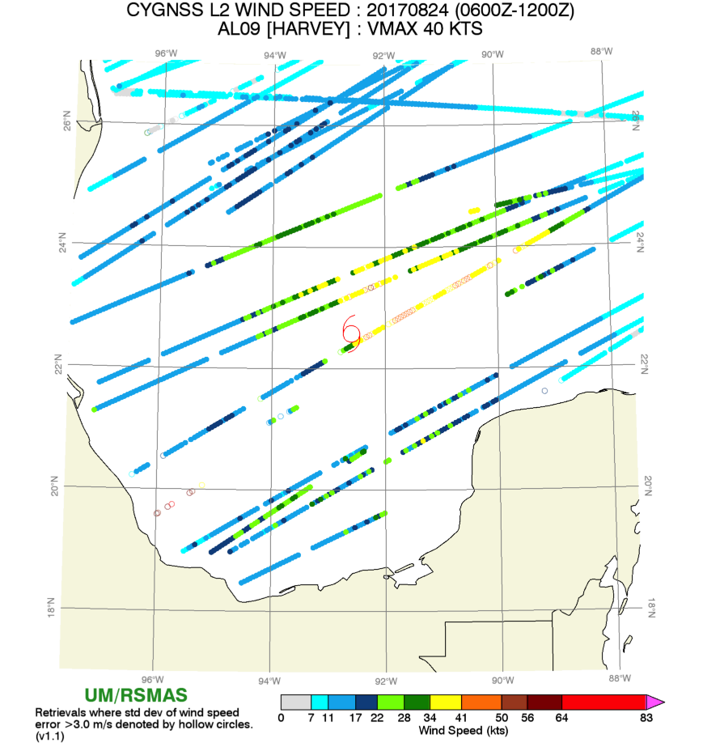
Harvey
Hurricane Harvey 08/17-09/01
Airforce flights: 08/23 -08/26
Tail Doppler Radar (TDR) collected : 08/24-08/25
CYGNSS data 08/23-08/24 12Z

Slide 3
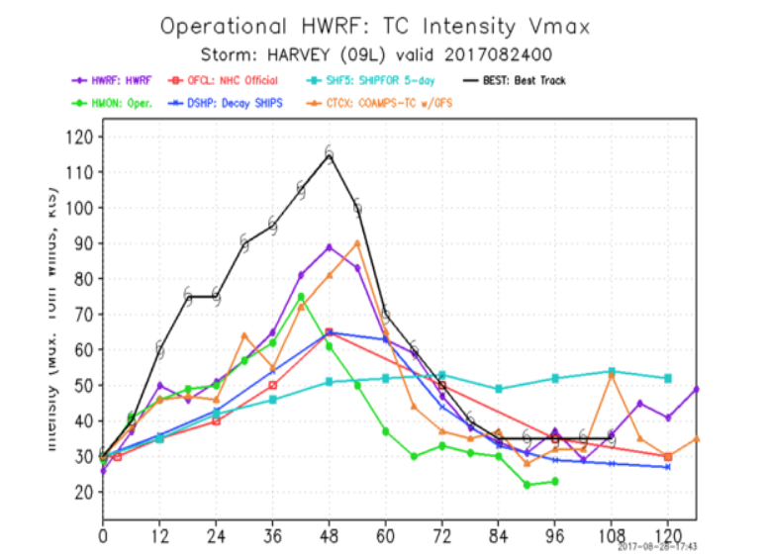
HWRF CYGNSS Observing System Experiments (OSEs)
Poor short term intensity forecast
Intensity: 25kts error after 24hr.
Track : Best track: 24/03Z 21.9N 92.6W
HWRF: 24/03Z 21.8N 92.8W

Slide 4
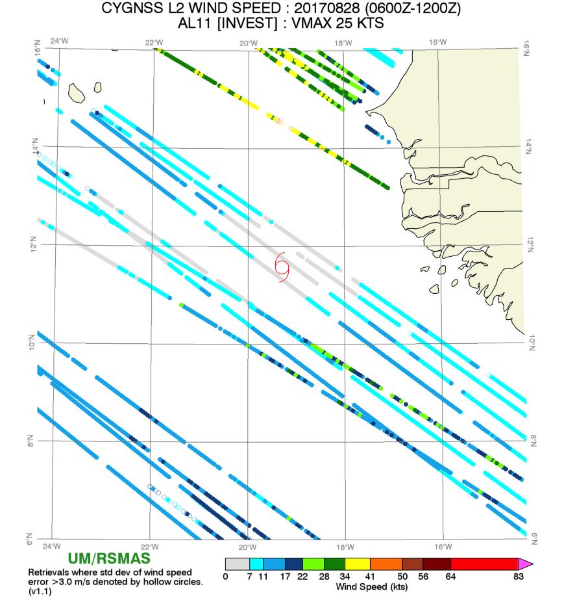
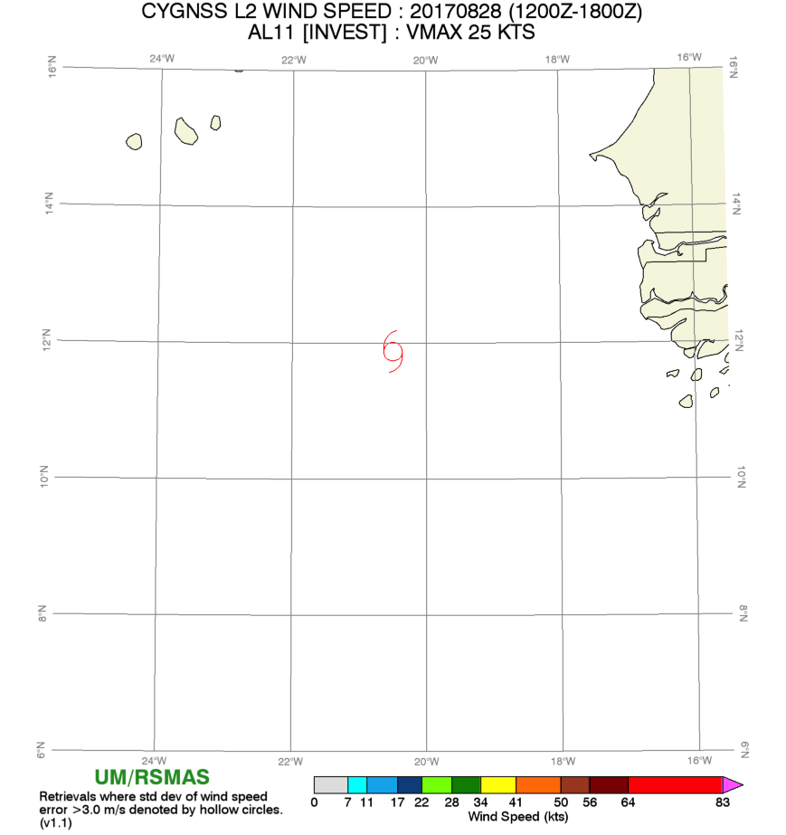
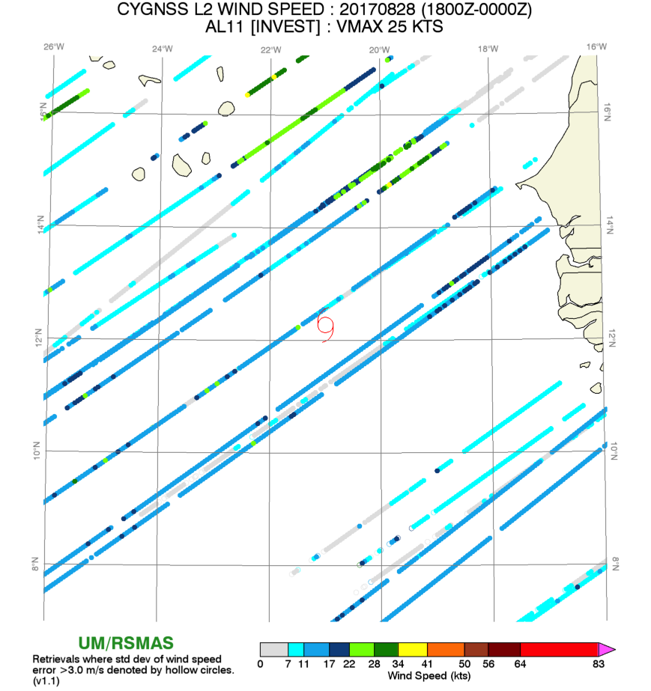
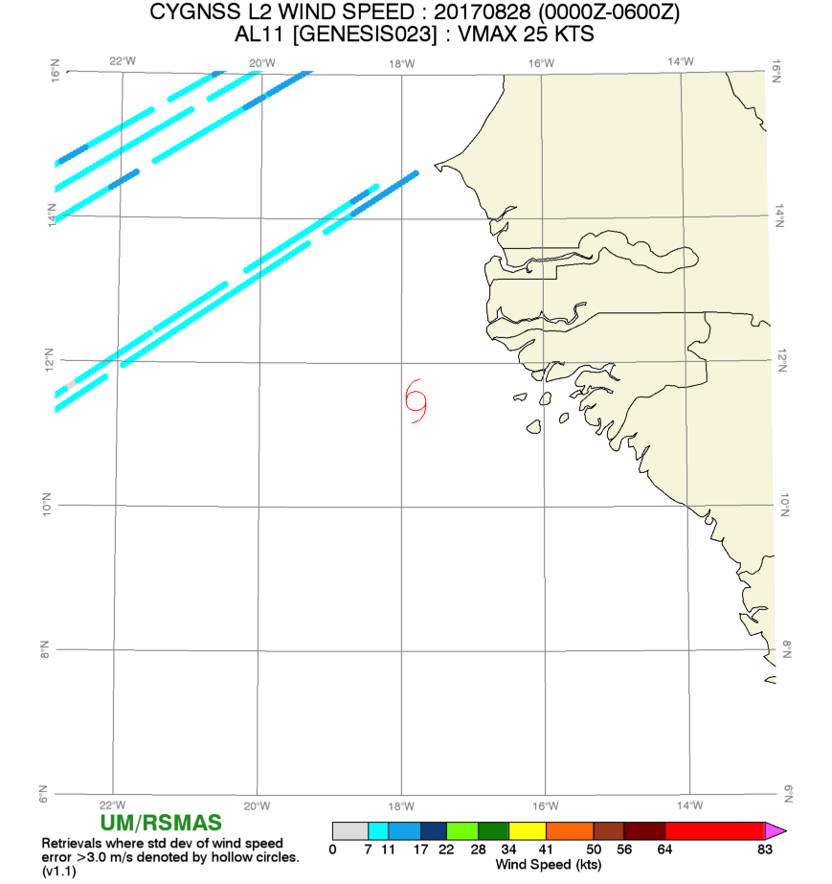
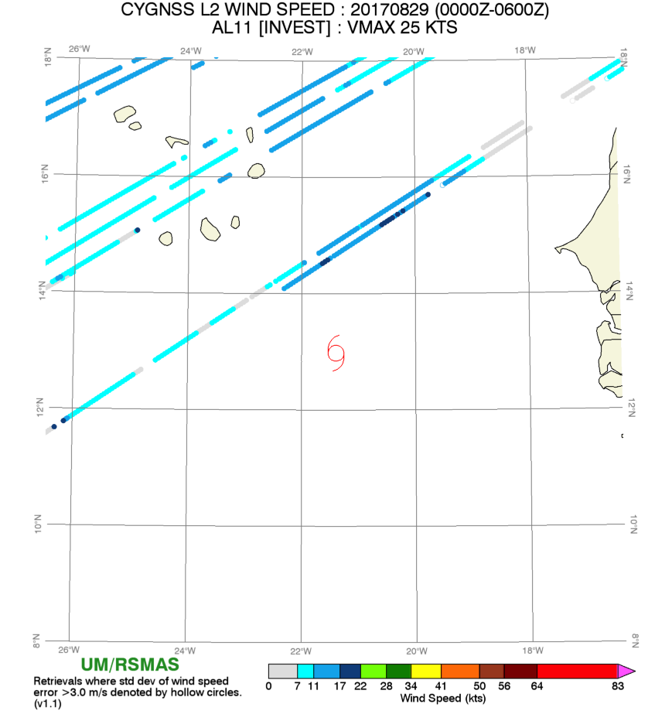
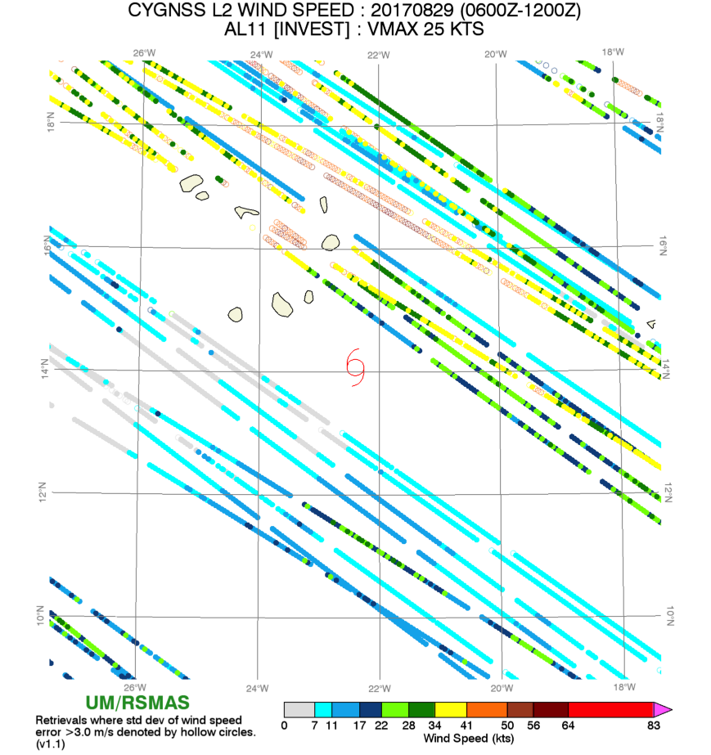
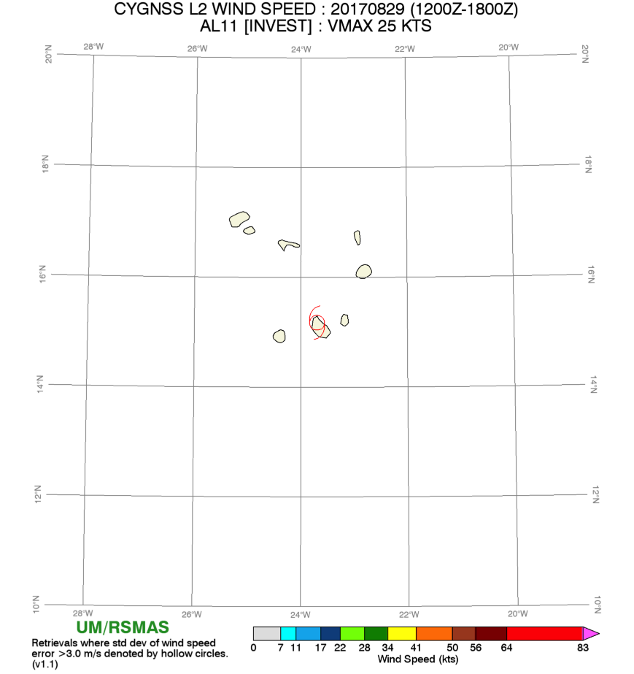
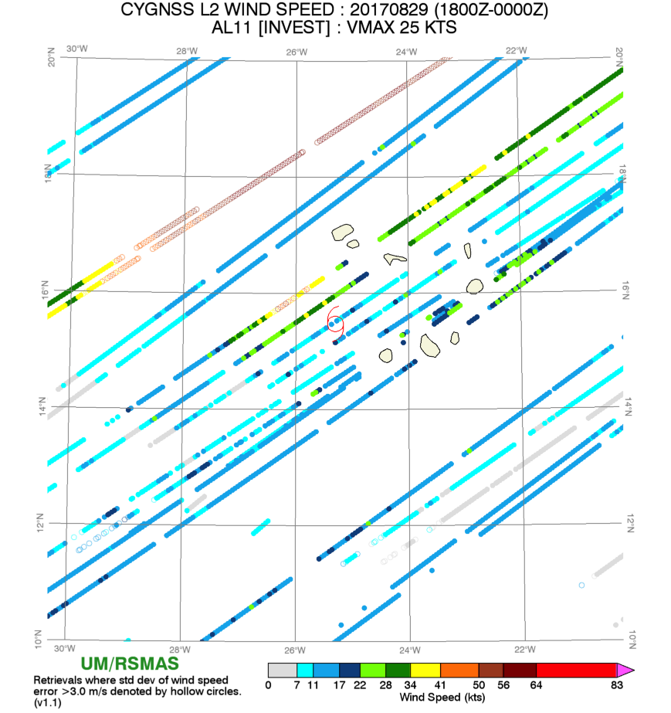
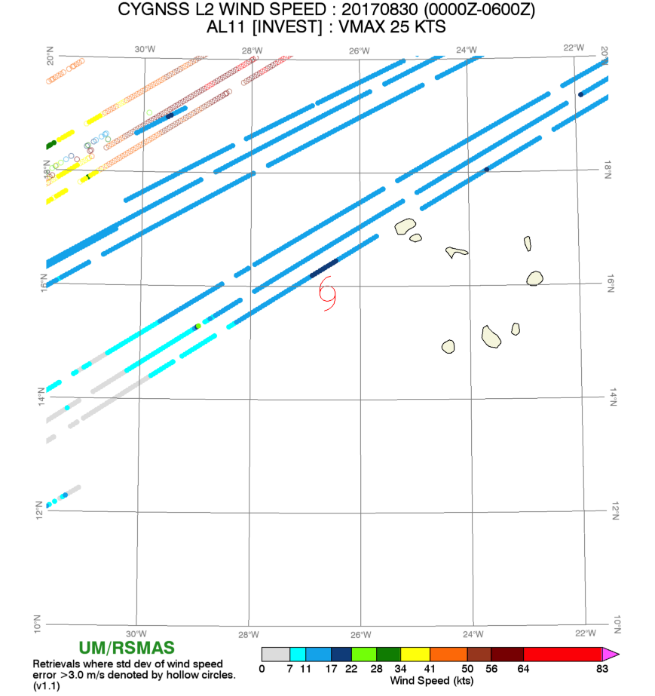
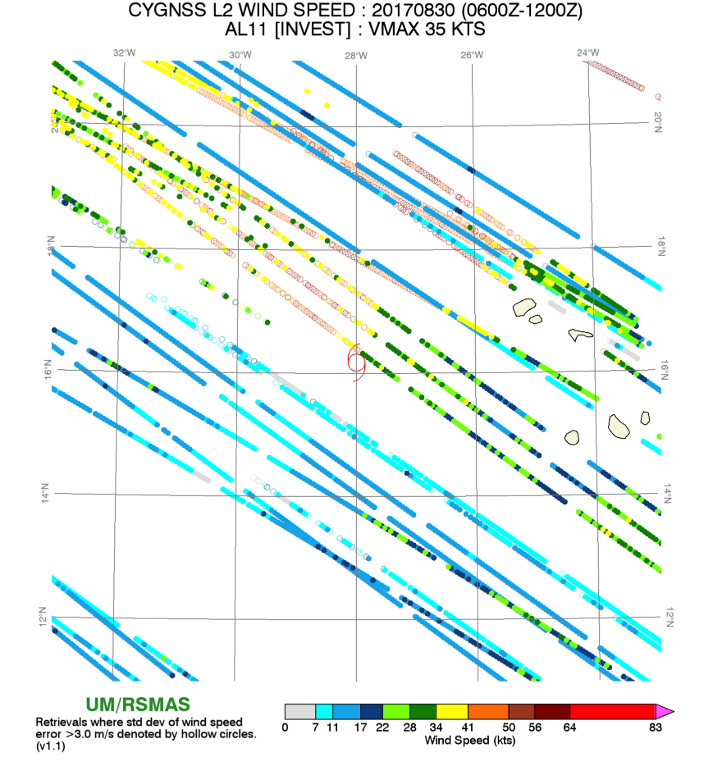
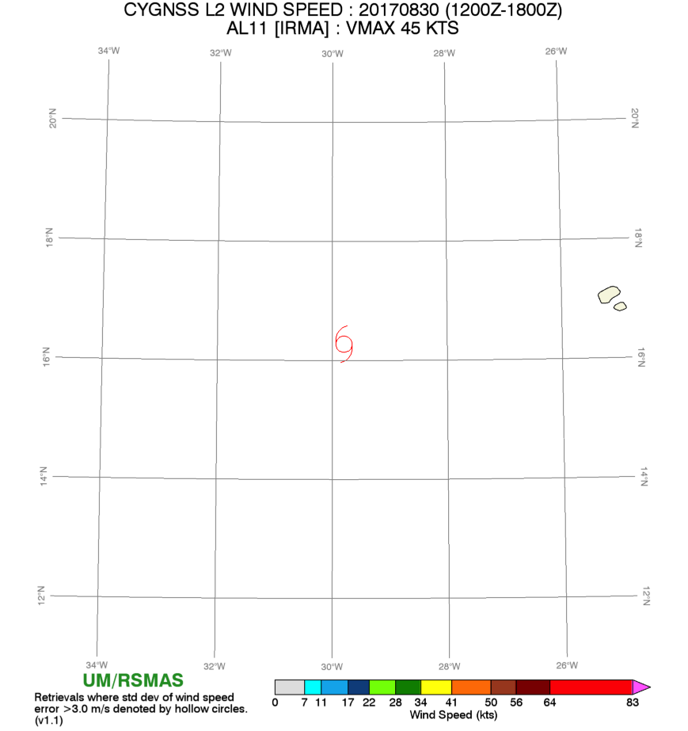
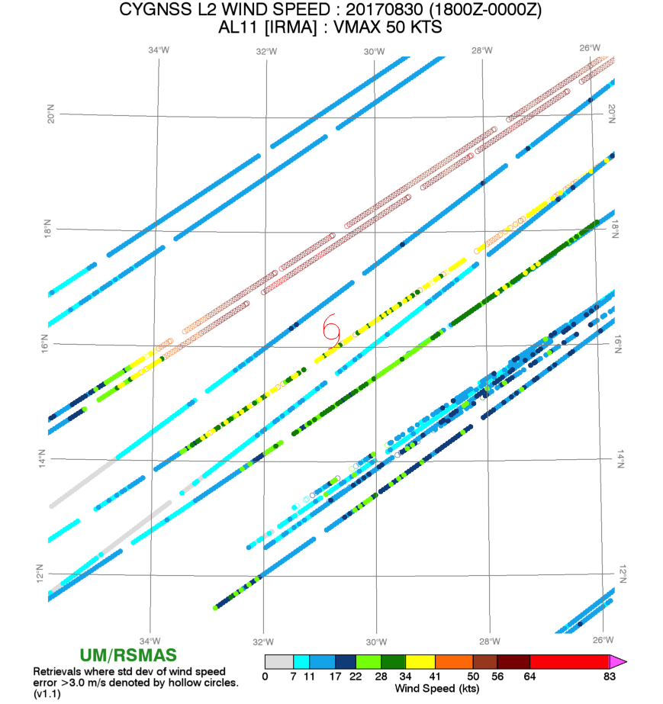
Irma
Hurricane Irma 08/30 (12Z)-09/12
Tail Doppler Radar (TDR) collected: 09/03-09/05 and 09/08
Air force started flying on 09/04
Tropical storm on 08/30 12Z (1004 CP)
CYGNSS data 08/28-08/30

Slide 5
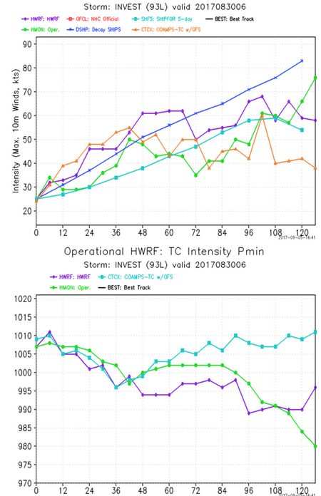
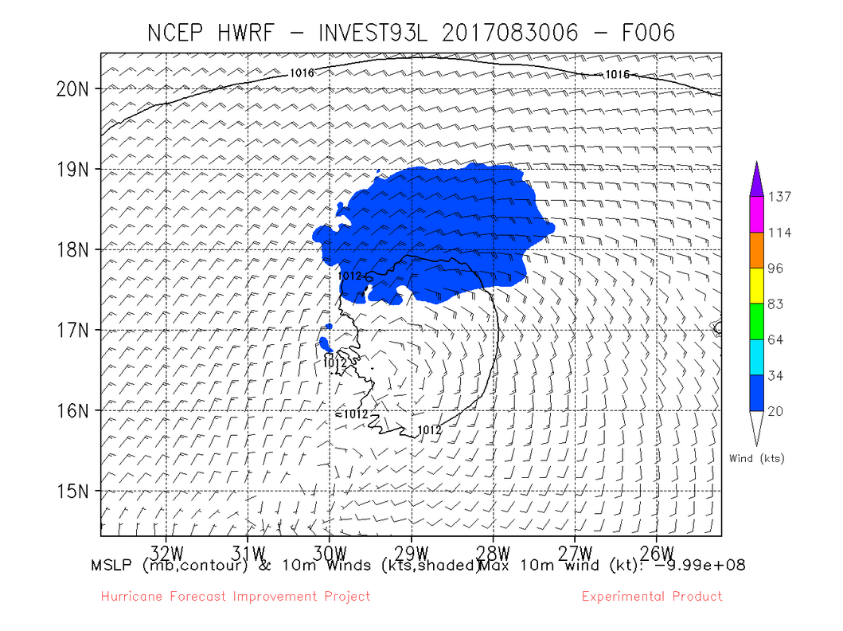
Irma
HWRF runs:
HWRF Invest 93L runs on 08/28 12Z to 08/30 06Z
Poor short term forecast (50kt error at hr 39).
NHC: 30/12Z 45kts, 16.4N 30.3W
31/21Z 100 KT

Slide 6
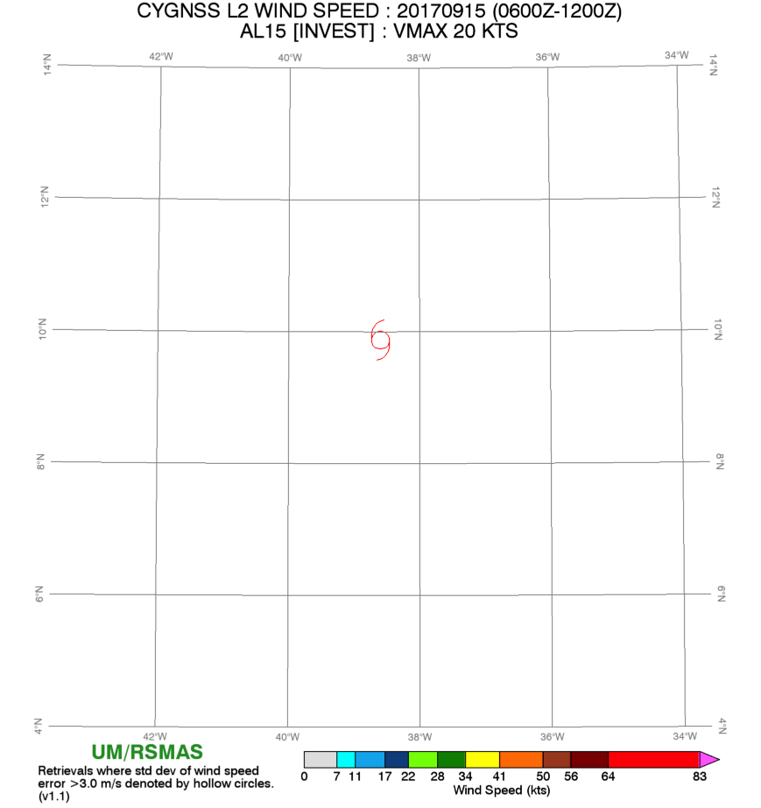
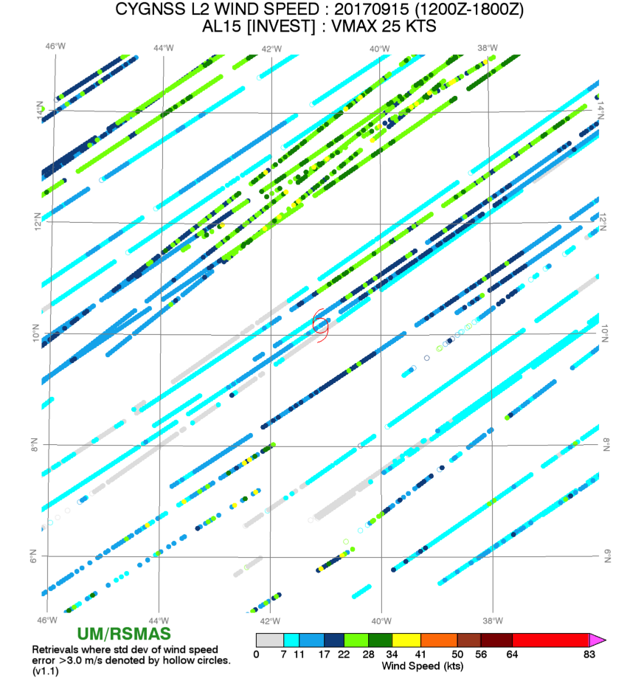
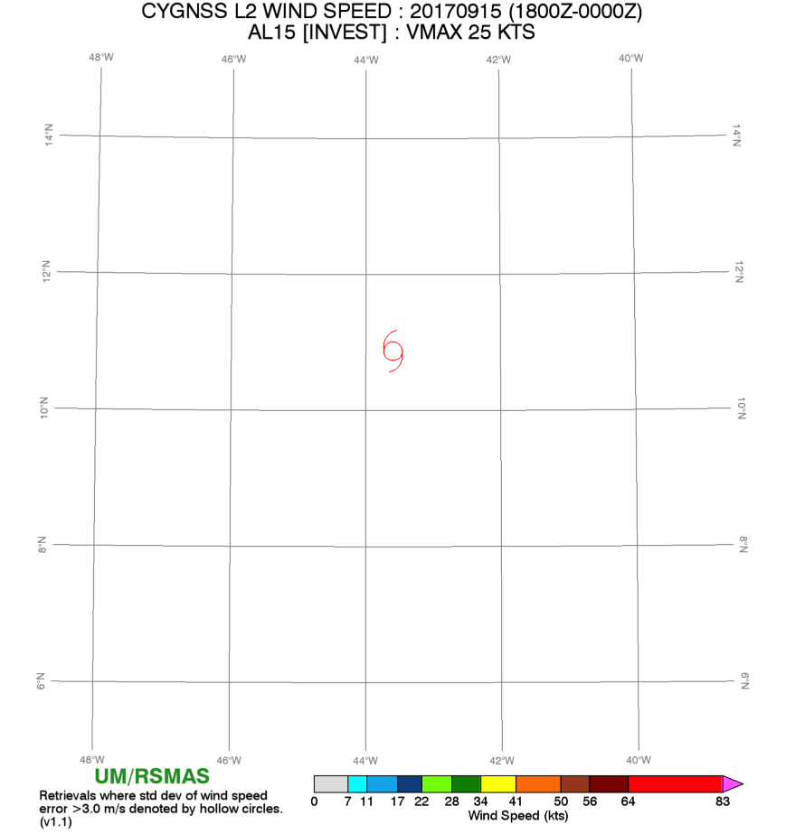
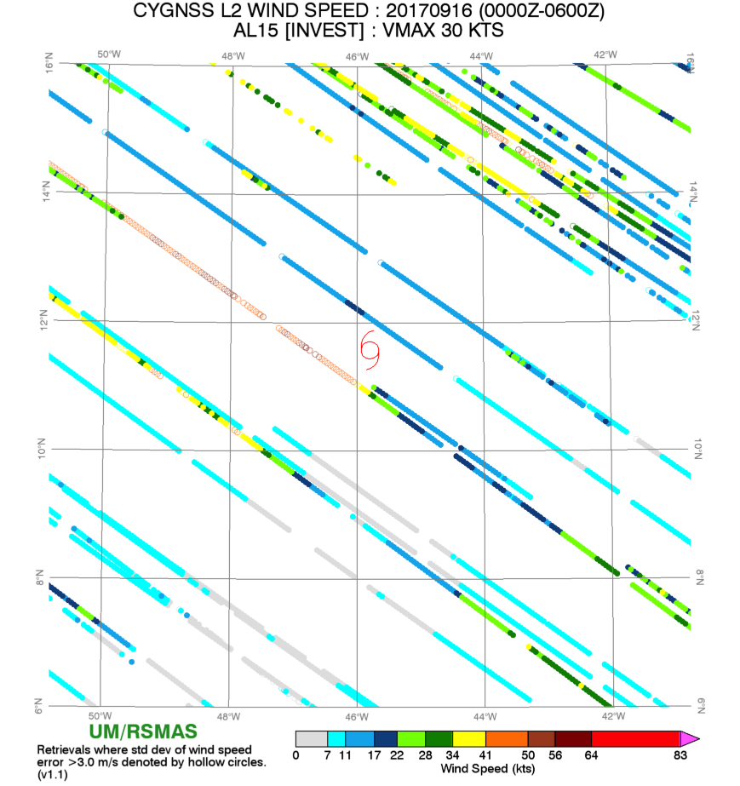
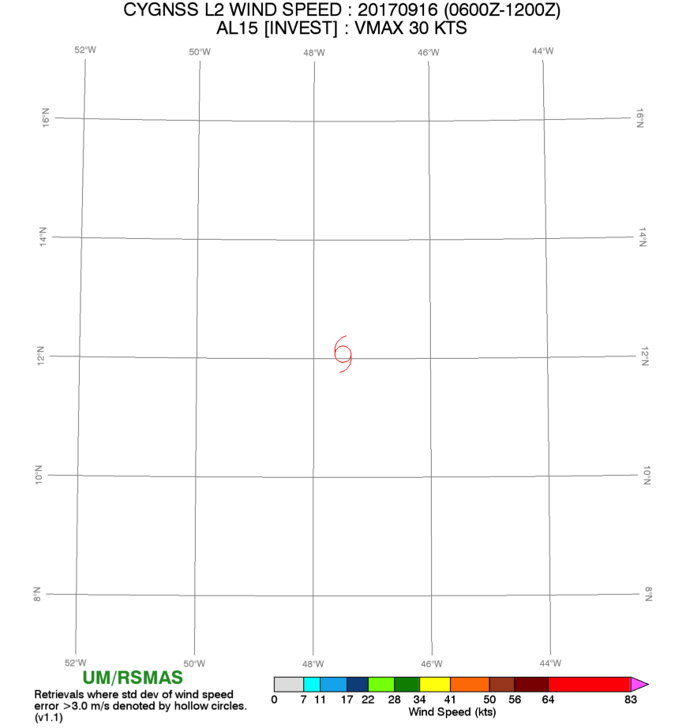
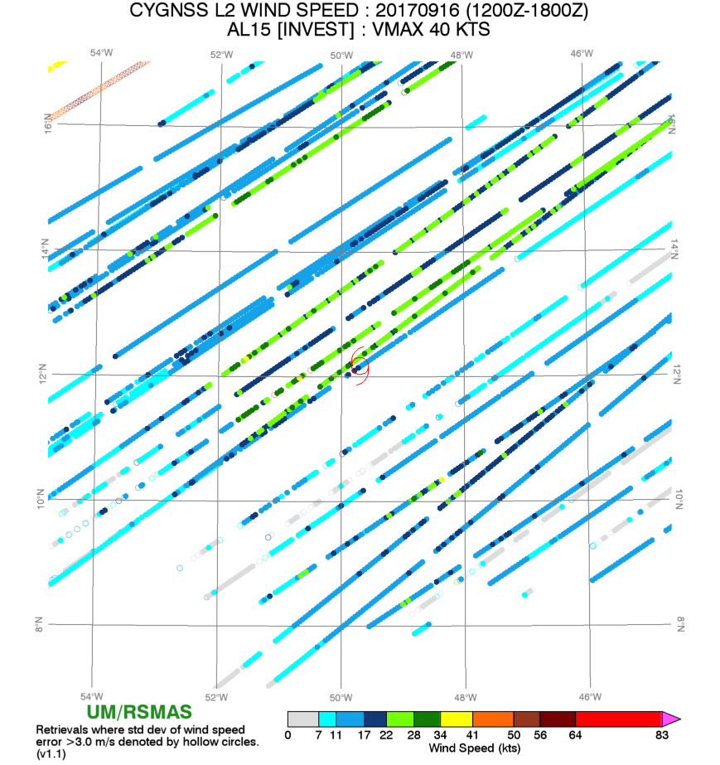
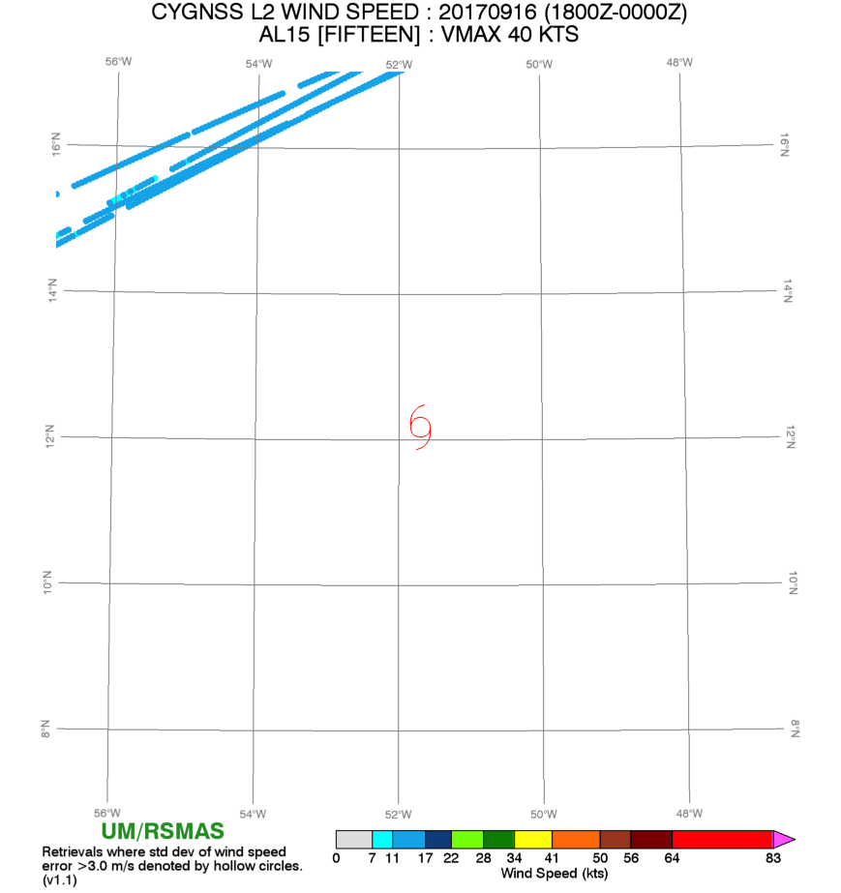
Maria
Hurricane Maria 09/16 - 09/30
Tail Doppler Radar (TDR) collected : 09/22-09/26
Air force started flying September 18.
CYGNSS data 09/15-09/16

Slide 7
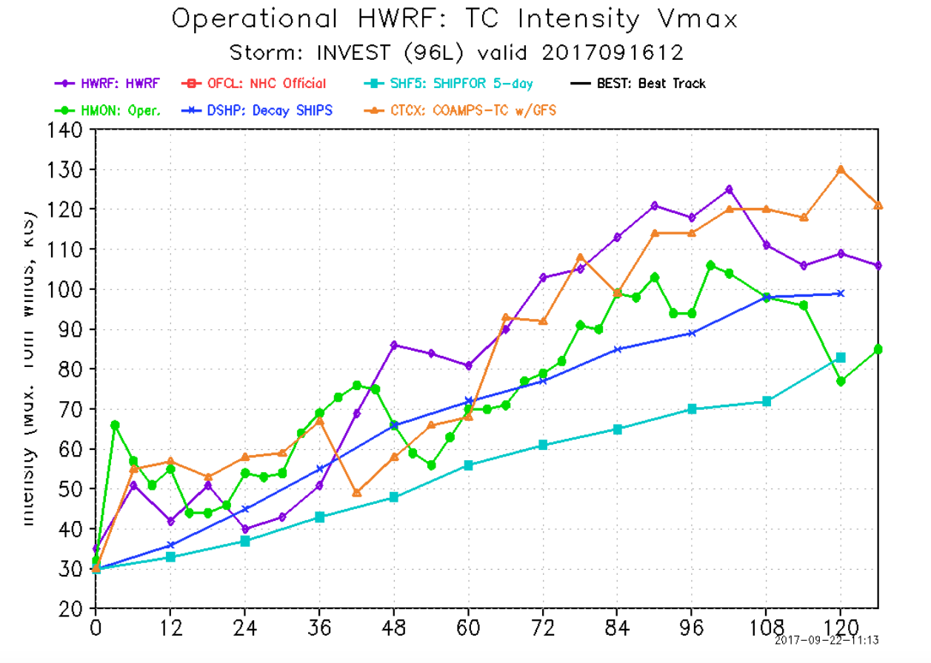
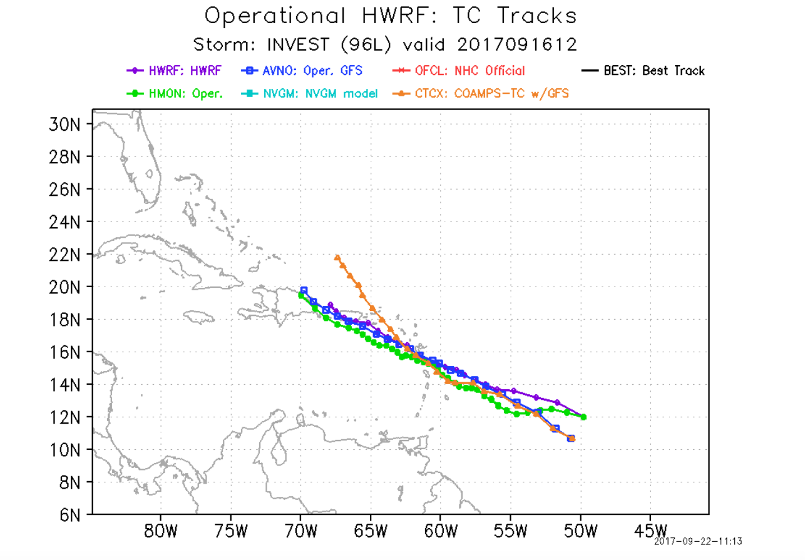
Maria
HWRF runs:
Invest 93L runs on 09/15 12Z to 09/16 12Z
TD 09/16 18Z
NHC: 16/15Z 12.2N 50.5W 30 KT
17/15Z 13.5N 56.2W 55 KT
Poor short term intensity forecast.

Slide 8
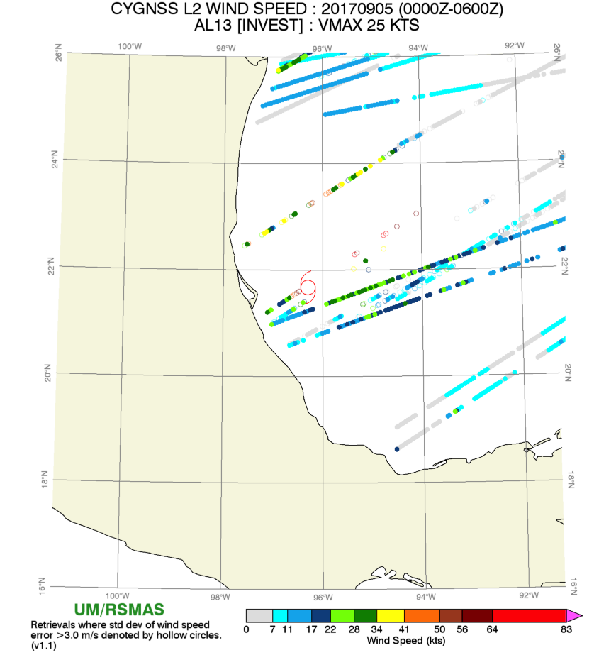
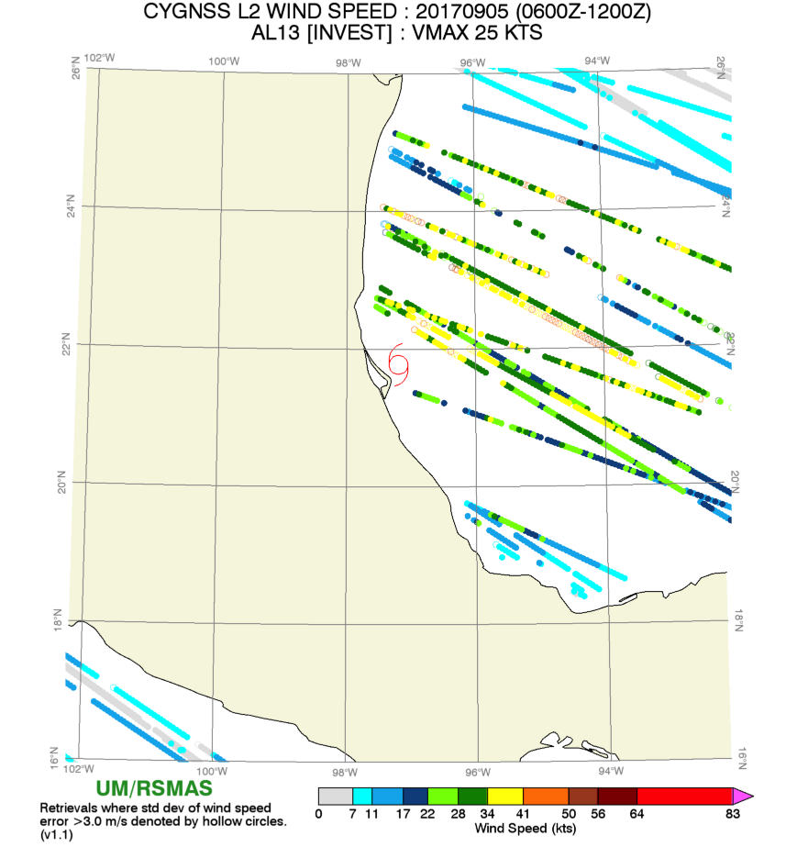
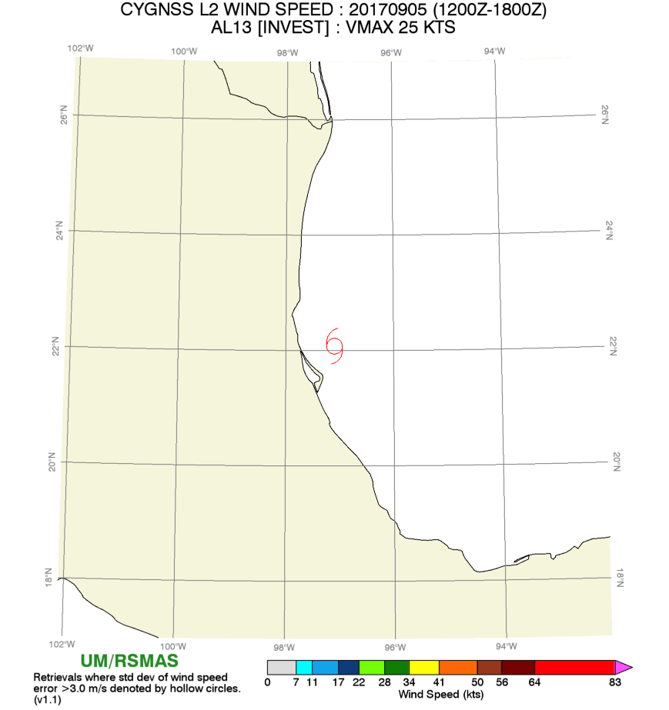
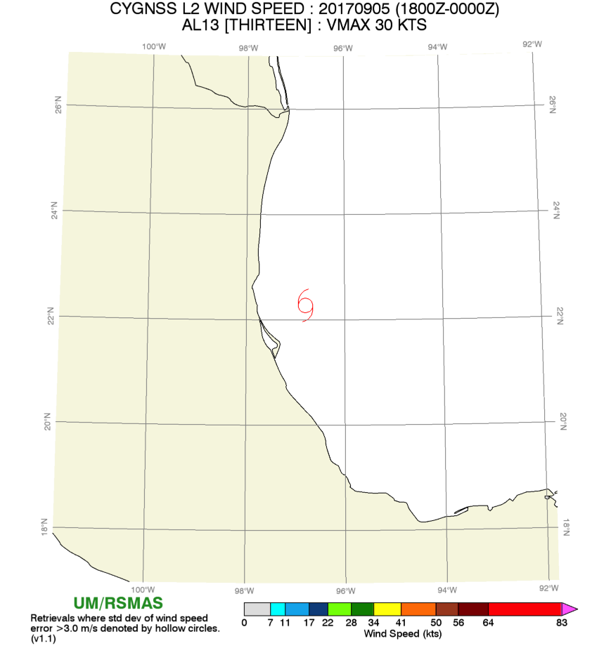
Katia
Katia 09/05-09/09
No TDR collected.
Airforce flight: September 06-08
CYGNSS data 09/05

Slide 9
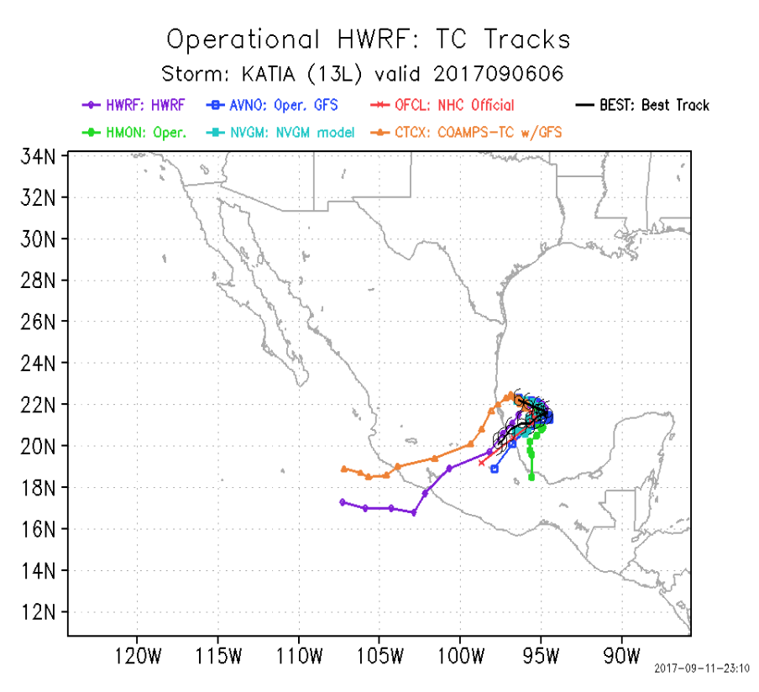
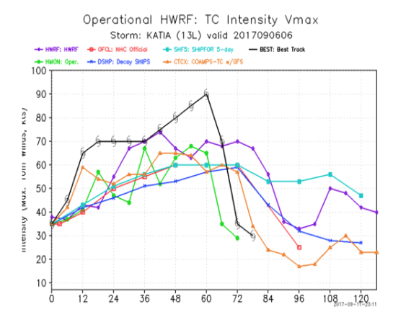
Katia
HWRF runs:
Invest 95L runs on 09/05 00Z to 09/05 12Z
TD 09/05 18Z
Poor short term forecast.

Slide 10
Additional Slides

Slide 11
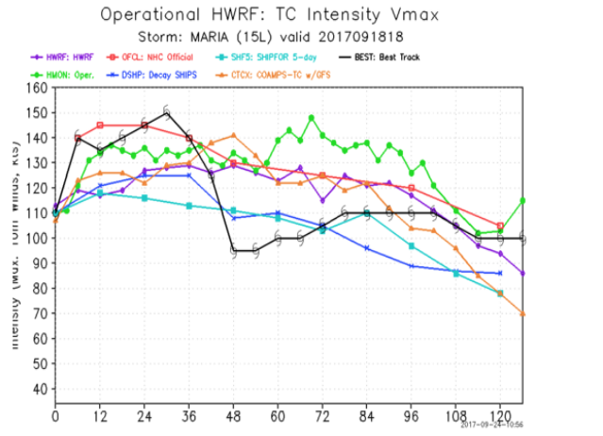
Maria
Poor short term forecast

Slide 12
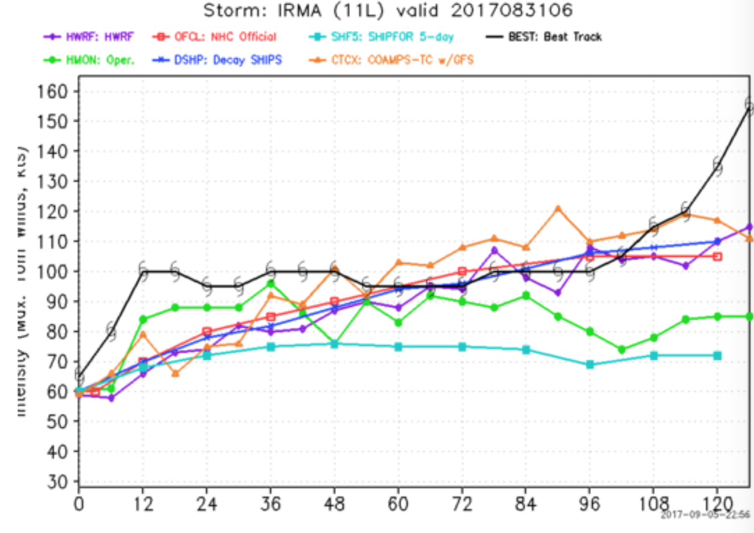
Irma
Poor short term forecast

