Slide 1
Regional OSSE System Summary of accomplishments - System development -Results
Bachir Annane, Javier Delgado, Lisa Bucci,
Altug Aksoy, Tomi Vukicevic and Xuejin Zhang

Slide 2
Major accomplishments over last 12 months Huge amount of work was done over short period of only 12 months toward a full-blown TC regional OSSE system starting from scratch This is in contrast to other existing OSSE systems which took advantage of more that 30 years of development of the operational DA and Forecasting systems. The regional TC DA system does not exist in NOAA operations
GSI
Implemented several versions of GSI
DTC, Whitaker’s , Liu’s (from EMC)
Performed a large number of sensitivity experiments toward optimal configuration
Each specific OSSE project had special requirements for tuning
Testing and tuning included: background and observation error parameters, satellite bias correction, data thinning
HEDAS
Tested and implemented HEDAS on large domain
Optimized for assimilation of large data sets
EnKF-hybrid
Implemented Whitaker’s EnKF-hybrid code with current version of HWRF
Performed tests with perfect and conventional simulated observations
Data preparation for assimilation and verification
Developed capability to produce BUFR format data from various input data
Performed conversion of nature run data into GRIB for use in assimilation and forecast verification
Devised computation of climatological background error covariance using global EnKF data
Developed capability to simulate airborne observations from nature-run using HEDAS modules
Optimization of forecast/model configuration for OSSEs
Performed many experiments with different d01 domain sizes
Solved LBC problems caused by assimilation of observations from the limited nature-run region
Solved problems with spawning inner nest from d01 analysis
Compared using restart vs wrf_input for purpose of cycling in DA; Settled on using wrf_input
Post processing and diagnostics
Developed a large number of new post-processing and diagnostic tools
Multi-panel 2D maps for comparison of analysis and forecast with nature fields
Multi-panel domain average errors as function of forecast time
Multi-panel TC-vitals diagnostics , values and errors as function of forecast time
Visualization of satellite bias and bias correction diagnostics
Visualization of observation distribution
OSSE system software package
Streamlined configuring production of experiments
Developed master program using work-flow management
Implemented automatic generation of diagnostic products

Slide 3
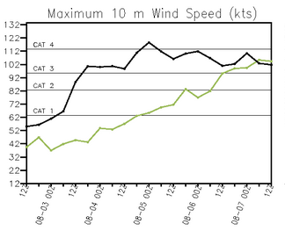
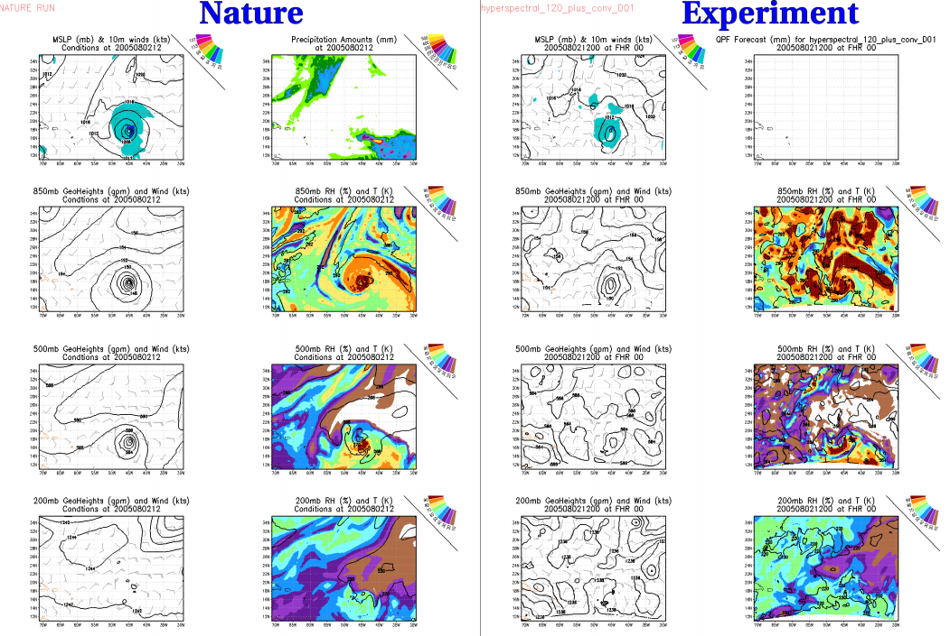
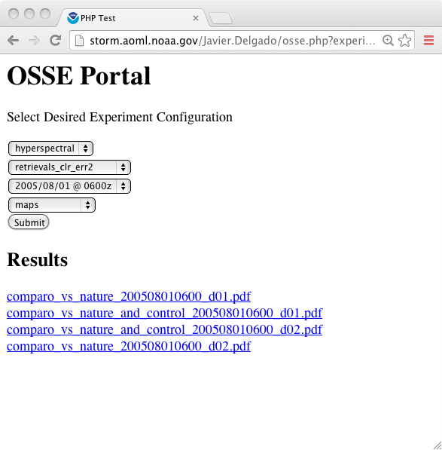
Data Assimilation Framework
User configures experiment via configuration files
Framework generates workflow
Framework invokes Rocoto, which runs the jobs
Frame-work
Rocoto
-Products are automatically generated and published by framework-provided scripts
Rocoto: http://rdhpcs.noaa.gov/rocoto

Slide 4
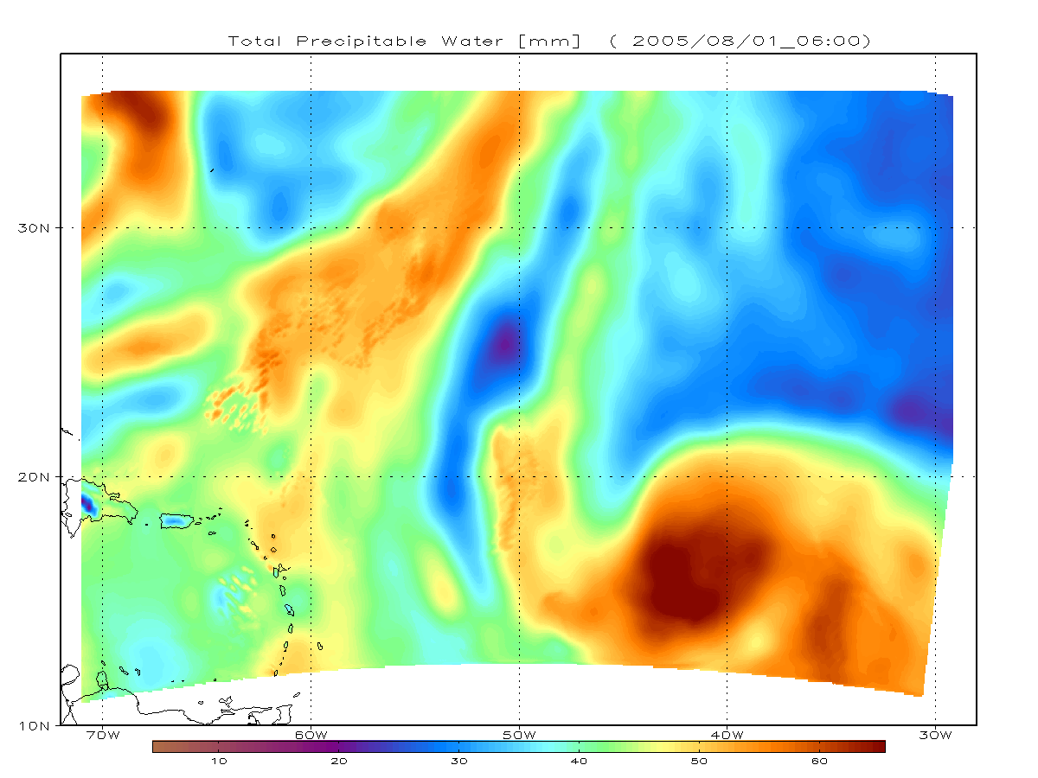
Workflow
Preprocessing
[Forecast Interval]
Background (Guess) Generation
[More cycles to process]
GSI
FForecast
Postprocessing for cycle data
Postprocessing for forecast data
Notes:
-Preprocessing actually consists of two tasks, Real and WPS.
It is in a dashed box since it need not be done for all experiments, only when the domain changes
-Forecasts are only performed at certain intervals

Slide 5
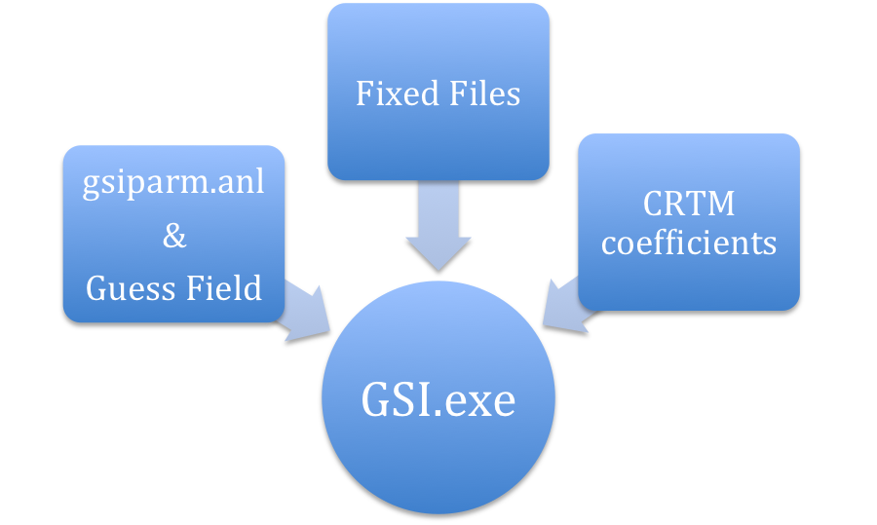
GSI.exe version (DTC, ESRL,EMC)
Added a new tool; update_bc_nmm.exe, bdy_update.exe, analysis_boundaries.exe
wrfrstart to wrfinput (August)
Added satang_update.exe and cycled satbias_ang.in, satbias_in

Slide 6
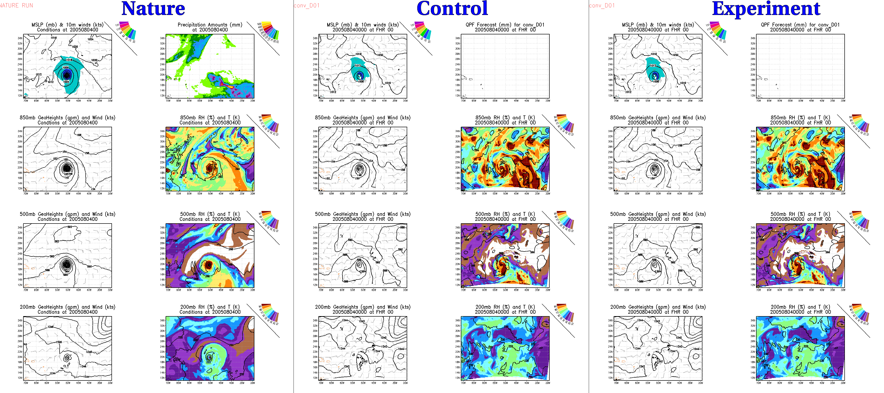
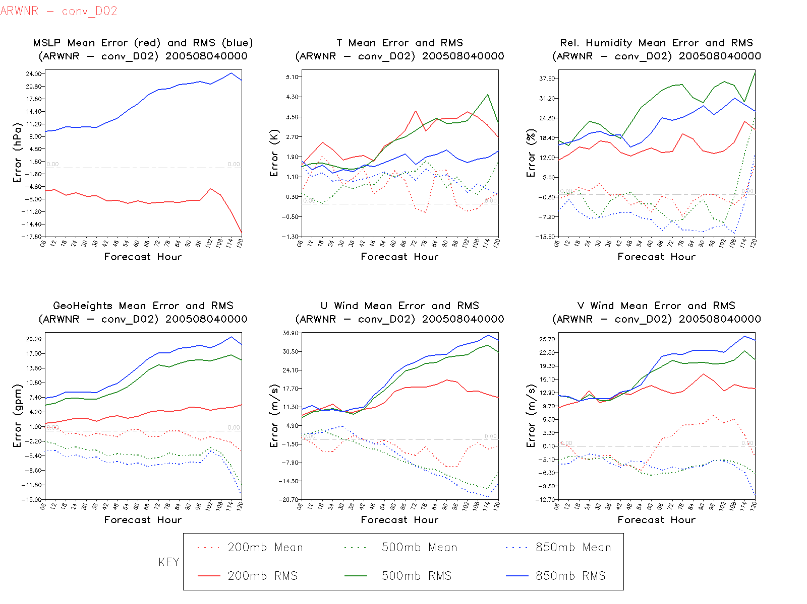
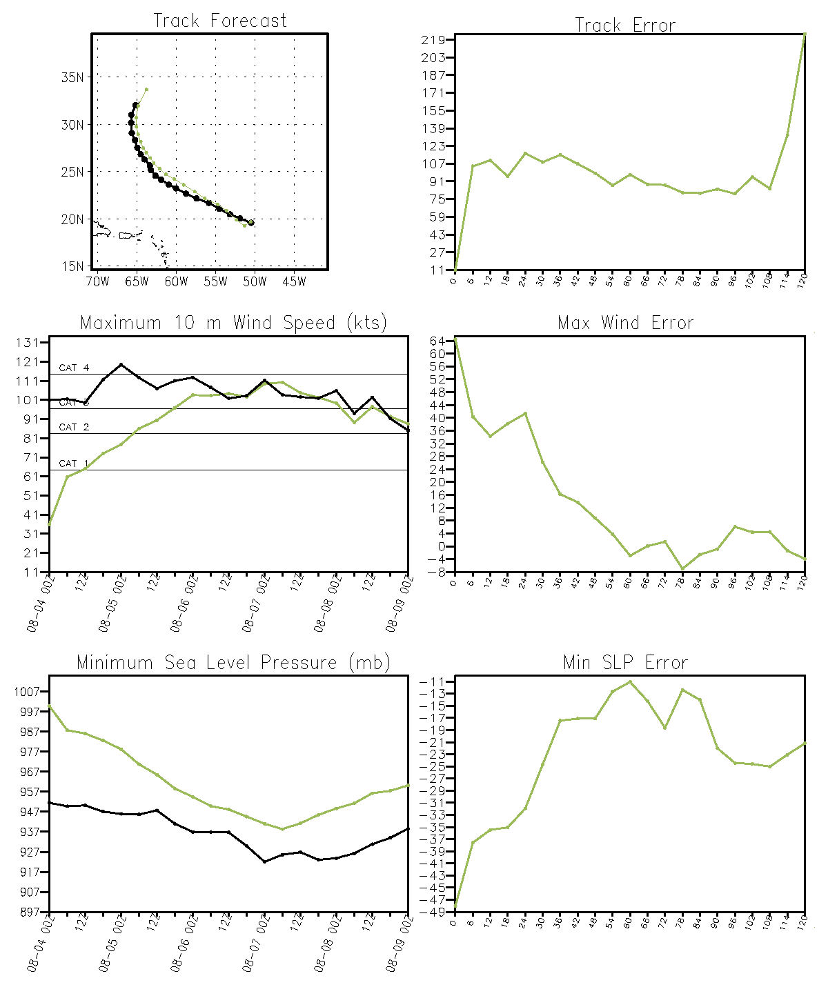
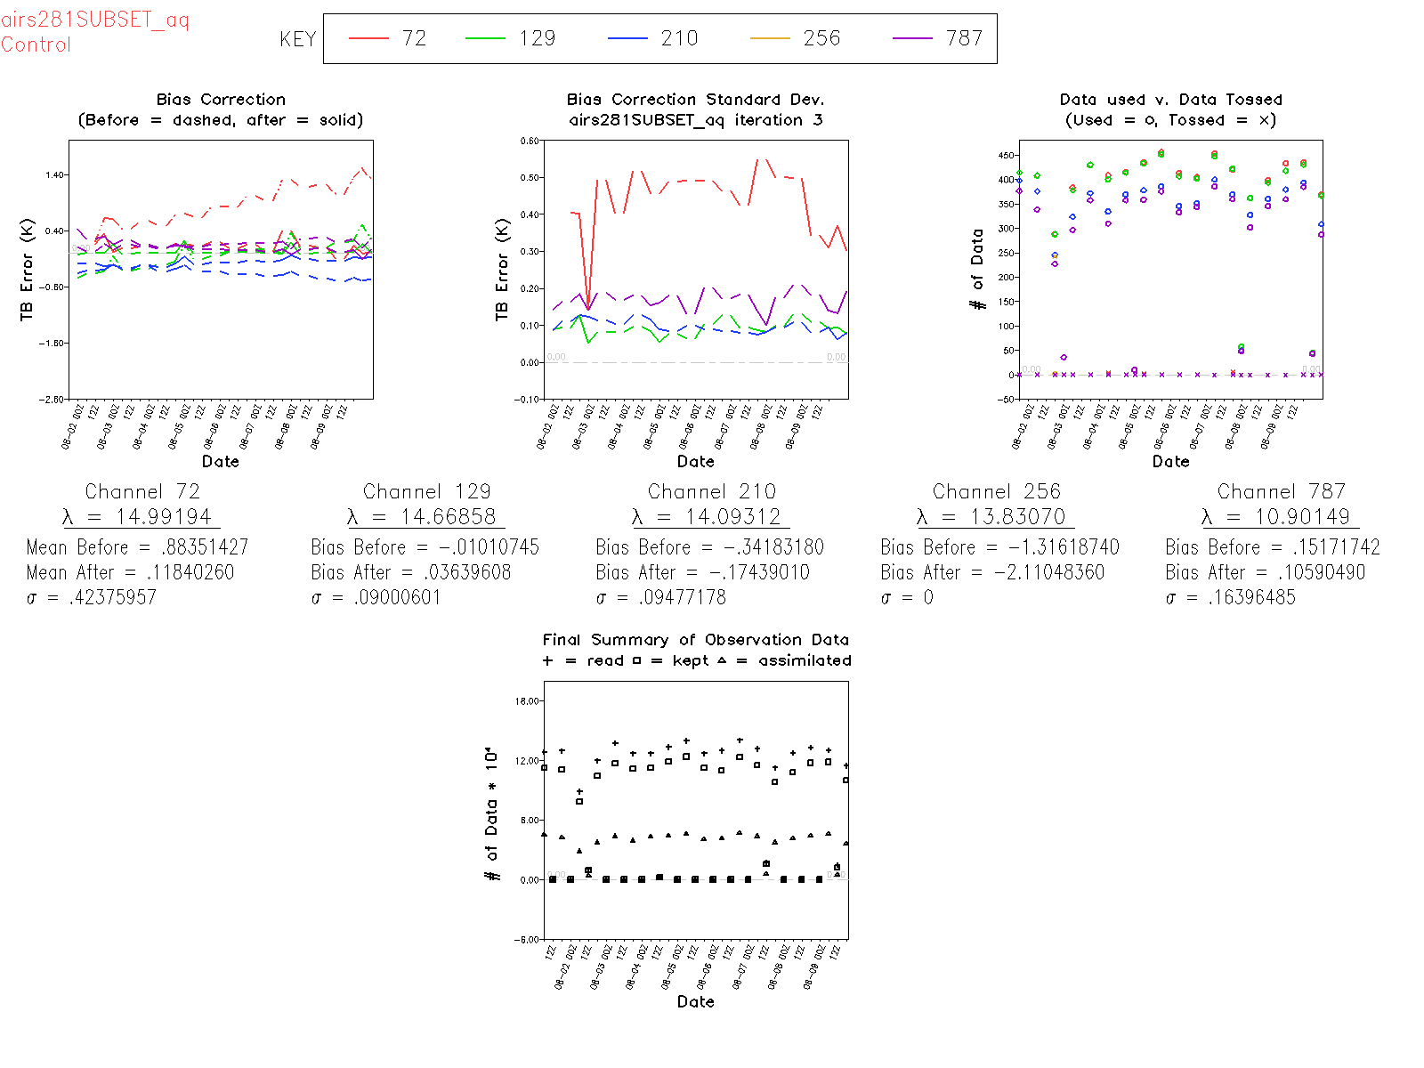
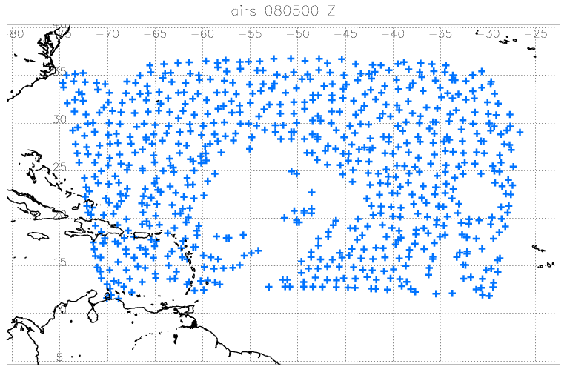
Available products for each experiment
Maps
Analysis and forecast
Domain average bias and RMS errors as function of forecast time
Satellite
Bias, standard deviation,
# of observations ingested, used and assimilated as function of time
Maps of obs distribution assimilated
TC vitals
values errors

Slide 7
Collaboration, coordination and planning ‘communication products’
Introduced Google shared interactive spread sheet to keep log of activities
https://docs.google.com/a/noaa.gov/spreadsheet/ccc?key=0AnC1wmqcWwXrdDVMY21QZ0w0bklaR05qM05Fck9KSGc&usp=sharing#gid=0
Portal for keeping and sharing OSSE results

Slide 8
Remaining necessary developmental work
Completing production of diagnostic
Computing of cumulative errors : average over all cycles for TC-vitals as well as domain average errors
Comparative display of cumulative errors
Multiple experiments
Maps of brightness temperatures simulated and HWRF (analysis and forecast)
Implement HWRF-SatV tool
Completing the implementation of EnKF-hybrid
Use of satellite data not yet working
LBC ensemble not adequate; need global EnKF-hybrid data
Validation of the OSSE system
This is include into developmental work for two main reasons
validation may indicate deficiencies that would need to be addressed
Experiment results for purpose of evaluating the impact of observations are not reliable unless the OSSE system is reliable
The main challenge for us is what system to use as reference since there is no operational equivalent. The following may be considered
Operational NDAS for out of TC core regions
Experimental HEDAS analysis with real observations for TC-core regions

Slide 9
Individual Project Efforts
Perfect
Developed code to extract NR data, randomize and convert into HEDAS or BUFR format
Conversion of NR into grib format
Creation of NR ATCF from all 4 domains
Created “tcvitals” from ARW NR and the EC NR
Developed climate perturbations to create GFS ensemble data
OAWL/WISSCR
Developed programs to bin and convert ASCII into BUFR
Cross section program which can plot between any two locations (including diagonals) to compare with lidar profiles
Visualization of color coded locations based on time
GeoStorm
Developed code to convert netCDF data to HEDAS and BUFR format
Hyperspectral
Developed code to convert netCDF to BUFR format
Created satellite bias cycling ability
Developed code to thin radiances prior to assimilation
Automated most diagnostics (8-panel maps, average errors, TC statistics, satellite bias and bias correction, observation distribution)
CYGNSS
Developed code to convert ASCII data to H*WIND format
Created idealized “SFMR” (u10 and v10) data

Slide 10
Results for ‘hyperspectral’ project
Experiments completed
Cold start
Control with global OSSE obs
Hyperspectral clear radiances from 27 km nature
Clear retrievals from 27 km nature with and without errors
All sky retrievals from 27 km nature with and without errors
Included in the document for interactive log keeping
https://docs.google.com/a/noaa.gov/spreadsheet/ccc?key=0AnC1wmqcWwXrdDVMY21QZ0w0bklaR05qM05Fck9KSGc&usp=sharing#gid=0

