Slide 1
Basic Data Inf

Slide 2
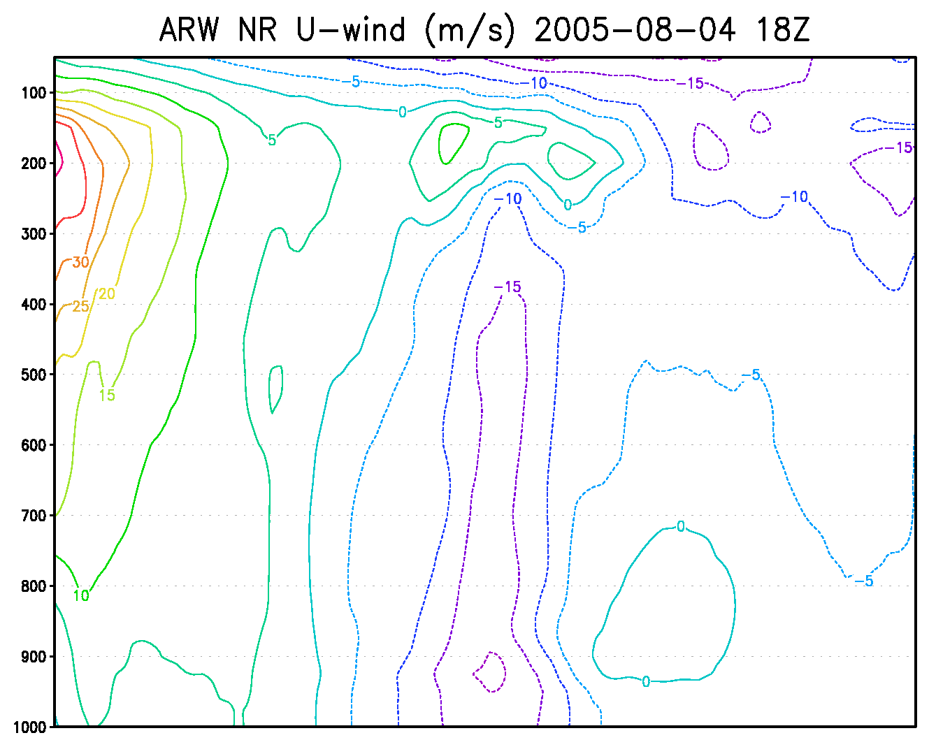
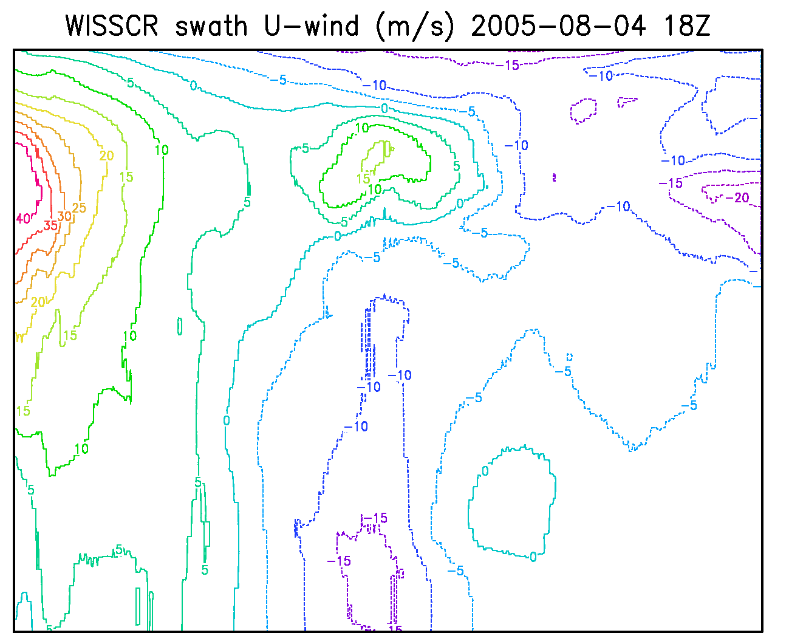
Nature vs. WISSCR swath (18Z)
New capability: Cross section in the Nature Run compared to all the profiles from 18Z swath

Slide 3
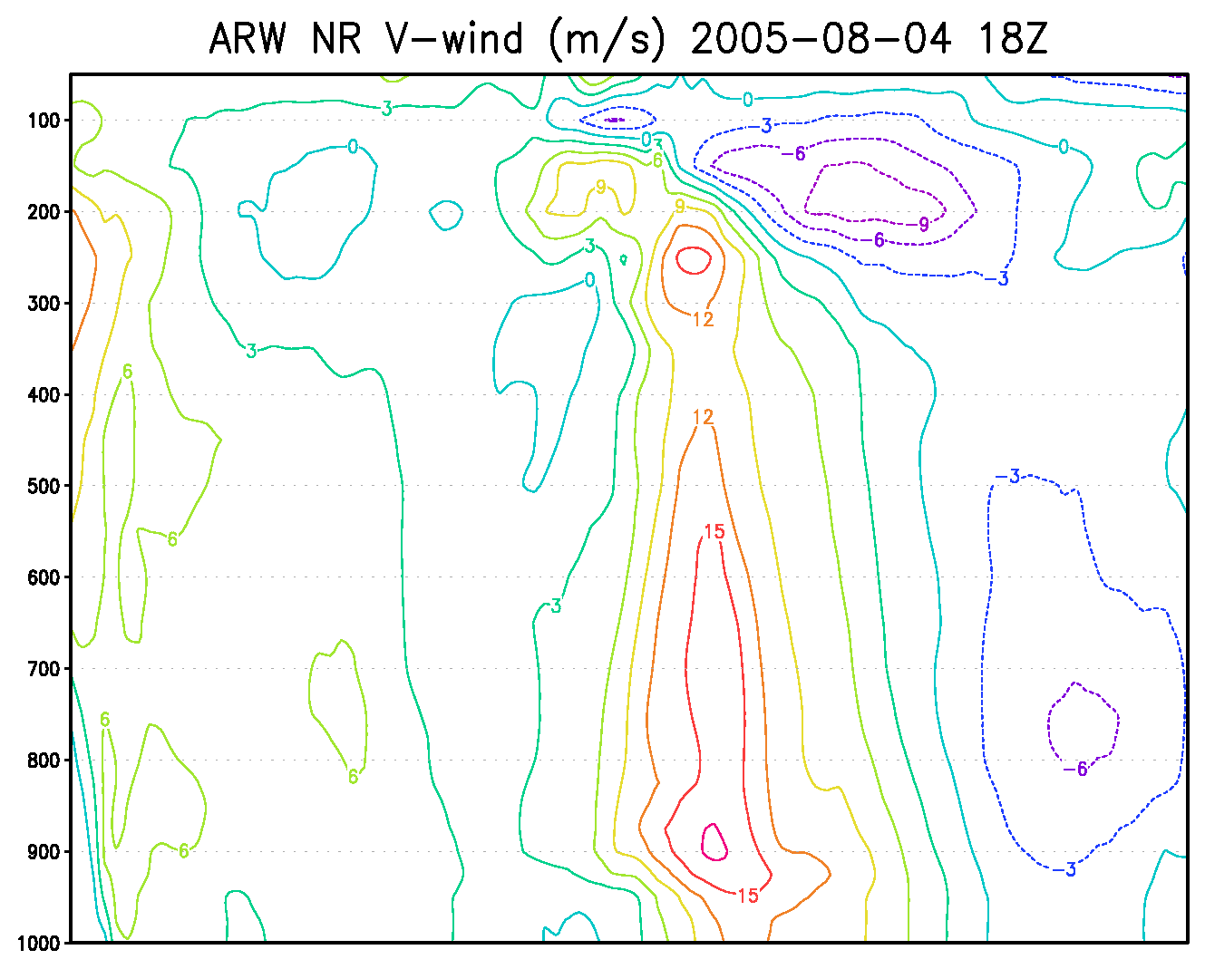
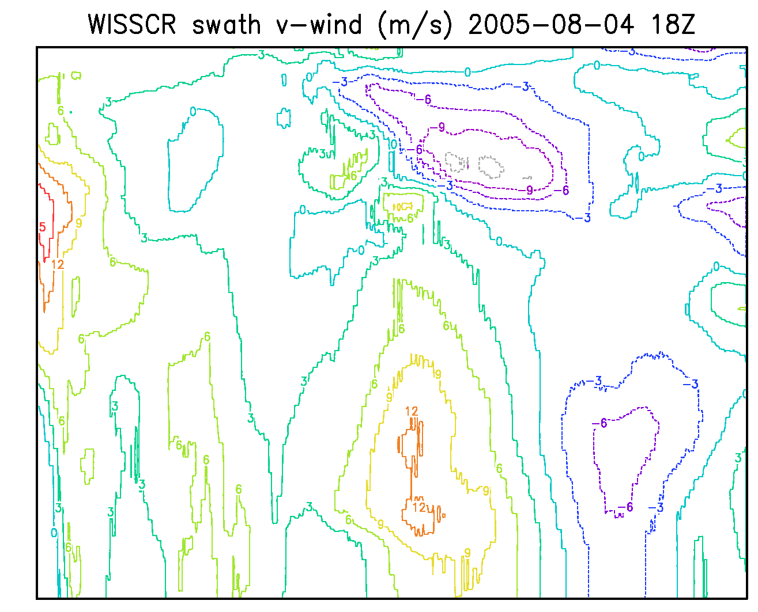
Nature vs. WISSCR swath (18Z)

Slide 4
Experiments
OAWL
30 point localizations
Observations randomly assimilated within cycle
No boundary perturbation inflation
6 hour spin up starting on August 4, 2005 at 00Z
Hourly cycling from 06Z to 20Z
10 cycles with data
8 cycle with data within HEDAS domain
WISSCR
Same as OAWL experiment

