Slide 1
GPSRO Data coverage example
Current Domain; center at 24.8, -50, 354x412
Time Period: 0801 6z to 0803 00z. Every 6 hrs
Overall no data was added from 12 and 18
Data was added for 30, an example is shown in the next slide

Slide 2
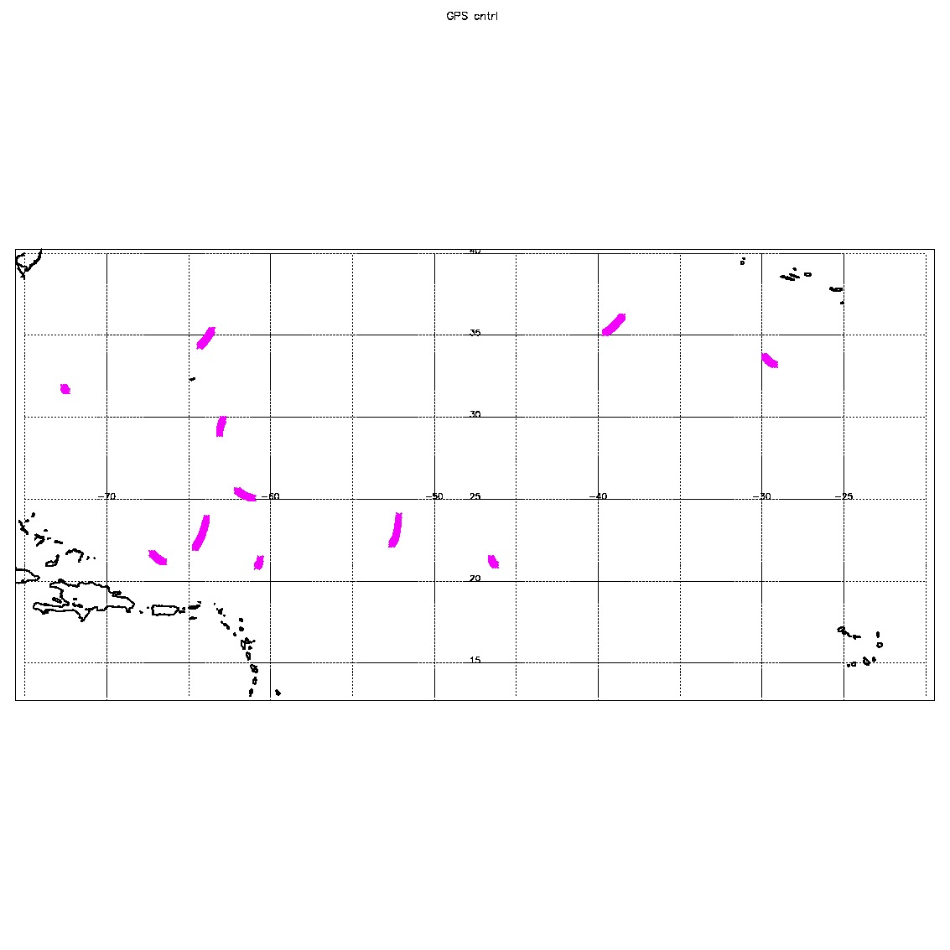
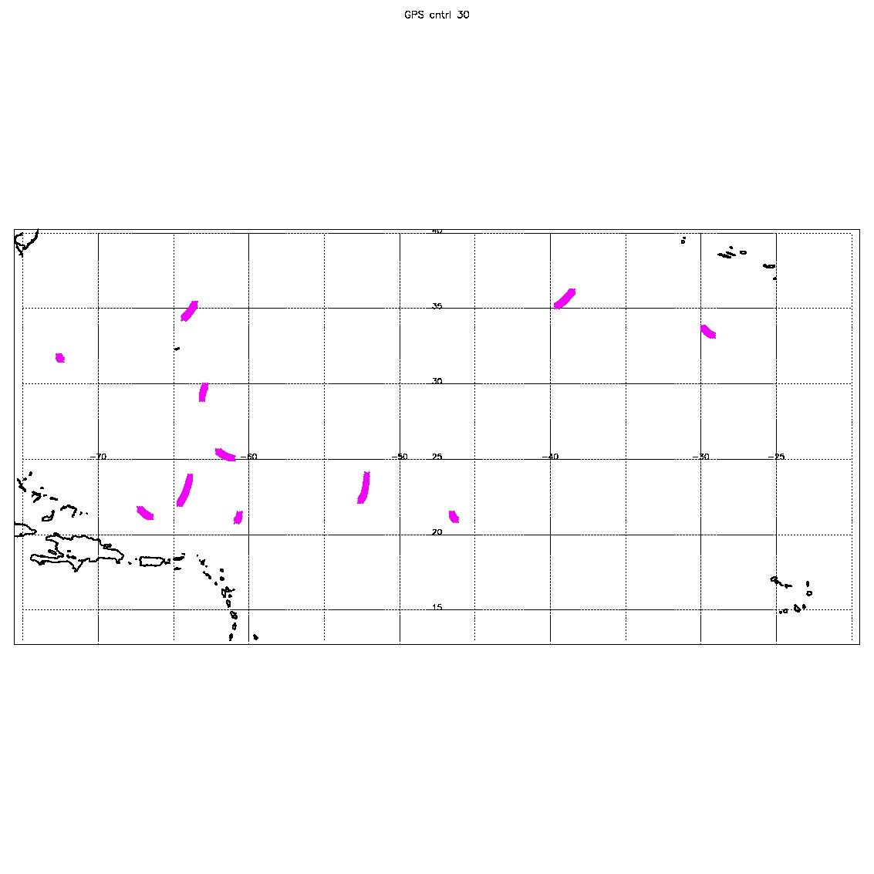
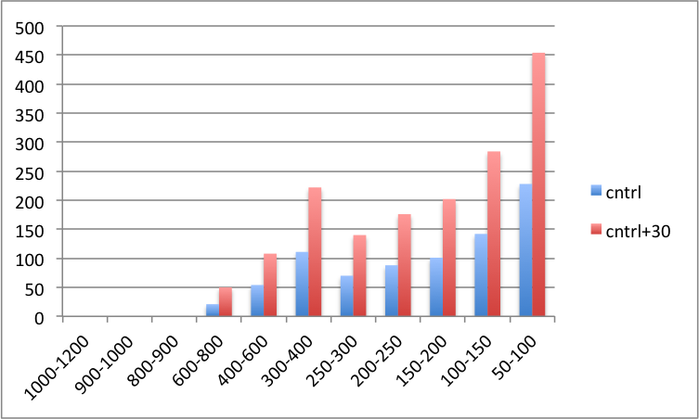
0802 at 00Z
CONTROL
Data coverage
CONTROL+30
Pts assimilated per layer
Number of data pts
mb

