Slide 1
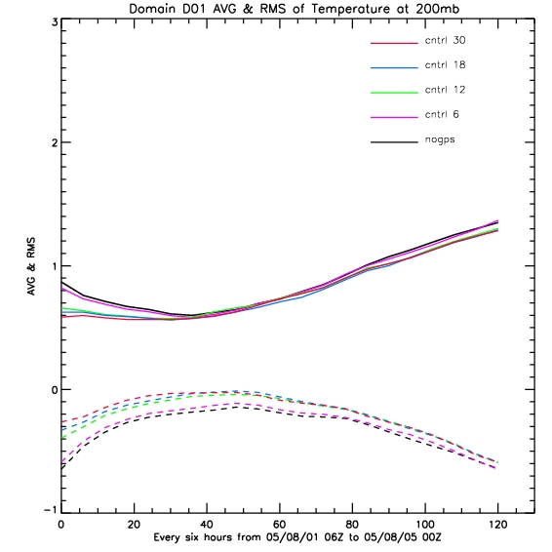
Temperature at 200mb

Slide 2
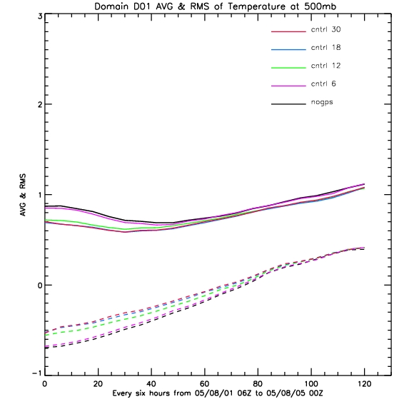
Temperature at 500mb

Slide 3
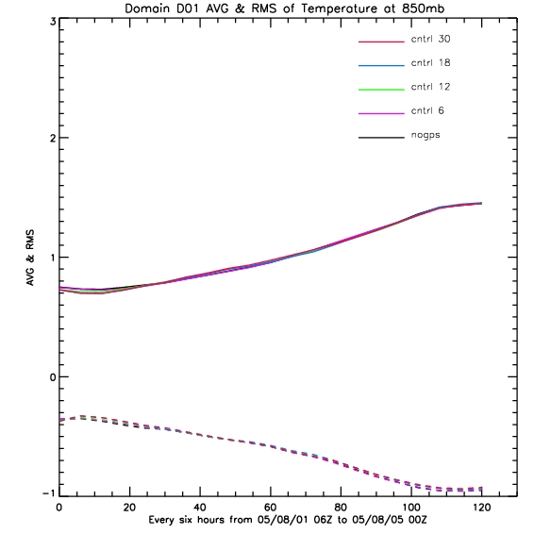
Temperature at 850mb

Slide 4
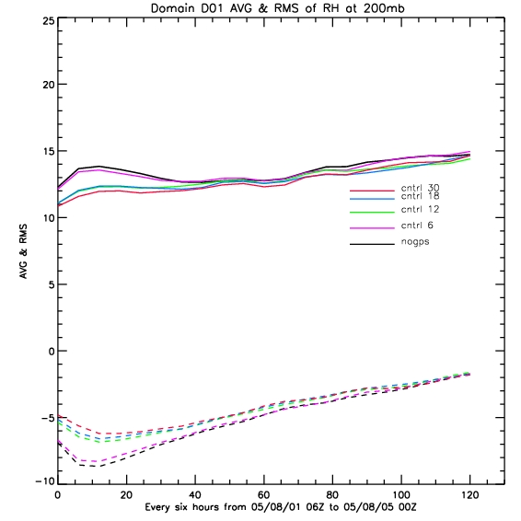
RH at 200mb

Slide 5
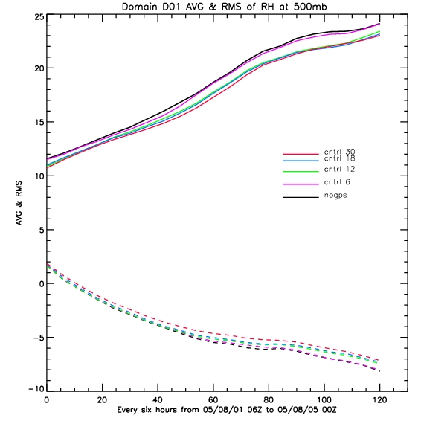
RH at 500mb

Slide 6
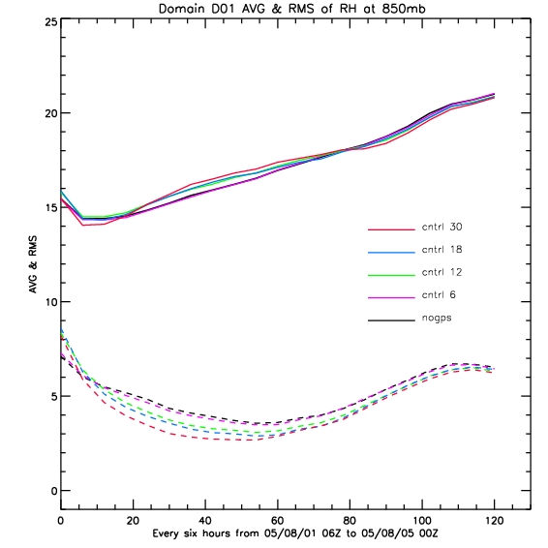
RH at 850mb

Slide 7
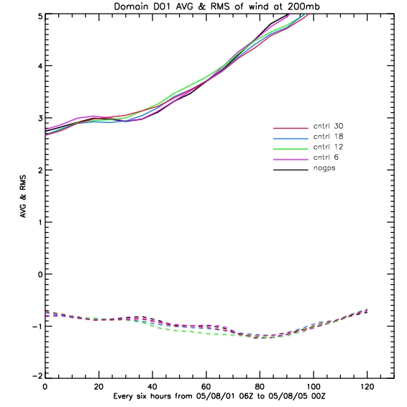
Wind at 200mb

Slide 8
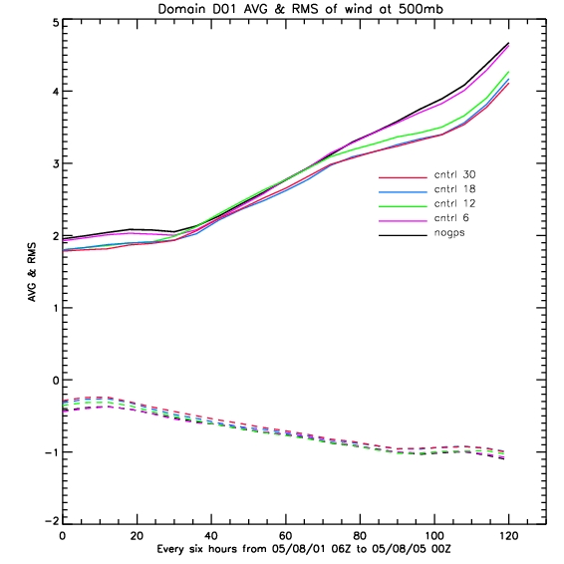
Wind at 500mb

Slide 9
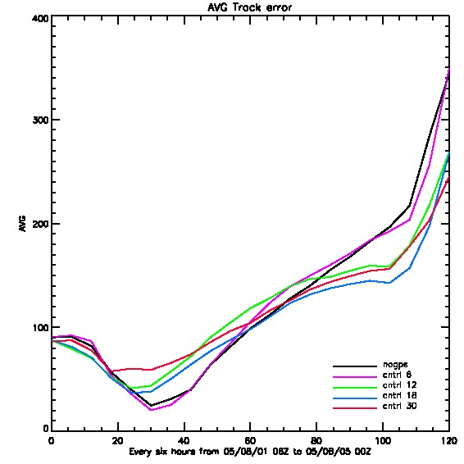
Storm Statistics
Track

Slide 10
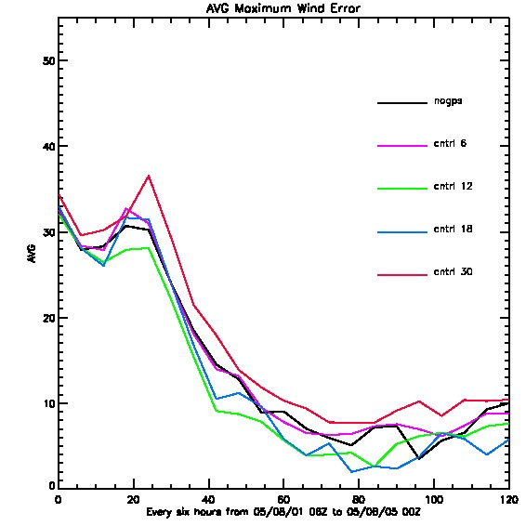
Storm Statistics
Max Wind Speed

Slide 11
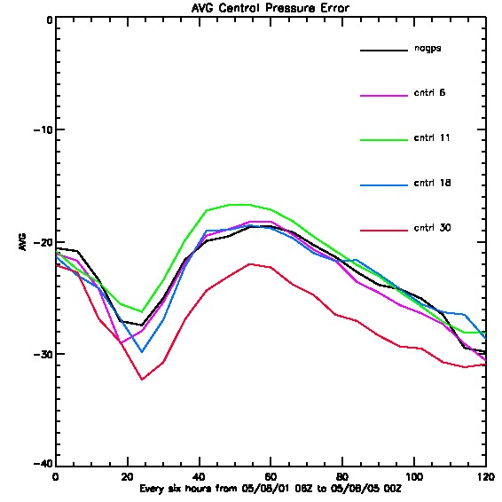
Storm Statistics
Central Pressure

