Slide 1
Temperature at 200mb

Slide 2
Temperature at 500mb

Slide 3
Temperature at 850mb

Slide 4
RH at 200mb

Slide 5
RH at 500mb

Slide 6
RH at 850mb

Slide 7
Wind at 200mb

Slide 8
Wind at 500mb

Slide 9
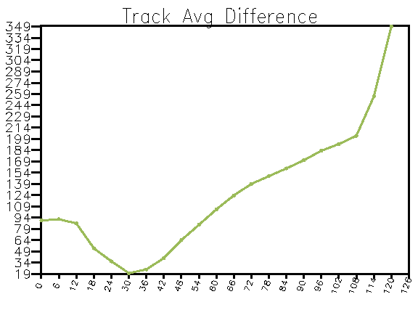
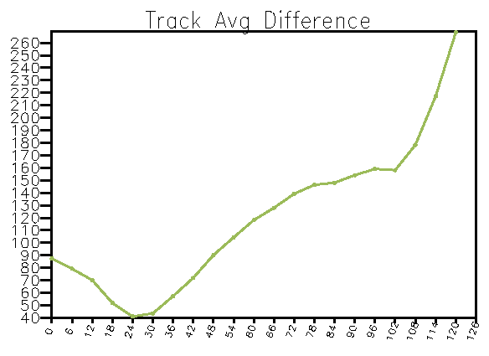
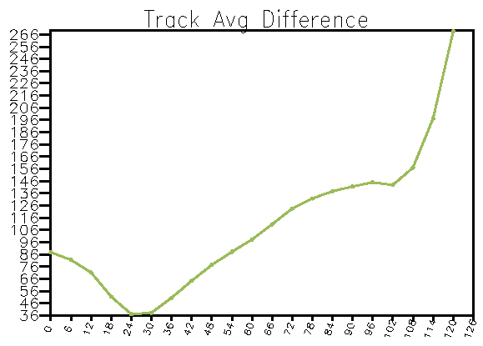
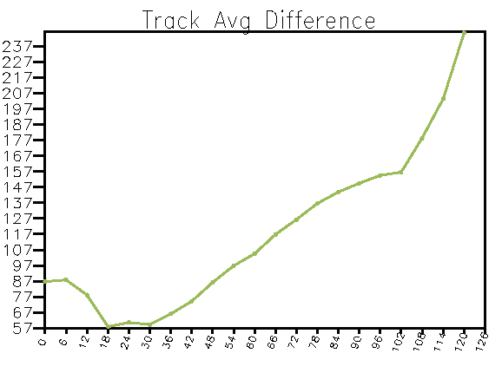
Track
No GPS
Cntrl 6
Cntrl 12
Cntrl 30
Cntrl 18

Slide 10
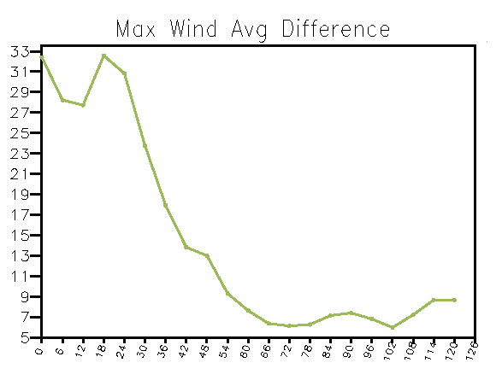
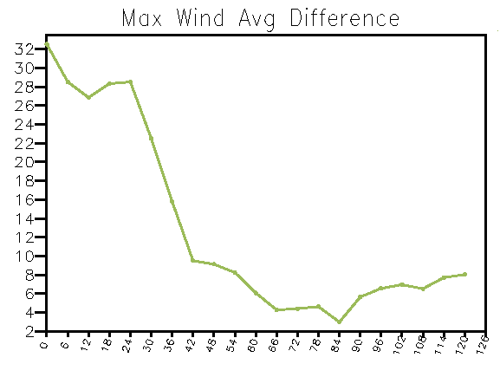
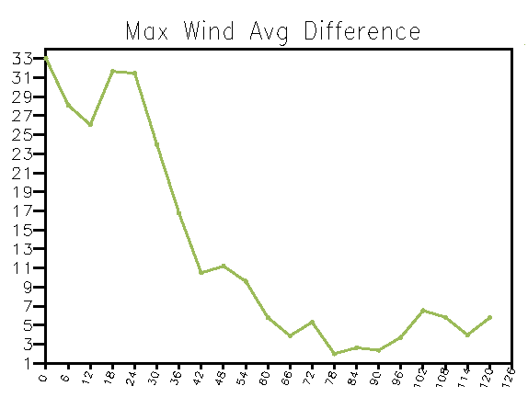
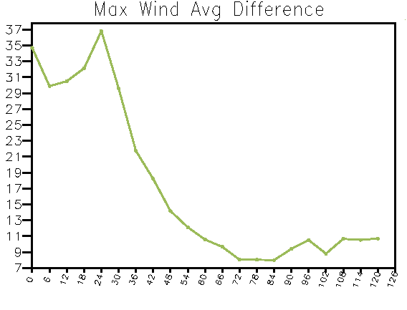
Maximum wind speed
No GPS
Cntrl 6
Cntrl 12
Cntrl 18
Cntrl 30

