Slide 1
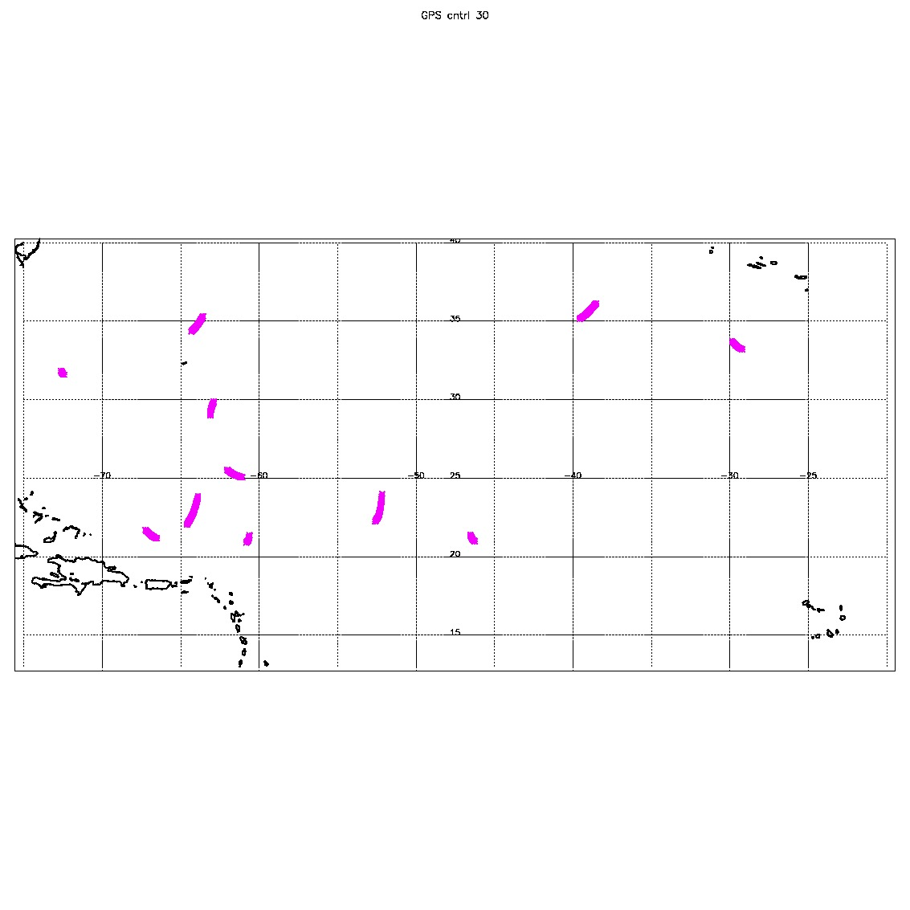
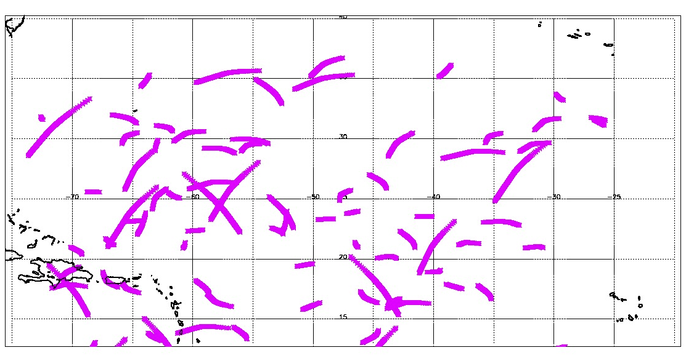
Control and C2EQ (12 satellites)
Notes:
#pts cntrl 2316
#pts equ 18909

Slide 2
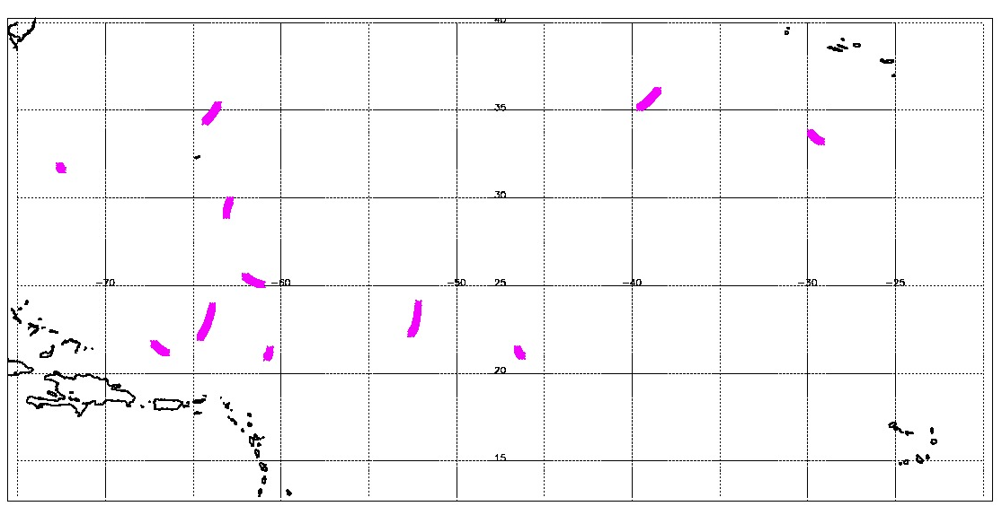
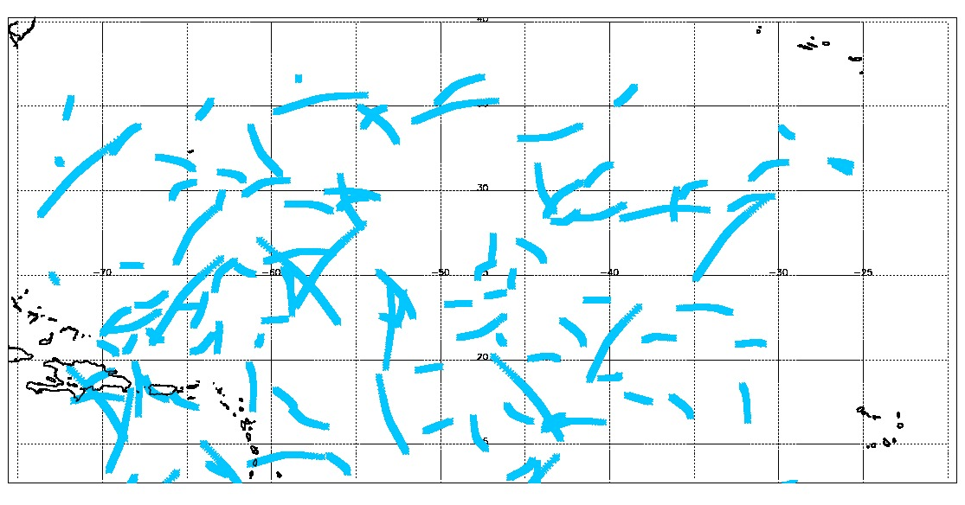
Control and C2PO (18 satellites)
Notes:
#pts plr 8718

Slide 3
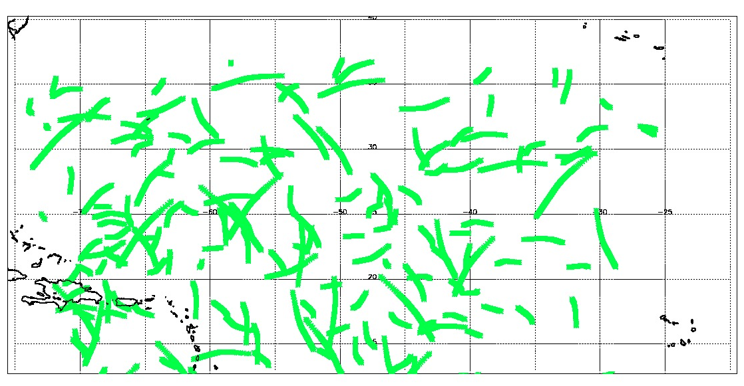
Control and C2GO (30 satellites)
Notes:
#pts geo 15726

Slide 4
