Slide 1
Introduction to
Global Navigation Satellite Systems reflectometry
(GNSS+R )
Involves making measurements from the reflections from the Earth of navigation signals from GPS.
Applications:
  Surface wind speed
  Altimetry
  Mean square slope
  Soil moisture
  Salinity
  Sea Ice

Slide 2
GNSS+R 2017 Conference
Day 1: Missions and Data assimilation, Calibration and Validation
Day 2: Ocean Altimetry and Ocean Scatterometry
Day 3: Land, Modeling and Theory, Cryosphere
Talks of interest: Paul Chang, Chris (storm surge)
Collaborators:
  Giuseppe Grieco (Netherlands) : The group is mainly involved in wind field remote sensing through active microwave sensors, mainly scatterometers. The group tries to expand its competences in wind field retrieval from GNSS-R measurements. One of the topic will be the impact of the assimilation of GNSS-R retrieved winds on NWP models. This could be the overlapping interest and therefore the area of collaboration.
  Shu-Chih (Taiwan): configuration GSI and VAM

Slide 3
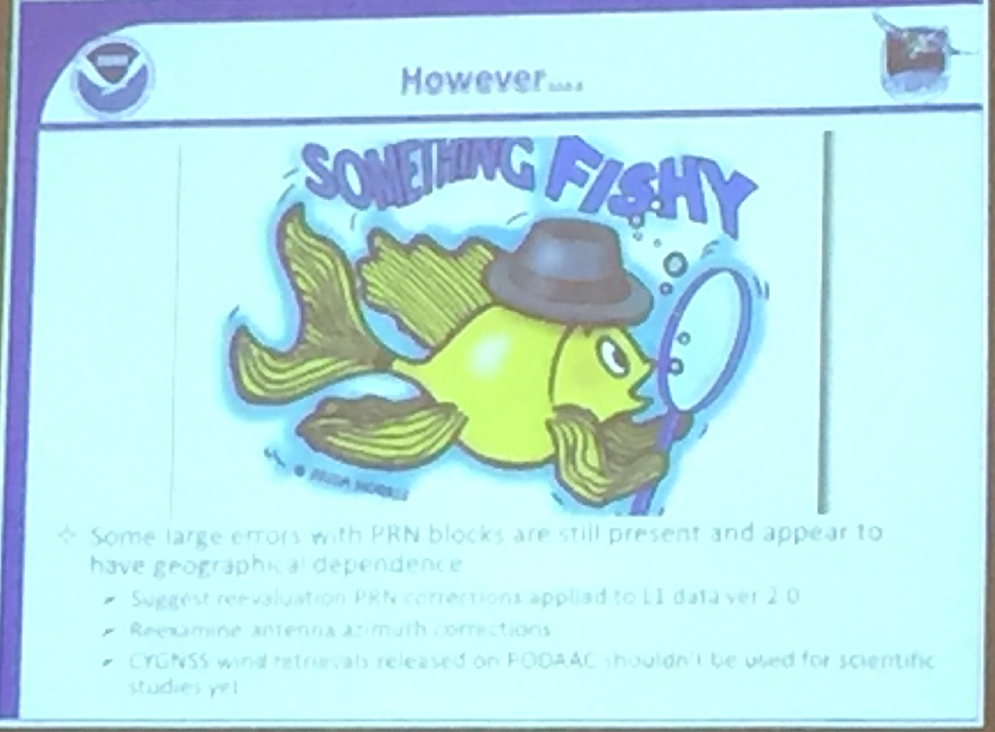
CYGNSS Level 2 Wind Speeds
Pre-released on JPL PO.DAAC Monday May 21
Paul and Zorana advise not using for science
Many relationships to account for in GMF
  Wind speed, incidence angle, mean square slope, SNR (signal to noise ratio), PRN (pseudo-random noise), wind direction (really small), antenna azimuth, low wind speed wave state.
Wind speeds top out at 35 m/s until validation data is available

Slide 4
Future missions:
  GEROS-ISS launching late 2021
  FORMOSAT 7/ COSMIC 2 (Taiwan)

Slide 5
Ella CYGNSS L2 winds

Slide 6
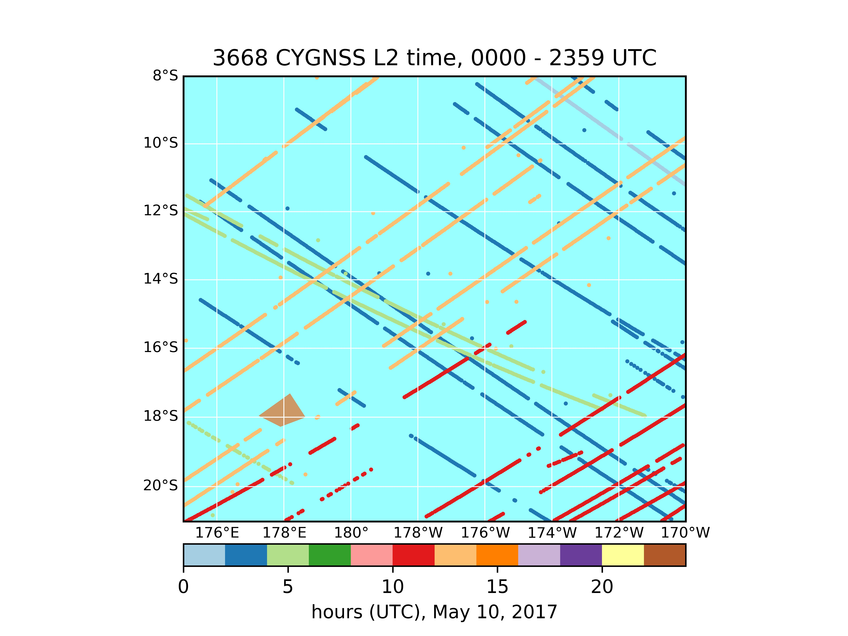
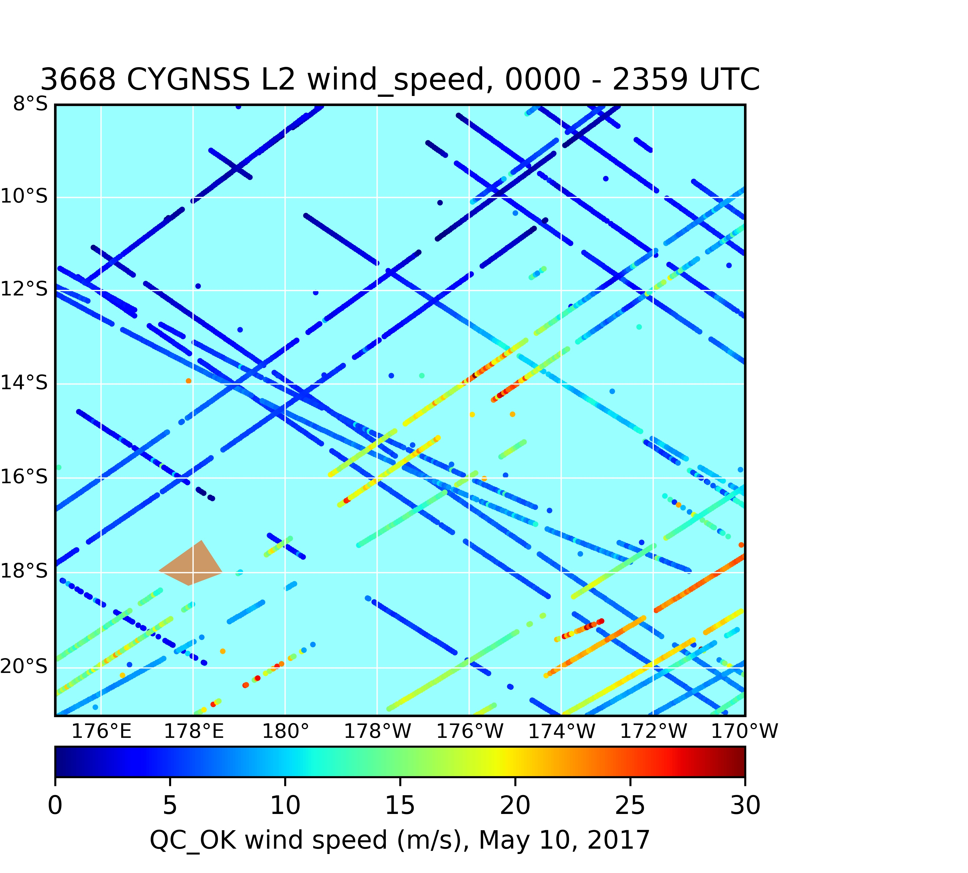

Slide 7
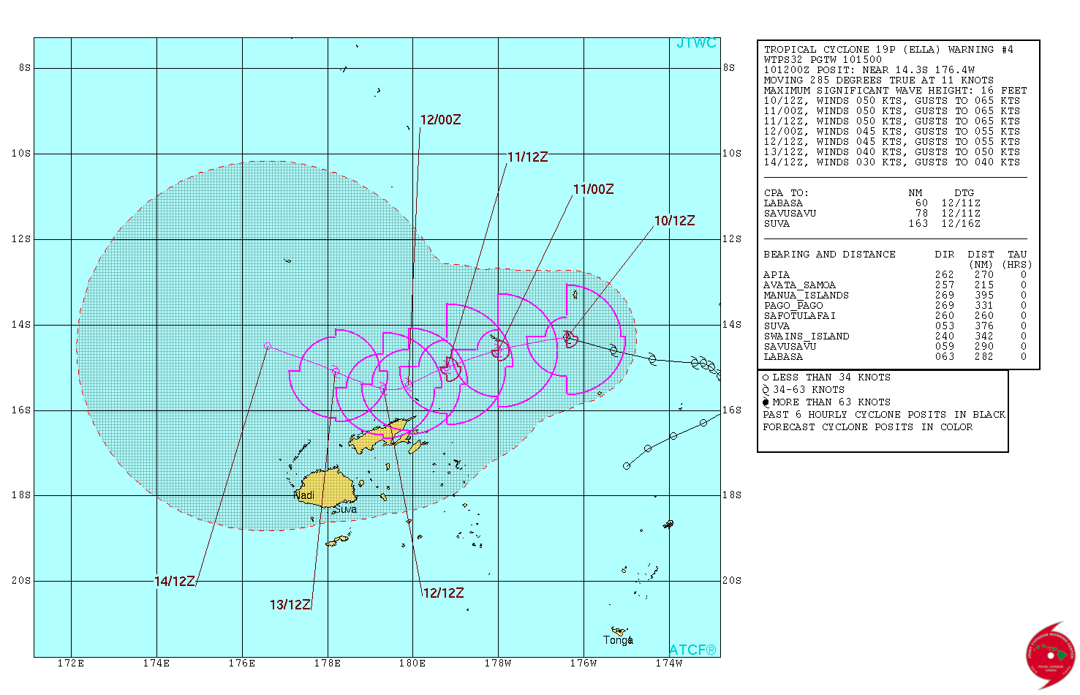

Slide 8
X

Slide 9
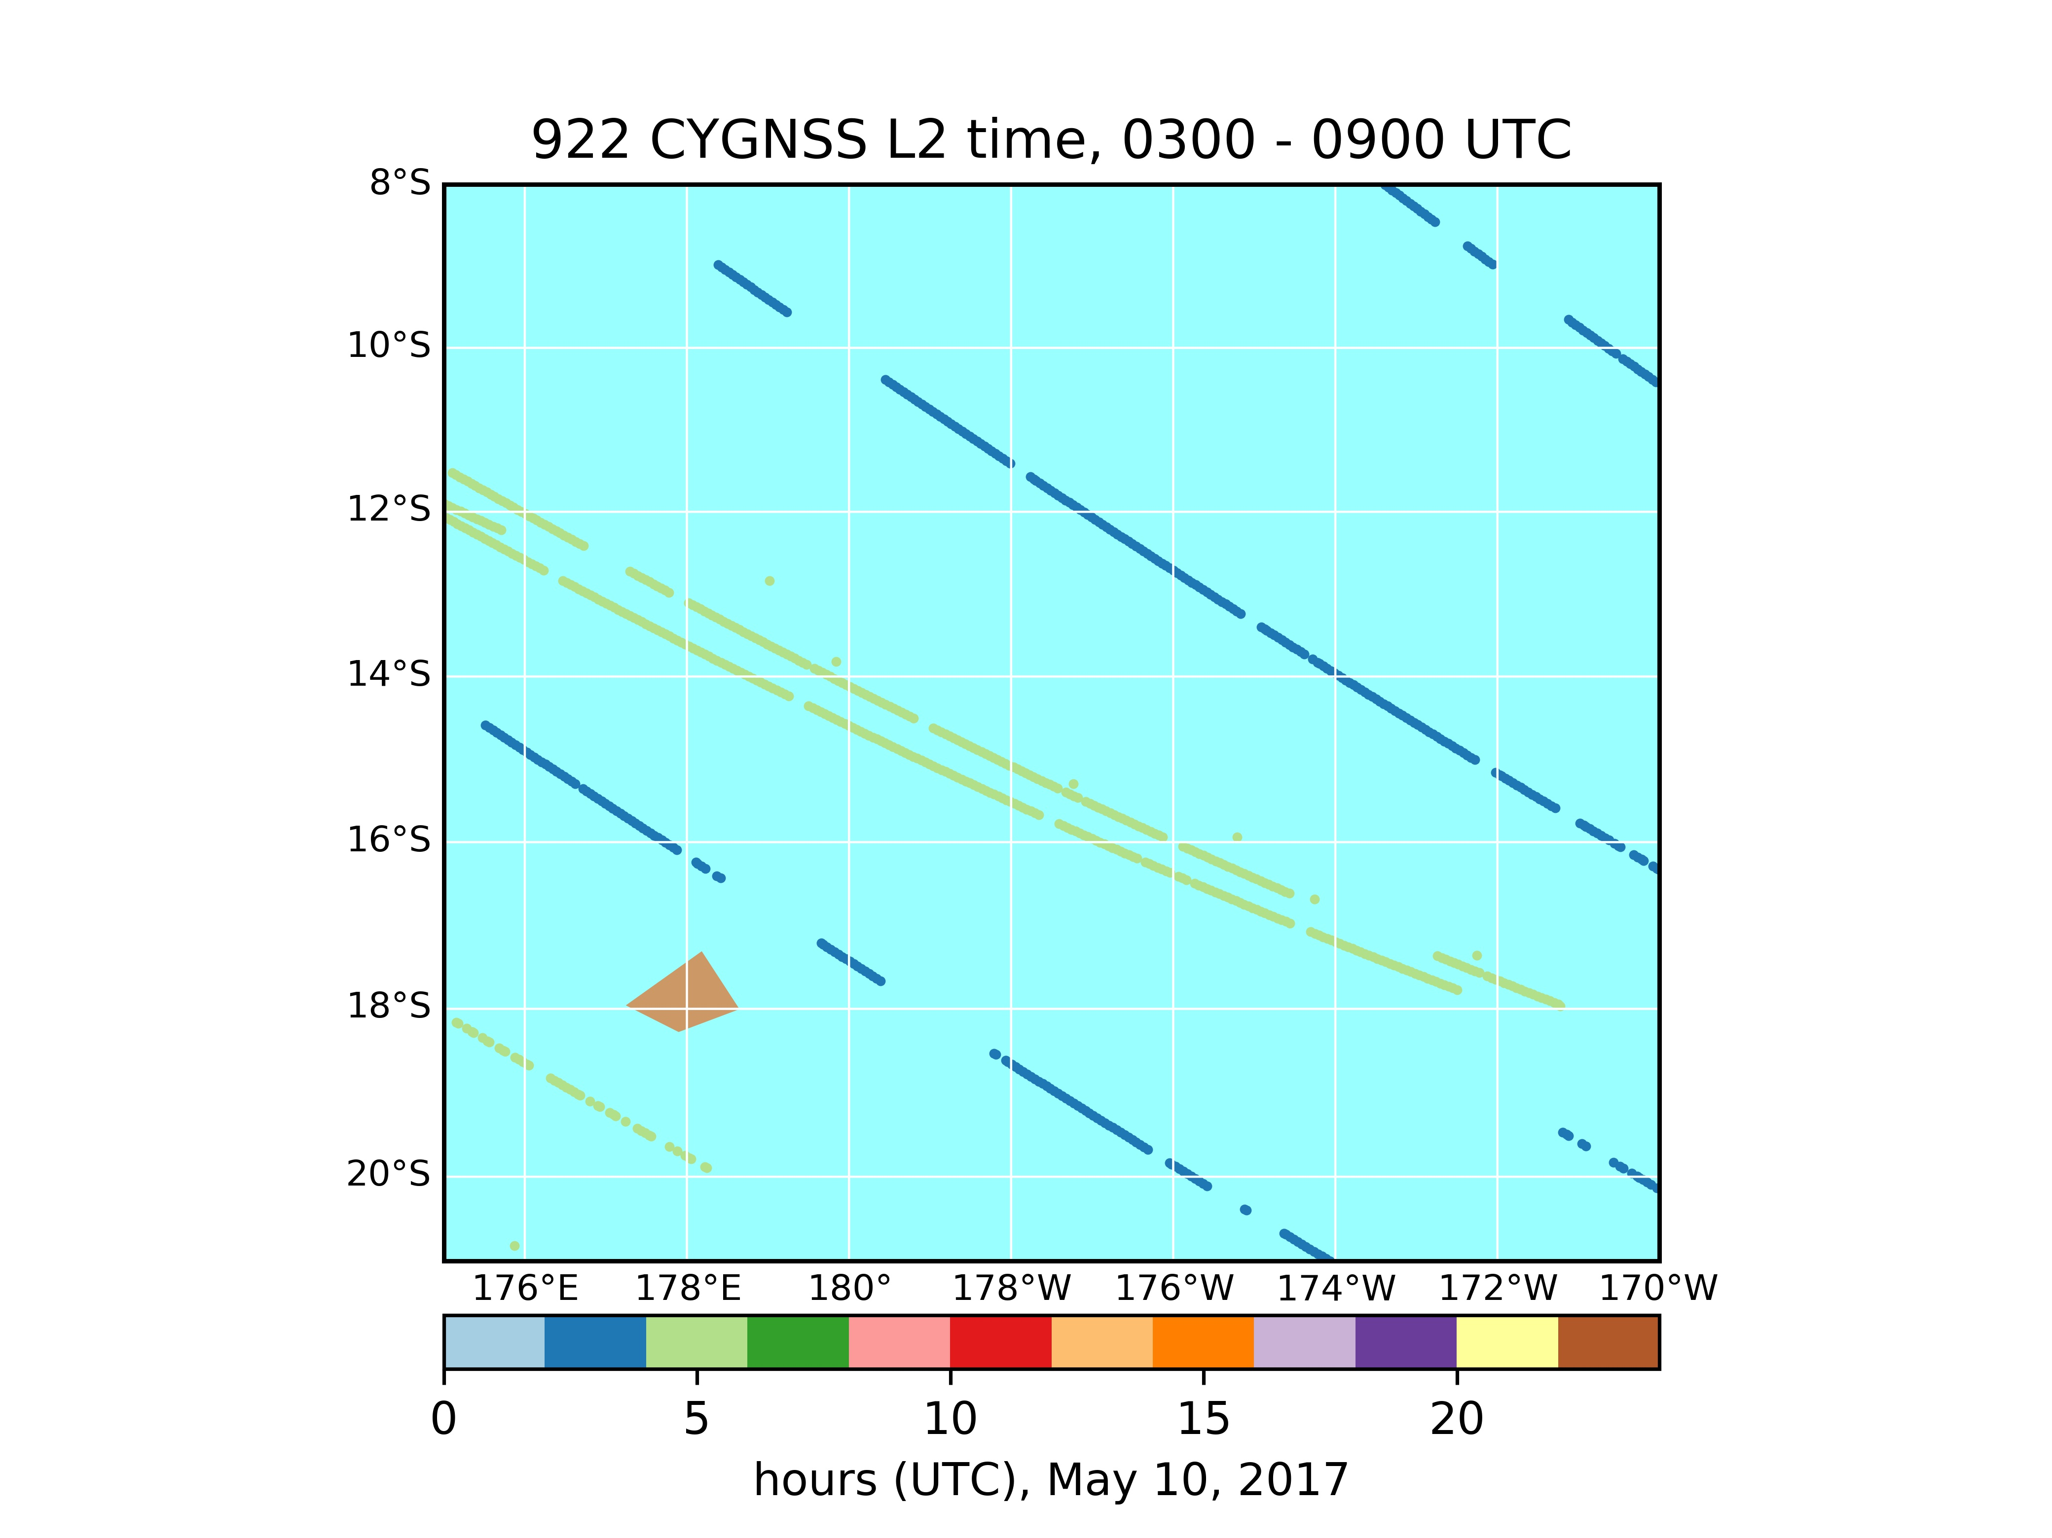
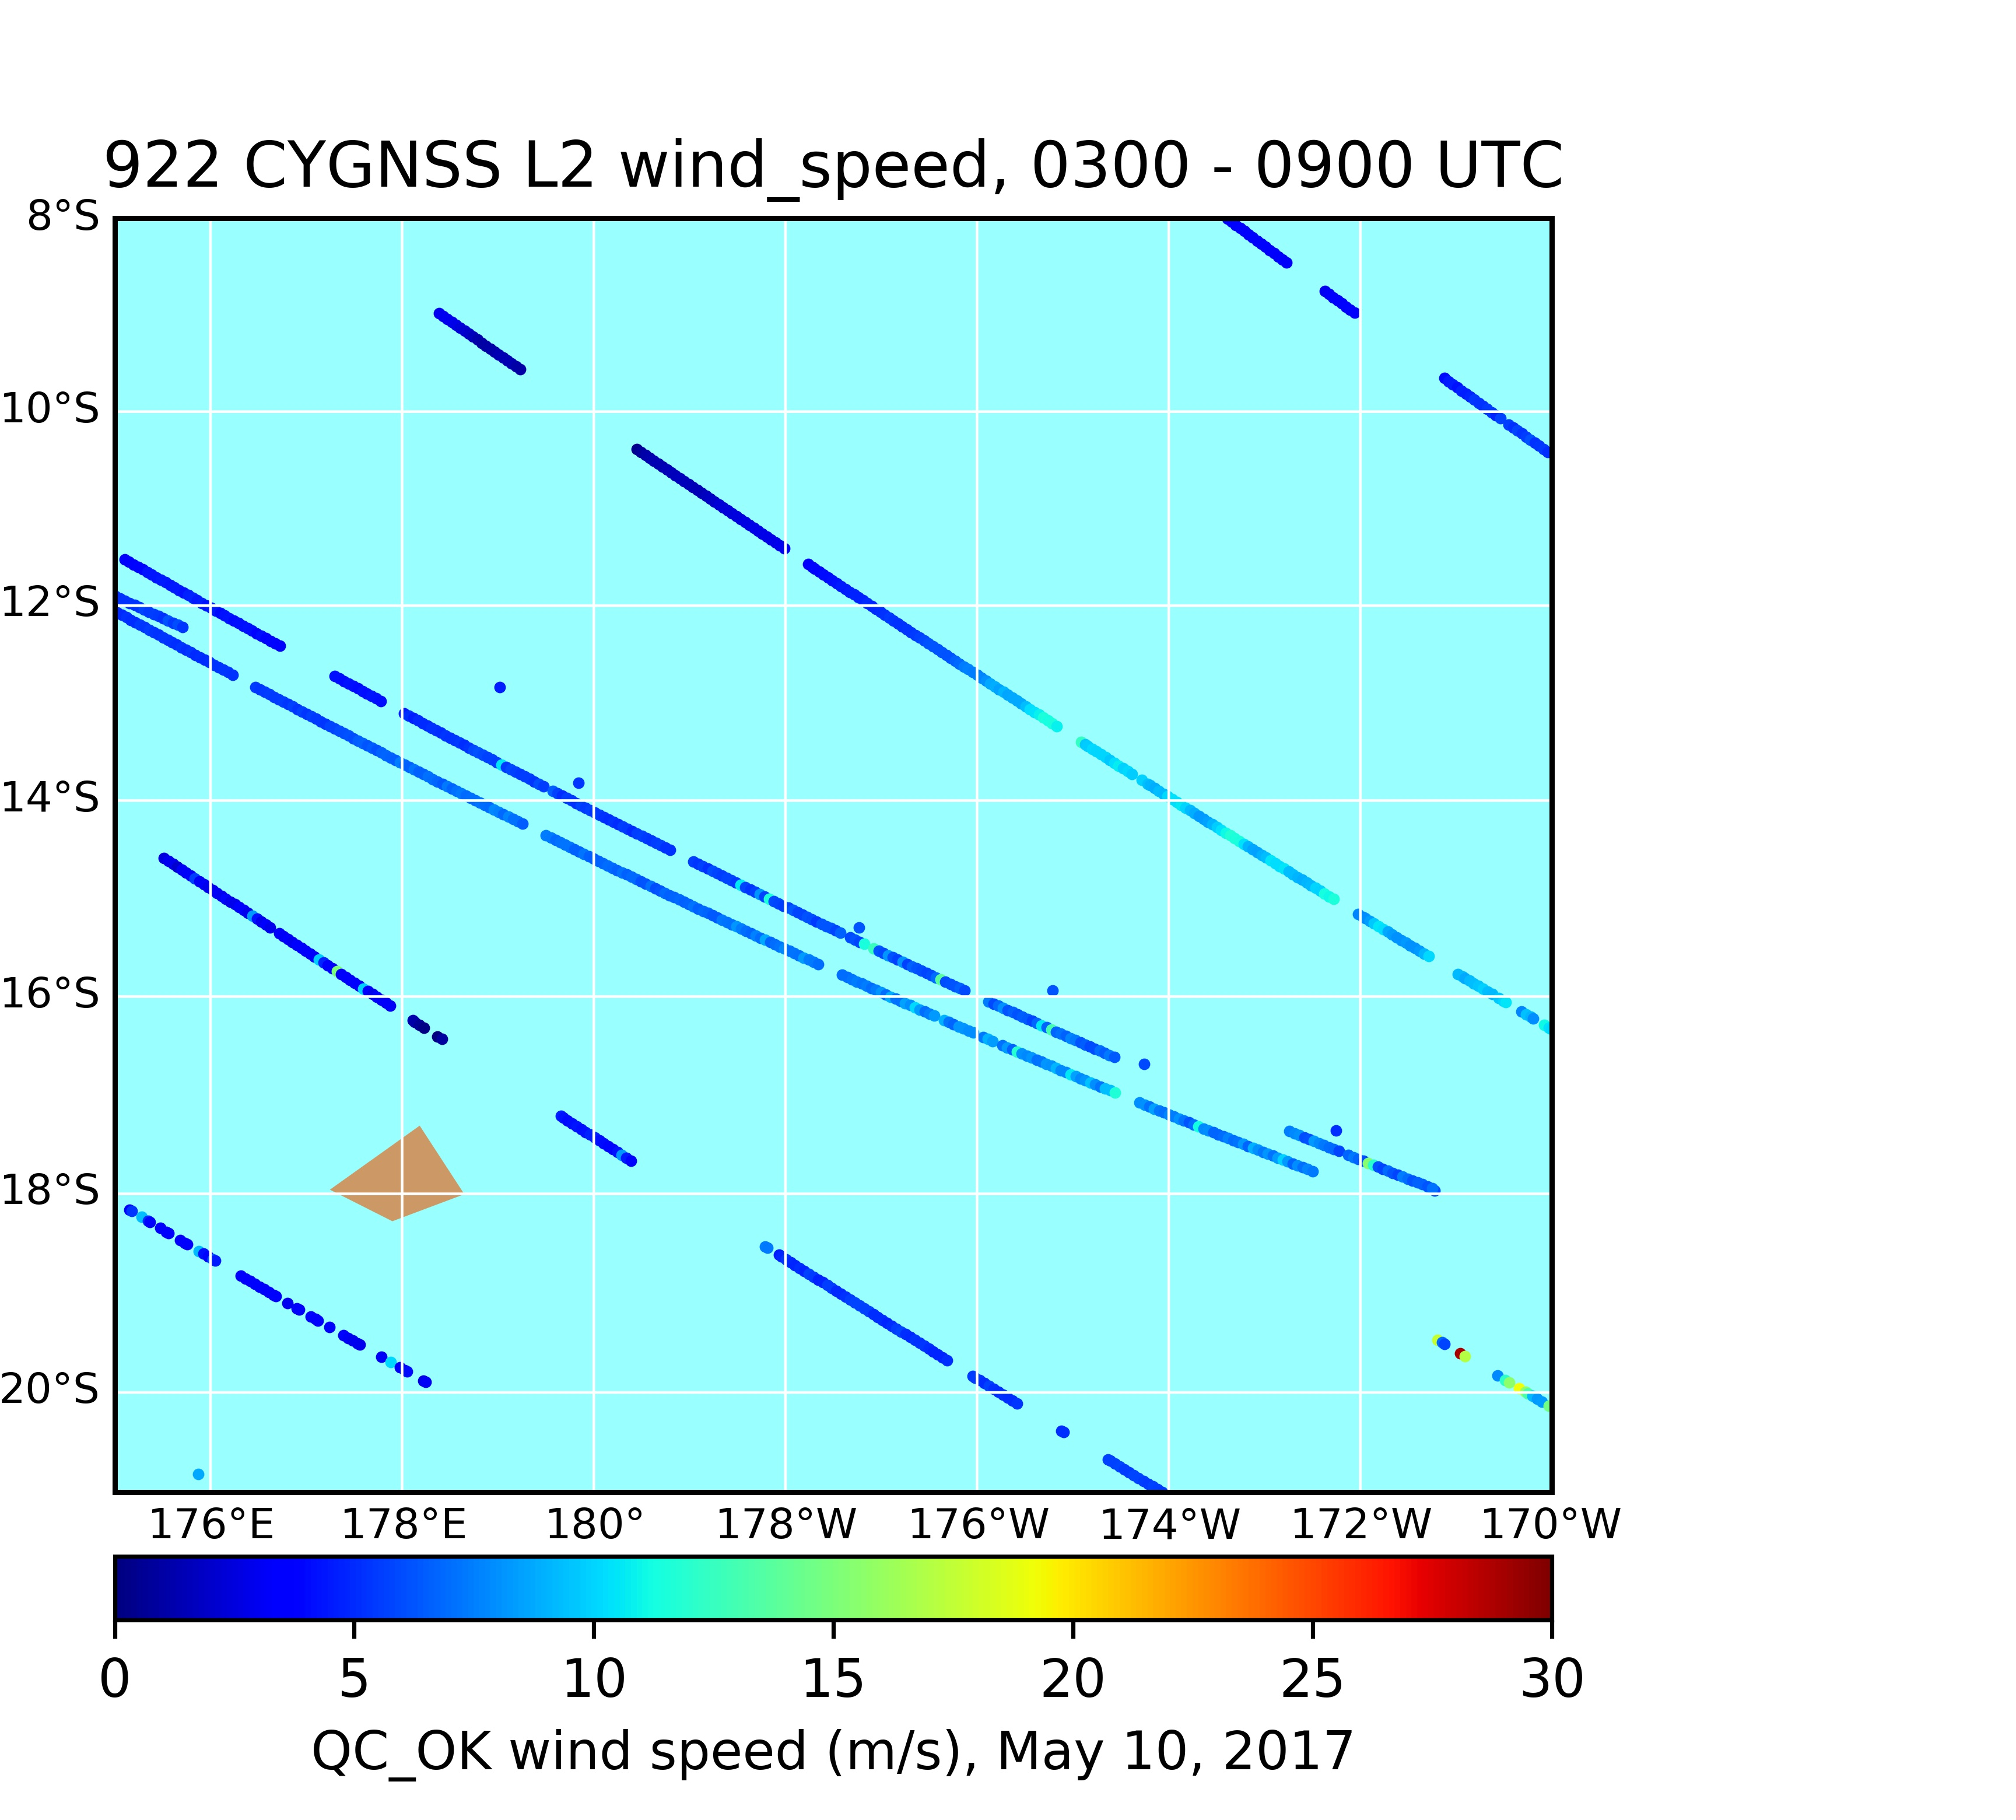
X

Slide 10
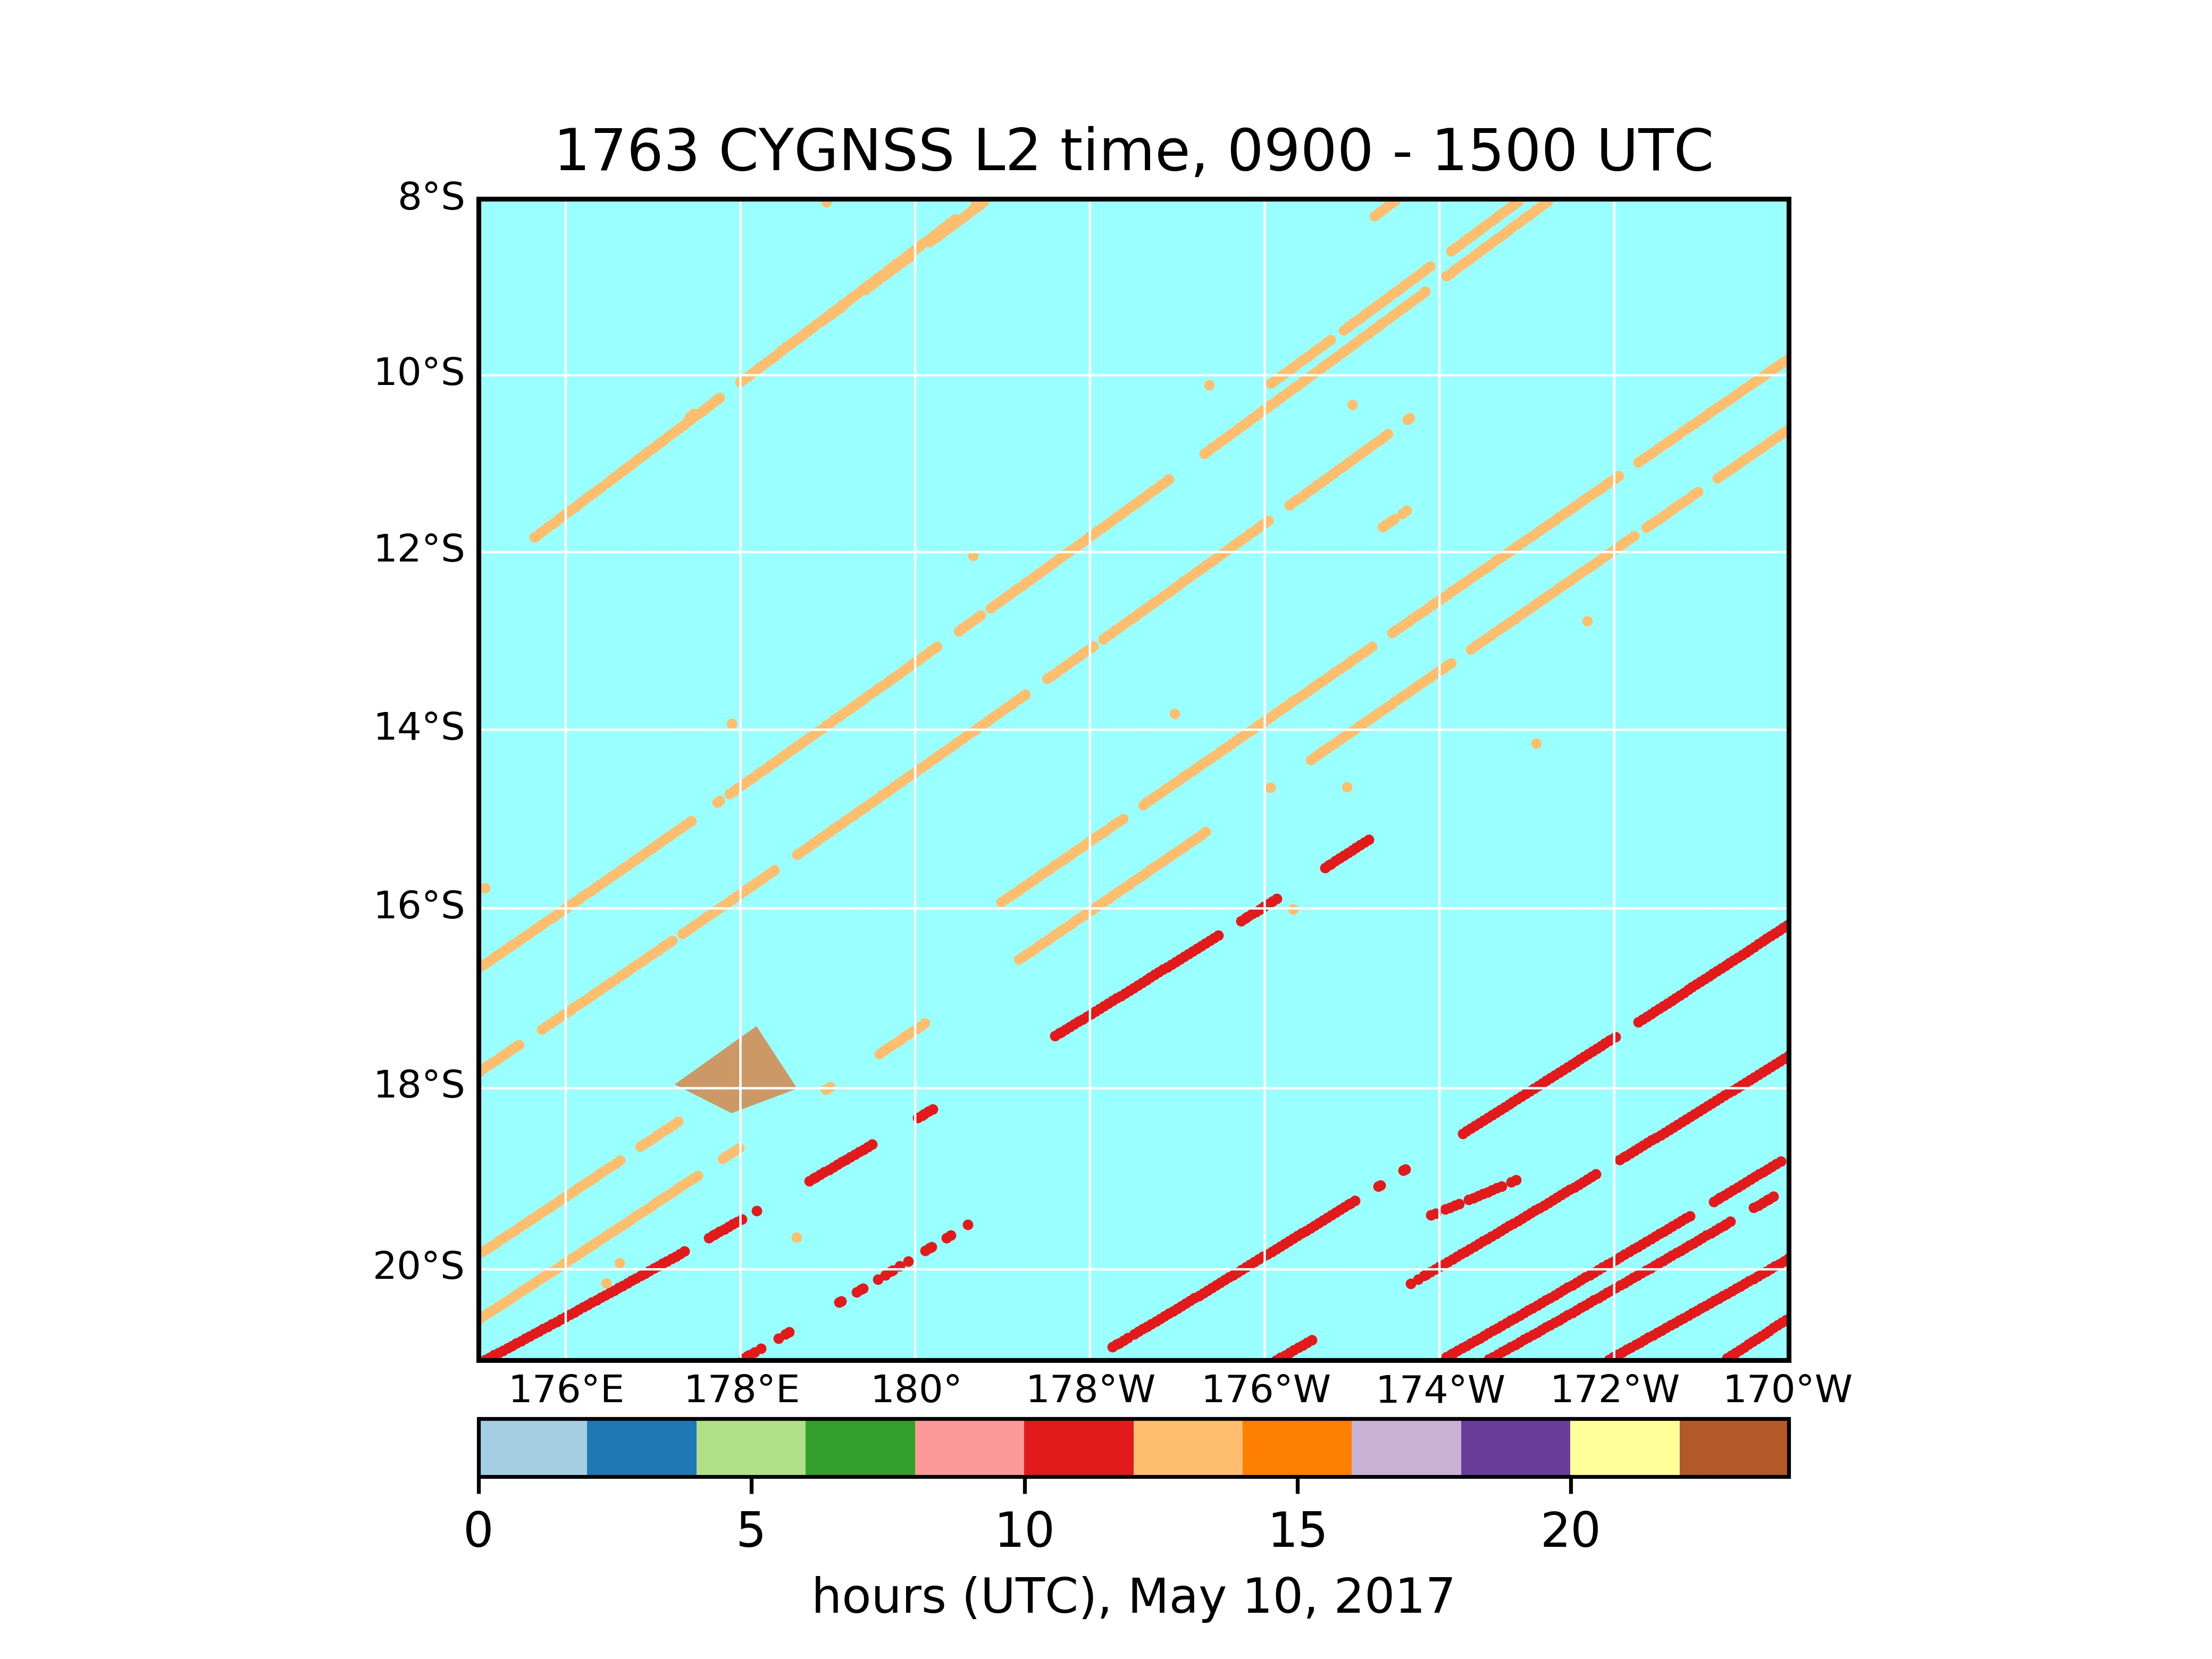
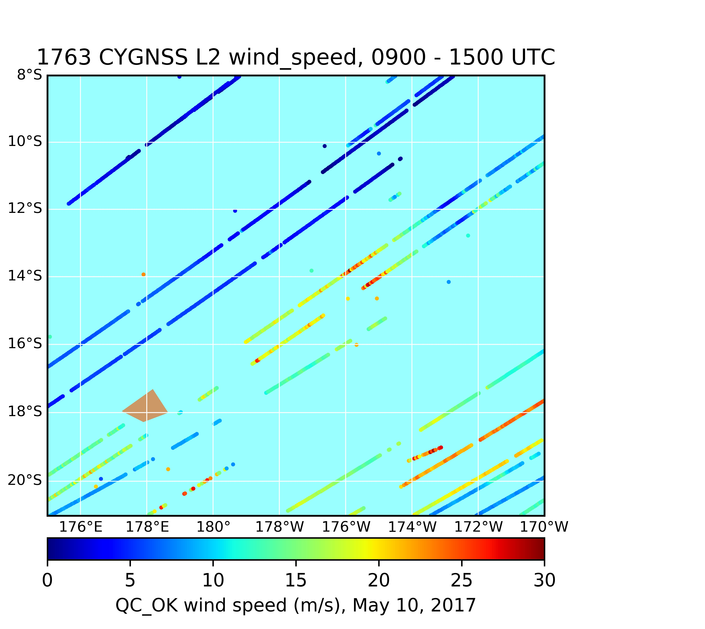
X

Slide 11
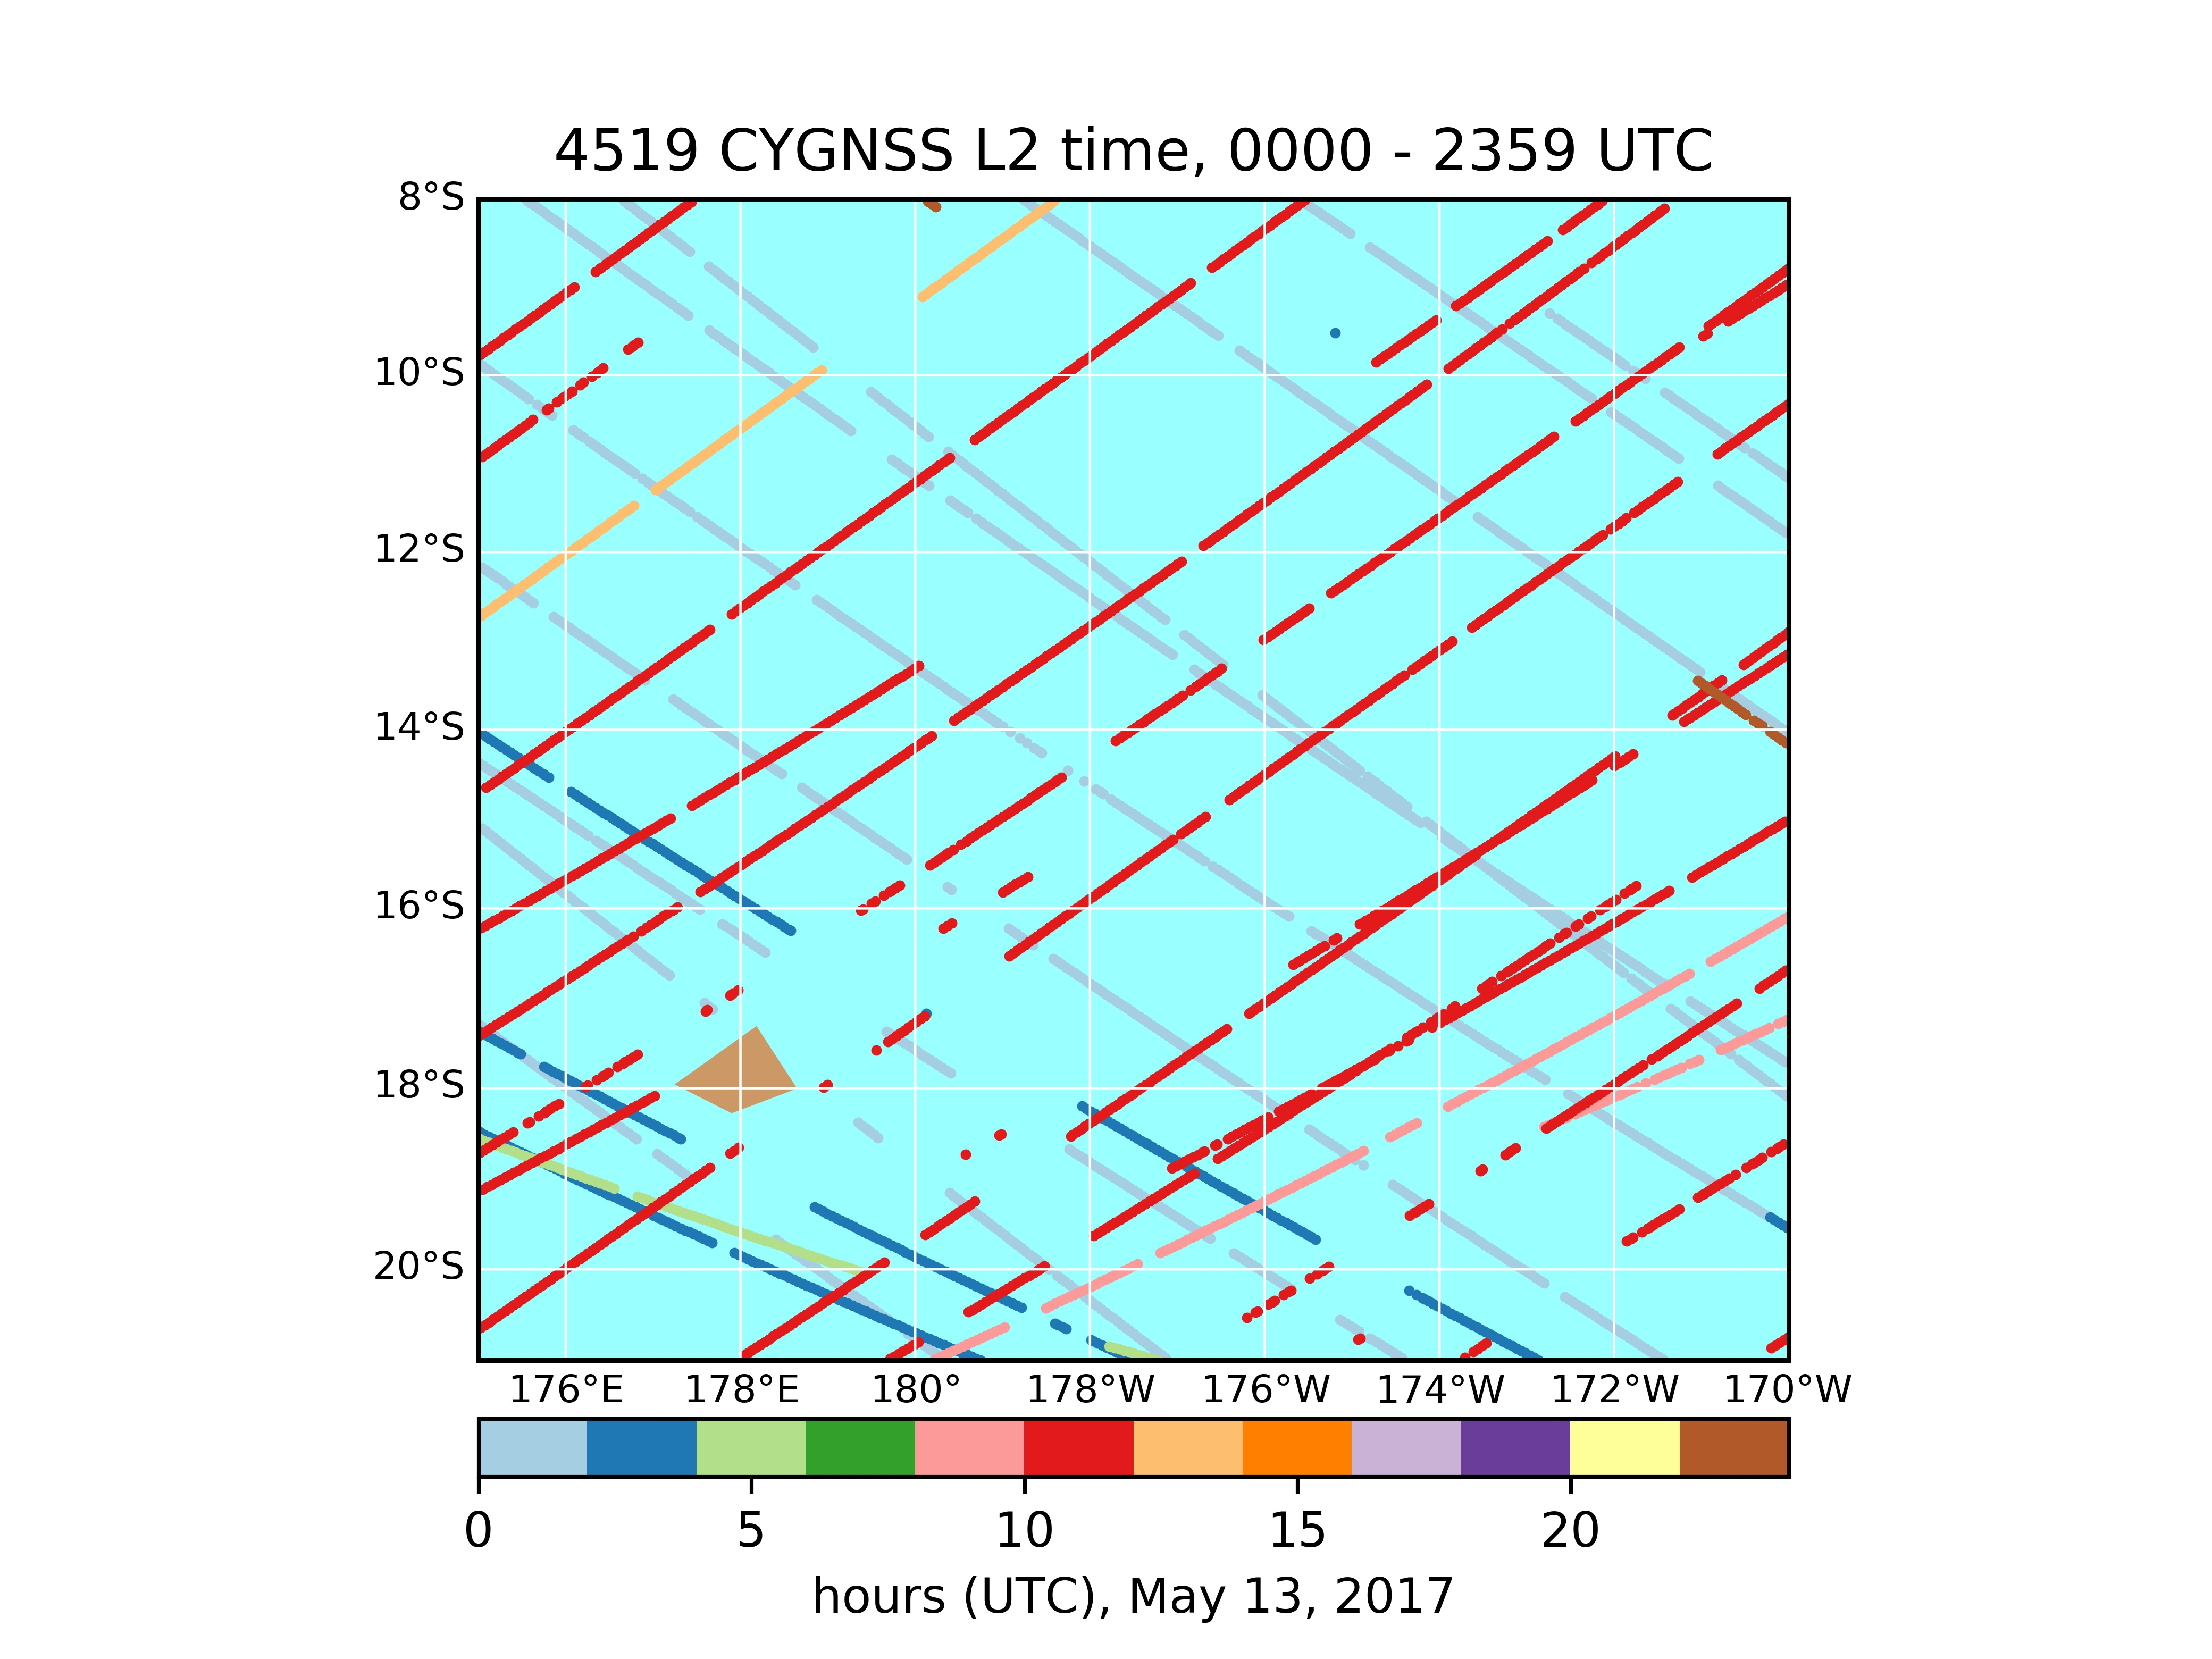
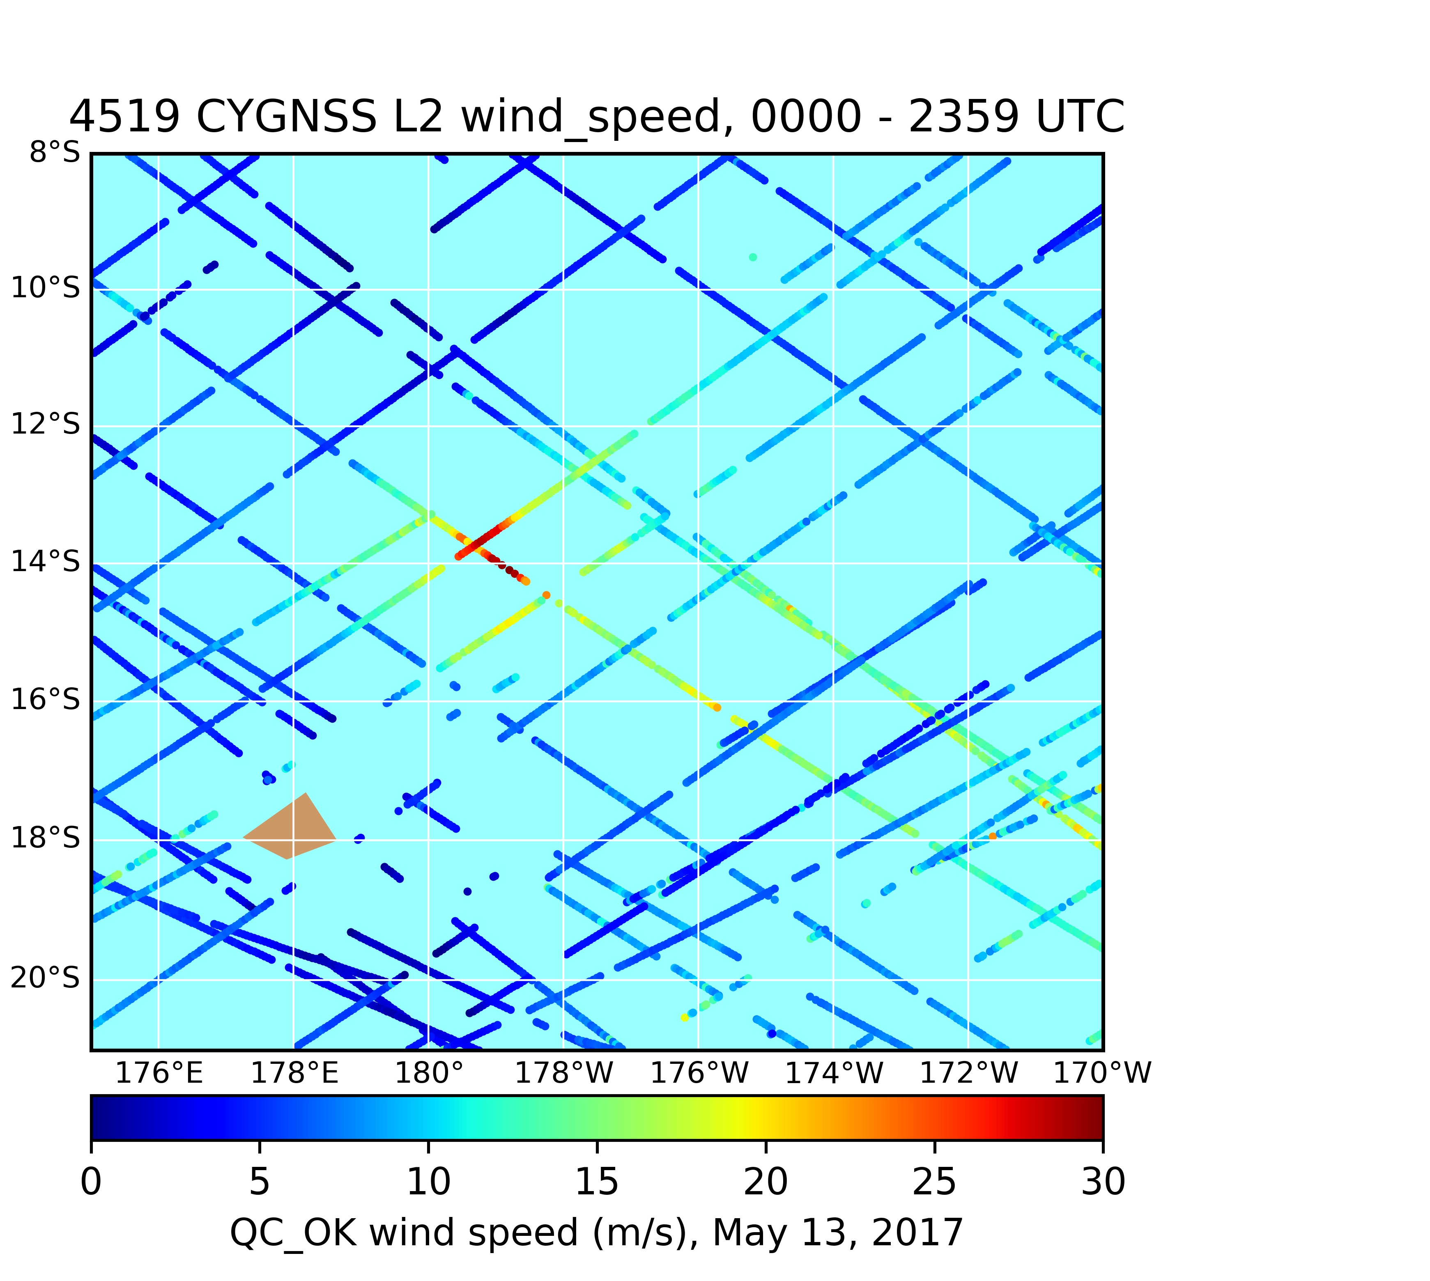

Slide 12
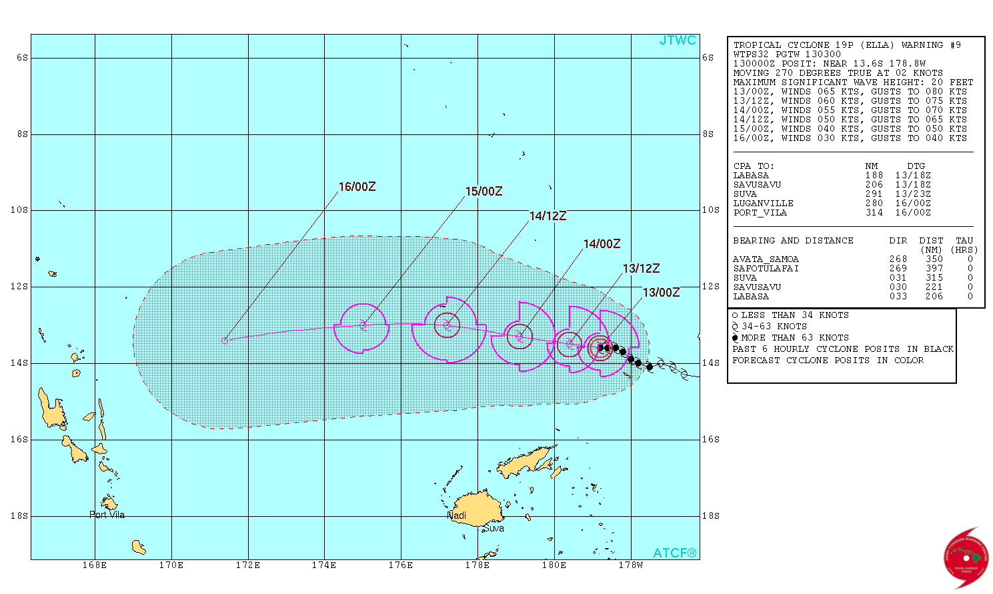

Slide 13
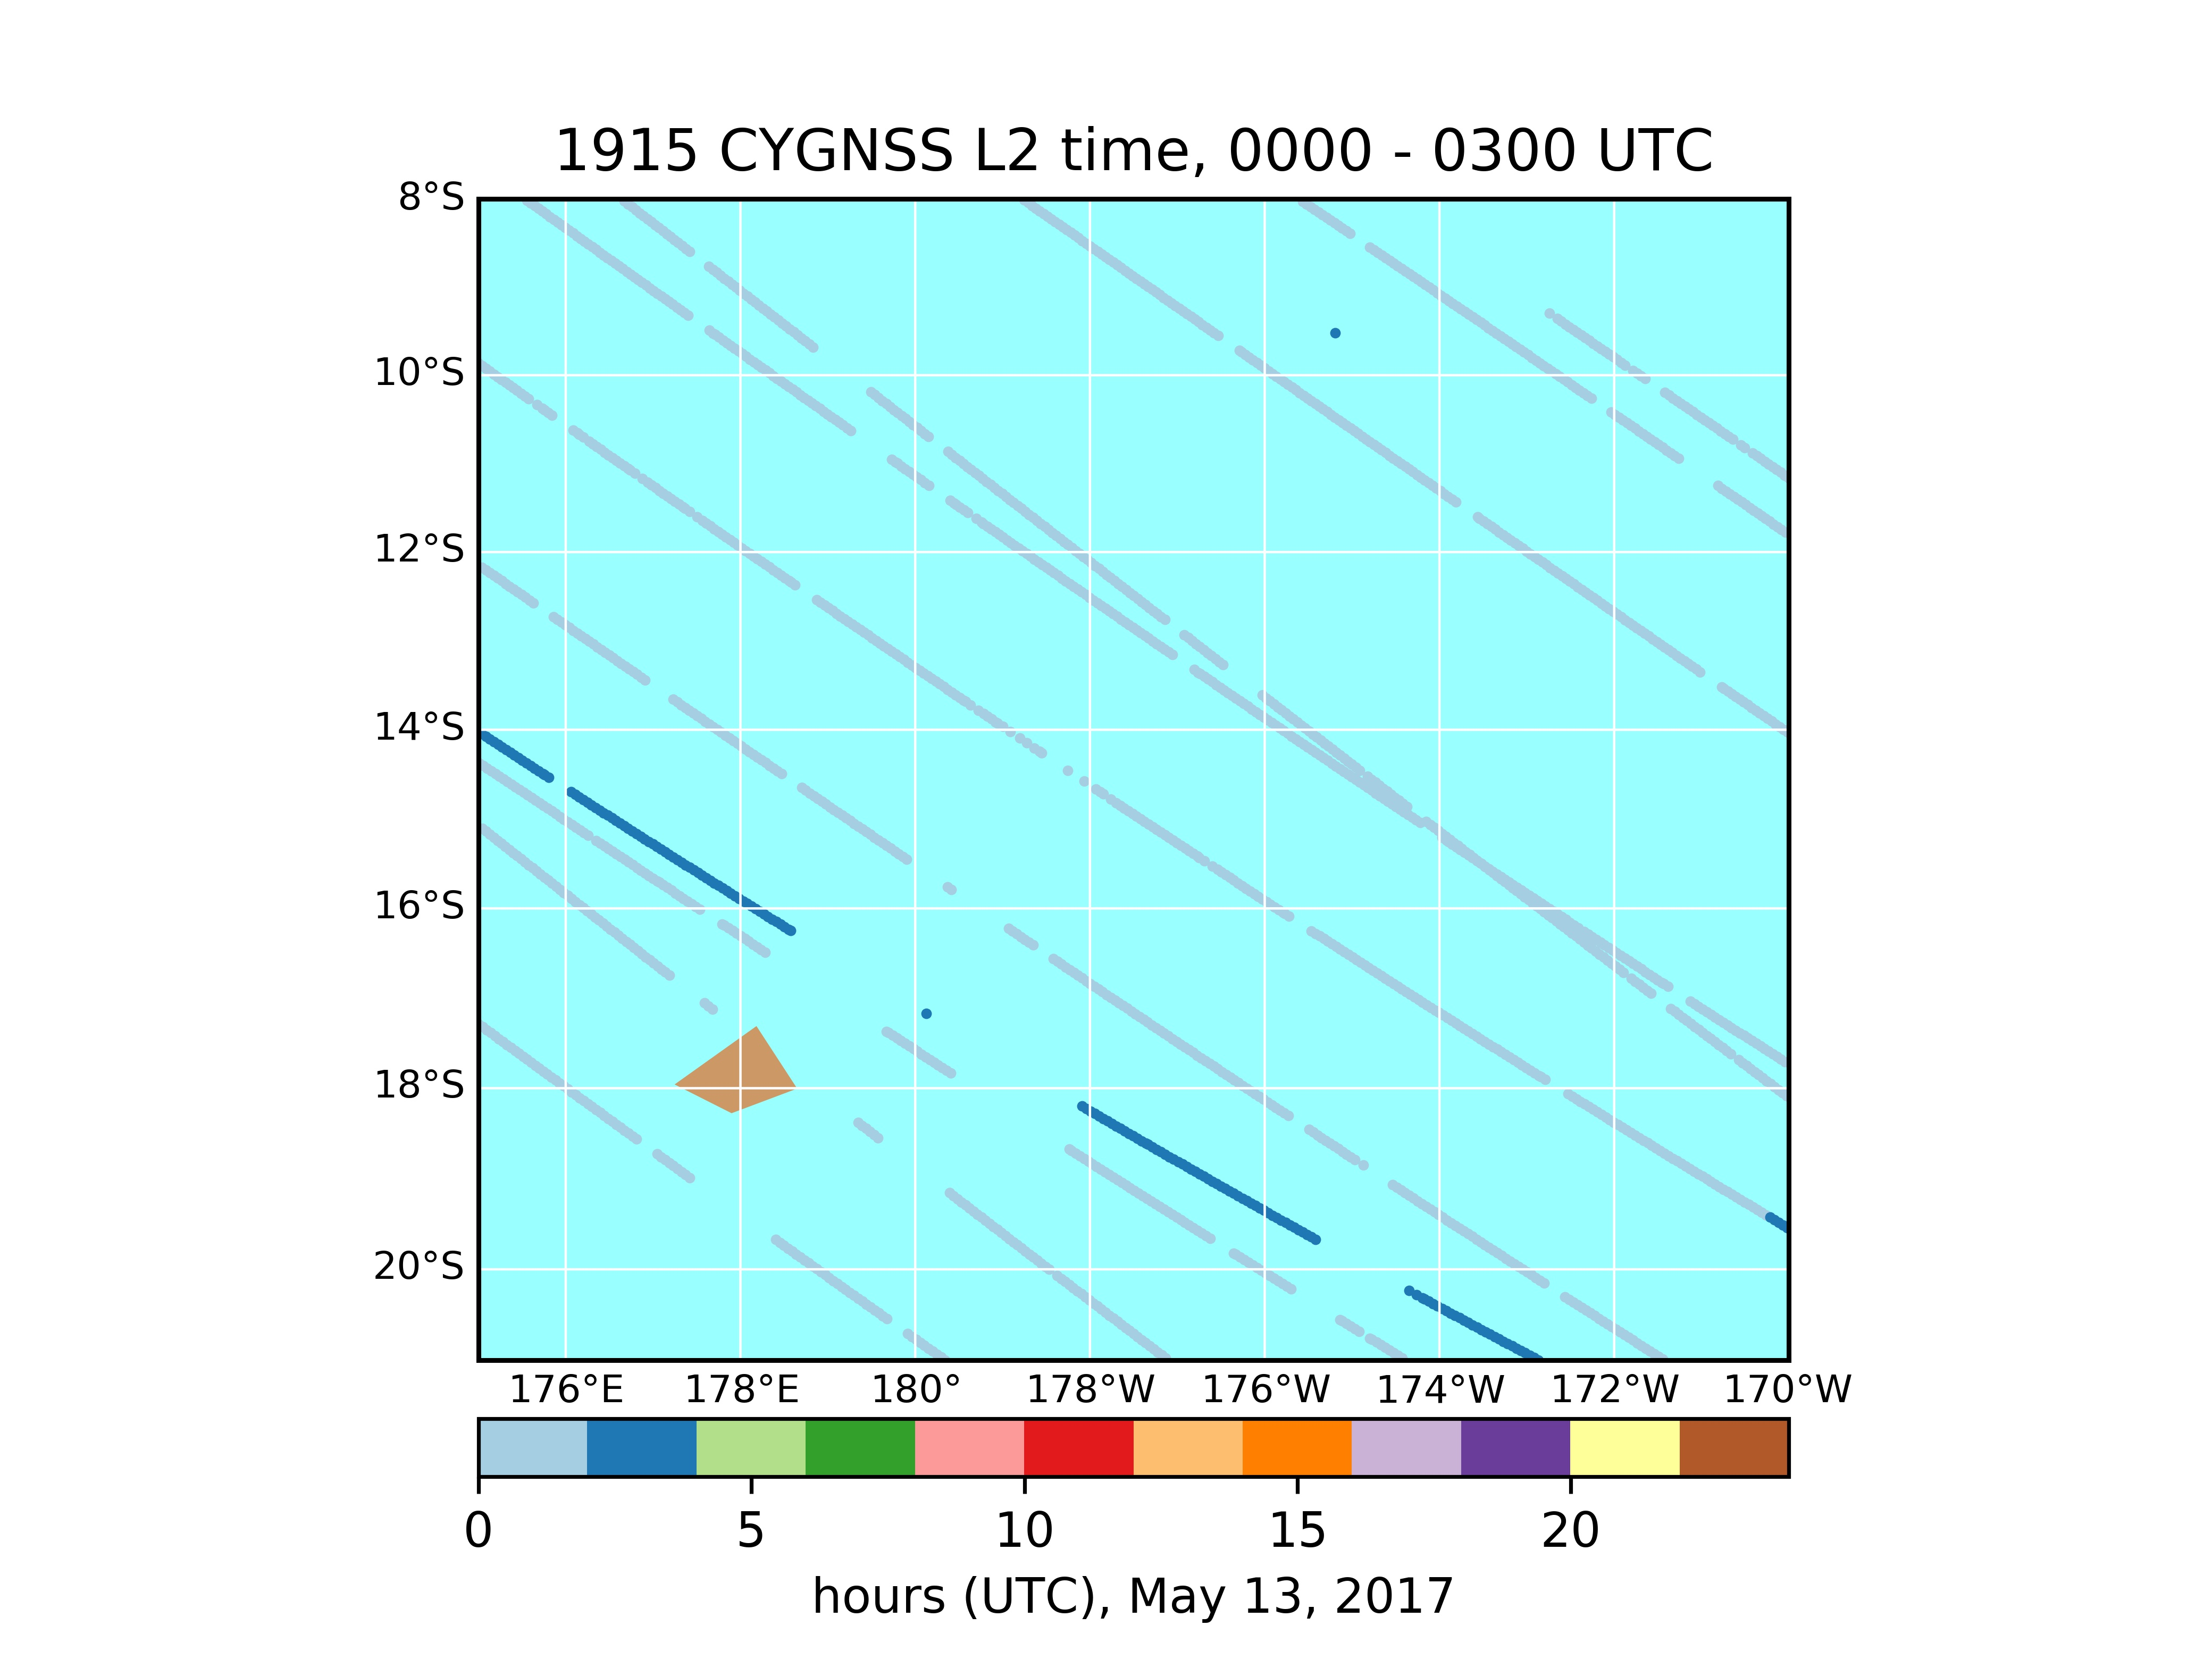
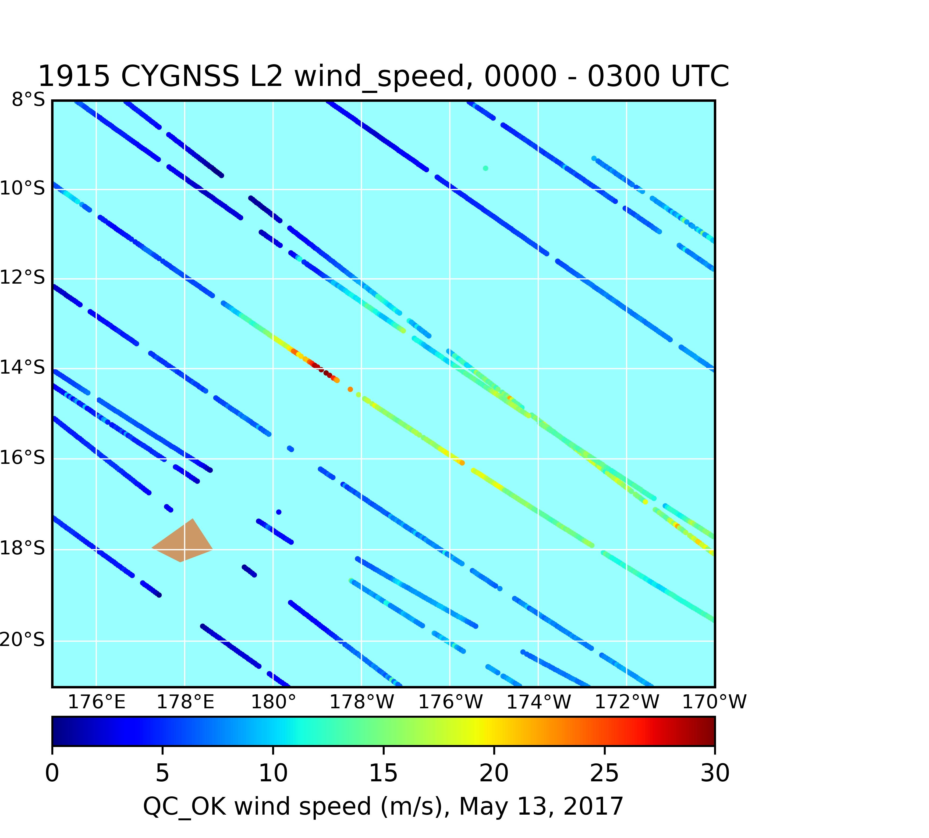
X

Slide 14
X₀₀

Slide 15
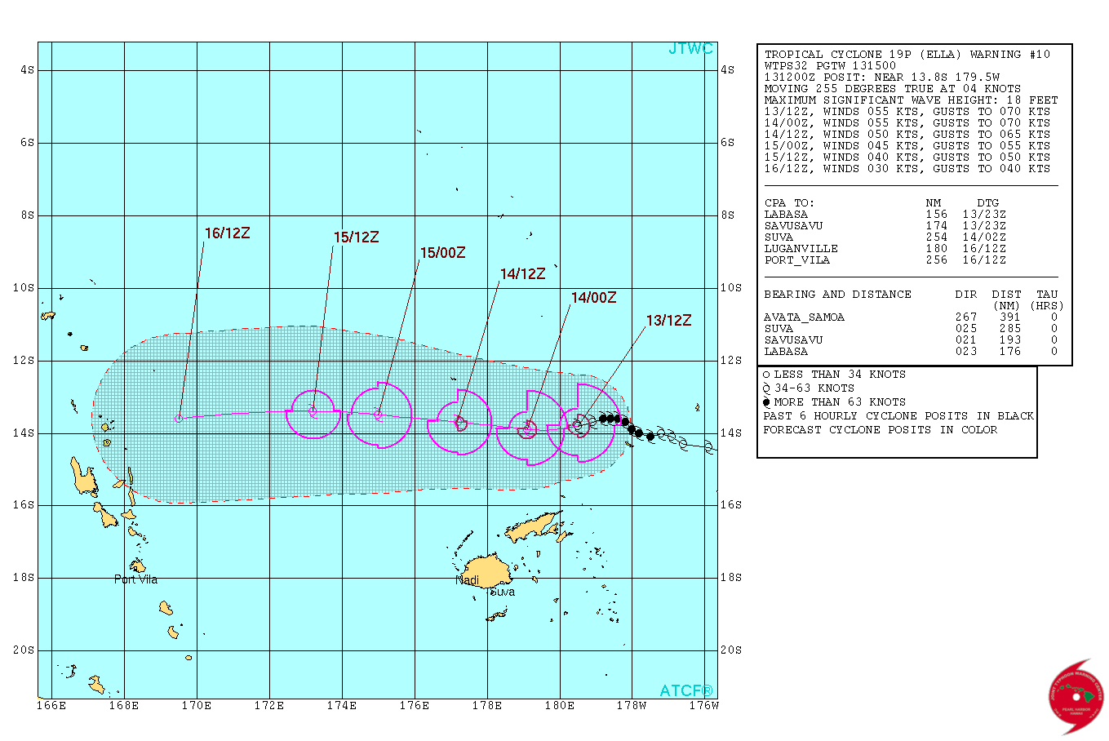

Slide 16
X

Slide 17
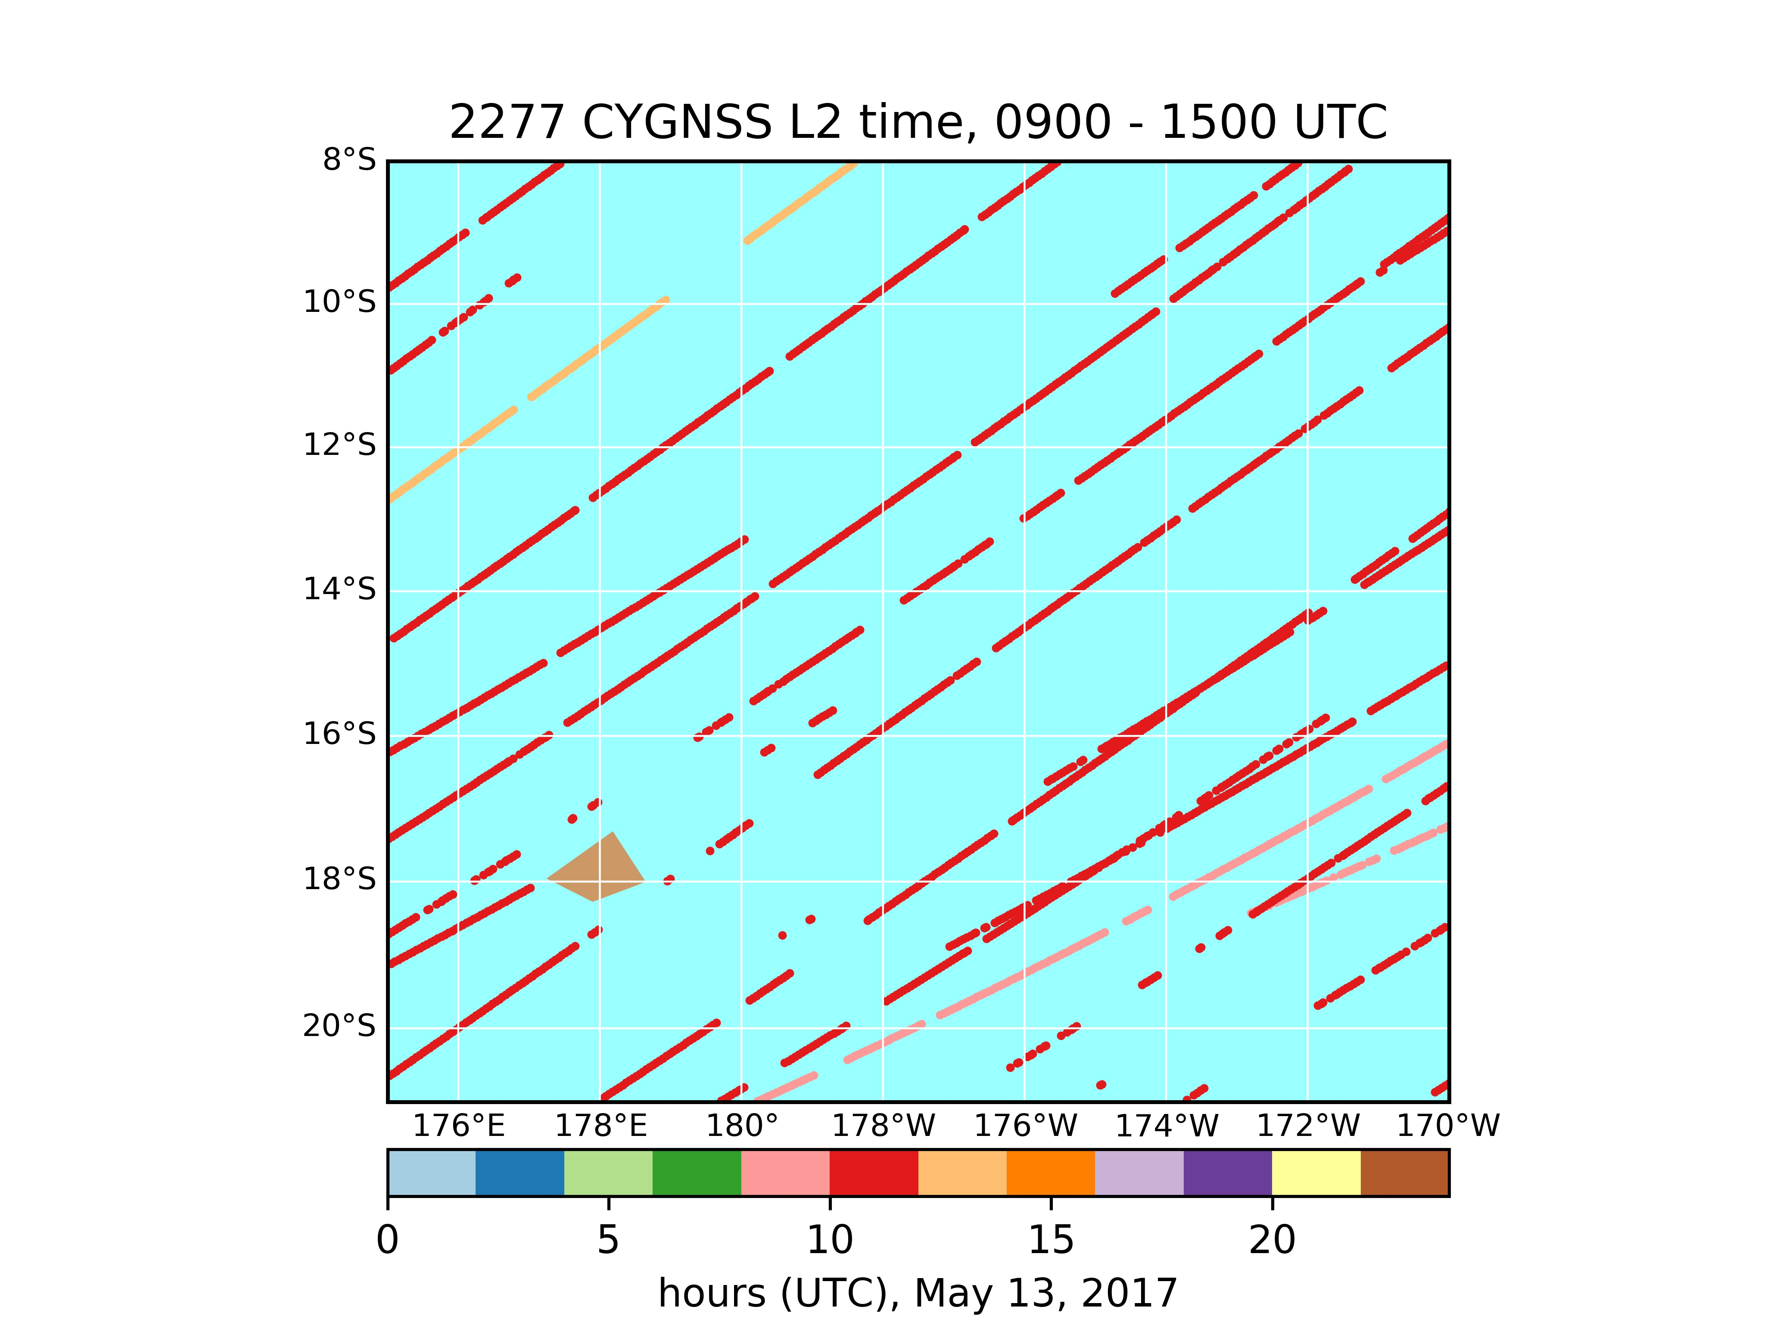
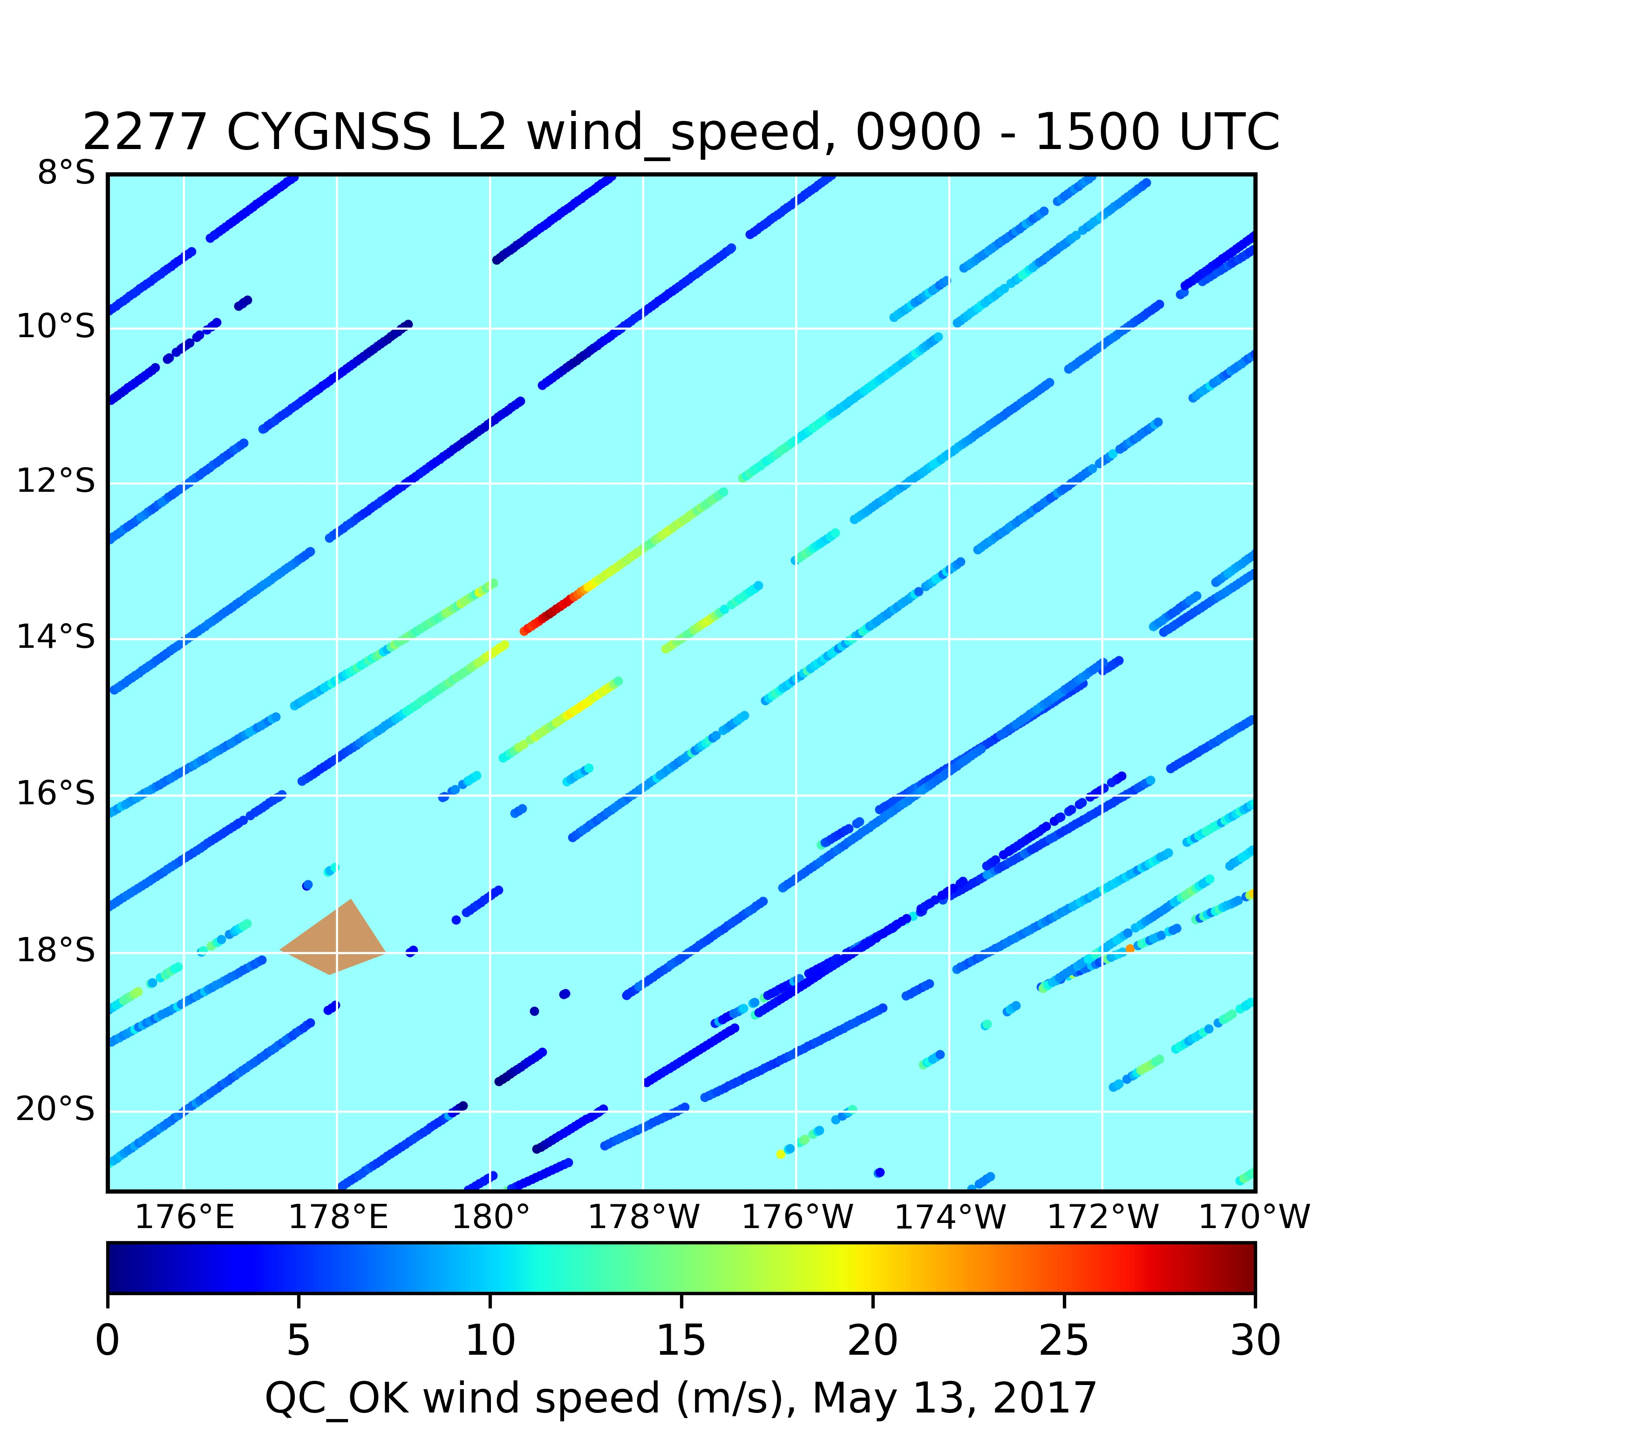

Slide 18
X₁₂

Slide 19



Evaluation of CYGNSS winds retrieved using an Extended Kalman Filter (EKF) and direct assimilation of Delay-Doppler Maps (DDMs)
Jim Garrison¹ – Principal Investigator
Mark Leidner², Bachir Annane³, Feixiong Huang¹, Kaitie Schoenfeld¹ and R. N. Hoffman⁴
¹ Purdue University, West Lafayette, USA
² Atmospheric and Environmental Research, Norman, OK, USA
³ Cooperative Institute for Marine and Atmospheric Studies (CIMAS), Miami, FL, US
⁴ Univ. of Miami/CIMAS and NOAA/AOML/HRD, Miami, FL
GNSS+R Workshop
Ann Arbor, MI
May 23-25, 2017

Slide 20
Overview
Comparison of EKF / Level 2 winds just getting underway
  no results yet (L2 data released on 5/18)
Preparatory work for direct assimilation of Level 1 DDMs
  Why assimilate DDMs?
  Progress toward a modular DDM forward model
  Example simulated DDMs from around Cyclone Enawo
Summary

Slide 21
Why assimilate DDMs?
Hi-resolution DDM from raw
Intermediate Frequency (IF) data
Low-resolution with 3x5
sampling region for L2 winds
Measurement geometry

Slide 22
Why assimilate DDMs?
One sample (1 s)
Three samples (3 s)
Measurement geometry

Slide 23
Assimilate DDMs by use of Jacobian, H
Data Assimilation:
Given
-- an observed DDM, y,
-- a simulated DDM, Hx_{b},
-- an analytical Jacobian of the forward model, H,
-- an estimate of background error covariance, B,
-- an estimate of observation error covariance, R,
the increment to the wind model (x_{a}—x_{b}) can be computed.

Slide 24
Validate the forward model with measured CYGNSS L1 data
Antenna
pattern
simulated
17x11 DDM
CYGNSS L1a DDM
Forward model
HWRF
analysis
Gridded
90x90km
wind field
Jacobian H matrix
Tx, Rx
Geometries

Slide 25
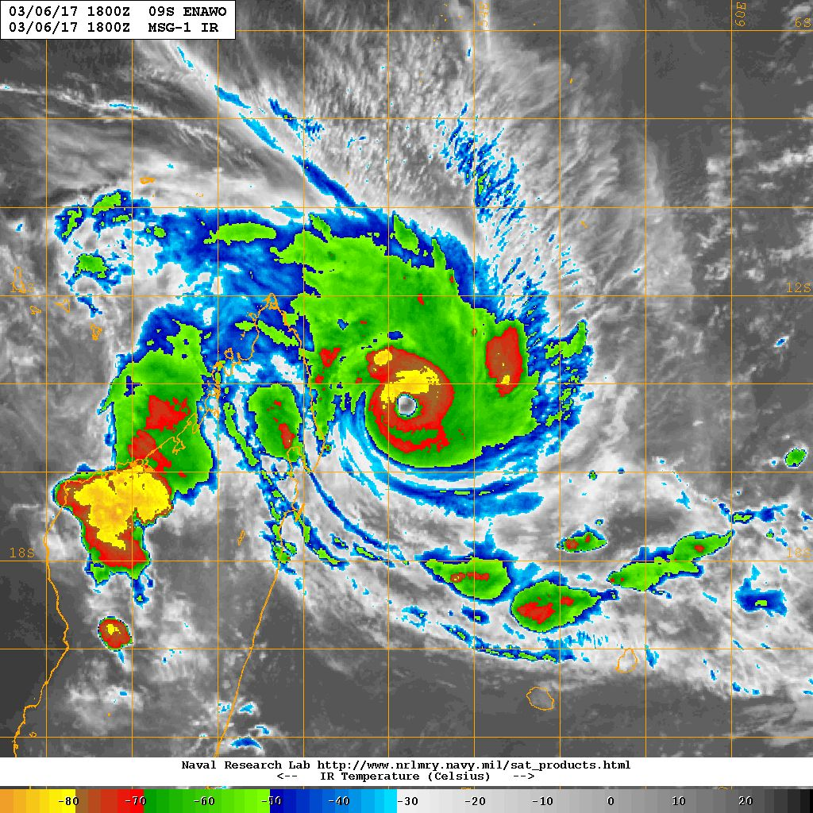
Cyclone Enawo

Slide 26
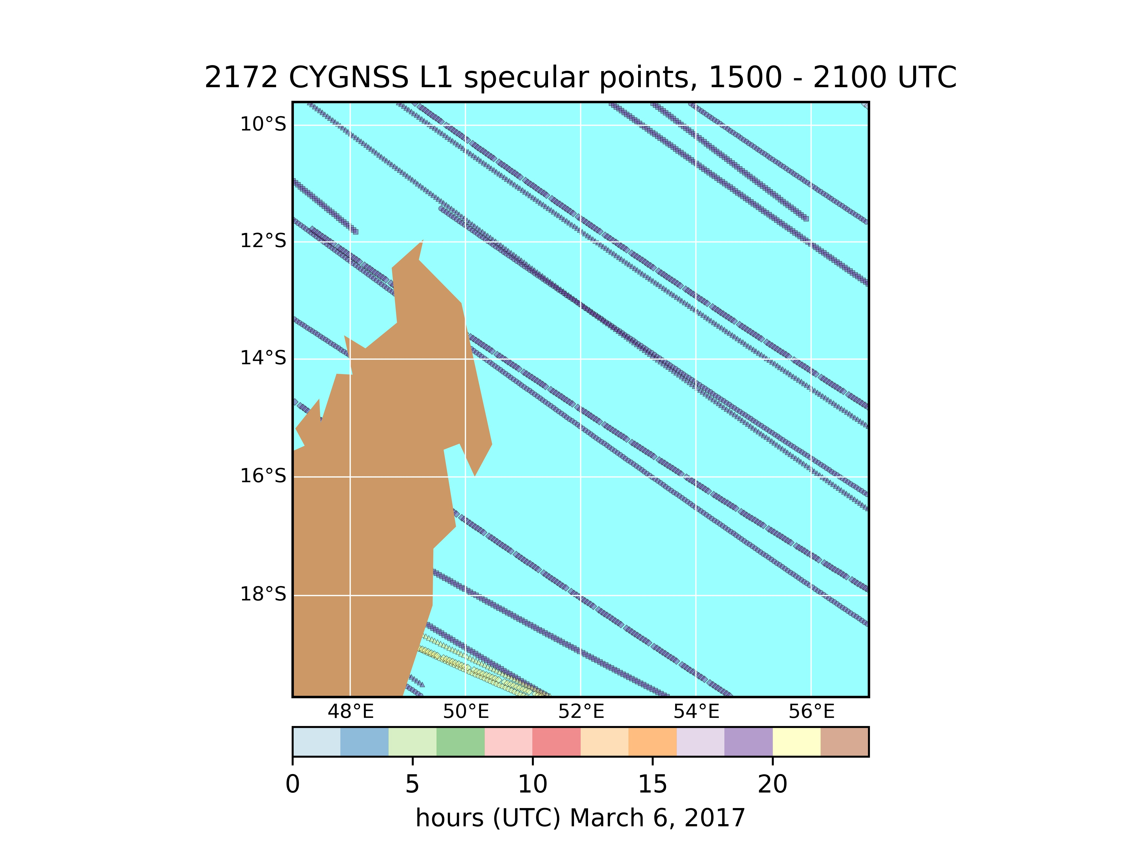
cyg02
cyg03
cyg04
cyg05

Slide 27
X – cyg05
moderate wind speed
HWRF U10 ~ 8 m/s
X – cyg02
flat wind field
HWRF U10 ~ 9 m/s
cyg02
cyg03
cyg04
cyg05
high wind speed
HWRF U10 ~ 40 m/s
cyg04 – X
cyg02 – X
high wind speed
HWRF U10 ~ 40 m/s

Slide 28
High and moderate wind speed examples effect of CYGNSS antenna pattern

Slide 29
2.22 km resolution
HWRF nested
domain (d02)

Slide 30
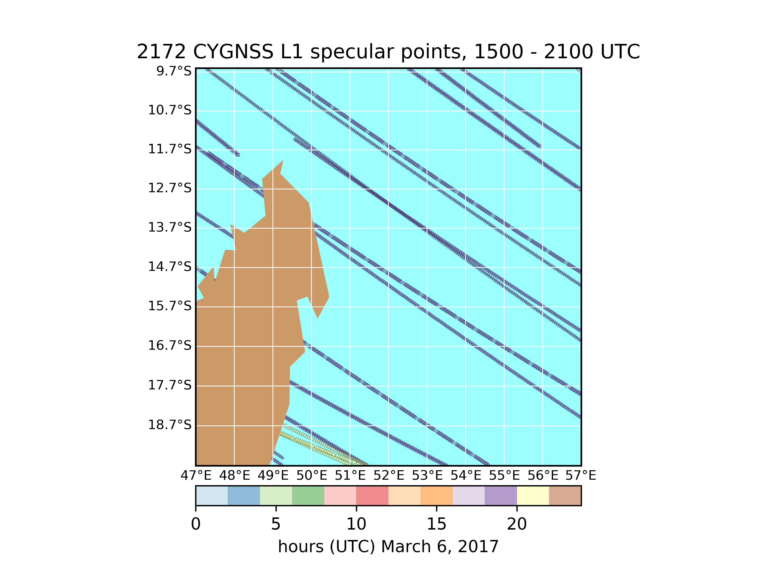

Slide 31
X – cyg05
moderate wind speed
HWRF U10 ~ 8 m/s
X – cyg02
Flat wind field
HWRF U10 ~ 9 m/s
2.22 km resolution
HWRF nested
domain (d03)
high wind speed
HWRF U10 ~ 40 m/s
cyg04 – X
cyg02 – X
high wind speed
HWRF U10 ~ 40 m/s

Slide 32
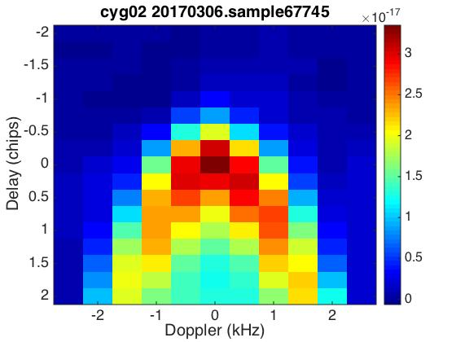
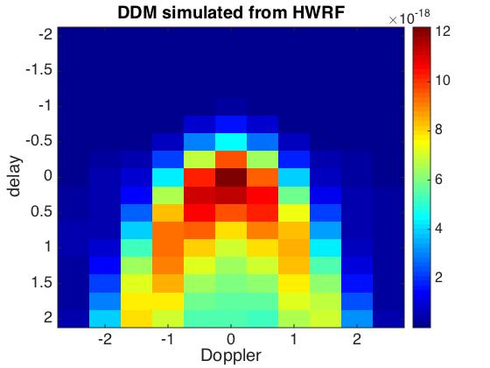
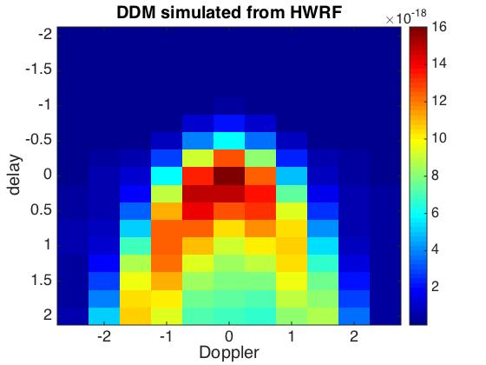
High wind speed (~40 m/s) example:
CYGNSS DDM
Forward Model:
Isotropic Antenna
Forward Model:
updated Antenna
Power Bias and differences in DDM pattern will effect Data Assimilation results.
-- variational data assimilation requires mean unbiased (observation – model) statistics

Slide 33
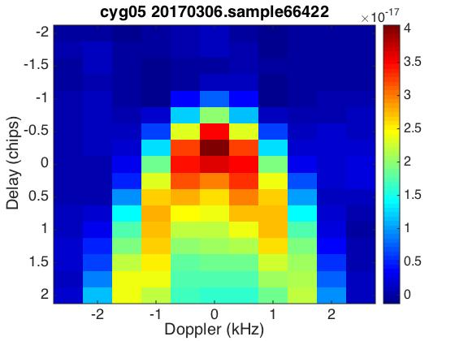
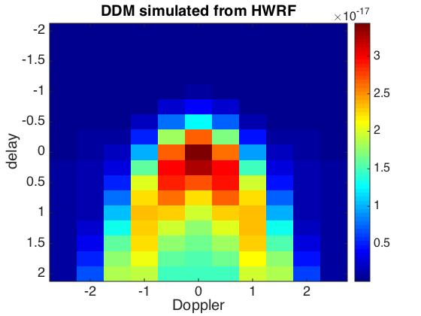

Moderate wind speed (~8 m/s) example:
CYGNSS DDM
Forward Model:
Isotropic Antenna
Forward Model:
updated Antenna

Slide 34
Low wind speed example effect of CYGNSS antenna pattern

Slide 35
HWRF 13.88 km
resolution domain (d02)
cyg05 – X
cyg05 – X

Slide 36
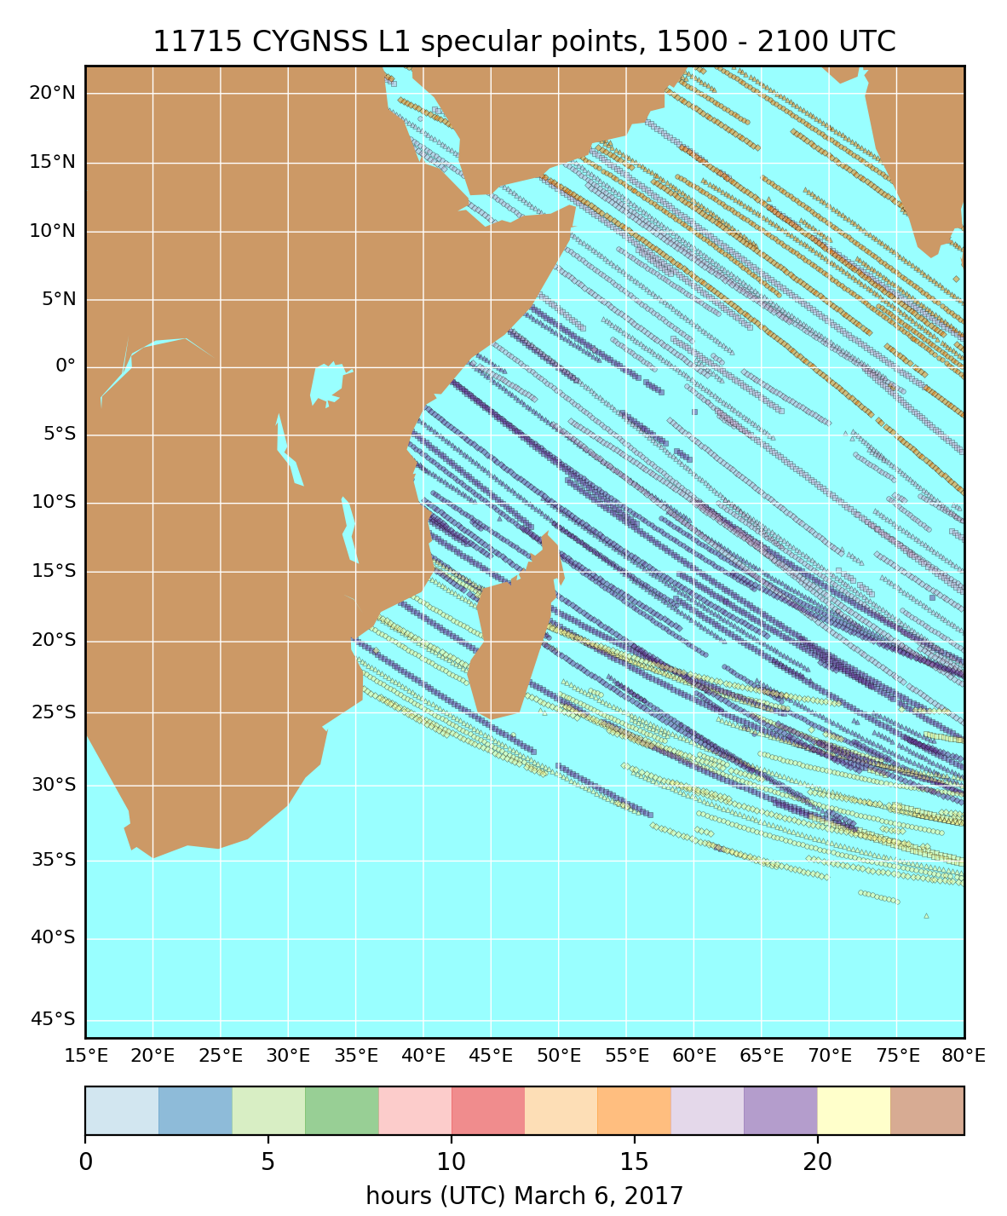
cyg05 – X
cyg05 – X

Slide 37
HWRF 13.88 km
resolution
domain (d02)
cyg05 – X
cyg05 – X

Slide 38
cyg05 – X
near-calm wind speed
HWRF U10 < 2 m/s

Slide 39
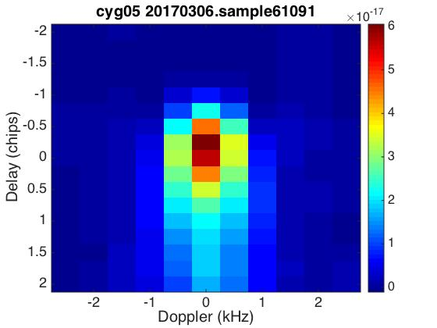
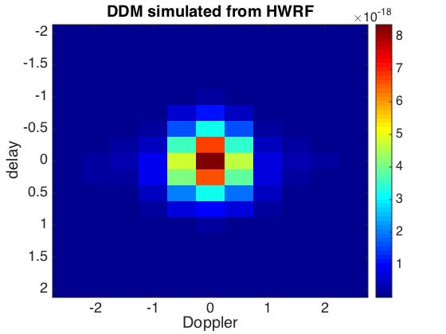

Near-Calm wind (< 2 m/s) example:
CYGNSS DDM
Forward Model:
Isotropic Antenna
Forward Model:
updated Antenna

Slide 40
Flat wind field (near uniform) example asymmetric CYGNSS DDMs

Slide 41
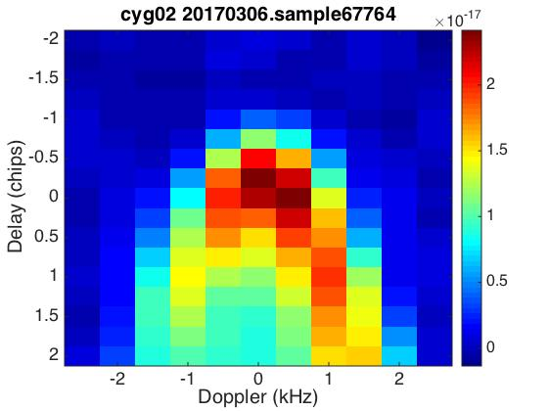
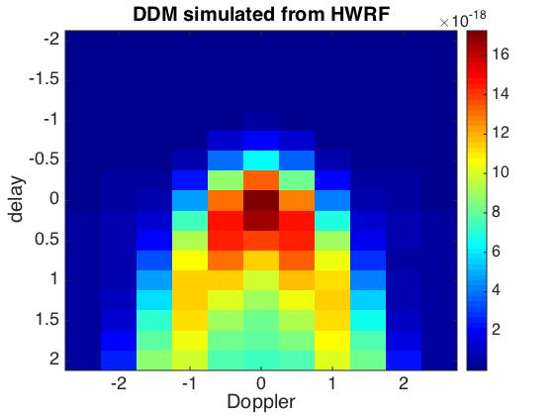
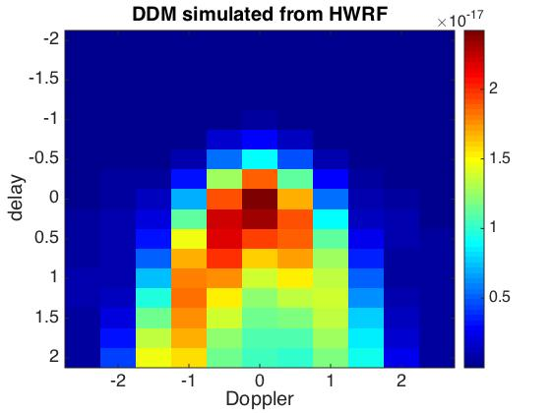
Flat wind field (~9 m/s) asymmetric example:
CYGNSS DDM
Forward Model:
Isotropic Antenna
Forward Model:
updated Antenna

Slide 42
Potential sources of differences between observed and simulated DDMs:
transmitter power / gain / eirp are not precise
Receiver antenna pattern is not accurate
HWRF differs from the real wind
forward model contains errors (empirical model between MSS and wind)
The observed DDM is under refinement

Slide 43
Summary
Exercising a path to generate simulated DDMs from NWP wind fields
  An important step toward data assimilation
Qualifying the forward model results
  Resolve L/R difference between observed and simulated DDMs
  Examine a larger population
Develop a software path forward for modularizing
Deploy forward model inside a 2-dimensional variational vector wind field model.
  Compare to results assimilating L2 CYGNSS winds

