Slide 1
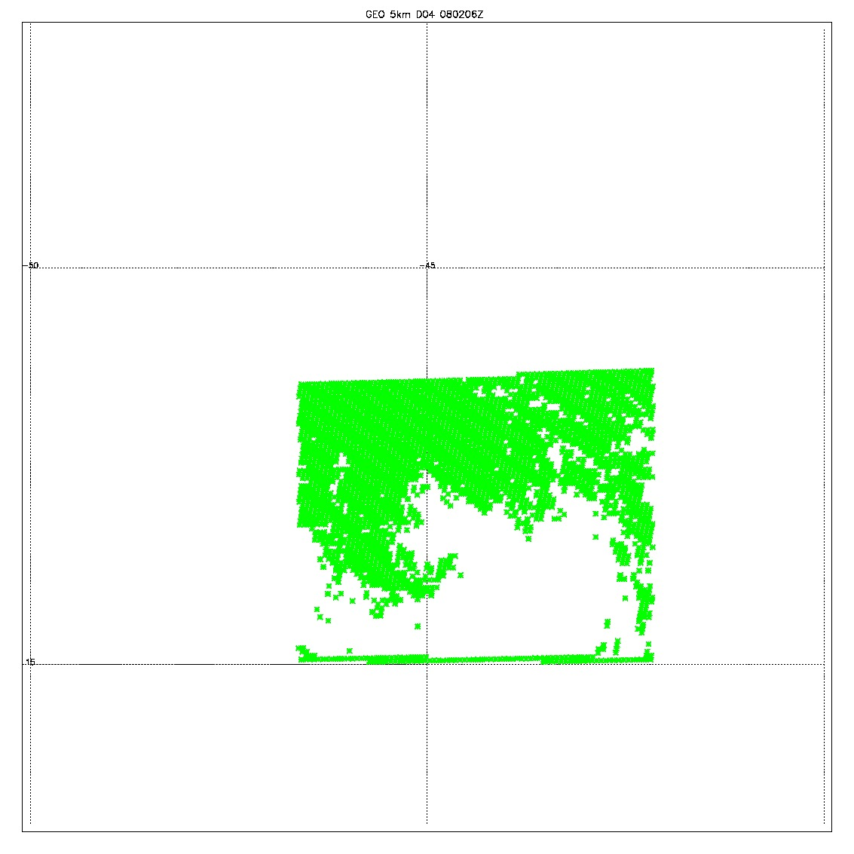
GEO 0802 6Z
Valid data from JPL; 98588
Filtered data (yellow); 82334
Removed 9 levels
Removed the zero data points
All zero data (blue); 16254
QCD (qc_t >0.1) data (green): 41889

Slide 2
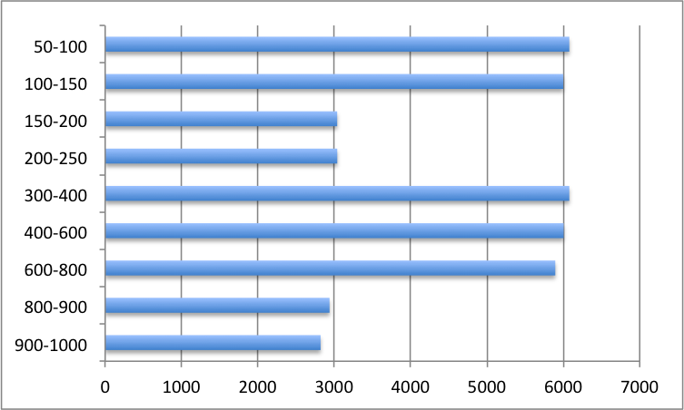
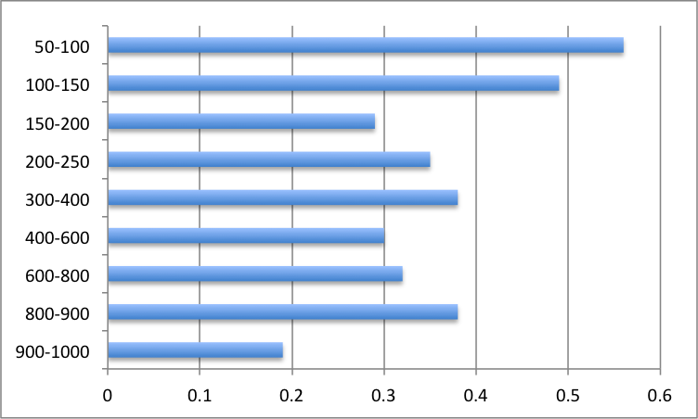
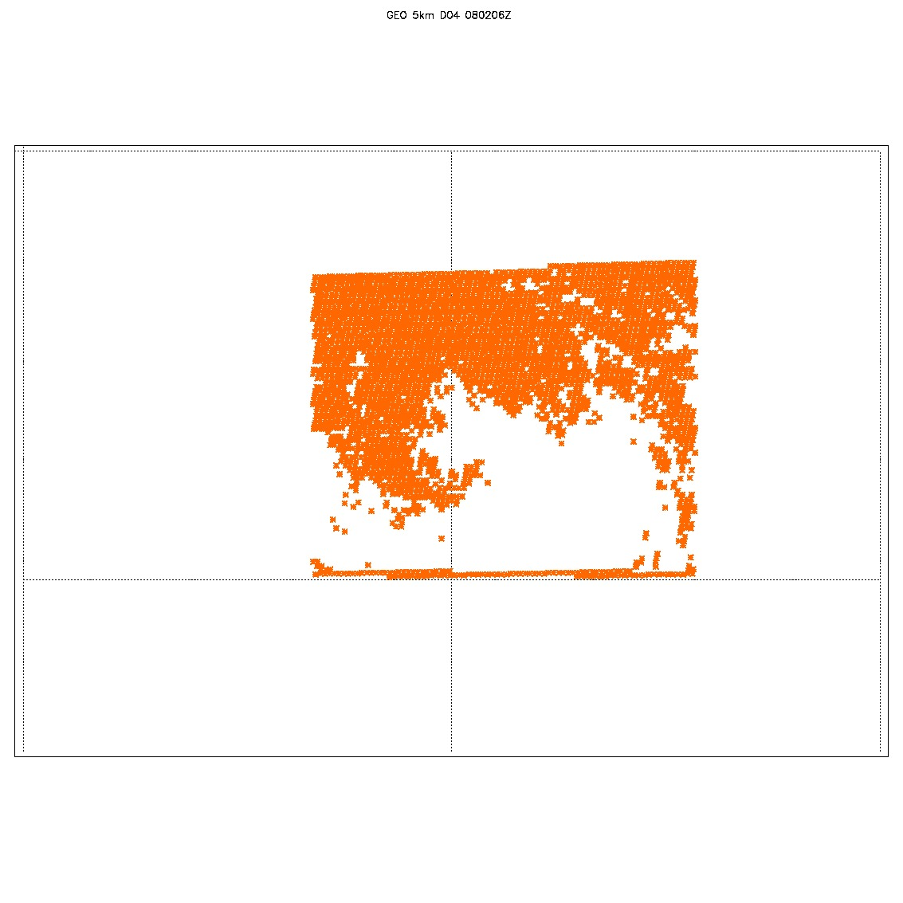
0802 6Z
All 41889 data point were assimilated
14 Levels; 943.8, 813.7, 705.8, 627.9, 544.1, 459.1, 381.9, 306.2, 240.5, 184.4, 142, 109.8, 82.9, 63.3
9 levels removed: 46.9, 30.3, 19.6, 11.5, 5.7, 3.3, 1.8, 0.96, 0.1

Slide 3
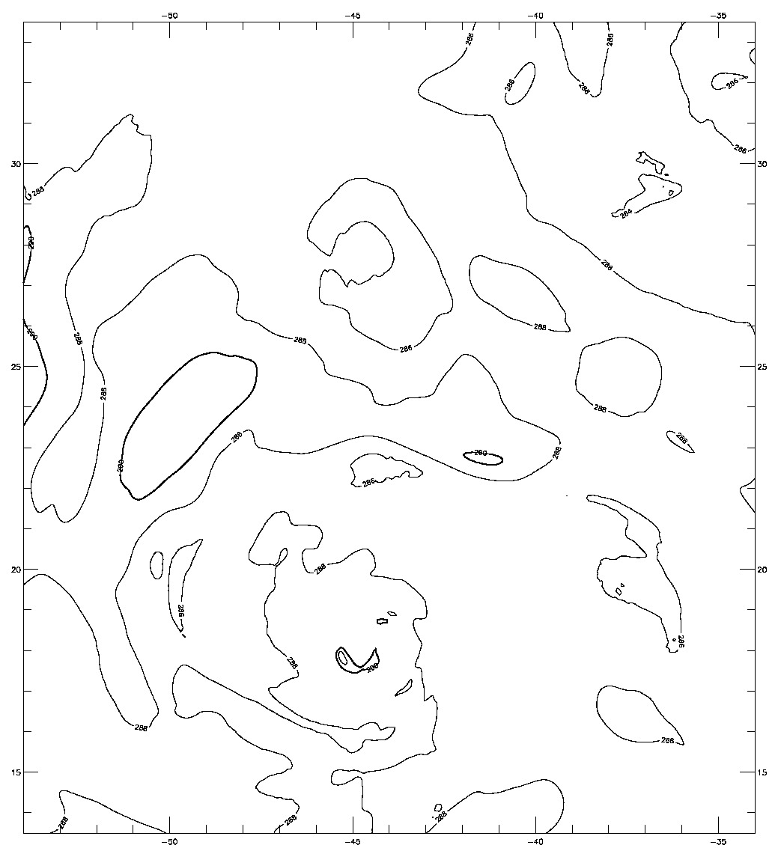
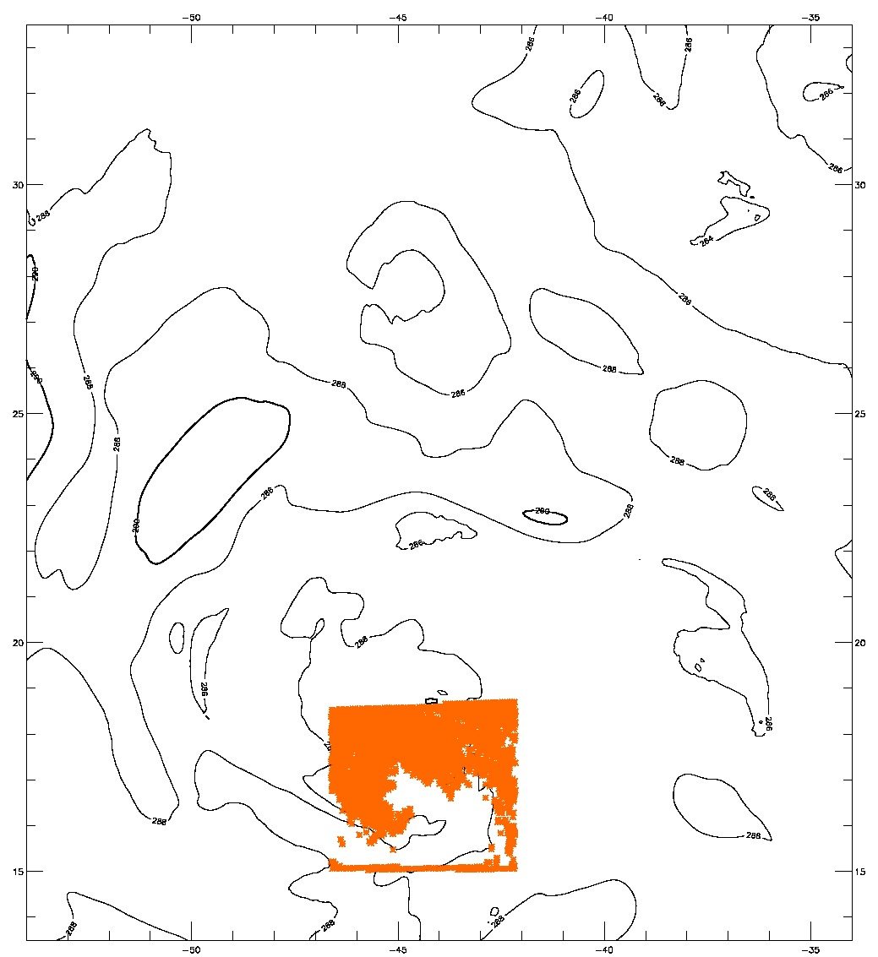
0802 6Z
Center at 16.7, -44.5
Analysis at 800mb
Obs at 813mb
287.65<obs<290.850

Slide 4
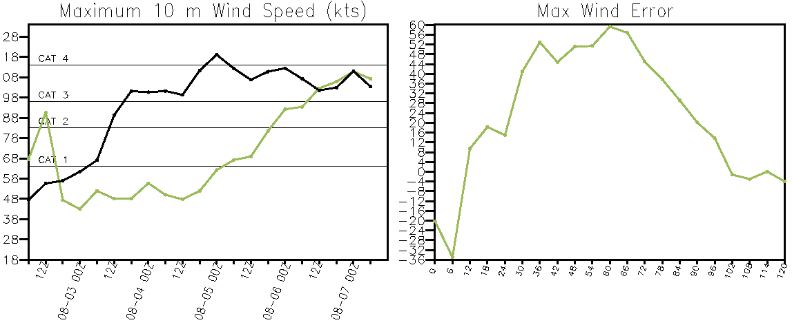
Nest has different center
Nest has the storm center at 17.476 -44.04
The analysis center is at 16.7 -44.5

Slide 5
0801 at 12z analysis center close to nest center

