Slide 1
Impact of CYGNSS Data on Tropical Cyclone
Analysis and Forecasts Using the Operational HWRF
Bachir Annane¹, Mark Leidner^{4 ,}Brian McNoldy²,
Robert Atlas³ ,Sharanya Majumdar², Ross Hoffman¹
¹ Univ. of Miami/CIMAS and NOAA/AOML/HRD, Miami, FL
² Univ. of Miami/RSMAS, Miami, FL
³ NOAA/AOML, Miami, FL
⁴ AER, Lexington, MA

Slide 2
Overview
What is CYGNSS?
Review of CYGNSS OSSE results
CYGNSS post-launch status
Preliminary OSE results/HWRF

Slide 3
What is CYGNSS?
The Cyclone Global Navigation Satellite System (CYGNSS) is a constellation of 8 micro-satellites that launched on December 15, 2016.
The body of each satellite measures roughly 51x64x28 centimeters, slightly larger than a standard carry-on suitcase., weigh about 29 kilograms, And each microsatellite has wingspan of 1.67 meters.
Rendition of a single CYGNSS observatory
in orbit over a hurricane. (NASA)

Slide 4
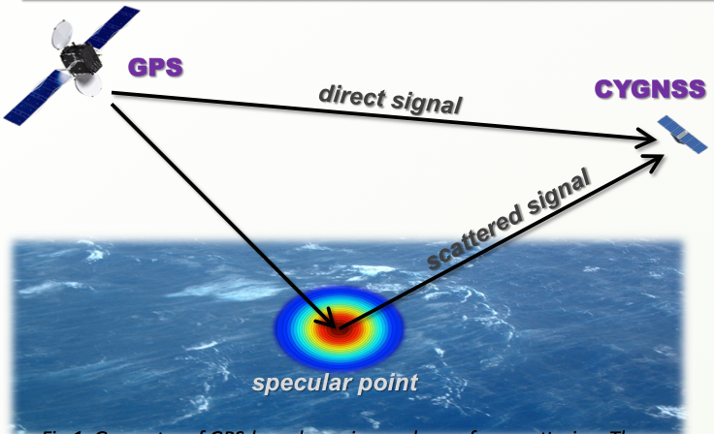
What is CYGNSS?
Utilize signals from existing GPS satellites to measure surface wind speeds (surface roughness affects forward-scattered signal)
Basic geometry of bi-static quasi-specular
scatterometry
· Capable of retrieving usable data over a large range of wind speeds (0-70 m/s) in all precipitating conditions throughout the tropics and subtropics with a frequent revisit times

Slide 5
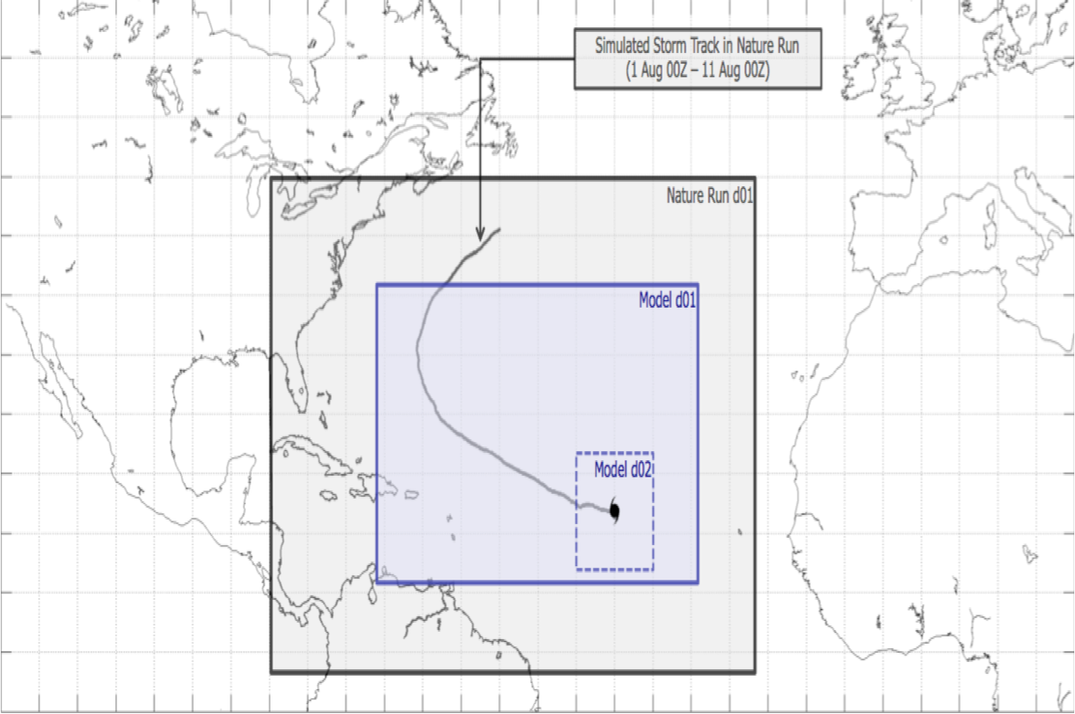
OSSE Framework Details
Nature Runs
- ECMWF: low-resolution T511 (~40km) “Joint OSSE Nature Run”
- WRF-ARW: high-resolution 27 km regional domain with 9/3/1 km storm-following nests (v3.2.1)
Data Assimilation Scheme
- GSI: Gridpoint Statistical Interpolation. a standard 3D variational assimilation scheme (v3.3).
Analyses performed at 9km resolution.
Forecast Model
- HWRF: the 2014 operational
Hurricane-WRF model (v3.5).
Parent domain has ~9km resolution,
single storm-following nest has ~3km
resolution.
DA and model cycling performed every 6,3, 1 hours, each run producing a 5-day forecast.

Slide 6
Simulated CYGNSS data
Four-day synthetic CYGNSS dataset generated to span the WRF nature run.
0801 00z - 0805 00z

Slide 7
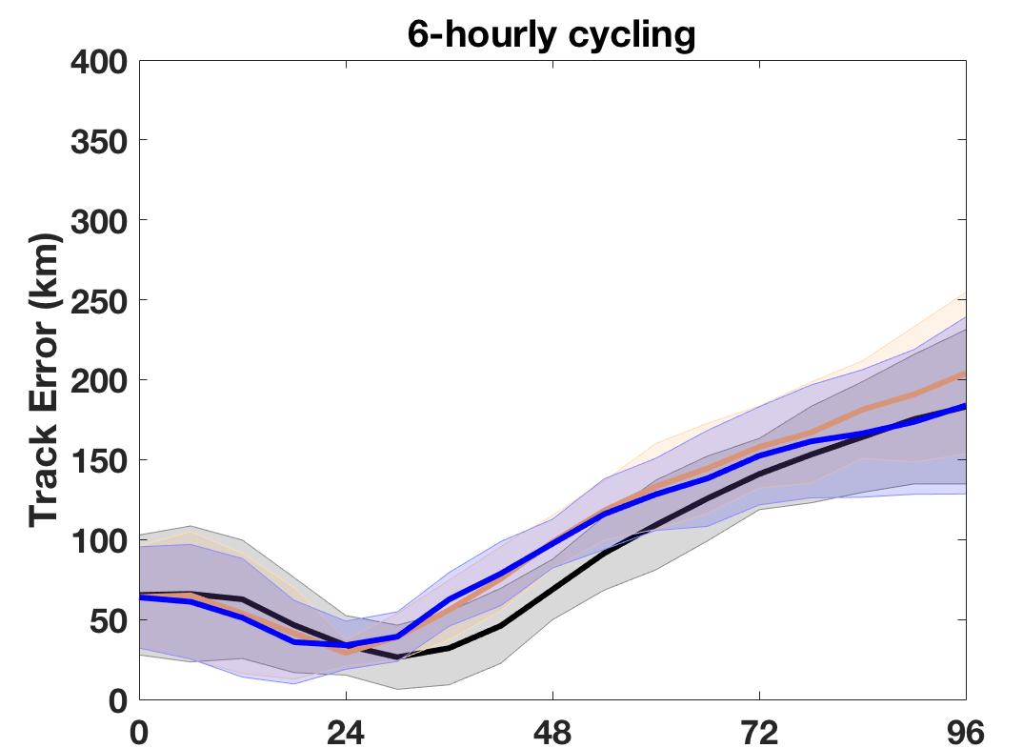
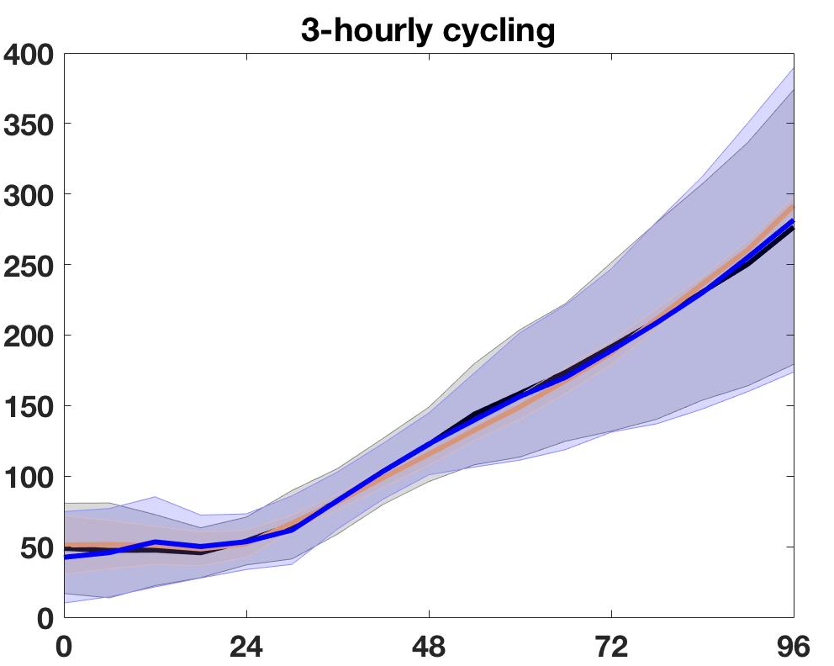
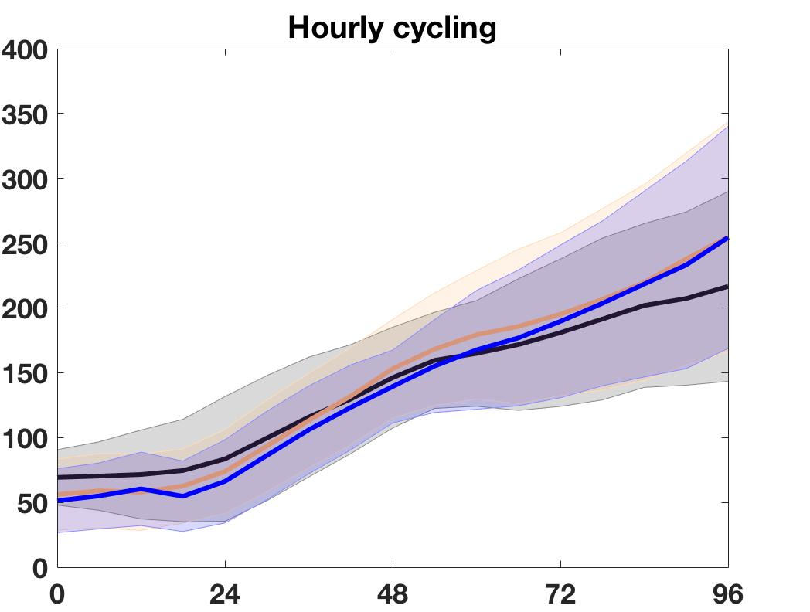
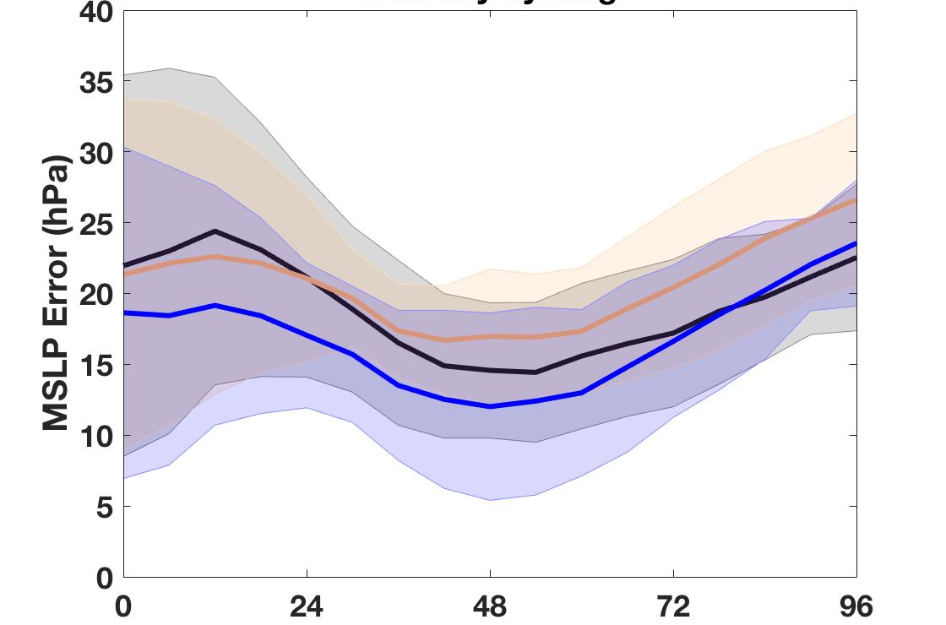
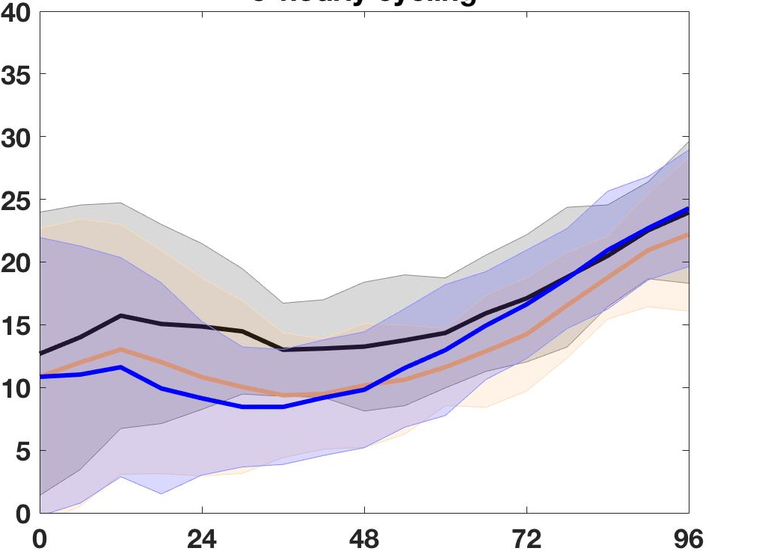
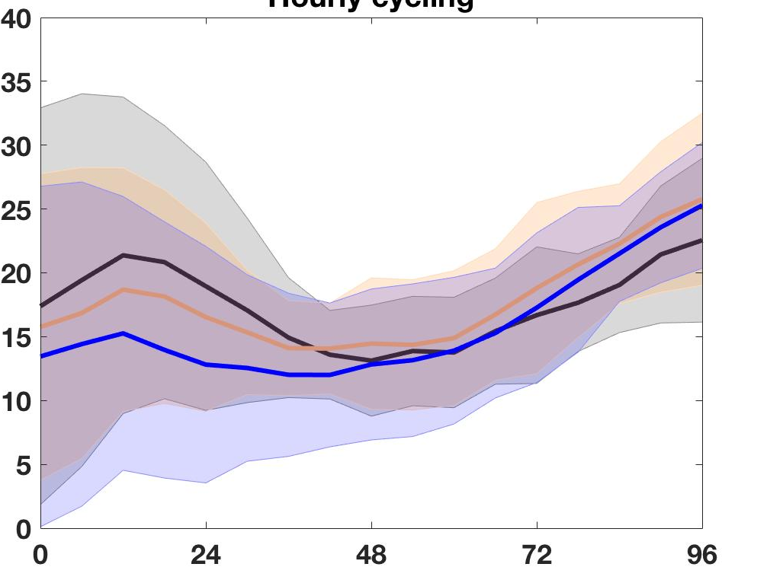
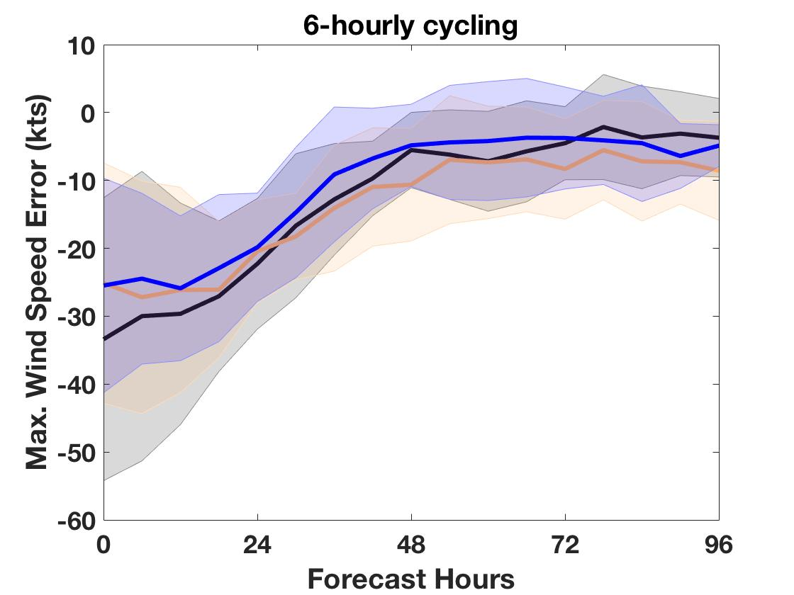
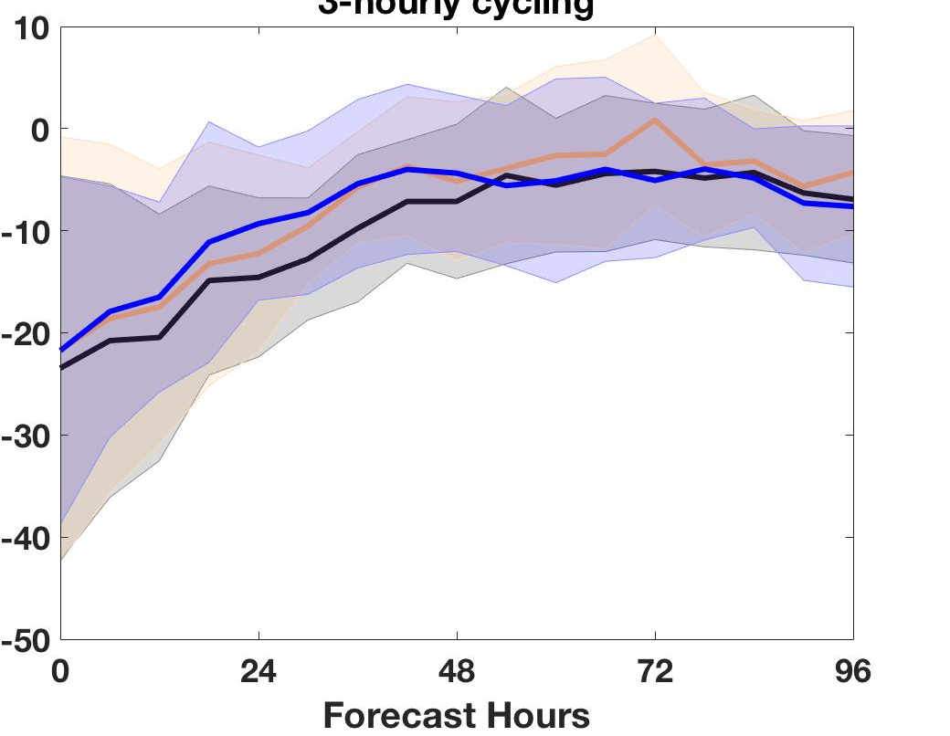
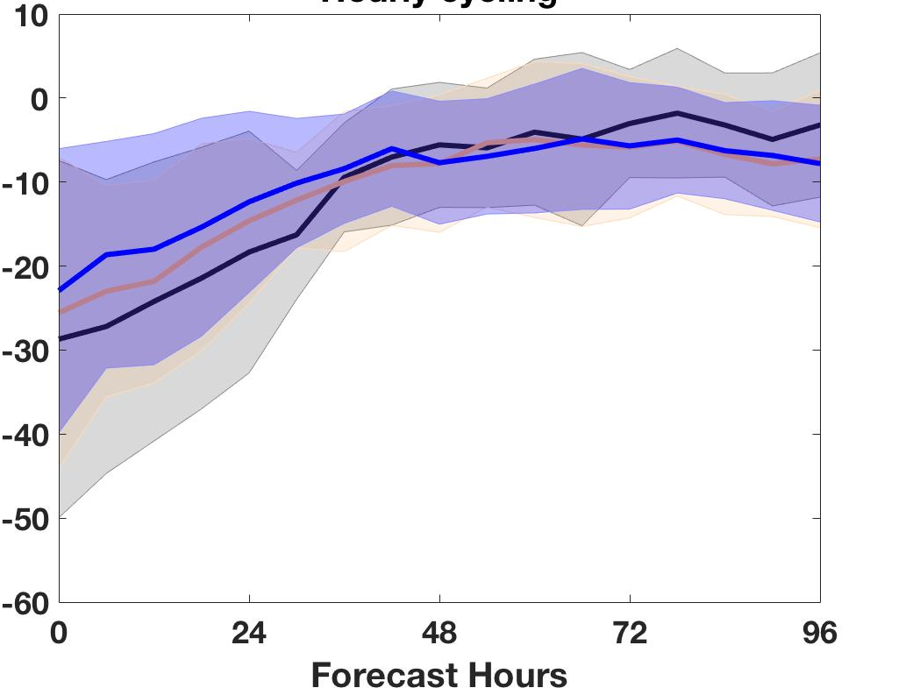
OSSE IMPACT RESULTS
(a)
(b)
(c)
CYGNSS OSSE Avg. T.C. Forecast Errors Track (km) MSLP (hPa) Maximum Wind (kts) (rows) 6-, 3- and hourly cycling (columns) black/grey for CNTL, orange/lgt. orange CYG blue/lgt. blue for VAM
(d)
(e)
(f)
(g)
(h)
(i)

Slide 8
OSSE RESULT SUMMARY
Assimilation of CYGNSS data almost always improves hurricane intensity, track analyses, and short range forecasts (0-48 hrs).
DA cycling frequencies affects analyses and forecast errors.
3-hrly cycling produced minimum errors in our study
There are relatively a few samples from one storm, so error statistics are not robust but provide guidance.

Slide 9
CYGNSS Post-launch status
Calibration of Level 1 data (delay-Doppler maps) is an on-going mission effort
Low wind speeds (< 13 m/s) are currently more reliable than higher winds (less noisy)
Release of version 2.1 of the Level 1 and Level 2 science data to science team & collaborators is expected end of April
v2.1 will address many of the outstanding cal/val issues

Slide 10
HWRF CYGNSS Observing System Experiments (OSEs)
Components of an OSE
Atmospheric forecast model (HWRF operational, “H217”)
Control experiment: NCEP HWRF operations, H217
Data assimilation system
Hybrid 3d-Variational/Ensemble Kalman Filter data assimilation system in the Gridpoint Statistical Interpolation (GSI) framework
Experiments using different treatments of CYGNSS data
Wind speed in HWRF operational configuration
VAM CYGNSS wind vectors in HWRF operational configuration
OSEs will focus on:
Sparsely observed periods of TC lifecycles
Operational HWRF forecasts with relatively high intensity error
Four candidate hurricanes identified:
Harvey, Irma, Katia, Maria
1-2 day forecasts of hurricane intensity are a focus (OSSE results)

Slide 11
OSE experiments
Explore impact of low CYGNSS winds speeds (< 13 m/s)
Smallest retrieval error and least noisy
Irma – impact of QC’d CYGNSS on surface wind analyses
CYGNSS v2.0 FDS wind speeds
Harvey, Katia – explore forecast impacts on early lifecycles
CYGNSS v2.0 YSLF wind speeds

Slide 12
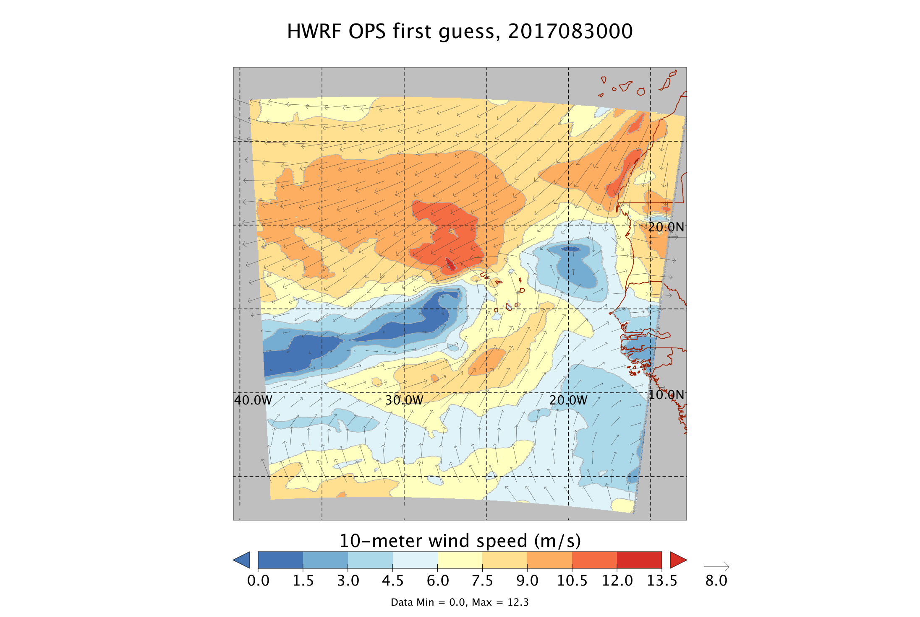
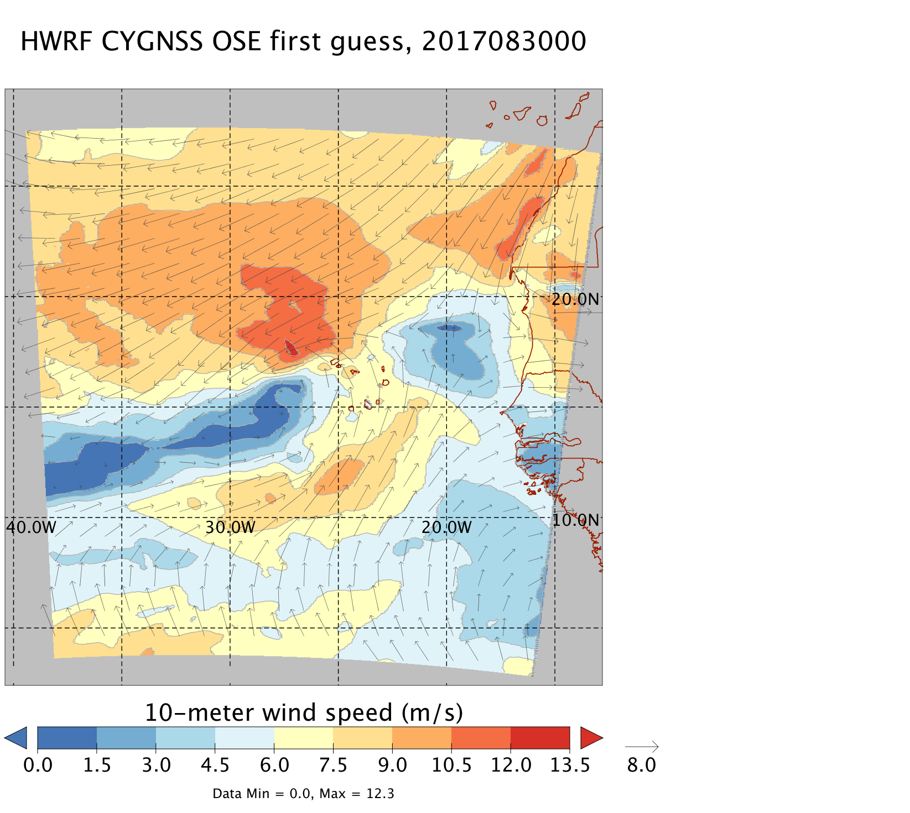
Irma first guess
Surface wind speed and vectors, 00 UTC Aug 30, 2017
TBD

Slide 13
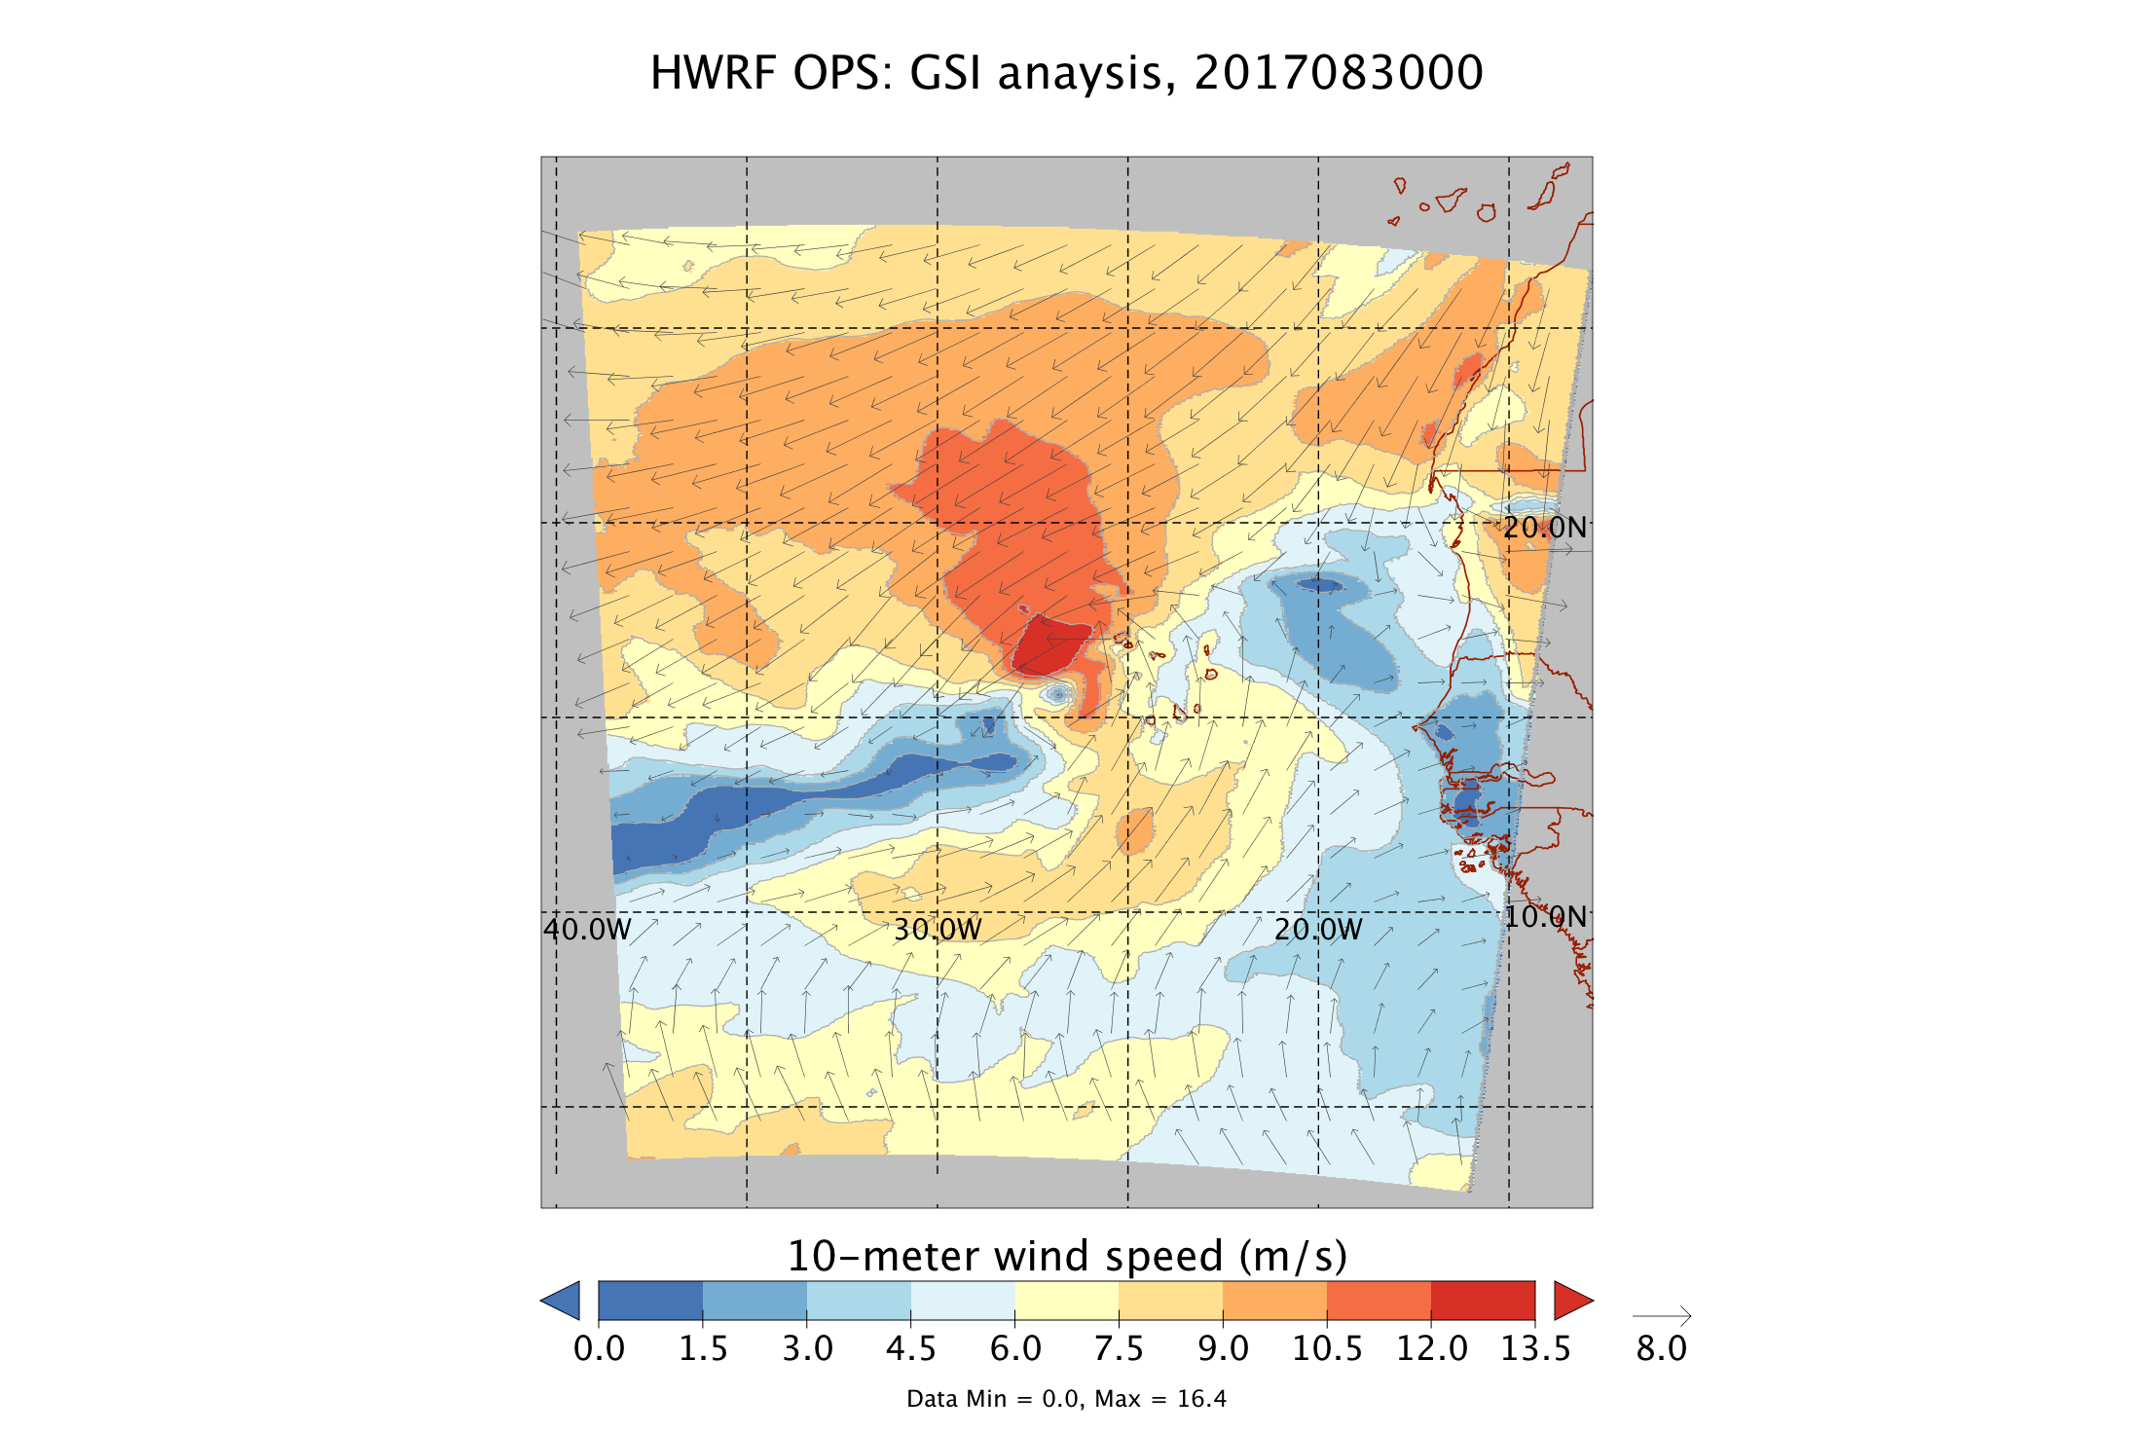
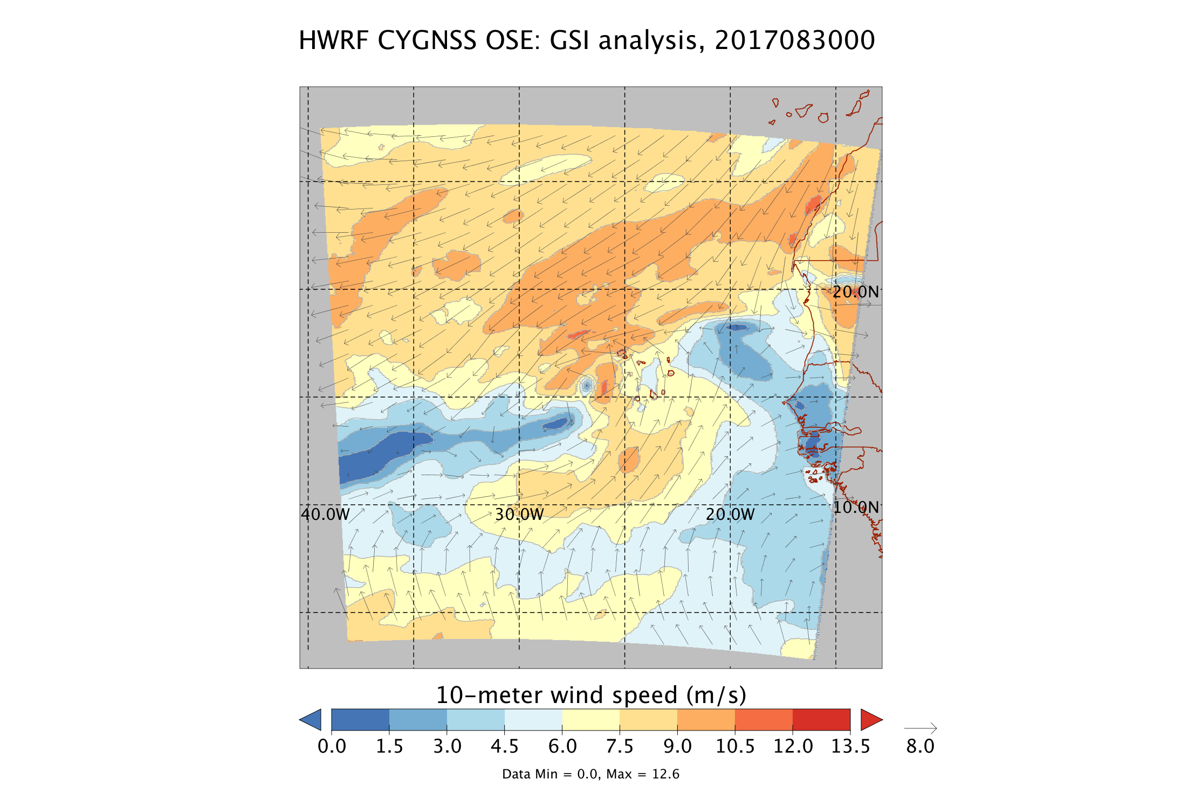
Irma HWRF DA analyses
Surface wind speed and vectors, 00 UTC Aug 30, 2017
HWRF OPS analysis, 2017083000
HWRF CYGNSS OSE analysis, 2017083000

Slide 14
Irma analyses/first guess/observations
Surface wind speed and vectors, 00 UTC Aug 30, 2017
HWRF CYGNSS OSE analysis, 2017083000
plus CYGNSS observations, +/- 3 hours

Slide 15
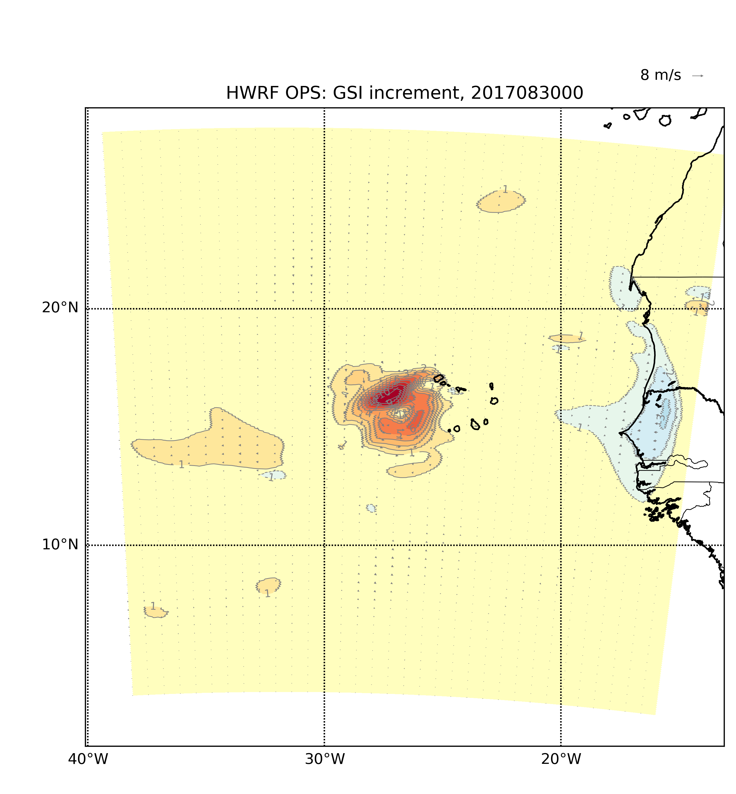
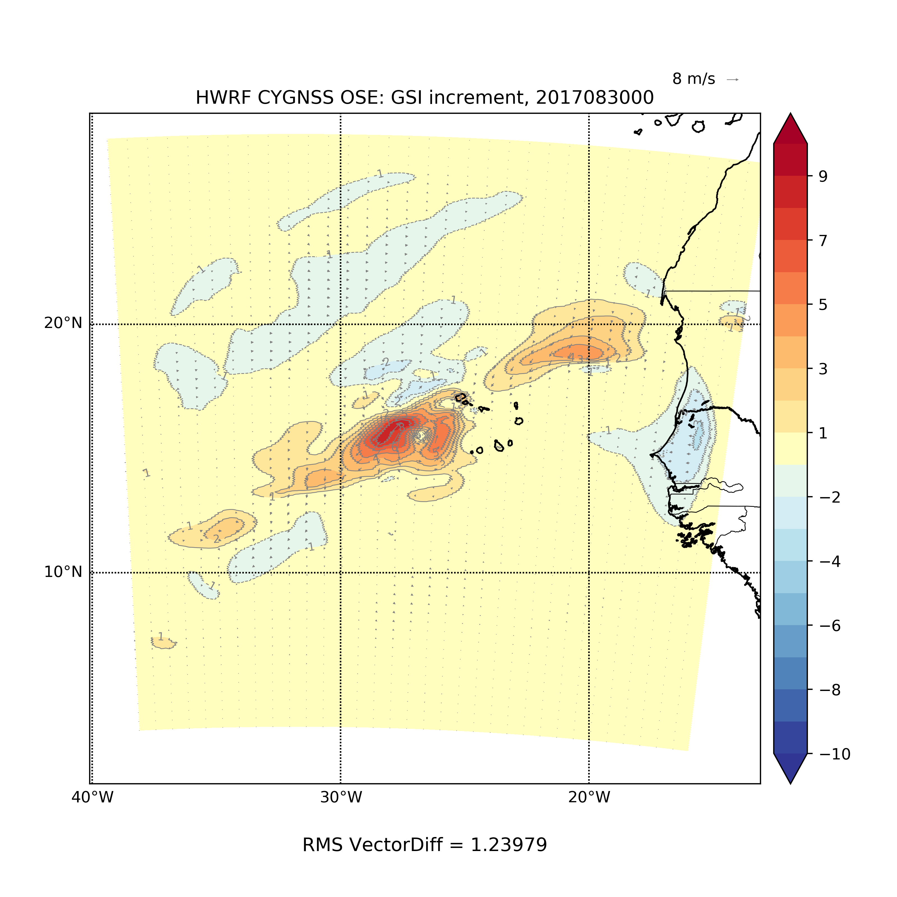
Irma DA analyses increments
Surface wind speed and vector increments, 00 UTC Aug 30, 2017
HWRF OPS analysis, 2017083000
HWRF CYGNSS OSE analysis, 2017083000
HWRF CYGNSS OSE analysis, 2017083000

Slide 16
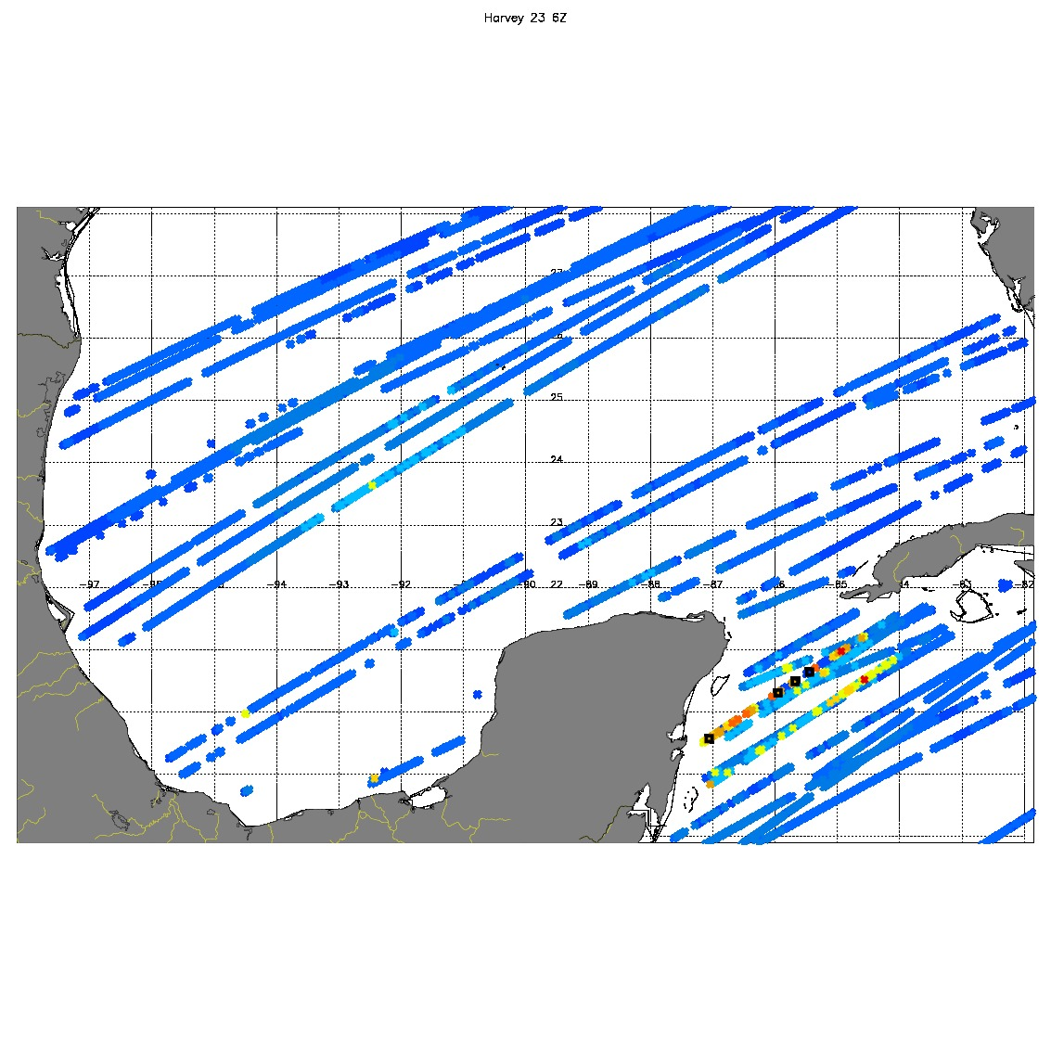
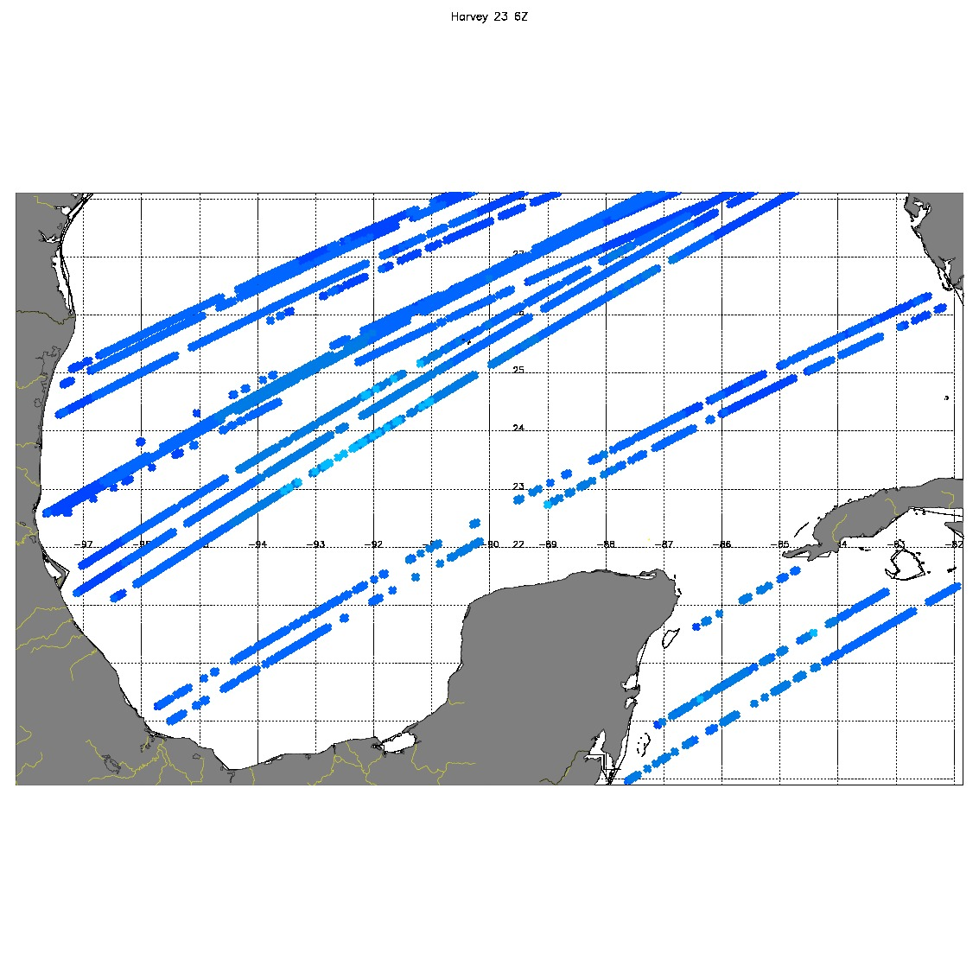
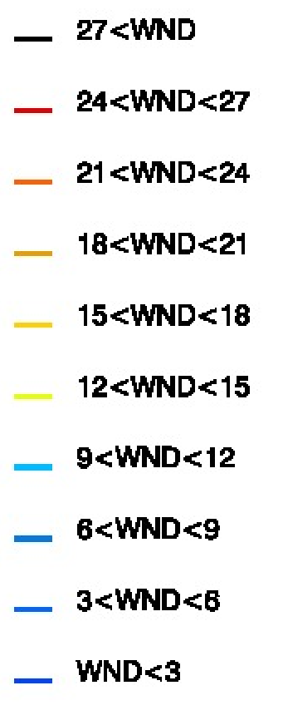
CYGNSS COVERAGE 08/23 06Z, +/- 3 hrs Harvey
CYGNSS: No QC
CYGNSS: Strict QC

Slide 17
Harvey
CYGNSS (o-b) & (o-a) statistics table
Storm Name | Cycle | Number of points | O-B(mean) | O-B(rms) | O-A(mean) | O-A(rms)
Harvey | 8/23/00 | 0 | n/a | n/a | n/a | n/a
 | 8/23/06 | 2221 | -0.45 | 1.43 | -0.05 | 0.42
 | 8/23/12 | 1725 | -0.42 | 1.17 | -0.04 | 0.48
 | 8/23/18 | 4159 | -0.61 | 1.84 | -0.03 | 0.55
 | 8/24/00 | 0 | n/a | n/a | n/a | n/a
 | 8/24/06 | 2619 | -0.46 | 1.13 | -0.02 | 0.37

Slide 18
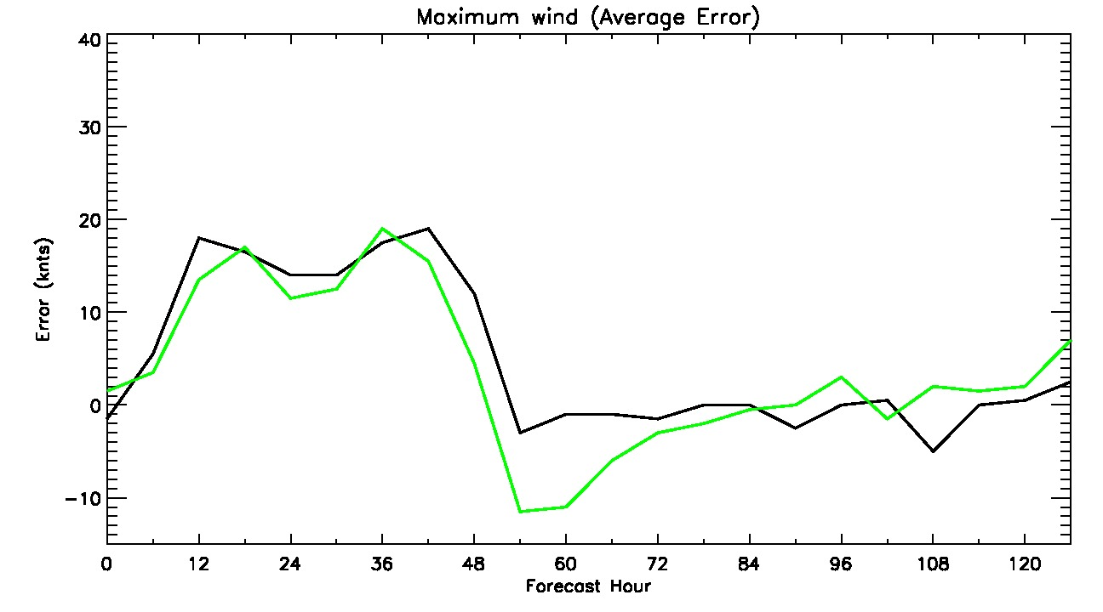
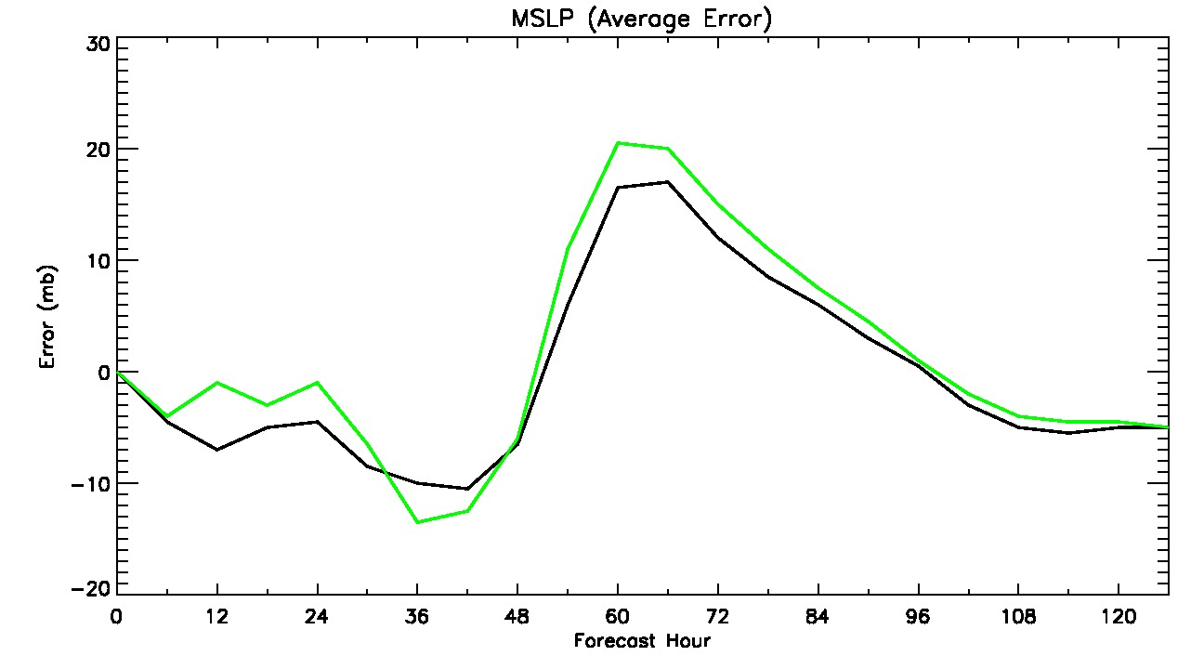
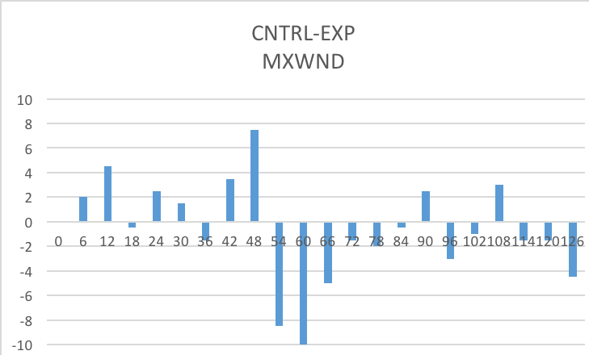
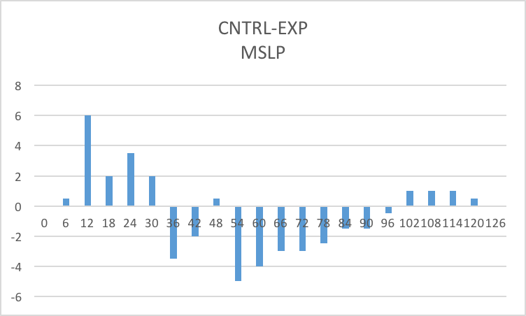
Harvey Average Intensity errors 08/24, 00Z & 06Z
— Control
— CYGNSS
— Control
— CYGNSS

Slide 19
Katia
CYGNSS (o-b) & (o-a) statistics table
Storm Name | Cycle | Number of points | O-B(mean) | O-B(rms) | O-A(mean) | O-A(rms)
Katia | 9/5/00 | 457 | -1.44 | 1.84 | -0.02 | 0.38
 | 9/5/06 | 1358 | -0.06 | 1.06 | -0.03 | 0.46
 | 9/5/12 | 1184 | -0.04 | 1.48 | 0 | 0.39
 | 9/5/18 | 0 | n/a | n/a | n/a | n/a
 | 9/6/00 | 727 | -0.74 | 1.64 | -0.02 | 0.53
 | 9/6/06 | 1788 | -0.17 | 1.05 | 0.01 | 0.43
 | 9/6/12 | 2116 | -0.03 | 1.50 | 0.01 | 0.44

Slide 20
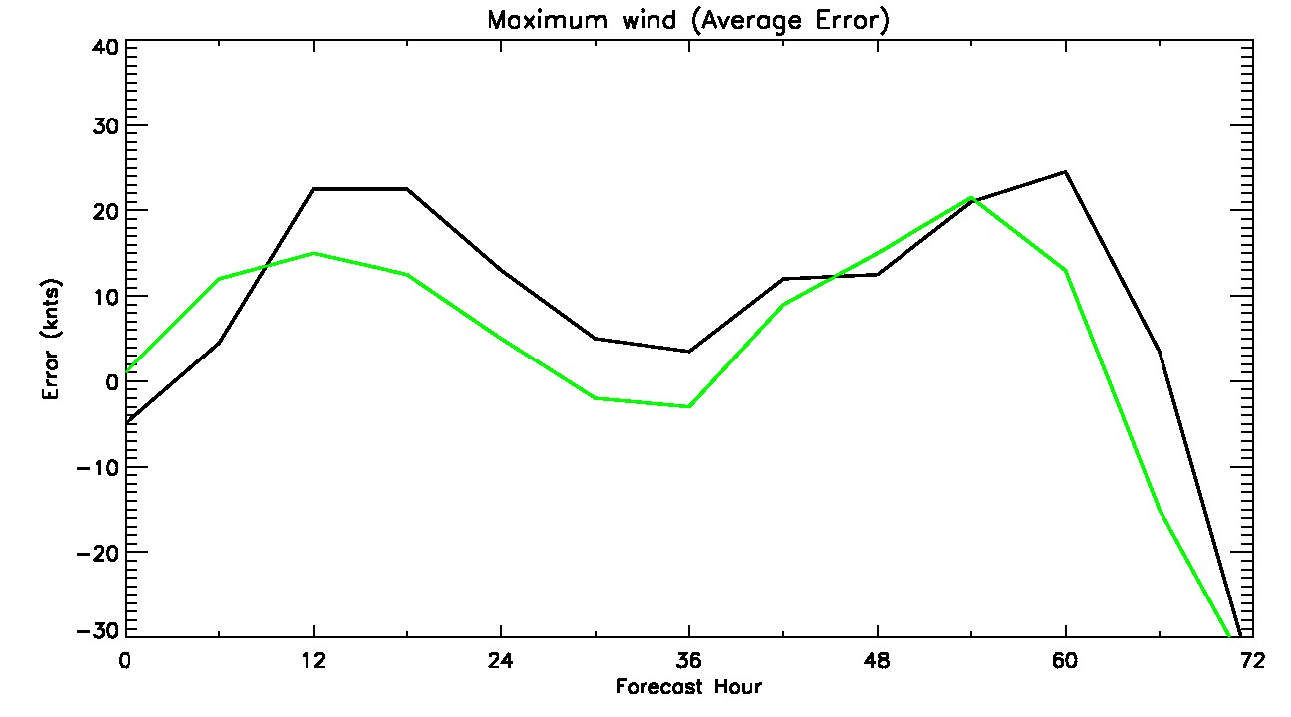
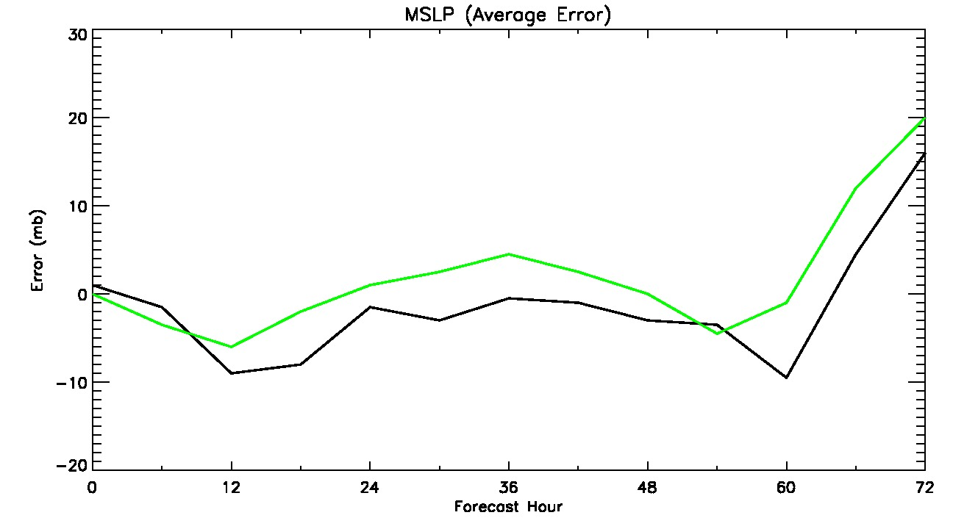
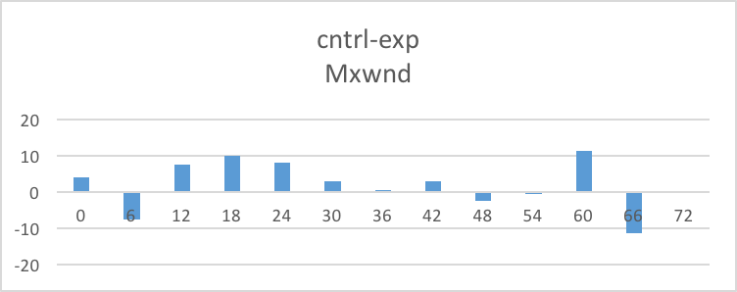
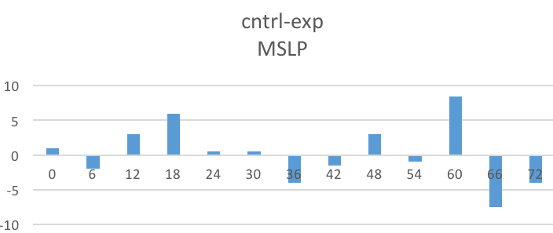
Katia Average Intensity errors 09/06, 06Z & 12Z
— Control
— CYGNSS
— Control
— CYGNSS

Slide 21
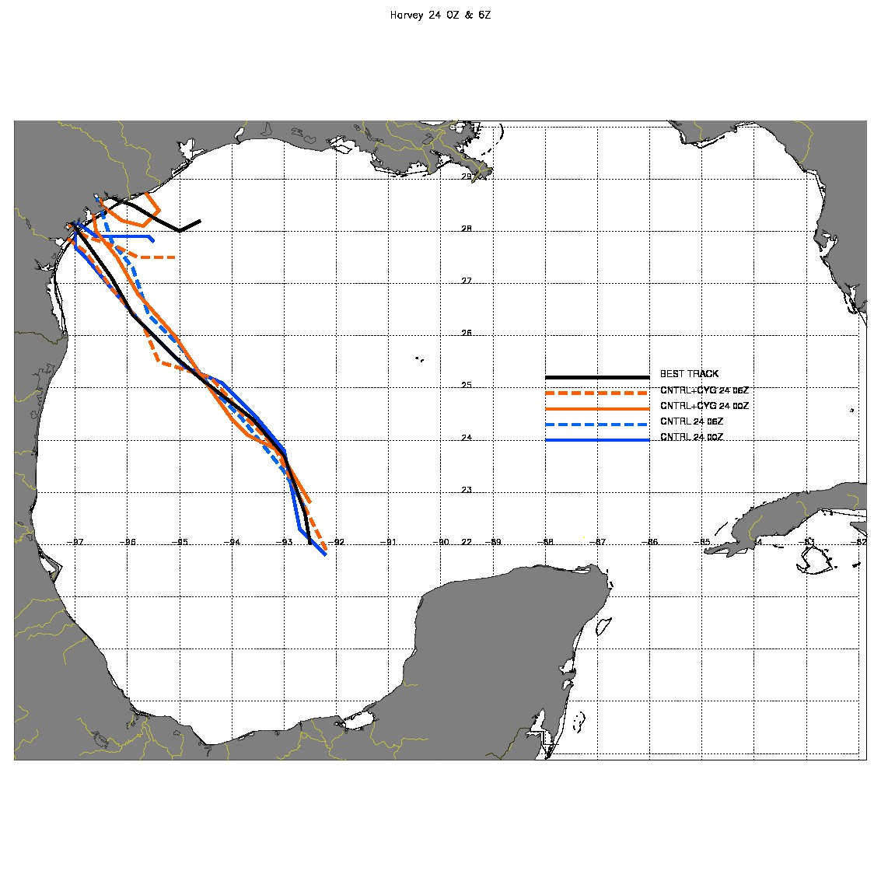
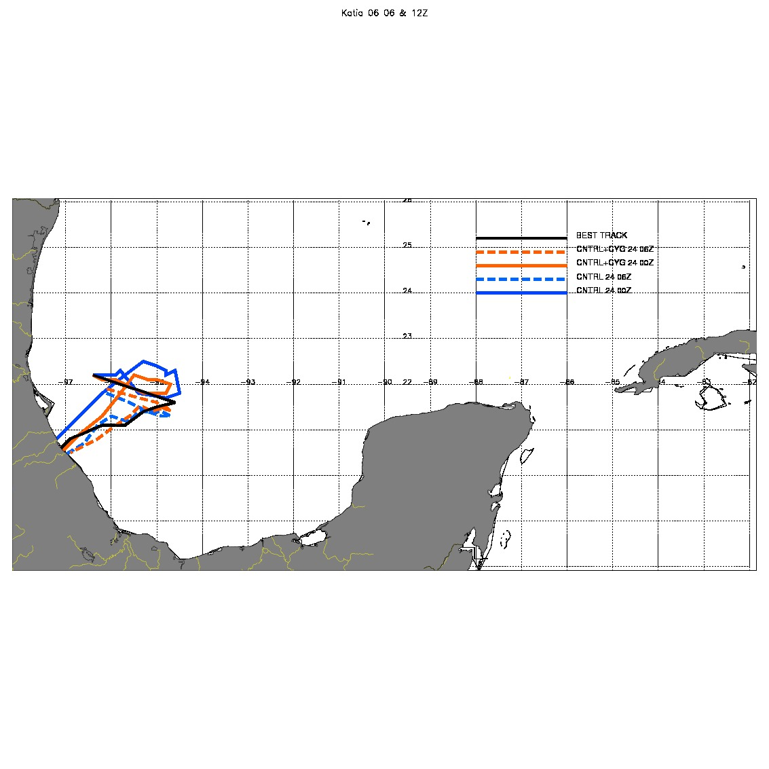
Harvey and Katia Best track and OSE tracks, 08/24 & 09/06

Slide 22
SUMMARY
Preliminary OSEs results:
Using strict CYGNSS observation quality filtering
Using CYGNSS wind speeds 0-13 m/s
Impact on short-term intensity is positive thus far, though not a significant improvement; little impact on track error.
Consistent with OSSE results.
Testing only a portion of eventual CYGNSS wind speed range.

Slide 23
Future work
Regenerate current results using CYGNSS v2.1 and future releases, and extend to assess full TC lifecycle impacts.
Reprocessed CYGNSS data (v2.1) will address many of the current noise issues.
Investigate the impact of hybrid 3dVar- ensemble covariances on distributing wind speed information in the vertical and to unobserved variables.
Use a 2D-Var (VAM) to generate CYGNSS wind vectors with adjusted weights, using high resolution HWRF as background, and assimilate.

Slide 24
QUESTIONS?

Slide 25
Backup Slides

Slide 26
OSE Framework Details
Global forecast system initialization and lateral boundary conditions
- 2017 GFS Operational analyses and forecasts
Data Assimilation Scheme
- Hybrid 3d-Variational/Ensemble Kalman Filter data assimilation system in the Gridpoint Statistical Interpolation framework
- Analyses performed at 2 and 6 km resolution.
Forecast Model
- HWRF: the 2017 operational
Hurricane-WRF model (v3.6).
Parent domain has ~18km resolution,
two storm-following nests with ~6-km and
~2-km resolution.
Compare Experiment treatments to Control
to assess impact hurricane metrics
(minimum sea-level pressure, maximum wind,
track error).
DA and model cycling performed every 6 hours, each cycle produces a 5-day forecast.

