Slide 1
Nature run for DOME Earth Venture
13 files in HDF5 format (Hierarchical Data format release 5)
07/29 to 08/10 at 6 mn resolution
Variables at 30km and 21 horizontal resolution
60 pressure levels

Slide 2
'freq_avg' (Instrument channel frequencies)
'Tb' (Instrument brightness temperature, without noise)
'Tb_noisy' (Instrument brightness temperature, with noise)
'pressure_mbar' (Pressure profiles)
'surface_pressure_mbar’
'temperature_K' (Truth temperature profiles)
'temperature_K_est' (Retrieved temperature profiles)

Slide 3
'qvapor_g_m3' (Water vapor profiles, truth)
'qvapor_g_m3_est' (Water vapor profiles, retrieval)
'rain_surface_mm' (Surface rain rate, truth: Units are mm/5s
'rain_surface_mm_est' (Surface rain rate, retrieval: Units are mm/5s

Slide 4
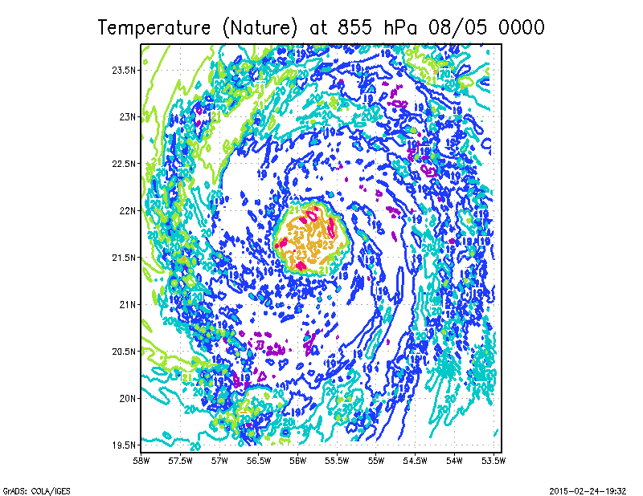
Temperature_est
Temperature from Nature

