Slide 1
CYGNSS HWRF OSE Results Sample Results for Hurricane Michael (2018)
September 10, 2019
Bachir Annane and Mark Leidner

Slide 2
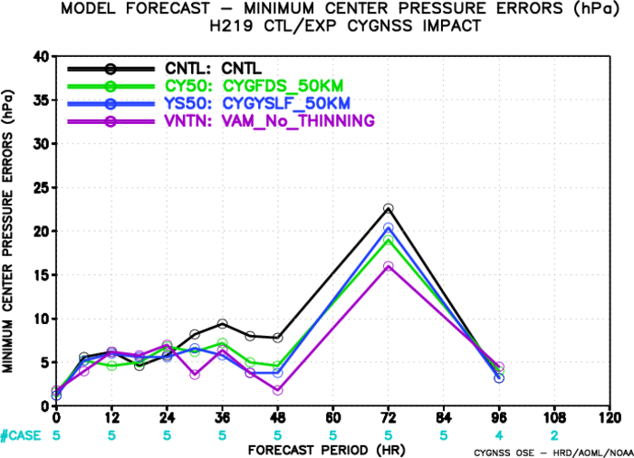
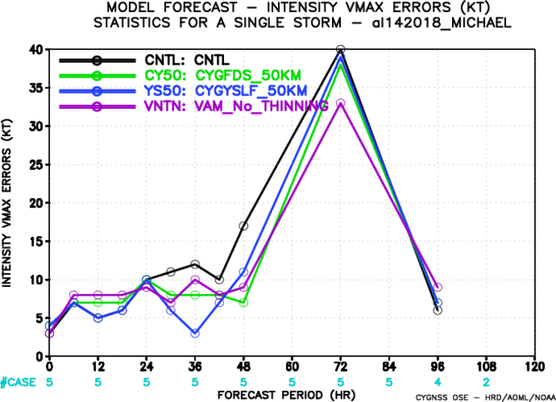
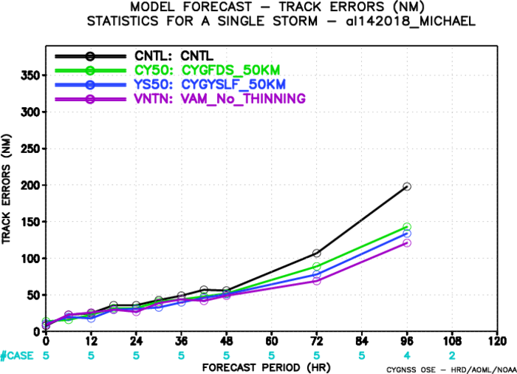

Slide 3
Immediate Analysis Impacts
6-hourly DA cycling
Start 0000 UTC 7 Oct 2018
Good CYGNSS coverage 0000 UTC, 0600 UTC and 1200 UTC in the region
Forecasts beginning 1800 UTC ( no CYGNSS data in region; accumulated impact )
Short-term forecast impacts (0-24 hrs)
What are the physical drivers influenced by CYGNSS data?

Slide 4
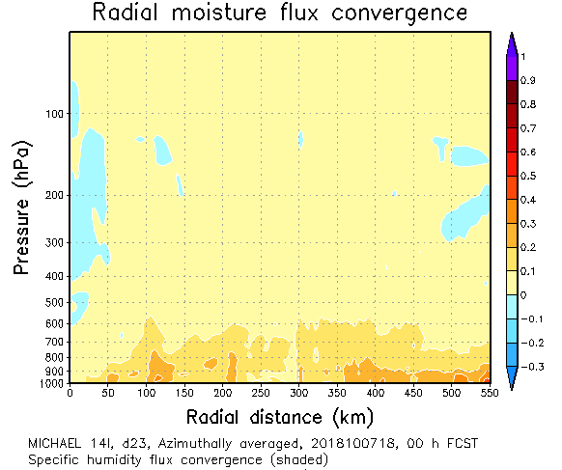
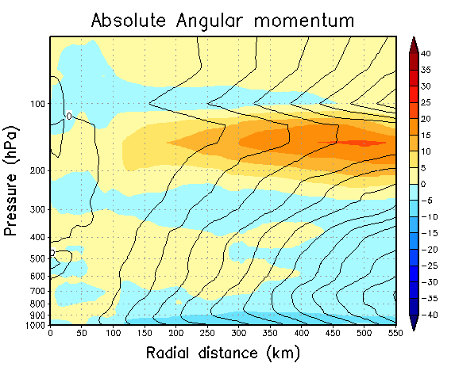
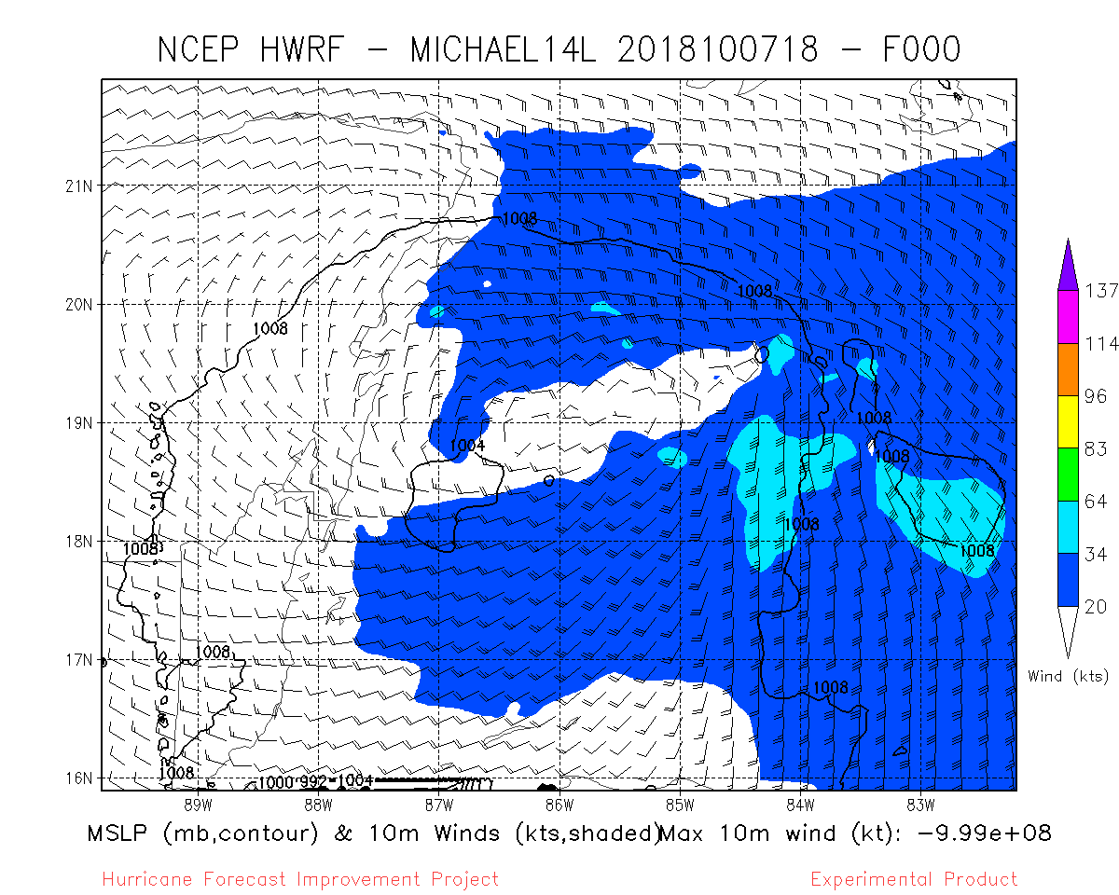
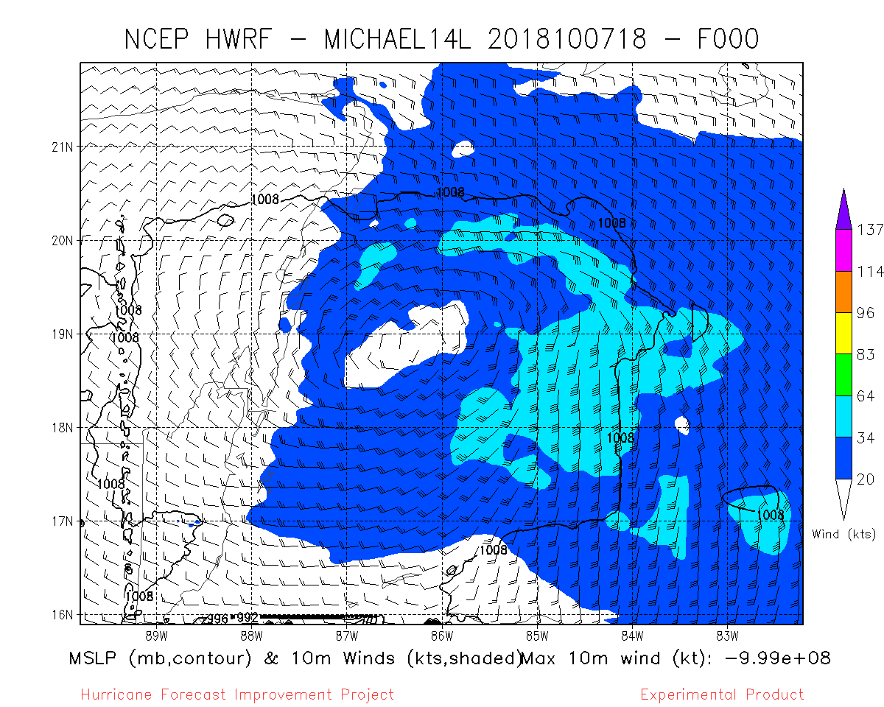
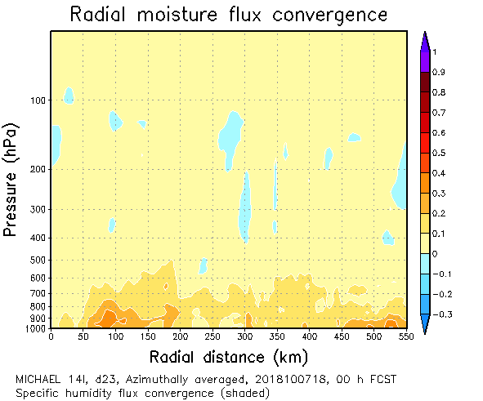
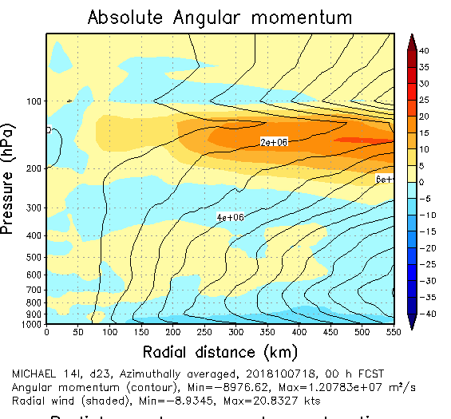
Analysis
Azimuthally-averaged
Temperature Deviation
Azimuthally-averaged
Radial Wind Component
10-m winds
Control
VAM
NoTHIN

Slide 5
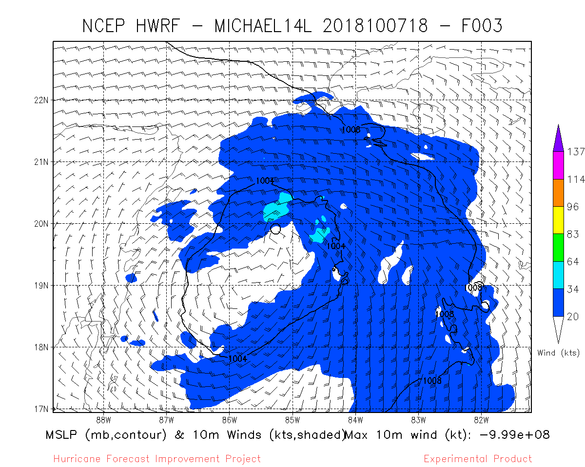
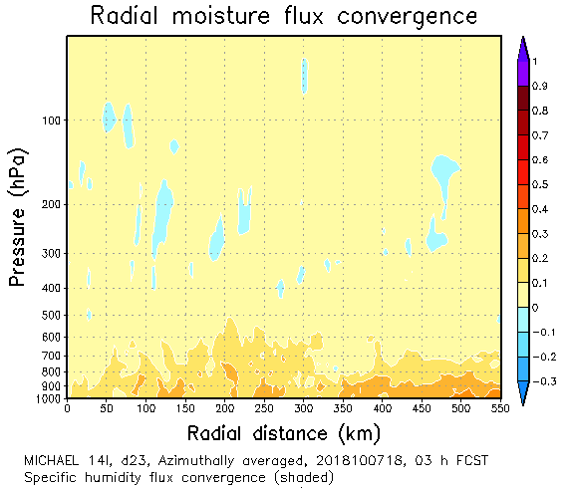
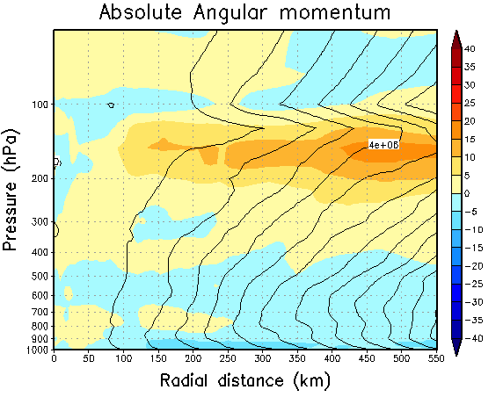
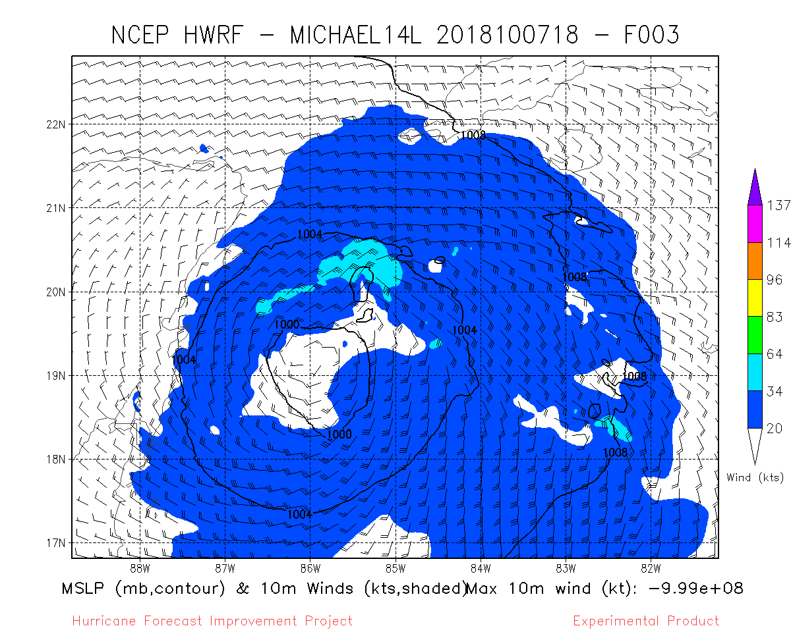
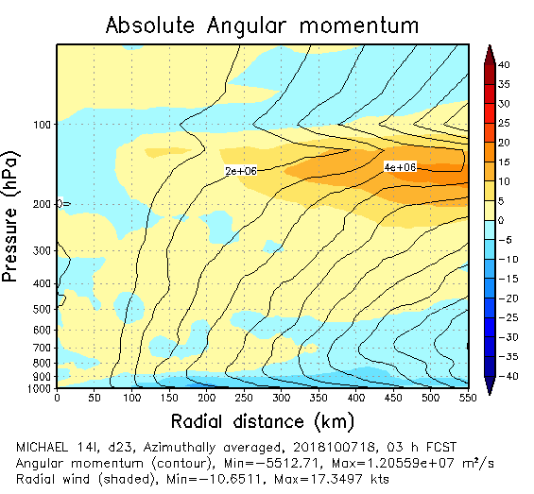
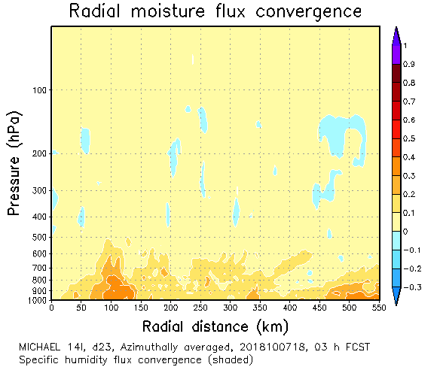
3 hour forecasts
Azimuthally-averaged
Temperature Deviation
Azimuthally-averaged
Radial Wind Component
10-m winds
Control
VAM
NoTHIN

Slide 6
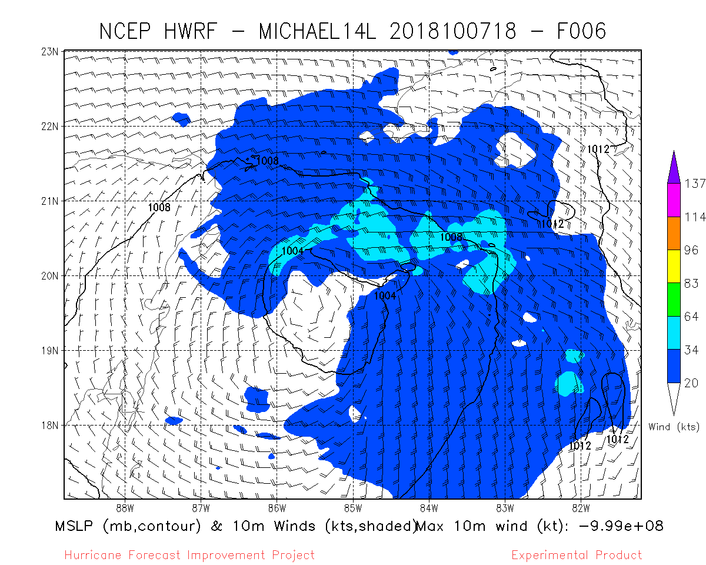
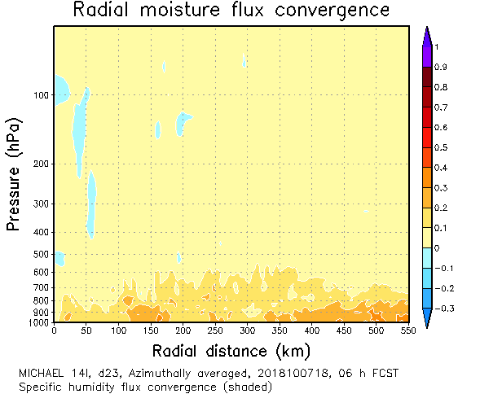
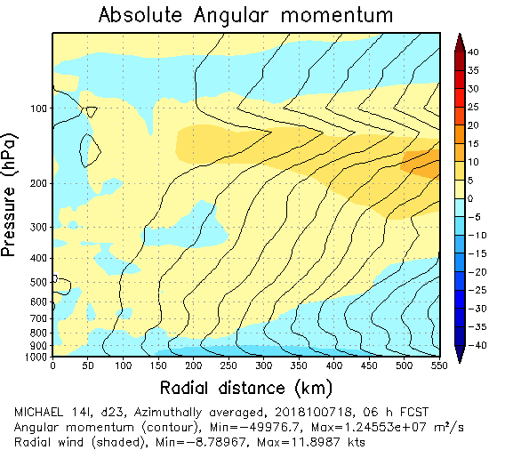
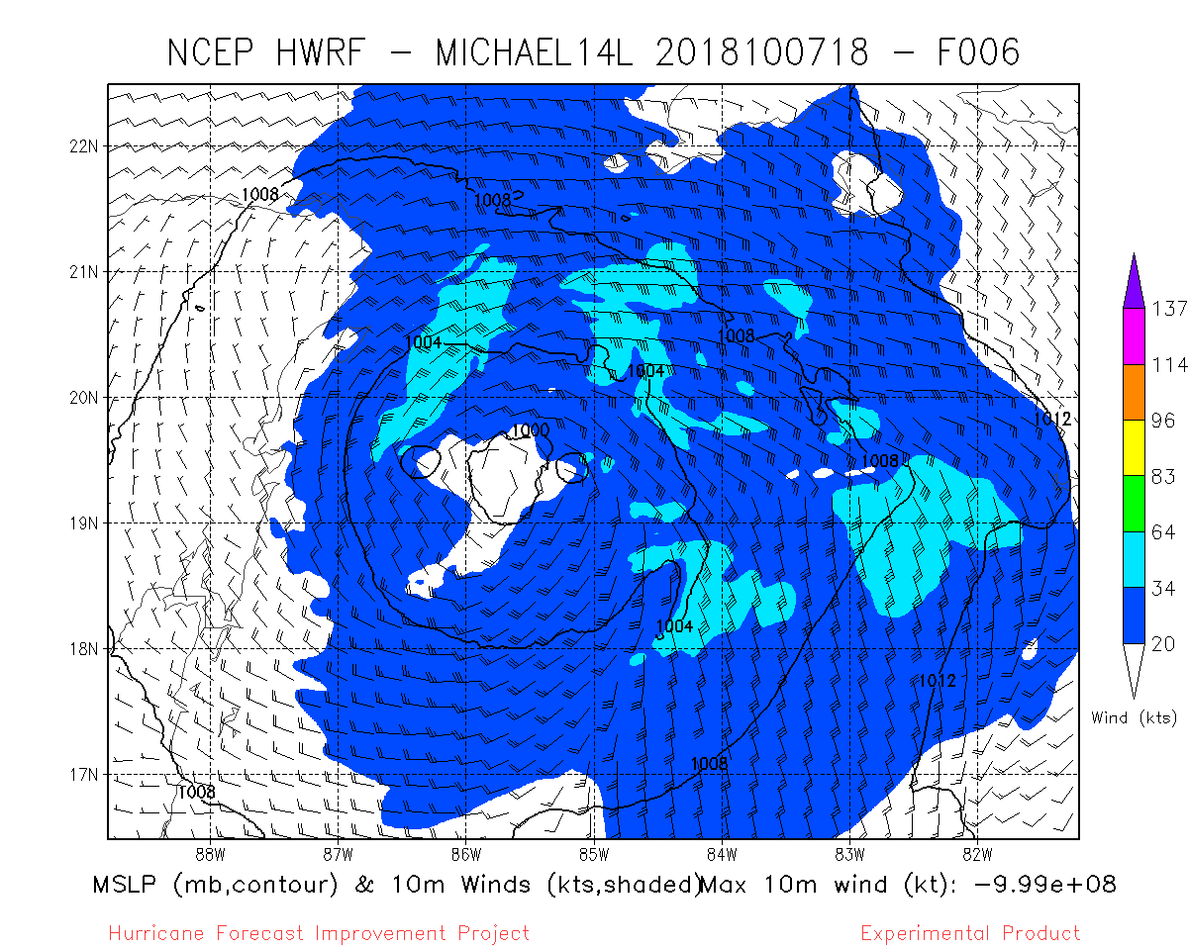
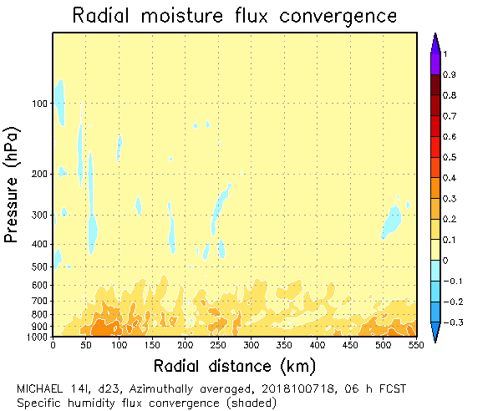
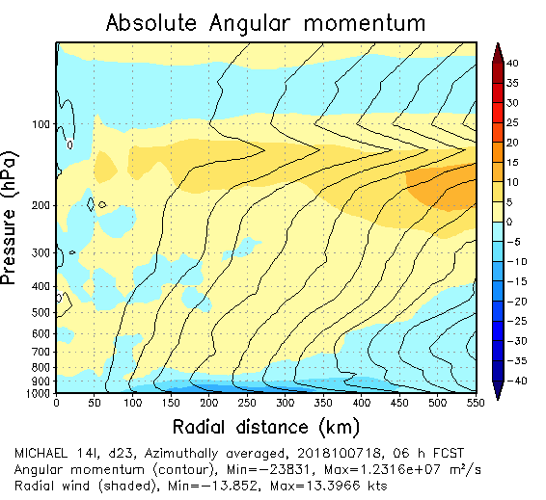
6 hour forecasts
Azimuthally-averaged
Temperature Deviation
Azimuthally-averaged
Radial Wind Component
10-m winds
Control
VAM
NoTHIN

Slide 7
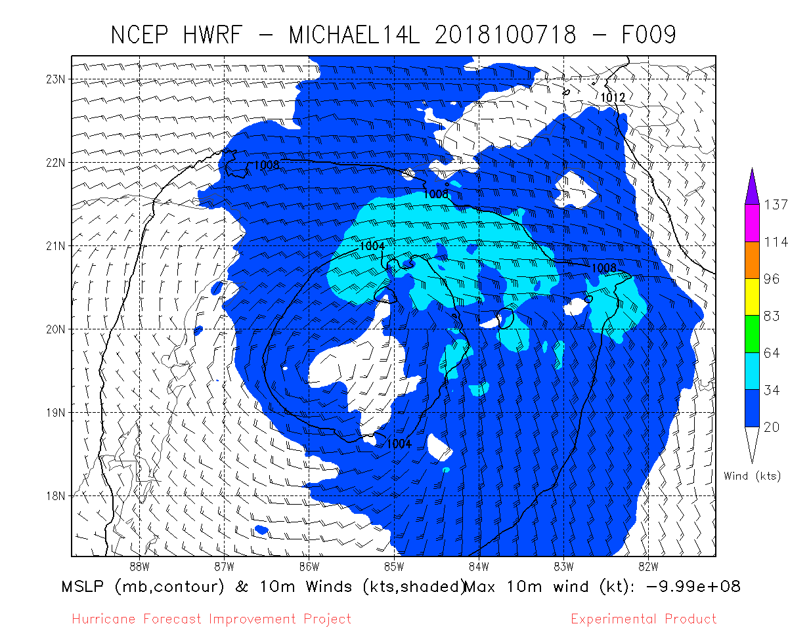
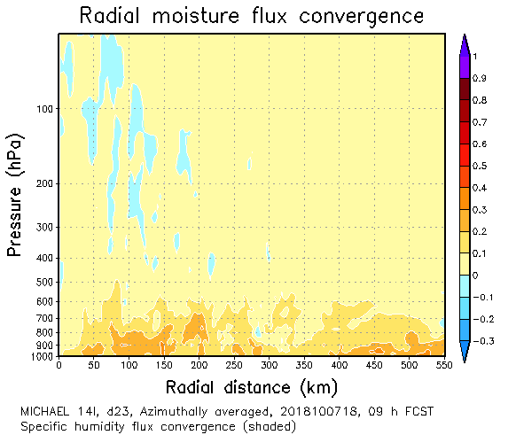
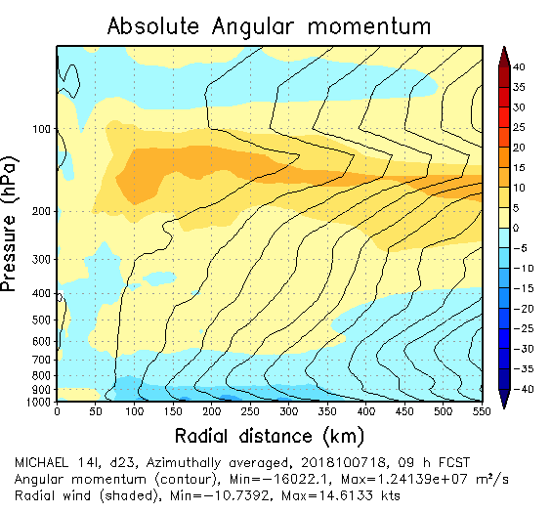
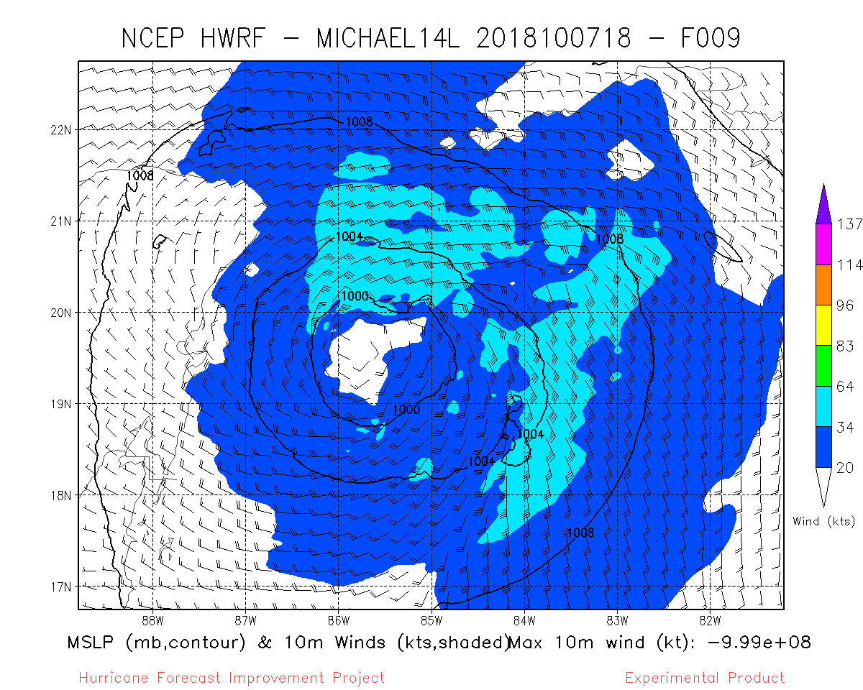
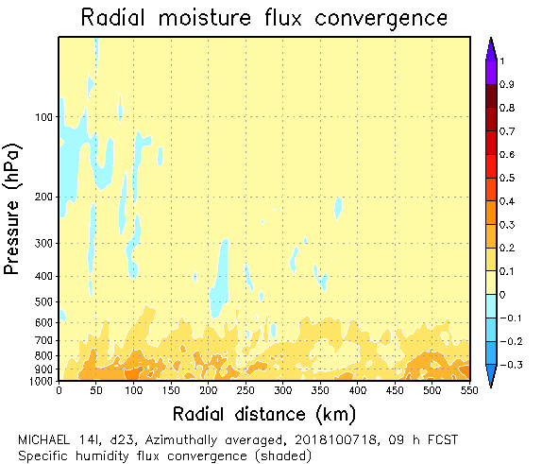
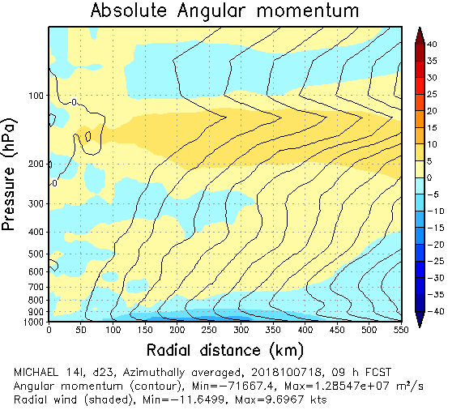
9 hour forecasts
Azimuthally-averaged
Temperature Deviation
Azimuthally-averaged
Radial Wind Component
10-m winds
Control
VAM
NoTHIN

Slide 8
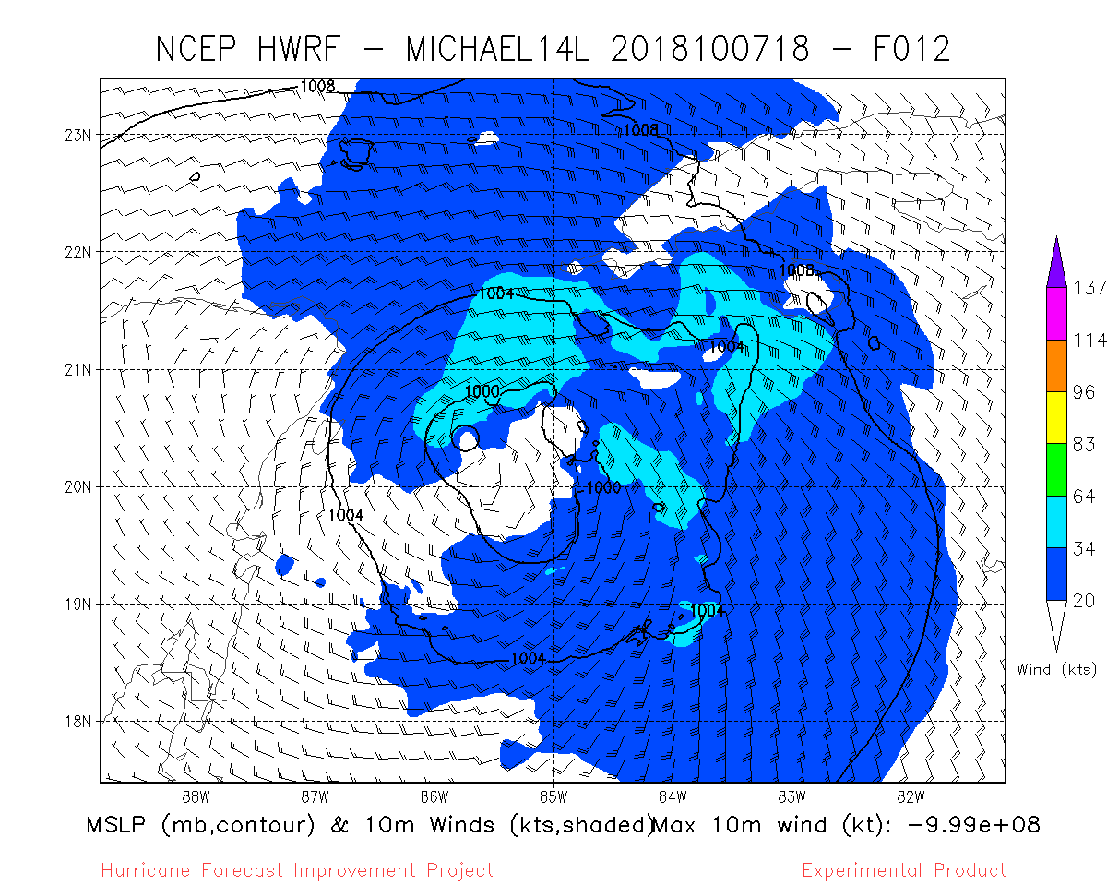
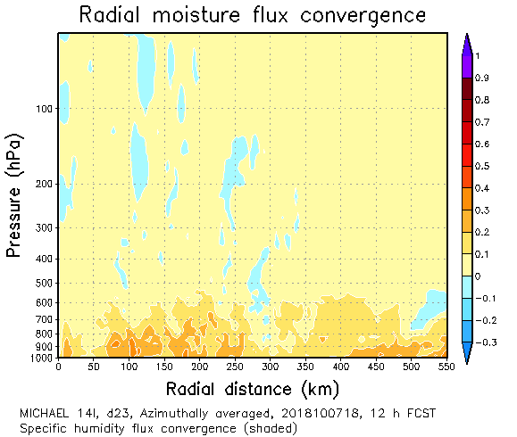
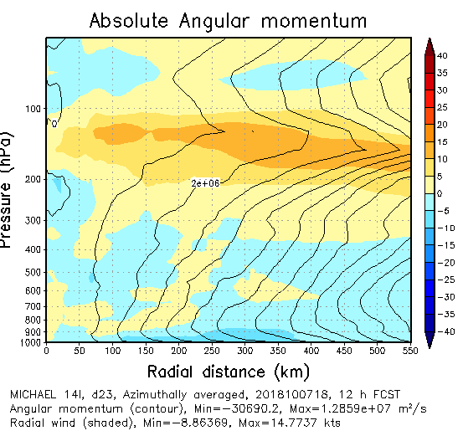
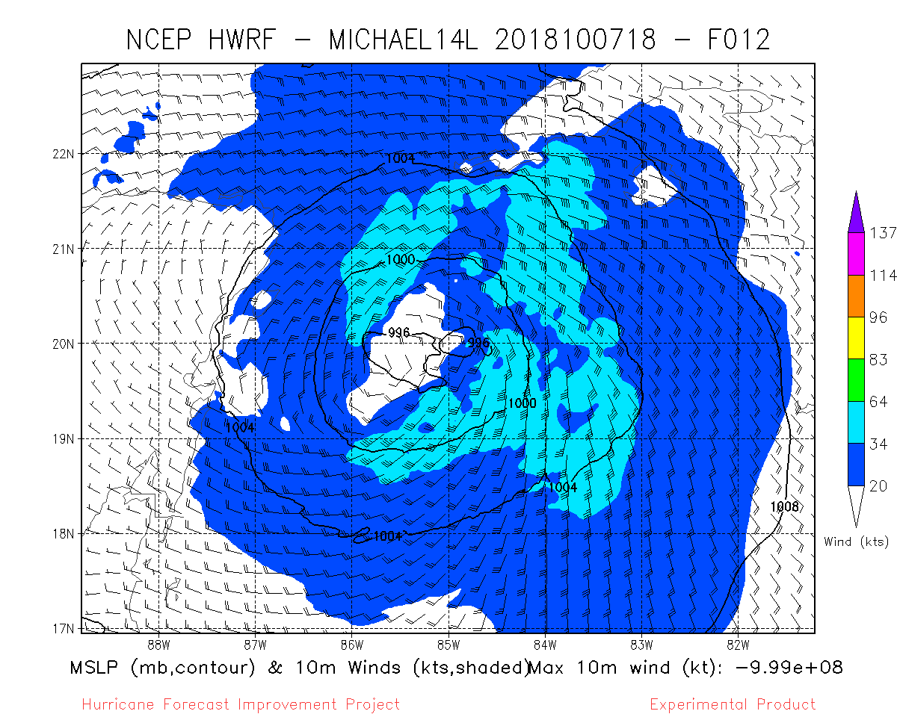
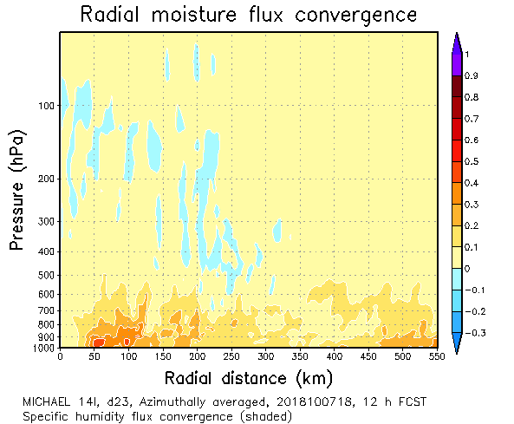
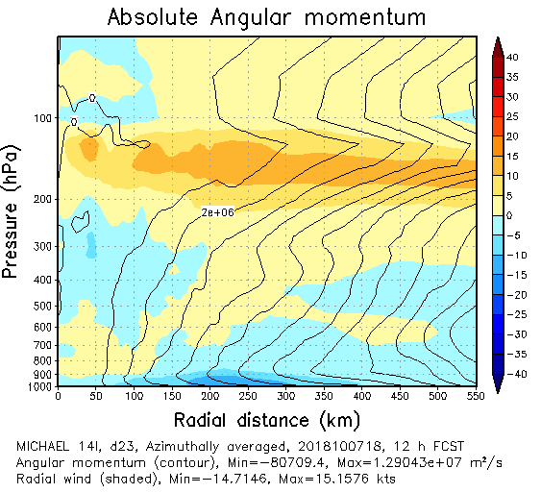
12 hour forecasts
Azimuthally-averaged
Temperature Deviation
Azimuthally-averaged
Radial Wind Component
10-m winds
Control
VAM
NoTHIN

Slide 9
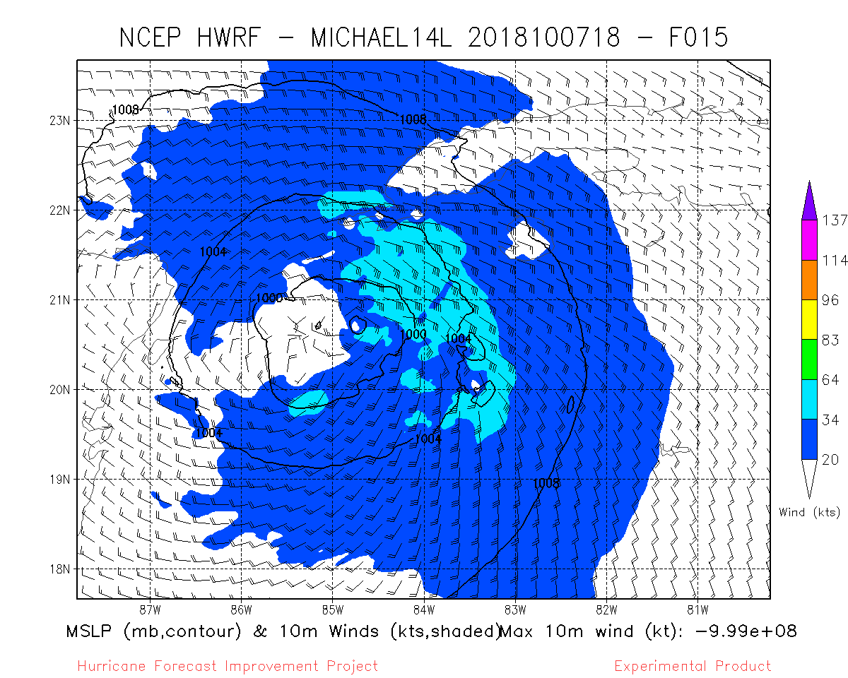
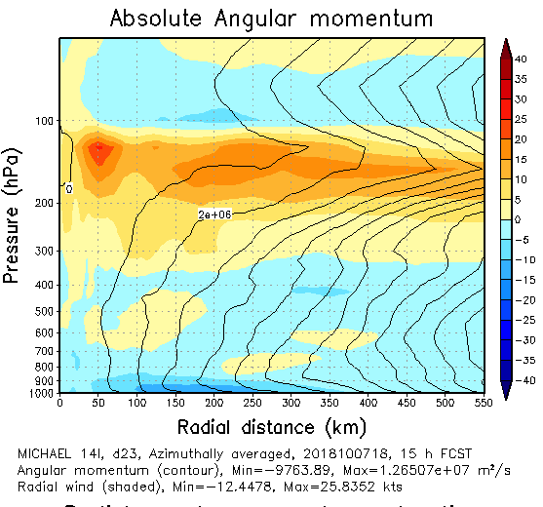
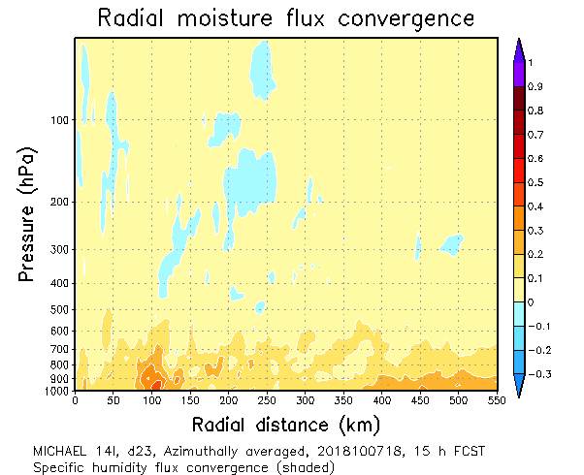
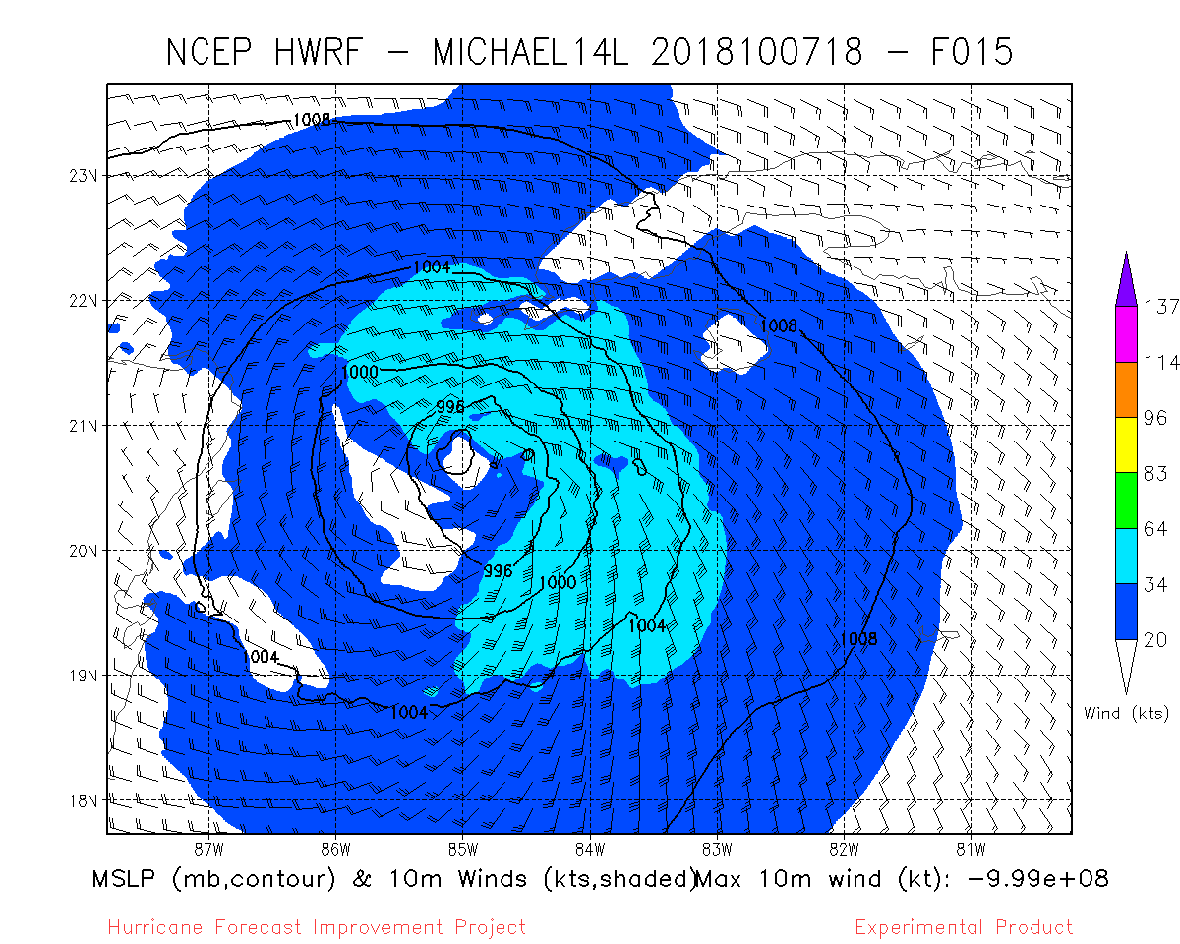
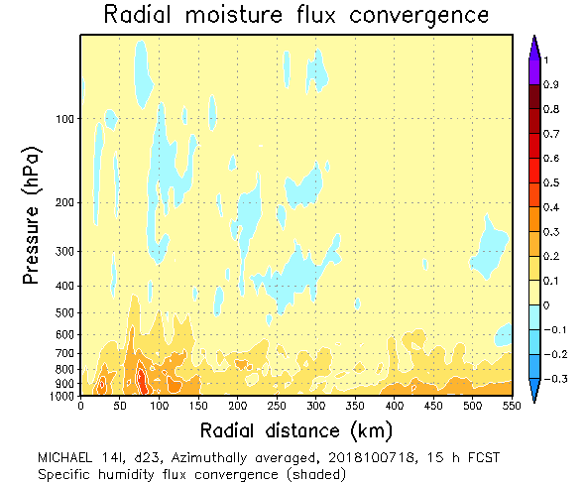
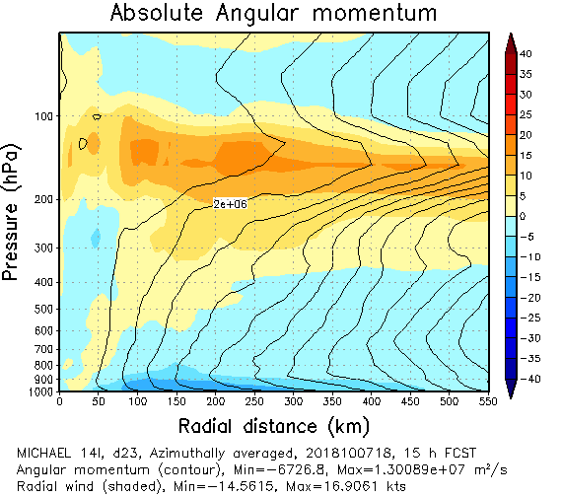
15 hour forecasts
Azimuthally-averaged
Temperature Deviation
Azimuthally-averaged
Radial Wind Component
10-m winds
Control
VAM
NoTHIN

Slide 10
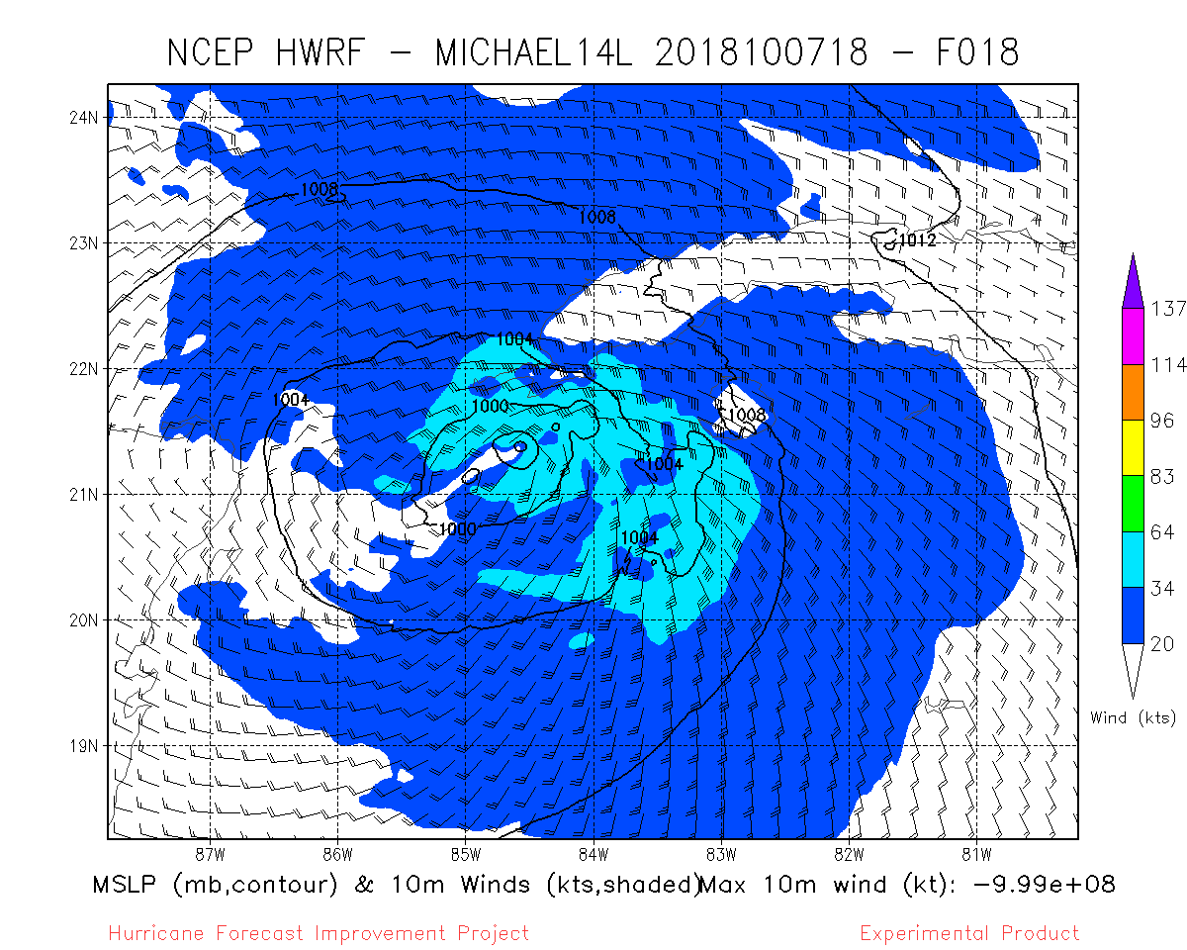
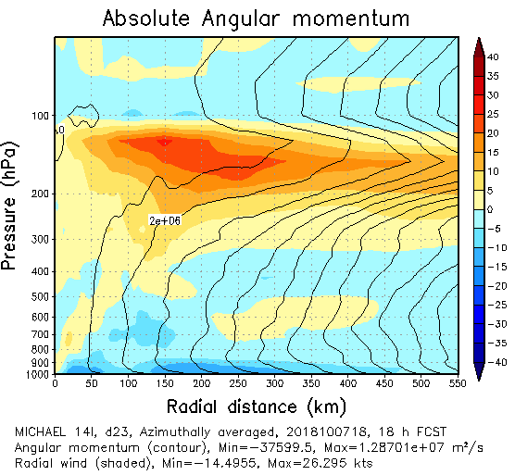
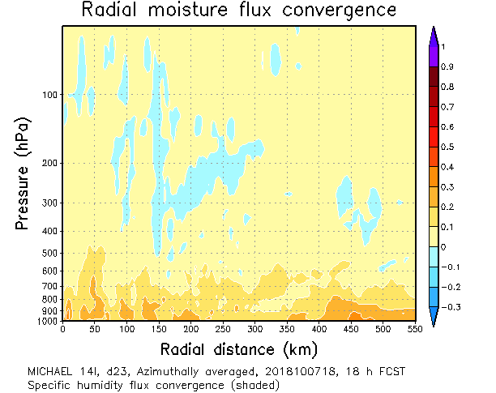
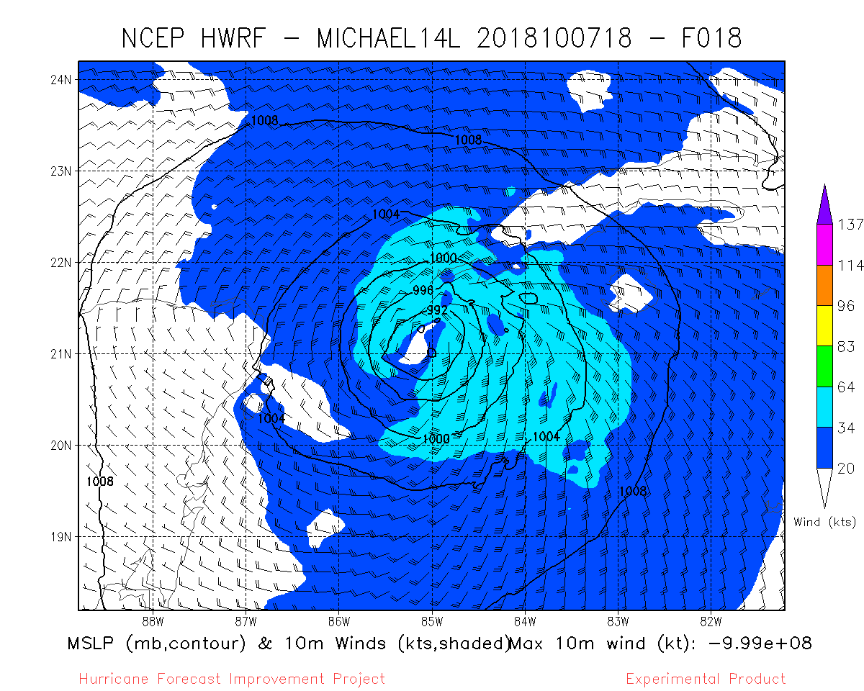
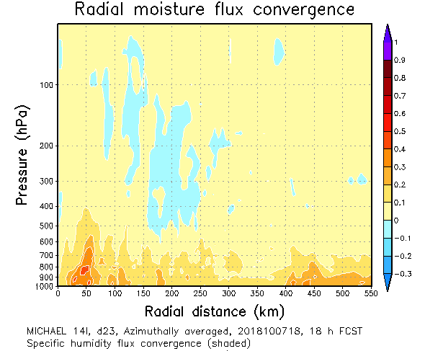
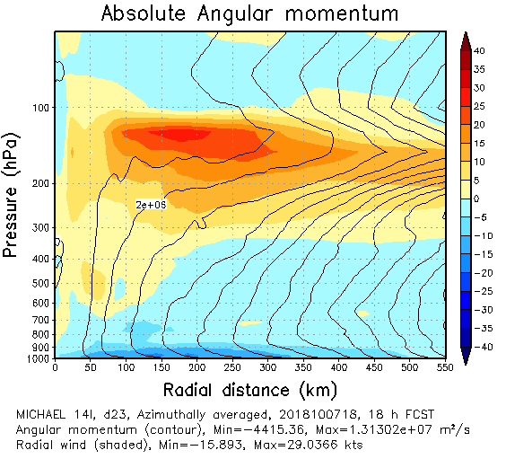
18 hour forecasts
Azimuthally-averaged
Temperature Deviation
Azimuthally-averaged
Radial Wind Component
10-m winds
Control
VAM
NoTHIN

Slide 11
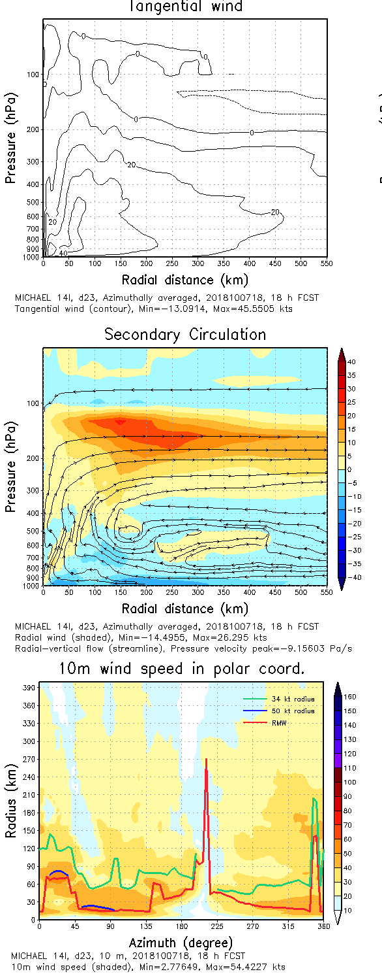
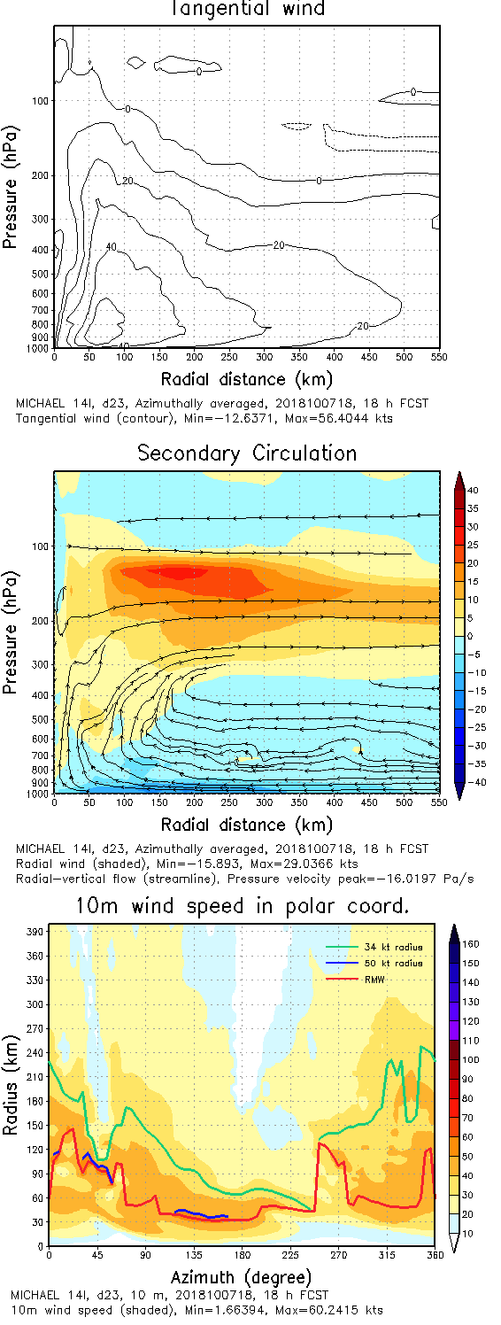
18 hour forecasts
VAM
NoTHIN
Control

Slide 12
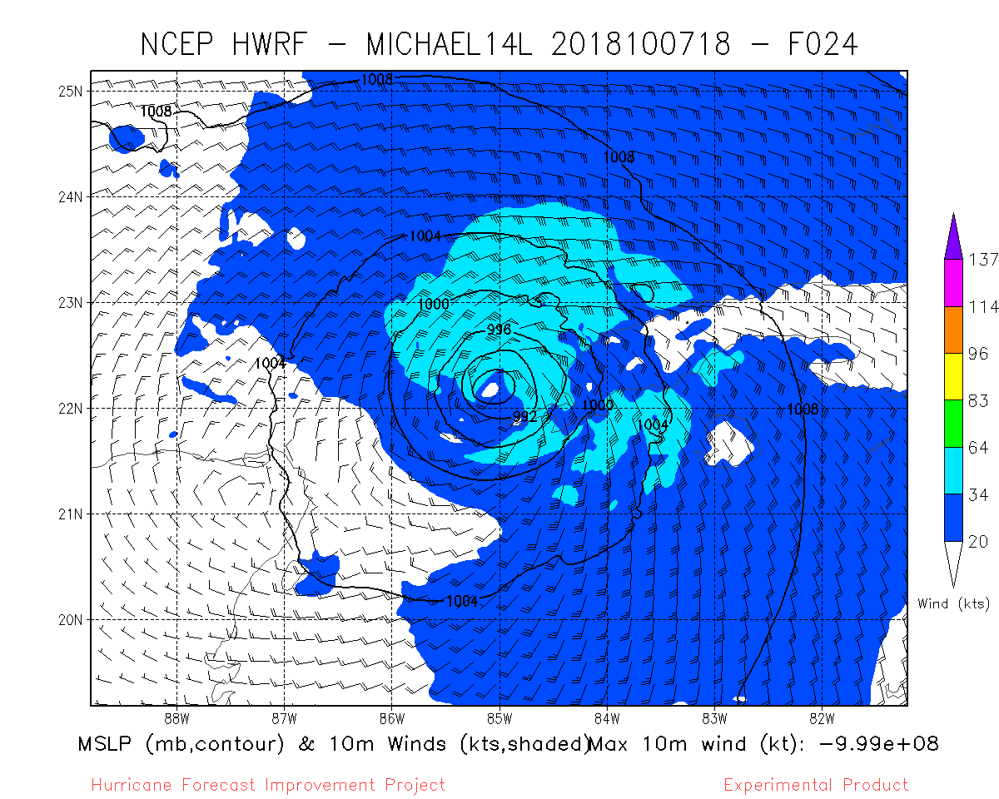
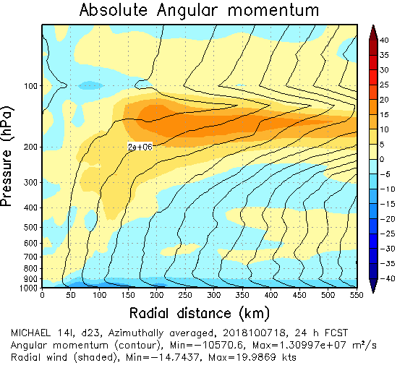
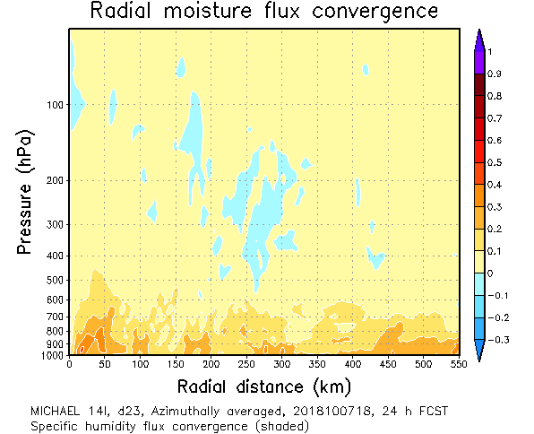
24 hour forecasts
Azimuthally-averaged
Temperature Deviation
Azimuthally-averaged
Radial Wind Component
10-m winds
Control
VAM
NoTHIN

Slide 13
Forecast Impacts
Forecasts beginning 1800 UTC 7 Oct 2018 ( no CYGNSS data in region )
Every 18 hours, starting at forecast hour 24, i.e., 24 hours, 42 hours, 60 hours.

Slide 14
24 hour forecasts
Azimuthally-averaged
Temperature Deviation
Azimuthally-averaged
Radial Wind Component
10-m winds
Control
VAM
NoTHIN

Slide 15
42 hour forecasts
Azimuthally-averaged
Temperature Deviation
Azimuthally-averaged
Radial Wind Component
10-m winds
Control
VAM
NoTHIN

Slide 16
60 hour forecasts
Azimuthally-averaged
Temperature Deviation
Azimuthally-averaged
Radial Wind Component
10-m winds
Control
VAM
NoTHIN

