Slide 1
Storm-Structure and Downdraft Characteristics of Hurricane Michael (2018) During Rapid Intensification
Joshua Wadler
Co-authors: Jun Zhang, Robert Rogers, Benjamin Jaimes, Nick Shay and Jonathan Zawislak
HRD October Science Meeting

Slide 2
Motivation
Build upon my results from Hurricane Earl (2010) that related downdraft kinematic and thermodynamic characteristics by comparing dropsonde and airborne radar observations

Slide 3
Motivation
Build upon my results from Hurricane Earl (2010) that related downdraft kinematic and thermodynamic characteristics by comparing dropsonde and airborne radar observations
What factors contributed to the rapid intensification of Hurricane Michael over a 2-day period in the Gulf of Mexico?

Slide 4
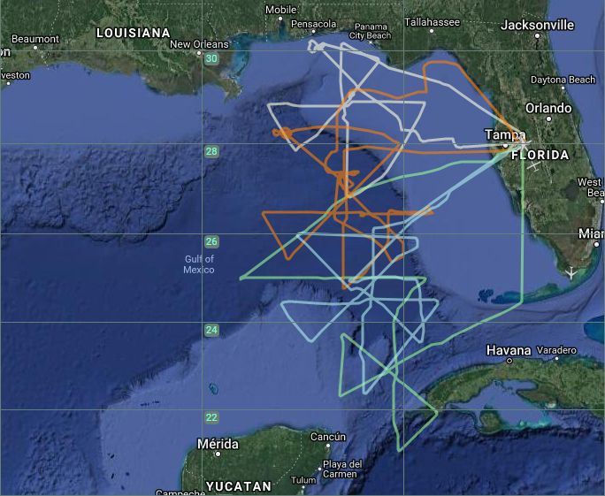
Motivation
Build upon my results from Hurricane Earl (2010) that related downdraft kinematic and thermodynamic characteristics by comparing dropsonde and airborne radar observations
What factors contributed to the rapid intensification of Hurricane Michael over a 2-day period in the Gulf of Mexico?
Excellent data coverage from NOAA aircraft
4 NOAA P-3 missions
Almost every dropsonde is paired with an AXBT for SST/OHC measurement
P-3 Flight Tracks
NASA MTS

Slide 5
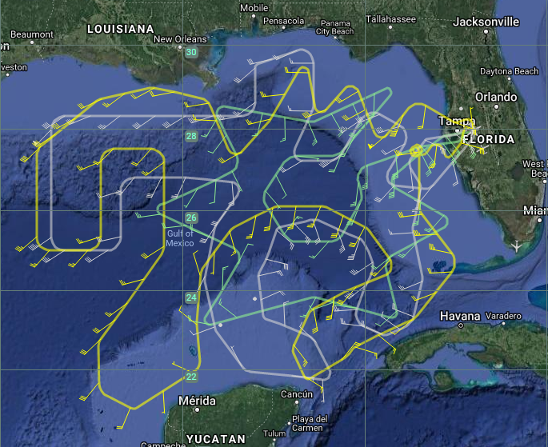
Motivation
Build upon my results from Hurricane Earl (2010) that related downdraft kinematic and thermodynamic characteristics by comparing dropsonde and airborne radar observations
What factors contributed to the rapid intensification of Hurricane Michael over a 2-day period in the Gulf of Mexico?
Excellent data coverage from NOAA aircraft
4 NOAA P-3 missions
Almost every dropsonde is paired with an AXBT for SST/OHC measurement
3 NOAA G-IV missions
P-3 Flight Tracks
G-IV Flight Tracks
NASA MTS
NASA MTS

Slide 6
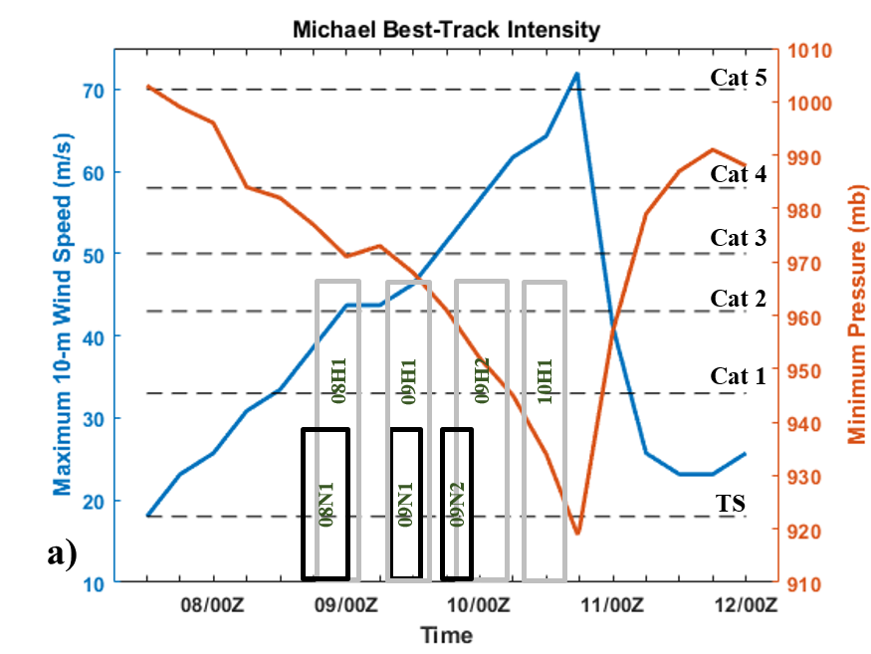
Motivation
Build upon my results from Hurricane Earl (2010) that related downdraft kinematic and thermodynamic characteristics by comparing dropsonde and airborne radar observations
What factors contributed to the rapid intensification of Hurricane Michael over a 2-day period in the Gulf of Mexico?
Excellent data coverage from NOAA aircraft
4 NOAA P-3 missions
Almost every dropsonde is paired with an AXBT for SST/OHC measurement
3 NOAA G-IV missions
P-3 Flight Tracks
G-IV Flight Tracks
NASA MTS
NASA MTS

Slide 7
Results – Early Stages of RI
Lower θ_{e} air to the north and west of the storm
G-IV Dropsonde Data at 5.0 km
θ_{e}(shaded), storm-relative winds
RMW and 2*RMW outlined

Slide 8
Results – Early Stages of RI
Lower θ_{e} air to the north and west of the storm
A closer look at the dropsonde skew-t’s show that there is dry air above 500 mb in dropsonde Y (~400 km radius)
G-IV Dropsonde Data at 5.0 km
θ_{e}(shaded), storm-relative winds
RMW and 2*RMW outlined

Slide 9
Results – Early Stages of RI
Lower θ_{e} air to the north and west of the storm
A closer look at the dropsonde skew-t’s show that there is dry air above 500 mb in dropsonde Y (~400 km radius)
The dry air does not exist closer to the center as shown in dropsonde c
G-IV Dropsonde Data at 5.0 km
θ_{e}(shaded), storm-relative winds
RMW and 2*RMW outlined

Slide 10
Results – Early Stages of RI
Lower θ_{e} air to the north and west of the storm
A closer look at the dropsonde skew-t’s show that there is dry air above 500 mb in dropsonde Y (~400 km radius)
The dry air does not exist closer to the center as shown in dropsonde c
Both skew-t’s are fairly representative of the dropsondes surrounding their entire regions
The resistance to dry air is important in the upshear-left quadrant, where there is storm-relative inflow between 4-10 km
G-IV Dropsonde Data at 5.0 km
θ_{e}(shaded), storm-relative winds
RMW and 2*RMW outlined
Secondary circulation from P-3 tail radar
Shading = radial wind
Black contour = vertical velocity

Slide 11
Results – Early Stages of RI
Lower θ_{e} air to the north and west of the storm
A closer look at the dropsonde skew-t’s show that there is dry air above 500 mb in dropsonde Y (~400 km radius)
The dry air does not exist closer to the center as shown in dropsonde c
Both skew-t’s are fairly representative of the dropsondes surrounding their entire regions
The resistance to dry air is important in the upshear-left quadrant, where there is storm-relative inflow between 4-10 km
G-IV Dropsonde Data at 5.0 km
θ_{e}(shaded), storm-relative winds
RMW and 2*RMW outlined
Visible Imagery

Slide 12
Results – Early Stages of RI
With favorable mid-level thermodynamic conditions upshear, what about the boundary layer?

Slide 13
Results – Early Stages of RI
With favorable mid-level thermodynamic conditions upshear, what about the boundary layer?
Highest θ_{e} in the upshear-right quadrant, largest gradient in the downshear-left quadrant
θ_{e} at 10 m

Slide 14
Results – Early Stages of RI
With favorable mid-level thermodynamic conditions upshear, what about the boundary layer?
Highest θ_{e} in the upshear-right quadrant, largest gradient in the downshear-left quadrant
The storm was interacting with a cool oceanic eddy in the downshear-right quadrant
θ_{e} at 10 m
SST

Slide 15
Results – Early Stages of RI
With favorable mid-level thermodynamic conditions upshear, what about the boundary layer?
Highest θ_{e} in the upshear-right quadrant, largest gradient in the downshear-left quadrant
The storm was interacting with a cool oceanic eddy in the downshear-right quadrant
Highest Enthalpy fluxes DSL quadrant and into DSR quadrant
Provide energy for the sustainment of convection into the upshear quadrants
θ_{e} at 10 m
SST
Total Enthalpy Flux

Slide 16
Results – Early Stages of RI
With favorable mid-level thermodynamic conditions upshear, what about the boundary layer?
Highest θ_{e} in the upshear-right quadrant, largest gradient in the downshear-left quadrant
The storm was interacting with a cool oceanic eddy in the downshear-right quadrant
Highest Enthalpy fluxes DSL quadrant and into DSR quadrant
Provide energy for the sustainment of convection into the upshear quadrants
Hypothesis: It is most important for intensification to have warm waters left of shear to help sustain updrafts and aide boundary layer recovery
θ_{e} at 10 m
SST
Total Enthalpy Flux

Slide 17
Results – Mature Hurricane
The highest boundary layer θ_{e} rotated to the downshear quadrants
Favorable configuration for development of convection
362 K at a 150 km radius downshear!
What could cause this asymmetry?

Slide 18
Results – Mature Hurricane
The highest boundary layer θ_{e} rotated to the downshear quadrants
Favorable configuration for development of convection
362 K at a 150 km radius downshear!
What could cause this asymmetry?
Not the SSTs

Slide 19
Results – Mature Hurricane
The highest boundary layer θ_{e} is downshear quadrants with 362 K at a 150 km radius!
θ_{e} at 10 m

Slide 20
Results – Mature Hurricane
The highest boundary layer θ_{e} is downshear quadrants with 362 K at a 150 km radius!
Quadrant averaged radial wind in the downshear-right quadrant reveals strong outflow above ~ 4 km altitude
Similar to composite structure of TCs in shear (Reasor et al. 2013)
Radial Wind (shaded)
Vertical Velocity (black)
θ_{e} at 10 m

Slide 21
Results – Mature Hurricane
The highest boundary layer θ_{e} is downshear quadrants with 362 K at a 150 km radius!
Quadrant averaged radial wind in the downshear-right quadrant reveals strong outflow above ~ 4 km altitude
Similar to composite structure of TCs in shear (Reasor et al. 2013)
Hypothesis: Mid-level outflow transports high θ_{e} air radially outward which can mix into the boundary layer through downdrafts and insulate the boundary layer, allowing for rapid energy increases (builds upon Barnes 2008)
Radial Wind (shaded)
Vertical Velocity (black)
θ_{e} at 10 m

Slide 22
Results – Mature Hurricane
Also evidence of high air upshear, especially upshear-right
θ_{e} at 10 m

Slide 23
Results – Mature Hurricane
Also evidence of high air upshear, especially upshear-right
Quadrant averaged radial wind in the upshear-right quadrant reveals strong outflow below ~ 2 km altitude
Similar to composite structure of TCs in shear (Reasor et al. 2013)
Radial Wind (shaded)
Vertical Velocity (black)
θ_{e} at 10 m

Slide 24
Results – Mature Hurricane
Also evidence of high air upshear, especially upshear-right
Quadrant averaged radial wind in the upshear-right quadrant reveals strong outflow below ~ 2 km altitude
Similar to composite structure of TCs in shear (Reasor et al. 2013)
Hypothesis: Low-level outflow transports high θ_{e} air radially outward which helps with boundary layer recovery
Radial Wind (shaded)
Vertical Velocity (black)
θ_{e} at 10 m

Slide 25
Results – Mature Hurricane
Any mid-level thermodynamic data to support this hypothesis?
Dropsondes from the P-3 only go up to 3.0 km
USL
DSR

Slide 26
Results – Mature Hurricane
Any mid-level thermodynamic data to support this hypothesis?
Dropsondes from the P-3 only go up to 3.0 km
The G-IV flew a research mission at nearly the same time
θ_{e} at 5.0 km
USL
DSR

Slide 27
Results – Mature Hurricane
Any mid-level thermodynamic data to support this hypothesis?
Dropsondes from the P-3 only go up to 3.0 km
The G-IV flew a research mission at nearly the same time
Average 3-4 dropsondes at ~100 km radius
θ_{e} at 5.0 km
Radial Wind
USL
DSR

Slide 28
Results – Mature Hurricane
Any mid-level thermodynamic data to support this hypothesis?
Dropsondes from the P-3 only go up to 3.0 km
The G-IV flew a research mission at nearly the same time
Average 3-4 dropsondes at ~100 km radius
θ_{e} at 5.0 km
Radial Wind
θ_{e}
USL
DSR

Slide 29
Summary
During the first two missions in Michael:

Slide 30
Summary
During the first two missions in Michael:
The storm was able to withstand nearby dry air in the vicinity of the storm

Slide 31
Summary
During the first two missions in Michael:
The storm was able to withstand nearby dry air in the vicinity of the storm
The storm intensified, even in the presence of cool SSTs, leading us to believe that the most favorable configuration for intensification is to have warm waters upshear-left

Slide 32
Summary
During the first two missions in Michael:
The storm was able to withstand nearby dry air in the vicinity of the storm
The storm intensified, even in the presence of cool SSTs, leading us to believe that the most favorable configuration for intensification is to have warm waters upshear-left
During the last two missions in Michael:
Strong mid-level outflow downshear and low-level outflow upshear likely transported high θ_{e} to outer radii.

Slide 33
Summary
During the first two missions in Michael:
The storm was able to withstand nearby dry air in the vicinity of the storm
The storm intensified, even in the presence of cool SSTs, leading us to believe that the most favorable configuration for intensification is to have warm waters upshear-left
During the last two missions in Michael:
Strong mid-level outflow downshear and low-level outflow upshear likely transported high θ_{e} to outer radii.
Downshear, this leads to an insulation of the boundary layer allowing for rapid energy increases
Upshear, this helps boundary layer recovery for convection to form downshear

