Slide 1
Forecast Impact Experiments To Optimize Utilization
of CYGNSS Wind Observations
Bachir Annane¹, Mark Leidner⁴, Brian McNoldy², Robert Atlas⁵, Sharanya Majumdar², Lidia Cucurull³, and Ross Hoffman⁴
¹ Univ. of Miami/CIMAS and NOAA/AOML/HRD, Miami, FL
² Univ. of Miami/RSMAS, Miami, FL
³ NOAA/AOML, Miami, FL
⁴ Atmospheric and Environmental Research, Lexington, MA
⁵ NOAA/AOML, Retired

Slide 2
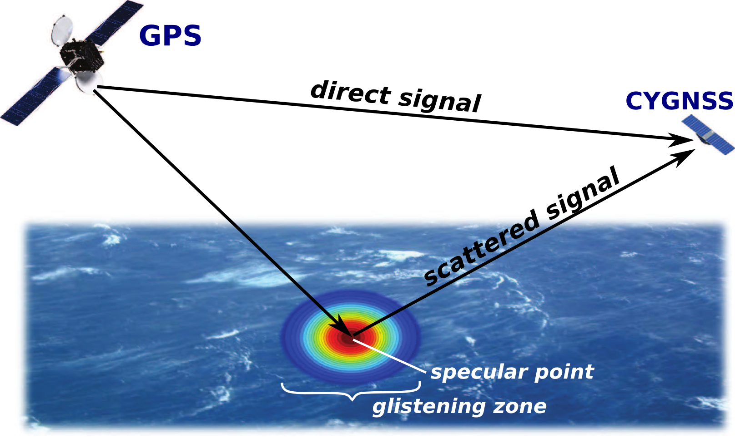
1. CYclone Global Navigation Satellite System (CYGNSS)
NASA Earth Venture Mission (PI: Chris Ruf)
8 micro-satellites launched in December 2016
Bi-static quasi-specular scatterometry
Utilizes signals (19 cm wavelength) from
GPS satellites to retrieve ocean surface wind speed
Surface roughness affects forward-scattered signal
Low-Earth orbit: 35°S - 35°N
Nominal grid spacing of gridded retrievals: 25 km
Median / mean revisit time: 2.8 h / 7.2 h
Goal of CYGNSS: to retrieve data over a large range of surface wind speeds in all precipitating conditions throughout the tropics and subtropics with frequent revisit times.
Goals of this study:
Pre-Launch: to investigate the potential for CYGNSS to improve analyses and forecasts of tropical cyclones (via OSSEs)
Post-Launch: to evaluate the actual influence of assimilating CYGNSS data into NOAA’s operational hurricane model (via OSEs)

Slide 3
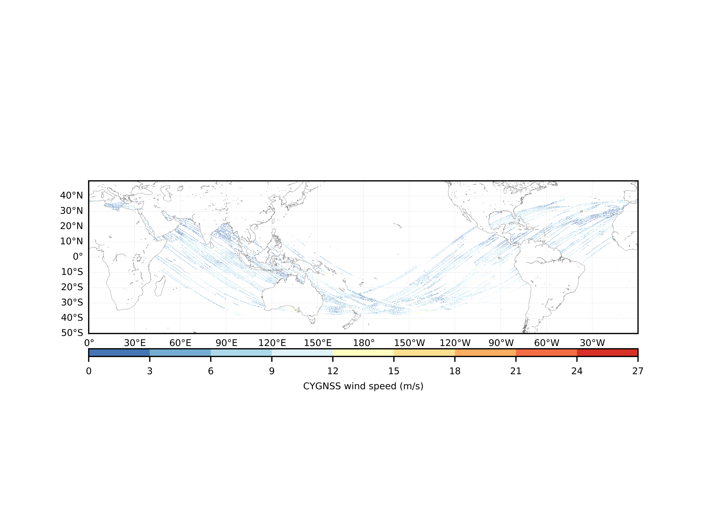
6 hours of CYGNSS data centered at 06 UTC on October 11, 2017.
24 hours of CYGNSS data.

Slide 4
CYGNSS impact on analyses and forecasts
for TC Michael (2018)
. Observing System Experiment (OSE) using 2019 HWRF (“H219”)
NOAA/NCEP FV3 GFS; 6-hourly Hybrid 3d-Var/EnKF
HWRF Model and DA nested grids: 14.5 km / 4.5 / 1.5 km
Observations
All operational observations including radiances
CYGNSS Version 2.1
Fully Developed Seas (FDS) and Young Seas Limited Fetch (YSLF)
Data thinning vs no thinning with inflated error values
CYGNSS data with retrieval errors 3 m/s or less are included
Wind directional information from VAM
There are two criteria that are used to pick case studies.
1. Based on the OSSE results, we are looking at cases where the operational HWRF had significant errors in the intensity forecast. We want to see if CYGNSS data can improve these forecasts.
2. Only lower-wind-speed retrievals are reliable. So, we are looking for tropical cyclones in their early stages (tropical depression and tropical storm), that are poorly observed. This is where CYGNSS can contribute information to the structure of the nascent system
Investigate early in Michael’s life cycle (Tropical Storm): Oct 7th 2018

Slide 5
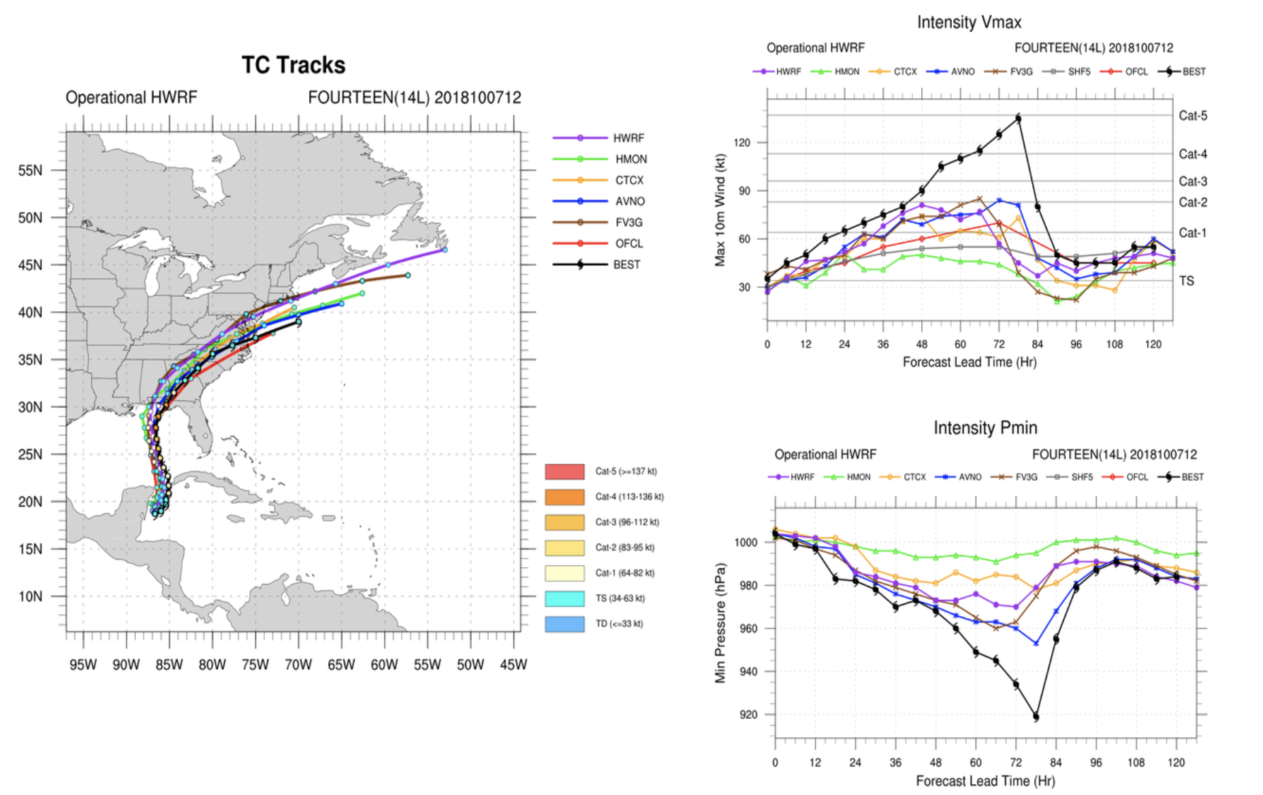
Case Study: Tropical Cyclone Michael 10/07/2018 00Z to 10/08/2018 06Z

Slide 6
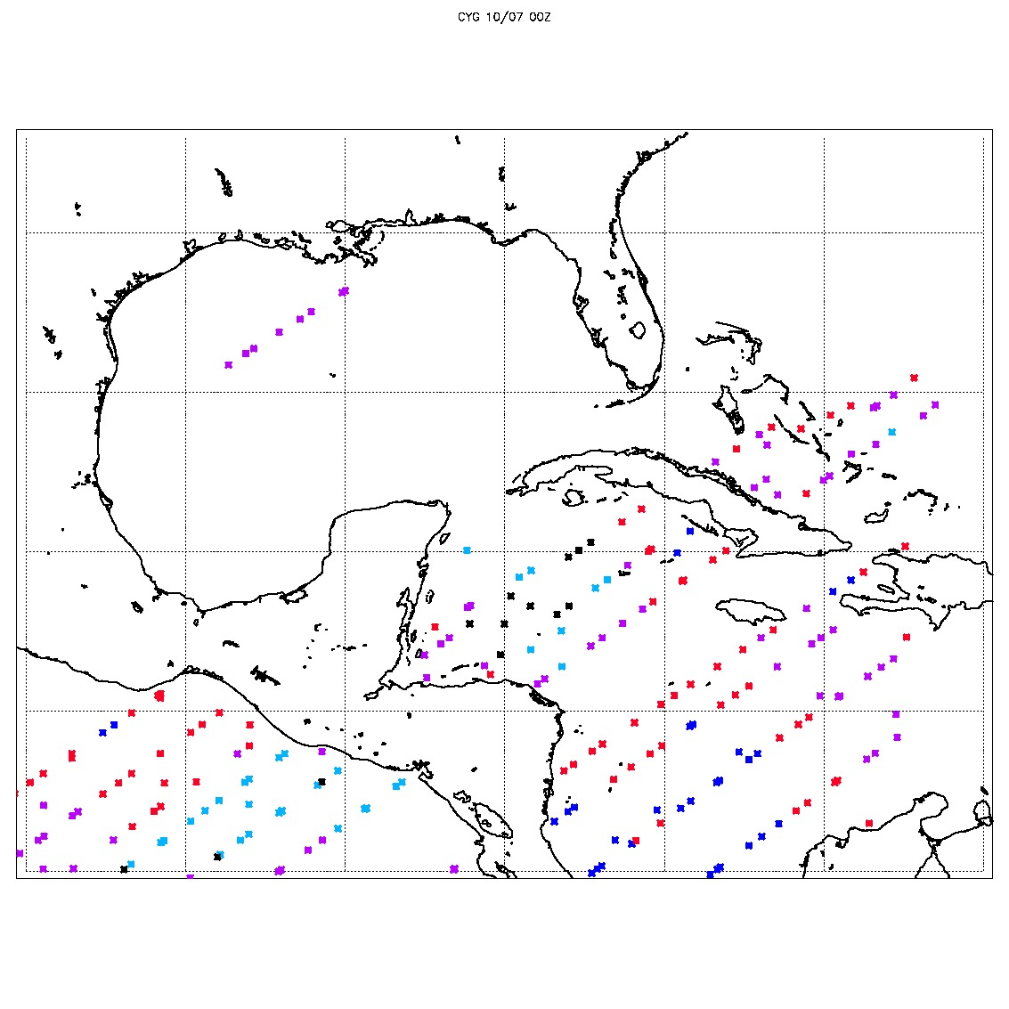
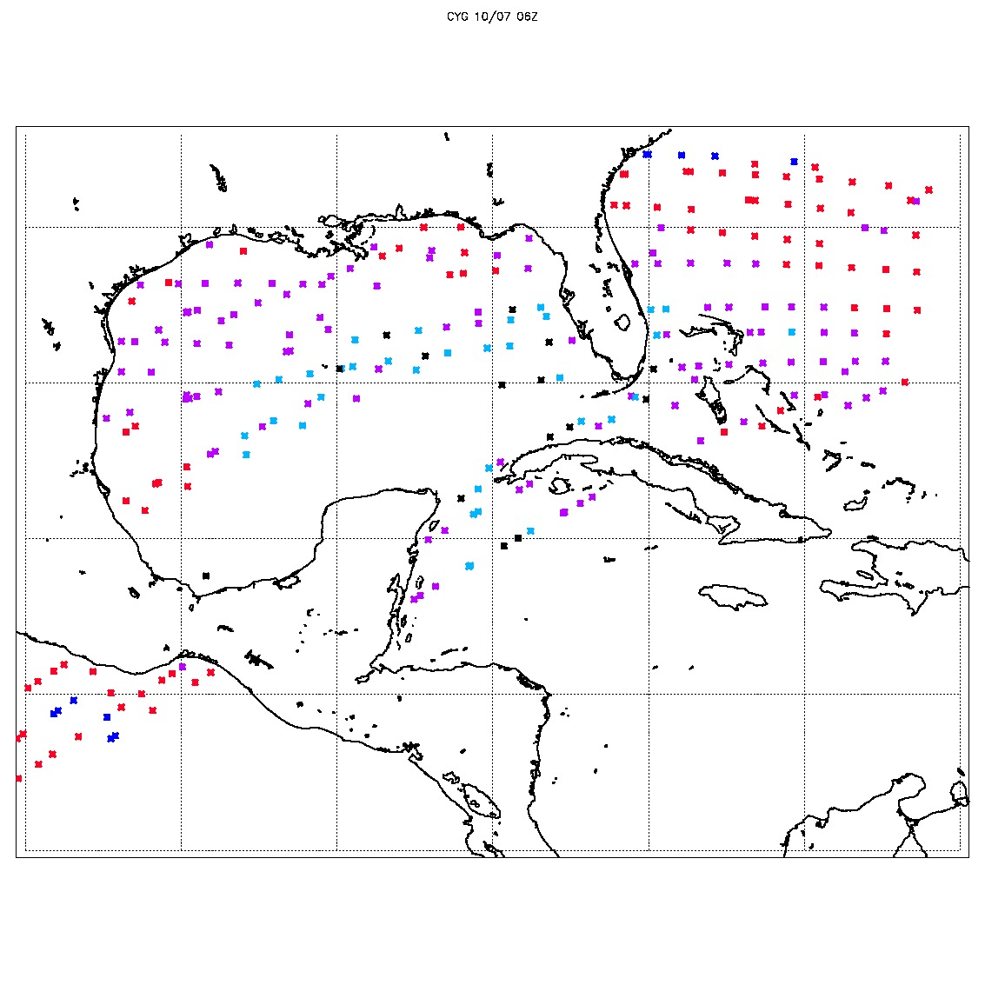
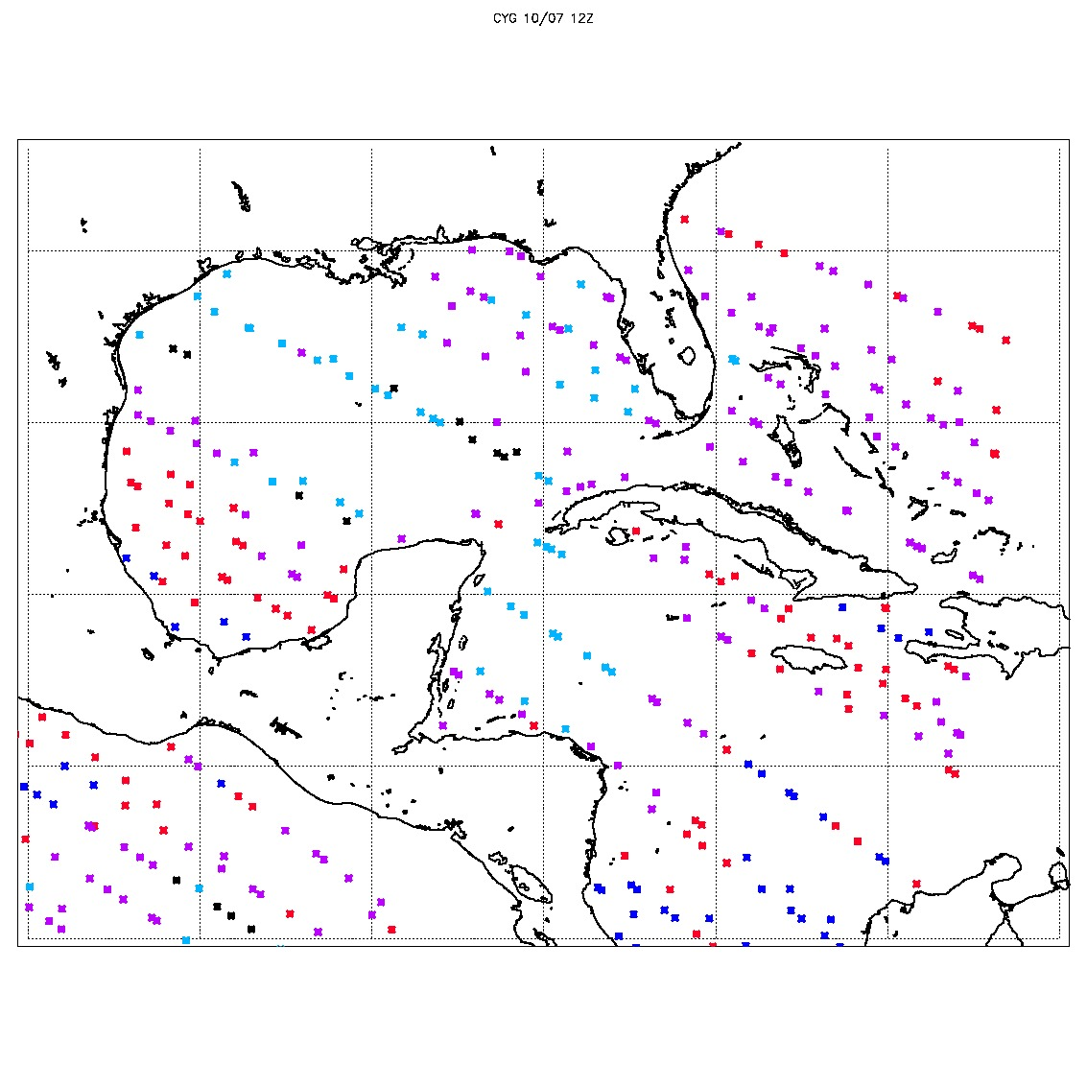
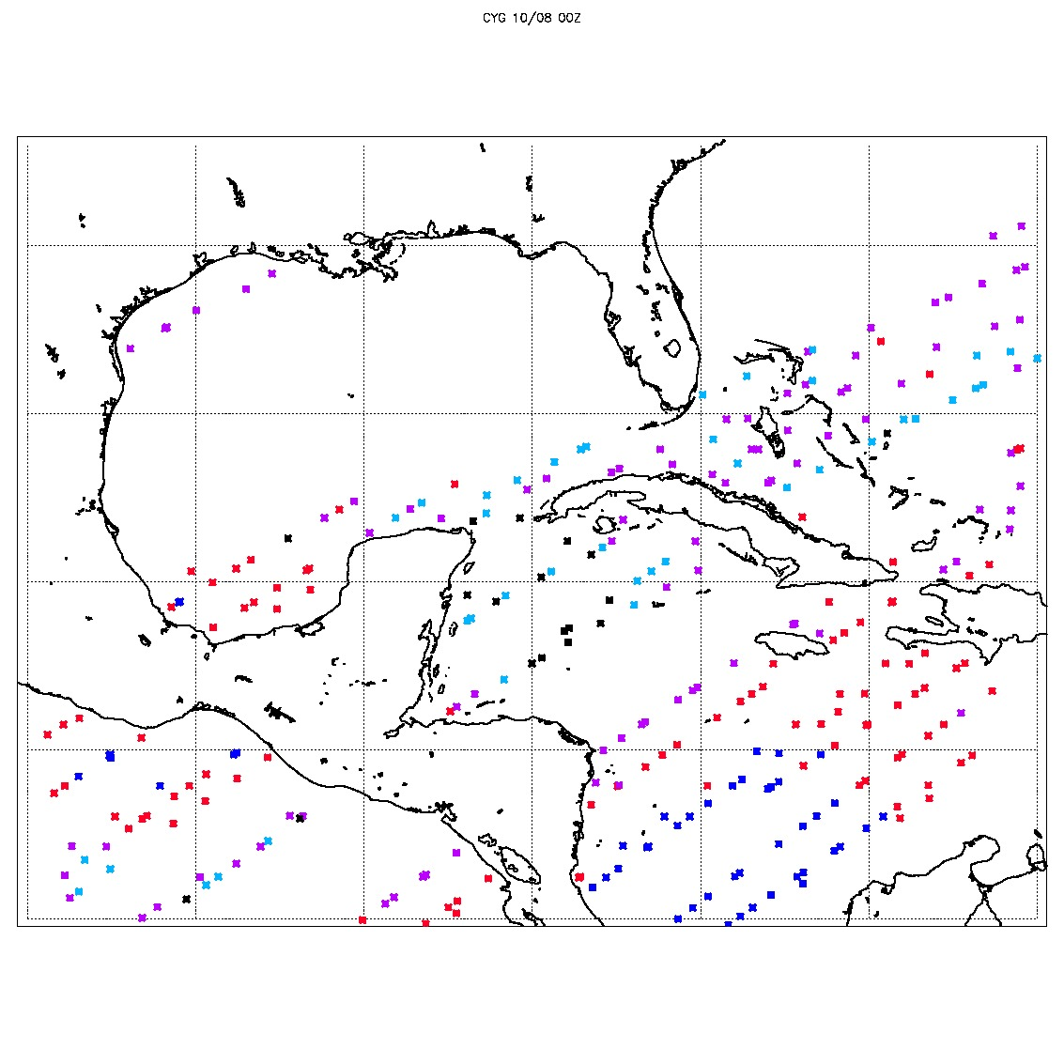
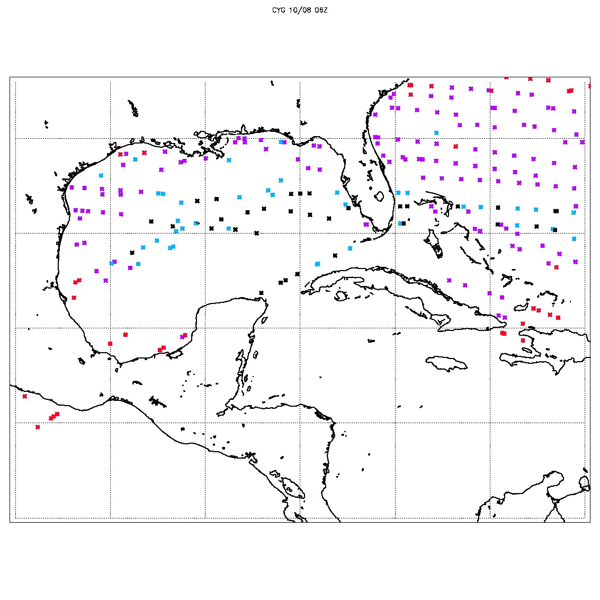
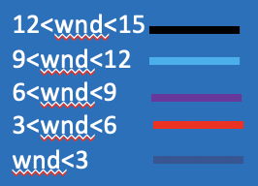
10/07 00Z
10/07 06Z
10/07 12Z
10/08 00Z
10/08 06Z

Slide 7
Vector wind analysis method 2-D Variational Wind Analysis
An optimal fit to CYGNSS observations is constrained by:
J_{b}: analysis should be “close” to the a priori, or “Background”, wind field
J_{o}: ensure the analysis is close to CYGNSS wind speeds
J_{c}: impose fluid dynamical constraints on the solution (vorticity, divergence)
MIN(J = J_{b} + J_{o} + J_{c})
Background winds are GFS operational analyses (0.25 x 0.25 degree).
Relative weights in minimization are consistent with CCMP analyses.
Hoffman, R. N., S. M. Leidner, J. M. Henderson, R. Atlas, J. V. Ardizzone, and S. C. Bloom, 2003: A two-dimensional variational analysis method for NSCAT ambiguity removal: Methodology, sensitivity, and tuning. J. Atmos. Oceanic Technol., 20 (5), 585–605.

Slide 8
6 hours of CYGNSS data: quality controlled/thinned
+/- 3 hours around 0600 UTC Oct 10, 2018
Key:
CYGNSS YSLF
CYGNSS FDS

Slide 9
Derived CYGNSS wind vectors
0600 UTC Oct 10, 2018 +/- 3 hours

Slide 10
Experiment Name | Assimilated Data set Cycles (10/07 00Z- 10/08 06Z)
 | Conventional | Radiances | CYGNSS | CYGNSS-VAM
CTRL | Yes | Yes | No | No
CYG50 | Yes | Yes | Yes | No
VAM50 | Yes | Yes | No | Yes
CYG_NOTN | Yes | Yes | Yes | No
VAM_NOTN | Yes | Yes | No | Yes

Slide 11
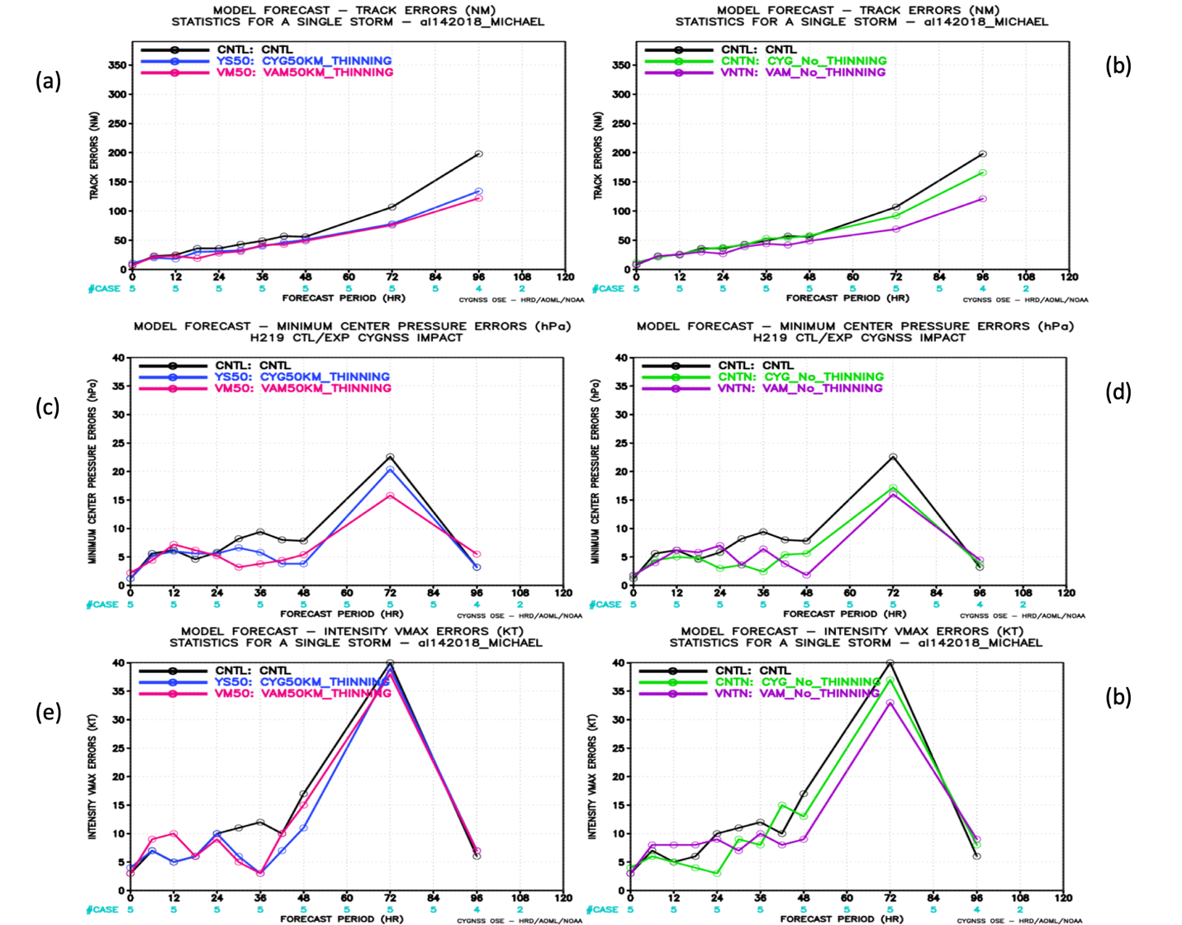
HWRF track and intensity forecast errors

Slide 12
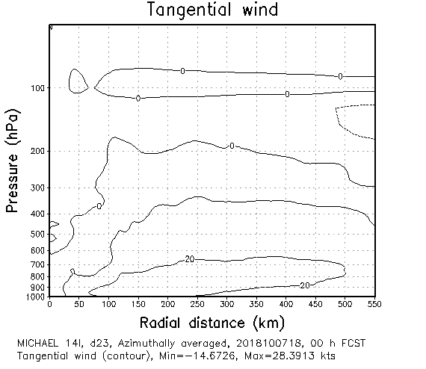
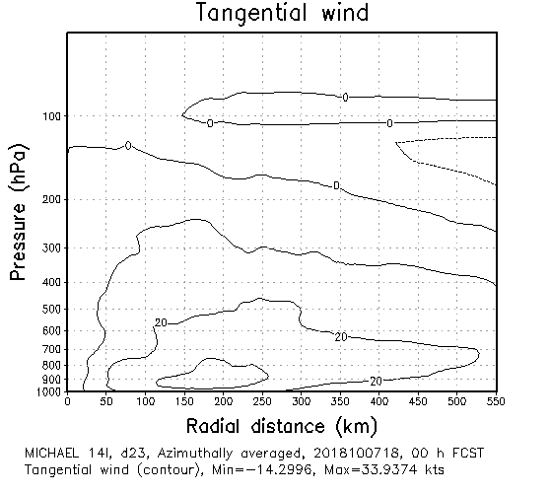
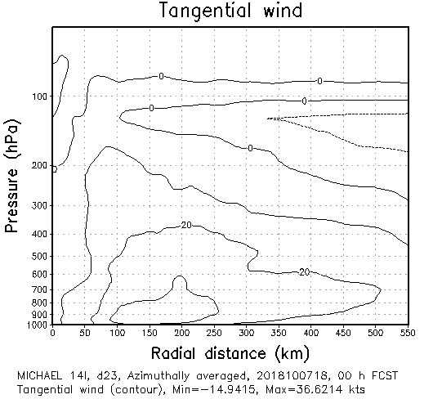
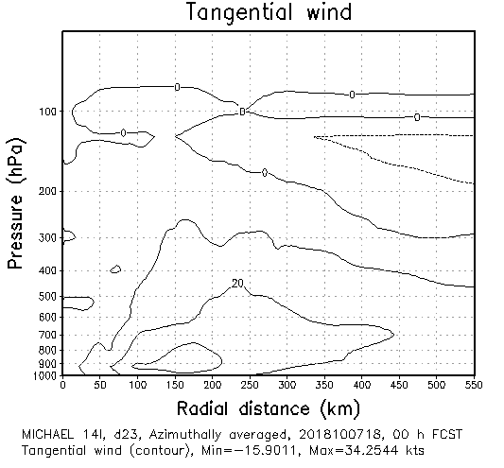
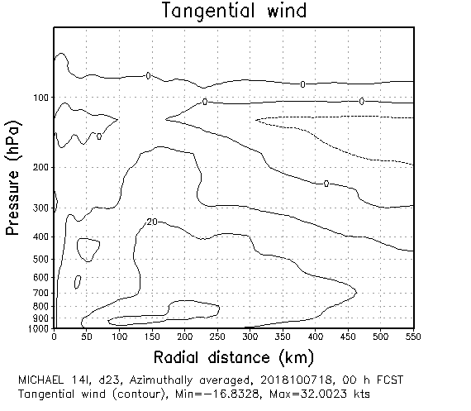
10/07 18UTC
CNTRL
CYG-NOTHN
VAM-NOTHN
CNTRL
CYG50
VAM50

Slide 13
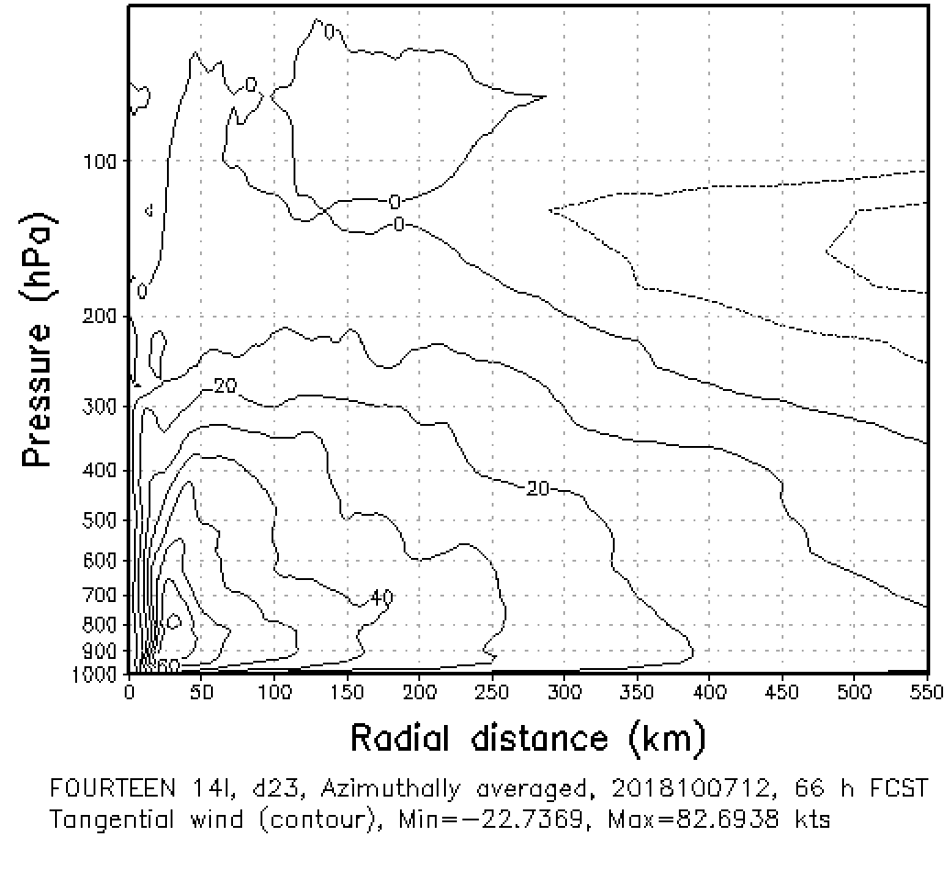
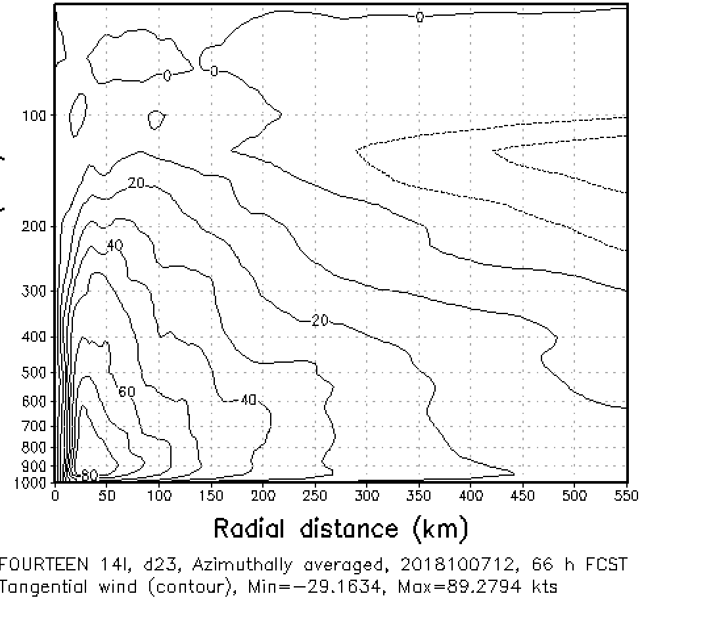
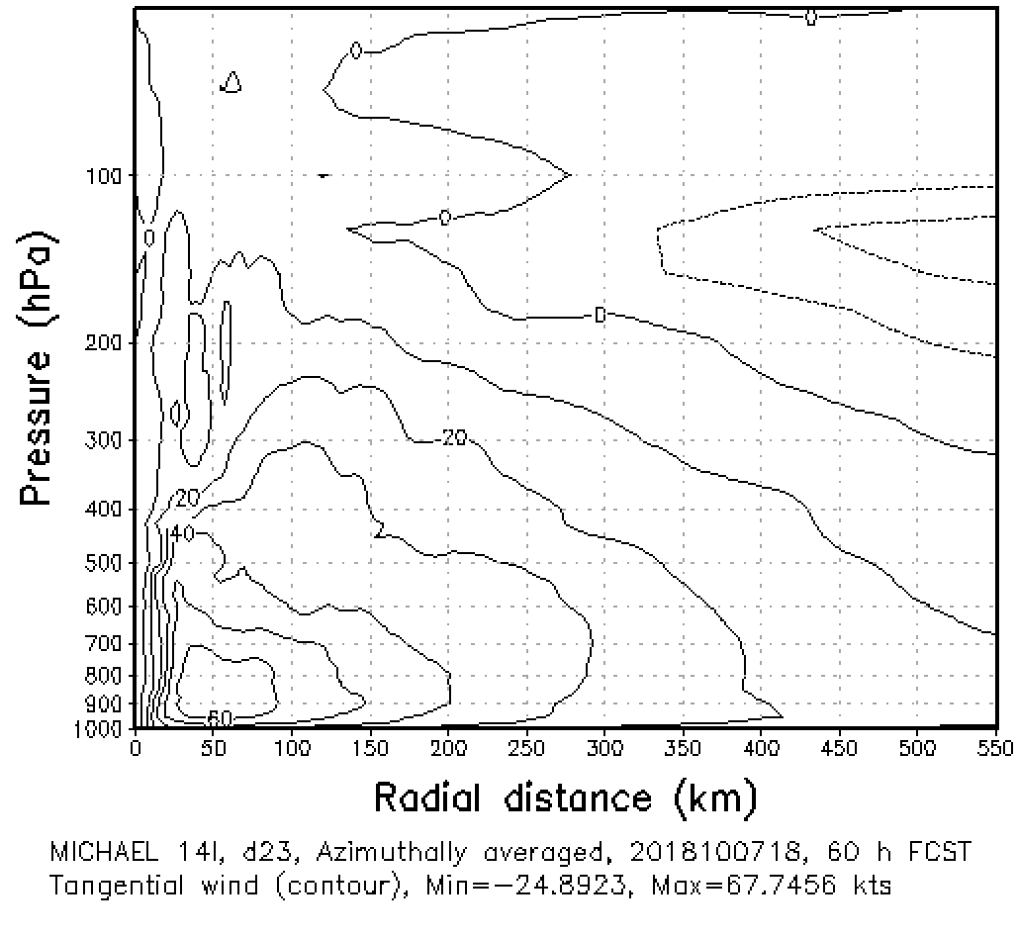
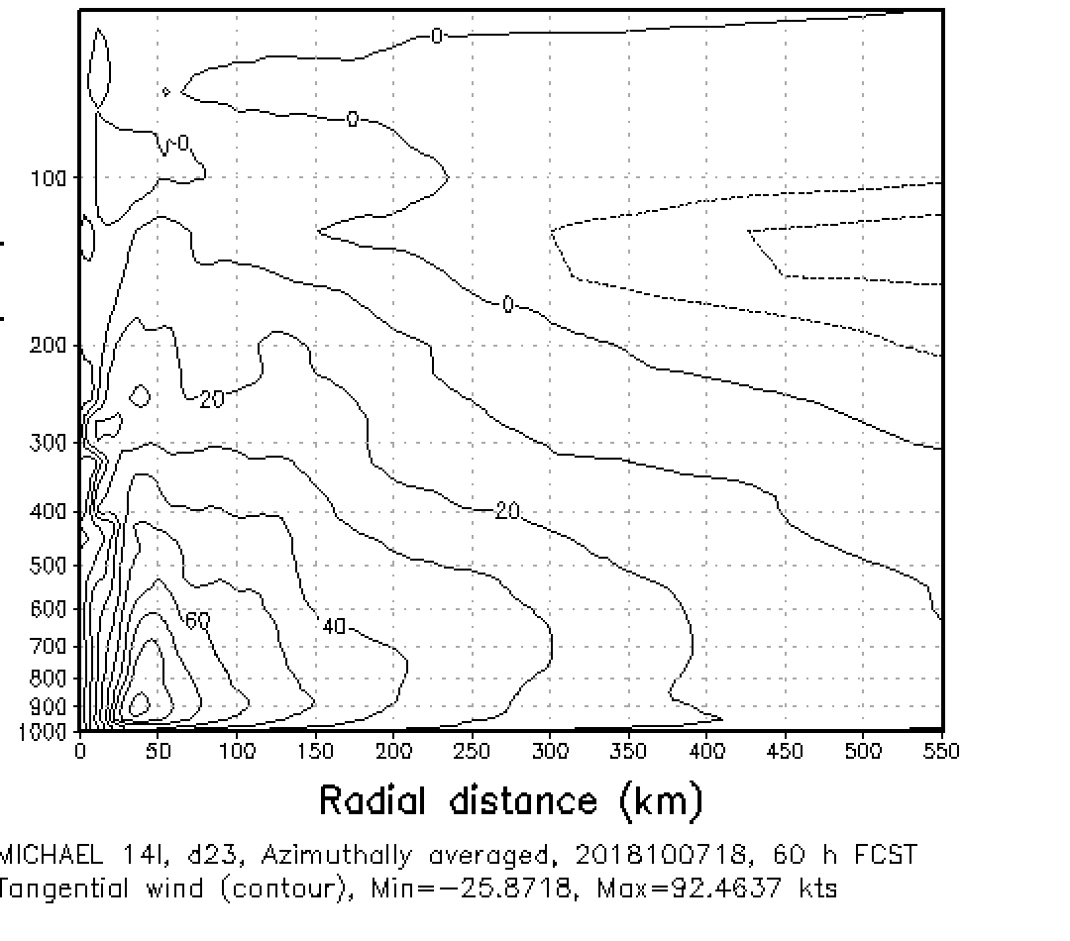
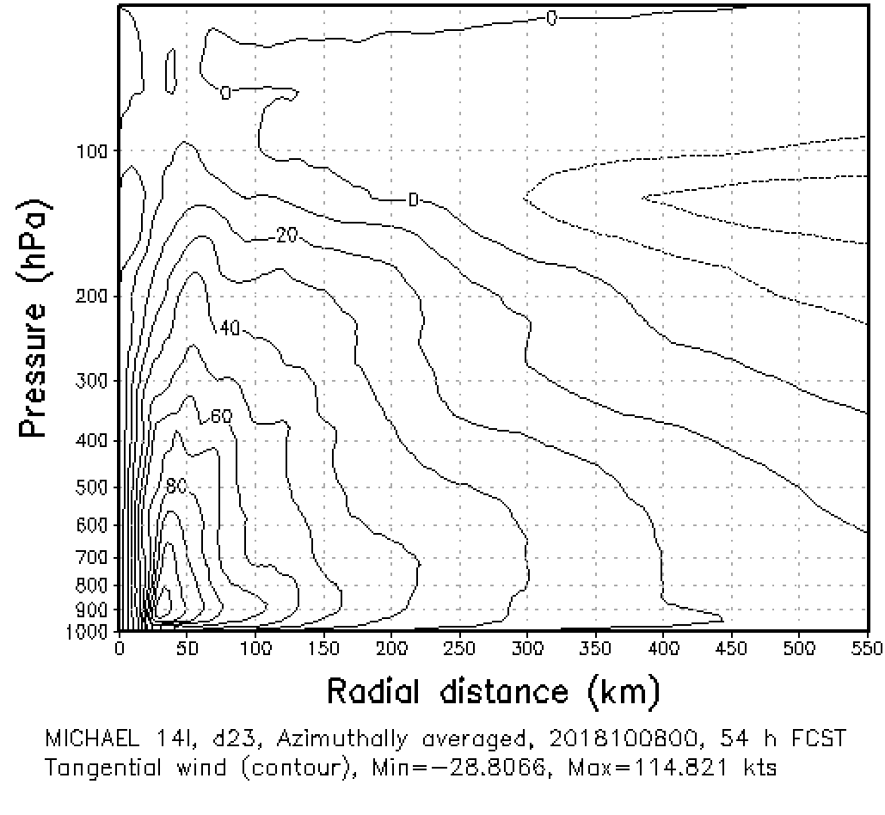
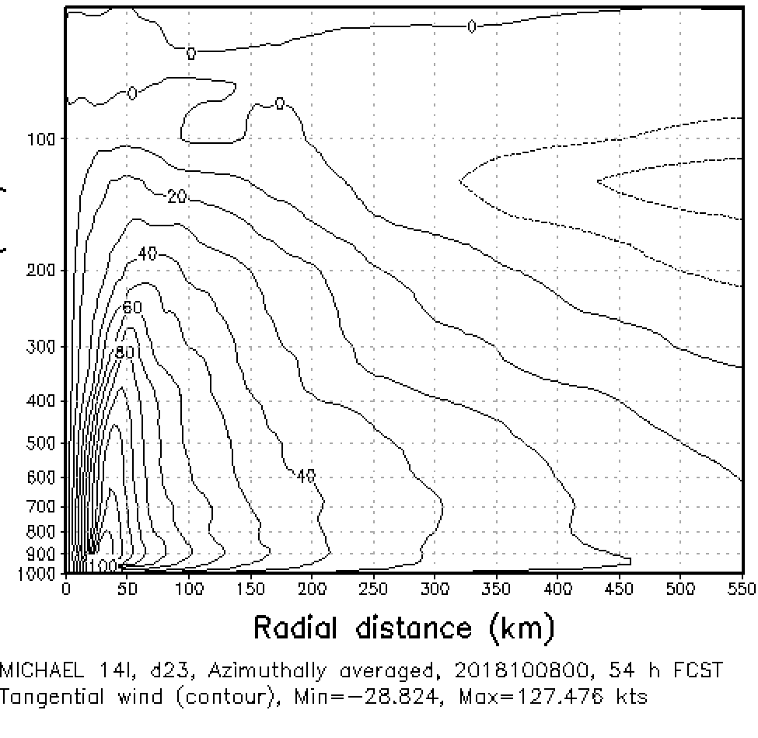
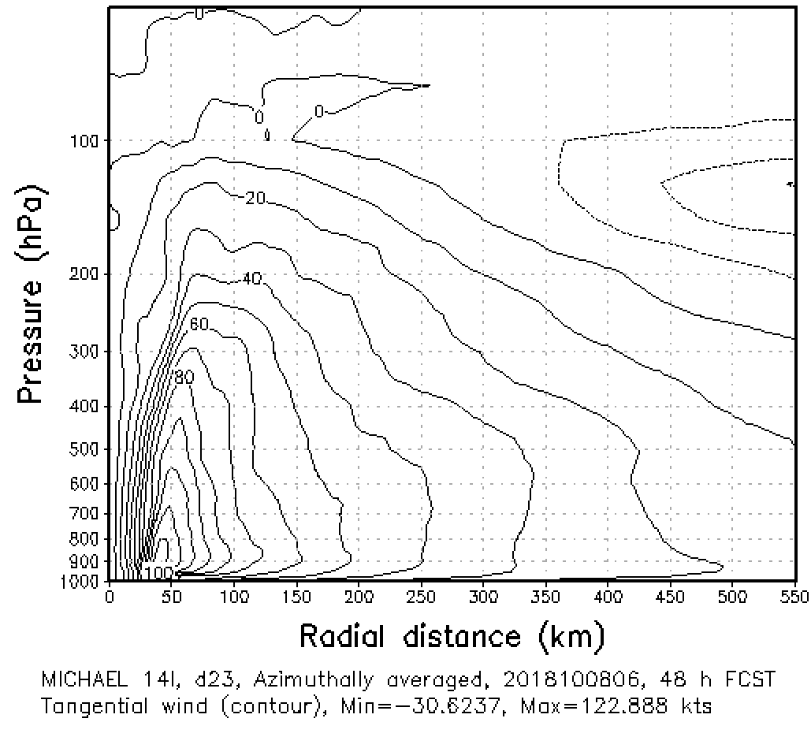
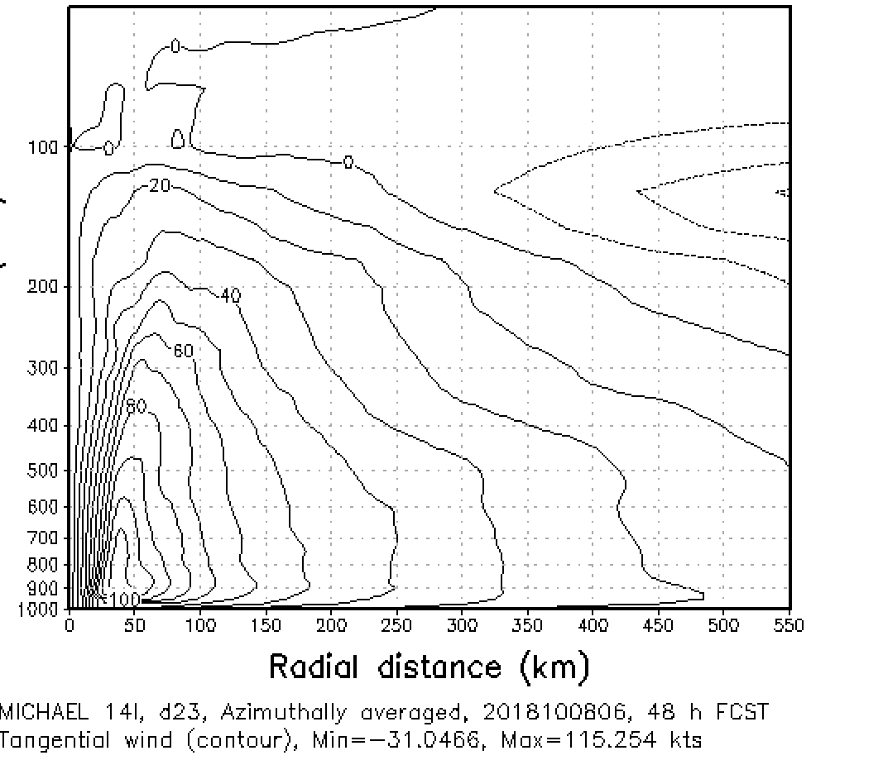
No CYGNSS
CYG_50
Forecasts
starting
0712
0718
Azimuthally averaged tangential wind cross sections of forecasts started at 6 hour intervals, all valid at the same time, 0600 UTC 10 August 2018, about 12 hours before hurricane Michael made landfall.
0800
0806

Slide 14
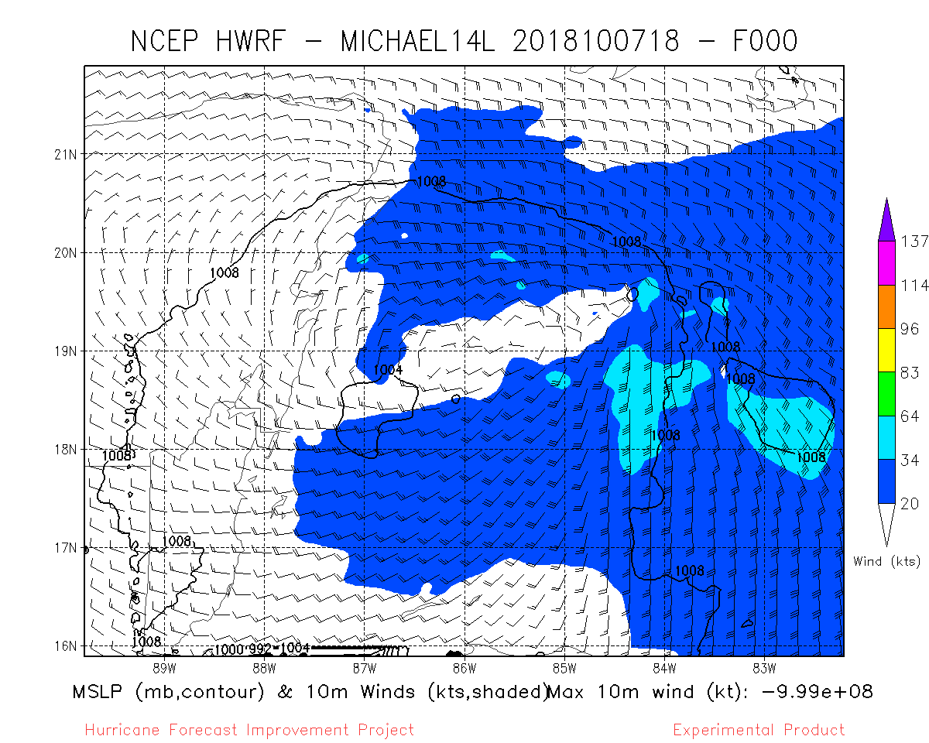
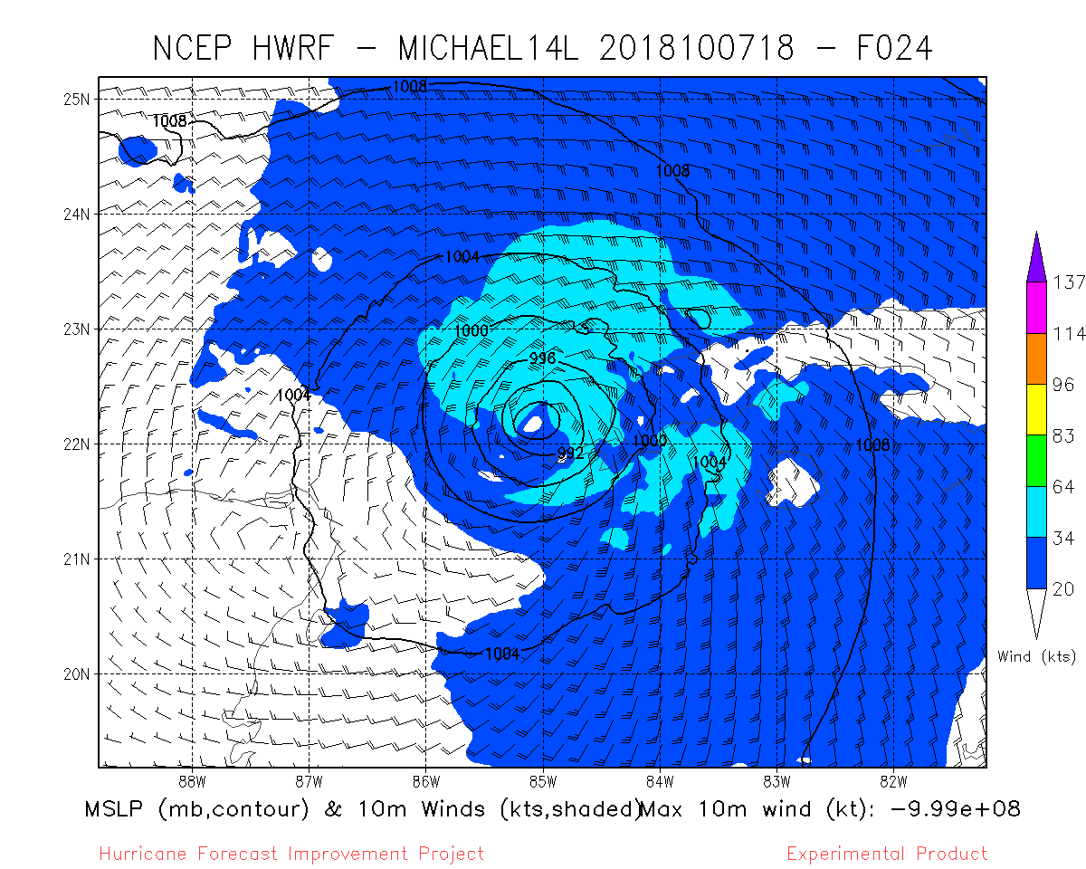
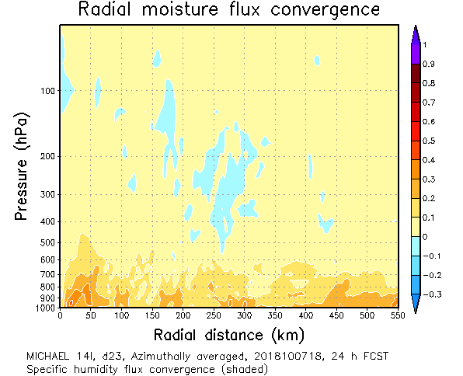
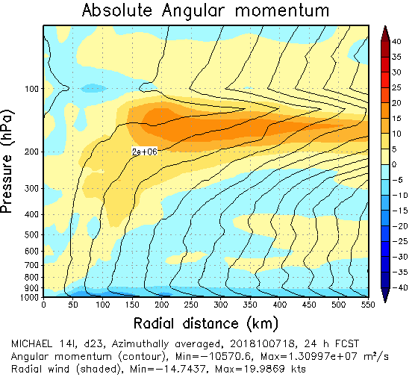
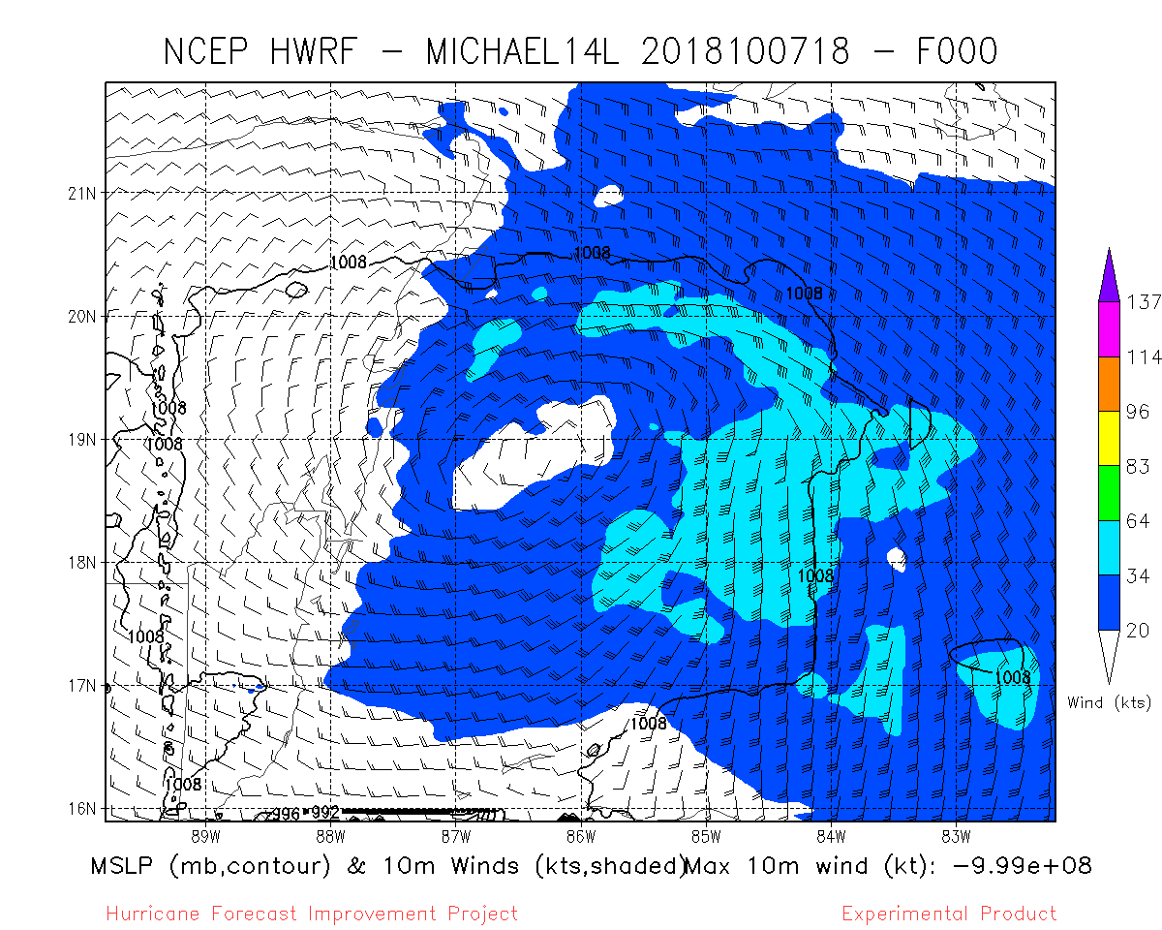
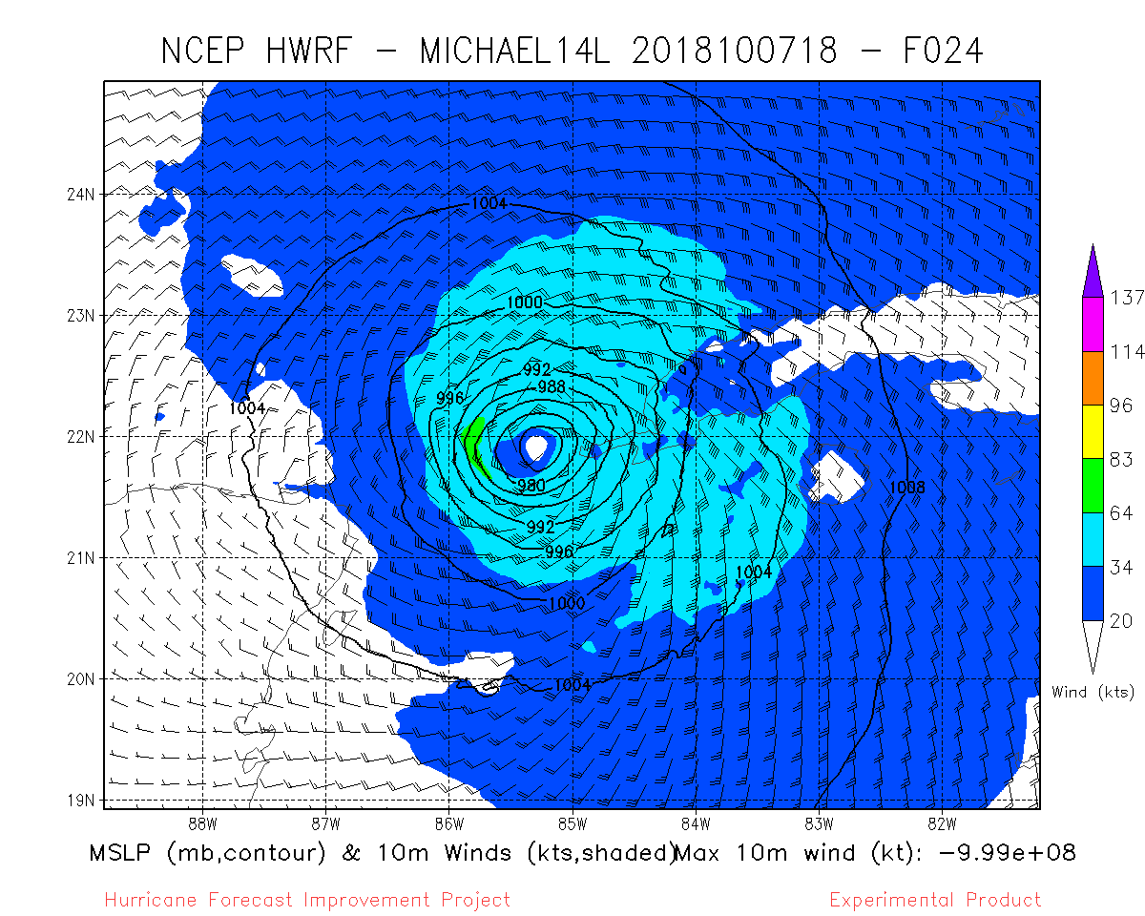
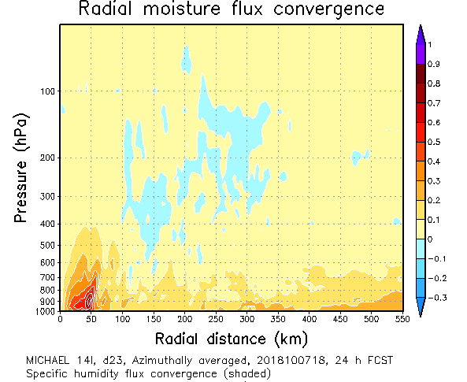
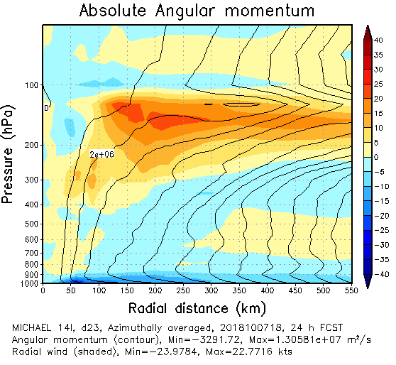
CYGNSS impact on analyses and forecast for TC Michael (2018)
Analysis
24 hour forecast
24 hour forecast
24 hour forecast
CNTROL NO CYCGNSS
CYCGNSS NO THINNING, VAM
Moisture convergence, latent heating, secondary circulation enhanced by CYGNSS data.

Slide 15
Conclusions & Next Steps
CYGNSS supplies critical observations early in Tropical Cyclone lifecycle
Other observing systems are often absent when tropical storms are weak
Improved early analyses lead to the improvement in intensity forecasts (66 hr)
Small changes to ocean/atmosphere fluxes can trigger a different evolution
Improved surface fluxes modify the distribution of latent and sensible heat
Continue tuning of vector CYGNSS winds in regional DA (HWRF)
Additional cases: Hurricane Dorian (2019), Typhoon Lekima (2019)
Preparing for use of vector CYGNSS winds in global DA (FV3-GFS)

Slide 16
Additional Slides

Slide 17
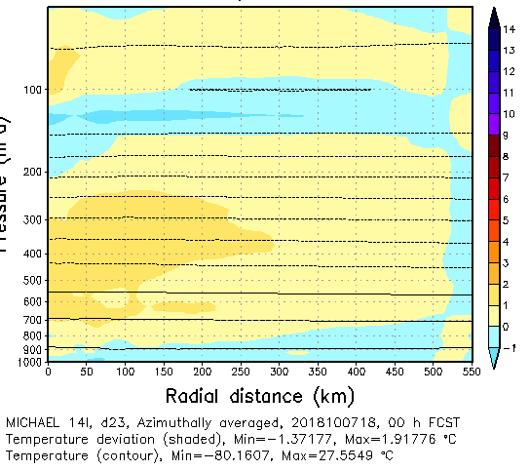
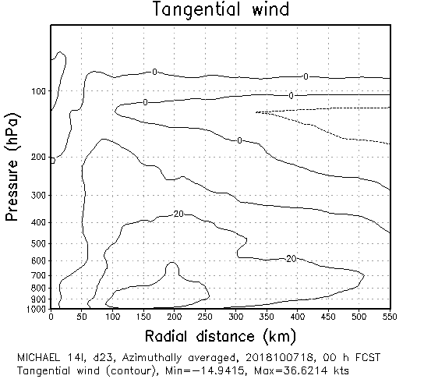
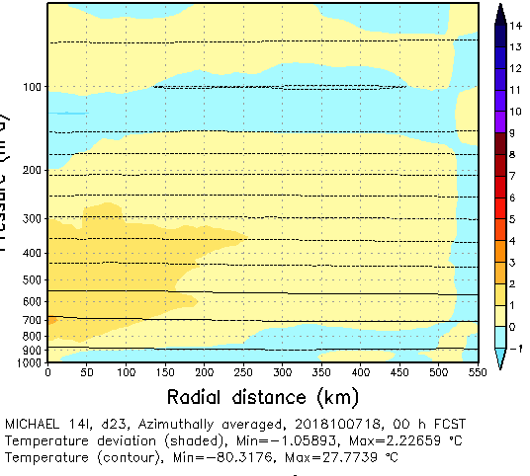
Analysis
valid
20181007
1800 UTC
10-m winds
Azimuthally-averaged
Tangential Wind
Azimuthally-averaged
Temperature Departure
Control
(no CYGNSS)
VAM-CYGNSS

Slide 18
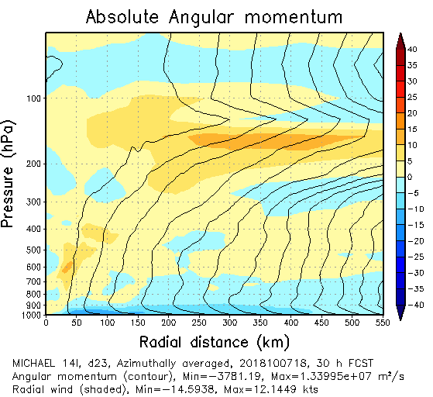
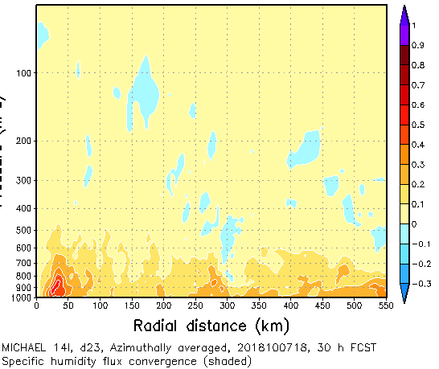
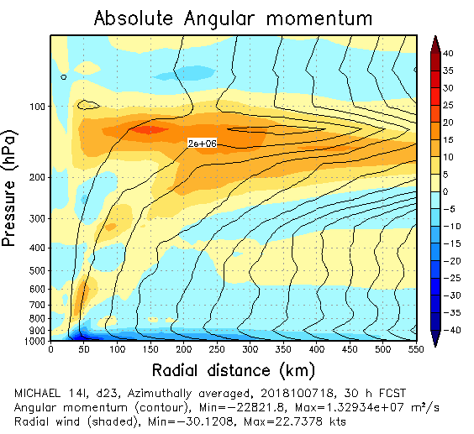
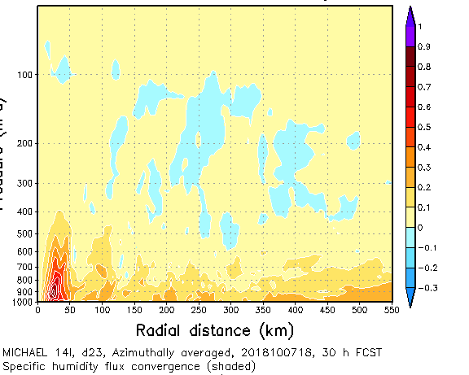
30-h Forecast
from
20181007
1800 UTC
Azimuthally-averaged Radial Inflow
Azimuthally-averaged Radial Moisture Flux Convergence
Control
(no CYGNSS)
VAM-CYGNSS

Slide 19
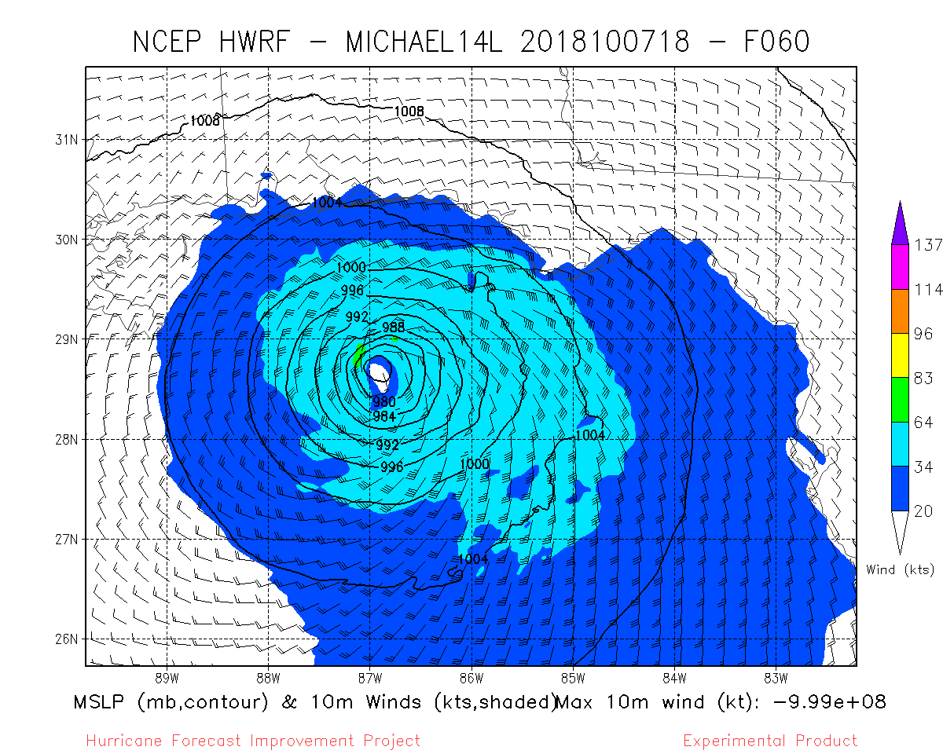
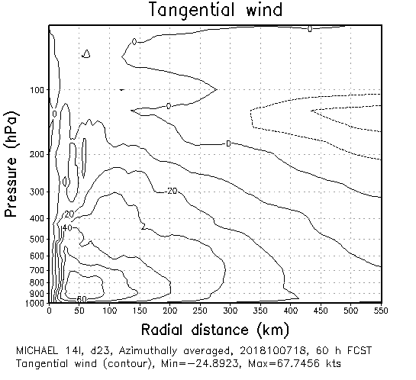
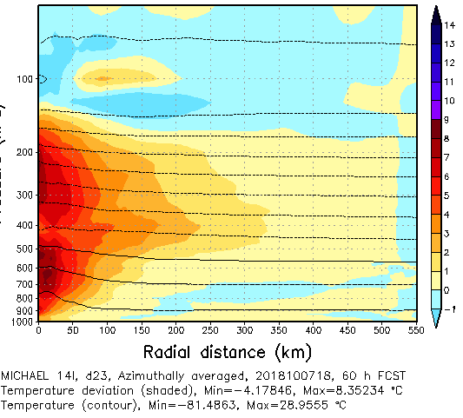
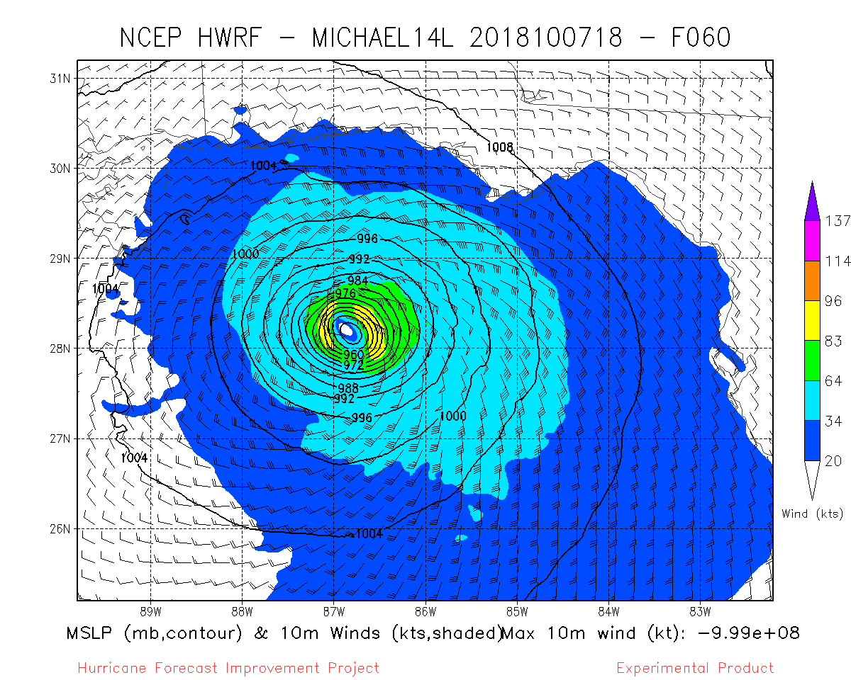
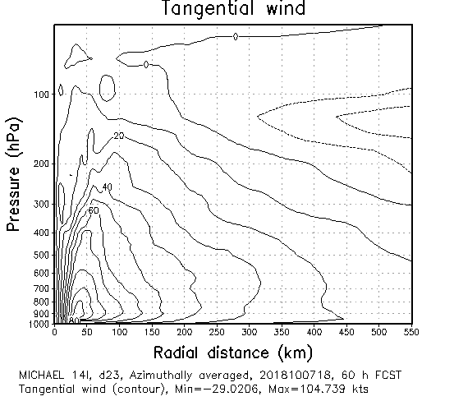
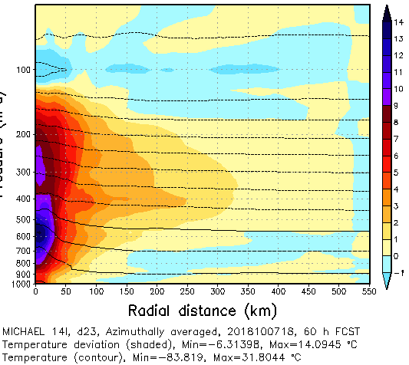
60-h Forecast
from
20181007
1800 UTC
10-m winds
Azimuthally-averaged
Tangential Wind
Azimuthally-averaged
Temperature Departure
Control
(no CYGNSS)
VAM-CYGNSS

Slide 20
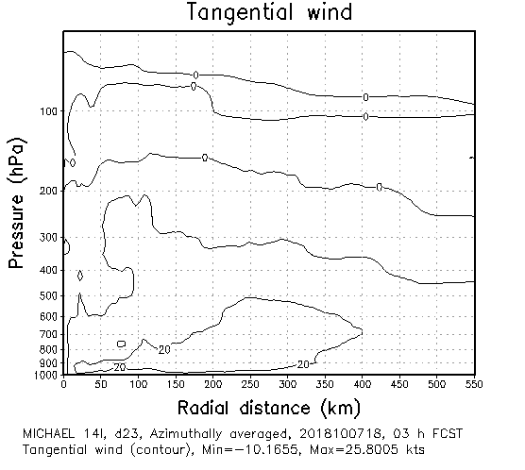
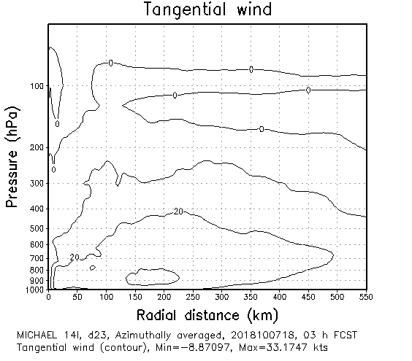
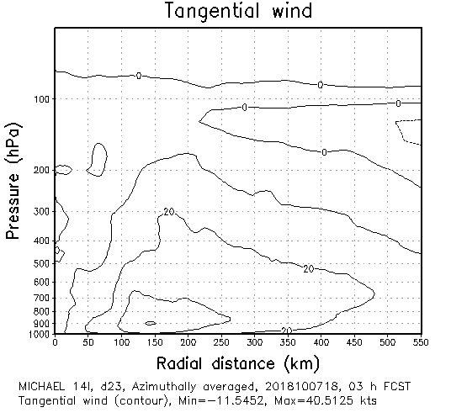
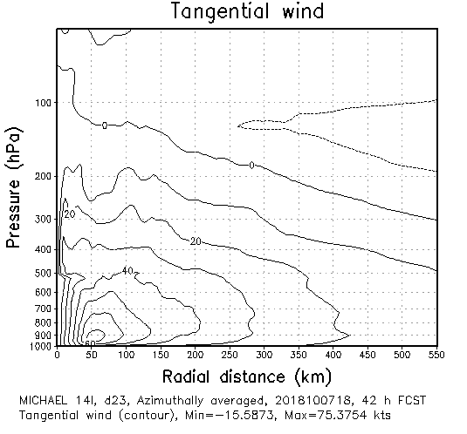
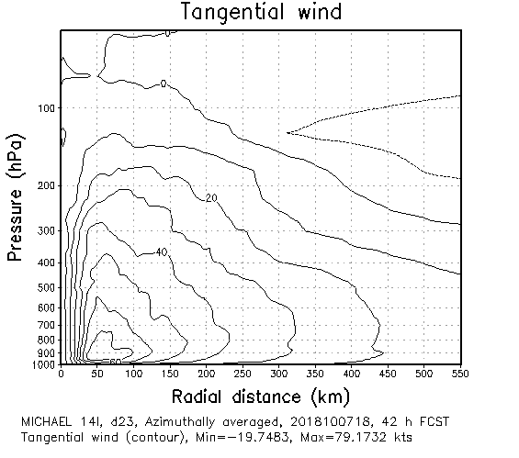
10/07 18UTC
cntrl
cygntn
vamntn

Slide 21
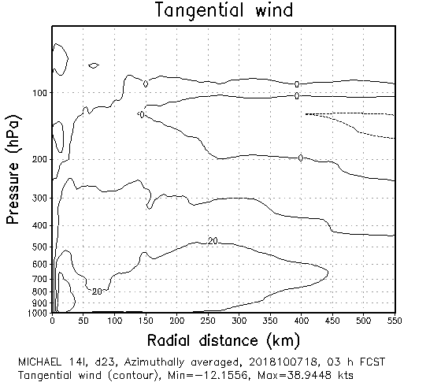
10/07 18UTC
cntrl
cyg50
vam50

Slide 22
10/07 18UTC
cntrl
cyg50
vam50

Slide 23
10/07 18UTC
cntrl
cygntn
vamntn

Slide 24
CYGNSS Measures Reflected GPS from Ocean

Slide 25
Underside view of a CYGNSS observatory (Courtesy of Southwest Research Institute).
The CYGNSS observatories are shown as yellow spheres. The white lines represent direct GPS signals and the blue ocean surface scattered signals. The lighter blue circles on the Earth surface represent individual samples of the delay doppler map.

