Slide 1
HAMSR retrieval assimilation in the GSI system
Andrew Kren
8/9/18

Slide 2
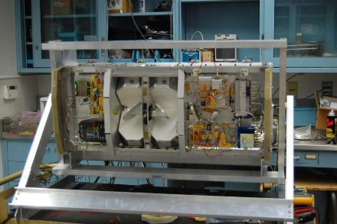
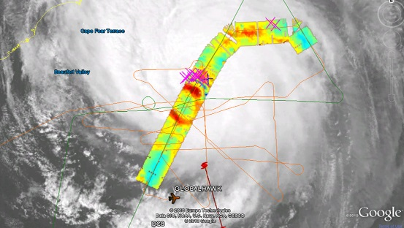
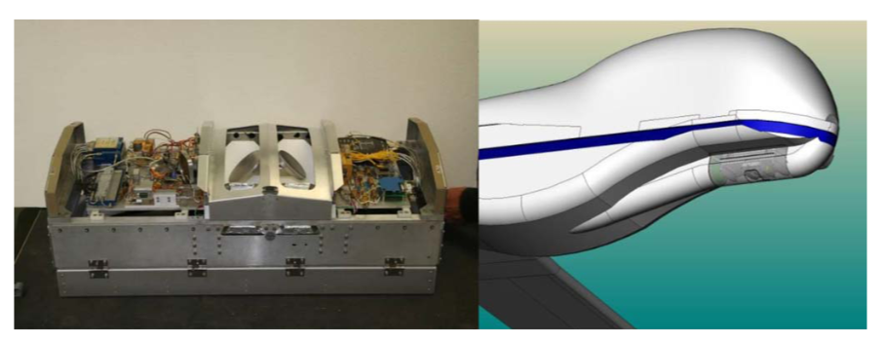
High Altitude Monolithic Microwave Integrated Circuit (MMIC) Sounding Radiometer (HAMSR)
Microwave radiometer operating at 25 spectral channels
8 channels at 60 GHz oxygen line complex, 10 at 118.75 GHz oxygen line, 7 near 183.31 GHz water-vapor line
3-D distribution of temperature and specific humidity
Horizontal resolution: 2km vertical, 2km horizontal (nadir), 60 km swath
Temporal frequency: profiles every 1-2 seconds
Notes:
Mention LIP

Slide 3
HAMSR Retrieval Assimilation
Bias corrected HAMSR retrievals successfully written to prepbufr
  Written as Type 122 sounding in GSI
  In future, will need to create new observation type in GSI
A few data thinning techniques developed
  Time, distance, structure thinning
    Retain profiles that are separated from each other in both space and time
    Avoid redundant/similar profiles but retain important changes in atmospheric conditions (T and Q)
  Superobing
    Subsampling by combining observations in close proximity into one super-observation

Slide 4
How to add new data into the HWRF assimilation package
Example with HAMSR
Create prepbufr:
  Bias corrected/thinned HAMSR retrievals successfully written to prepbufr written as type 122 (sounding)
Edit the hwrf_input
  Cat the newly created prebufr file to the existing control prepbufr file
  Update the location of the file in the hwrf_input.conf
  Testing successfully for both GFS and HWRF
  Similar setup to run using your own GFS files
1- Create prepbufr
2. hwrf_input.conf
HWRF package
Flow Chart

Slide 5
HAMSR Retrieval Superobing Method
  Create a global grid at either 0.125, 0.25 or 0.5 deg resolution
  Loop over profiles within specified time period (15 mins) to avoid superobing from multiple fly-overs
  Loop over each lat/lon grid square within the specified time period
  Make sure at least 2 points within the scene before proceeding
  Check for outliers by computing standard deviation of the observations in the scene
  If any points exceed 2 standard deviations, exclude from average.
  Compute superob using weighted average based on latitude of remaining observations
  If less than 2 observations after removing outliers, superob not created
  Currently set observation errors:
    1.5 degC
    2.0 g/kg
    Currently tested assimilation using 0.125 and 0.25 degree grids for Matthew case
    Using 15 minute interval (average distance of GH is 155.1 km at 620 km/hr)

Slide 6
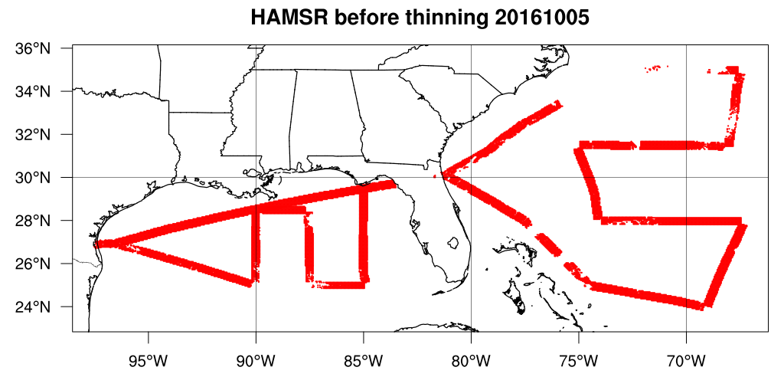
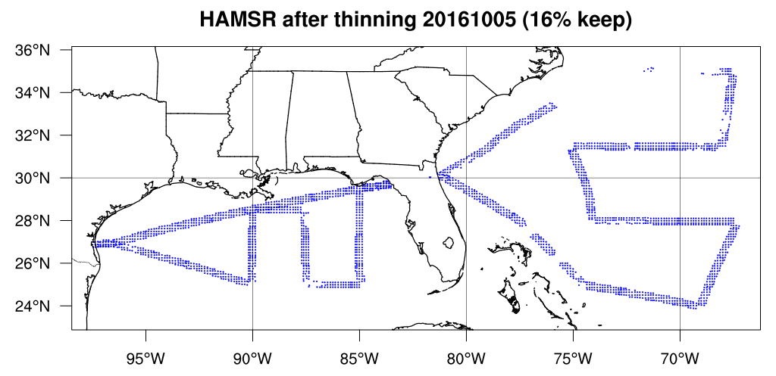
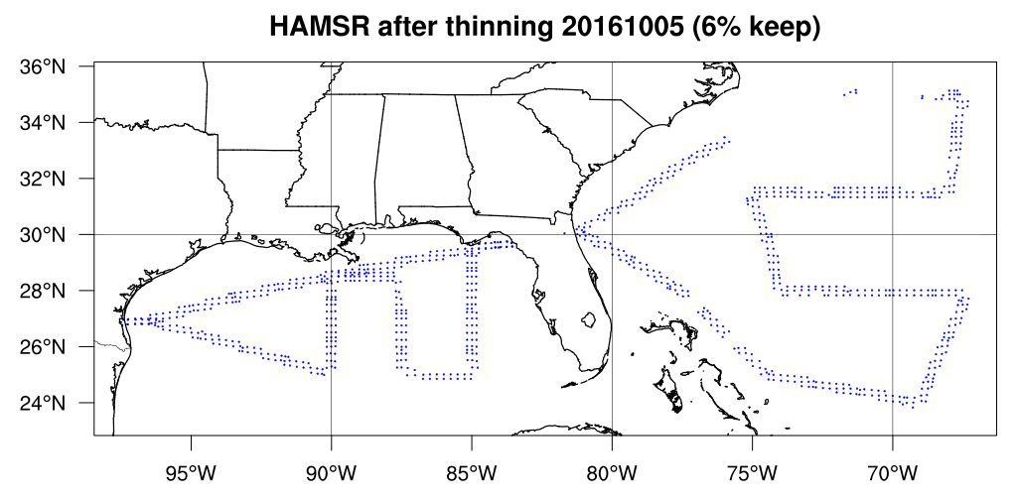
0.125 deg grid 0.25 deg grid

Slide 7
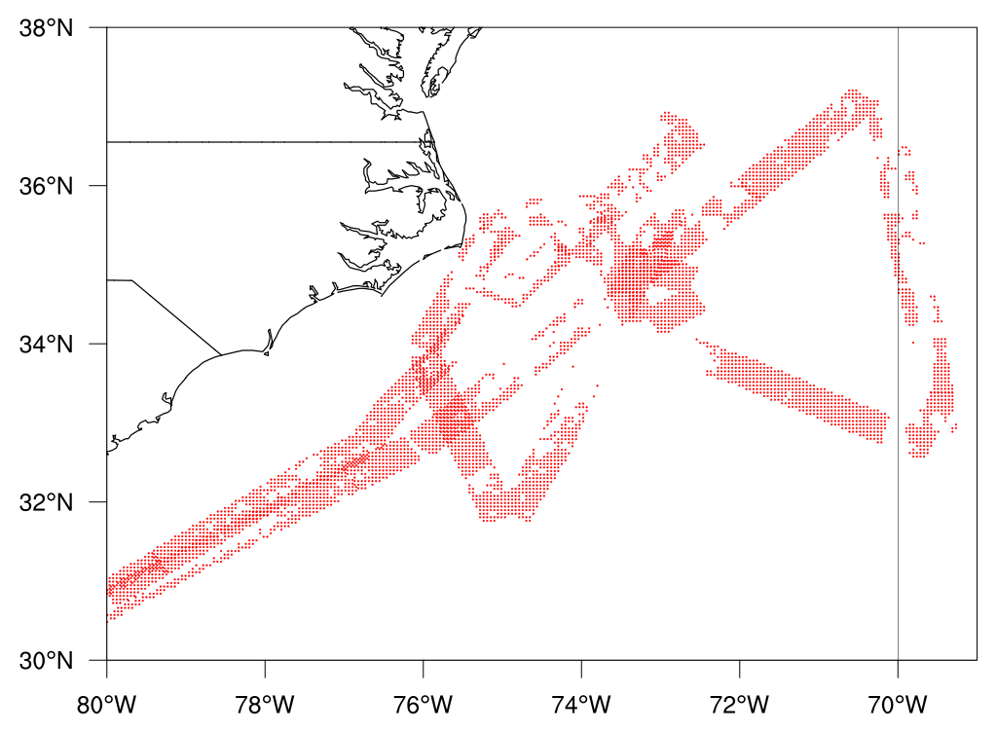
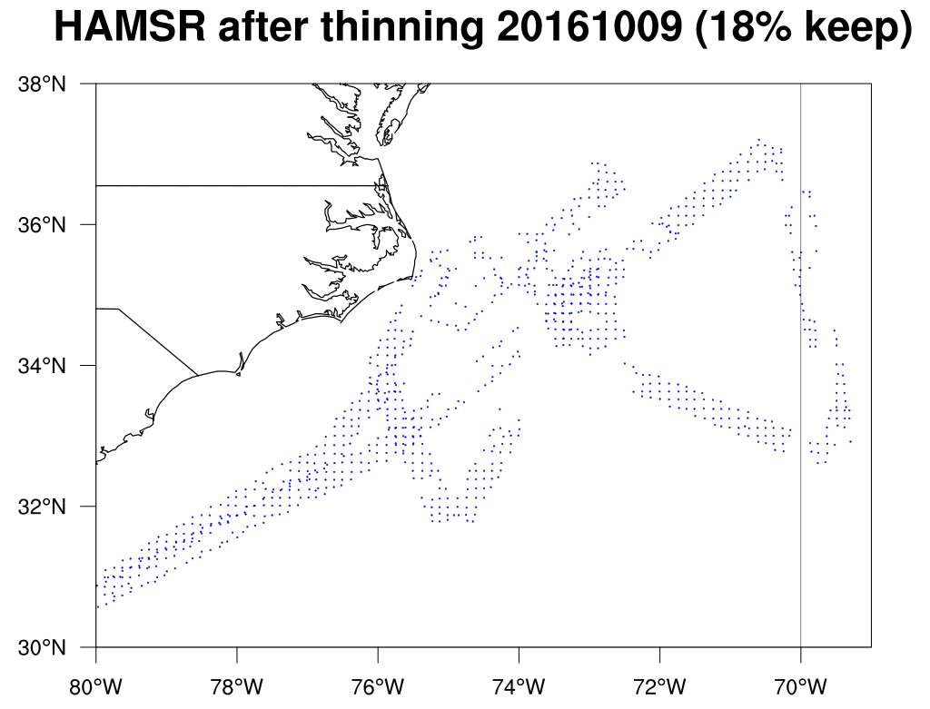
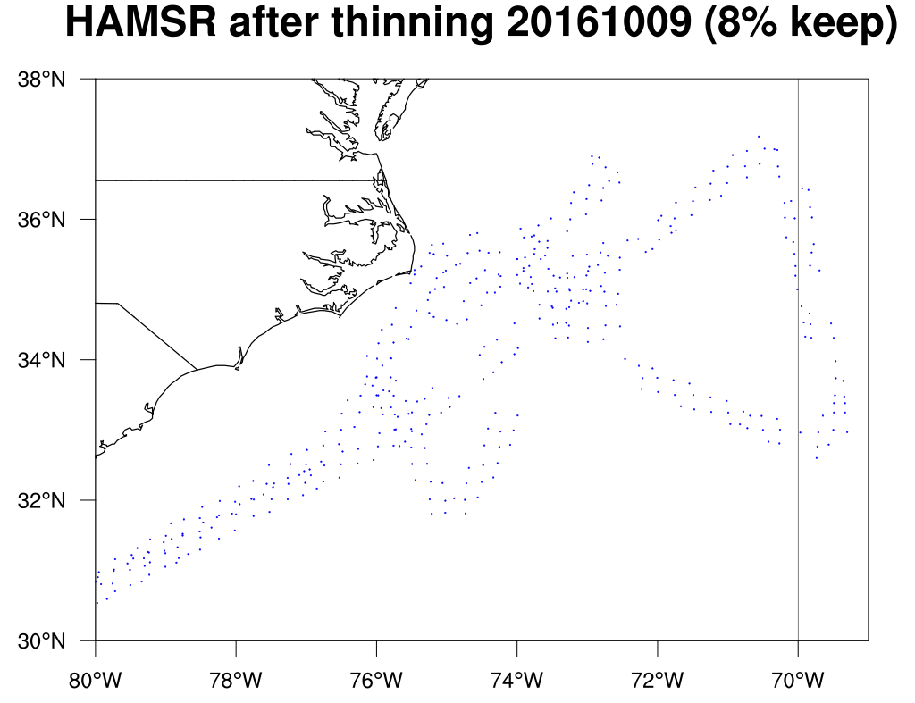
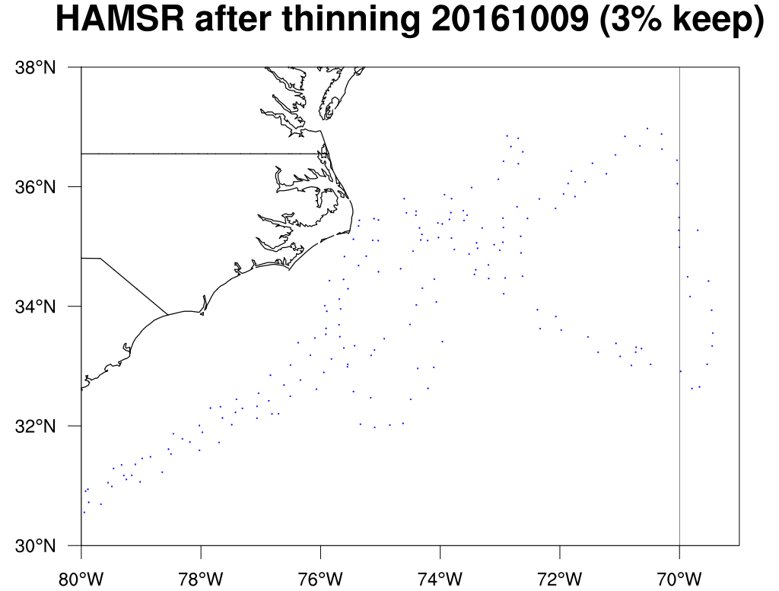
Results Oct 9
Matthew
0.125 deg
0.25 deg
0.5 deg

Slide 8
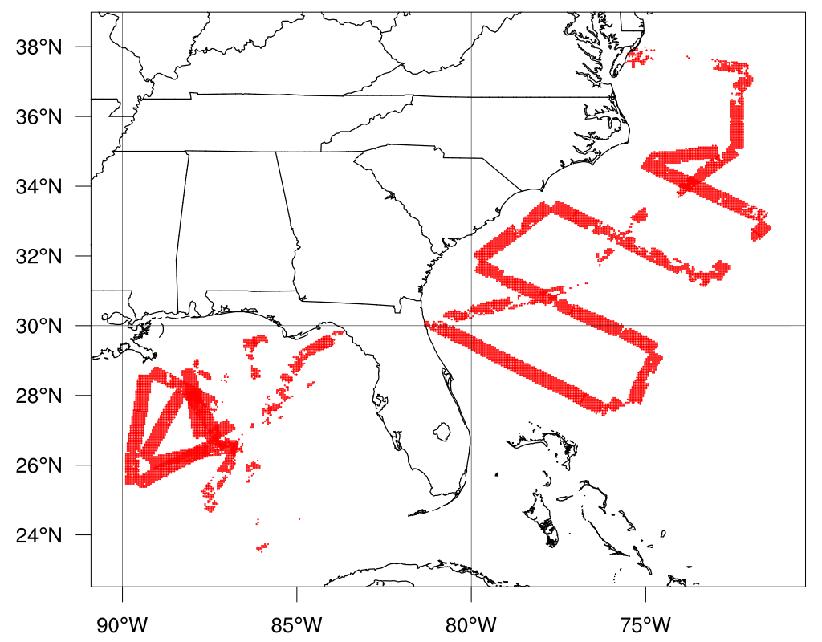
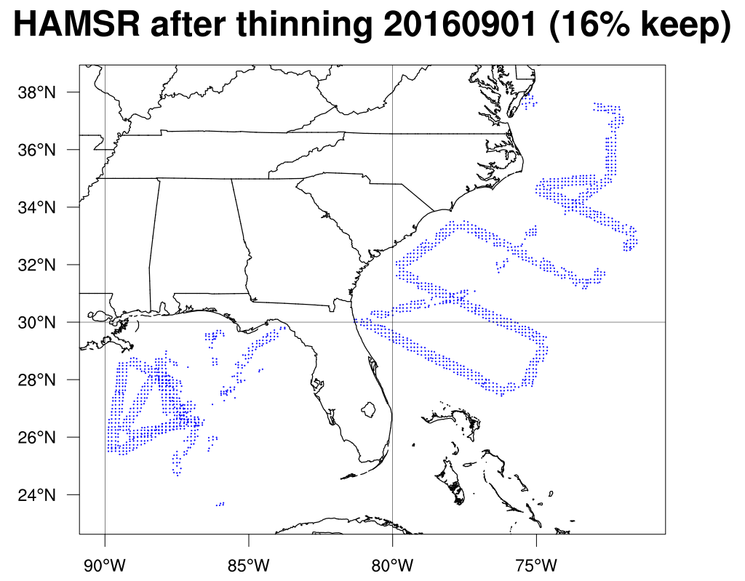
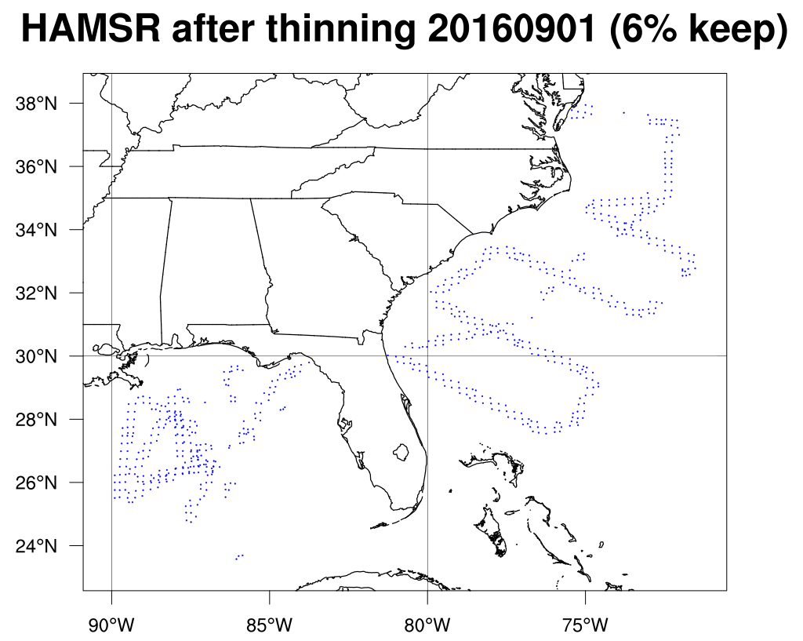
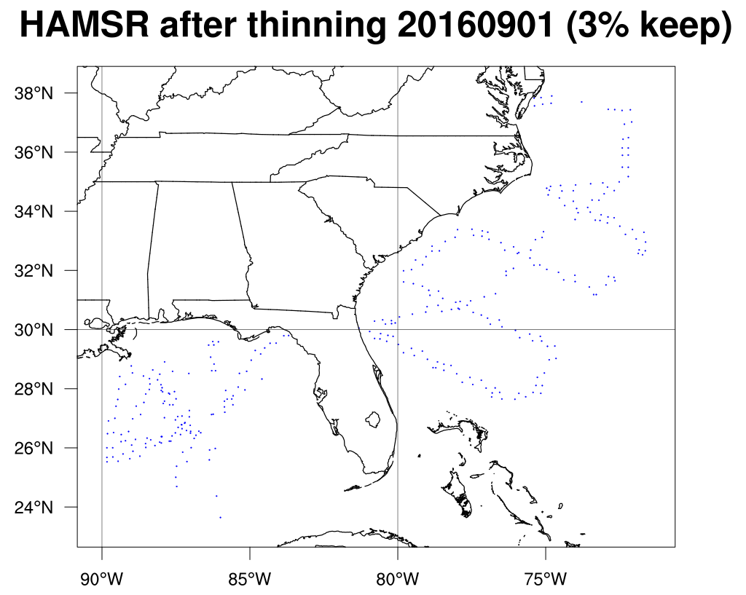
Results Sept 1
Hermine
0.125 deg
0.25 deg
0.5 deg

Slide 9
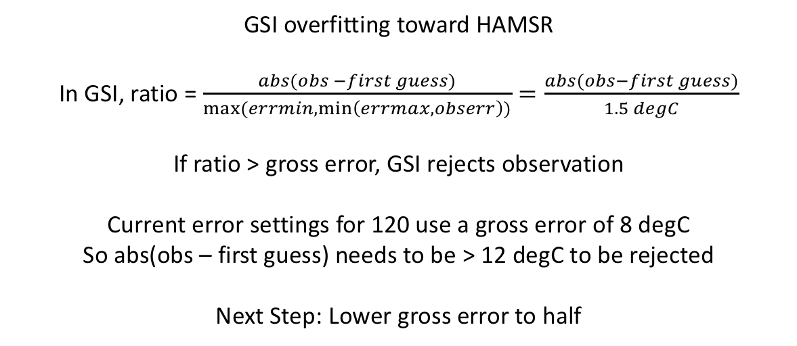
Assimilation O-G statistics
Variable | Type | First Iteration RMS | Third Iteration RMS
Temperature | 120 (radiosonde) | 1.31 | 1.22
Specific Humidity | 120 (radiosonde) | 14.07 | 12.69
Temperature | 122 (HAMSR) | 1.06 | 0.59
Specific Humidity | 122 (HAMSR) | 18.46 | 6.25
GSI overfitting toward HAMSR
In GSI, ratio = $\frac{abs(obs −first guess)}{max⁡(errmin,\min\left(errmax,obserr\right))}=\frac{abs(obs−first guess)}{1.5 degC}$
If ratio > gross error, GSI rejects observation
Current error settings for 120 use a gross error of 8 degC
So abs(obs – first guess) needs to be > 12 degC to be rejected
Next Step: Lower gross error to half

Slide 10
GFS
0.125 deg
0.25 deg
Matthew October 5

