Slide 1
Summer 2018 Nerto Update
Miguel Cortez
Mentors: Lidia cucurull
Andrew Kren

Slide 2
Methodology
NCEP’s GDAS/GFS (Q3FY17) – Operational version at NCEP July 19, 2017
GDAS cycles every 6 hours (4DEnVar GSI)
Global cycling with GFS (4 cycles)- Harvey
Regional Cycling HWRF using GFS Boundary conditions
GFS forecasts run at T670L64 (~ 20 km), GSI at T254L64 (~ 50 km)
Next steps- HWRF CTL runs finished, HWRF GH in progress

Slide 3
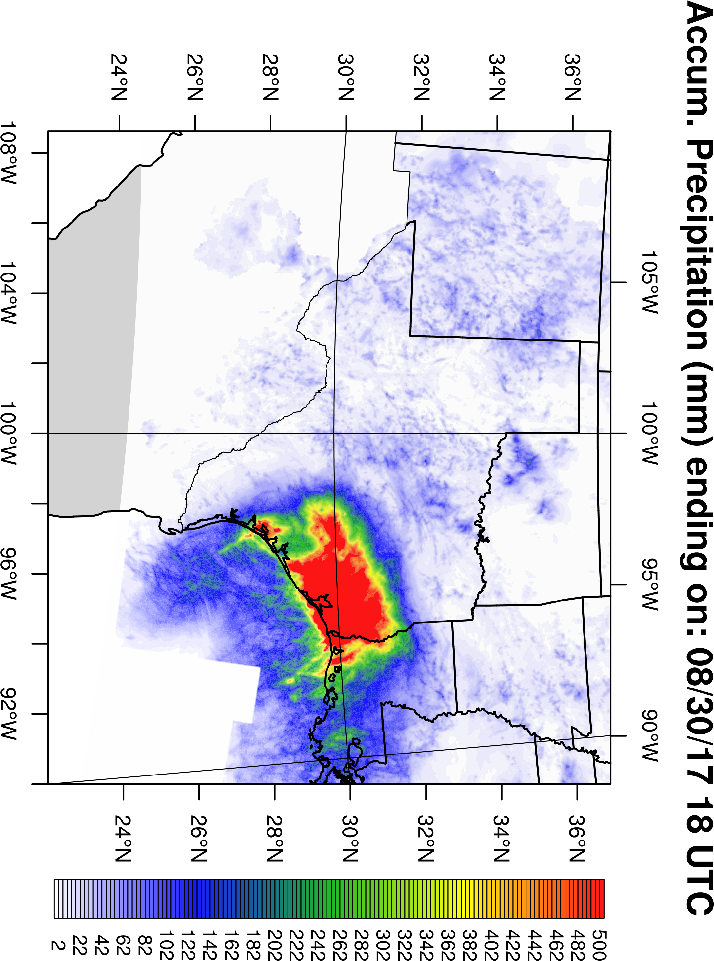

Slide 4
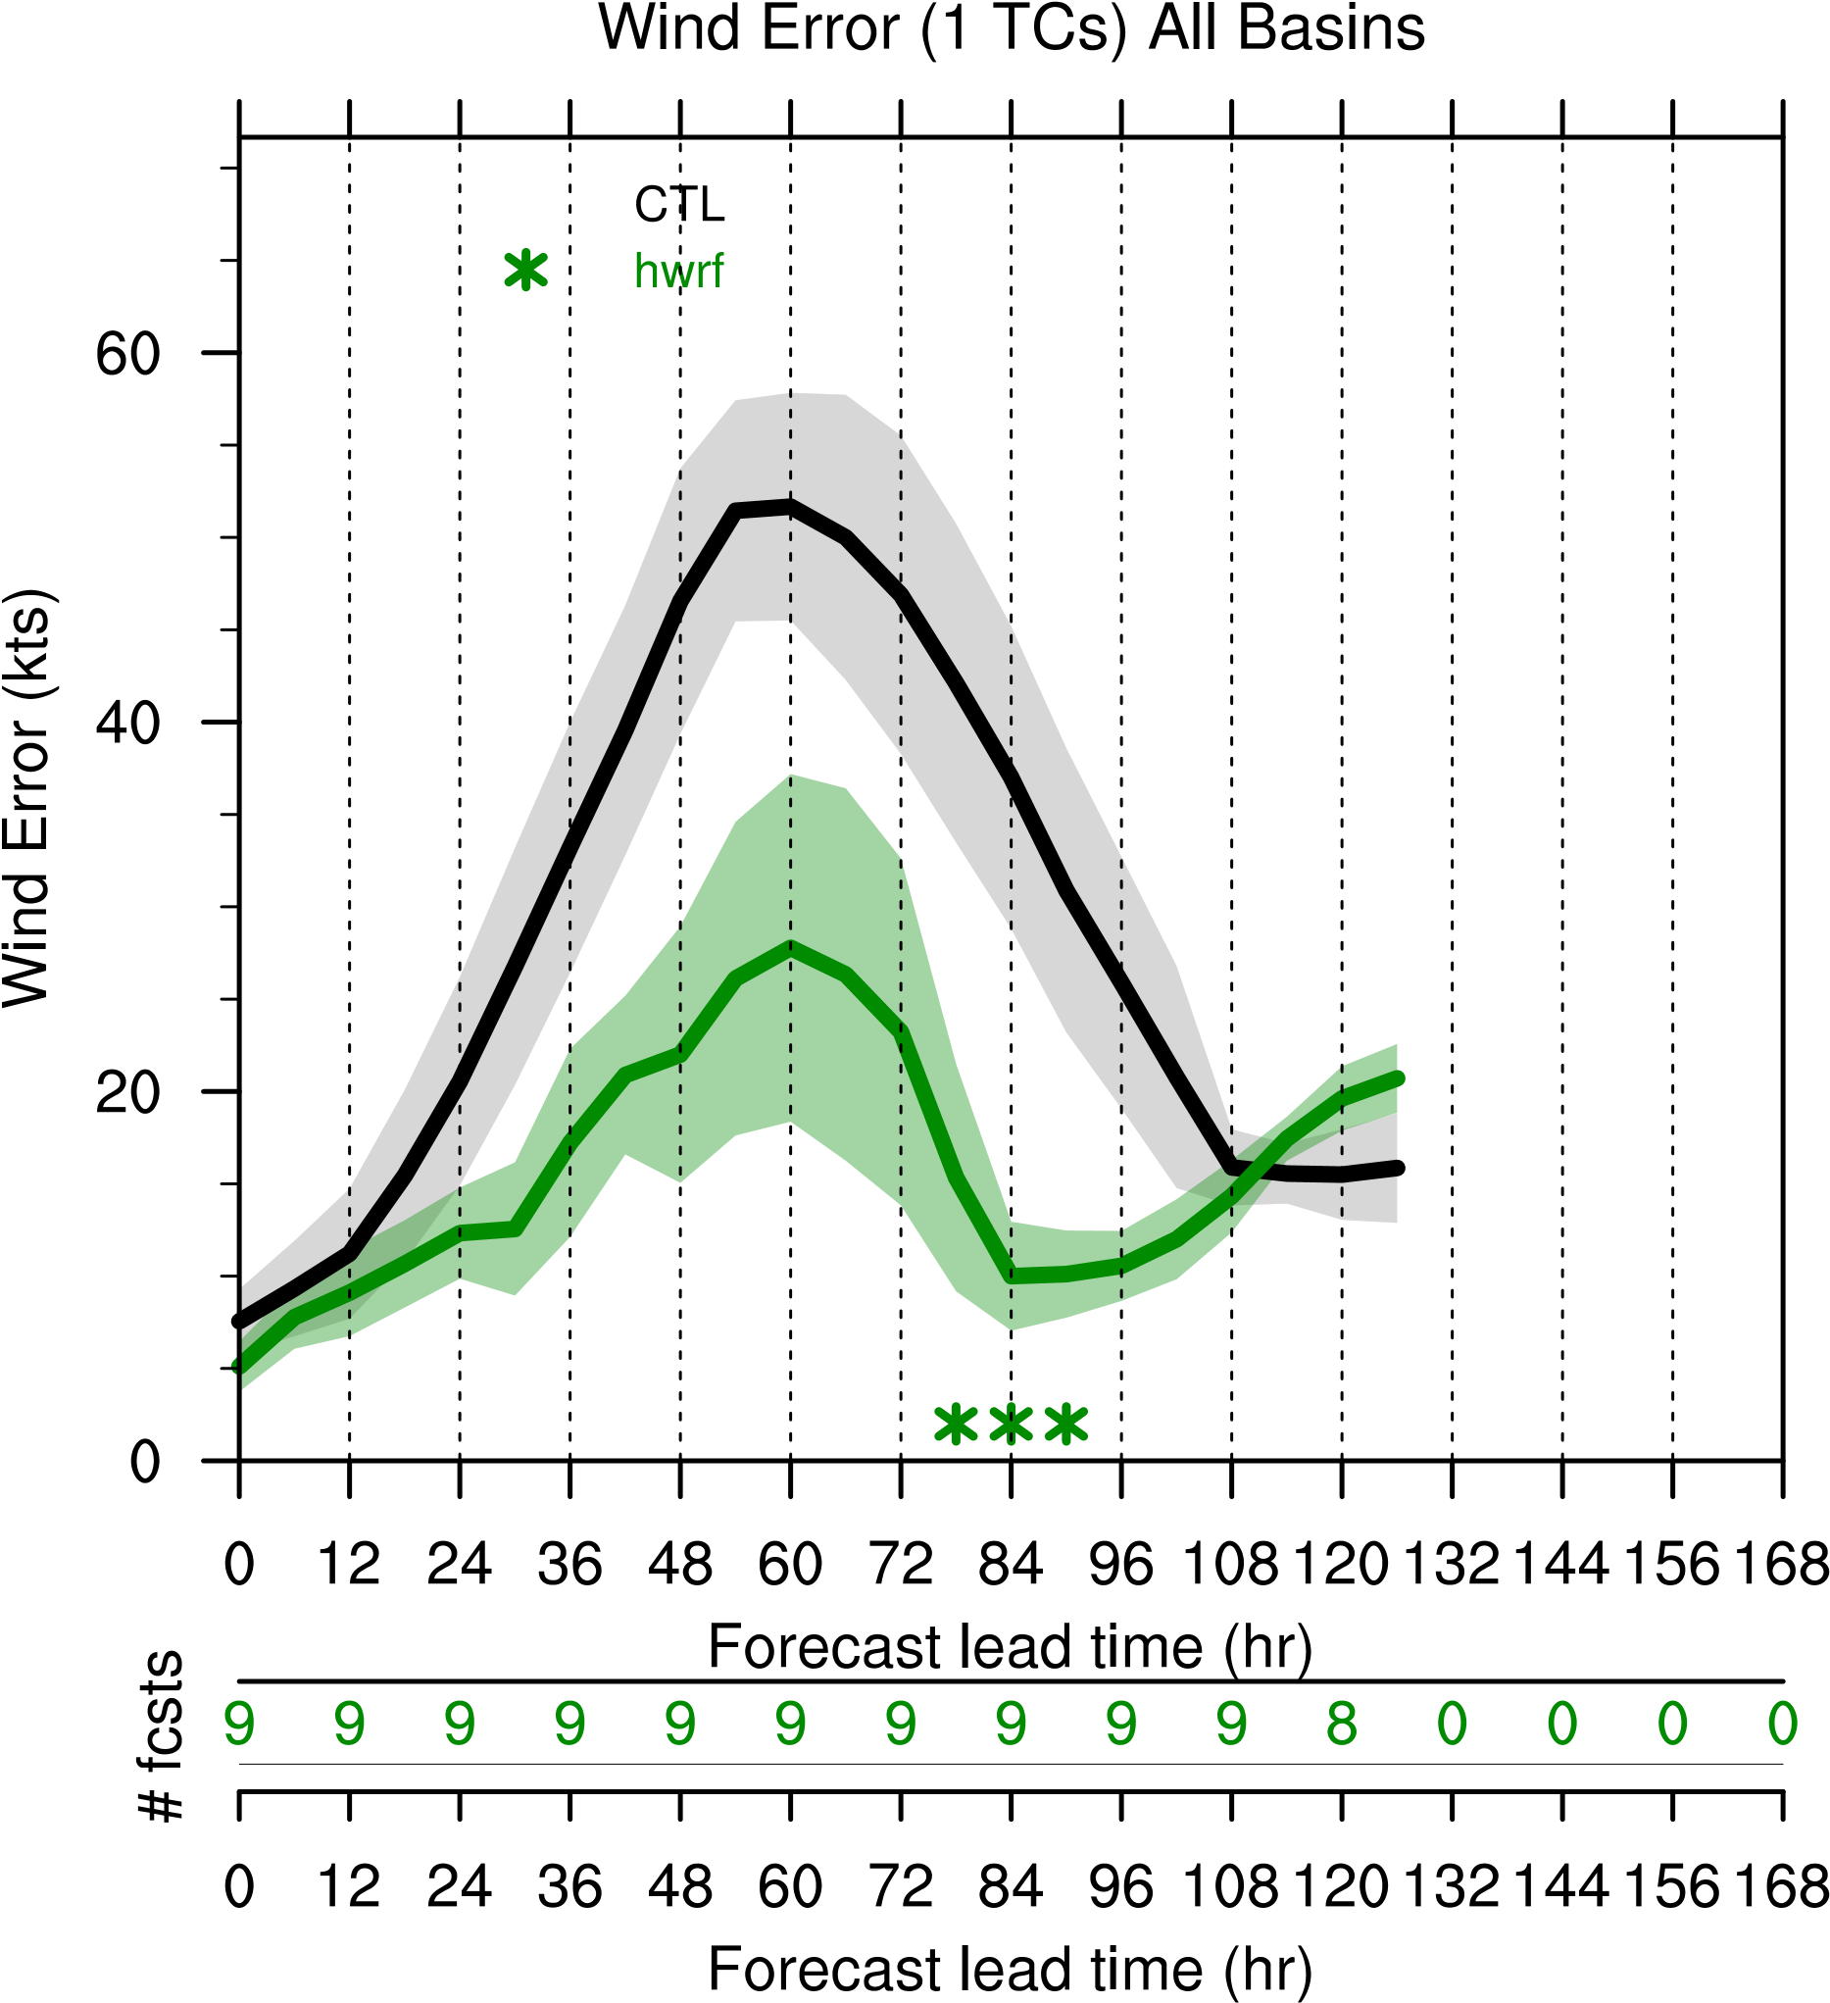
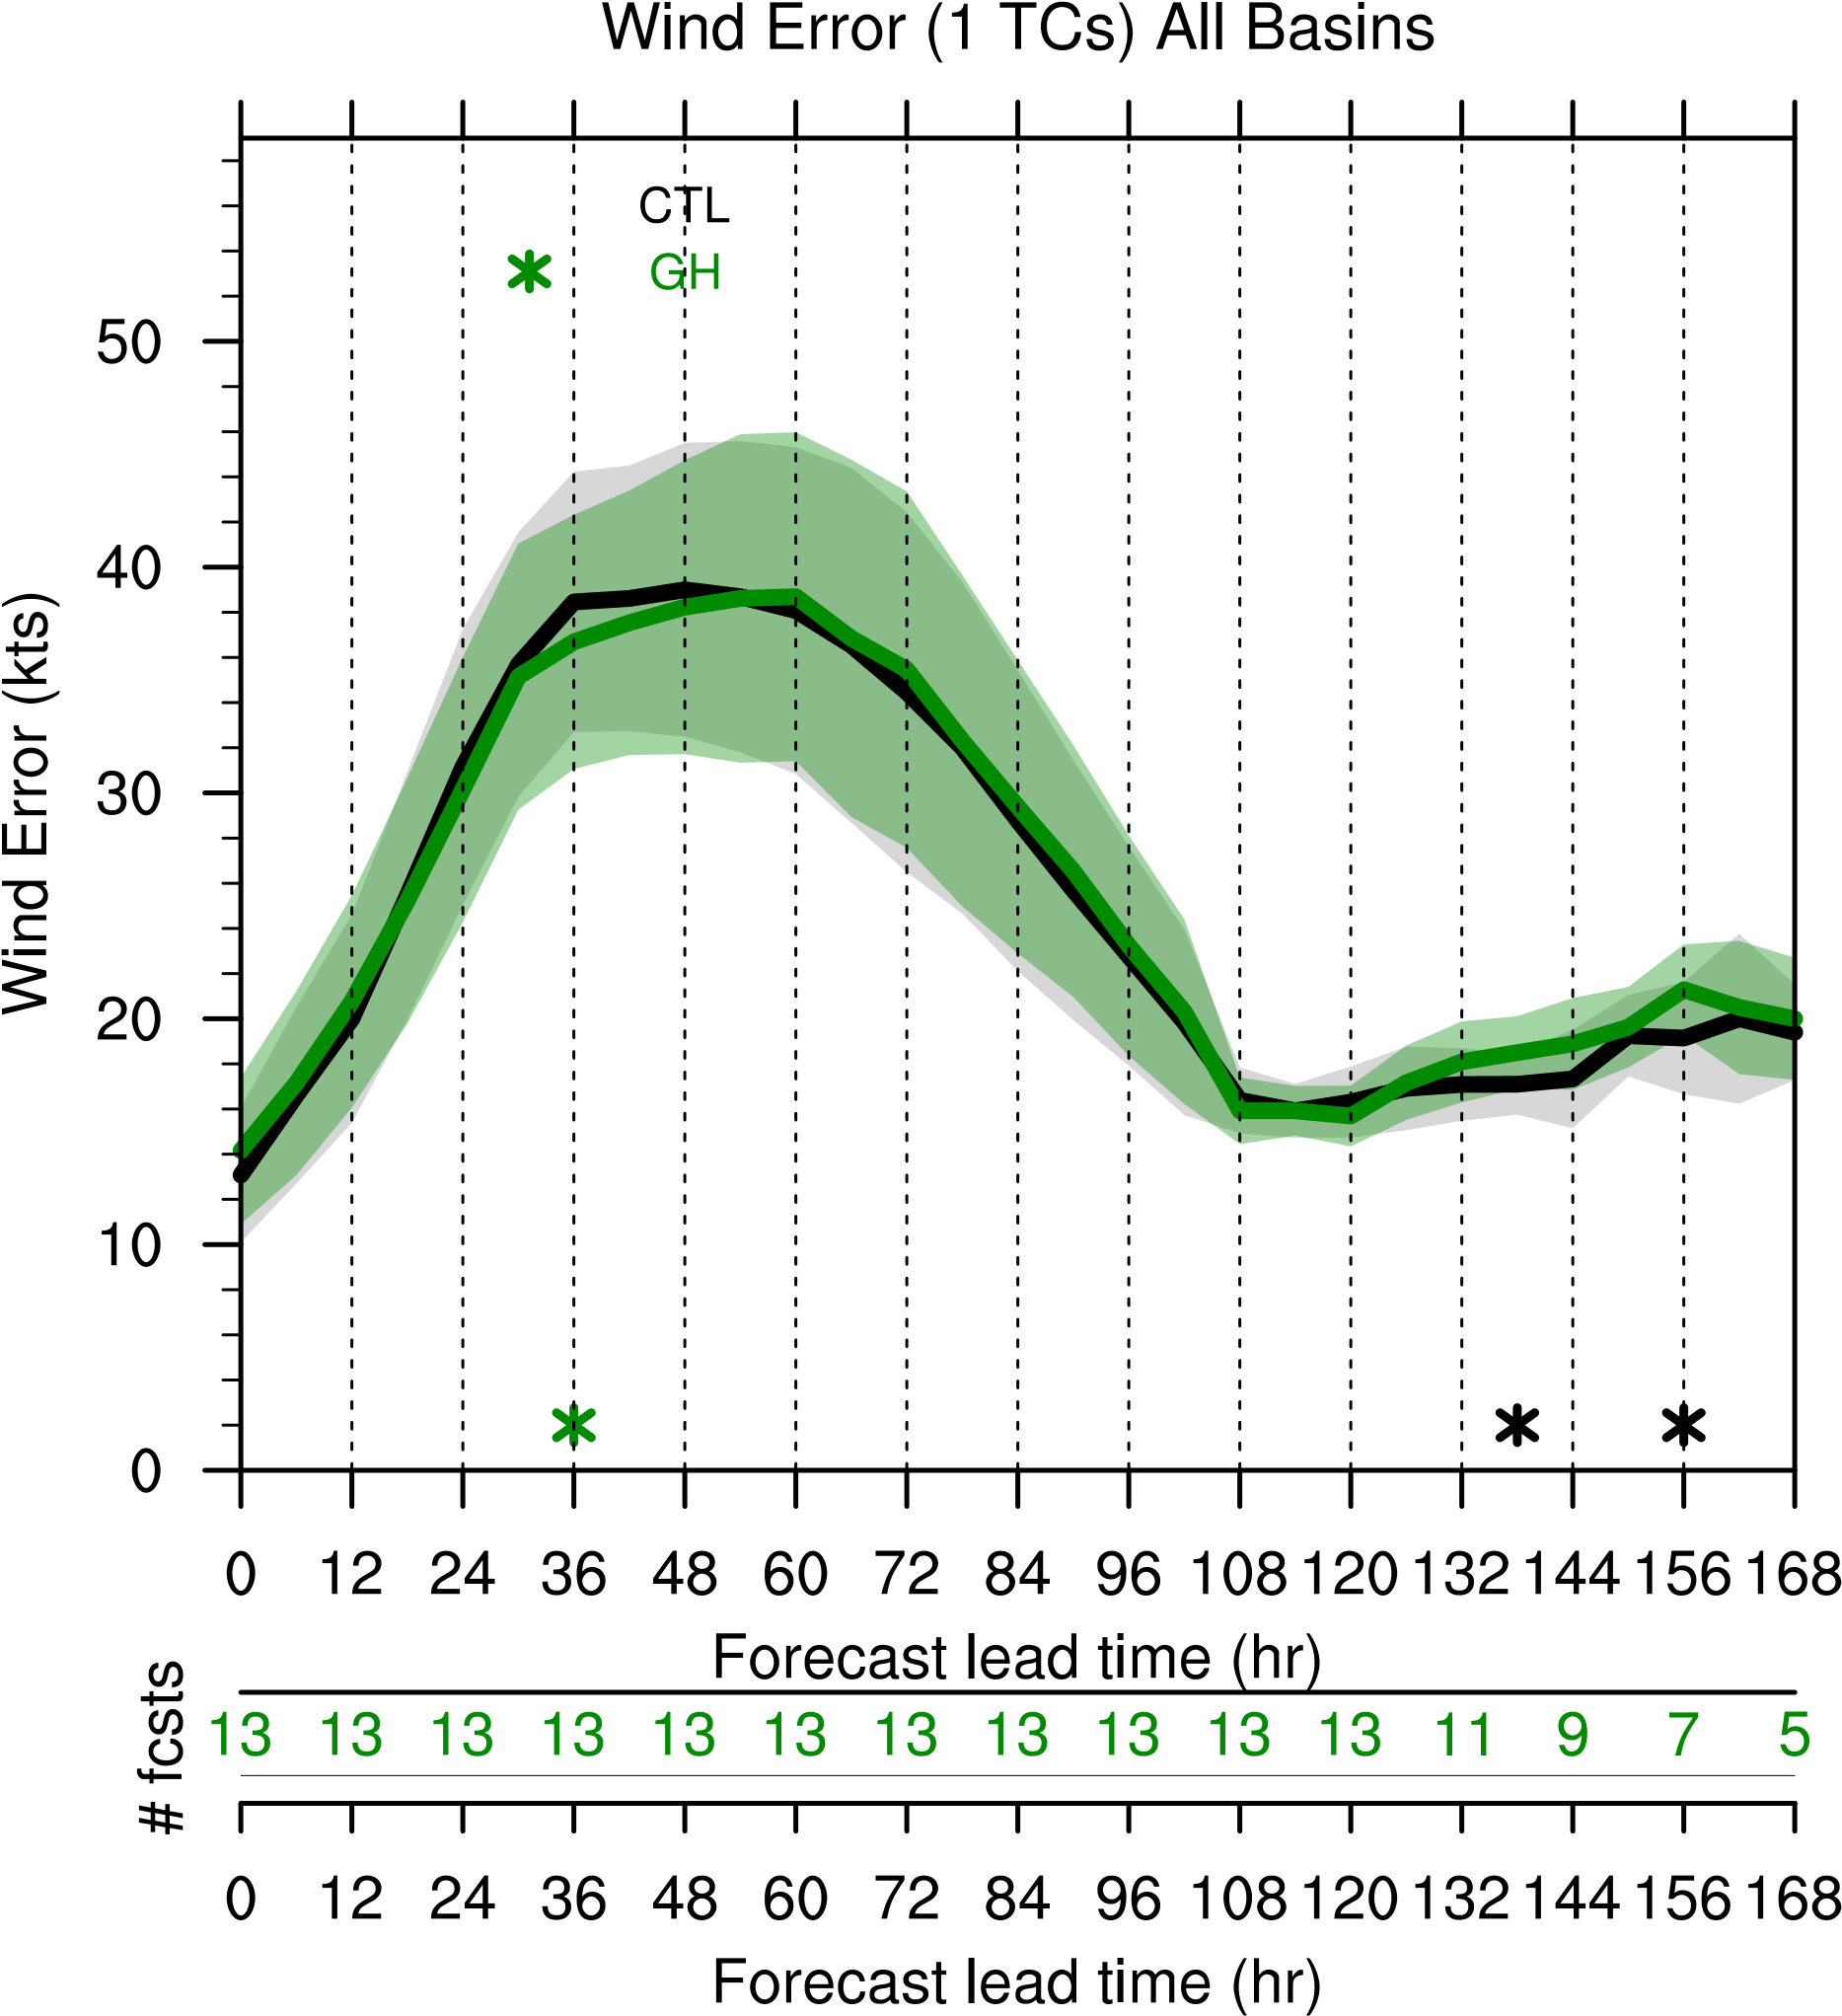
GFS w/out GH
HWRF w/out GH
GFS w/out GH
GFS w/ GH

Slide 5
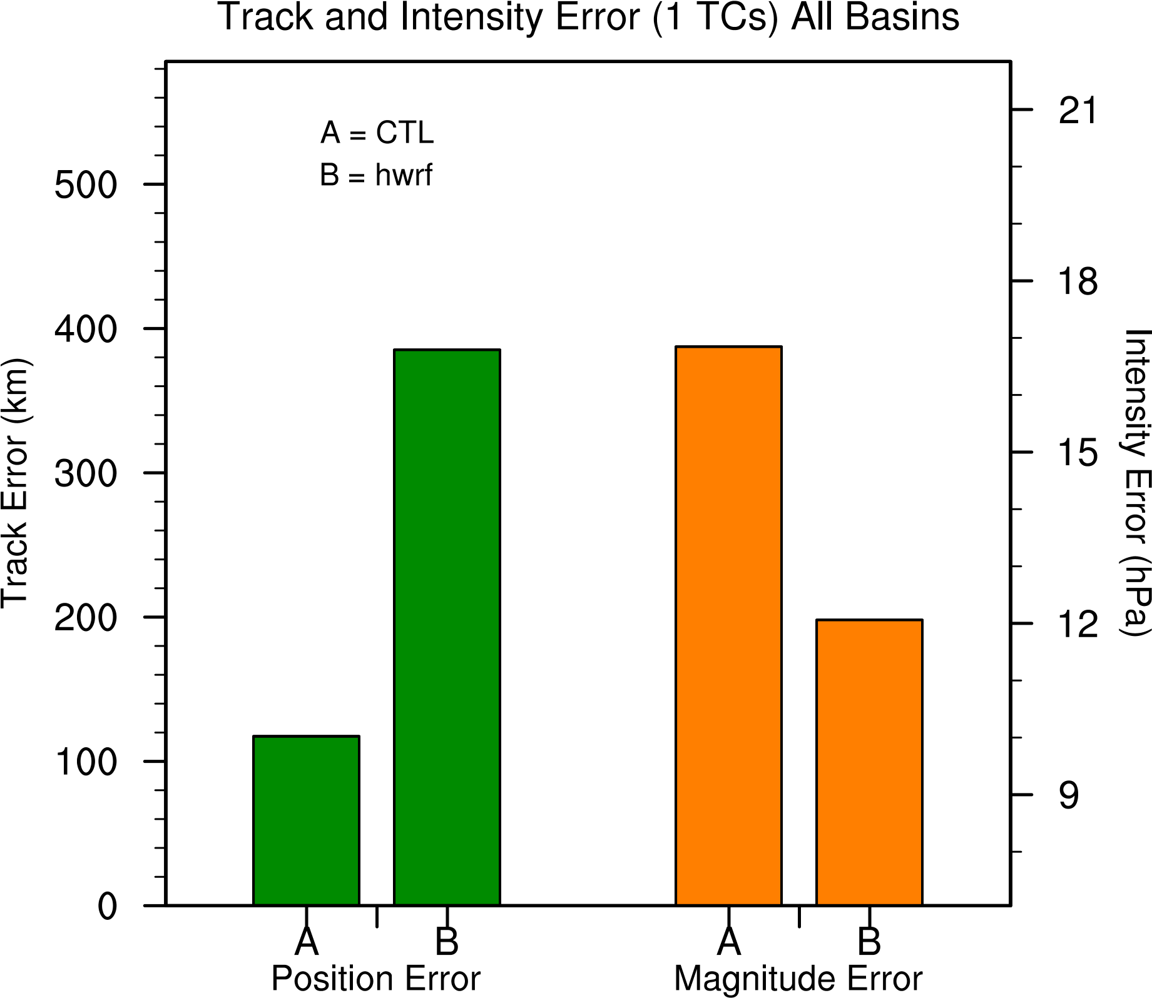
A=GFS w/out GH
B=HWRF w/out GH
A=GFS w/out GH
B=HWRF w/out GH

Slide 6
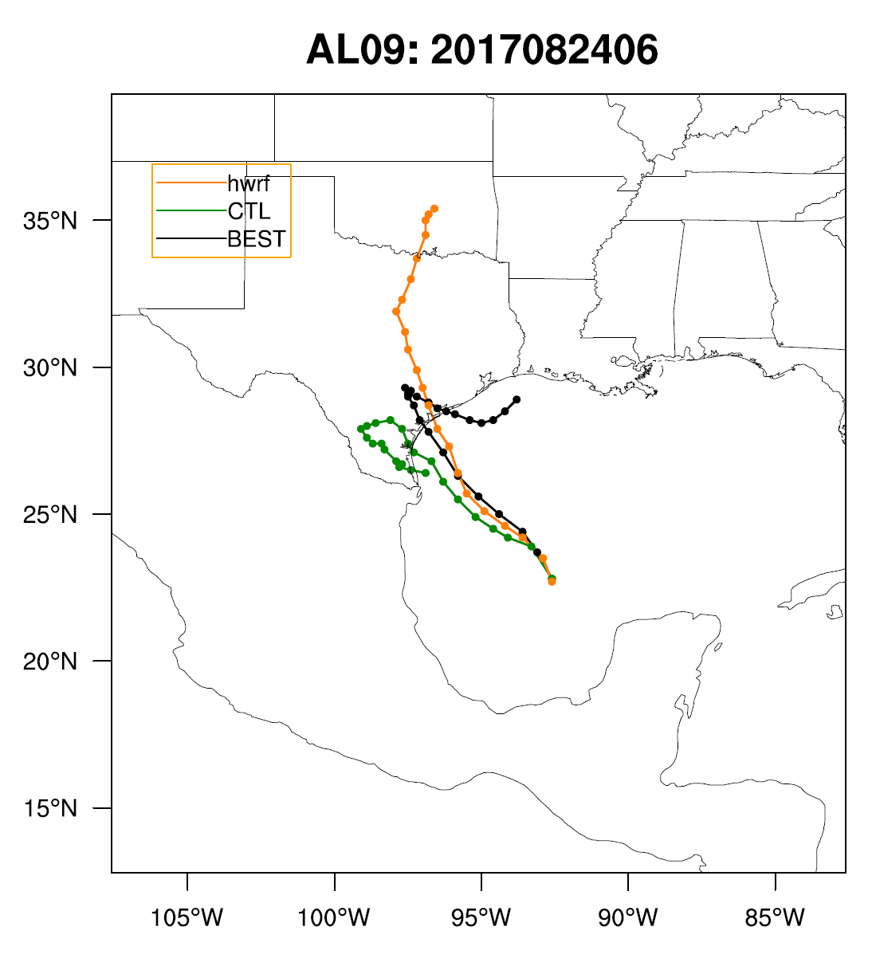
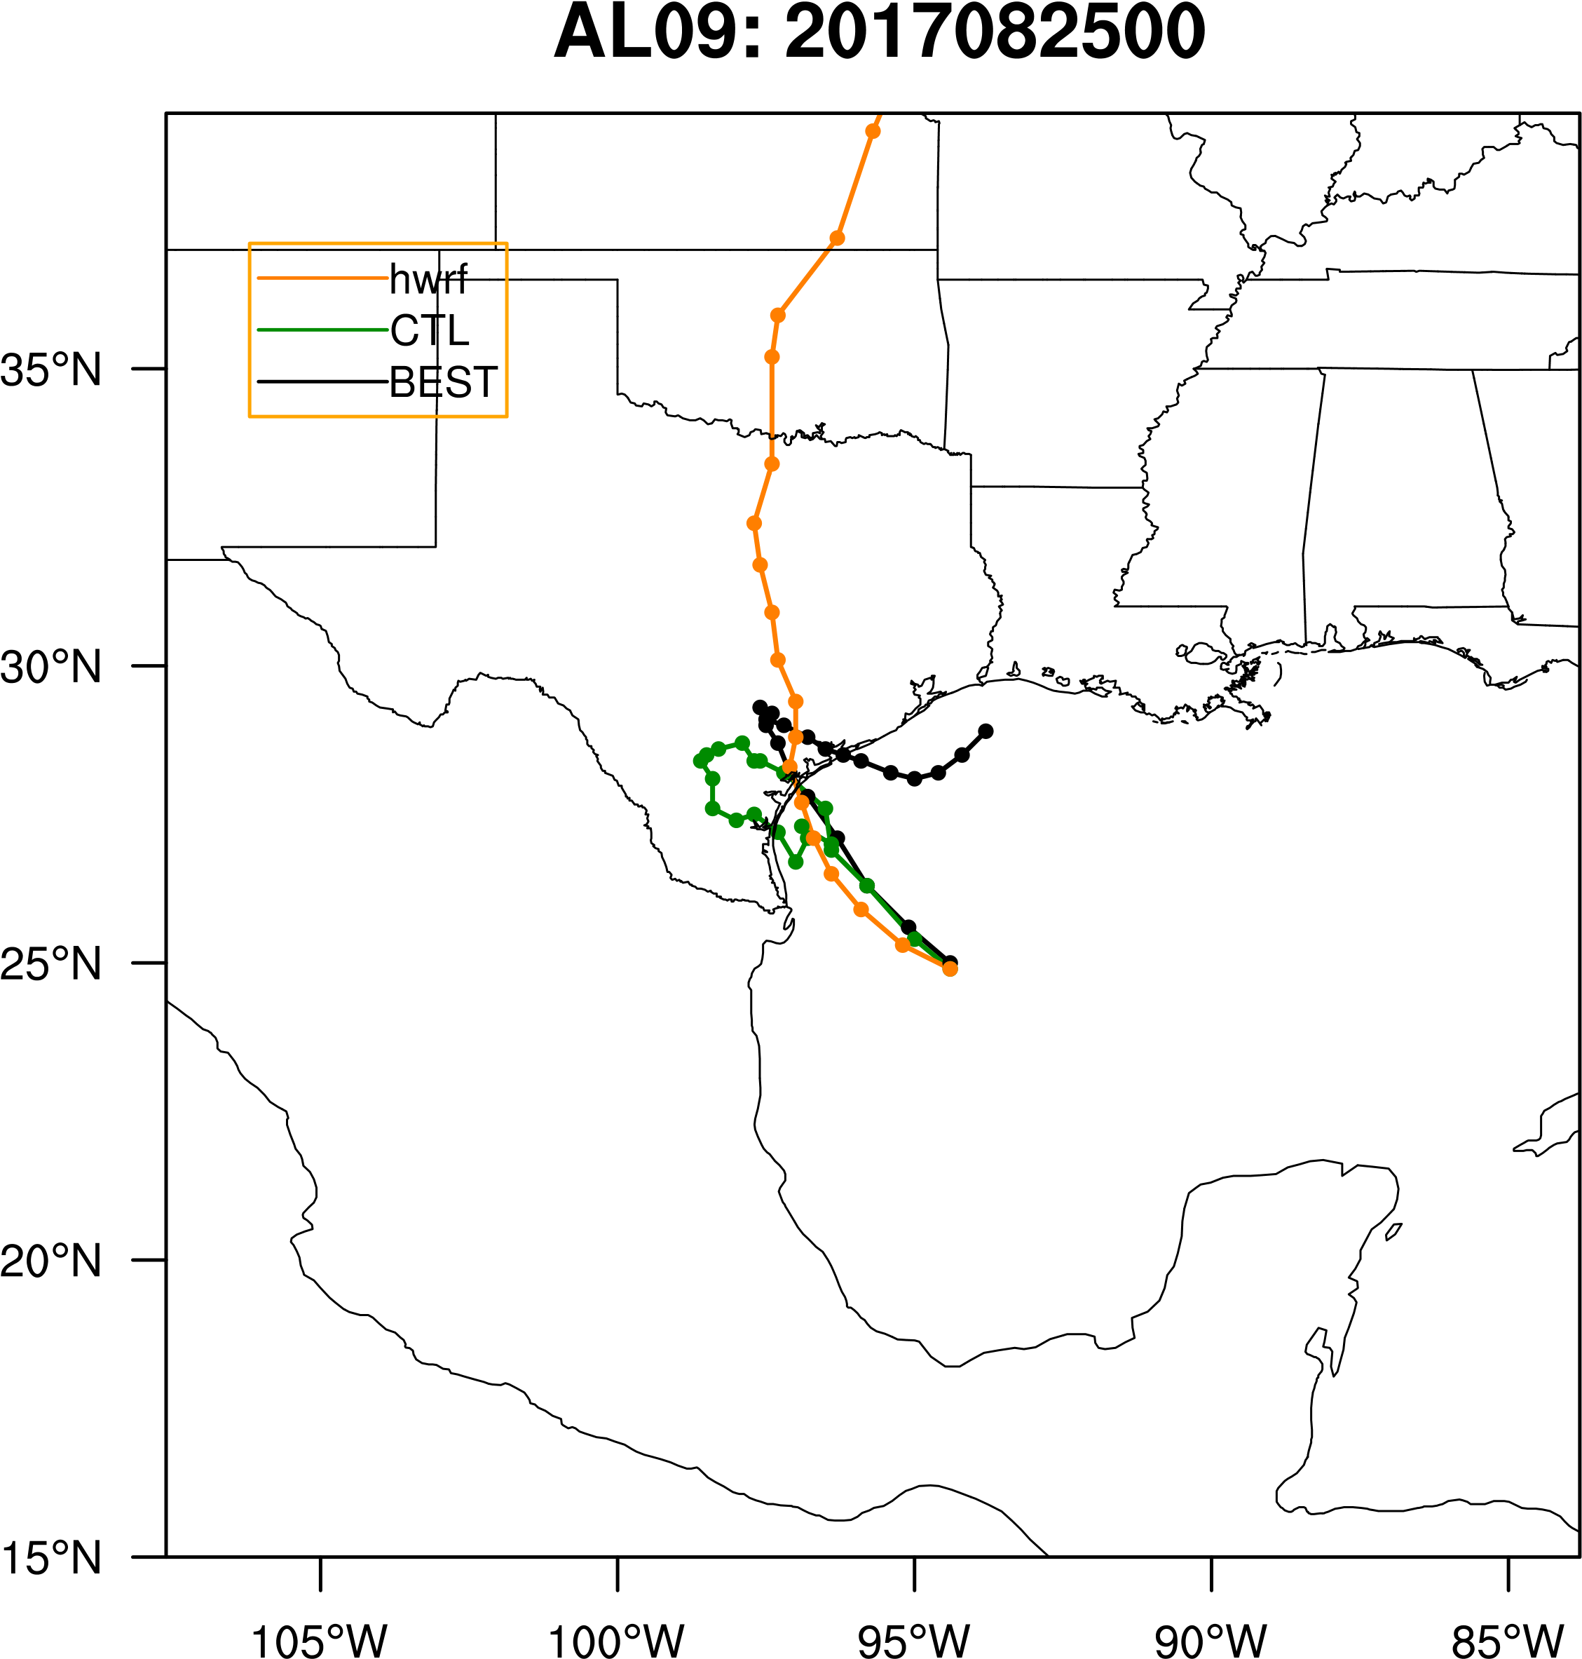
HWRF Without GH
GFS without GH

Slide 7
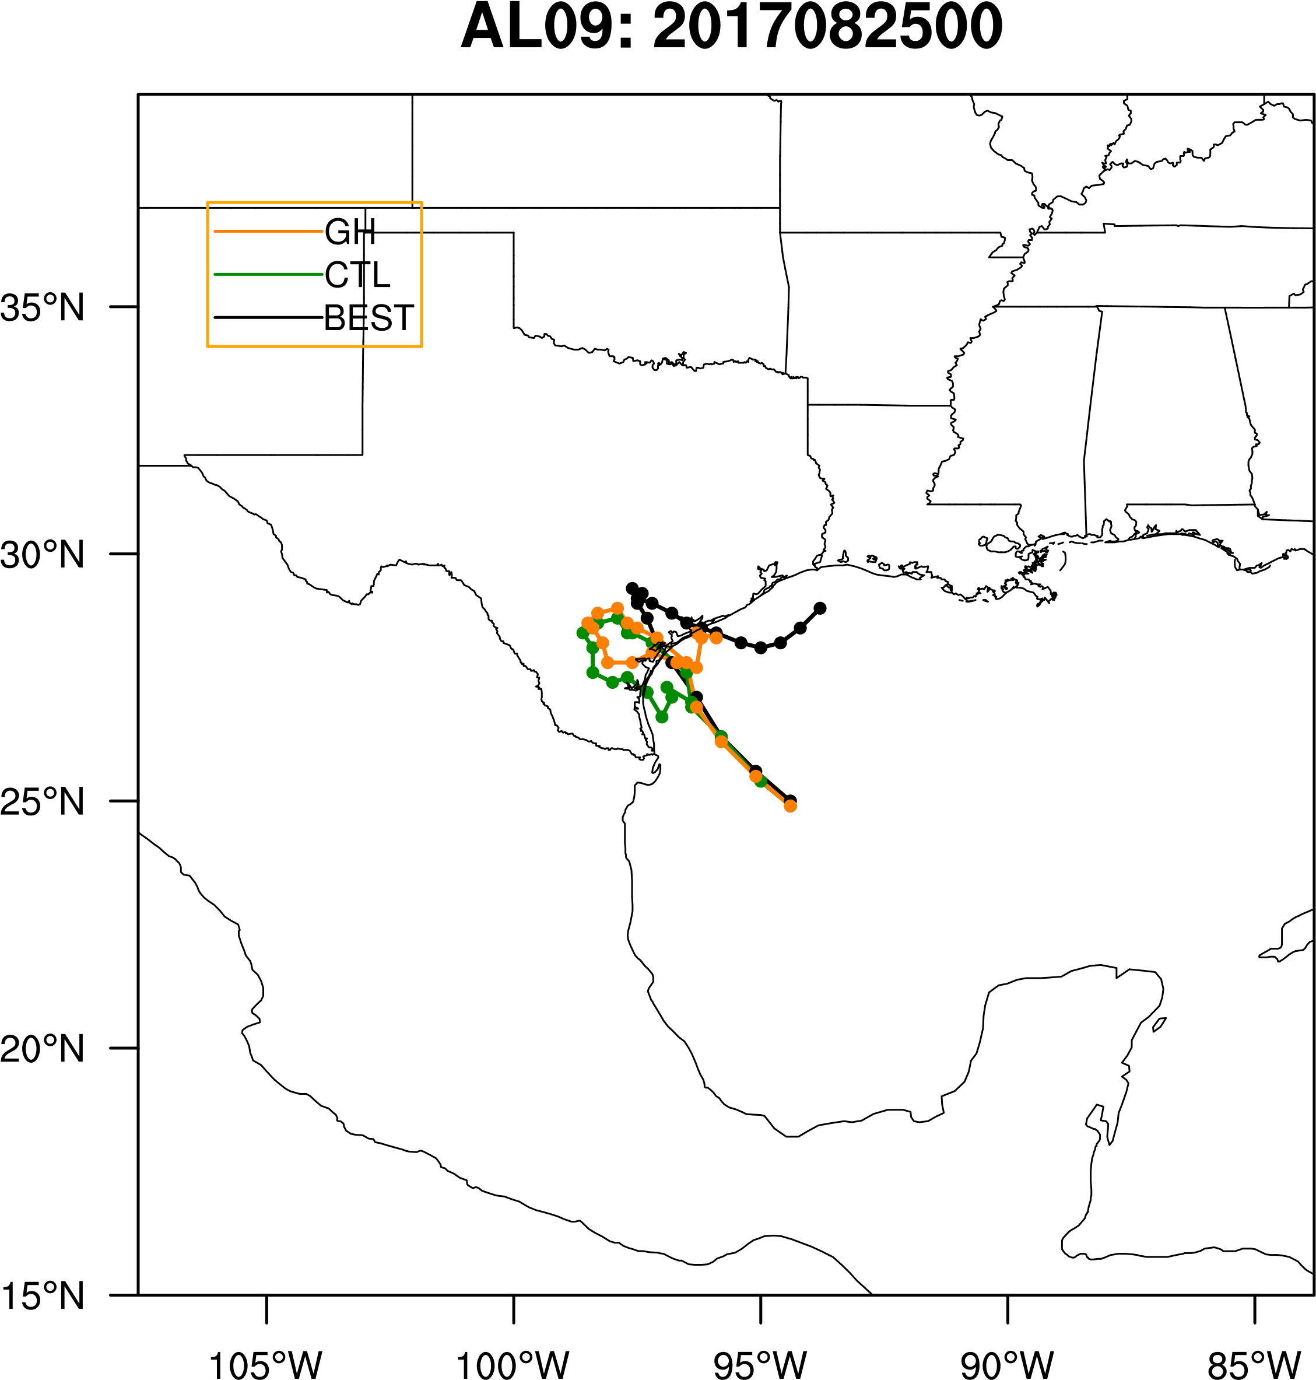
GFS Results

Slide 8
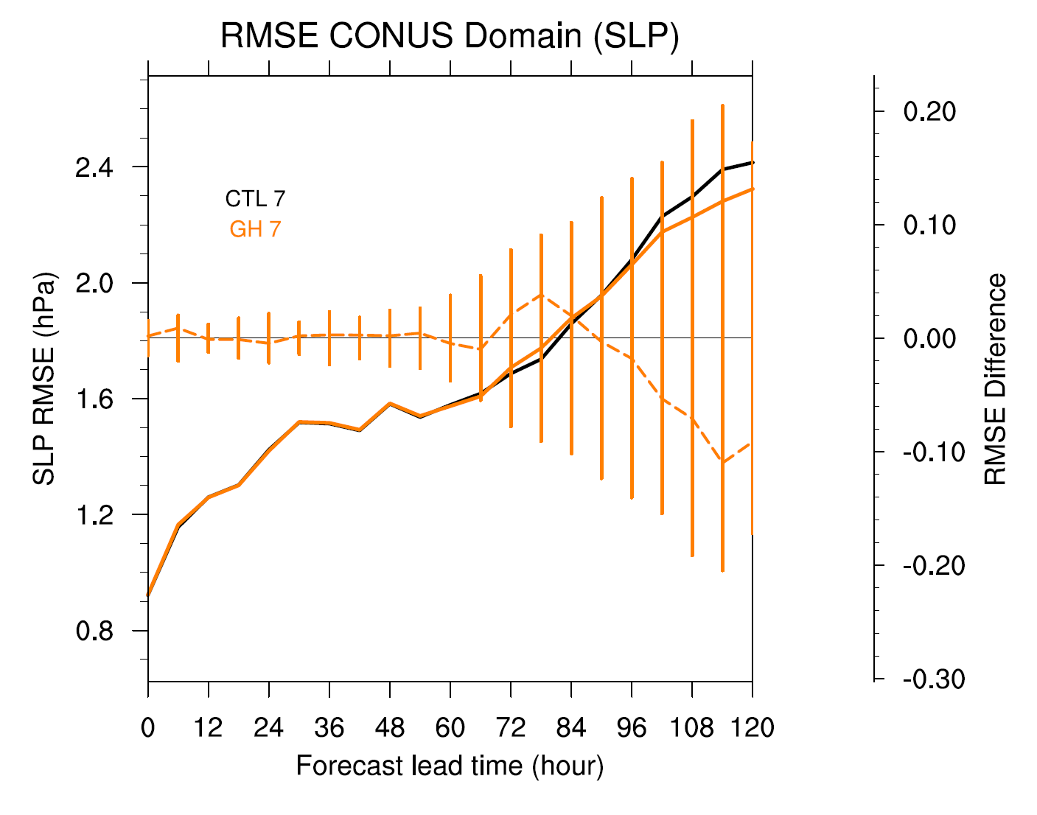
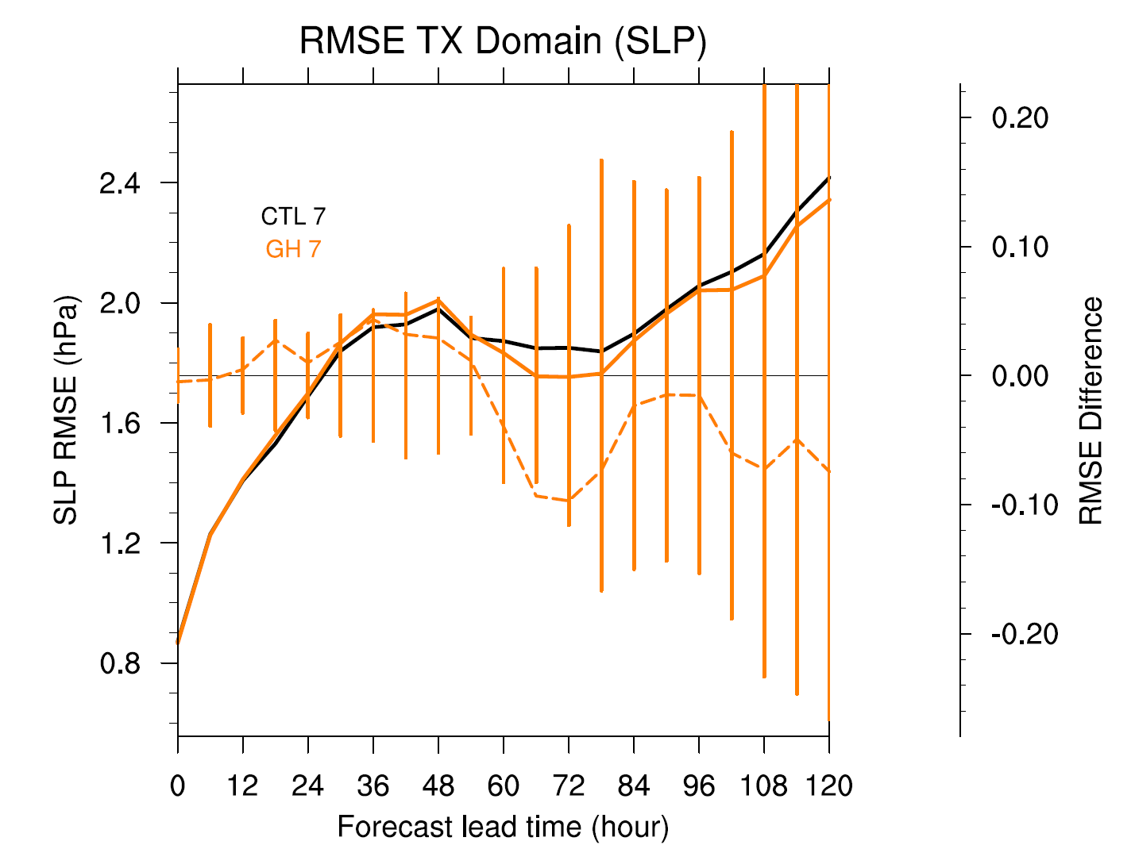
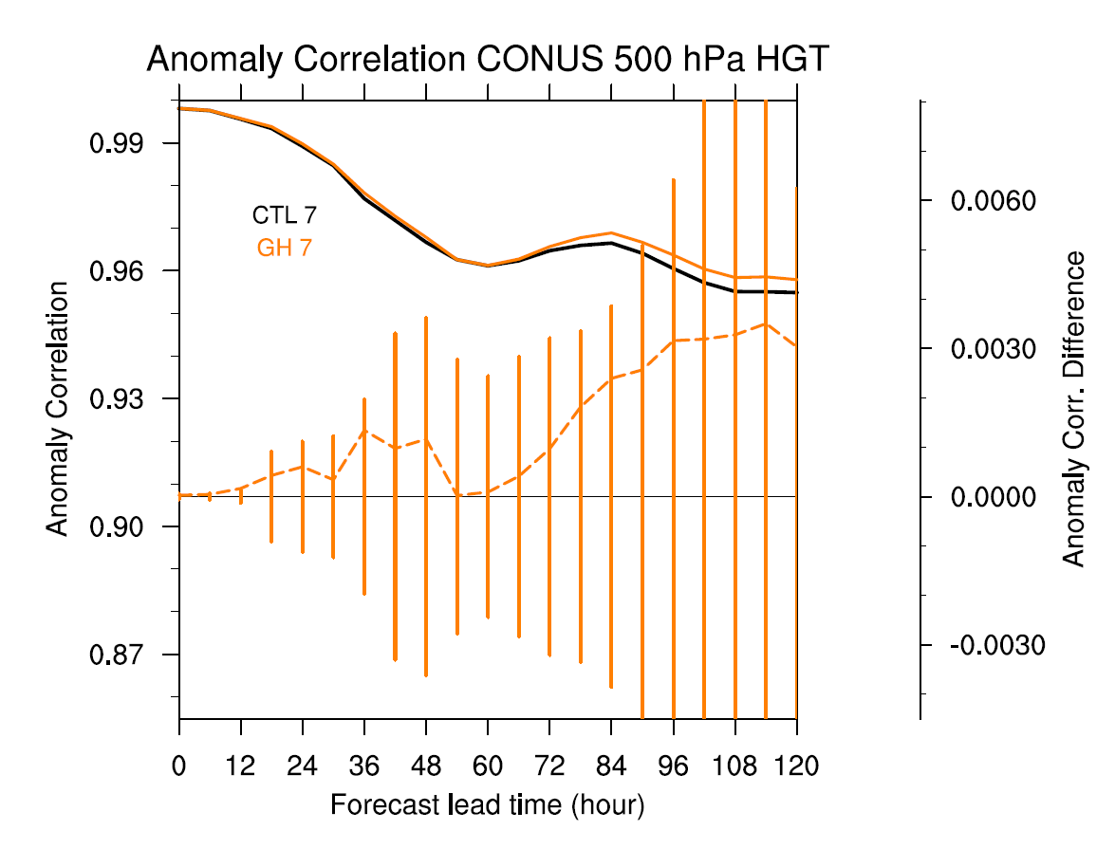
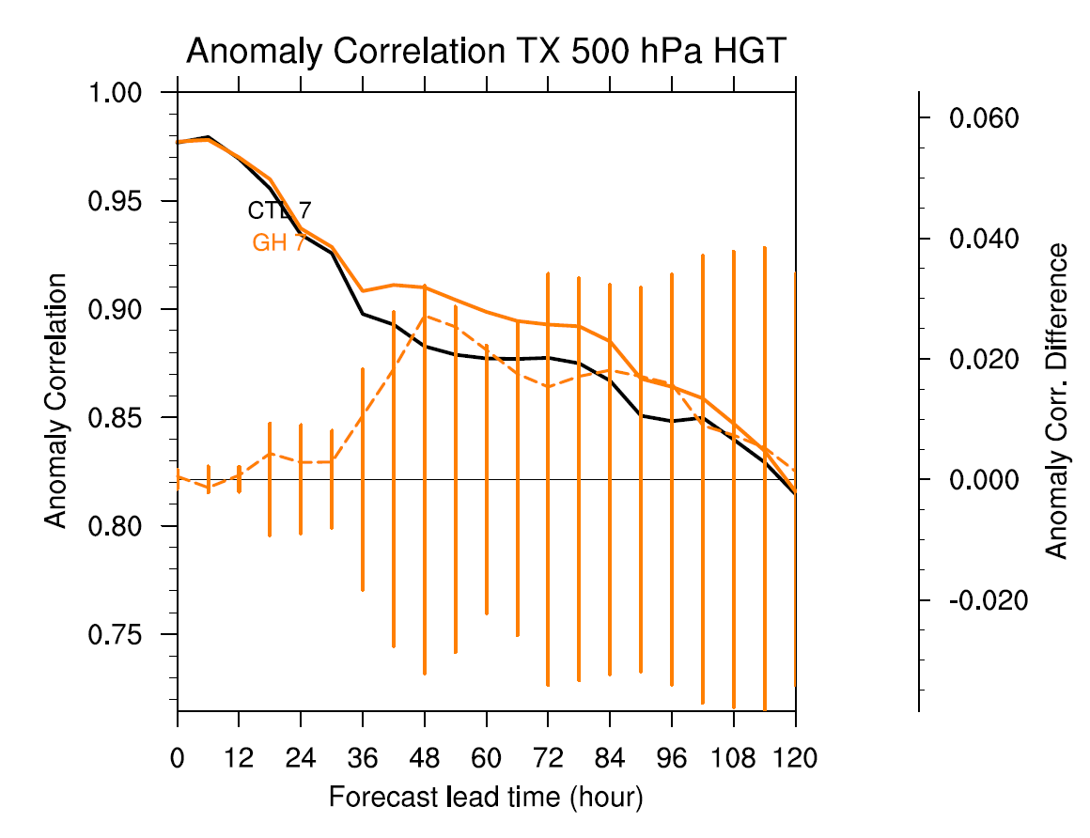
GFS

Slide 9
Questions??

