Slide 1
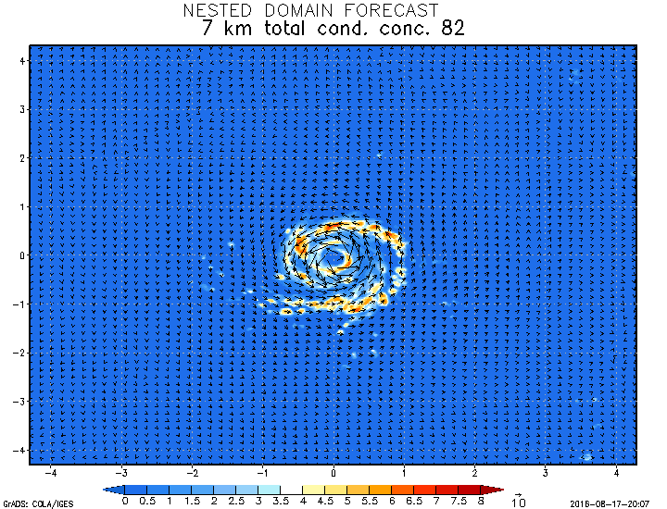
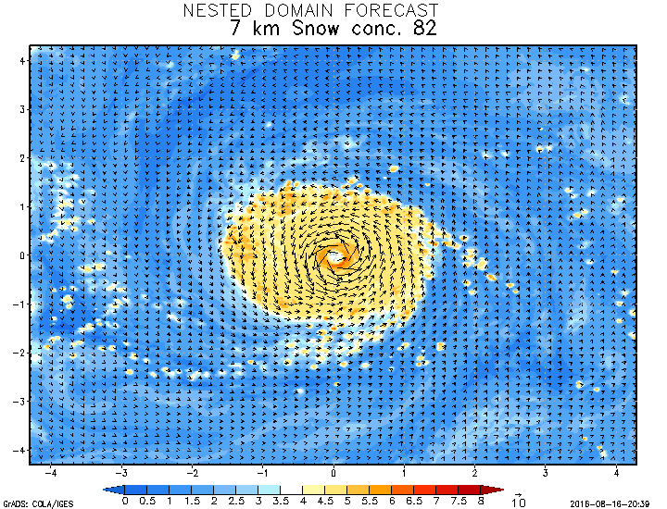
Ferrier vs Thompson MP
Ferrier total condensate
Thompson Snow condensate
Notes:
As you can see, the differences are very obvious. Thompson keeps more ice mass aloft at all times, somewhat over-doing the CDO. Ferrier does not have any CDO.

