Slide 1
Time-Resolved Observations of Precipitation and storm Intensity with a Constellation of Smallsats (TROPICS)
Proposal to be submitted to an anticipated NASA call for venture-class proposals (these are typically multi-million dollar projects; HS3 was a venture-class project)
Comprises 12 CubeSats in three low-earth orbital planes
Each CubeSat will host a high performance radiometer
temperature profiles using eight channels near 118.75- GHz
water vapor profiles using 6 channels near 183 GHz
imagery in a single channel near 90 GHz for precipitation ice detection
single channel at 206 GHz for cloud ice measurements
Rapid-refresh (~15 min) microwave measurements over the tropics
Observe thermodynamics and microphysics of the troposphere for storm systems at the mesoscale and synoptic scale over entire lifecycle
Improve fundamental understanding of the underlying environmental thermodynamic control and in-storm microphysical processes associated with tropical cyclones in all tropical oceanic basins
The TROPICS team has asked AOML to perform an OSSE to predict the impact of their data on TC track and intensity forecasts

Slide 2
OSSE Framework
The regional OSSE (Observing System Simulation Experiment) framework described here features a high-resolution regional nature run embedded within a lower-resolution global nature run. Simulated observations are generated and provided to a data assimilation scheme which provides analyses for a high-resolution regional forecast model.
· Nature Runs
- ECMWF: low-resolution T511 (~40km) “Joint OSSE Nature Run”
- WRF-ARW: high-resolution 27km regional domain with 9/3/1 km storm-following nests (v3.2.1)
· Data Assimilation Scheme
- GSI: Gridpoint Statistical Interpolation. a standard 3D variational assimilation scheme. Analyses performed at 9km resolution.
DA and model cycling performed every 6 hours, each run producing a 5-day forecast, for total of 16 cycles.
background
ECMWF NATURE RUN
observation
simulator
SYNTHETIC DATA
GSI
ANALYSIS
HWRF
WRF NATURE RUN
FORECASTS
verification

Slide 3
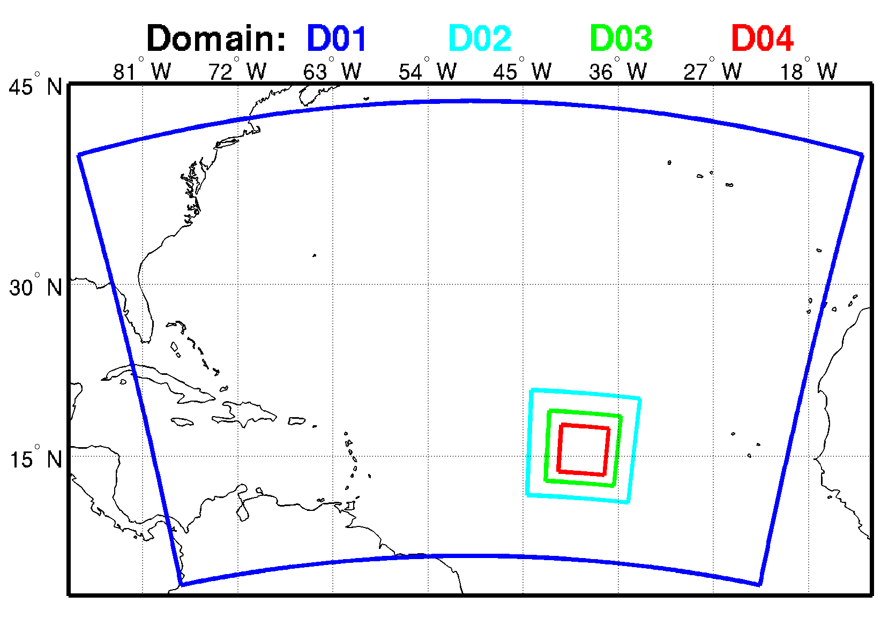
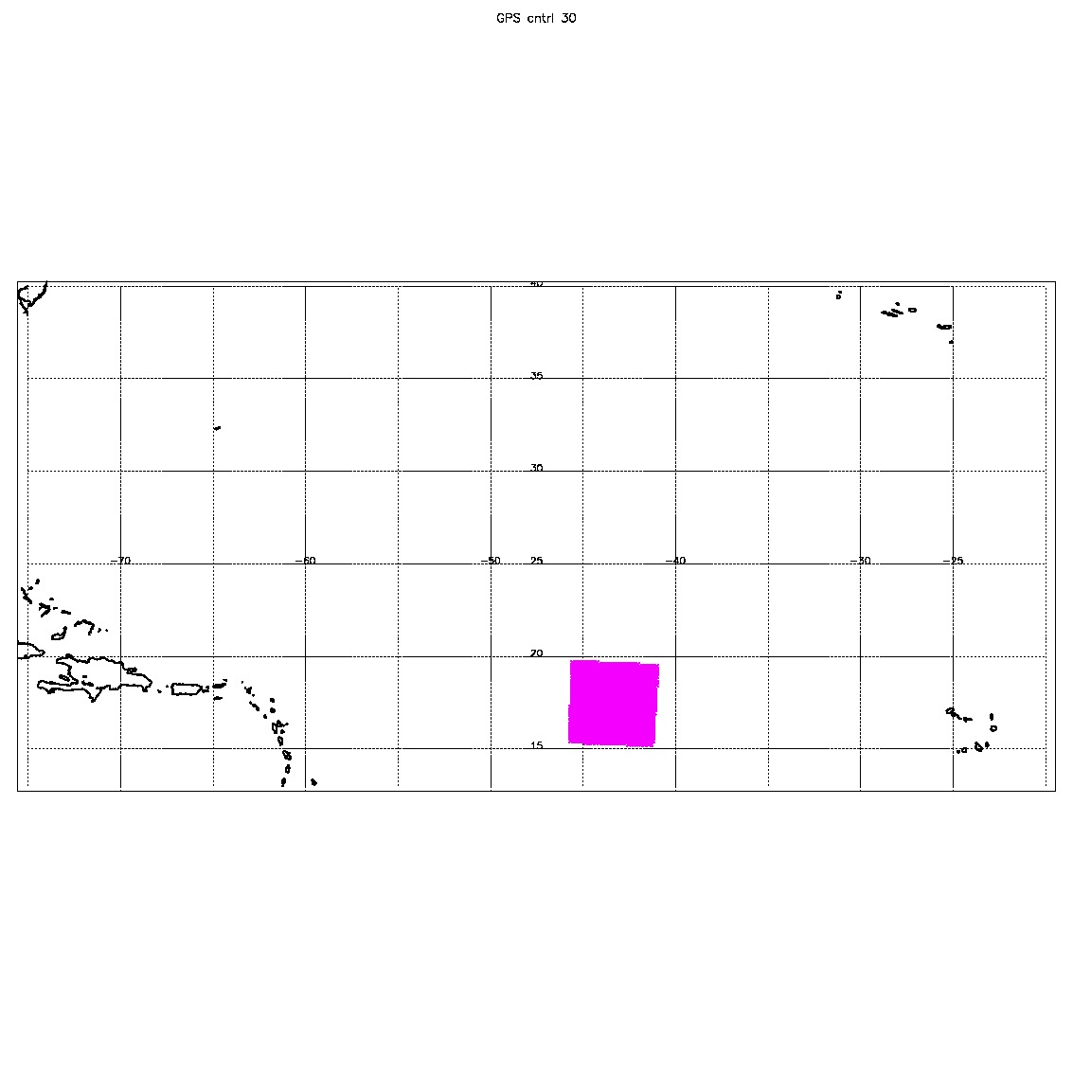
Four domains with different spatial and temporal resolutions
D01: 27 km(240x160), 30 min
D02: 9 km (120x120), 30 min
D03: 3 km (240x240), 30 min
D04: 1 km (480x480), 6 min
TROPICS data location
(res: 21 km) 0802 00z storm center at 17.5N 43.4W

Slide 4
Data Details
What is included in “CONTROL”?
YES
Radiosondes, ships, buoys, surface stations
AMVs from GOES-Imager, SEVERI
T,q soundings from GOES-Sounder, HIRS, AIRS, MHS, GPS
T soundings from from AMSU-A, q soundings from AMSU-B
NO
Scatterometer
Ozone

Slide 5
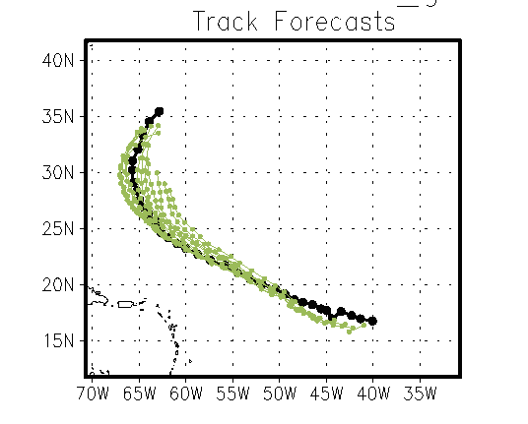
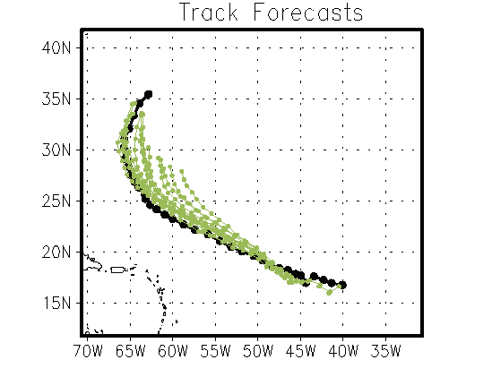
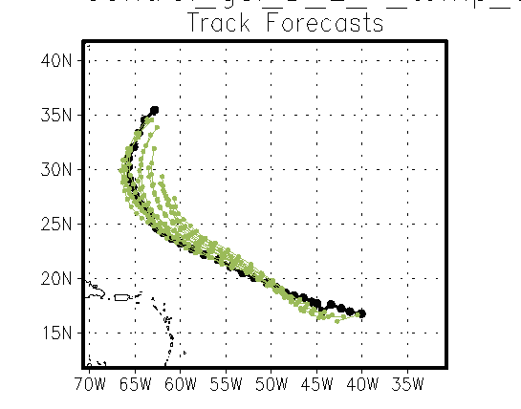
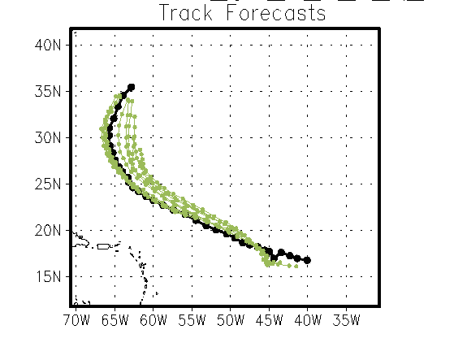
Control
Control, T
Control, T,Q
Control,Q

Slide 6
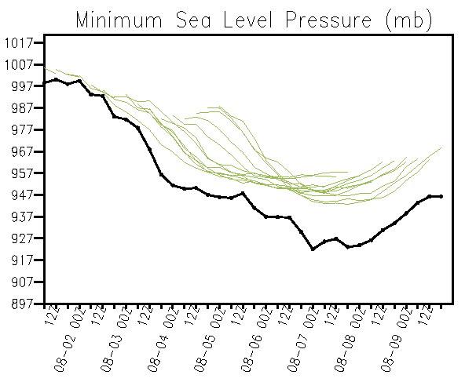
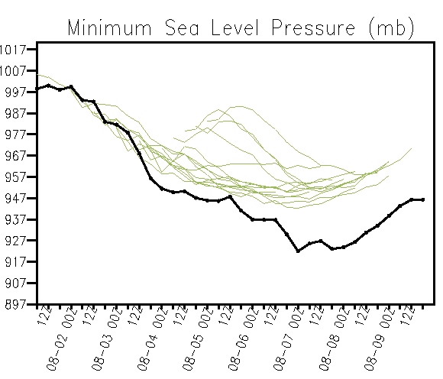
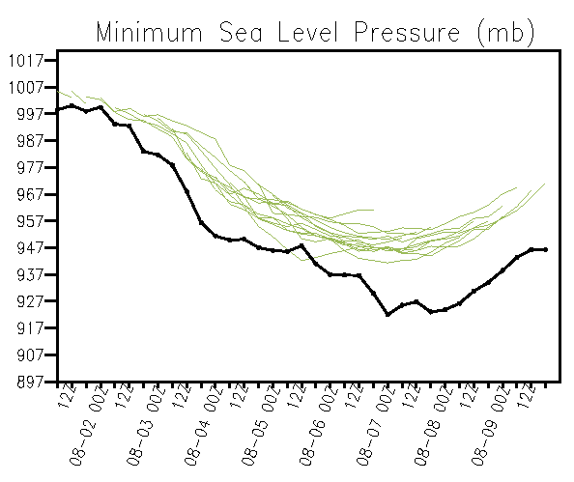
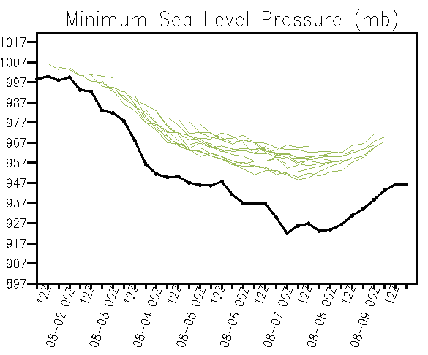
Control
Control, T
Control, T,Q
Control, Q

Slide 7
TC Stats

Slide 8
TC Stats

Slide 9
What is next?
TROPICS data location
(res: 21 km) 0803 00z storm center at 18.2N 46.5W
Assimilate Tb
Assimilate Data from D02 (~10x10)

