Slide 1

Large Scale Verification of HWRF
Christina R. Holt and Ligia Bernardet
Developmental Testbed Center
NOAA ESRL GSD
CIRES/University of Colorado

Slide 2
Background
DTC recently performed a test of HWRF using RRTMG with Partial Cloudiness as an alternate radiation scheme to GFDL
In an attempt to go beyond only track and intensity analysis, we wanted to take a look at large scales since our experiment would affect those scales the most
Need to know large scale behavior before examining case studies

Slide 3
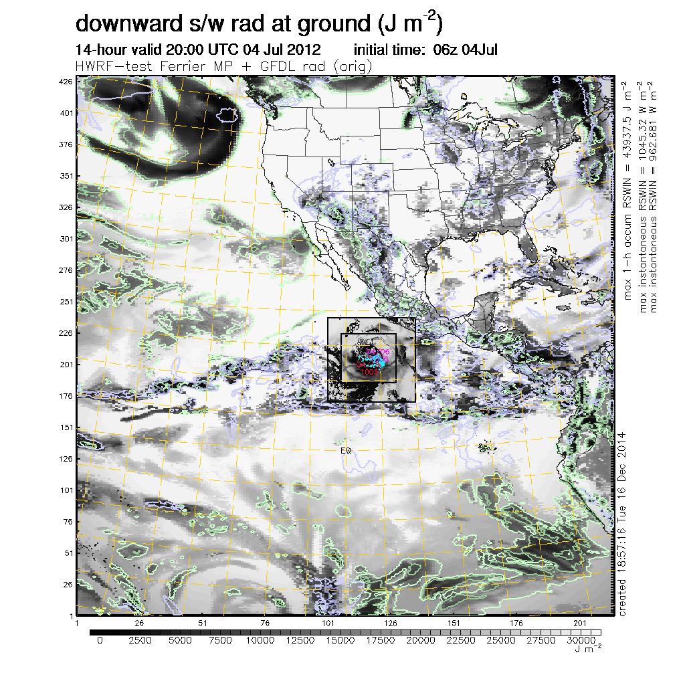
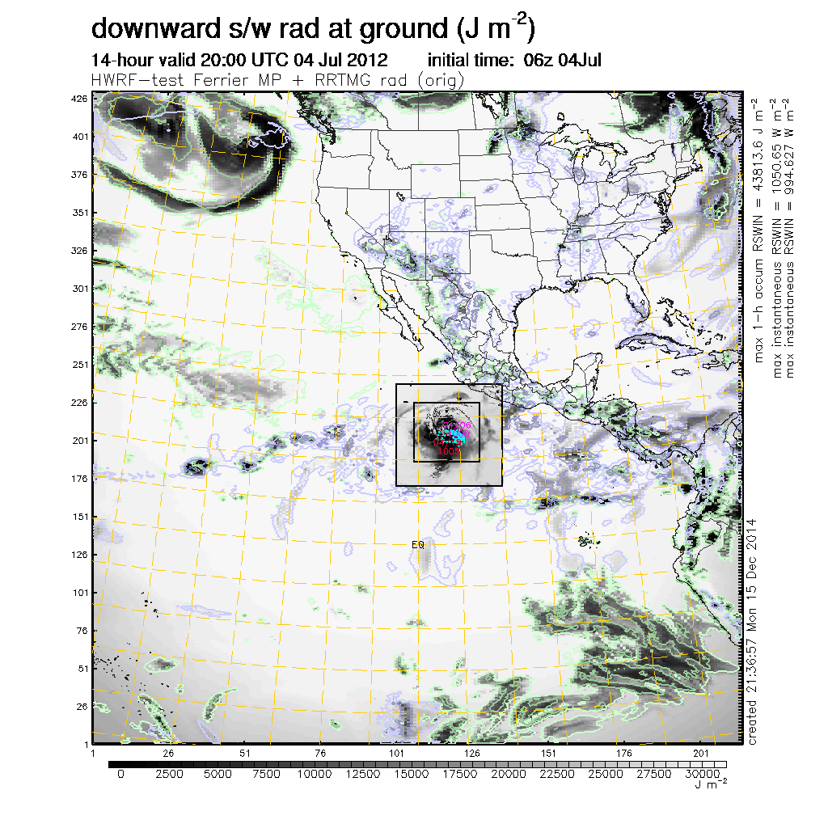
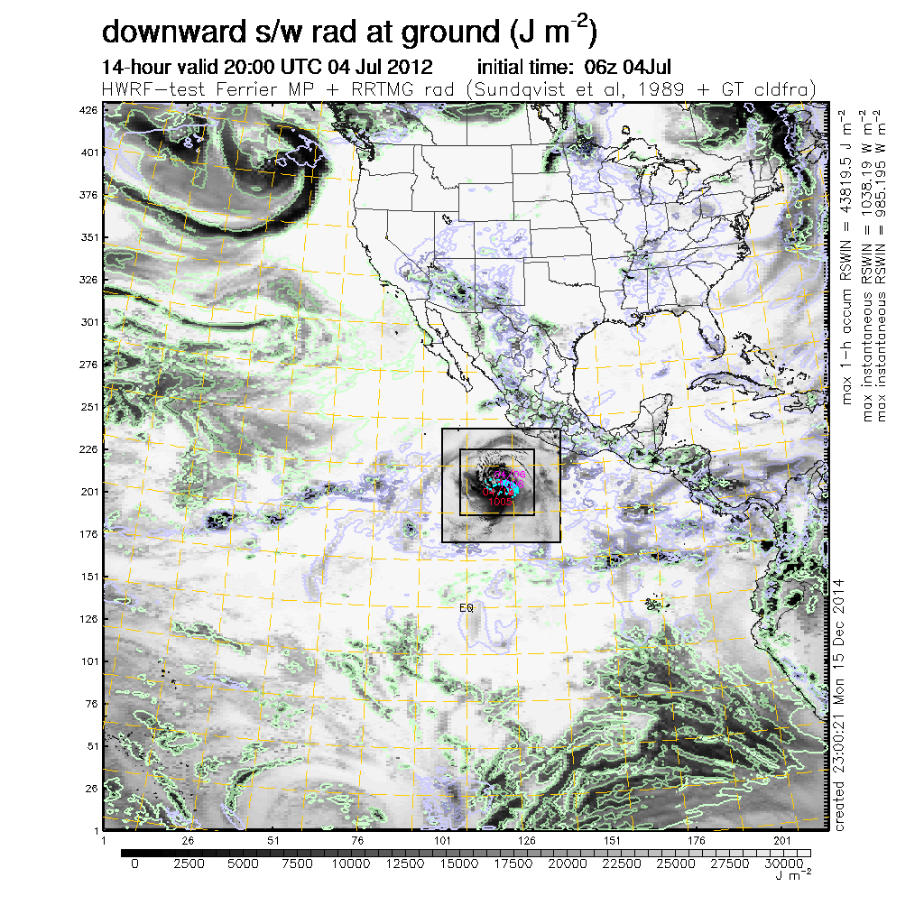
Addressing issues in RRTMG-cloud connection
Ferrier/GFDL radiation
Ferrier/RRTMG radiation
Ferrier/RRTMG/part cloud
Control: Reasonable SW attenuation but documented problems in LW
Excessive SW radiation reaching surface: SAS clouds transparent to RRTMG radiation and lack of stratus representation
Reasonable SW attenuation with partial cloudiness scheme implemented by DTC
Notes:
Left: The SW radiation reaching the ground for the operational HWRF physics (Fer+ GFDL rad) seems reasonable.
Right: When Fer+RRTMG is used, the SW at the ground is unrealistic. SW is attenuated by explicit clouds (shown as green contours for liquid water and blue contours for solid water). But SW is not attenuated over the large areas in the Pacific where there are no explicit clouds, only convective SAS clouds (not shown).
Disabling convective cloud influence for GFDL results in SW radiation at the ground is similar to RRTMG – confirming RRTMG is not responding to the SAS clouds.
The gray shades in d01 are 1-h accumulated SW radiation on the ground. The d02 and d03 are showing the instantaneous RSWIN value and are scaled 0 to 1100 W/m2 (roughly max) using the same color scale as bottom of graphic and its done with linear scale. So there should NOT be an identical match in color between d01 and the nests.

Slide 4
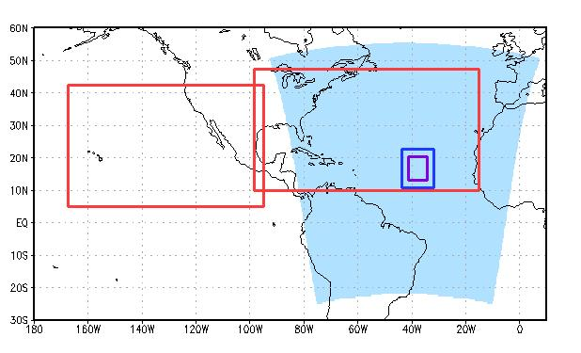
Configuration
ATL Ocean Domain
9 ATL Storms
101 Cases
EP Ocean Domain
9 km
1/16°
3 km
2014 Ops Suite
27 km
CTL
EXPT
 | HDGF | HDRF
Microphysics | Ferrier | Ferrier
Radiation | GFDL | RRTMG
Rad. Δt | 1 hour | 15 mins
Partial Clouds | no | yes
Convection | SAS | SAS
PBL/Sfc Layer Phys | GFS/GFDL | GFS/GFDL
9 EP Storms
97 Cases

Slide 5
Method for Vx
Regrid all d01 output (hwrfprs_p grid) onto a large 0.25°×0.25° grid covering both basins → Mega Domain
Regrid all global analyses onto identical grid for “truth”
Use DTC’s Model Evaluation Tools (MET) Series Analysis tool to create error statistics
  RMSE, ME (Bias), Matched Pair Count, etc.
  Could also use HWRF Analysis or gridded obs as “truth”
MET writes out NetCDF files that show geographical distribution of errors on a single vertical level

Slide 6
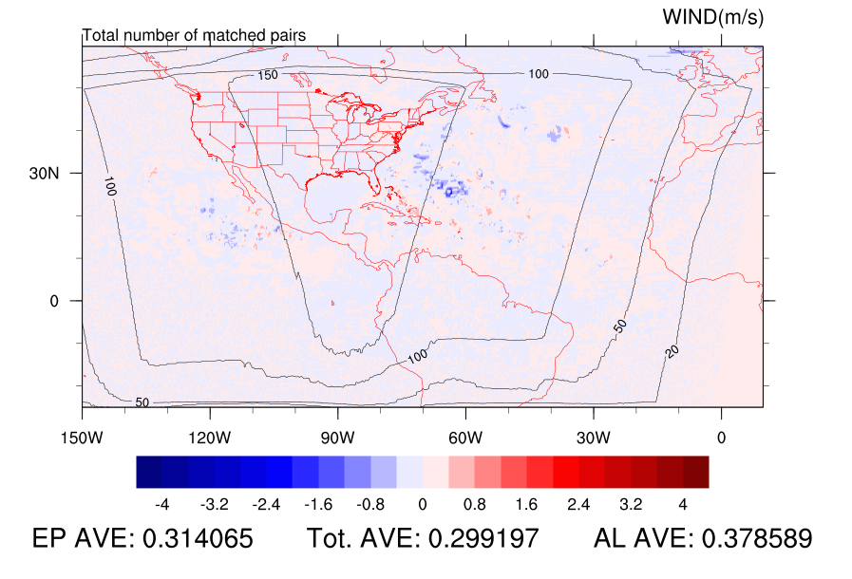
Mega Domain
0.25°× 0.25°
Verification against GFS Analysis

Slide 7
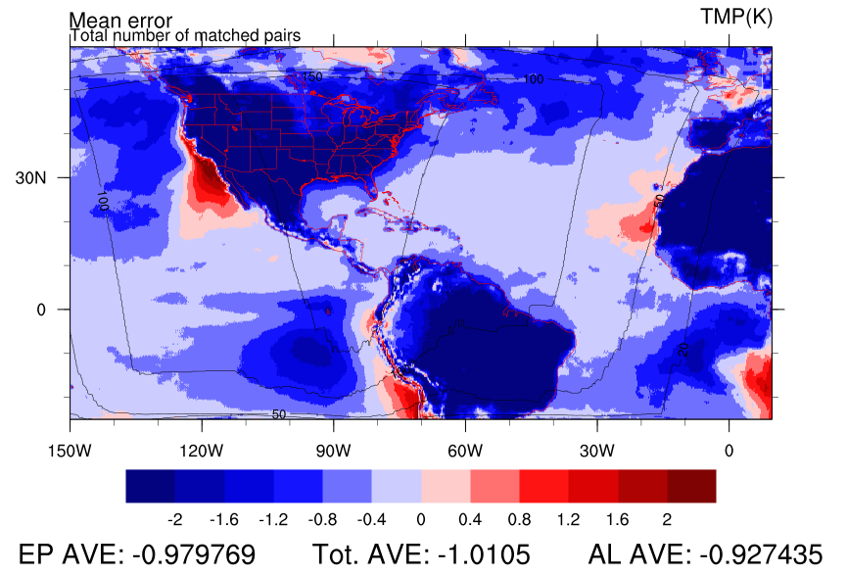
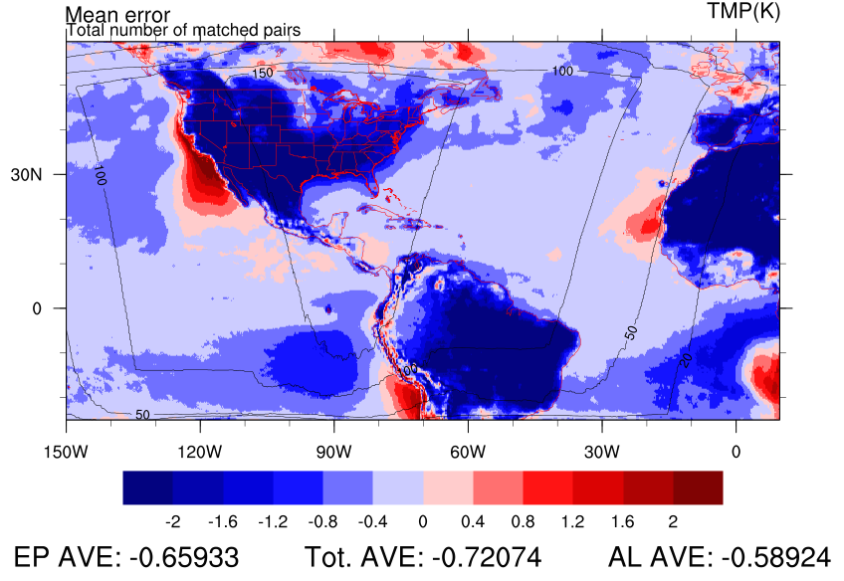
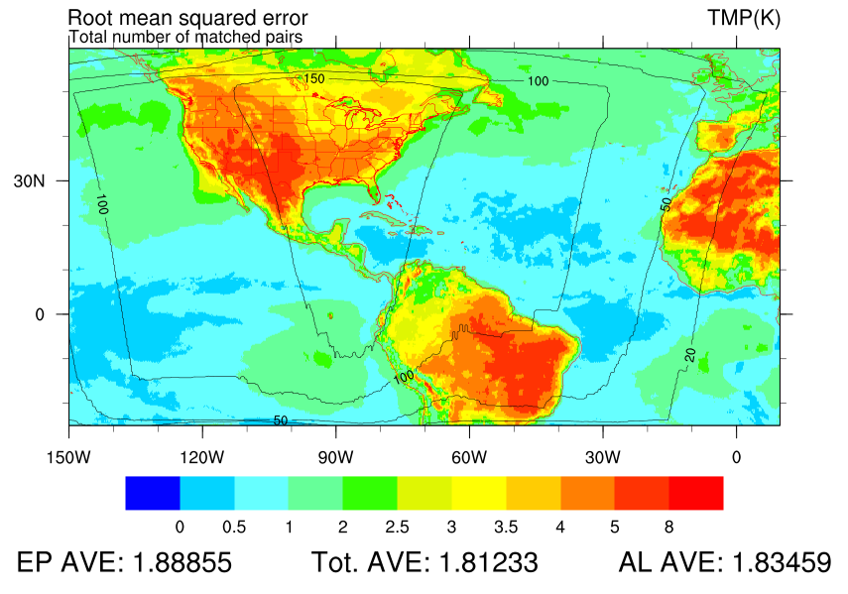
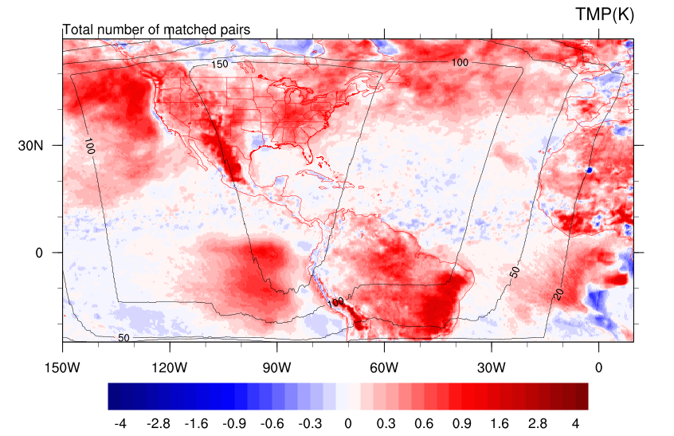
1000 hPa Temp (K)
CTL BIAS
EXPT BIAS
Too Cold Too warm
Too Cold Too warm
Improvement/Degradation
CTL RMSE
Geographical distribution of errors
DIFF RMSE
EXPT Degrades EXPT Improves
Notes:
Negative bias in general.
Off west coasts of NA and SA where stratus decks set up

Slide 8
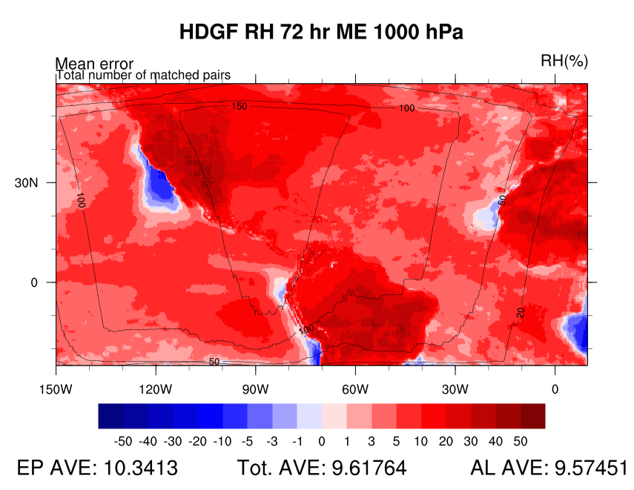
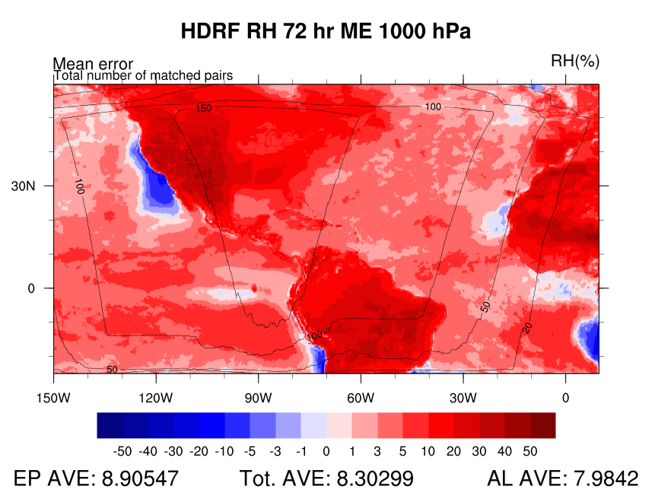
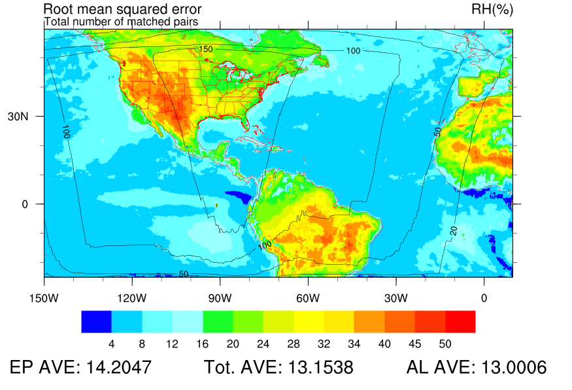
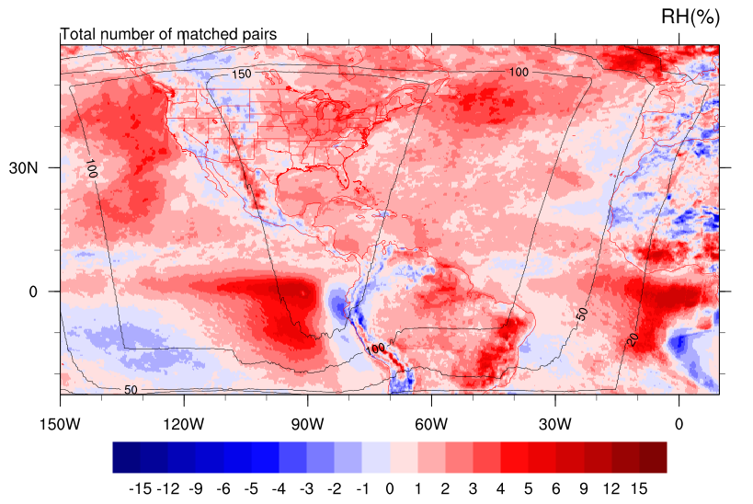
1000 hPa RH (%)
CTL BIAS
EXPT BIAS
CTL RMSE
DIFF RMSE
HDRF Degrades HDRF Improves

Slide 9
Question to answer?
?
?
?
?
?
What are the vertical and temporal distribution of errors?
Are there differences between the basins? Overall?
?
?
How does the experiment compare to the control?
?
?
?
?
What are the error characteristics of the control?
?
?
?
?

Slide 10
Mega Domain
EXPT-CTL Bias
Mega Domain
Control Bias
Experiment has higher heights aloft, lower heights a low levels
HGT
Too low at upper levels and too high at low levels
Pressure Level (hPa)
What are the errors in the control?
What effect does the EXPT have?
TMP
Experiment is warmer
Pressure Level (hPa)
Less warm, more humid at 850
Too cold and humid in lower troposphere
Pressure Level (hPa)
RH
Forecast Hour
Forecast Hour
Notes:
Experiment is decreasing static stability at near the surface and in middle troposphere.

Slide 11
RMSE Percent Error
Mega Domain
Height is improved at upper levels and 1000 hPa, but degraded in mid trop.
HGT
Control RMSE – Experiment RMSE
Control RMSE
How much does the EXPT improve the CTL?
Mid tropospheric Temp is degraded
TMP
Low-level heat and moisture are improved
RH

Slide 12
EP Area
ATL Area
Percent Error
Does one basin behave differently?
HGT
More improvement, or less degradation in EP than ATL
TMP
RH

Slide 13
Summary
Large scale analysis of errors using MET Series Analysis tool highlights areas of errors, and when compared to a baseline, areas of improvement
Using averages over basins and displaying as a hovmoller-type diagram allows for a big picture view of the improvement/degradation, areas of greatest sensitivity, and even some physical processes at work on the large scale
After a look at the coarse hovmoller diagrams, you can go back to maps with a better idea of what you’re looking for

Slide 14
Still to come…
Hovmoller diagrams and maps at more vertical levels, including surface
Additional variables – wind, rainfall, cloud distribution, etc.
Vx against HWRF analysis and observations
Physical interpretation of changes and case study investigation
  How does cloud distribution change?
  How are hurricanes affected by the radiation changes?

