Slide 1


Evaluation of Proposed FY15 Upgrades for NCEP Operational HWRF: NATL/EPAC Storms, 2011-2014
HWRF Team @EMC, in collaboration with
NHC, DTC, GFDL, URI, UCLA, Purdue/NSF, HRD
Presented by
Vijay Tallapragada
HRD Monthly Science Meeting, April 09, 2015
Notes:
1
1

Slide 2
Scope of FY15 HWRF Upgrades
System & Resolution Enhancements
  Replace current partial HWRF python based scripts with complete Python based scripts for a unified system
  GFS data Upgrades
  Increase the horizontal resolution of atmospheric model for all domains from 27/9/3 to 18/6/2 km.
Initialization/Data Assimilation Improvements
  Upgrade and improve HWRF vortex initialization scheme in response to both GFS and HWRF resolution increases
  Upgrade Data Assimilation System with hybrid HWRF-based EnKF and GSI system.
Physics Advancements
  Upgrade Micro-physics process (Ferrier-Aligo)
  Upgrade GFDL radiation to RRTMG scheme with partial cloudness
  Upgrade surface physics and PBL, momentum and enthalpy exchange coefficients(Cd/Ch)
  Upgrade current GFDL slab model to NOAH LSM.
First time in 2015….
  Self cycled HWRF ensembles based warm start for TDR DA
  Expand HWRF capabilities to all global (including WP/SH/IO) basins through 7-storm capability in operations to run year long

Slide 3
HWRF Upgrade Plan for 2015 Implementation
Multi-season Pre-Implementation T&E
 | Model upgrades | Physics and DA upgrades |  |  |  | Combined
 | Baseline (H15B) | NOAH LSM (H15W) | Upgraded Ferrier (H15W) | RRTMG/ PBL/ Surface Physics (H15W) | Data Assimilation* (H15T) | H215
Descriptions | 1.Resolution increase: 18/6/2km w/ same domain size; 2. Python scripts 3. New GFS T1534 4. Init improvement, GFS vortex filter | NOAH LSM (w/ Ch cap over land) | Separate species, w/o advection | 1.Radiation 2.Variable α 3.Scale-aware partial cloudiness scheme | Hybrid GSI/HWRF-EPS based DA | Baseline + NOAH/LSM +newMP+RRTMG+ Surface Physics + PBL + DA changes
Cases | Four-season 2011-2014 simulations in ATL/EPAC, cases (~2300) | Priority cases | Priority cases | Priority cases | Only TDR cases for 2011-2014 | Four 2011-2014 retrospectives ~2300 simulations in ATL/EPAC
Platforms | Jet | WCOSS | Jet | Jet/Zeus | Jet | Jet/WCOSS/Zeus
The plan is based on the assumption that 2015 operational HWRF system will have 3x computer resources as current system on WCOSS within HWRF operational time windows. We will be using only 2.5X for each storm
* DA experiment requires additional computer resources outside current operational time window.

Slide 4
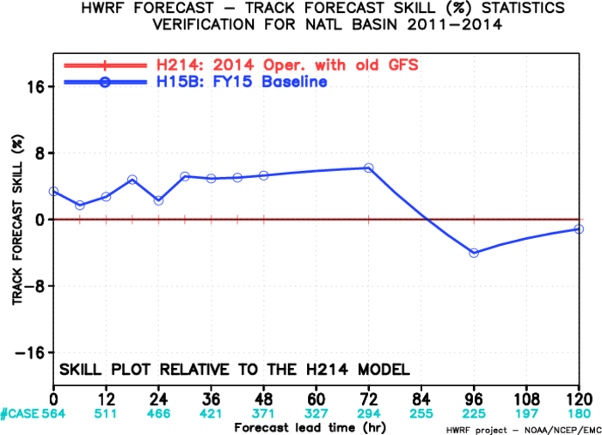
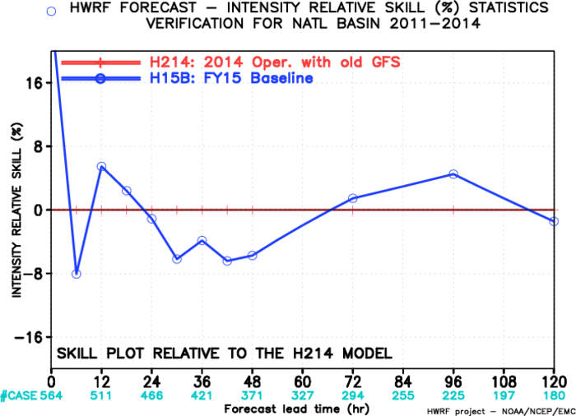
HWRF Infrastructure/Resolution Upgrades
The NMM core of the operational HWRF model upgraded to latest community version WRF V3.6.1.
The horizontal resolution increased from 27/9/3km to 18/6/2km, which allow the model to resolve more storm scale features and have better storm-large scale interactions.
Use high resolution GFS T1534 as IC/LBC
Fix a major bug in vortex initialization for tropical storms in Southern Hemisphere
Adjust the size of the filter domain in response to res. GFS res. increase
Add more smoothing if the radius of maximum wind speed is significantly smaller than observation
Remove the basin-dependence in vortex initialization

Slide 5
Data Assimilation Upgrades (H15T)
DA Upgrades for non-TDR cases (included in H215)
  Upgrade to the latest EMC GSI v5.0.0, and will be further tuned to improve the initial analysis for all HWRF domains.
  use the 80-member global ensemble based one-way hybrid EnKF-3DVAR 6h forecast fields to calculate the covariance.
  Enlarged d2 (6km) and d3 (2km) analysis domains to address discontinuity in the initial condition between forecast domains;
  Run GSI on d2 analysis domain and add analysis increment to d3;
  No satellite DA on d3 analysis domain due to pronounced negative impact;
  Added the assimilation of tcvitals MSLP data along with all dropsonde data.
DA Upgrades for TDR cases (H215 Final):
  run 40-member HWRF ensembles for 6h to provide more accurate, flow-dependent, vortex-dependent data assimilation covariance.
  Run GSI on both d2 and d3 analysis domains;
  Larger data assimilation domains

Slide 6
Upgraded Land Surface model
GFDL slab to NOAH LSM – NSF VSP Contributions
NOHA LSM provides realistic land surface physics, and predicts soil moisture, soil temperature, land surface skin temperature, land surface evaporation and sensible heat flux, and total runoff.
NOAH LSM significantly reduced the negative temperature bias
A major bug fix for NOAH LSM is introduced to prevent occasional model crash due to inconsistent stability dependent heat exchange coefficients over land (Subramaniam, NSF-NOAA VSP)
HWRF will include additional products for down-stream applications (e.g. storm surge, inland flooding)
Track errors for land-falling storms are improved based on preliminary tests
GFDL Slab
NOAH LSM

Slide 7
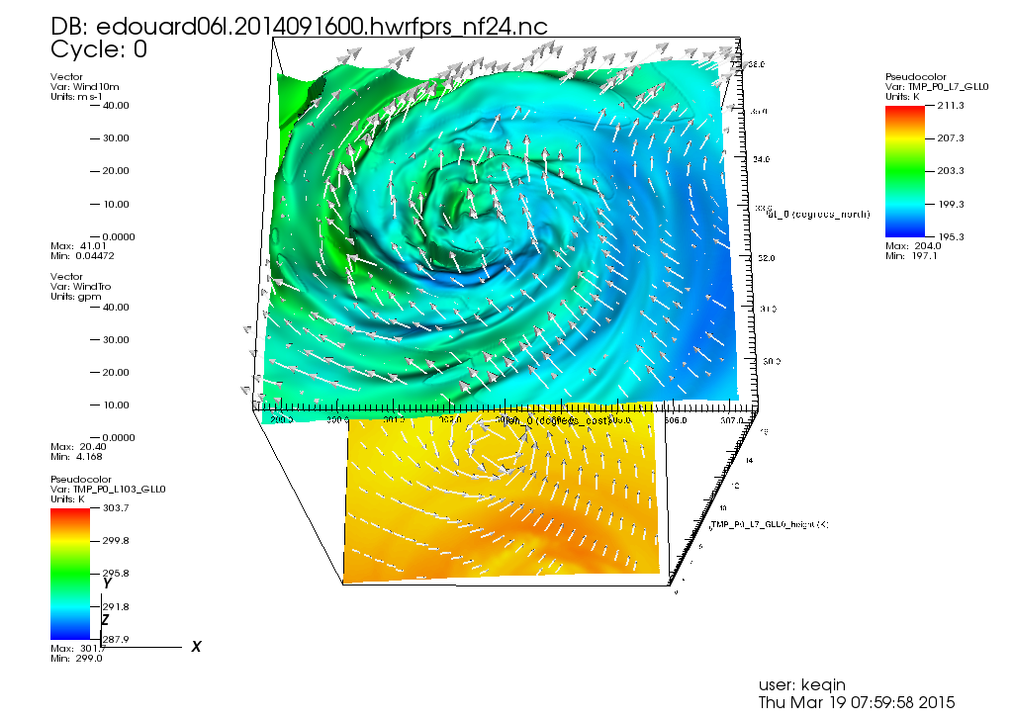
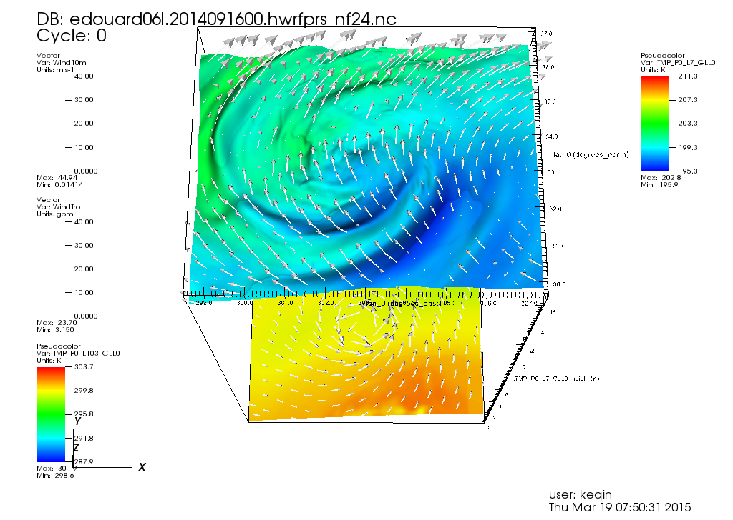
Upgraded Hi-Res Ferrier-Aligo Microphysics
New ice nucleation scheme to reduce no. concentration of small ice crystals
New, simpler closure for diagnosing small ice crystals and large, precipitating ice particles from ice mixing ratios
Slightly slower fall speeds of rimed ice
Increase the maximum (minimum) number concentration of small (large) ice in order to simulate better anvil cloud
Individual test showed positive impacts on structure and intensity forecasts
With upgraded Ferrier, High-Res
H214 Current Ferrier

Slide 8
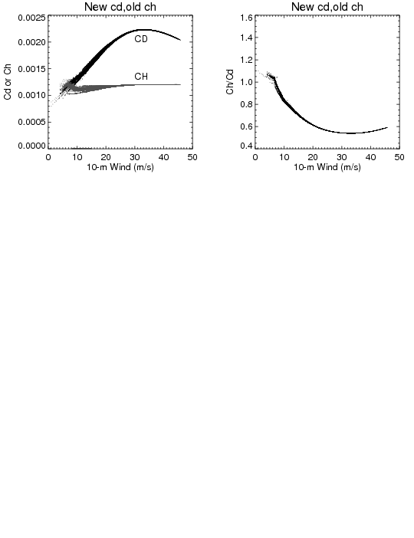
  Upgrade surface physics and PBL, momentum and enthalpy exchange coefficients(Cd/Ch) (H15U)
Cd/Ch change, suggested by URI, to better match observations values. The modified configuration provides improved intensity bias.
Increase of Ch at higher wind speeds (as implemented in GFDL) was causing model to become unstable and crash for stronger storms, suggestive of strong dependency of heat exchange coefficients at air-sea interface on model horizontal resolution

Slide 9
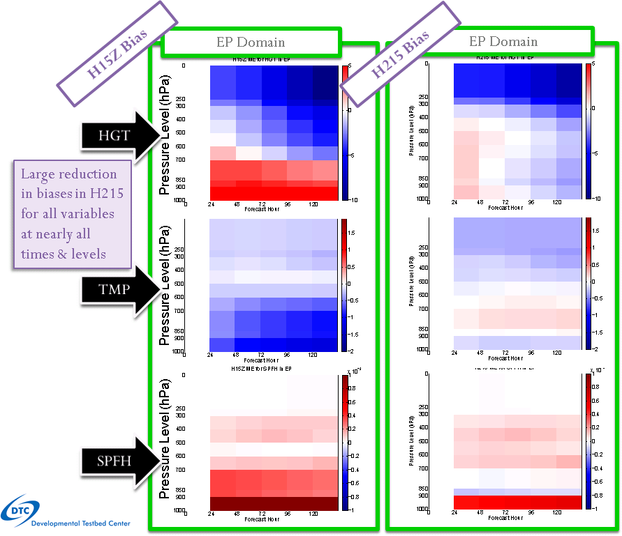
Upgraded SW/LW radiation schemes
(GFDL radiation to RRTMG)
GFDL radiation schemes have problems of proper representations of cloud-radiation interactions, especially net cloud top cooling and net cloud base warming.
Introduced much improved RRTMG radiation with parameterized sub-grid scale cloudiness and variable alpha (wind-speed dependent) vertical mixing coefficient (following work done by Robert Fovell, UCLA; Greg Thompson, NCAR; Ligia Bernardet/Christina Holt,DTC).
Dramatic Reduction in biases for Height, Temperature and Specific Humidity
Identified a problem in RRTMG related to O₃/CO₂ initialization. Fixed in final H215 configuration

Slide 10
Code Optimization & Workflow Modifications
  Sped up 2015 HWRF from 160 minutes to 96 minutes
    Increase from 13 compute nodes to 22 (~2.5x increase w.r.t. WCOSS Phase 1 16 core nodes, to fit of new 24 core Phase 2 compute nodes).
    Change the task geometry so that WRF compute processors within one compute node are adjacent to one another in a 4x4 grid.
    Switch to the quilt_pnc implementation of WRF I/O servers. This gained us about 30-35 minutes of runtime.
    Turn off the logging from all WRF processors. This gained us about 8 minutes of runtime.
  End-to-end HWRF scripting system in Python for all global ocean basins
  Switch to 100% GRIB2 output from HWRF
  Further changes to the HWRF workflow to improve the timing and reliability of forecast delivery
  New procedures for SDM to launch HWRF and GFDL separately

Slide 11
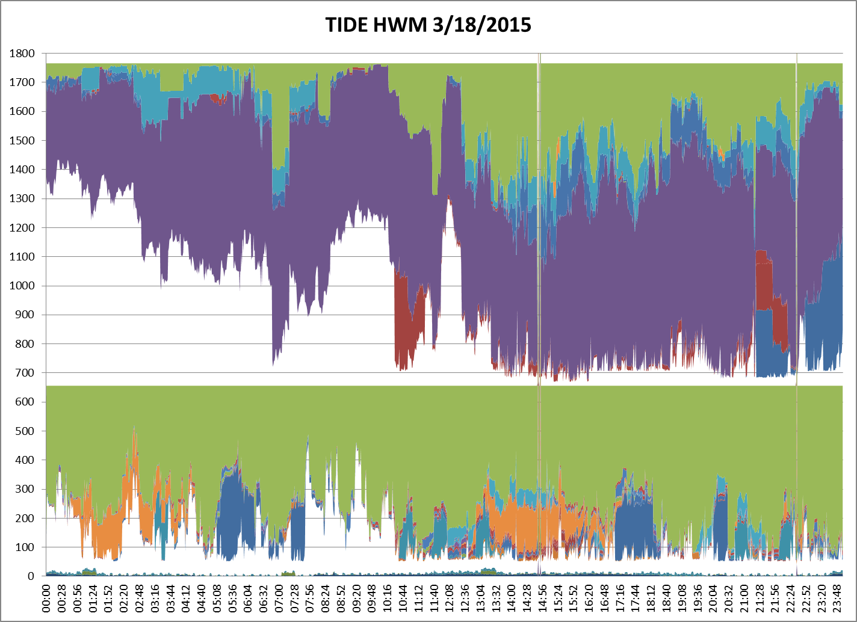
WCOSS Development Machine 03/18/2015
RTOFS
HWRF
NAM
GFS
CFSV2
GEFS
SREF

Slide 12
Acronyms
H15B: FY15 HWRF baseline, 18/6/2km resolution, L61, input: T1534L64 GFS (Spectral files for both IC and BC);
H214: 2014 version of operational HWRF, 27/9/3km resolution, L61, input: T574 L64 GFS (Spectral files for both IC and BC);
H15Z: H214 driven by New GFS (Control)
H215: H15B + All Physics upgrades;

Slide 13
Verification for Atlantic Storms (2011-2014)

Slide 14
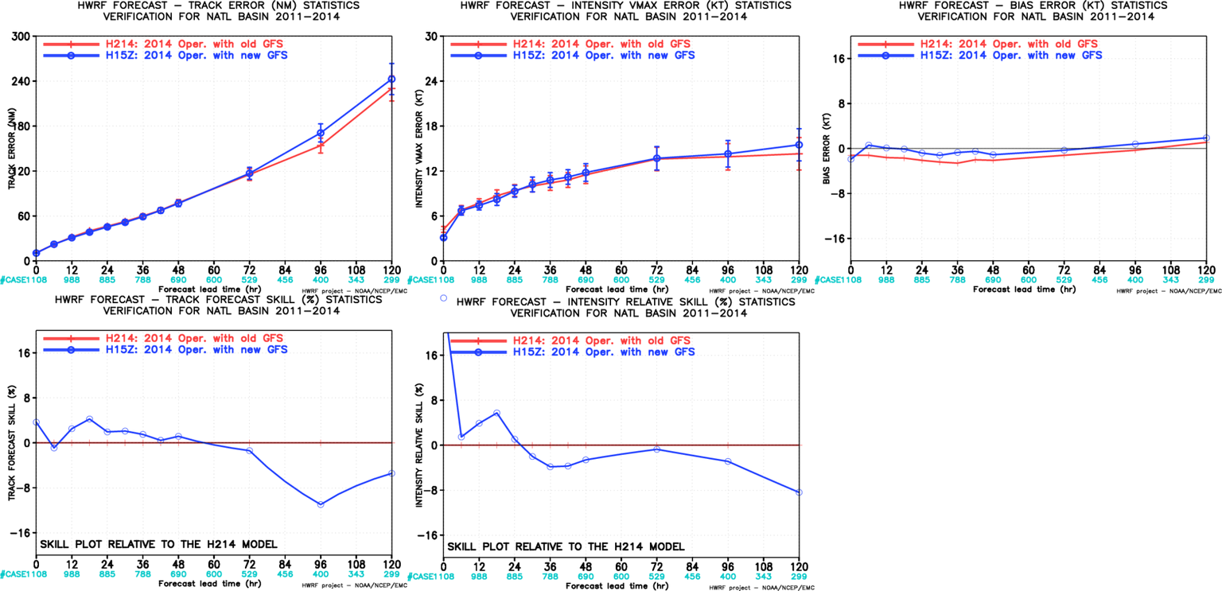
Impact of New GFS, NATL, 2011-2014
New GFS degraded track/intensity forecasts

Slide 15
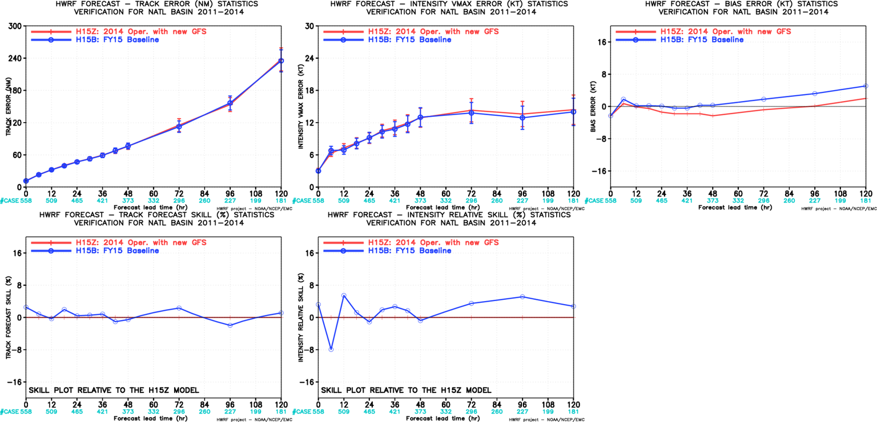
Impact of HWRF Resolution, NATL, 2011-2014
Neutral track impact;
Neutral to positive intensity impact;
Relative large intensity bias;
Resolution upgrades and vortex initialization changes have offset the loss of skill due to new GFS

Slide 16
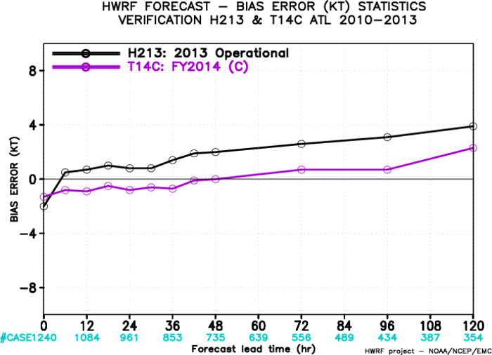
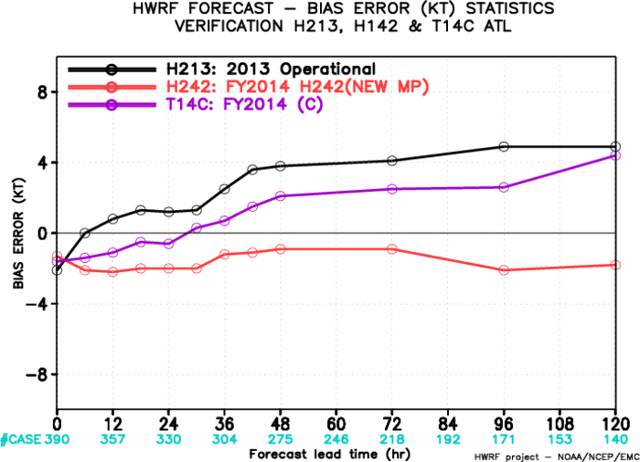
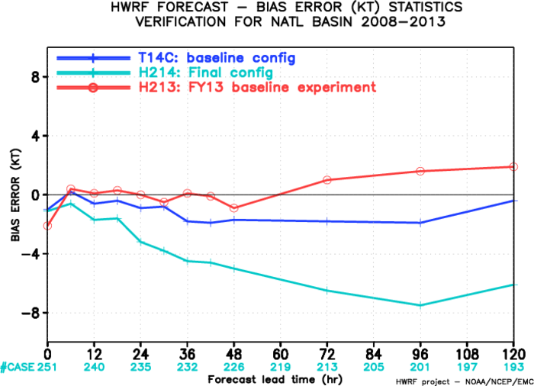
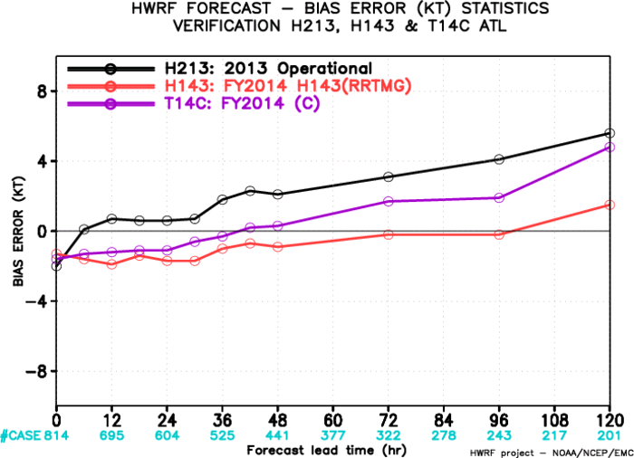
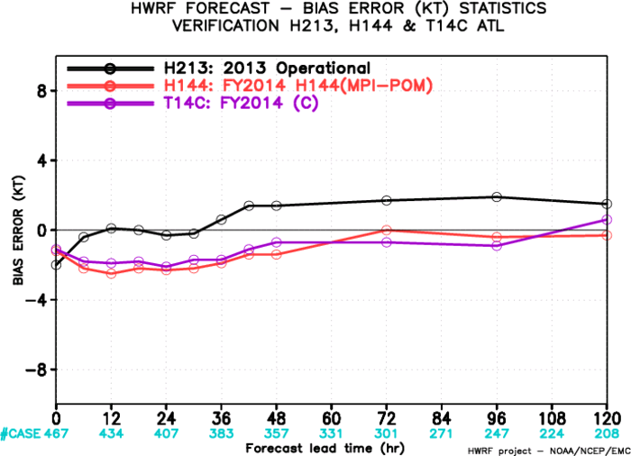
BIAS
T14C
Initial combination
H242
Control configuration
Microphysics upgrades
Combination
Infrastructure+MP+Radiation+Ocean
Radiation upgrades
Ocean upgrades

Slide 17
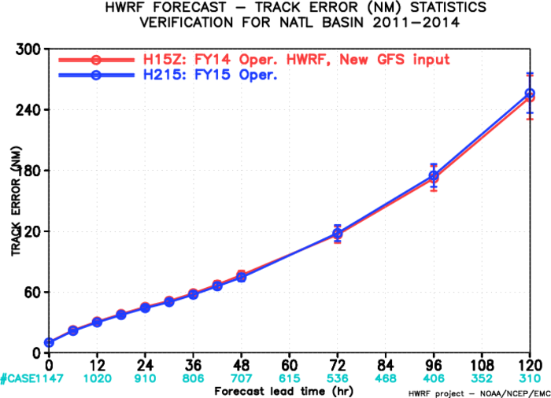
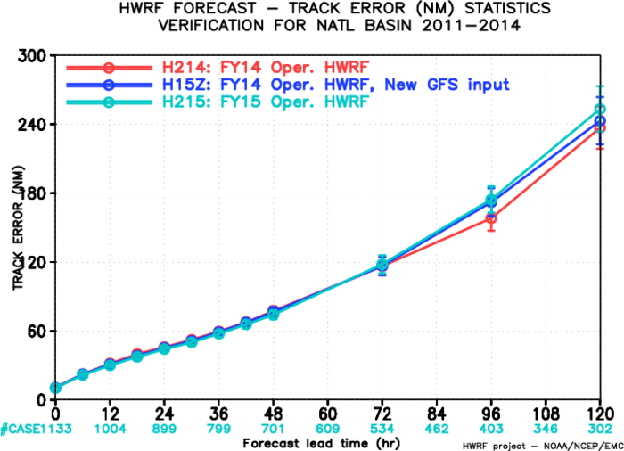
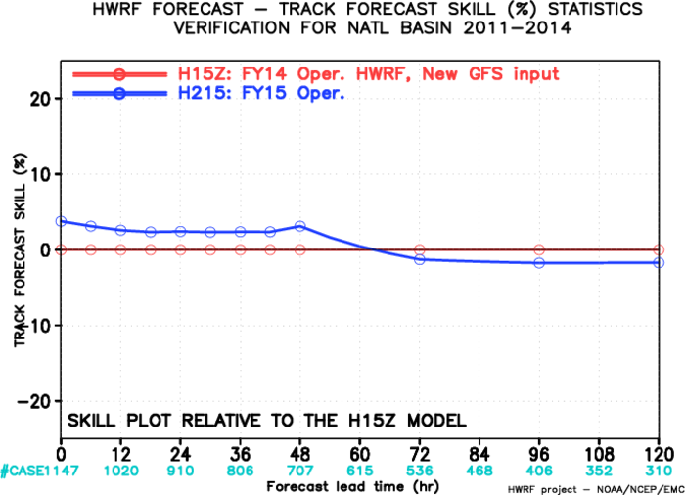
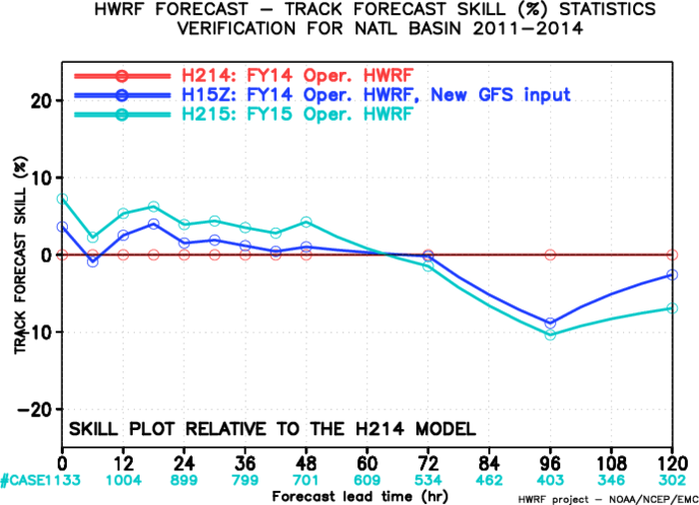
Impact of Physics, Resolution & New GFS, (H215 vs H15Z & H214)
NATL Track Forecasts 2011-2014
Track Forecast Performance from H215 showed neutral impact (slightly better, ~5% through 48 hrs and slightly worse, ~5% from 72-120 hrs compared to H214 as well as H15Z.

Slide 18
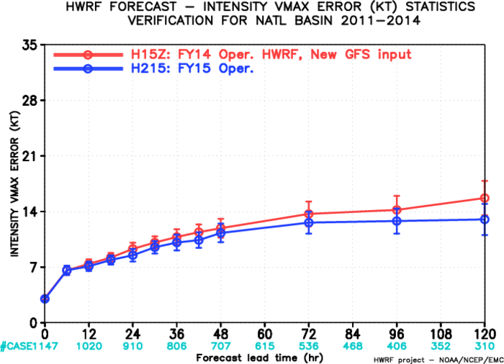
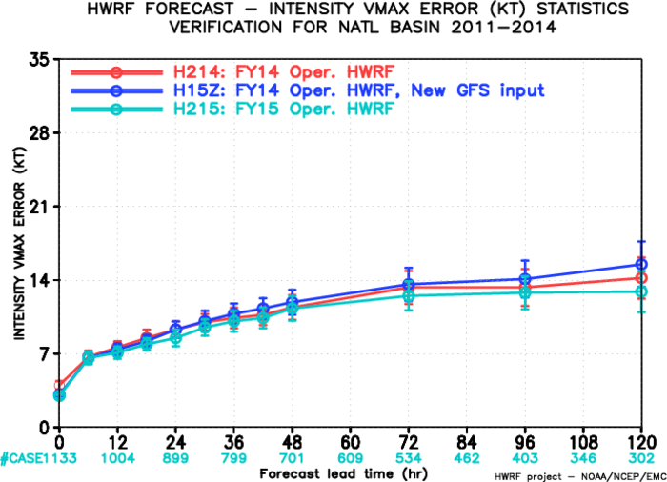
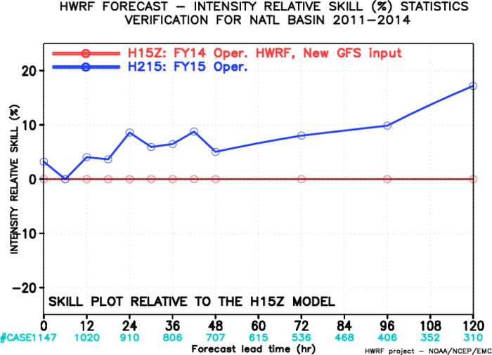
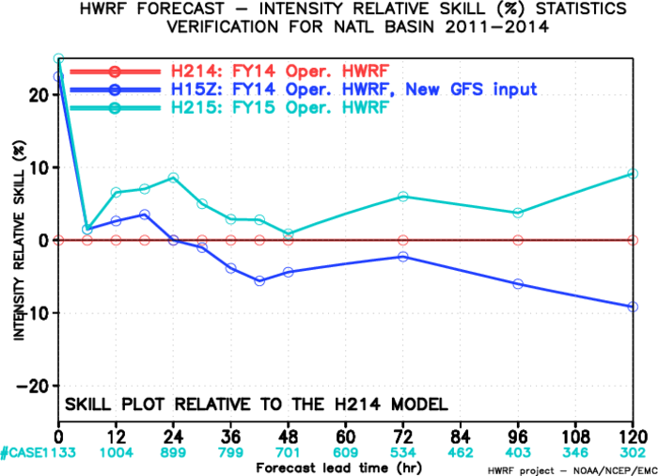
Impact of Physics, Resolution & New GFS, (H215 vs H15Z & H214)
NATL Intensity Error Forecasts 2011-2014
Intensity Forecast Performance from H215 showed significant improvements (~10% at 24, 36, 72 and 96 hrs, and about 18% at 120 hrs). H15Z indicated significant degradations due to use of new GFS.
Physics enhancements were carefully evaluated based on resolution and initialization upgrades to address the negative impacts noted in H214 evaluation as well as degradations due to new GFS.

Slide 19
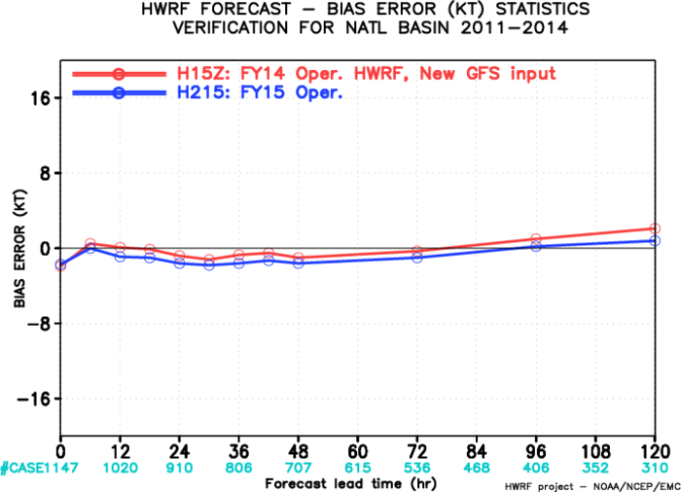
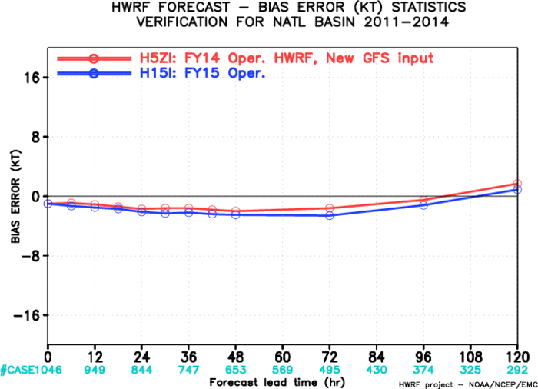
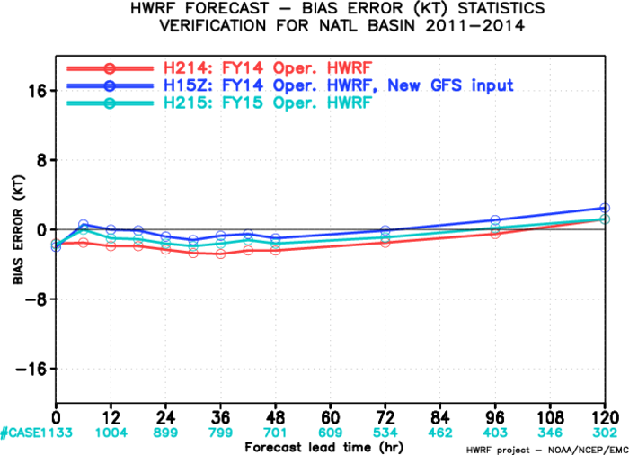
Impact of Physics, Resolution & New GFS, (H215 vs H15Z & H214)
NATL Intensity Bias Forecasts 2011-2014
Intensity Forecast Bias stayed largely neutral, with slight improvements compared to H214/H15Z, trending towards positive bias at day-5.

Slide 20
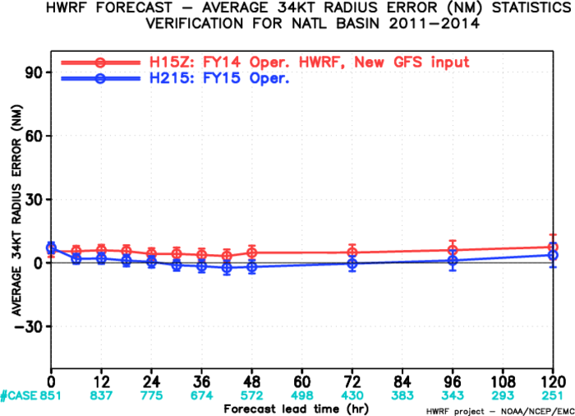
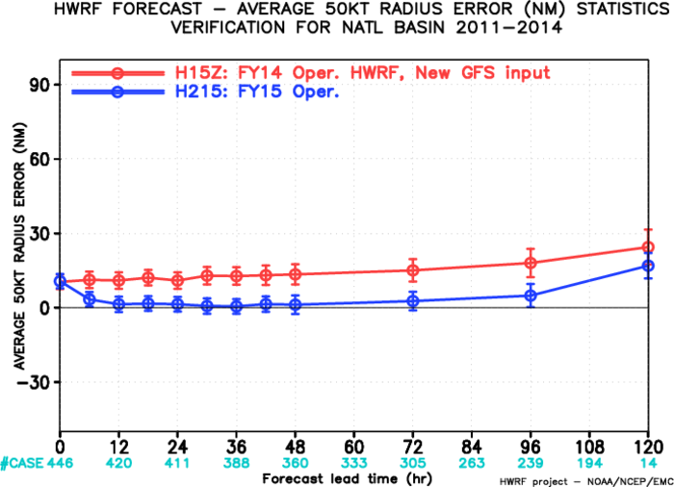
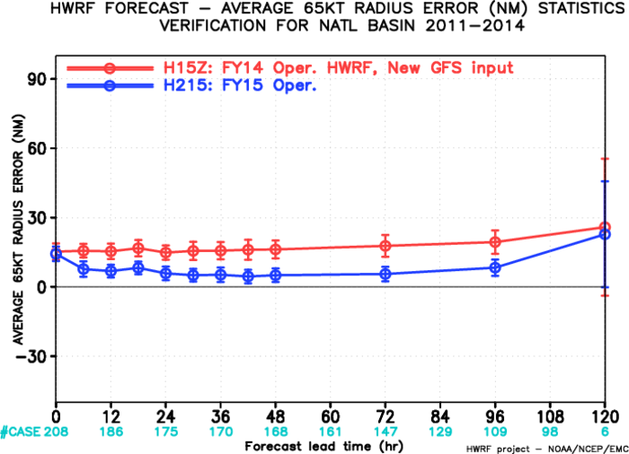
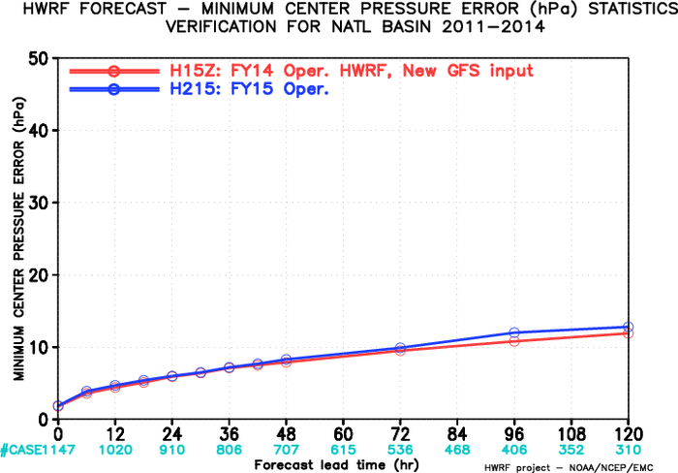
Storm Structure Verification for H215 vs H15Z,NATL
AL-R34
Storm size improved in H215 in all three radii categories for ATL storms. No impact on MSLP forecasts

Slide 21
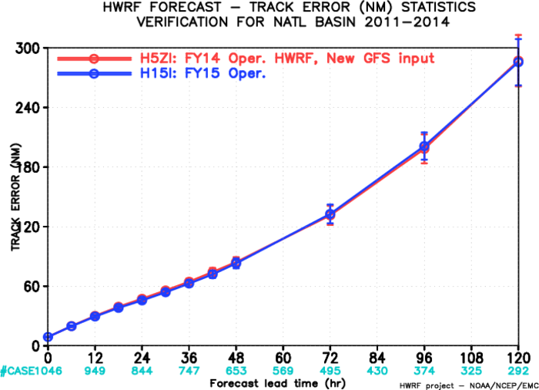
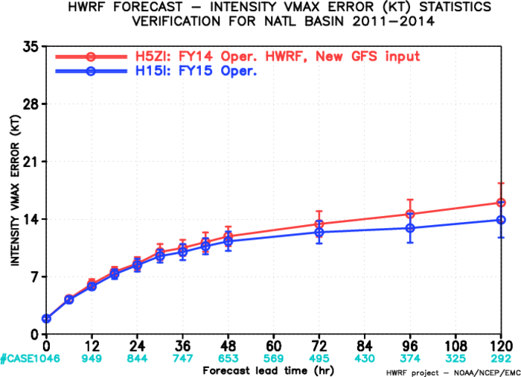
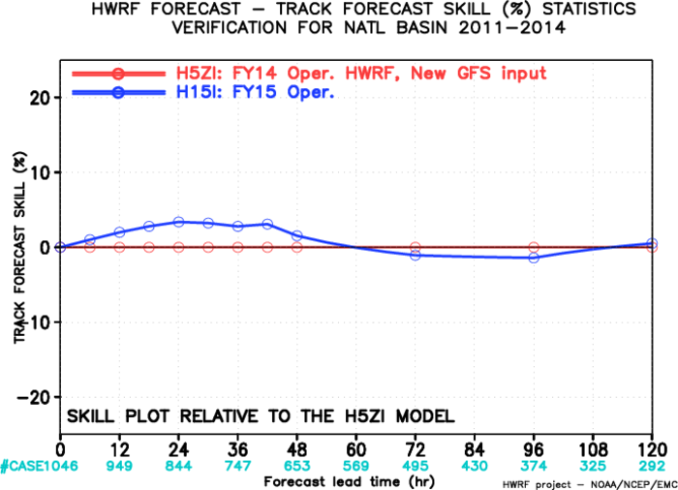
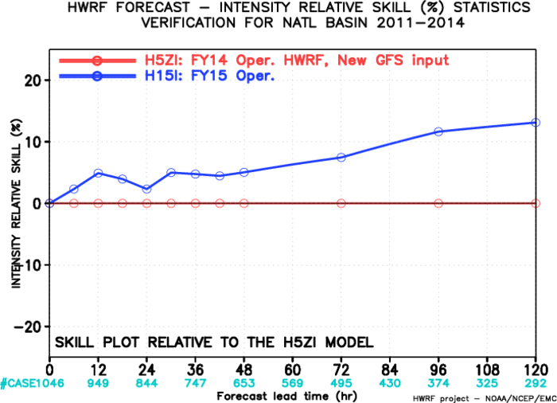
Verification of interpolated guidance, NATL, H15I vs. H5ZI

Slide 22
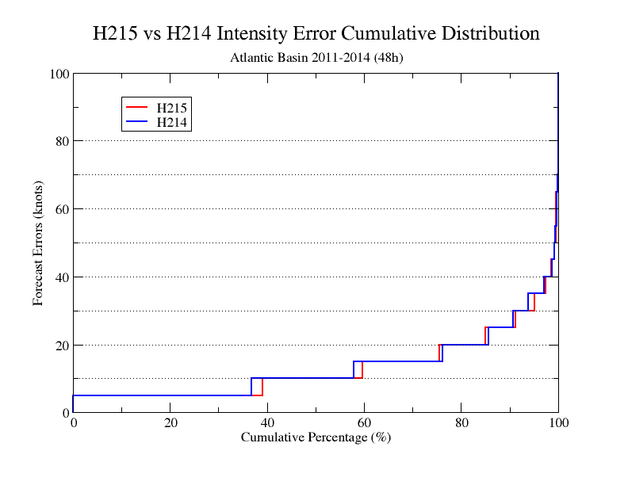
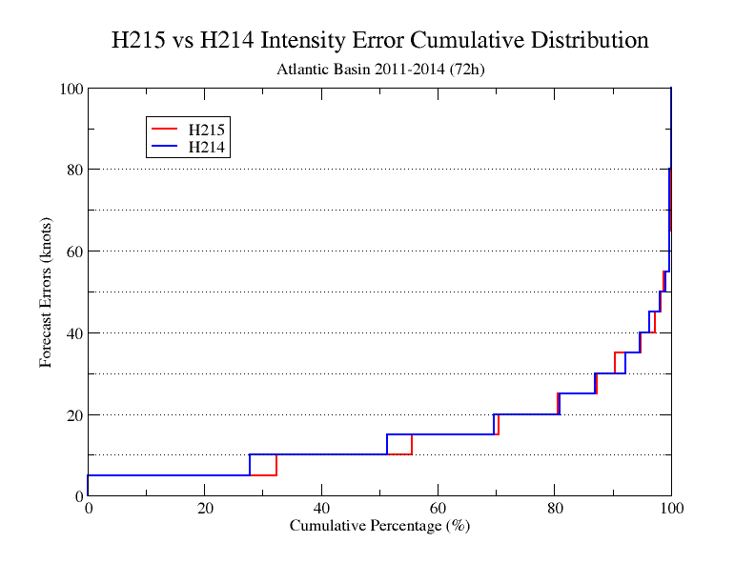
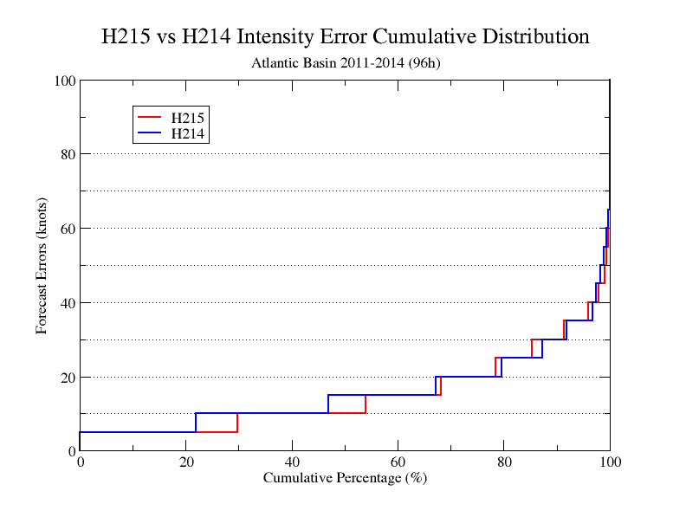
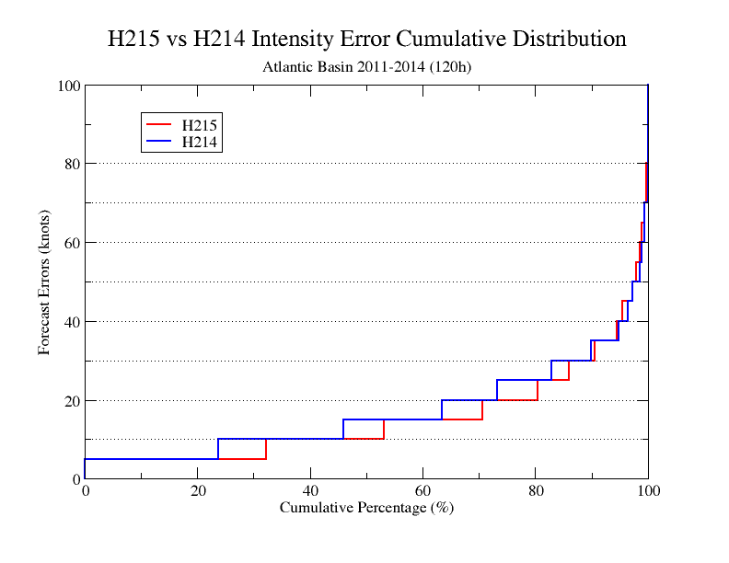
Improvement of Intensity Cumulative Distribution of H215,AL
Day 2
Day 3
Day 4
Day 5

Slide 23
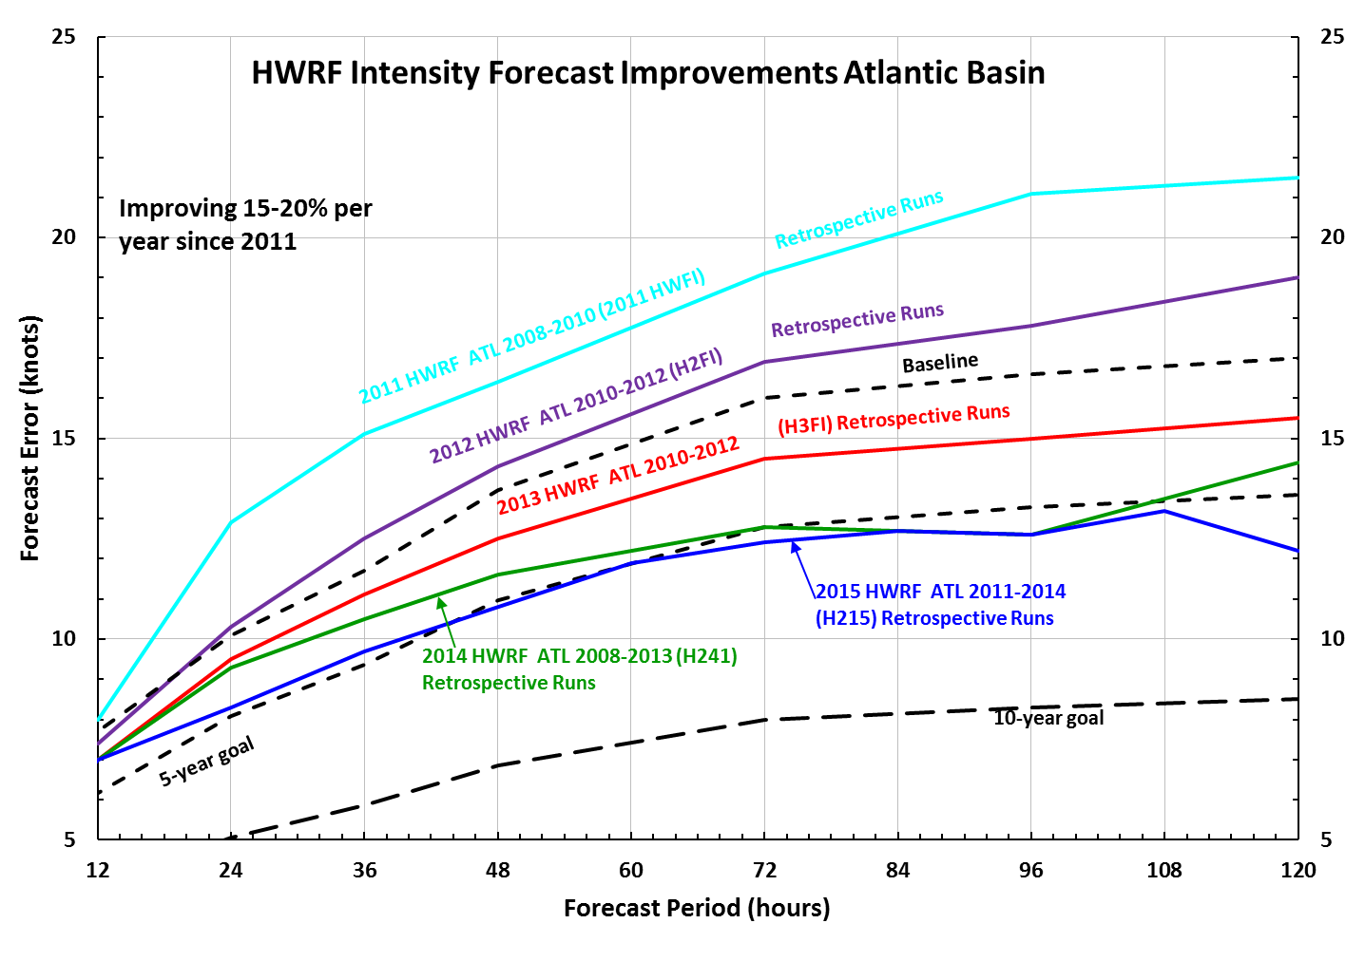
2015 HWRF: Continuing the trend of incremental but substantial improvements in ATL intensity forecasts
This marks 4th year in a row of demonstrating continuous improvements as measured through heterogeneous verification of multi-year retrospective runs.

Slide 24
Verification for East-Pacific Storms (2011-2014)

Slide 25
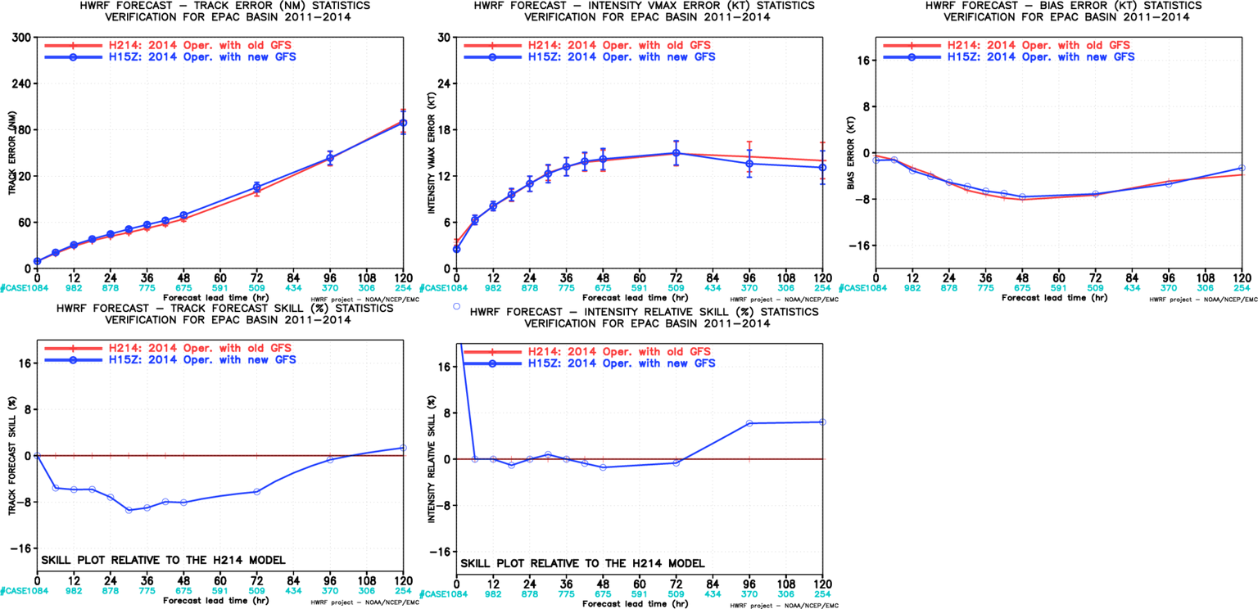
Impact of new GFS, EP, 2011-2014
Track Forecast degraded from using new GFS upgrade. Some improvement in intensity forecasts at days 4/5, neutral intensity bias

Slide 26
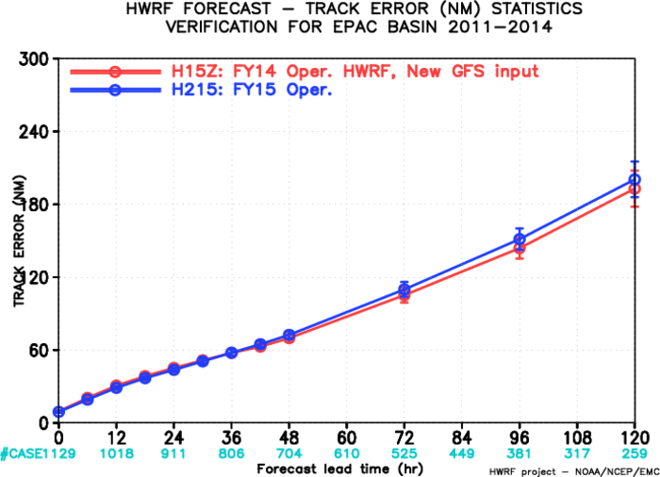
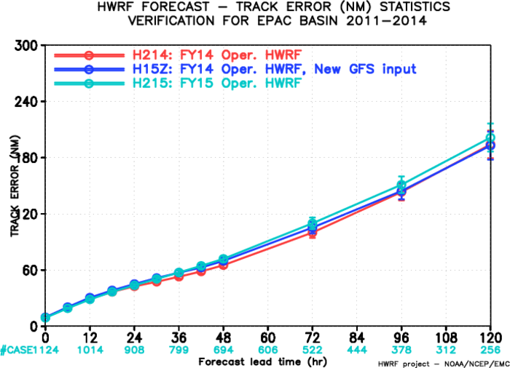
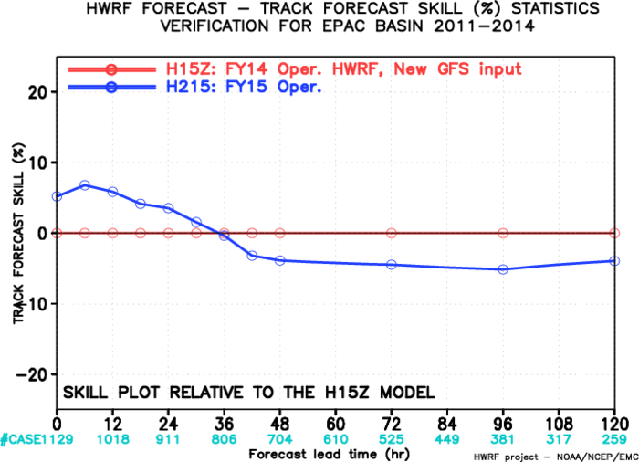
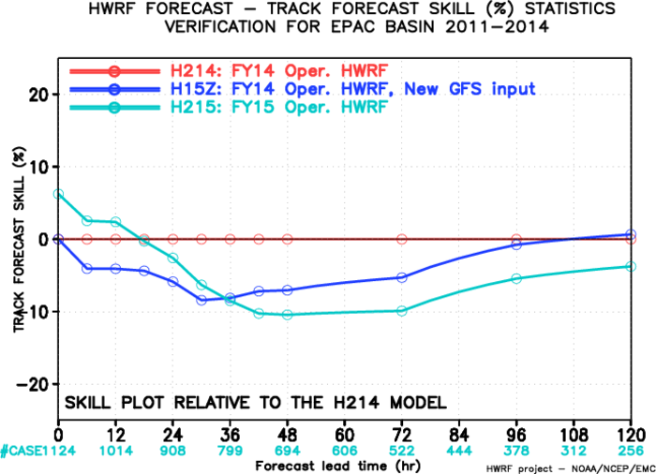
Impact of Physics, Resolution & New GFS, (H215 vs H15Z & H214)
EP Track Forecasts 2011-2014
2015 HWRF upgrades were able to recover the loss of track forecast skill due to new GFS through 24 hrs, but remained largely negative 48 hrs and beyond

Slide 27
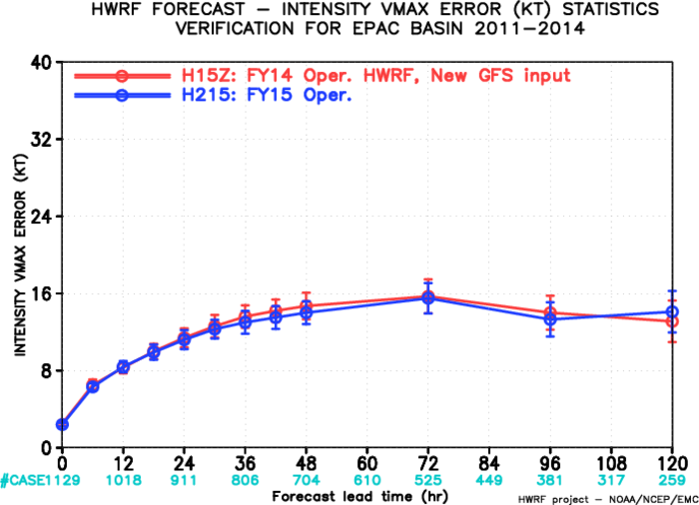
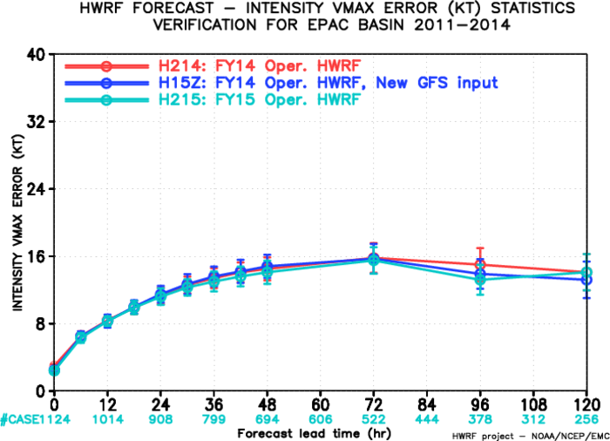
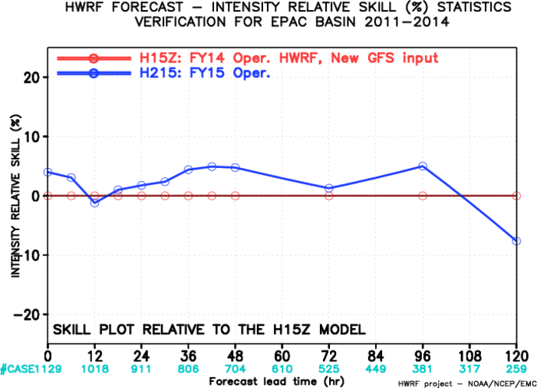
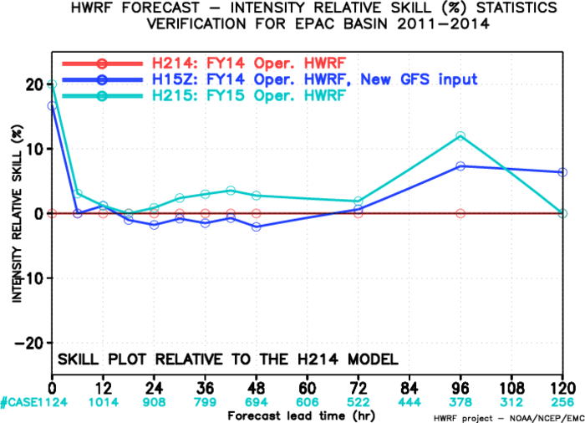
Impact of Physics, Resolution & New GFS, (H215 vs H15Z & H214)
EP Intensity Forecasts 2011-2014
2015 HWRF upgrades were able to show modest improvements (<5%) in intensity forecasts through 96 hrs.

Slide 28
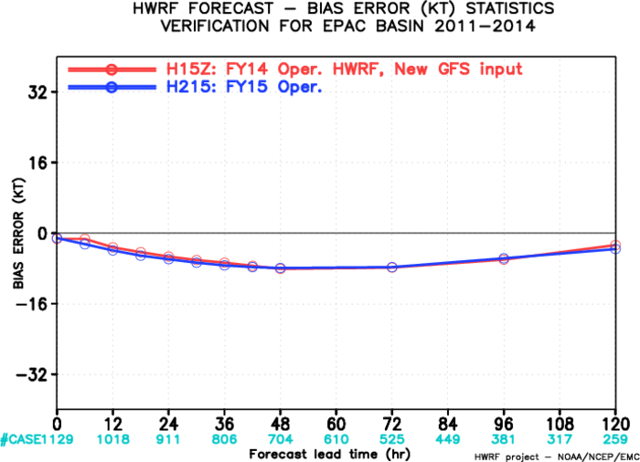
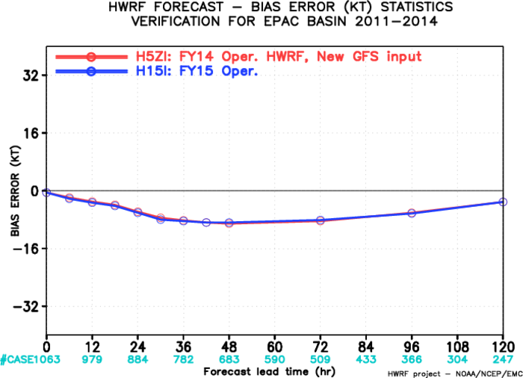
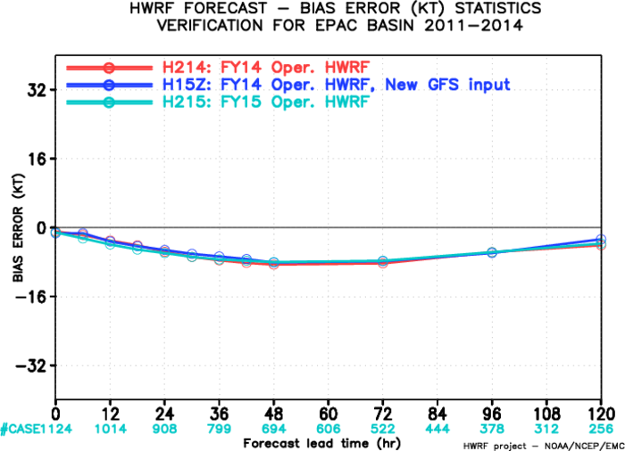
Impact of Physics, Resolution & New GFS, (H215 vs H15Z & H214)
EP Intensity Bias Forecasts 2011-2014
Intensity Forecast Bias remained the same (mostly negative) despite higher resolution and improved physics

Slide 29




Storm Structure Verification for H215 vs H15Z, EP
EP-R50
EP-R34
Storm size improved in H215 in all three radii categories for ATL storms. No impact on MSLP forecasts
EP-R65
EP-MSLP

Slide 30




Verification of interpolated guidance, EP, H15I vs. H5ZI

Slide 31


Verification Against new GFS, EP

Slide 32




Improvement of Intensity Cumulative Distribution of H215,EP
Day 2
Day 3
Day 4
Day 5

Slide 33




Verifications in Skill Space, H215 vs. H15Z, ATL/EP

Slide 34




Verifications in Skill Space, H215 vs. H214, ATL/EP

Slide 35
Summary
Further enhancements suggested for 2015 operational HWRF include:
  Increase the horizontal resolution from 27/9/3 to 18/6/2 km.
  Upgrade and improve HWRF vortex initialization scheme
  Upgrade DA with hybrid HWRF-based EnKF and GSI system.
  Upgrade model physics to accommodate model resolution increase, including micro-physics process, radiation, surface physics, land surface and PBL.
H215 retrospective evaluation of 2011-2014 hurricane seasons (1147 verifiable cycles in NATL, 1129 in EP ) demonstrated improved forecasts compared to both FY14 operational HWRF (H214) and FY14 driven by new GFS (H15Z), except for the track forecasts in the Eastern Pacific;
Results from H215 for the Atlantic basin suggested additional 10-15% improvement possible from the newly upgraded model compared to H15Z, about 5-10% improvement compared to H214.
Results from H215 for the Eastern Pacific basin suggested about 5% more track forecast errors compared to H15Z, however, H215 track forecasts are still comparable or better than the new GFS track forecasts. A modest (~5%) improvement in intensity forecasts is shown possible from 2015 HWRF upgrades .

Slide 36
Evaluation metrics in the skill space confirmed the positive improvements from H215 compared to H15Z in both basins for intensity forecasts, and in the Atlantic for track forecasts.
High-resolution ensemble based TDR DA paves way for the next generation vortex scale DA efforts supported by HFIP, while bringing immediate benefits in the operations.
Centralized HWRF Development Process for both research and operations with community involvement is critical for making further enhancements.
Looking forward to realize these improvements in real-time during the upcoming hurricane season, and help enhance the skills of official forecasts
Evaluation of model upgrades for WPAC and other basins in progress
NCEP will provide HWRF forecast guidance for TCs in all global basins starting around May 29, 2015

