Slide 1
KITsonde
Modular Multi Sensor Dropsonde for High Resolution Measurements
Andreas Wieser

Slide 2
KITsonde Concept
High Resolution
  30 Sondes
  Low fall speed
Modular
  Multi sonde release
  Easy sensor integration
Data Telemetry
  Aircraft (400 MHz)
  Internet (Iridium option)
Compatible
  RD-94 size

Slide 3
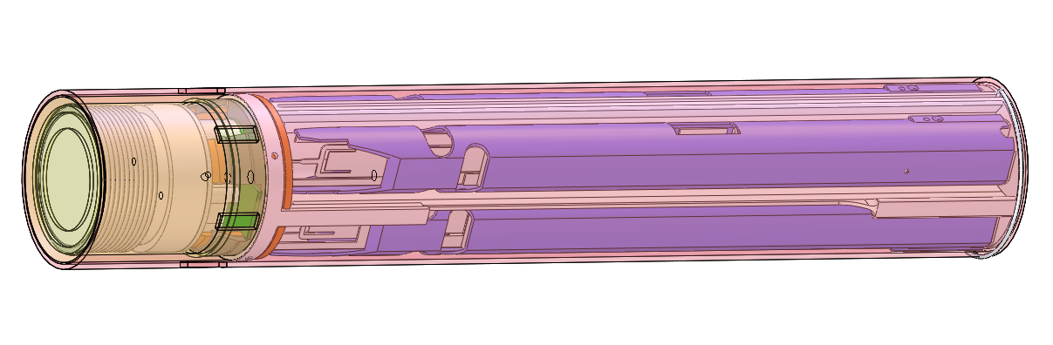

Release Container
Protective sonde casing during release from aircraft
  Operation phases:
  Spin and aerodynamic deceleration
  Stabilization
  Parachute opening
  Sonde release
Multi sonde release
Multi aircraft

Slide 4
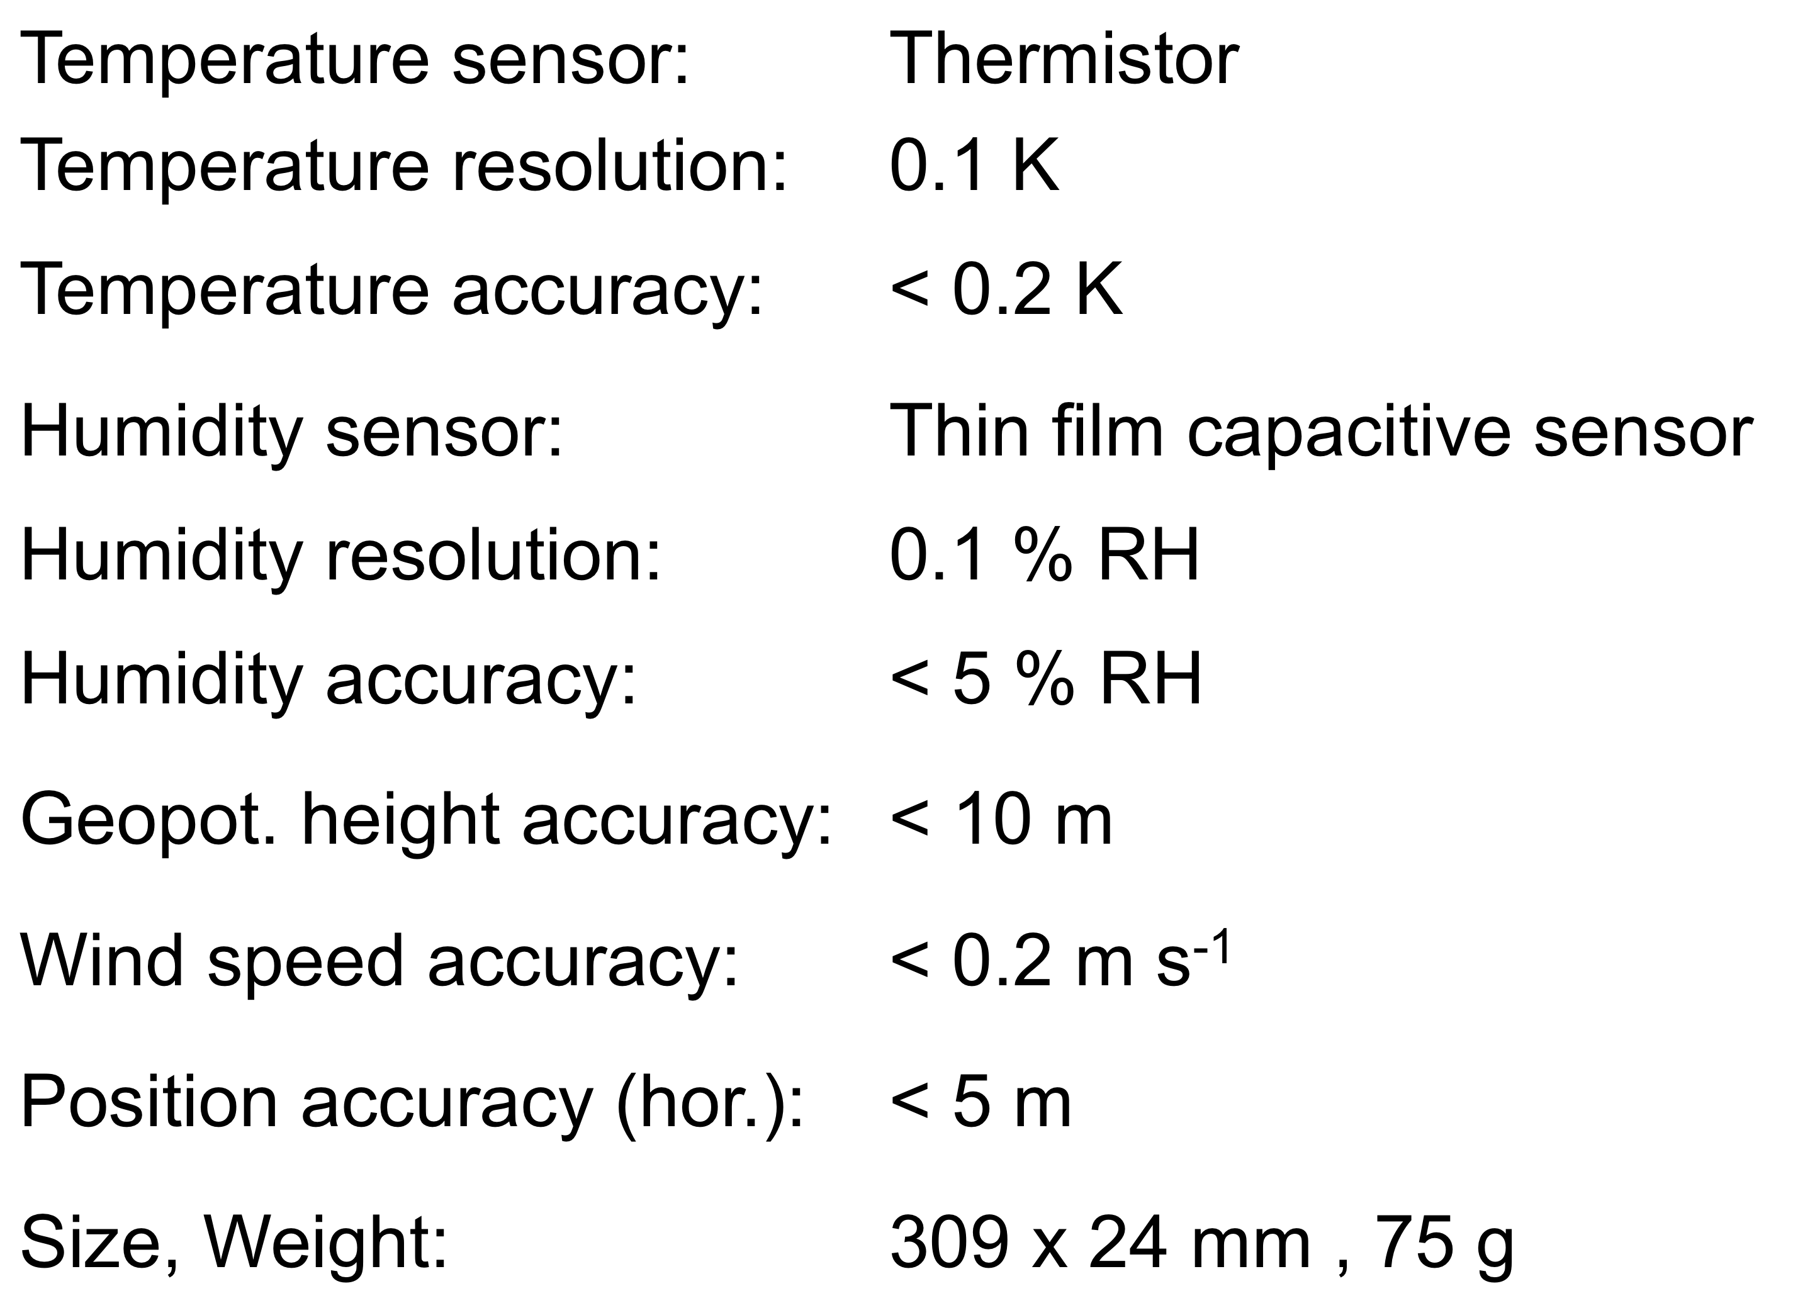
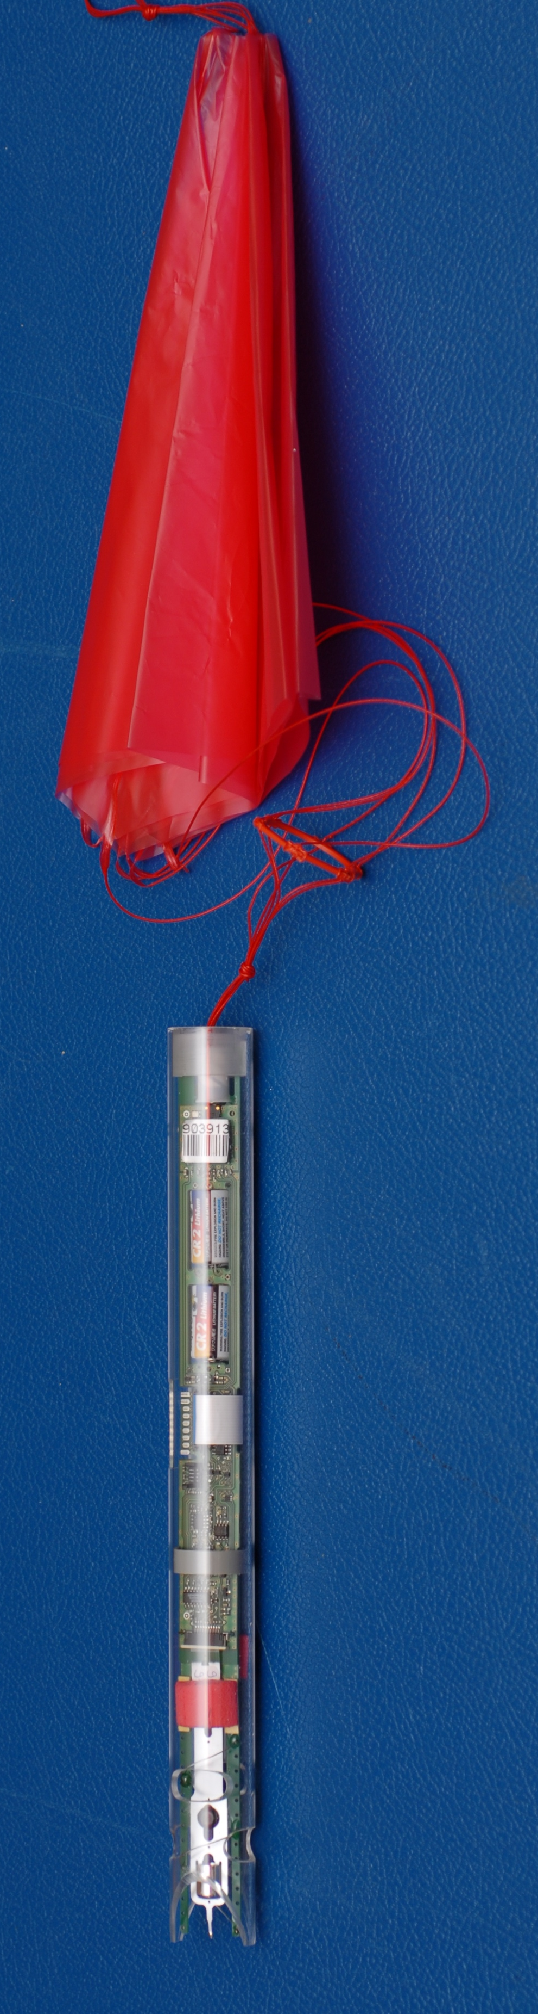

Meteorological Sensor Package EL-08
including housing and parachute
EL-08 uses sensors of DFM-09 Radiosonde
Very good results at WMO intercomparison 2010
Average score of 4.66 on a range from 1 to 5, minimum score 4.25
1: Minimum acceptable performance, 3 Meets operational requirements, 5 as good as can be expected

Slide 5
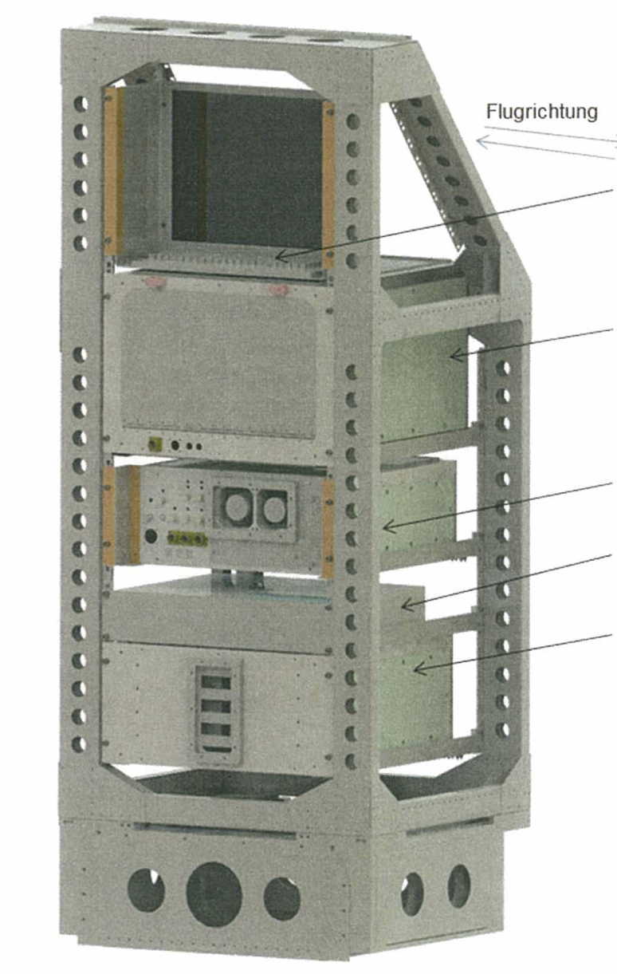
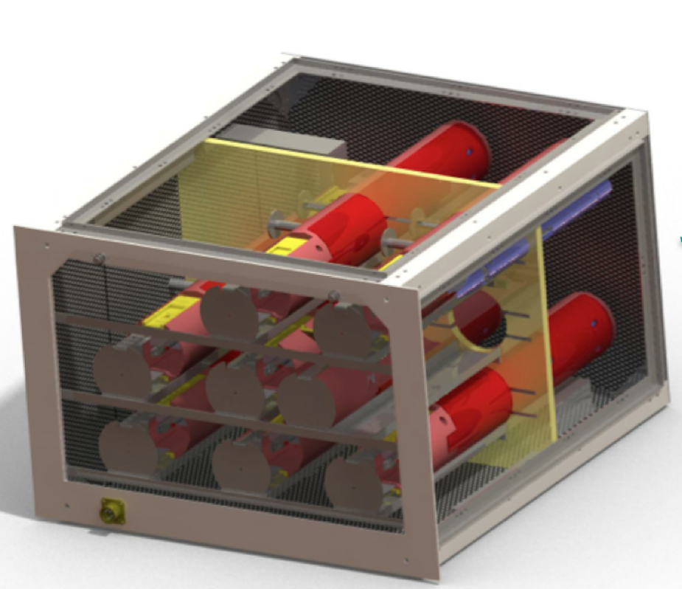
Cabin Installations
KVM
Sonde configuration
(8 Release Container)
System control, decoding
Data acquisition
Receiver (32)
Rack space: 26 HU
Weight: 74.7 kg
Power: 28 VDC, 11 A

Slide 6
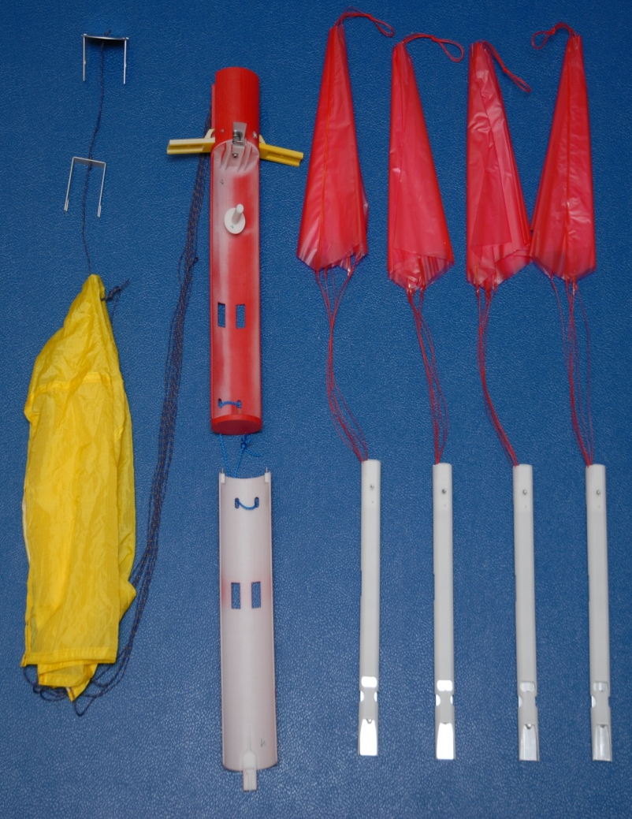
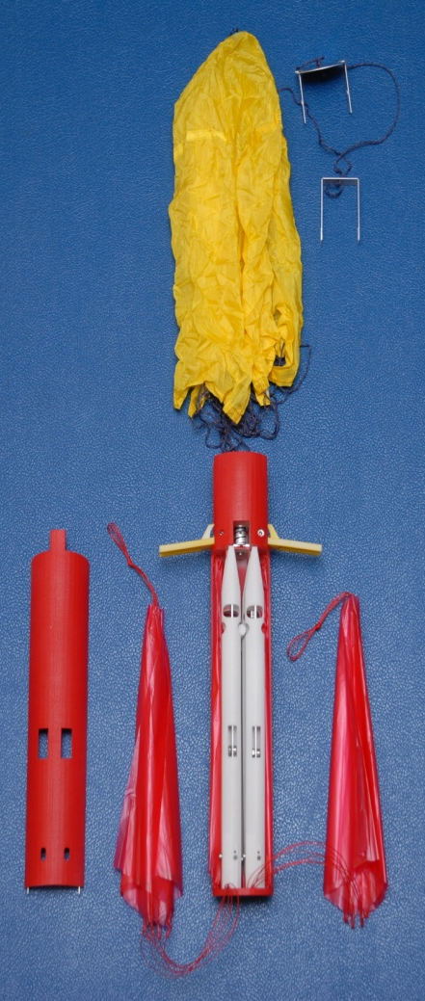
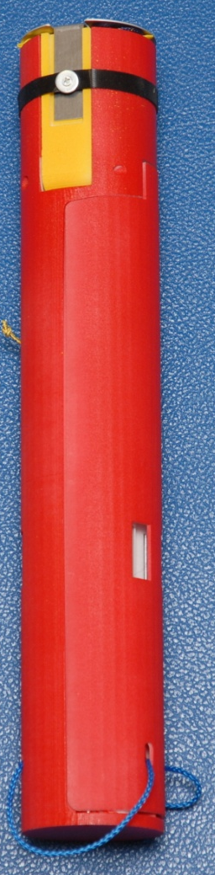
Release Container (v1.0)

Slide 7
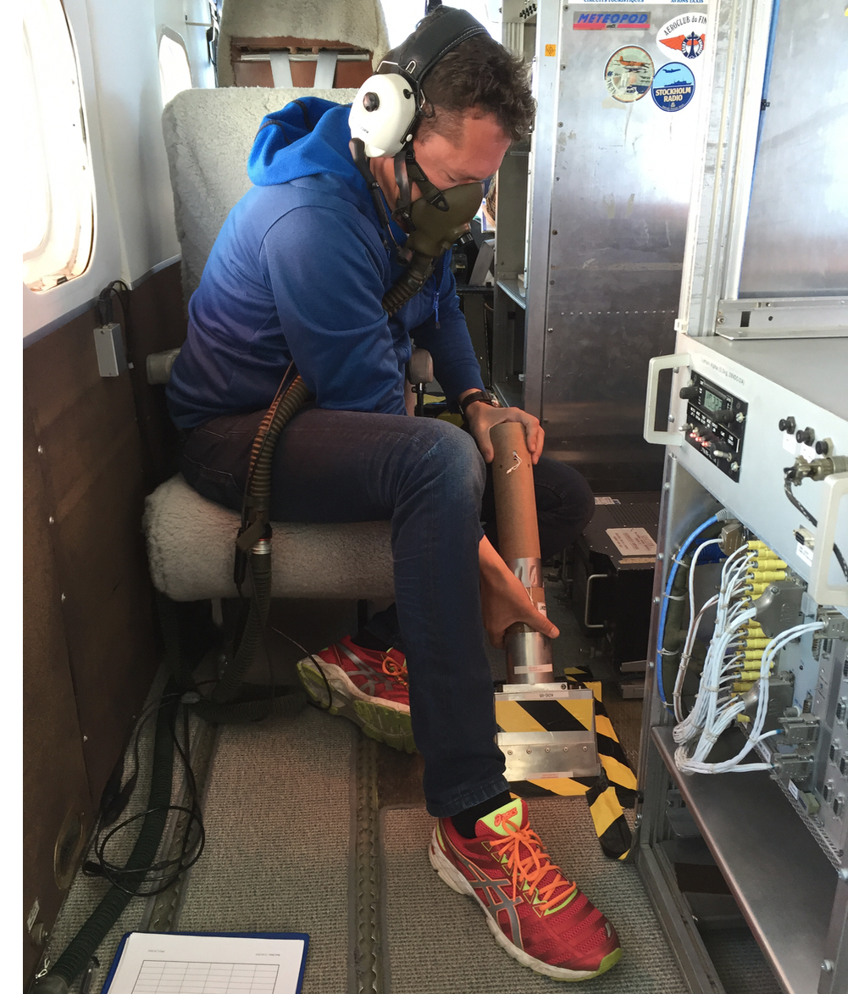
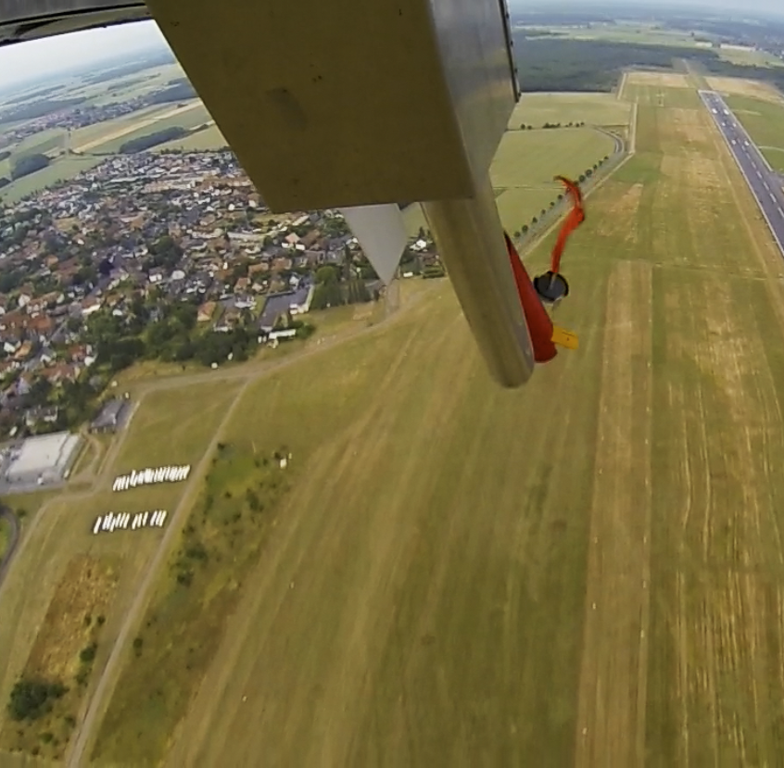
Release .

Slide 8
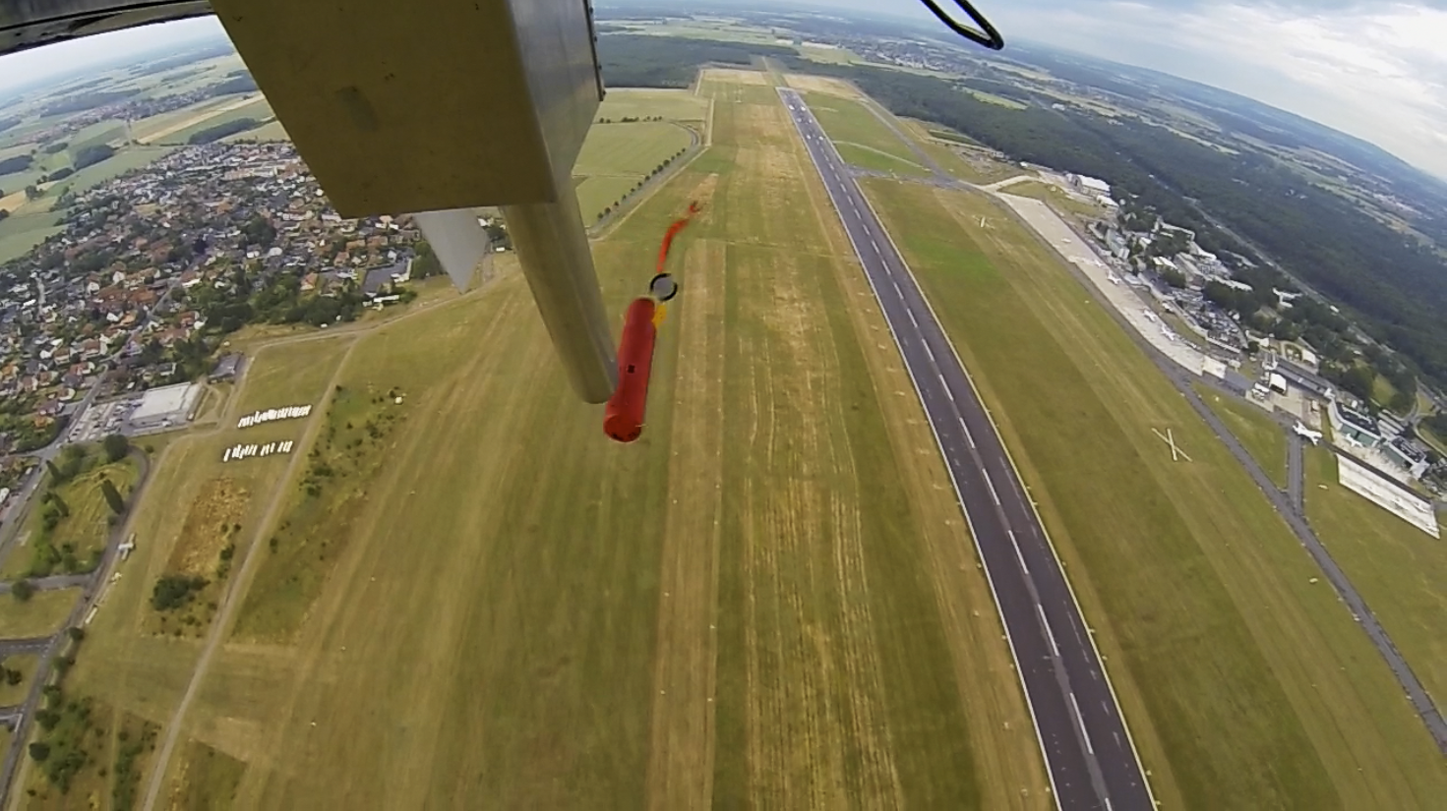
Release ..

Slide 9
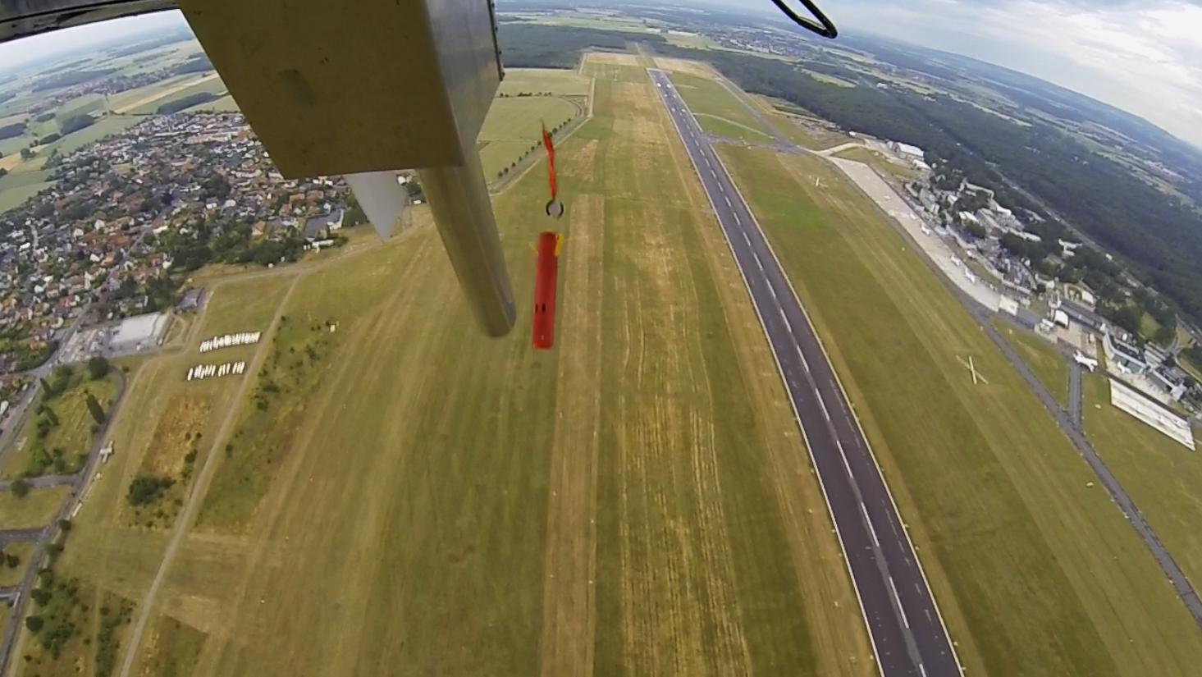
Release ..

Slide 10
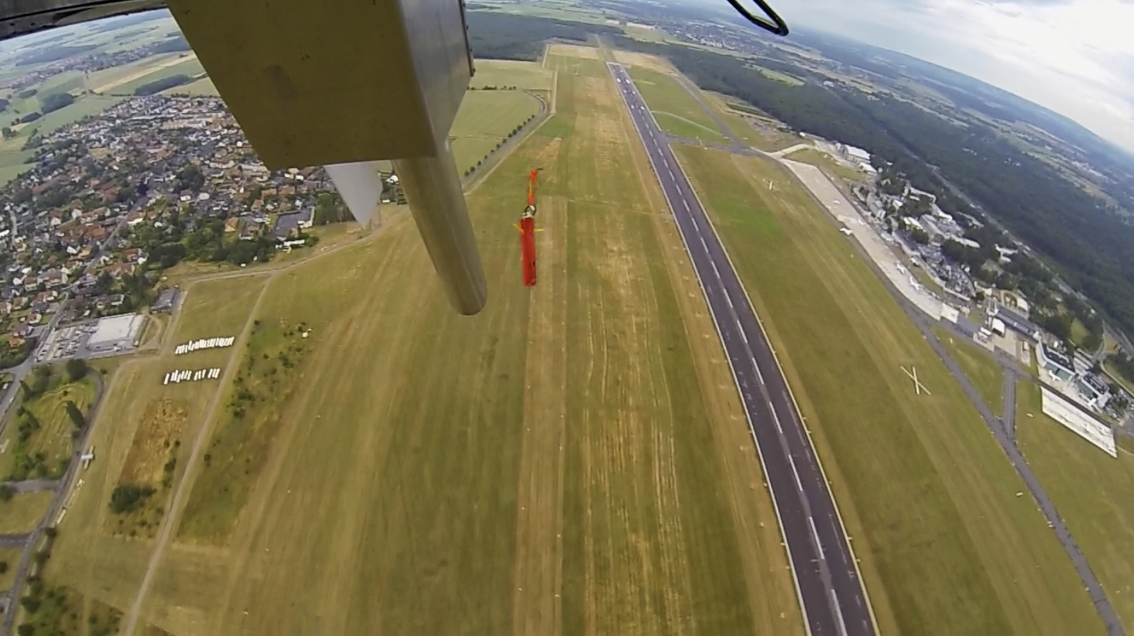
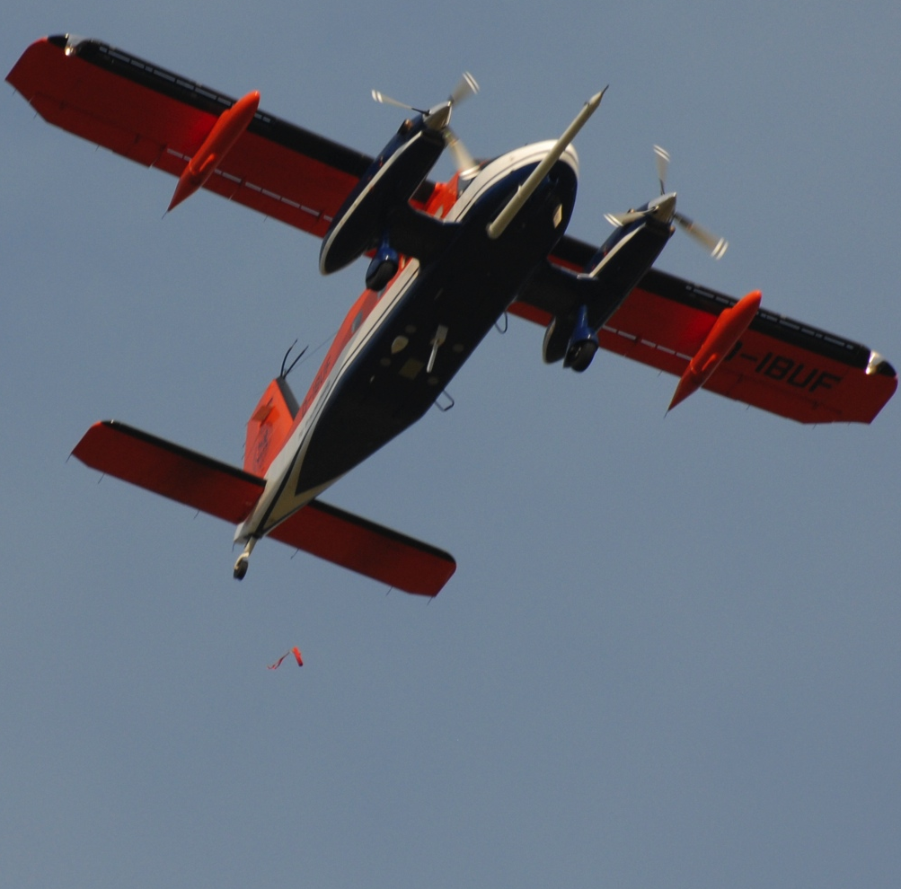
Release ....

Slide 11
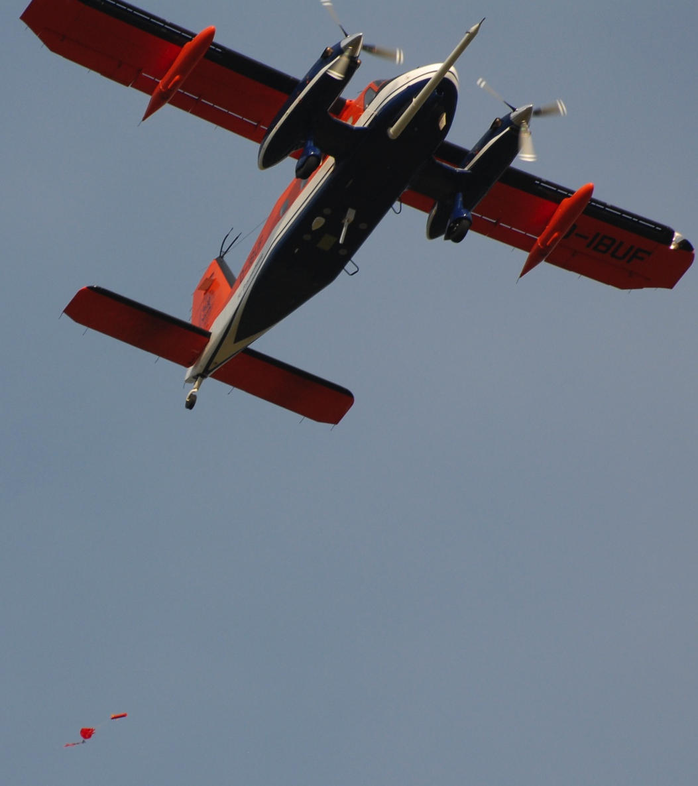
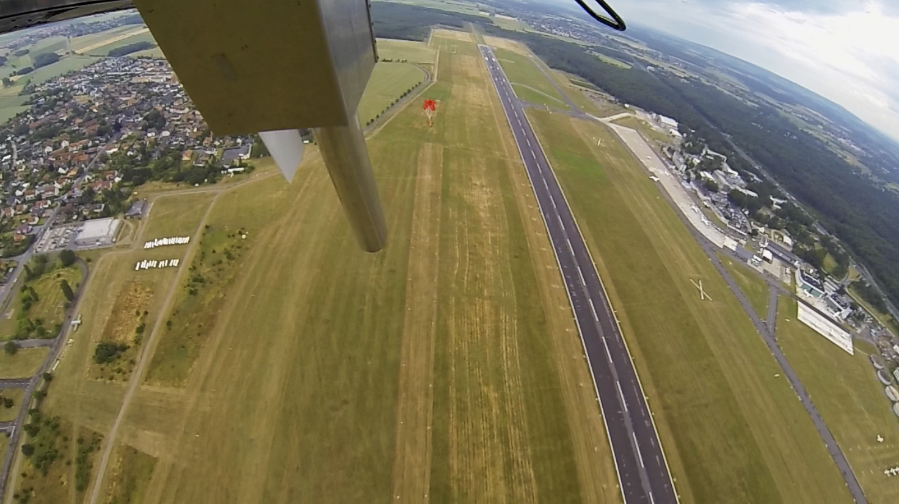
Release ....

Slide 12
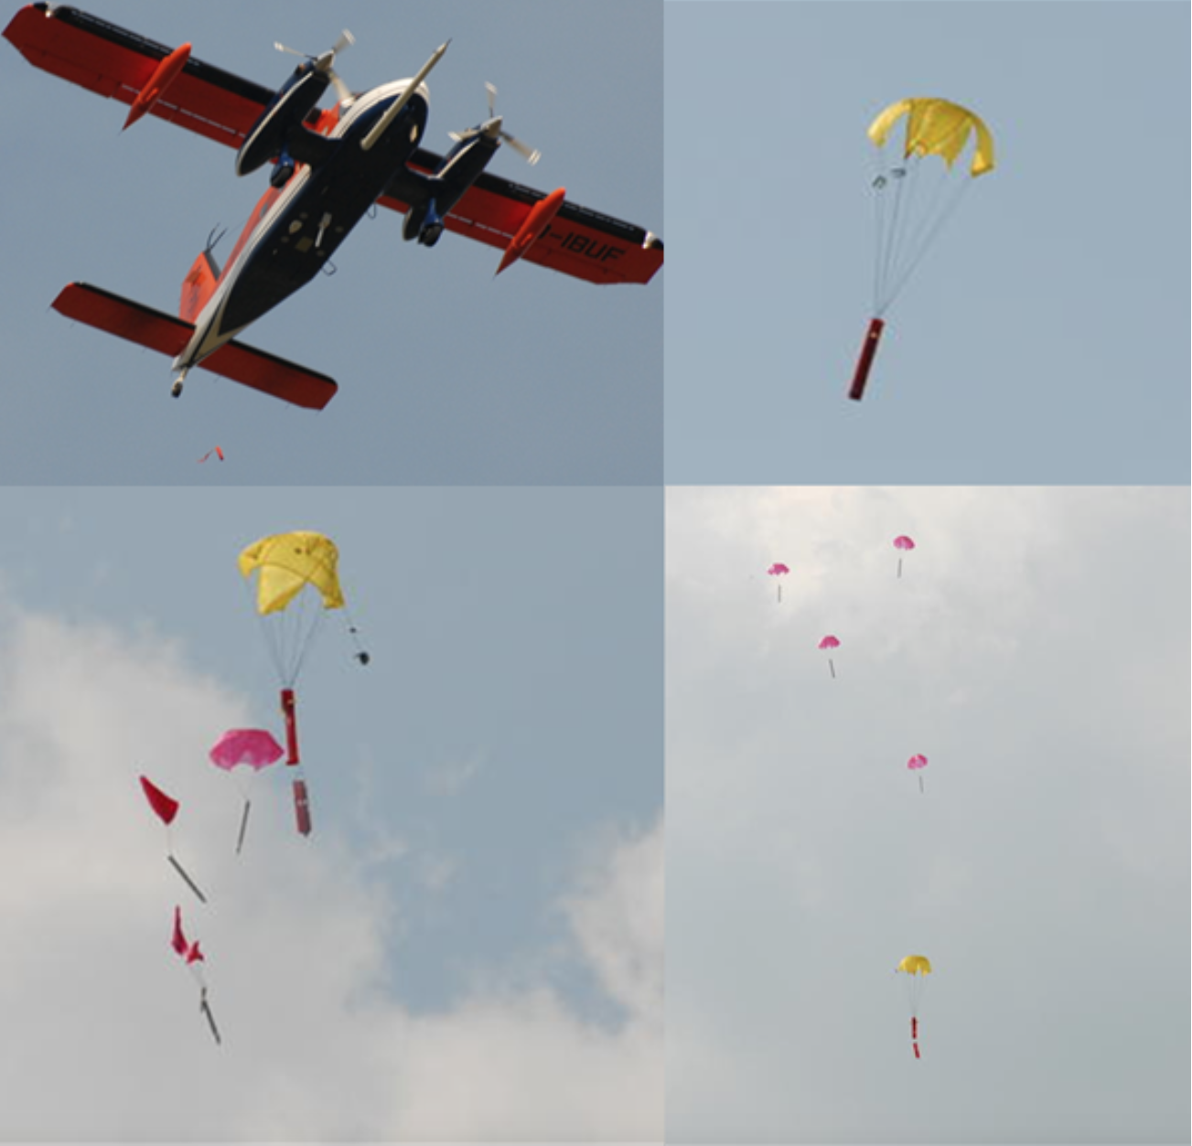
Release Test

Slide 13
KITsonde operated on Dornier 128

Slide 14
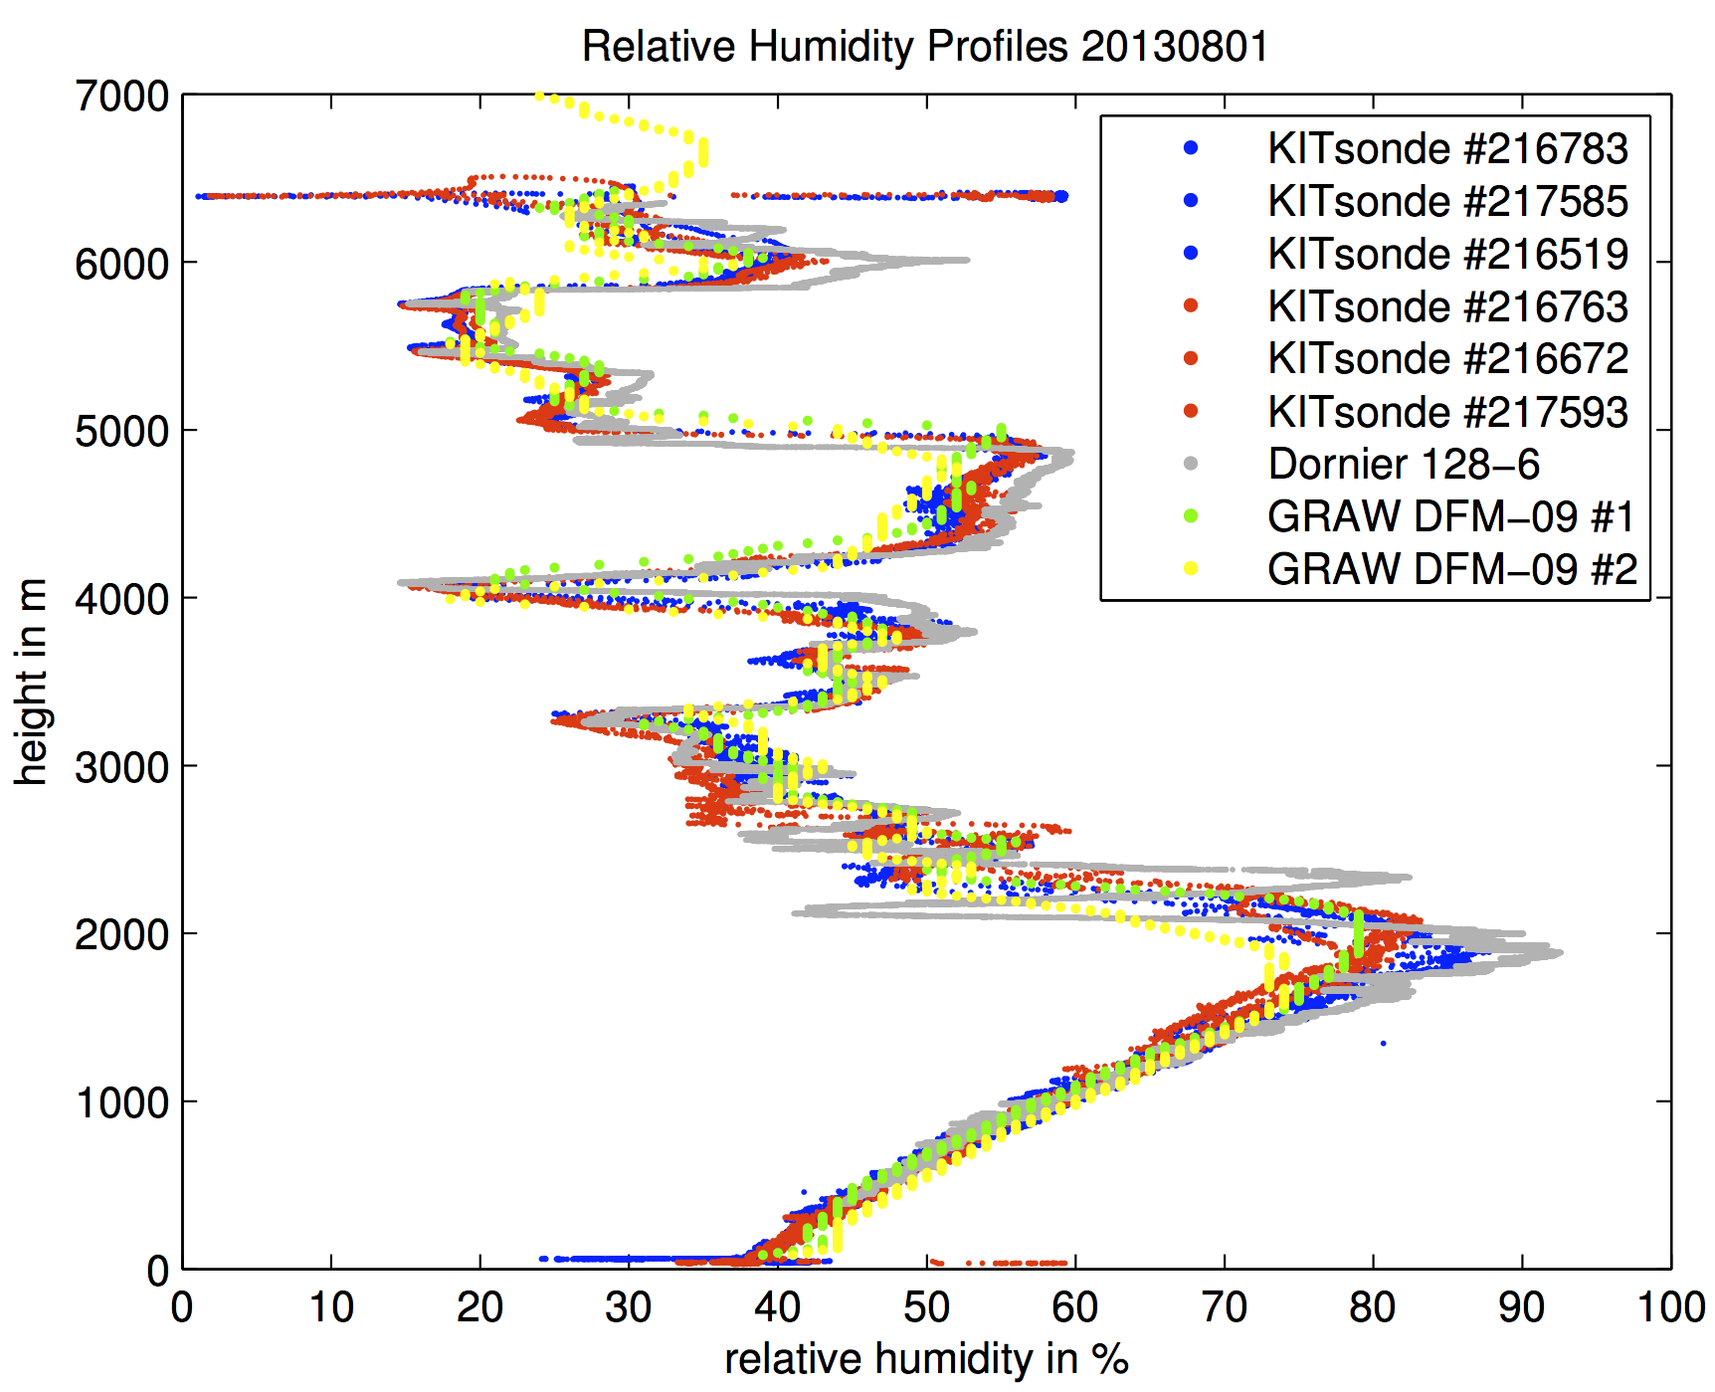
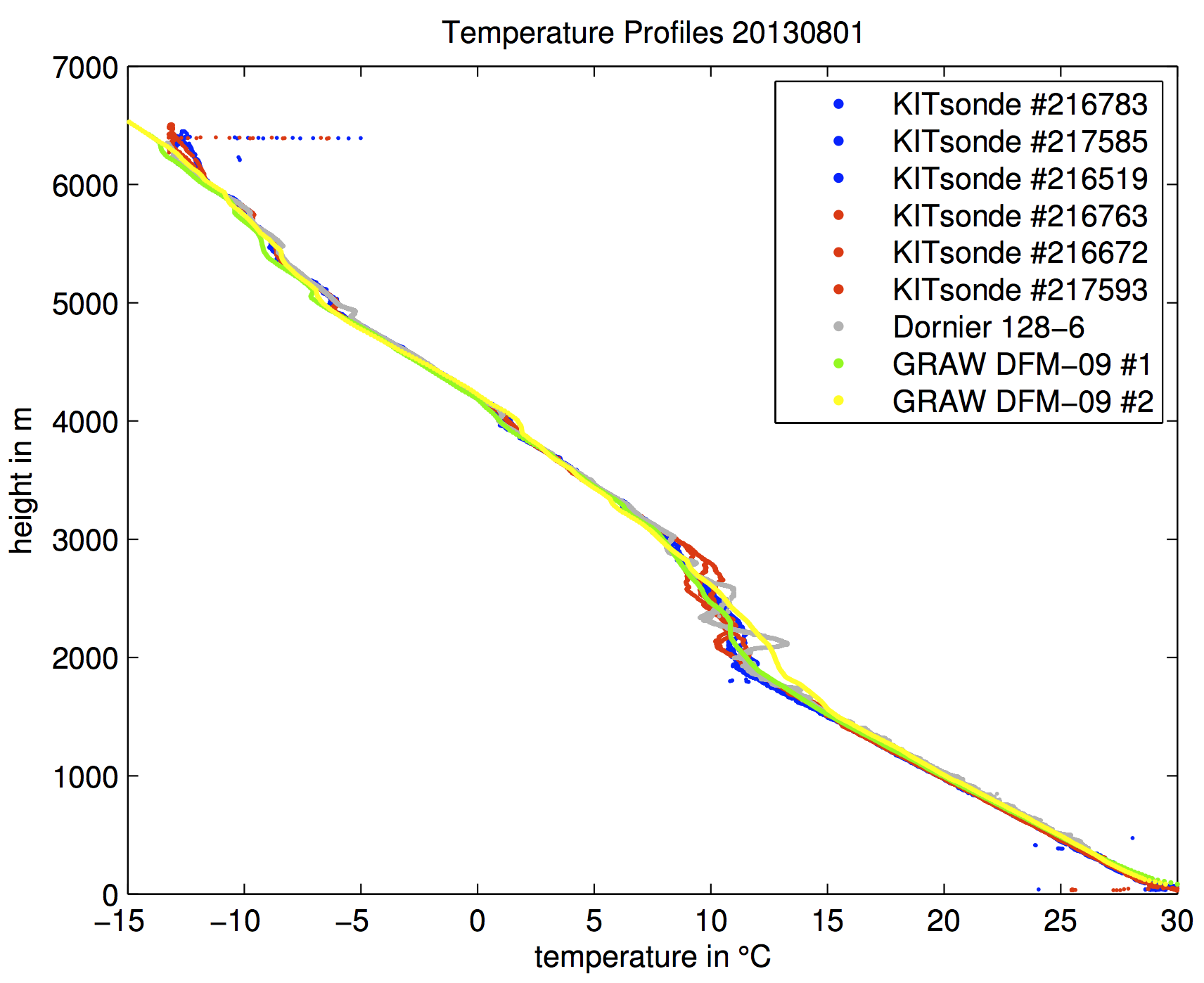
Humidity and Temperature Profile Intercomparison

Slide 15
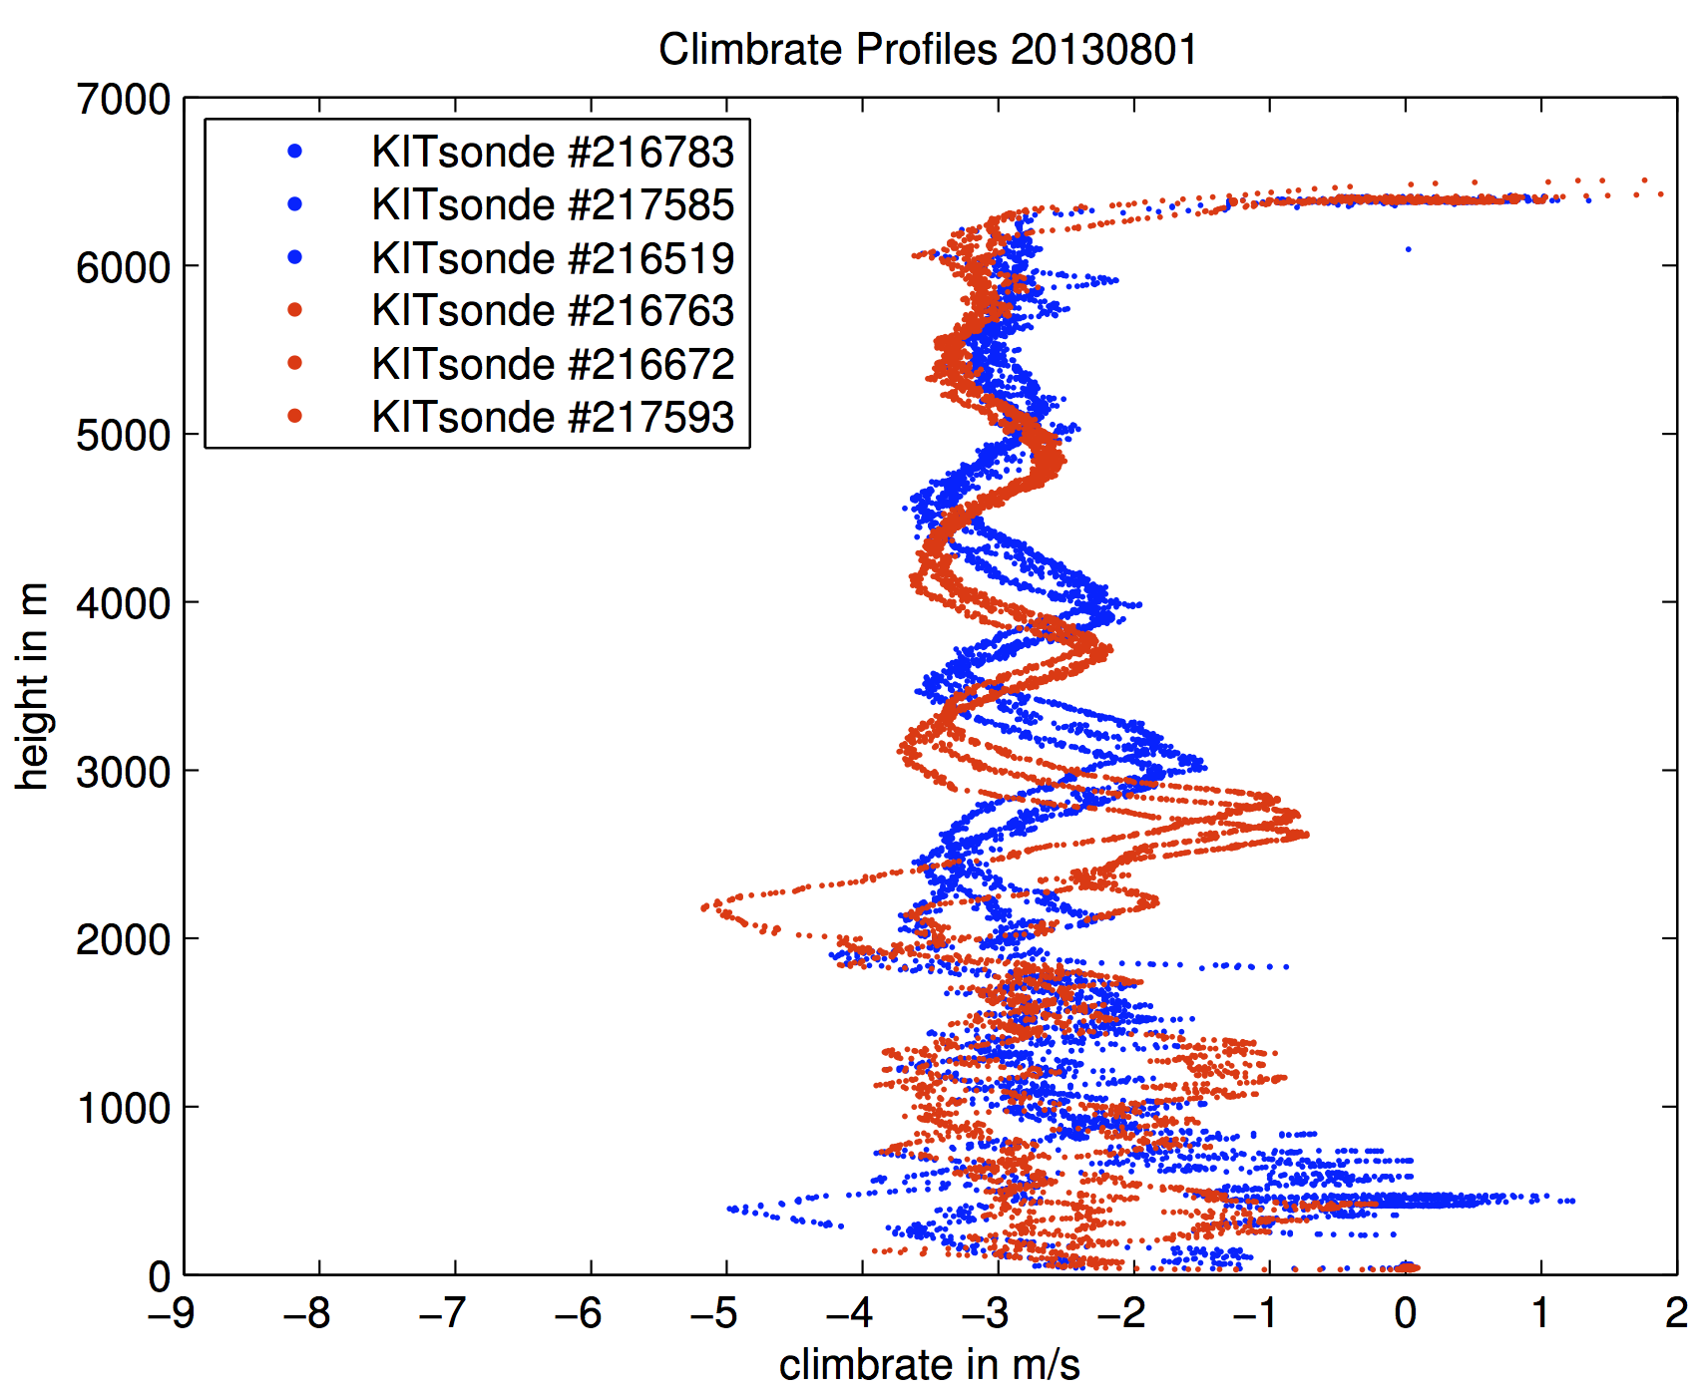
Fall speed

Slide 16
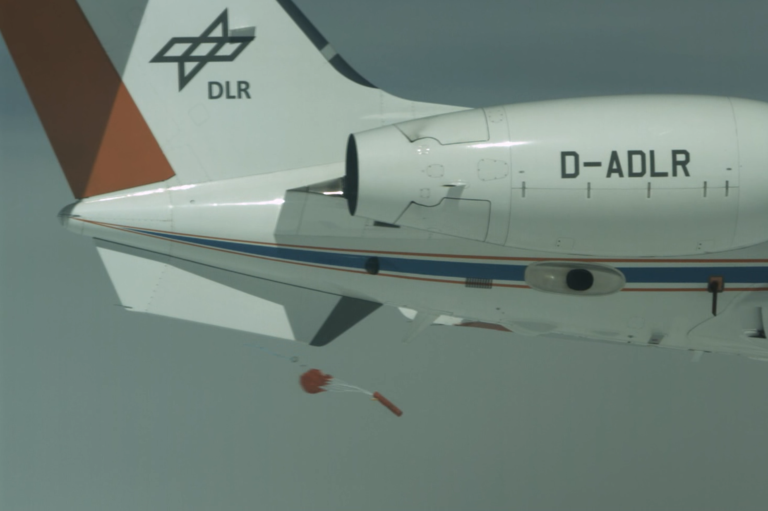
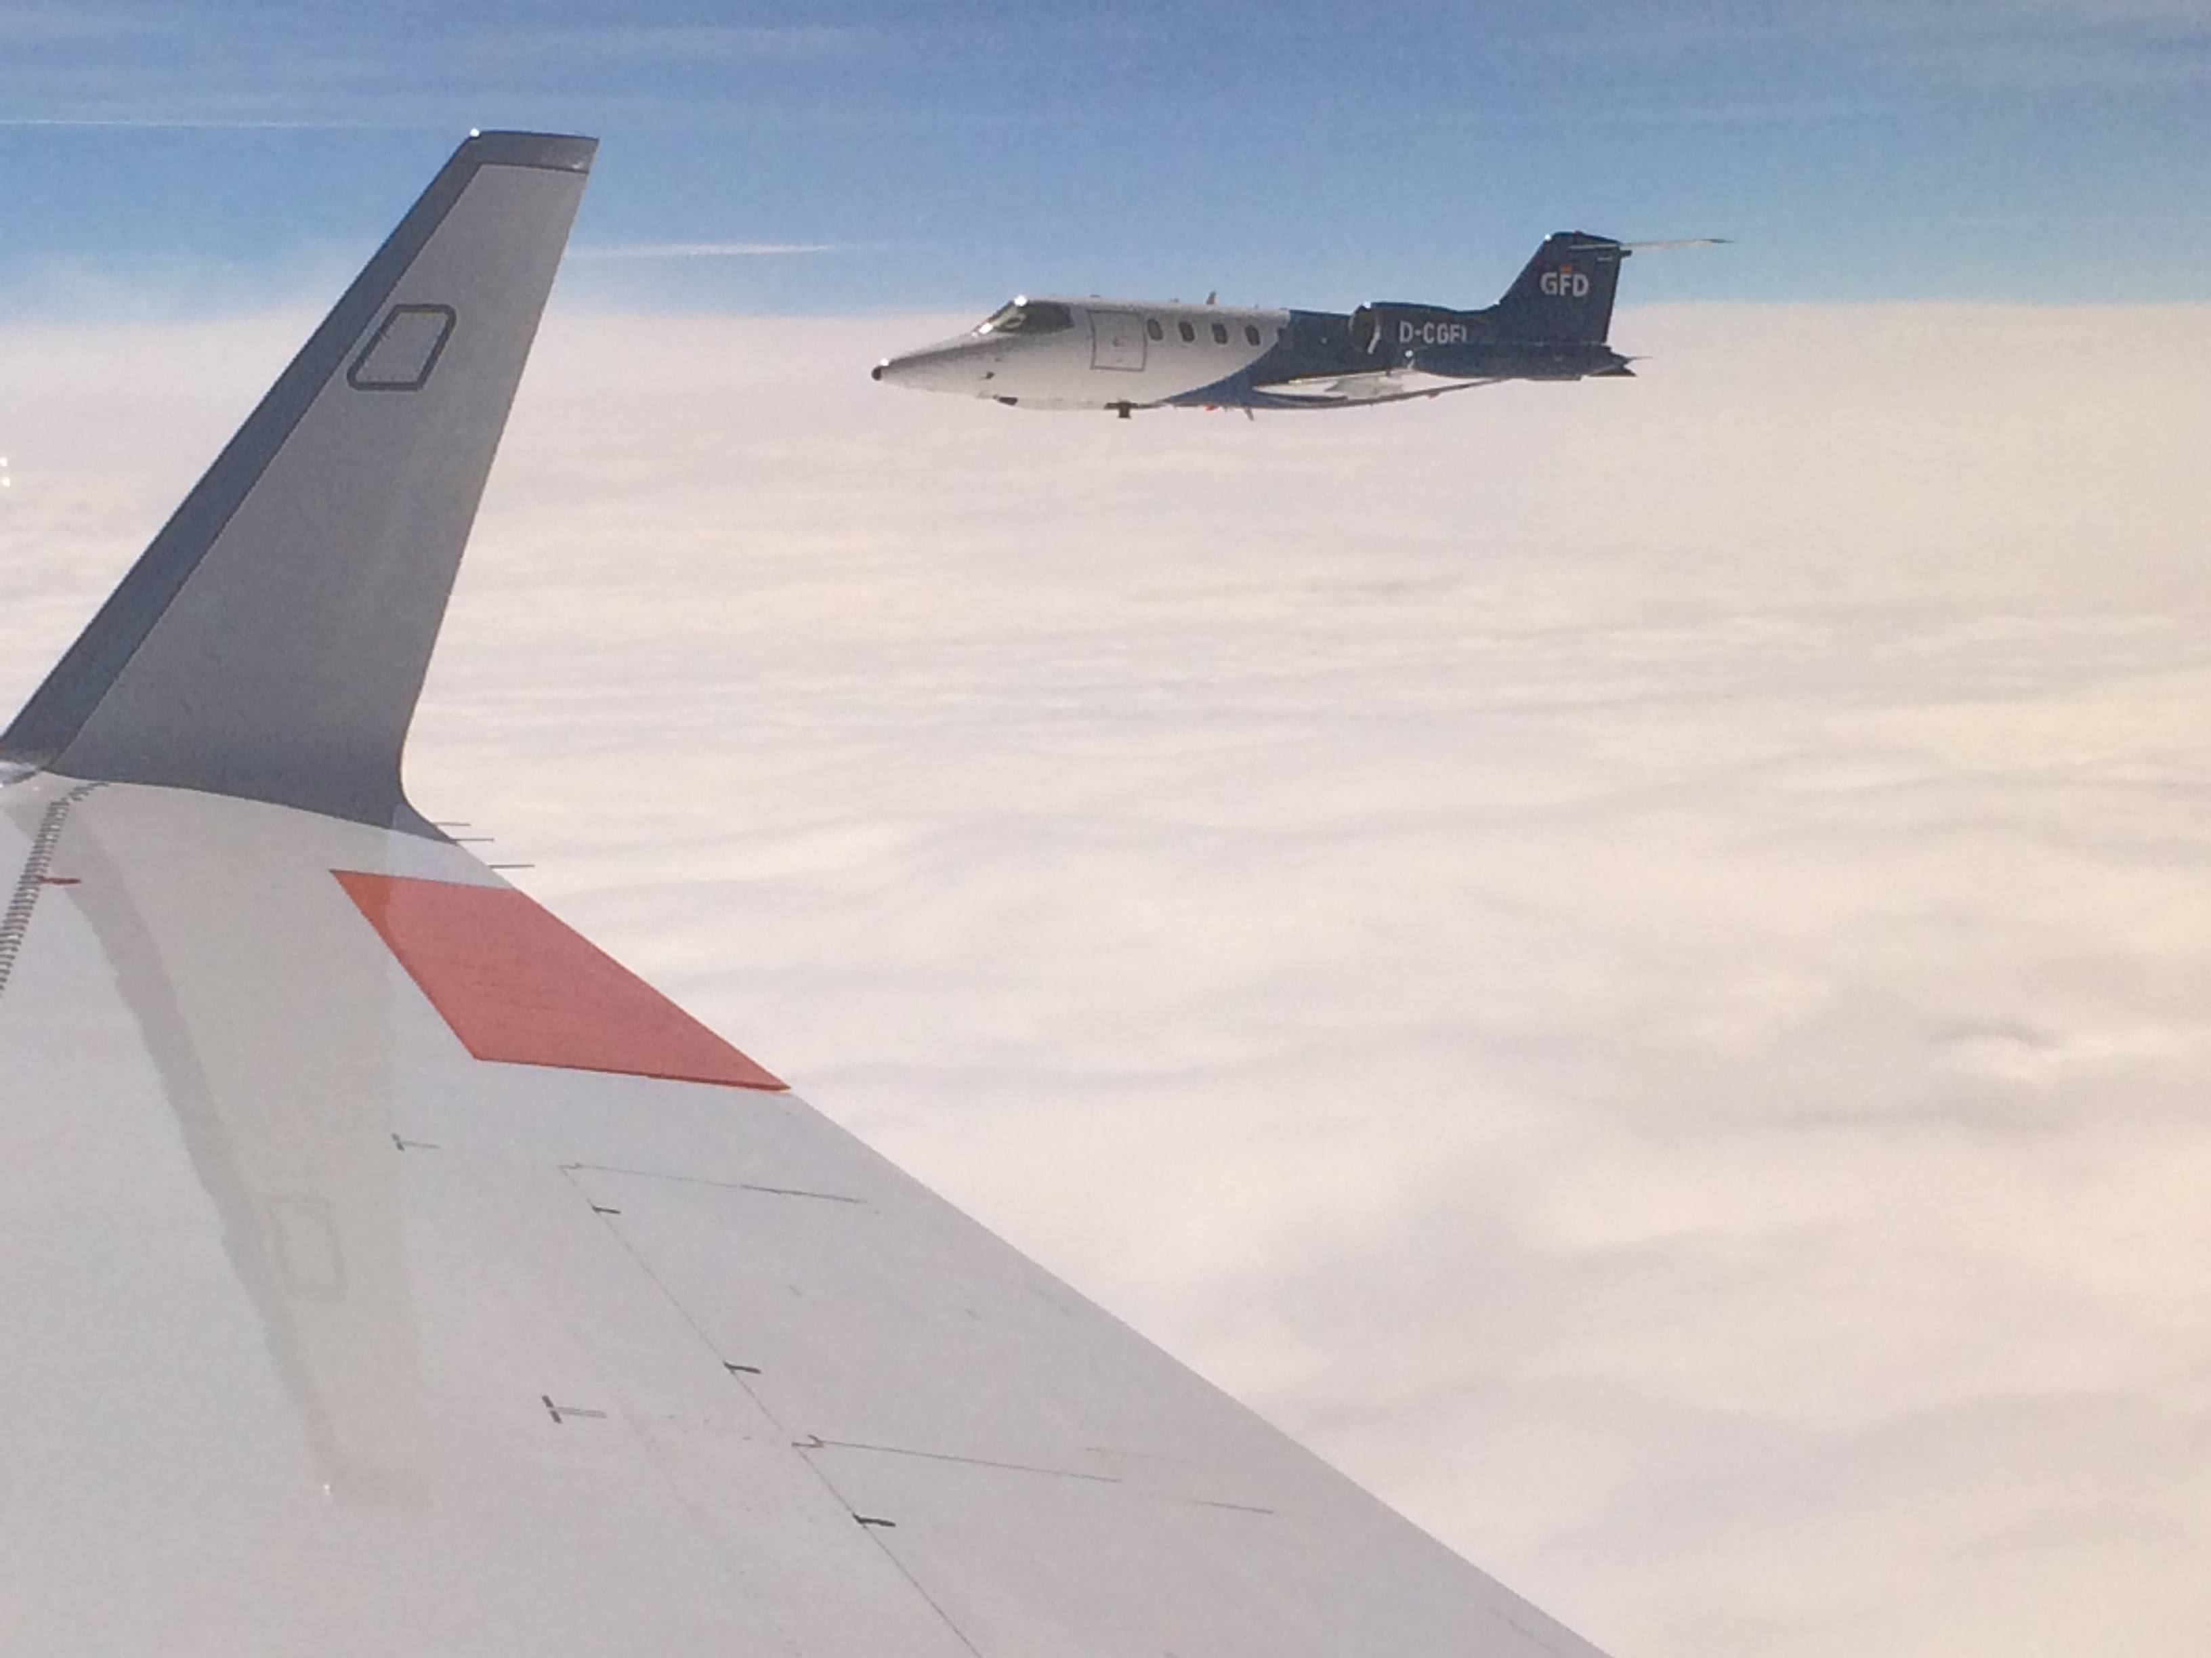
High Speed Release with Chase Aircraft

Slide 17
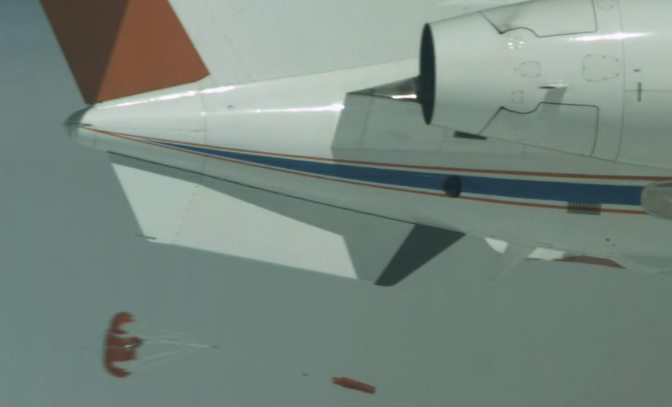
Aerodynamical Problem
Wake area behind release tube can lead to open flaps for some milliseconds ....

Slide 18
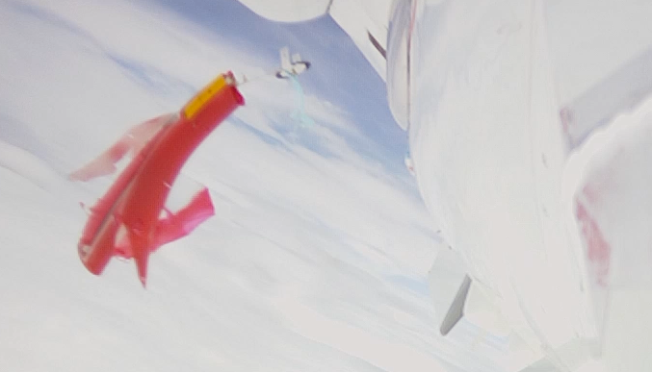
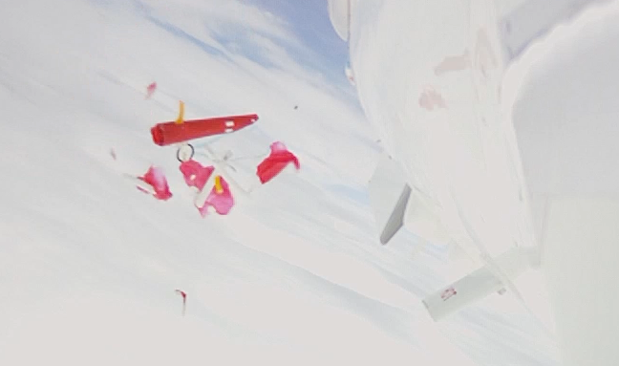
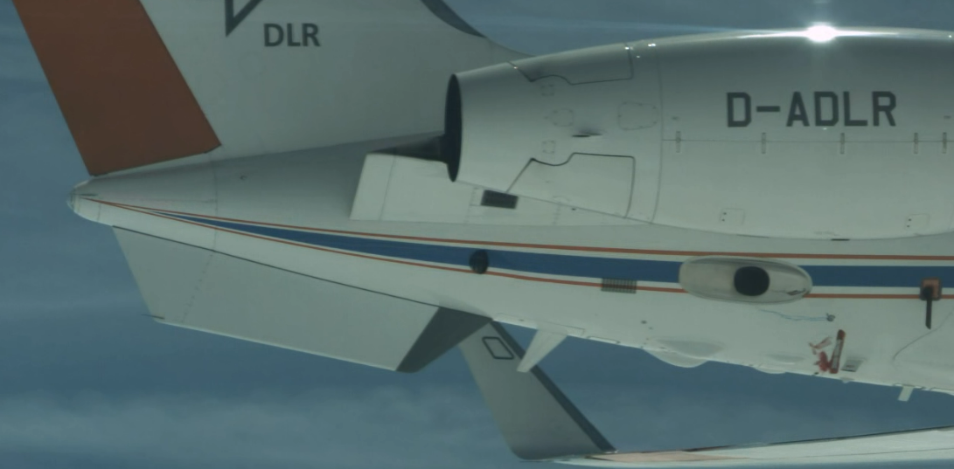
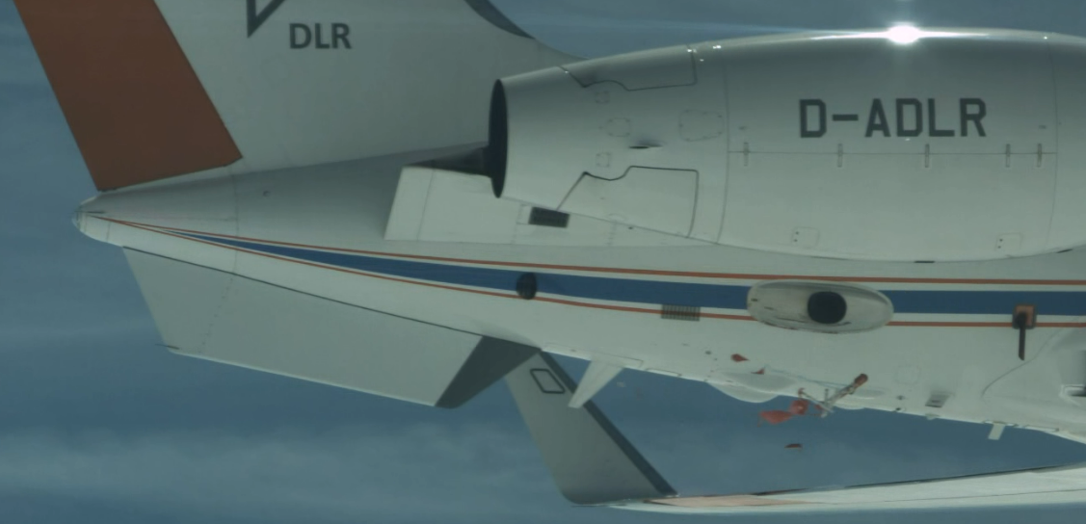
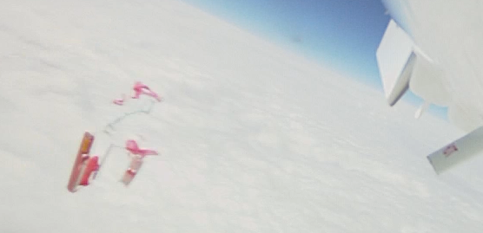
Structural collapse at FL 400, M0.86
... also observed with AVAPS RD-94 at FL400,M0.75 >

Slide 19
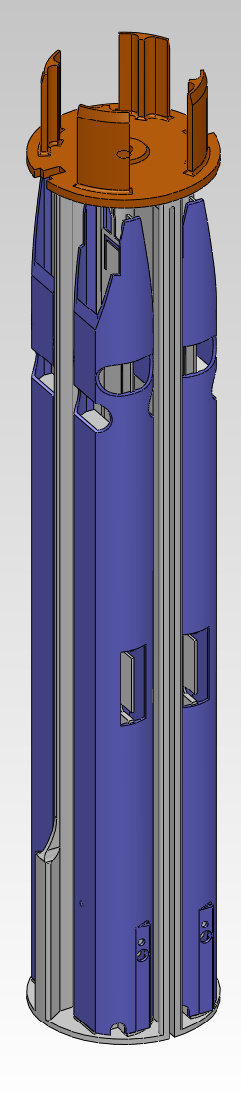
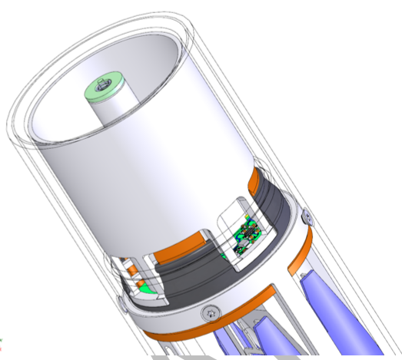
Release Container Redesign (v3.0)
(1) Sonde Support Insert, (3) Release Container
(5) Electronics (3-axis motion sensor, micro controller *)
(6) Parachute Container (14) Spring Release
(12) Motor Drive
*release detection by combination of acceleration and rotation rate thresholds, programmable delay times

Slide 20

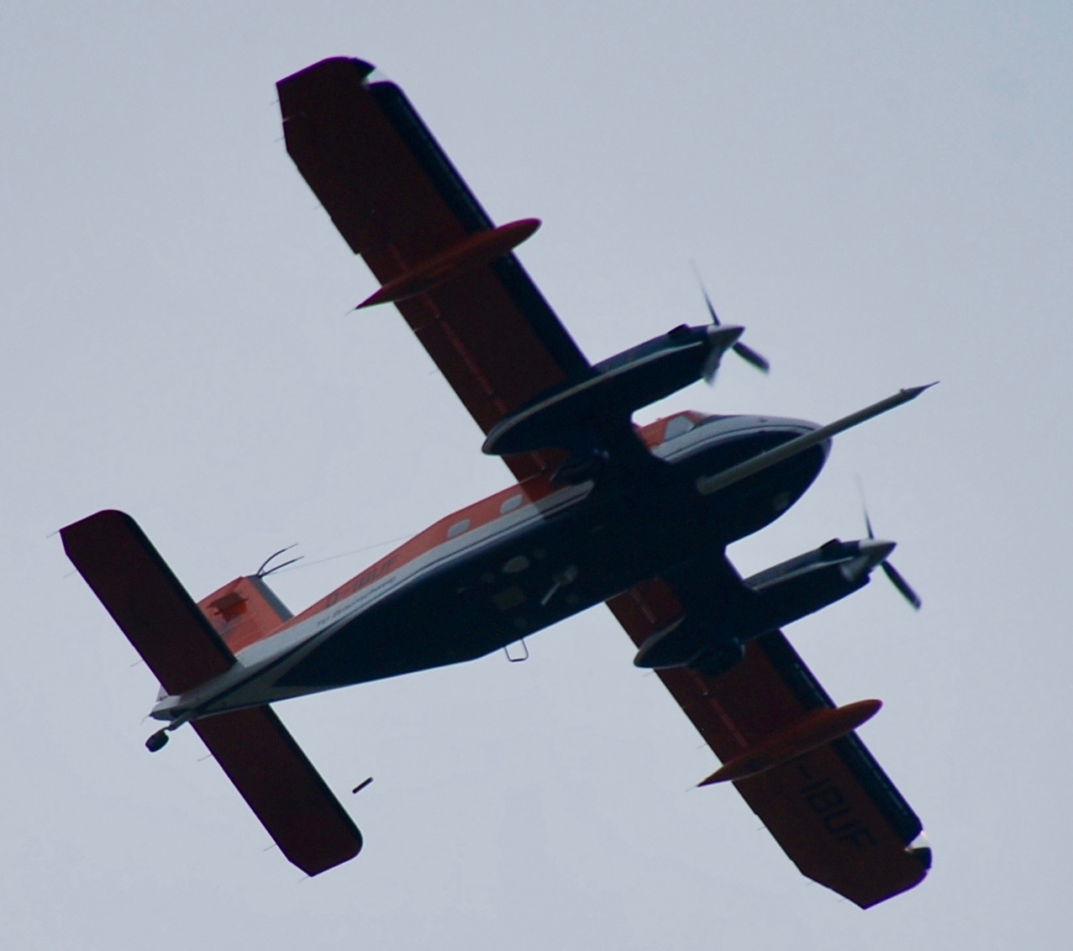
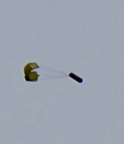
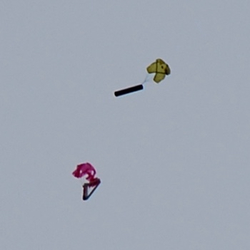
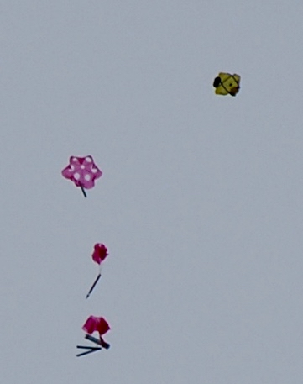
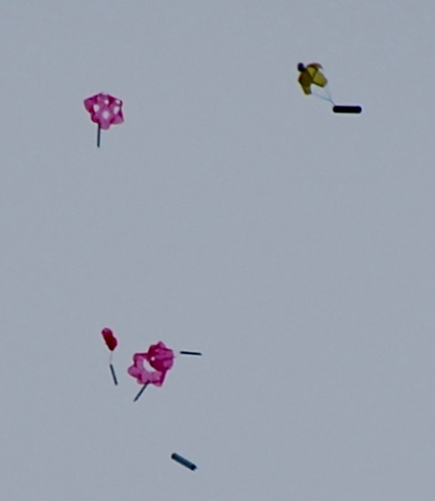
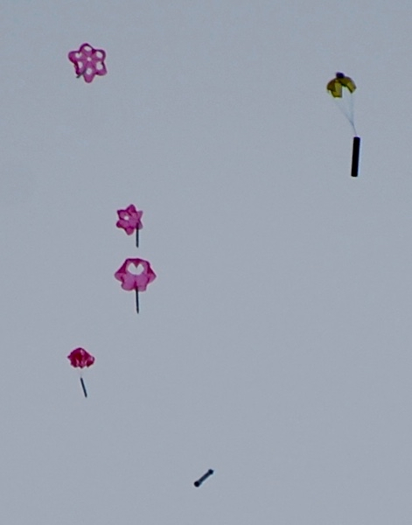
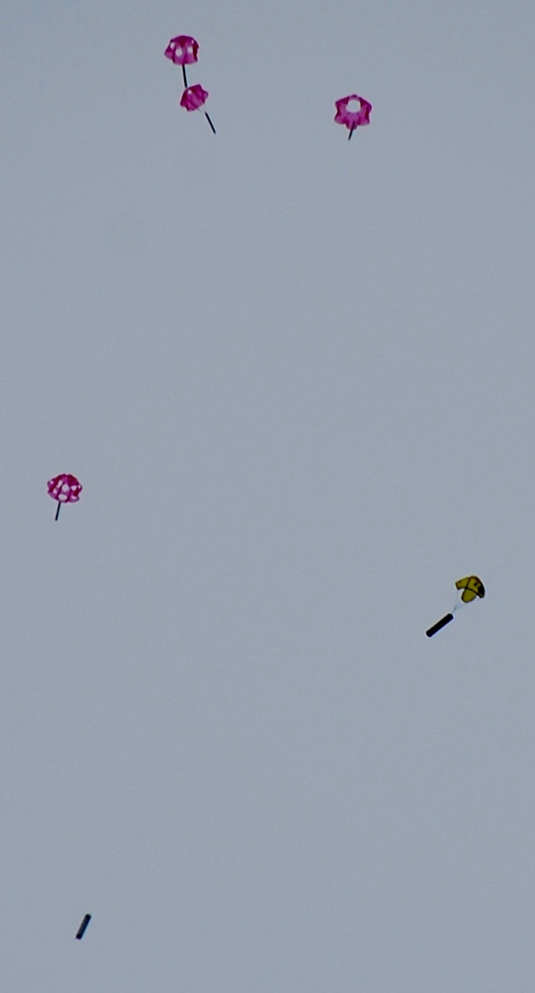
Test Release Dornier 128-6 D-IBUF

Slide 21
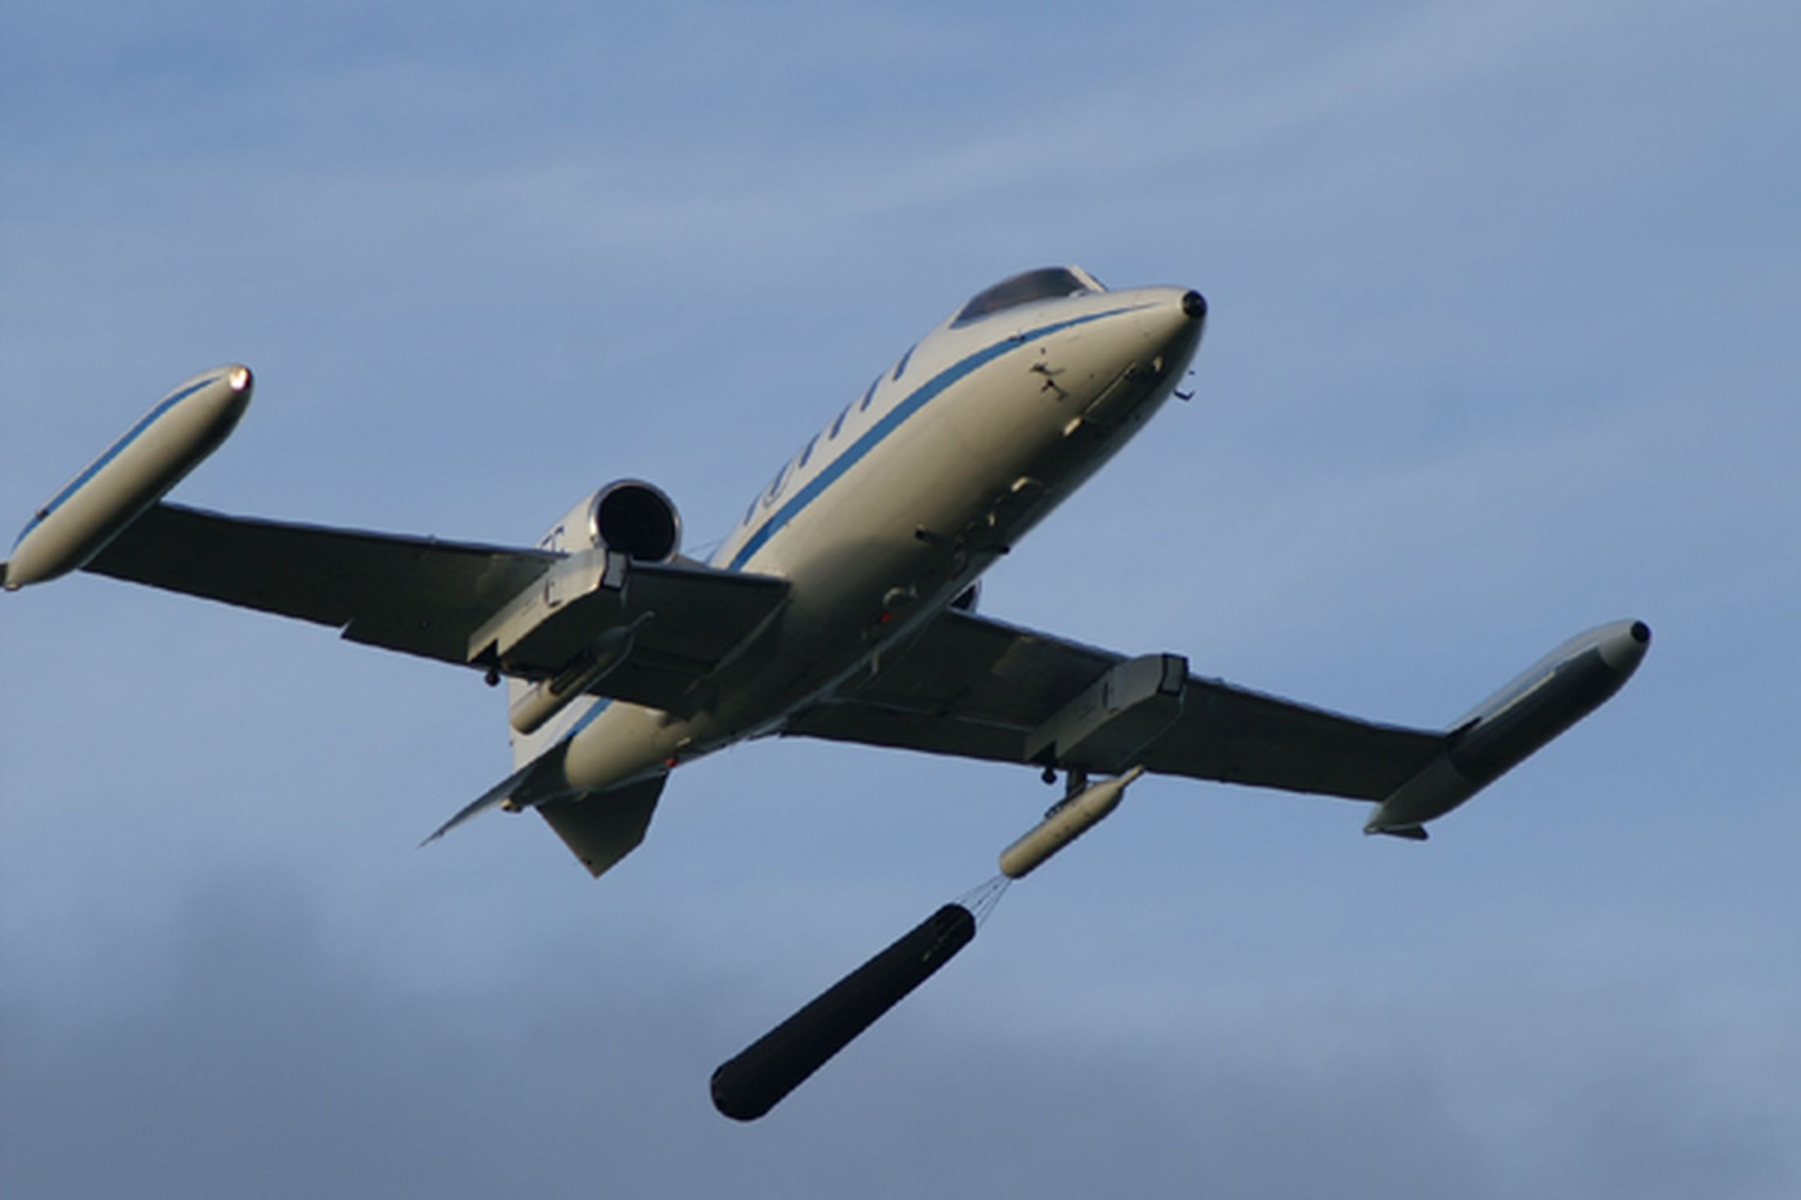
High Speed Low Budget Flight Test
No cabin installations!
Polystyrene insert fit into underwing pod

Slide 22
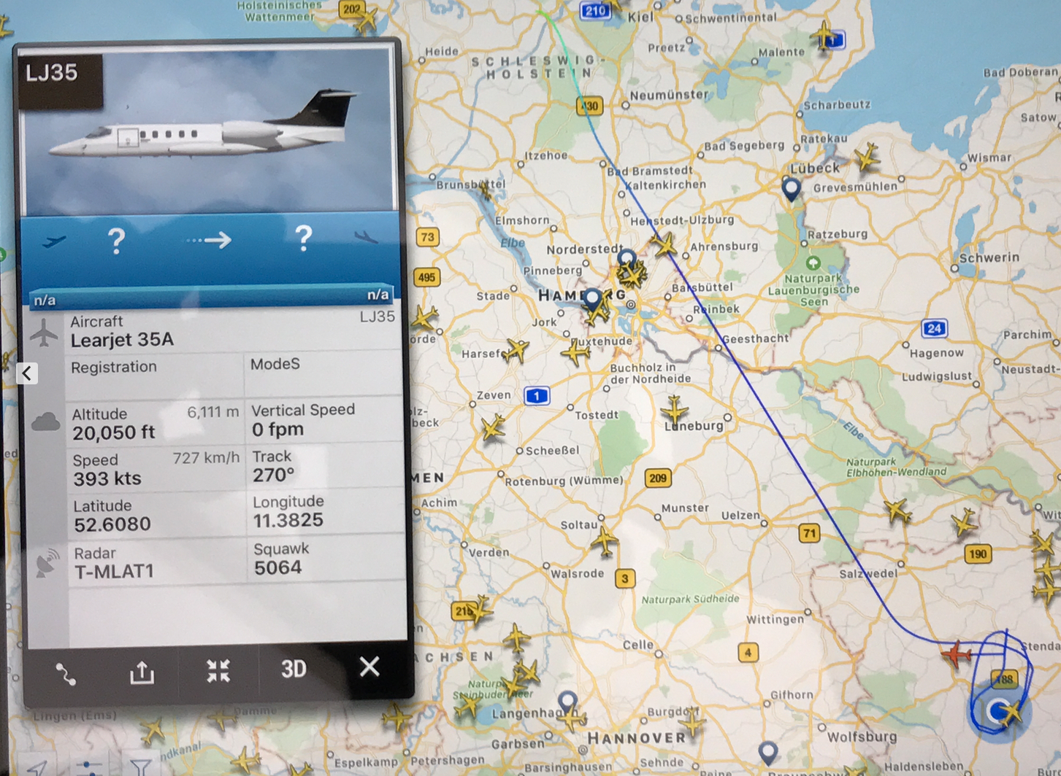
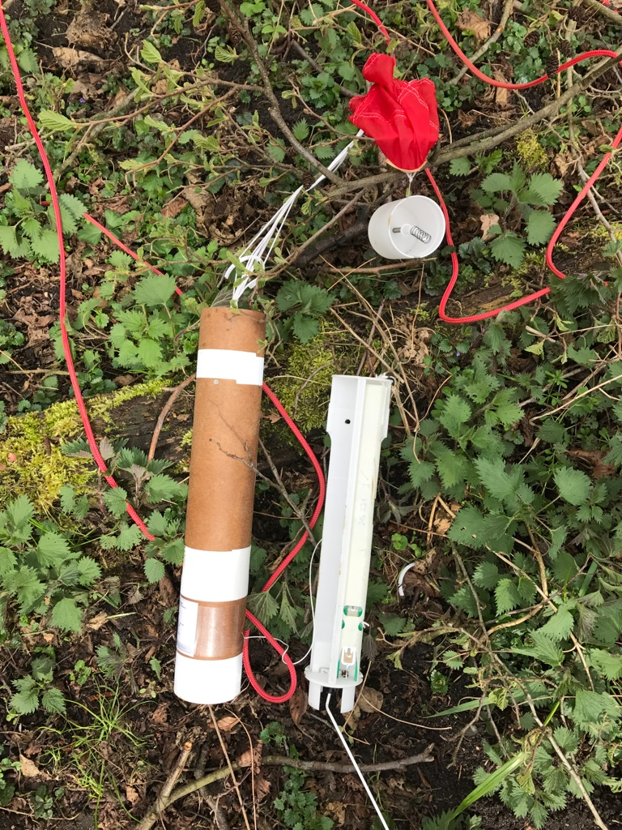
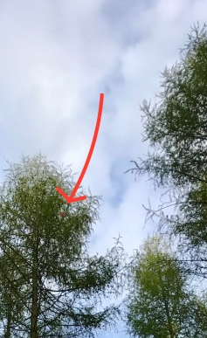
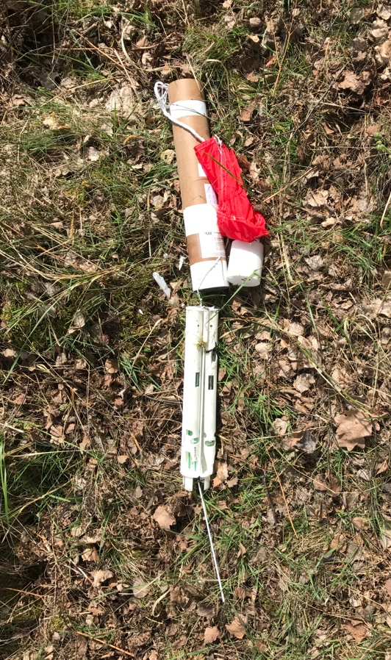
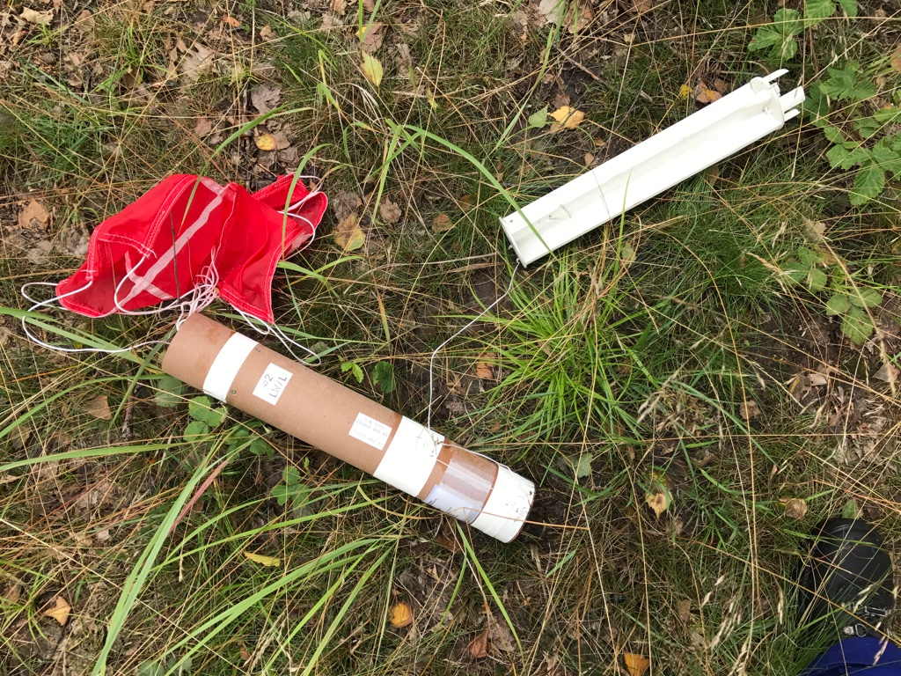
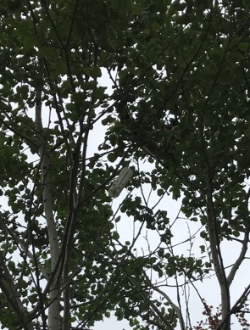
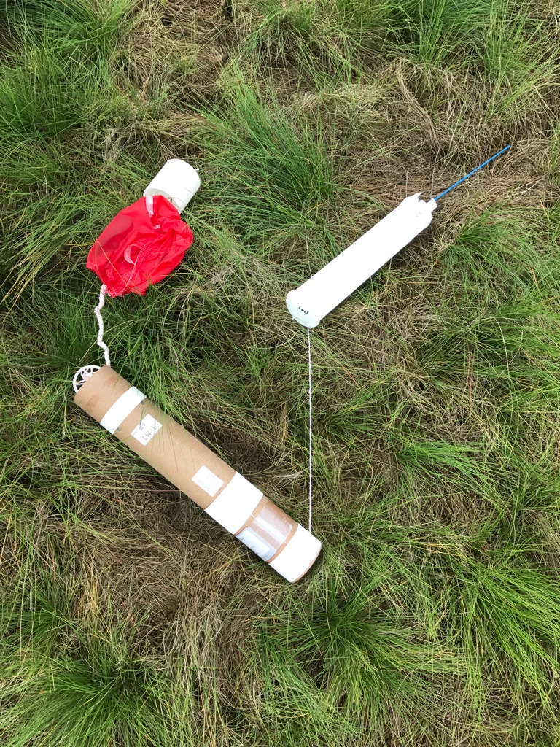
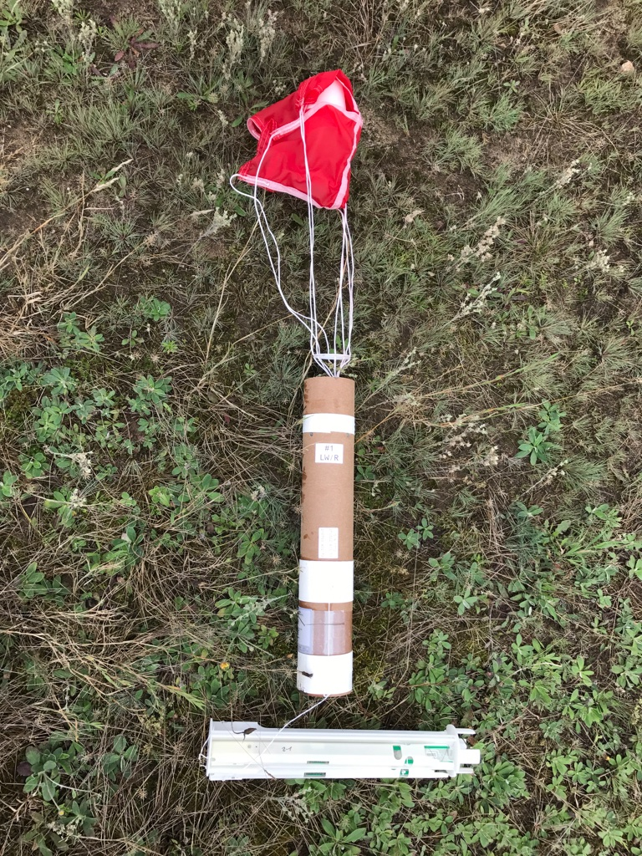
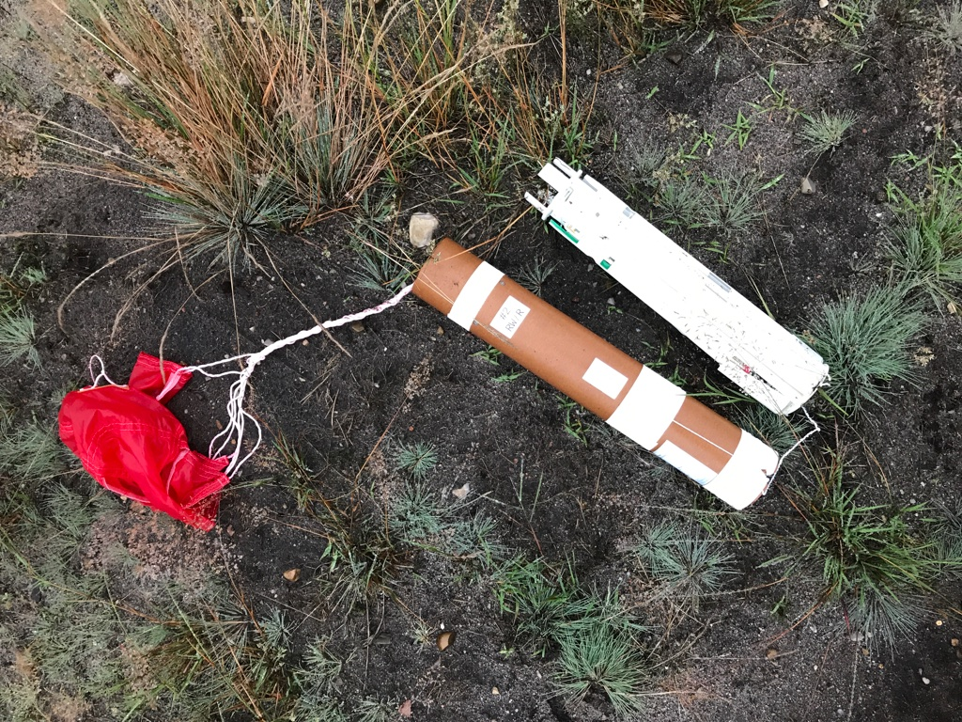
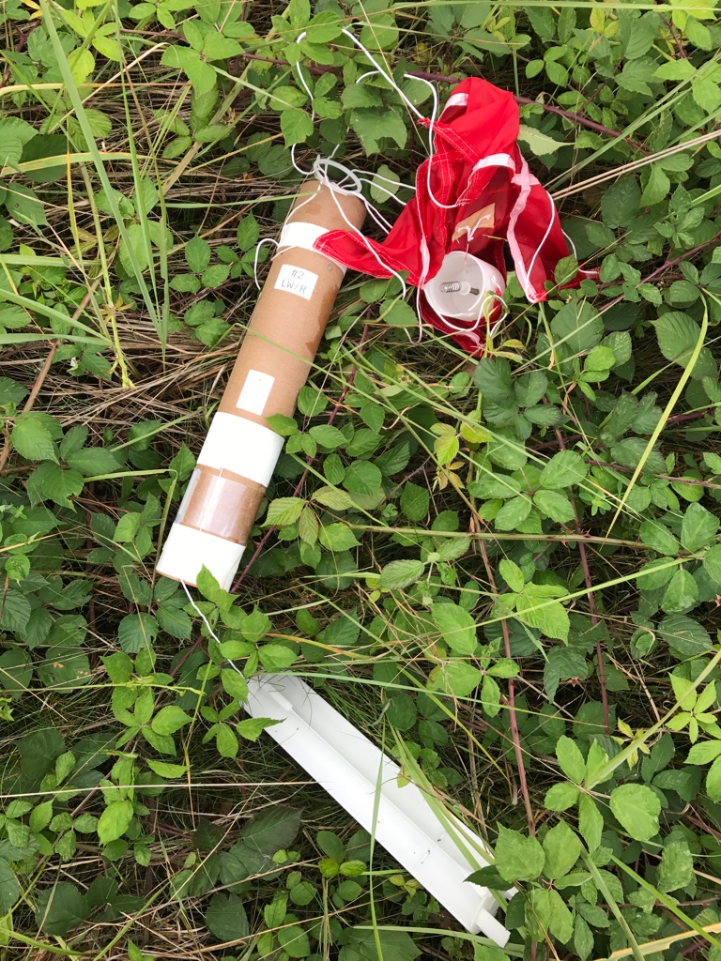
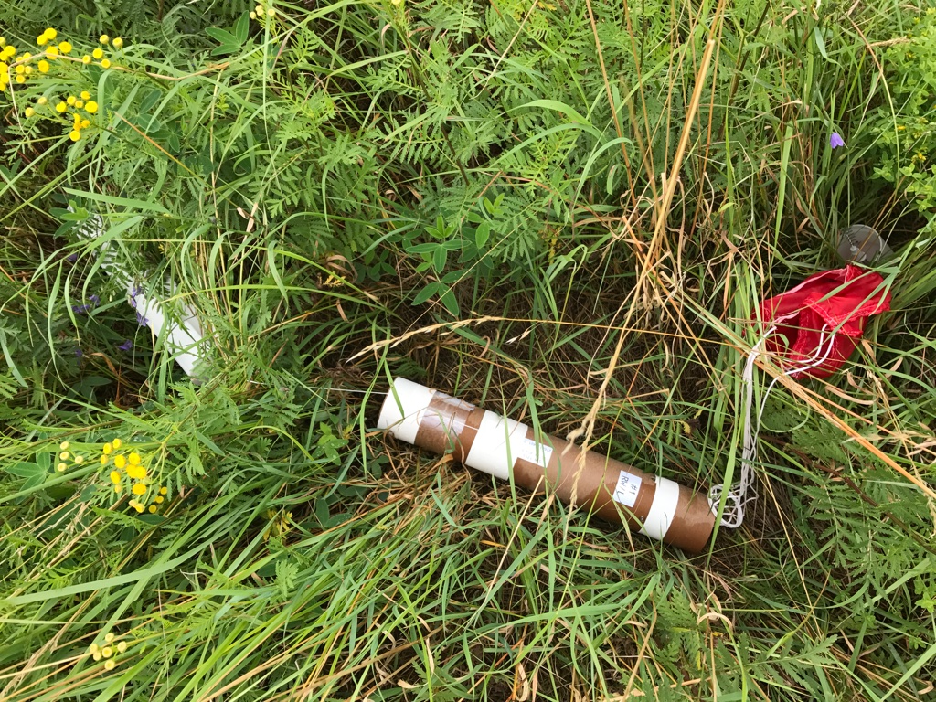
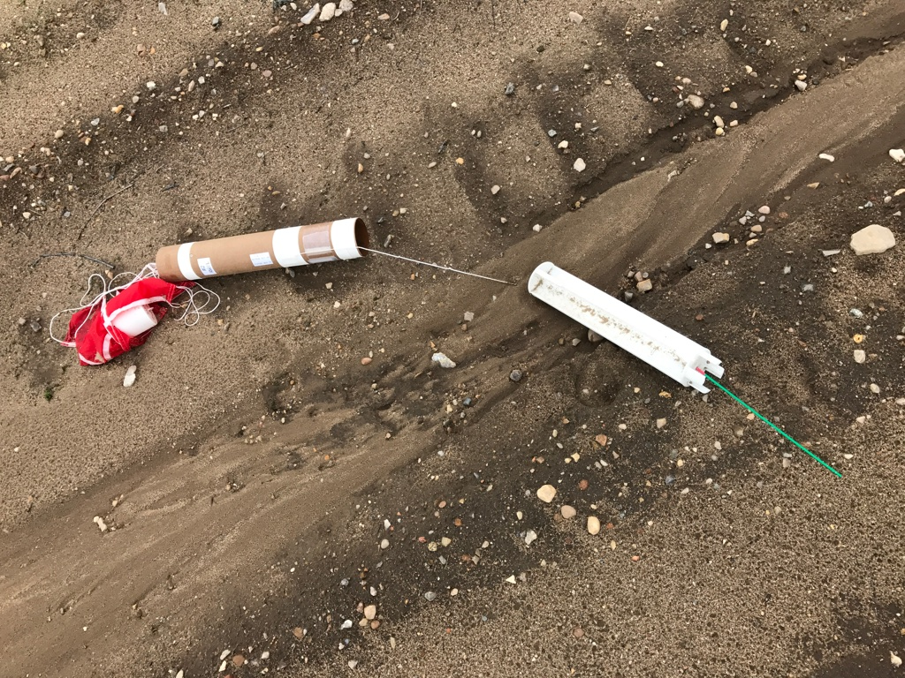
High Speed Flight Test - Learjet
13 April 2017 1 Flight - 4 container released
2 Release containers recovered OK
1 unrecoverable – functional according data
1 not found near village – functional according data
26 July 2017 2 Flights - 8 container released
8 Release containers recovered
6 recovered OK
2 recovered, but parachute cords coiled – faster fall

Slide 23


Easy Integration of new Sensors
Easy Integration of new Sensors
UCASS
Universal Cloud and Aerosol Sounding System
Joseph Ulanowski
Open path miniature particle counter
Mineral Dust
Volcanic Ash
Cloud Droplets

Slide 24


EGU, 2015

Slide 25


EGU, 2015

Slide 26
Outlook 2018 … 2019
New meteorological sonde EL-18 development and testing
Adaption of KITsonde HW and SW to new met. sonde
Production of 20 rel. containers and 80 met. sondes for HALO
HALO certification flight (slot early 2019 requested)
HALO campaign SOUTHTRAC (autumn 2019)

