Slide 1
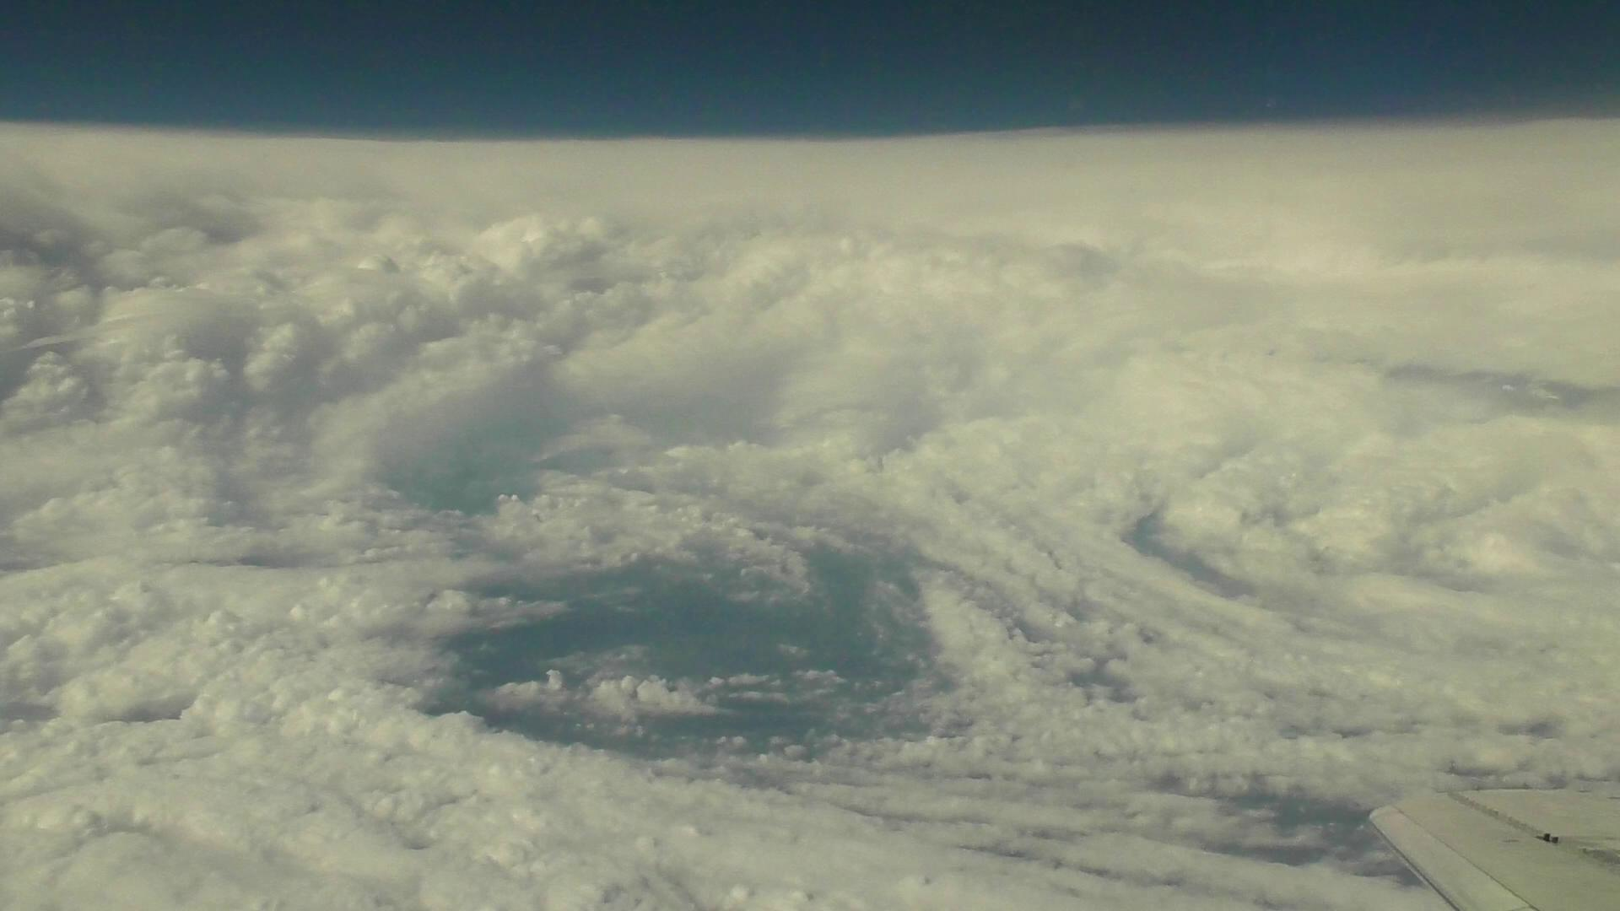
20th AVAPS Users Group Meeting
24-25 April 2018
NCAR Center Green 1, Boulder, CO 80301
Dropsonde observation of a typhoon in the T-PARCII project:
Typhoon Lan (2017) observation
Kazuhisa TSUBOKI
Institute for Space-Earth Environmental Research, Nagoya University
Collaborators:
Nobuhiro Takahashi¹, Taro Shinoda¹, Tadayasu Ohigashi¹, Hiroyuki Yamada², Kosuke Ito², Munehiko Yamaguchi³, Tetsuo Nakazawa³, Norio Nagahama⁴, and Kensaku Shimizu⁴
¹Institute for Space-Earth Environmental Research, Nagoya University
²Faculty of Science, University of the Ryukyus
³Meteorological Research Institute, Japan Meteorological Agency
⁴Meisei Electric Co., Ltd

Slide 2
Violent wind and heavy rainfall associated with a typhoon cause huge disaster in East Asia including Japan.
For prevention/mitigation of typhoon disaster, accurate estimation and prediction of typhoon intensity are very important as well as track forecast.
However, intensity data of the intense typhoon category such as supertyphoon have large error after the US aircraft reconnaissance was terminated in 1987.
Intensity prediction of typhoon also has not been improved sufficiently for the last few decades.
To improve these problems, in situ observations of typhoon using an aircraft are indispensable.
The main objective of the T-PARCII (Tropical cyclone-Pacific Asian Research Campaign for Improvement of Intensity estimations/forecasts) project is improvements of typhoon intensity estimations and forecasts.

Slide 3
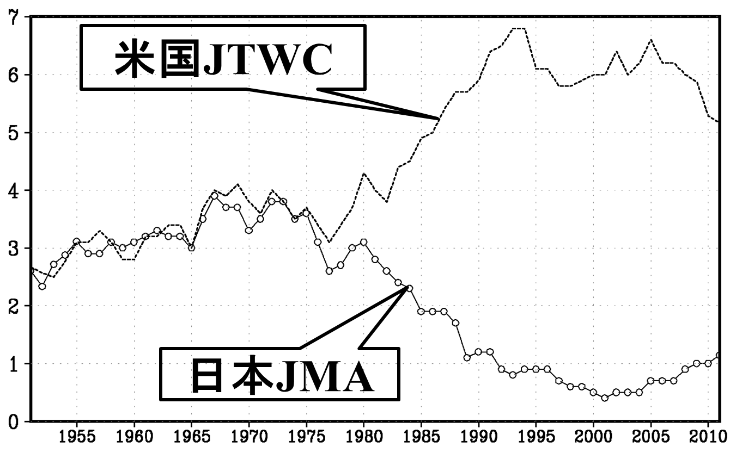
Problem in historical data of typhoon intensity
The historical data of typhoon include large uncertainty.
In particular, intensity of intense typhoons includes large error after the termination of the typhoon reconnaissance by the US aircraft in 1987.
In fact, the annual number of the JMA-strongest category of typhoon (10 min. averaged sustained wind is 54 m/s or more) shows large difference between JMA and JTWC.
US JTWC
Annual number of the JMA-strongest category of typhoon
Number of typhoon
JMA-RSMC
No in-situ observation by an aircraft makes it unknown which is better estimation of intensity; JMA or JTWC.

Slide 4
Problem in typhoon intensity prediction
Error of track
Error of intensity
(Ito 2016, SOLA)
In the last 25 years, track prediction has been improved while intensity not improved.
For accurate and quantitative prediction of typhoon intensity;
High resolution: 2km at least to resolve inner core process of tropical cyclones (e.g. Hill and Lackmann 2011).
Non-hydrostatic, cloud-resolving model
And in-situ observation data.

Slide 5
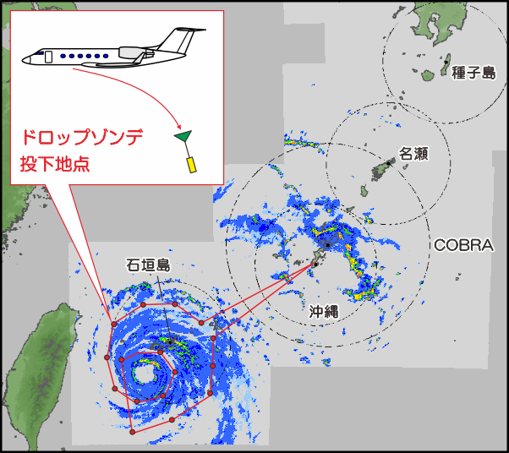
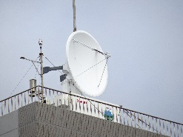
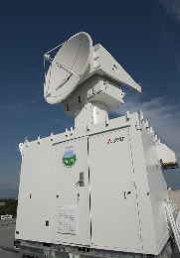
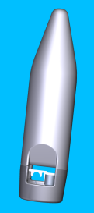
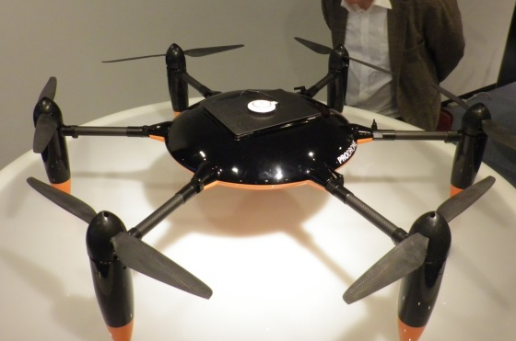
T-PARCII (Tropical cyclone-Pacific Asian Research Campaign for Improvement of Intensity estimations/forecasts) is aiming to improve estimations and forecasts
Using dropsondes dropped from the aircraft, temperature, humidity, pressure, and wind are measured in the surrounding region of the typhoon eyewall.
dropsonde from the aircraft
X band radar
Ka radar
drone
Typhoon prediction using numerical model
The dropsonde data are assimilated to the numerical models
Notes:
T=PARK2は、沖縄、那覇をベースにして、沖縄周辺の台風をターゲットにします。
ここは、台風が最大強度になる地点であり、日本または台湾の進路が変わる不確実が高い地域です。
T-PARK2では、同時に沖縄本島にXバンドレーダー等の地上観測を置きます。

Slide 6
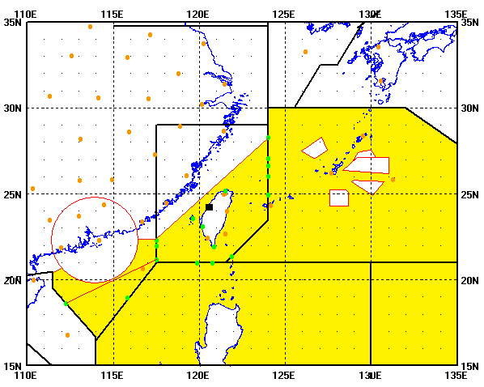
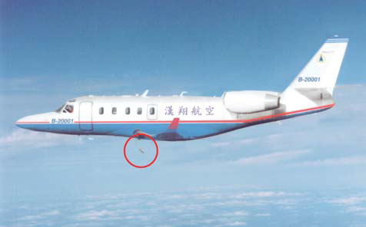
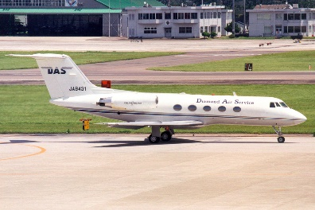
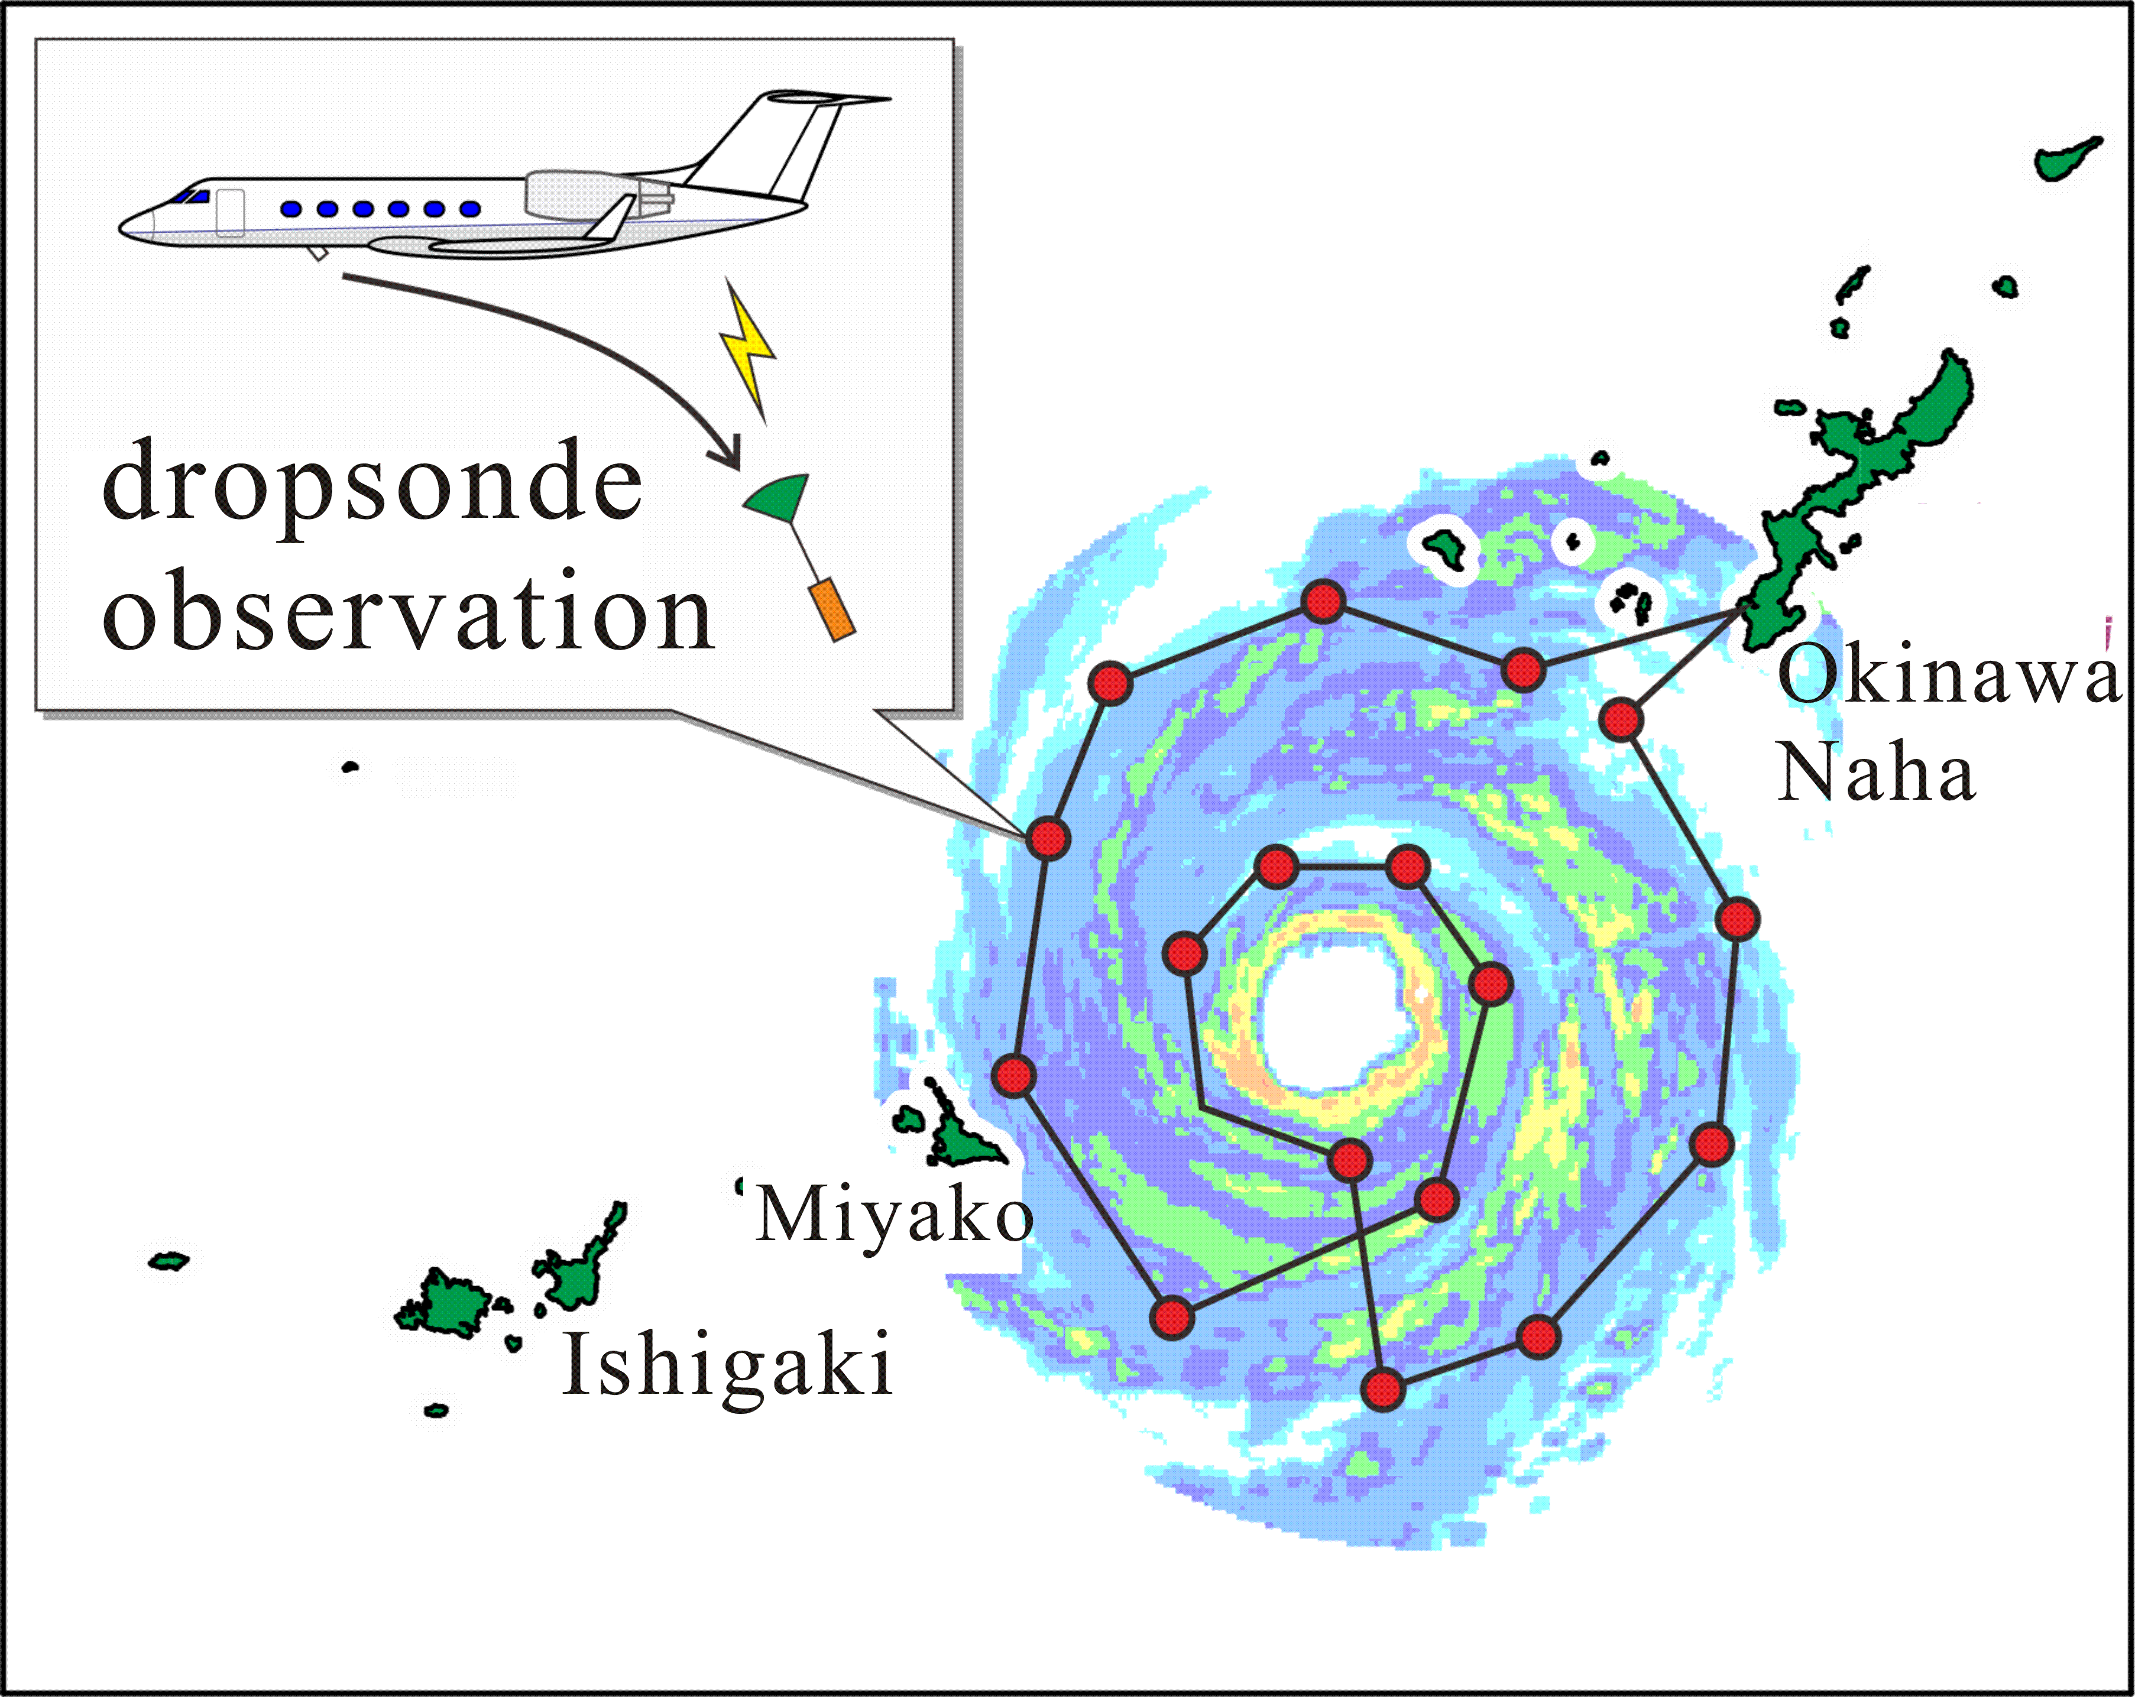
The period of the research is 5 years; from 2016-2020.
The Gulf Stream II aircraft is used for dropsonde observation around a typhoon (similar to DOTSTAR in Taiwan).
A test flight was made on July 27, 2017 to the north of the Noto Peninsula .
Typhoon observations are performed for the 4 years; 2017-2020. Once or twice flights a year because the budget is limited.
The main target area of observation is the south of Okinawa.
Dropsonde data is planned to transmit to GTS in real-time.
We hope that T-PARCII cooperates with Taiwan DOTSTAR observation.
Taiwan obsevation
Wu et al. (2005, BAMS)
Japanese aircraft
Japan obs.

Slide 7
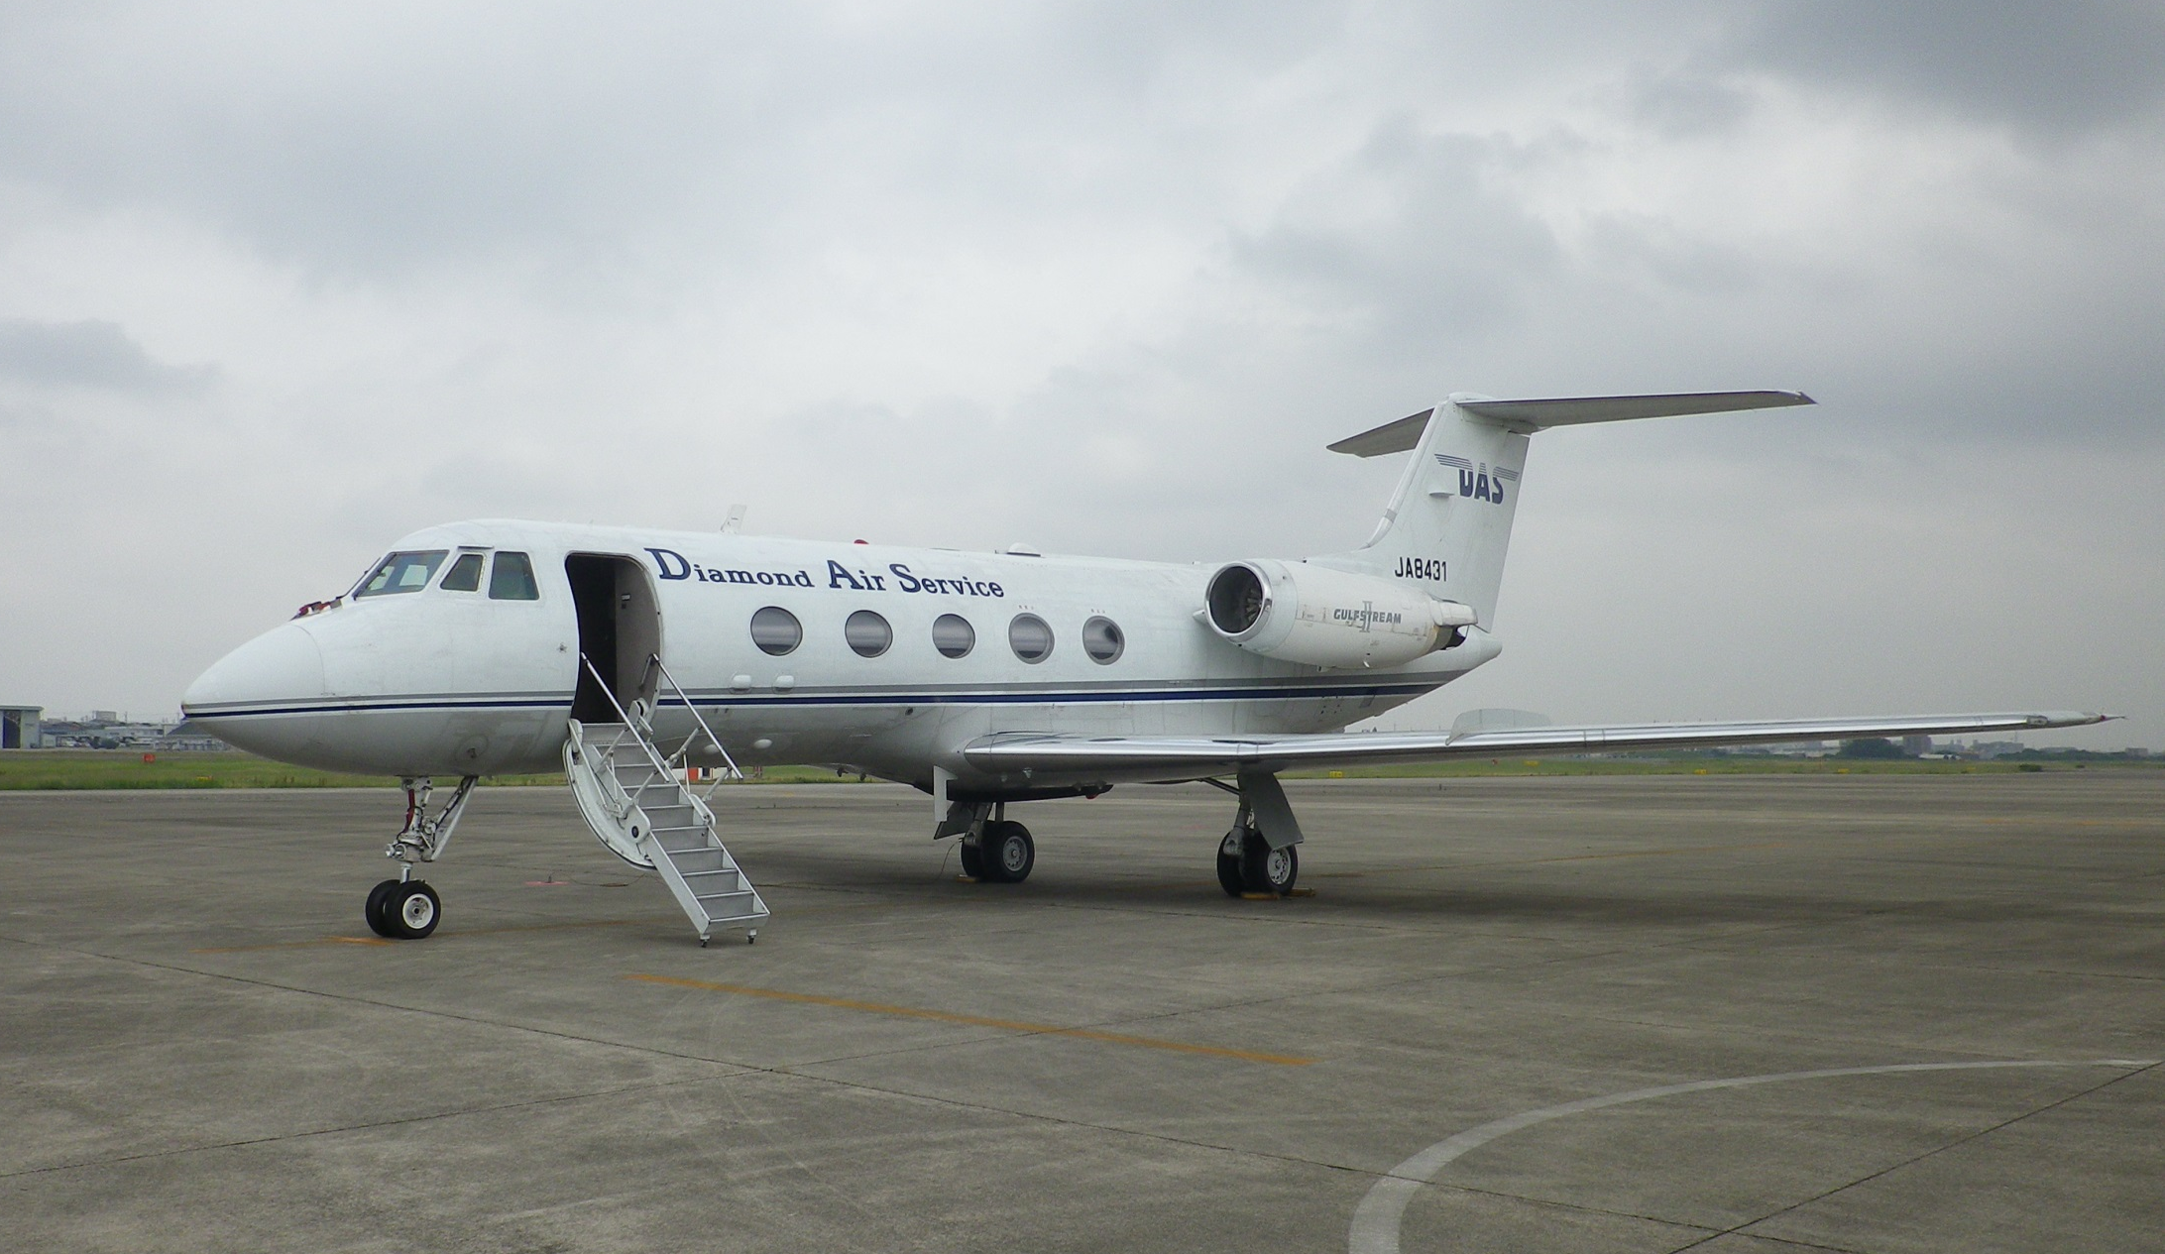
Diamond Air Services (DAS) will operate the Gulfstream II aircraft for the project. DAS is located in the Nagoya City Airport which is close to Nagoya University.

Slide 8
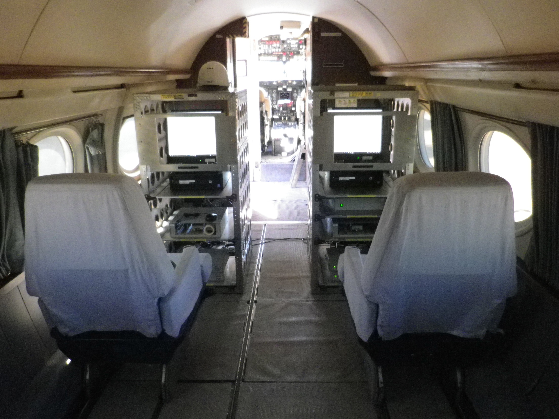
Newly developed dual two-channel receivers of dropsonde in GII
(Meisei electric Co and Nagoya University)

Slide 9
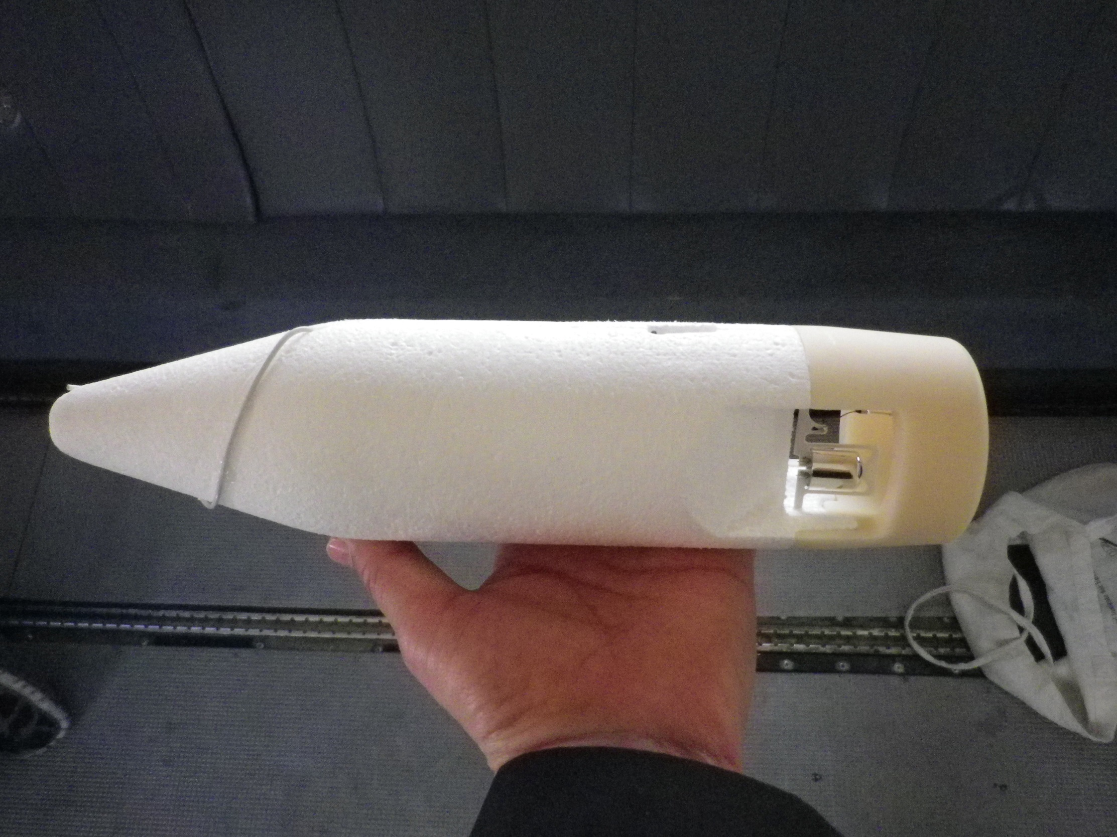
Newly developed dropsonde
(Meisei electric Co and Nagoya University)

Slide 10
JTWC 20171021 06UTC: Supertyphoon LAN (2017)
Typhoon LAN (2017)
JMA: huge size, very intense
JTWC: supertyphoon
Rapid intensification
100 kts =51m/s (10min)=58m/s(1min)

Slide 11
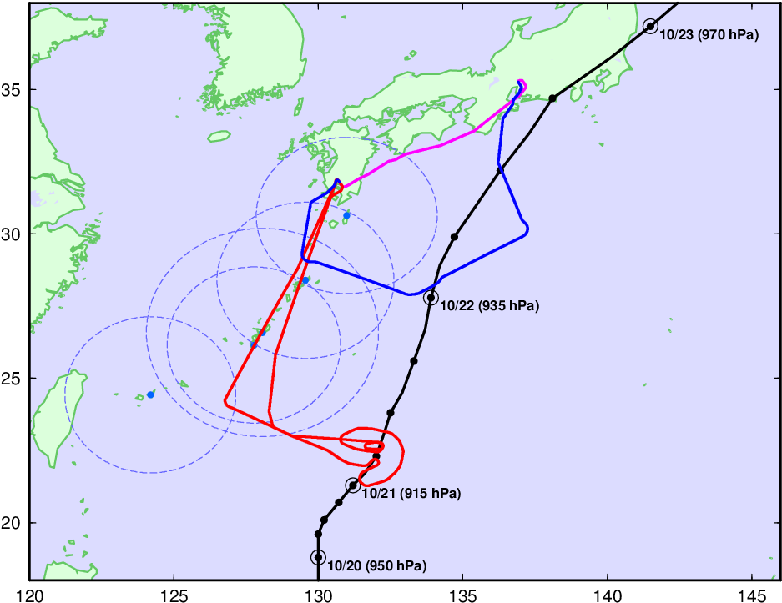
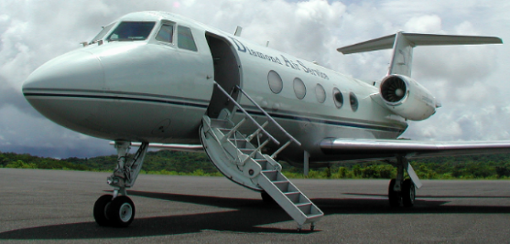
T-PARCII Flight Mission into
Typhoon Lan (T1721)
21-22 Oct. 2017

Slide 12
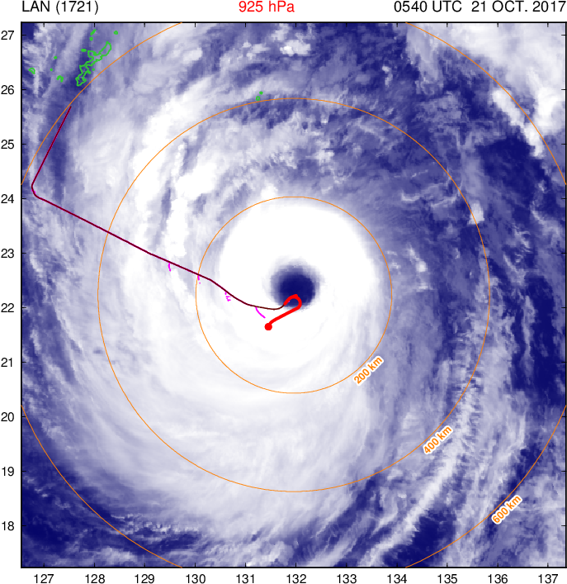

Slide 13
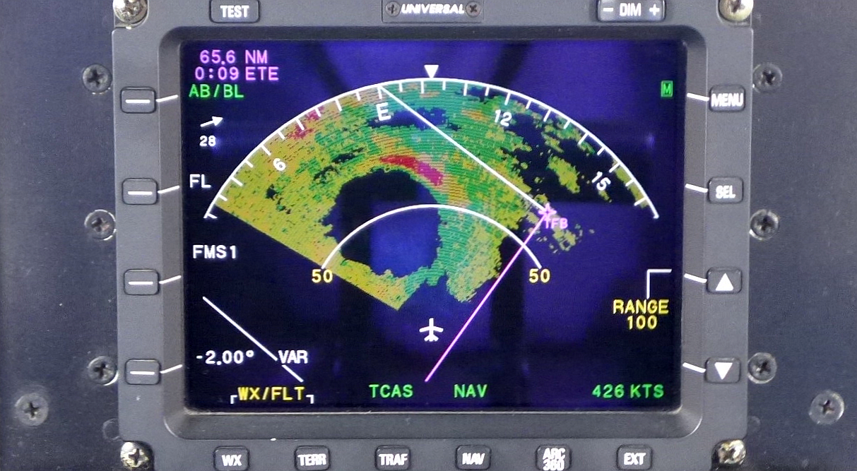
Courtesy of Professor H. Yamada of University of Ryukyus

Slide 14
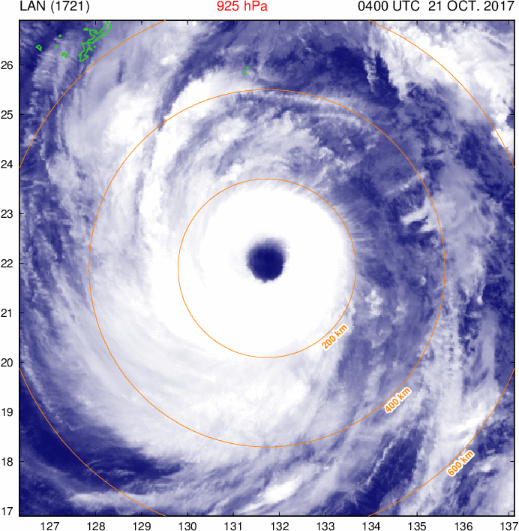

Slide 15
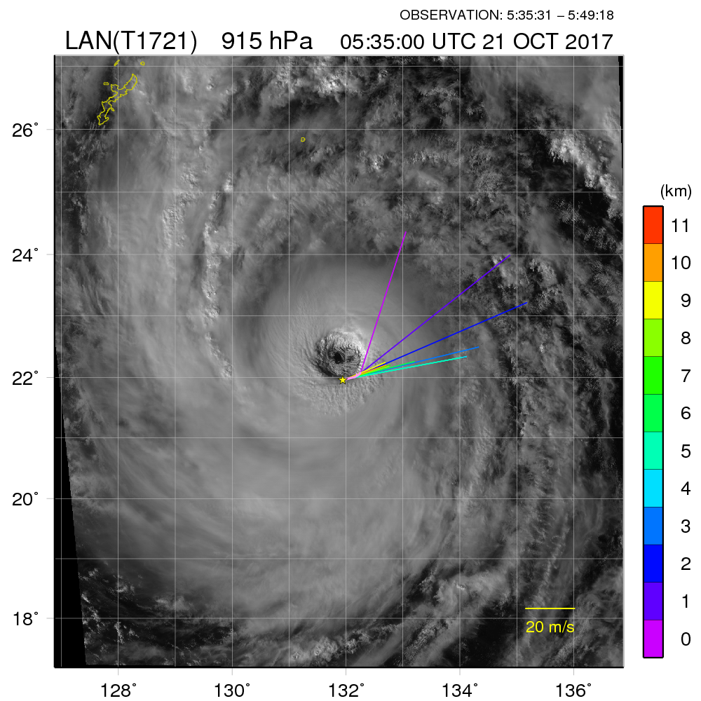
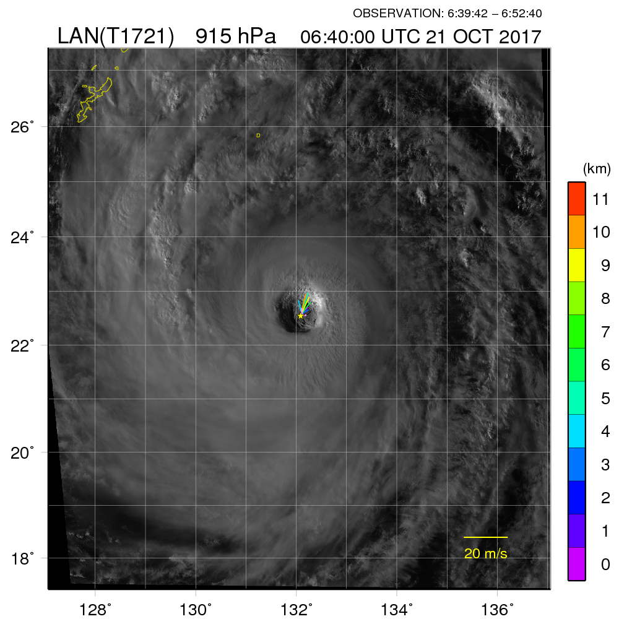
Dropsonde soundings from the aircraft in the surroundings of the eyewall

Slide 16
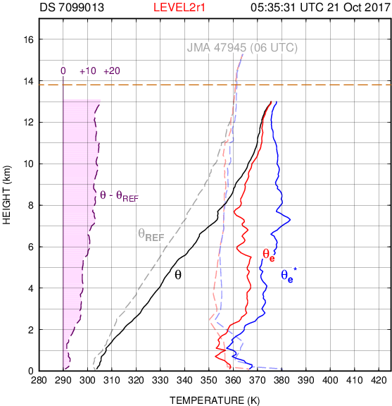
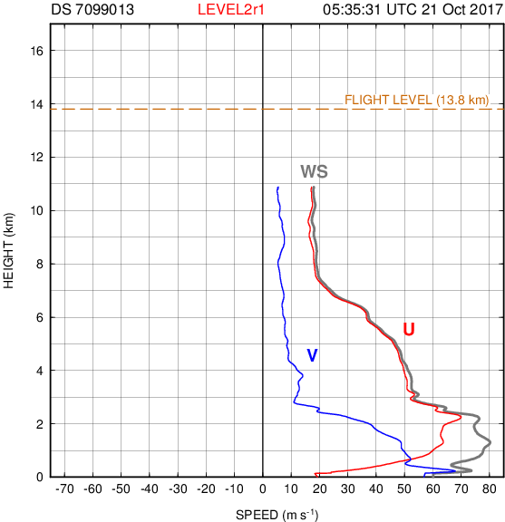
Vertical profiles of potential temperature and wind at the south side of the eyewall .
Courtesy of Professor H. Yamada of University of Ryukyus

Slide 17
Courtesy of Professor H. Yamada of University of Ryukyus

Slide 18
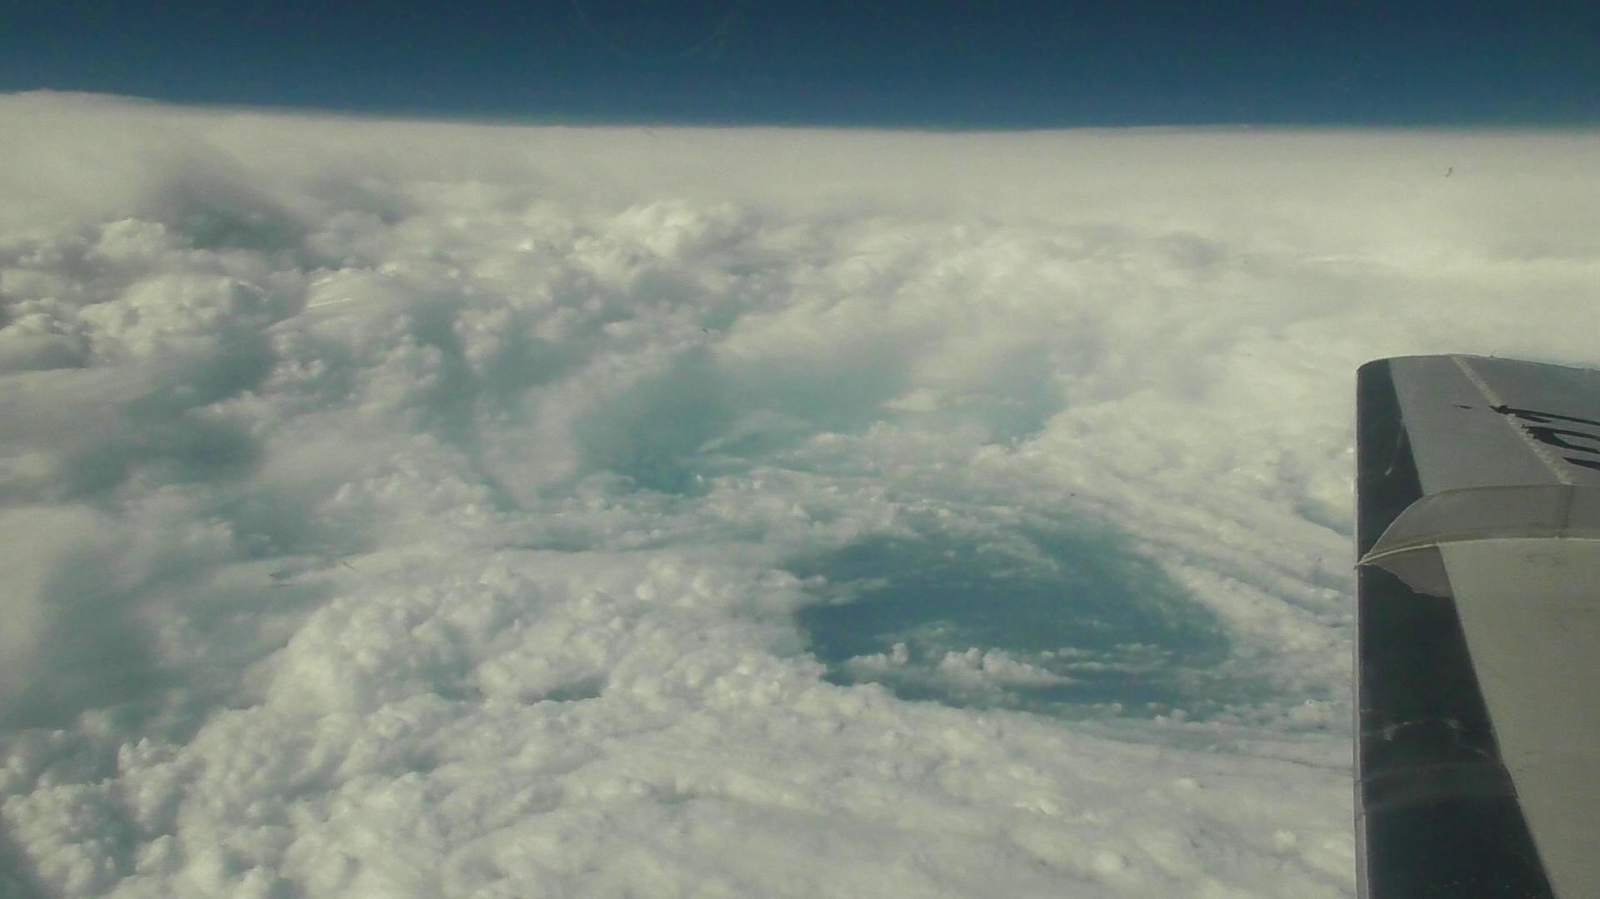
The eye of typhoon Lan (2017) observed by the T-PARCII project on October 21, 2017
The eyewall cloud and mesoscale vortex with open sea are shown in the photo.

Slide 19
The T-PARCII is aiming to improve estimations and forecasts of tropical cyclone intensity as well as storm track forecasts.
Nagoya University and the Meisei Electric Co., Ltd. developed a new dropsonde and four-channel receiver.
First observation was performed on October 21 and 22, 2017 to observe the very large and intense typhoon LAN (2017) to the southeast of Okinawa.
This observation was performed as a joint observation with Taiwan DOTSTAR group.
We made dropsonde observations around the eyewall of LAN and in the eye from a height of 43,000 ft.
Penetration observations into the eye were performed twice on 21 and once on 22 of October.
The observation provides very important data for the improvements of intensity estimation and forecast as well as for studies of the typhoon.

Slide 20
In the eye of Supertyphoon LAN (2017)
Thank you !!

