Slide 1
Initial test-result of Japanese dropsonde system for T-PARCII
MEISEI ELECTRIC Co.
Confidential
AVAPS Users Group Meeting 2018
24.April.2018
Kensaku Shimizu

Slide 2
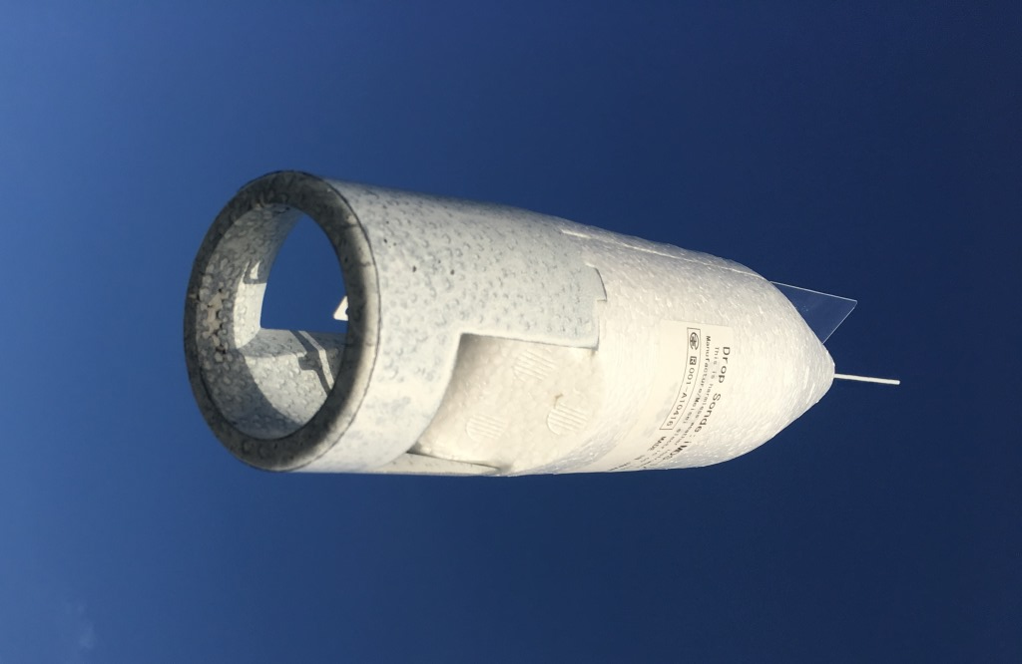
Today’s topics
System overview
Initial test flight
Technical update for next observation
Summary

Slide 3
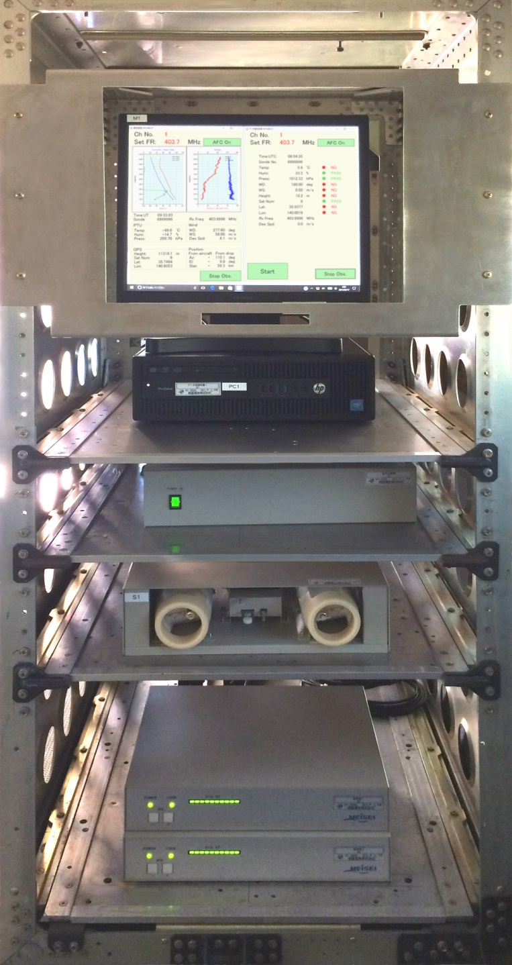
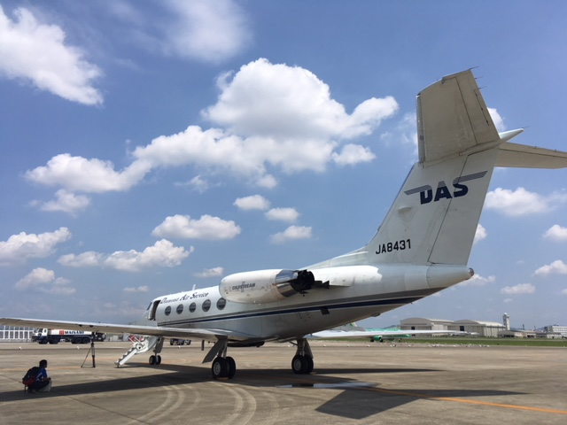
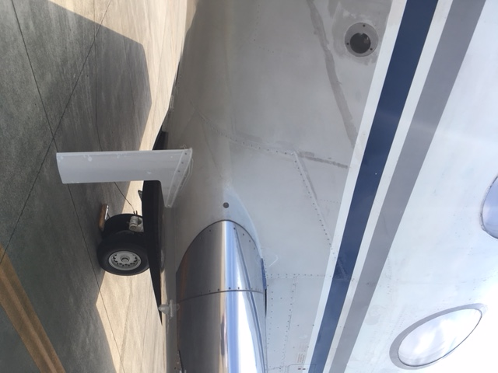
System overview – Receiver -
Equipped in DAS's Gulfstream-II
One launch device (φ=70mm)
4 receivers (One rack consists two receivers with one PC. They operate independently for redundancy.)
Touch panel controlled software for easy operation
Pre-flight-check and GPS pre-heat

Slide 4
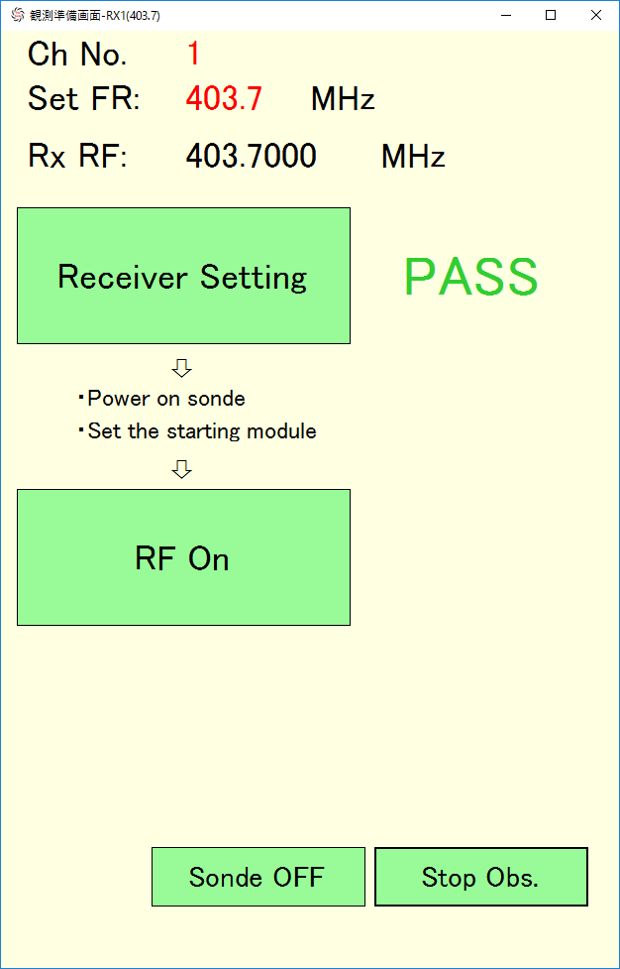
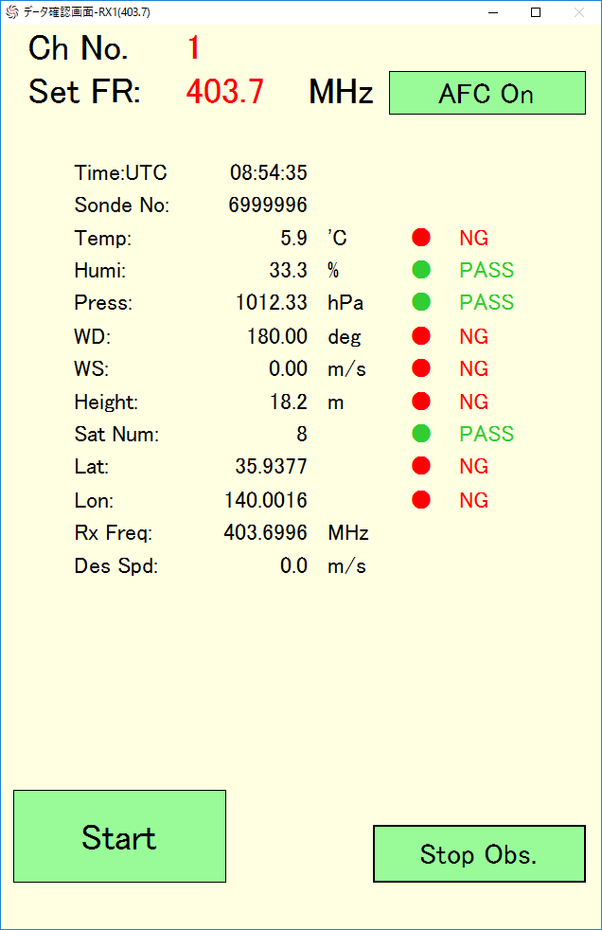
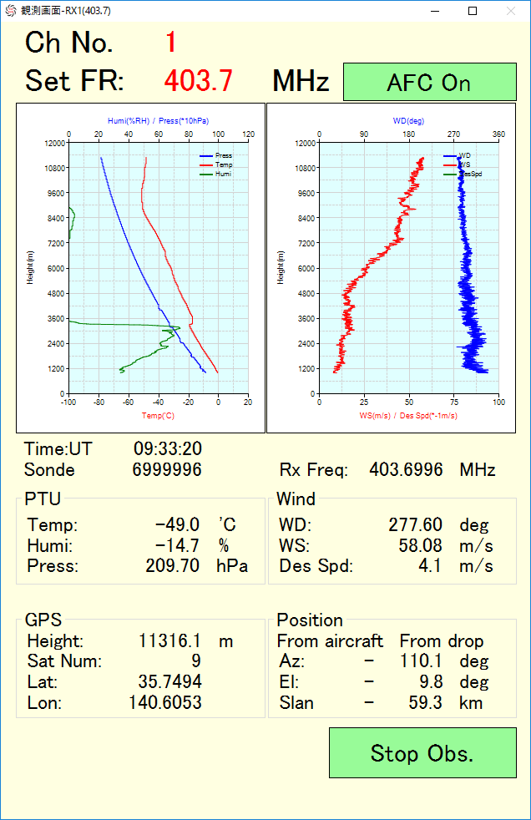
System overview – Receiver -
Block diagram of Receiver
Software flow
400 MHz RF signal is divided into four.
Each PC controls two receivers and one storage box.
Storage box can activate and inspect two sondes at the same time and keep sondes until just before launch.
①
②
③
①：System activation window
②：Pre-flight check window
③：Observation window

Slide 5
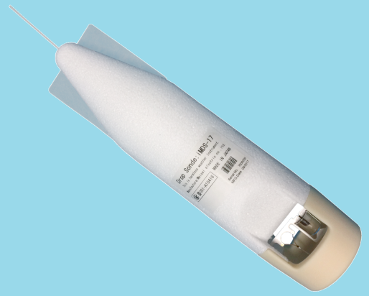
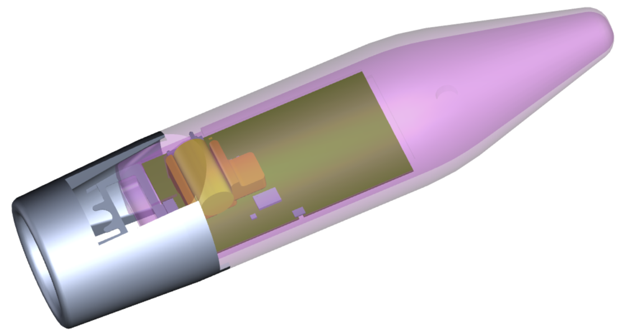
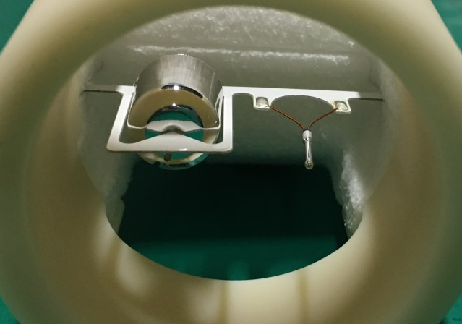
System overview – Dropsonde -
Feature
In order to avoid mechanical trouble, “no parachute design” is adopted.
Attitude during descending is guaranteed by nose heavy design.
The position of the TU sensor became parallel in order to bring a heavy object such as a battery close to the nose as closely as possible
Terminal speed is approximately 13 m/s using the aerodynamic brake.
To avoid the interference in airplane, transmission power increases from 1 dBm to 20 dBm when the dropsonde itself detects launching.

Slide 6
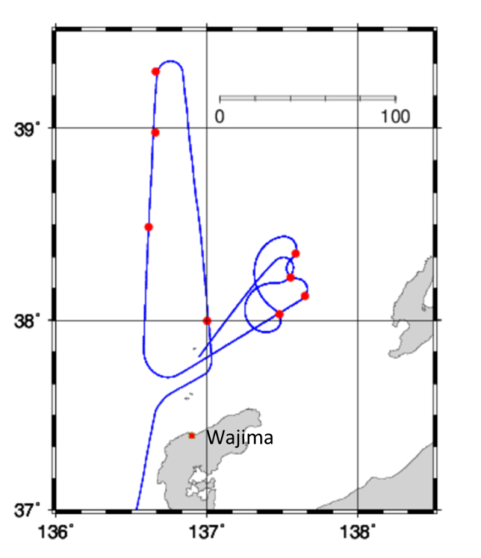
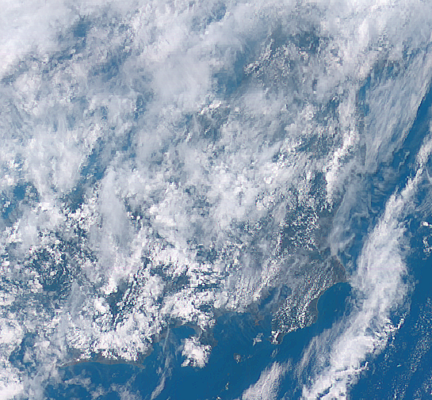
Initial test flight - Plan -
Initial Test Flight has conducted at 27th July in 2017 over Sea of Japan near Wajima
System Test
1ch, 4ch continuous, 3ch simultaneous
Hardware test
Antenna test ( Spiral or Straight)
GPS firmware (Un-speed limited or Not)
Data test
Comparison with RS-11 at Wajima

Slide 7
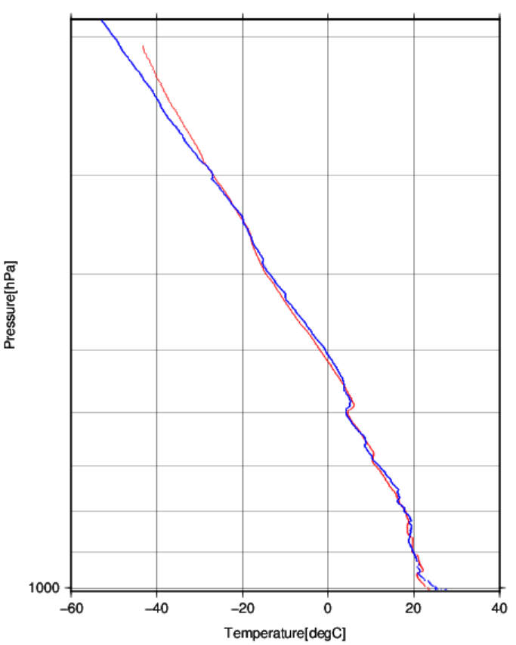
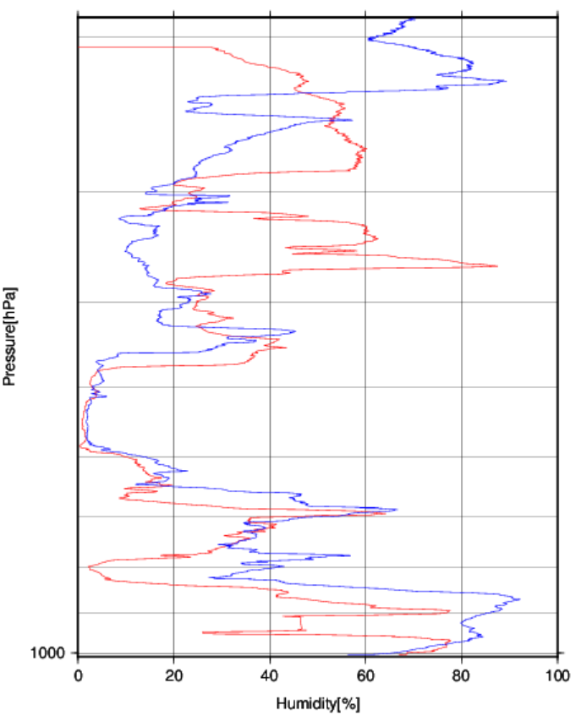
Comparison Dropsonde and RS-11G
― Dropsonde
1200 LST
― RS-11G
1030 LST
300
500
Observations are about 50 km apart and 1.5 hour time difference.
There is a remarkable difference in the temperature ｆor a while after dropping.
It is hard to determine whether the difference in humidity is measurement error or environmental difference with 50km apart.

Slide 8
Initial test flight - Result -
Success are 4, Minor problem is 1 and Failure are 3 soundings.
Straight antenna is better than spiral antenna.
GPS sensitivity is not good under 20 dBm 400Mhz transmission power.
Because the time constant of temperature sensor is large, temperature does not coincide with RS-11G at Wajima above 300 hPa

Slide 9
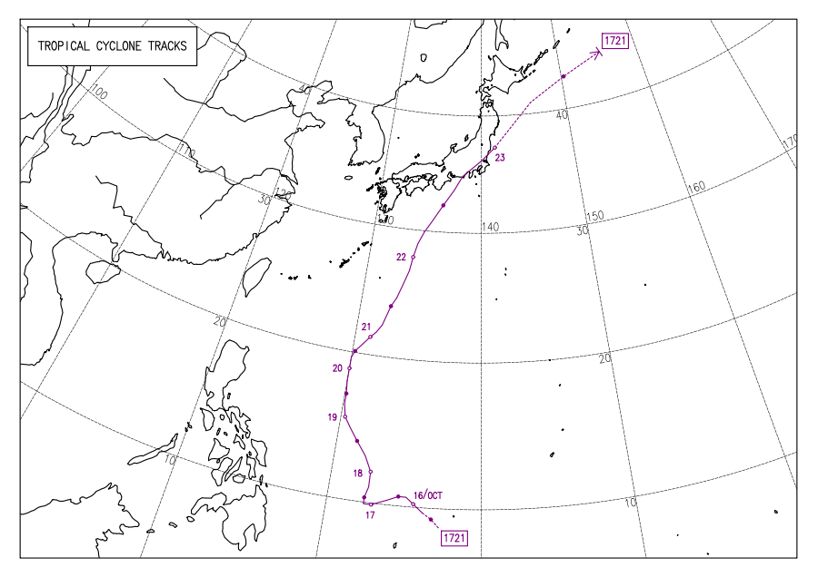
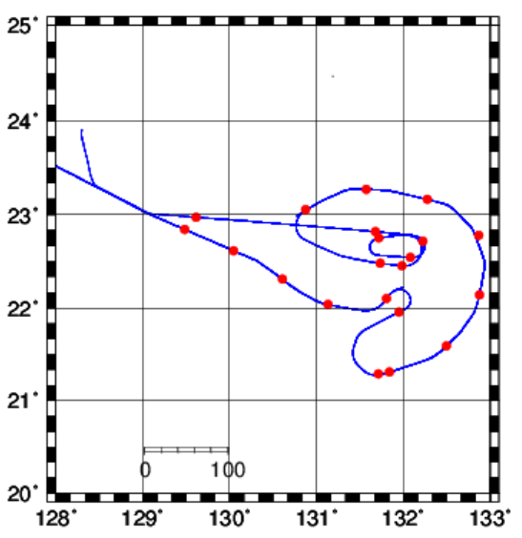
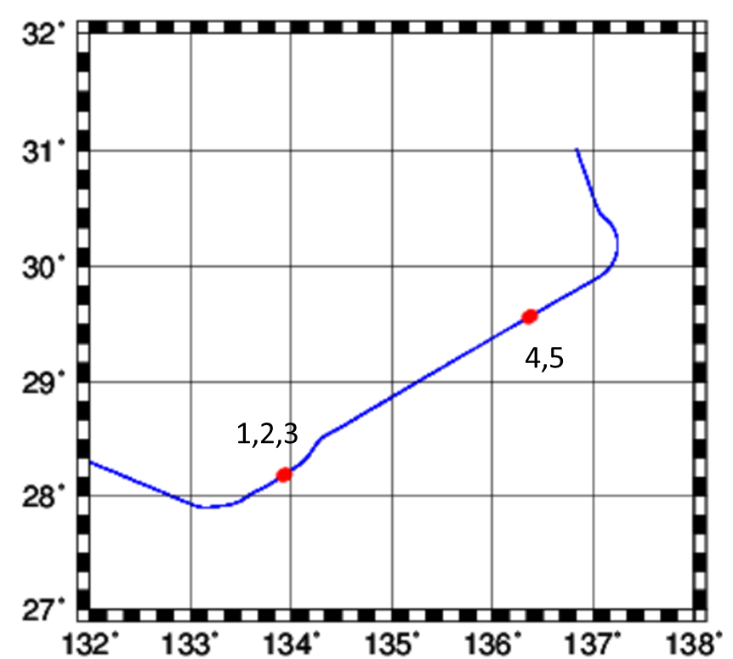
“LAN” typhoon observation
Technical update for “LAN” observation
Straight antenna is adapted for all dropsondes
Transmission power is restricted to 17 dBm to increase GPS sensitivity
To improve the acquisition rate of GPS data, the error correction code has changed.
21st October
21 launch
22nd October
5 launch
21
20
1
15
10
5
[km]
from JMA HP

Slide 10
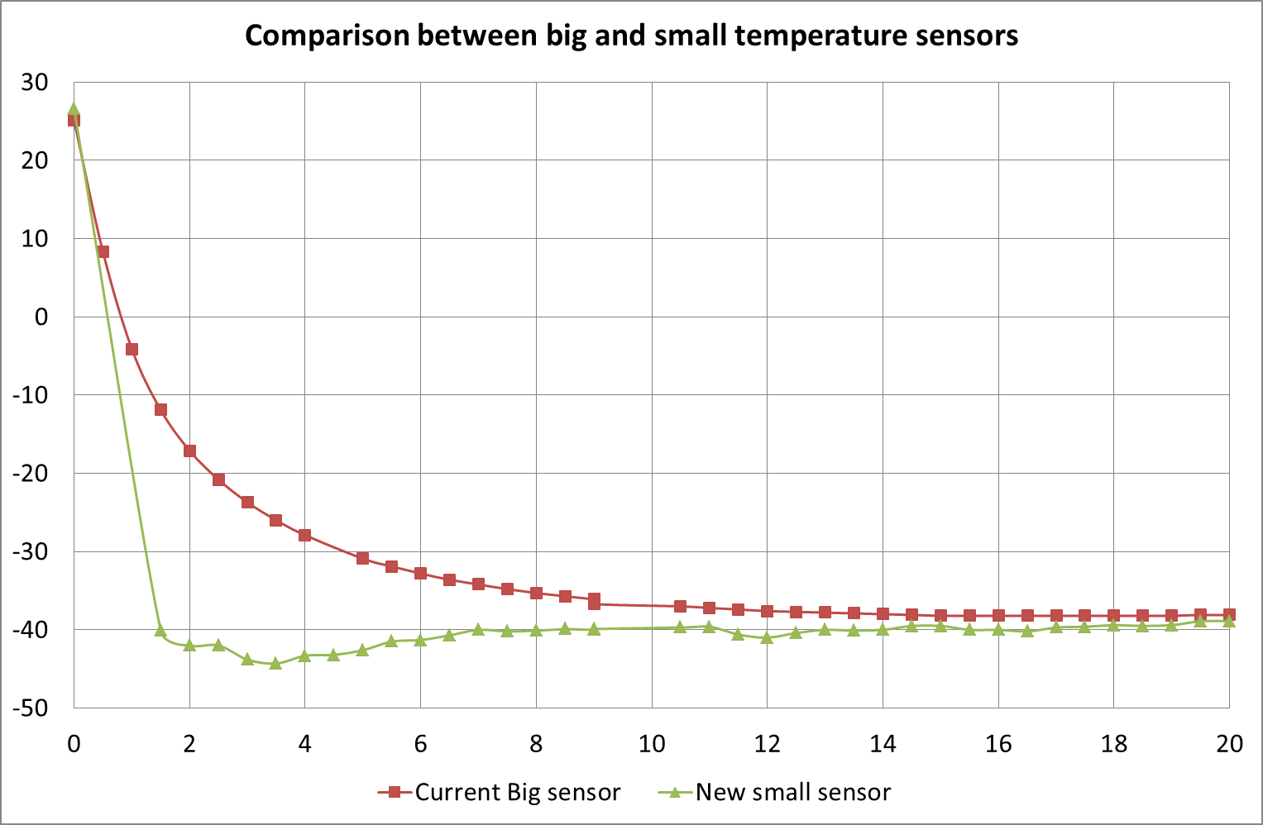
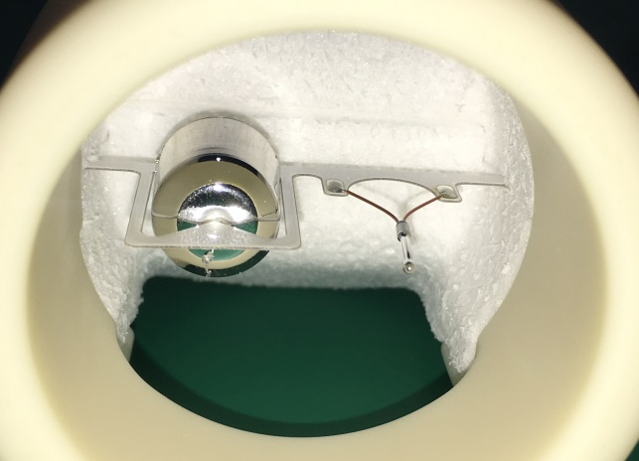
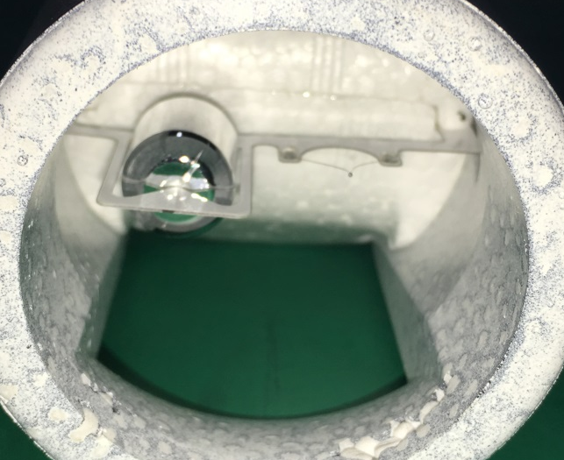
Technical update - Temperature sensor -
On October 22, dropsondes with large temperature sensor and small temperature sensor were dropped almost simultaneously.
Small temperature sensor was confirmed that dose not destroyed by wind shock at the launch and can obtain good profile.
Large sensor
Small sensor

Slide 11
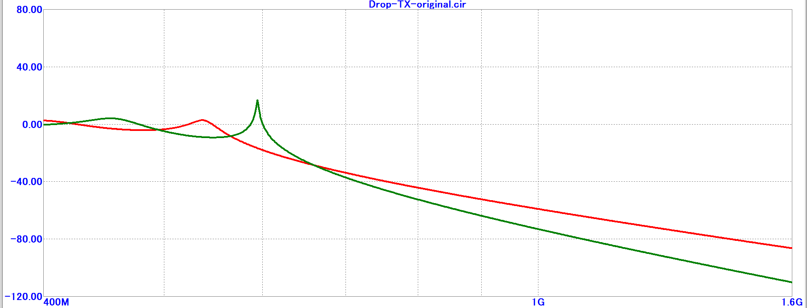
Technical update - Telemetry and GPS -
Less sensitivity of GPS was found to be caused by the interference of the 4th harmonic wave of 400 MHz to the GPS.
Solved by improving the filter of the transmitter circuit.
Even if the transmitter power is raised, the sensitivity of the GPS does not decrease.
2017 model was 17 dBm 2018 model is 20 dBm
Filter characteristics of transmitter circuit
― current
― new
1575 MHz
TX IC
Filter
Attenuation at 1575 MHz : from -85dB to -109 dB

Slide 12

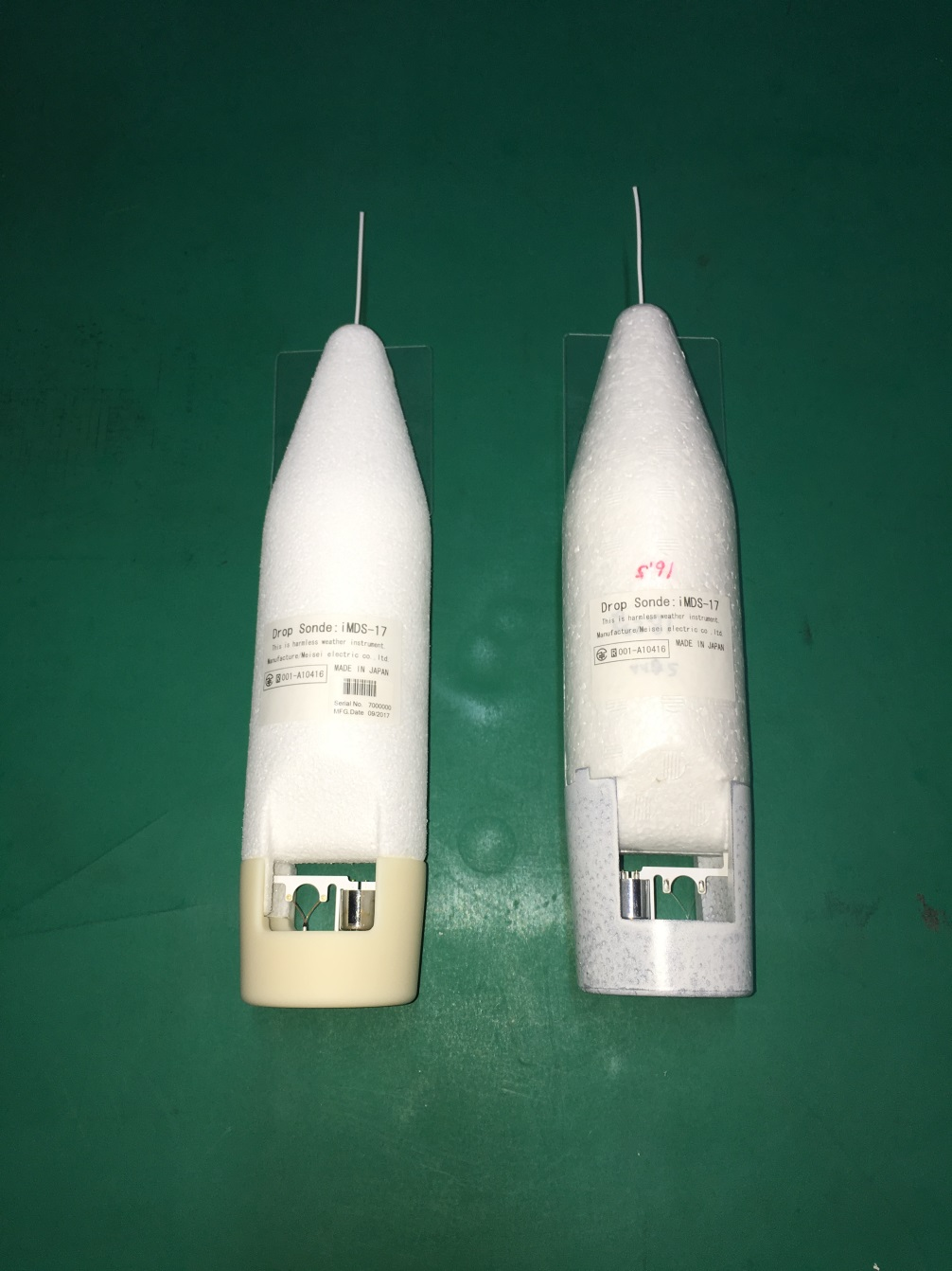


Technical update - Reduction of environmental burdens -
In order to reduce the environmental burden, dropsonde package has been changed to plant (corn) based material.
Depending on the conditions, they biodegrade in a few years.
Body
Styrofoam made from corn
（LACTIF by JSP Corporation)
Head
Molded biodegradable plastic by mixing "beads of styrofoam made of corn" and "sand iron"
Body ・
EPS
Made from Oil
Head ・
ABS
Made from Oil

Slide 13
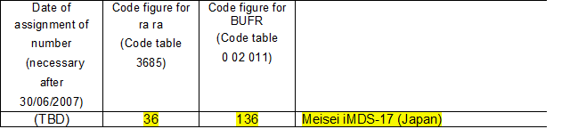
Technical update - GTS communication -
Equipment information is important in TAC and BUFR.
In operational sondes, each model has its own WMO code.
(EX. RS92 = 80, RS41 = 41, iMS-100 = 135 etc.)
Currently, dropsonde has only one WMO code, number 96.
This means that all dropsondes are treated as the same dropsonde.
In order to solve this, Meisei 's dropsonde gets its own WMO code.
“iMDS-17” Meisei’s dropsonde will be added on “WMO manual on codes” in this May.

Slide 14
Summary
Developed dropsonde system was tested in Wajima in July 2017.
As a result of the test,
Antenna shape
Is determined, and problems of
GPS sensitivity
Response time of temperature sensor above 300 hPa
has been found.
In LAN typhoon observation,
② was solved by restricting transmitter power and changing error correction code.
③ can be solved by applying a time-lag filter. (Verification of time lag is necessary)
For observation in 2018,
Small temperature sensor and new transmitter filter will be applied.
Bio-based package will be applied to reduce environment burdens.
iMDS-17 will be add on "WMO manual on code" for TAC and BUFR message.

Slide 15
Thank you for your attention!!
Kensaku Shimizu
shimizuk@meisei.co.jp

Slide 16
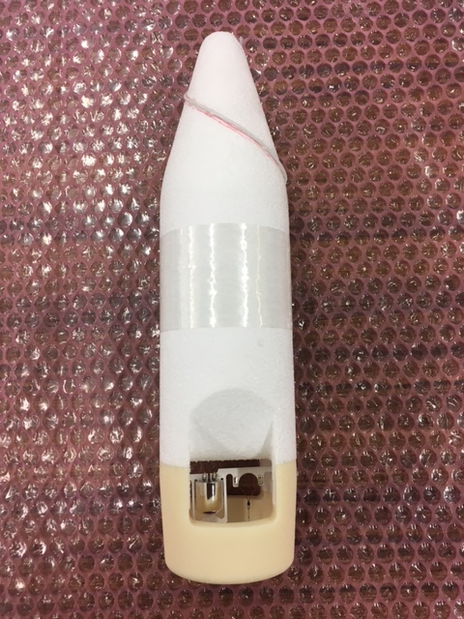
Straight antenna and Spiral antenna

