Slide 1
Review of typhoon surveillance dropsonde mission (2003-2017) at Taiwan
Po-Hsiung Lin¹ Chun-Chieh Wu¹ Kun-Hsuan Chou² Feng Lei ³
¹National Taiwan University
²Chinese Culture University
³Taiwan Typhoon and Flood Research Institute

Slide 2
OUTLINE
Quick view on three Phases
Some Statistics Numbers (2003~2017)
Characteristics of Typhoon Outer Core
Summary and Next step

Slide 3
Quick view on three Phases
Pre-Phase: 2002 summer (visiting NOAA/RHD, AOC)
Phase 1 : 2003~2005 (NTU, supported by NSC)*
Phase 2: 2006~2012 (NTU, supported by CWB +
2008 TPARC + 2010 ITOP)
Phase 3: 2013~2017 (TTFRI, supported by CWB)
* DOTSTAR: Dropsonde Observations for Typhoon Surveillance near the TAiwan Region

Slide 4
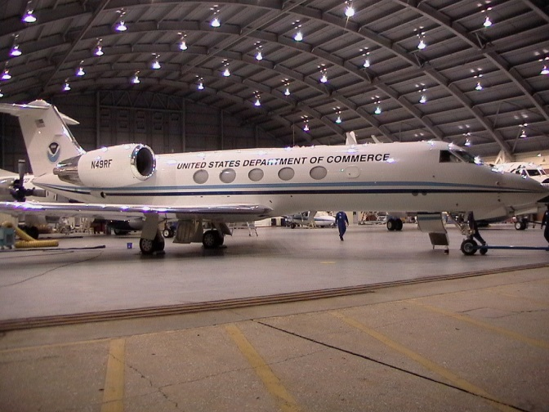
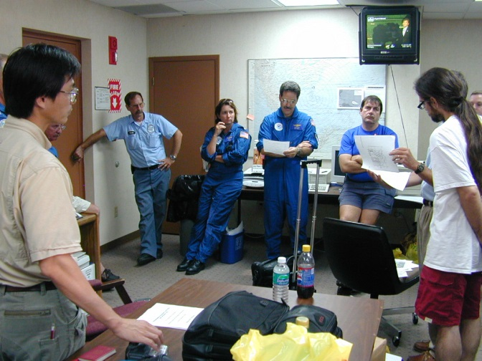
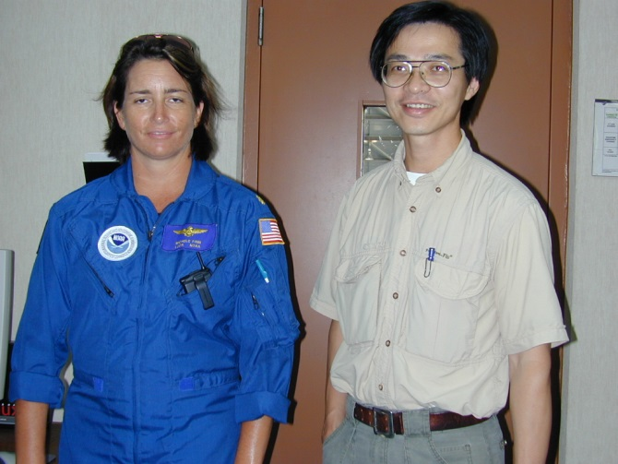
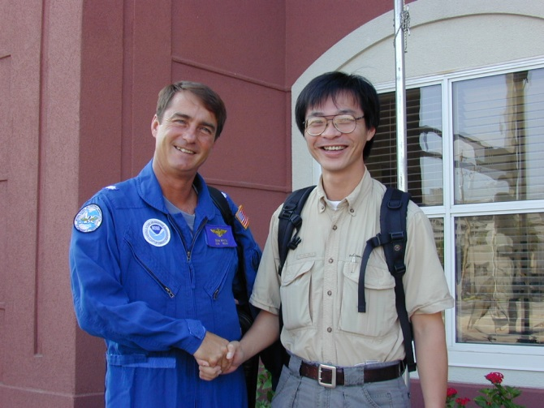
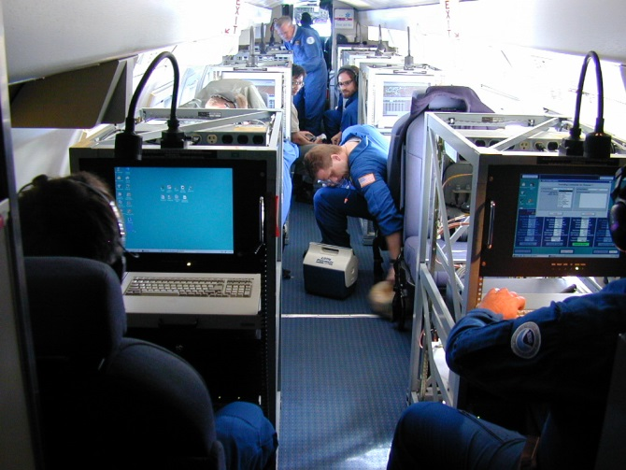
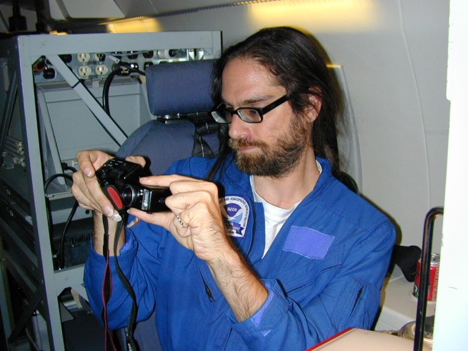
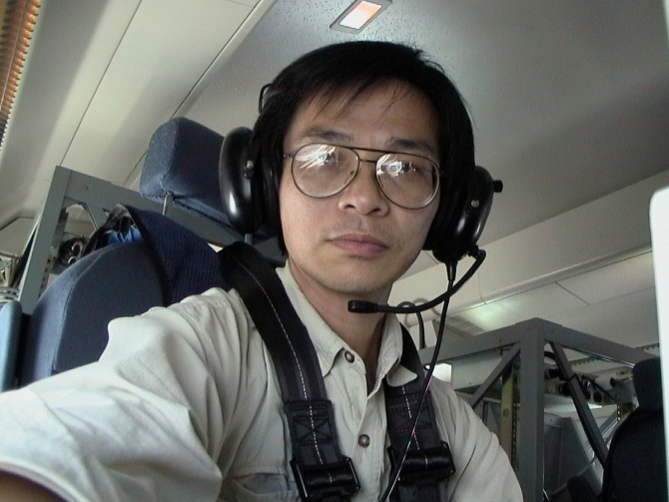
Pre-Phase: 2012
NOAA/RHD, NOAA/AOC/G4
Atlantic 2002
TD EDOURAD
TD FAY

Slide 5
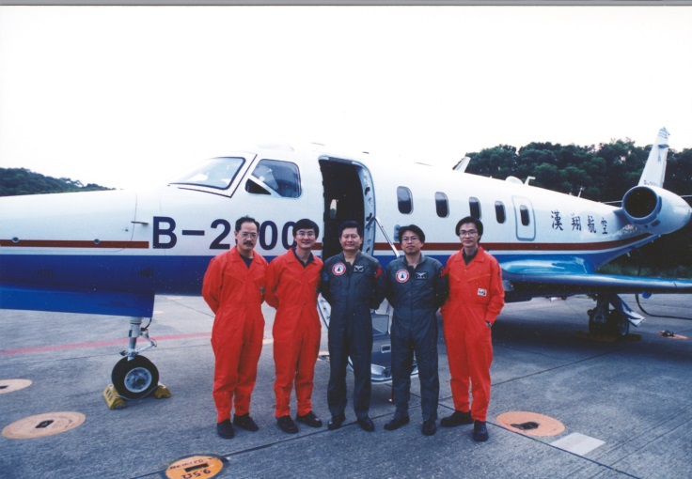
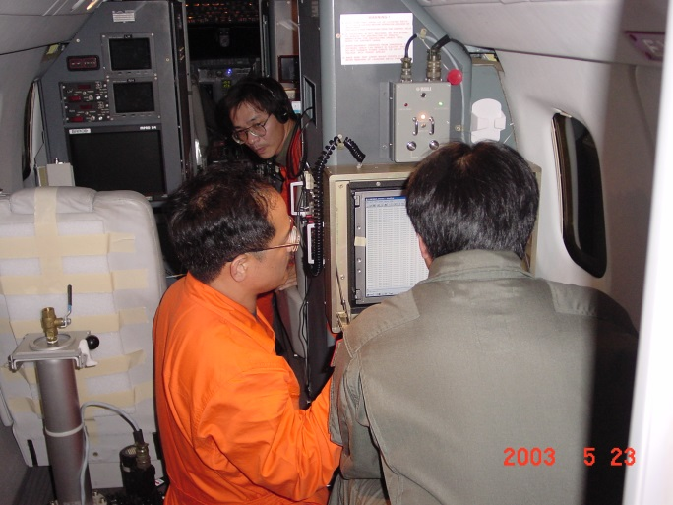
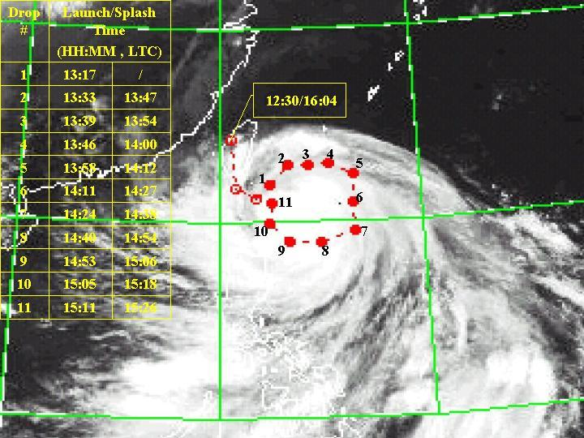
Phase 1 : 2003-2005
Funding support by NSC
Airplane owners: Japan Diamond Air Service, Taiwan AIDC
AIDC ASTRA Jet AVAPS setup
Interface for flight path making (Virtual Basics, Windows-Based)
Onboard flight-aid software (NTU-Madonna , NCAR-ASPEN)
1st test flight: May 23, 2003
1st typhoon mission: Dujuan (Sept. 1, 2003)
ASTRA (Gulfstream 100)

Slide 6
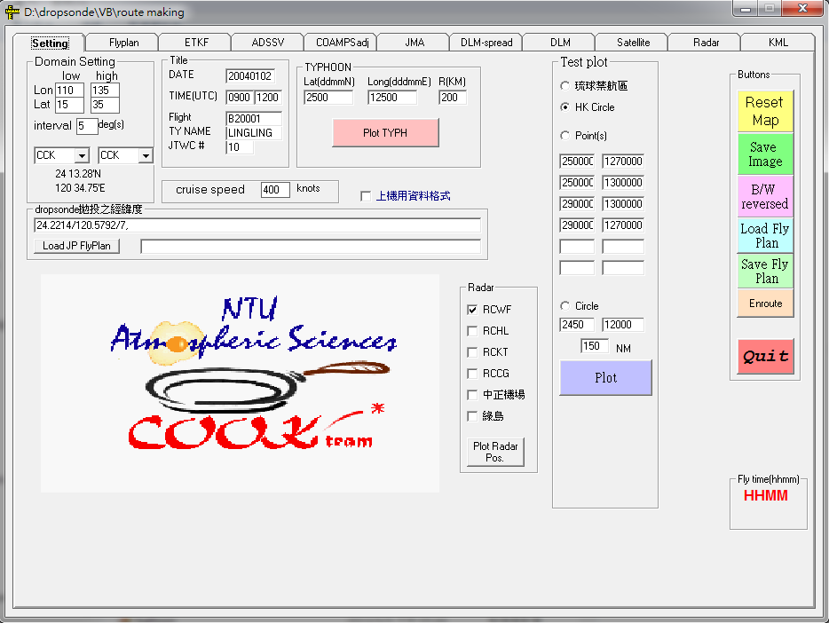
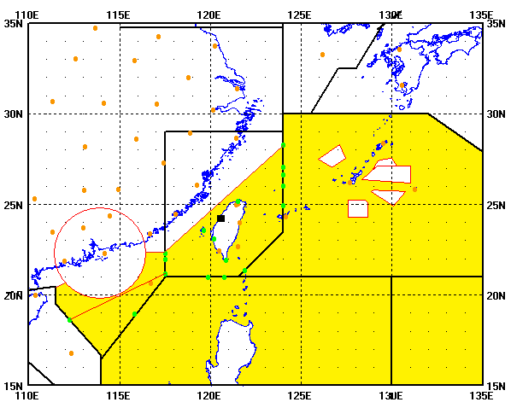
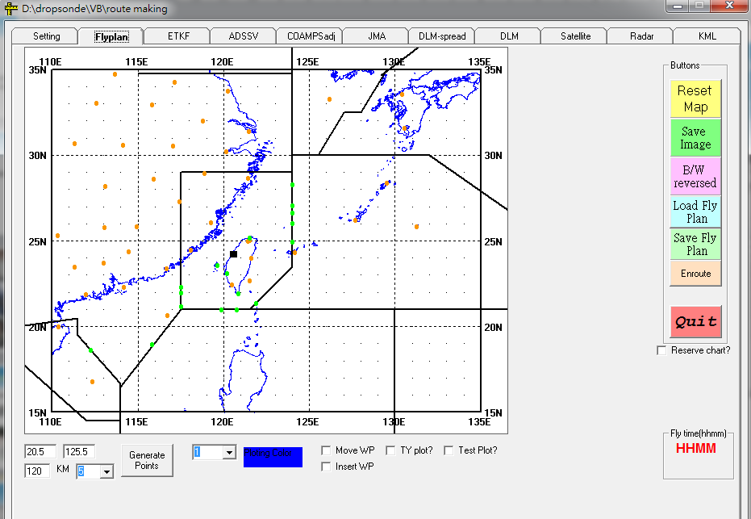
Windows Interface for flight path making (Virtual Basics)
Flight domain
Taipei FIR
Naha FIR
HK FIR
Philippines FIR

Slide 7
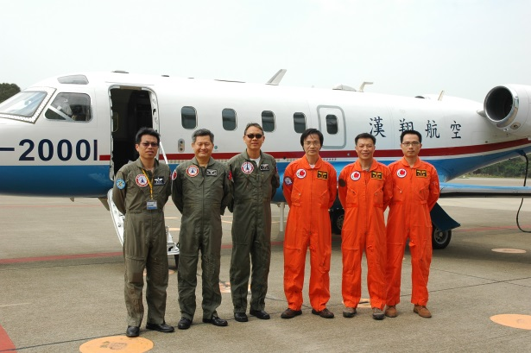
Mission Flow of DOTSTAR
DB 5~3 days
Storm Watch (CWB, NTU)
DB 3~2 days
Flight path making (NTU)
Flight plan sending to NAHA, Philippines, HK FIR (AIDC)
DB 2~1 days
Crews Call (NTU)
Decision making (Go or not) (NTU+CWB)
DB: Day Before
DA: Day After
DB 5~2 hrs
Ground transportation Taipei---Taichung (NTU)
DB 2~1 hrs
Final ground check (AIDC + NTU)
test flight (each April)
ASTRA: high altitude
AVAPS: function/operation
Data flow: air-ground-world
DB 1hr
Mission + Weather briefing (AIDC + NTU)
DA 0~6hrs
Drop + onboard code editing + voice communication (NTU, AIDC, CWB)

Slide 8
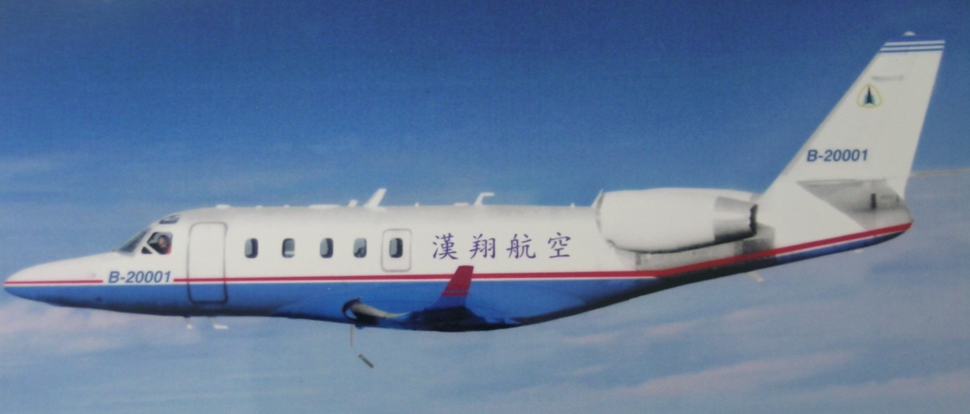
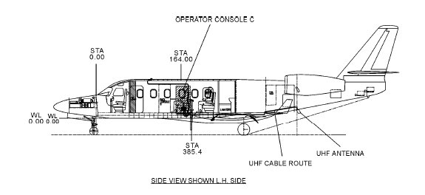
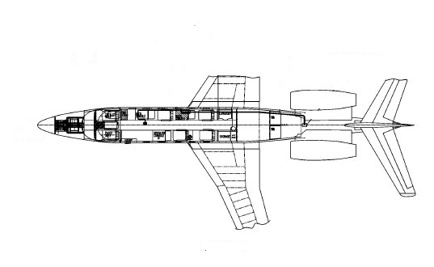
ASTRA (modified Gulfstream 100)
RD94 dropsonde
AVAPS operator
System Engineer
Code editor
Launcher + PI (visitor)

Slide 9
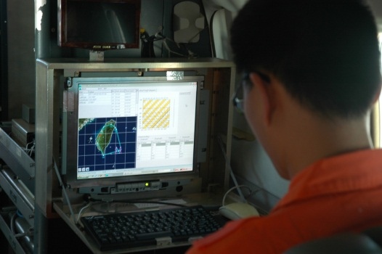
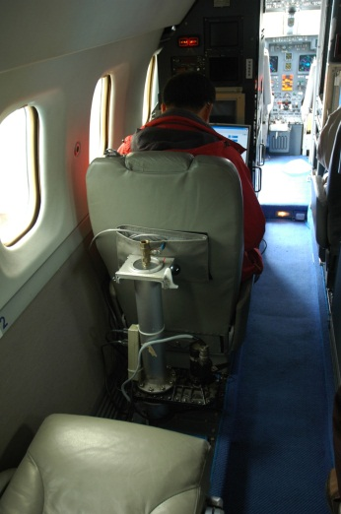
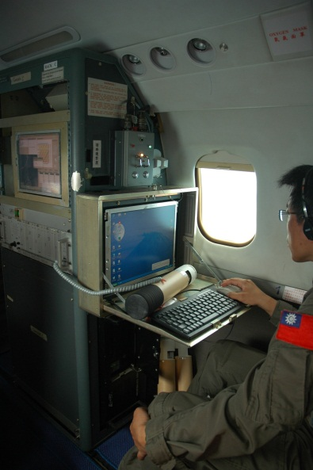
pilots
gate
Satcomm
Code editor
SE
internet
launcher
AVAPS
operator
PI / Visitor
toilet
After 2016:
SE monitor is connected to TTFRI office
ASPEN is operated in TTFRI office, too.

Slide 10
Onboard data processing
Astra Jet flight Information
RD94 dropsonde in-air data
Pilot console
AVAPS
(Airborne Vertical Atmospheric Profiling System )
AR-429 Bus-Card
Vaisala
Madonna (2003-2006)
(realtime airborne and dropsonde data ploting & diagnosis system )
Britney (2007~2014)
(Bright tool for onboard enjoy)
ASPEN
(Atmospheric Sounding Processing Environment )
NCAR
DCF
(Data Compress and FTP sending )
NTU
TTFRI
NTU
Satcomm
TTFRI
FTP
CWB

Slide 11
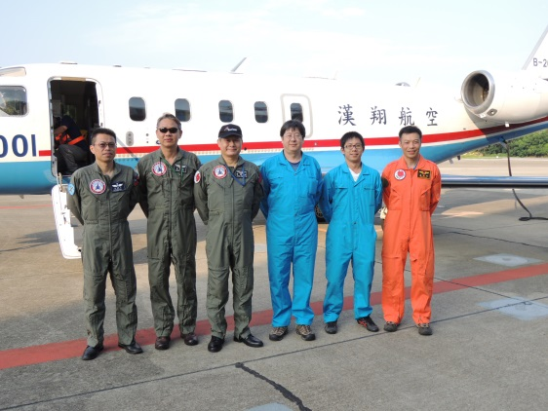
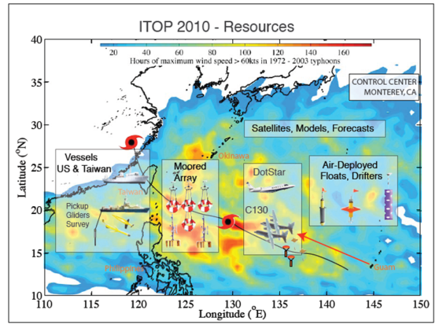
Field campaigns
Public education
2004 “e-Taiwan” Film by Government Information Office
2008 ”T-PARC”
2008 “National Geography” TV program
2009 “NSC-50th” film program
2010 “ITOP”
2012 “Follow me” TV children program
2013 Technical transfer from NTU to TTFRI

Slide 12
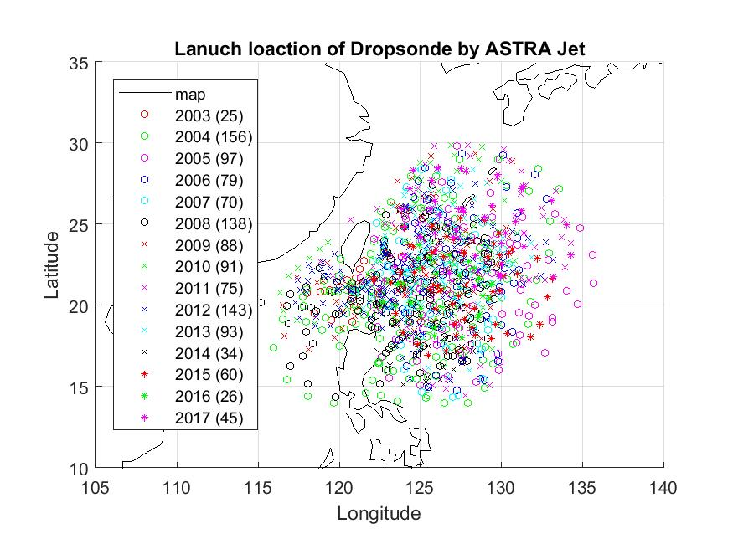
Some Statistics Numbers (2003-2017)
Flights: 80, TY : 64
Dropsonde: total_1325, fail_105
(8% bad, most of this number contributed by old RD93 dropsonde before 2009)
Limit annual funding on aircraft rental fee
(~15 thousounds/hr)

Slide 13
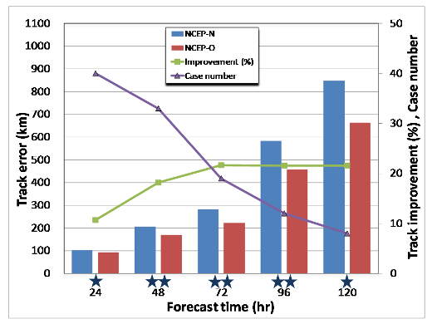
Dropsonde impact study by NCEP GFS
2003-2009 45 TCs (35 cases)
Improvement of track
error 12~18%
The case-averaged track error statistics of 2003–2009 DOTSTAR cases at every 24-h forecast time for different periods. Bars represent the case-averaged track error of control (NCEP-O) and denial (NCEP-N) forecasts (in km). The solid line indicates the case-averaged track error improvement (in %) and the dashed line the number of cases in each forecast time. The single (double) asterisk shown on the abscissa indicates that the forecast error difference between the control and denial runs is statistically significant at the 90% (95%) confidence level. (Chou et al.,2011)

Slide 14
Dropsonde impact study by CWB TWRF
2008-2016 37 TCs (49 cases)
Improvement of track
error 6~8%

Slide 15
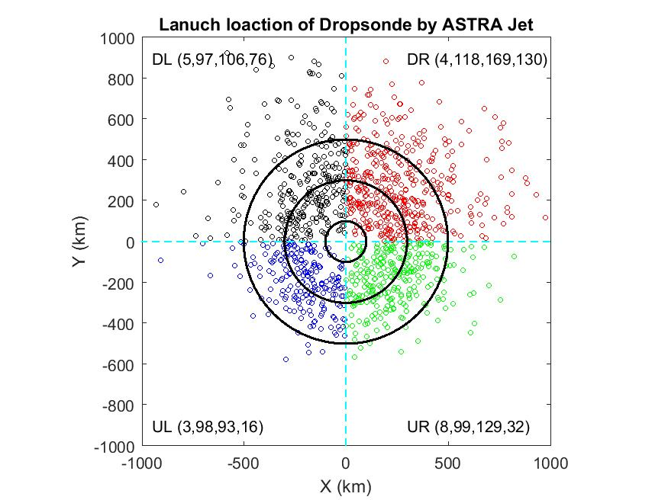
Some Statistics Numbers (2003-2017)
Distance to eye / dropsonde number
0-100 km (inner core) / 20
100-300 km (outer core) / 412
300-500 km / 497
> 500 km / 254
Target observation for sensitivity regions
DR
UR
DL
UL
Downwind vs. Upper wind
Left vs. Right

Slide 16
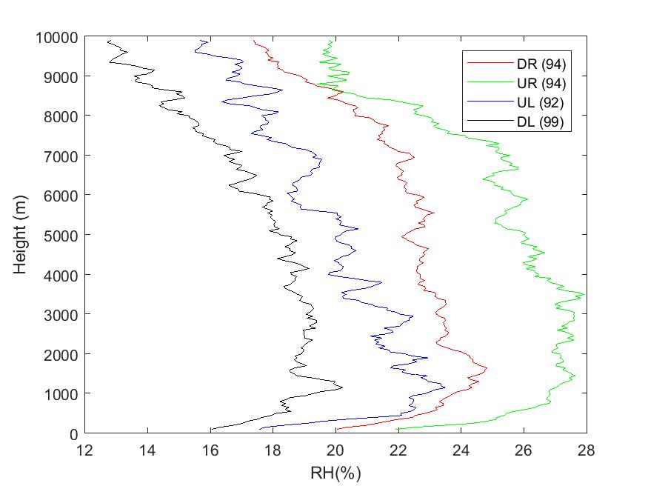
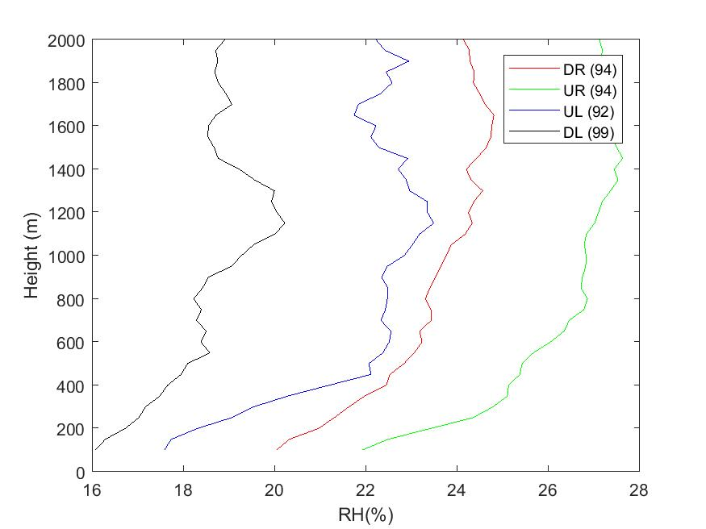
Characteristics of Typhoon Outer Core
Tangential velocity profilers
❷
DR
UR
❶
❹
DL
Asymmetric structure of maximum wind speed
wind speed in UR is the biggest.
UL
❸
Tangential wind speed (m/s)

Slide 17
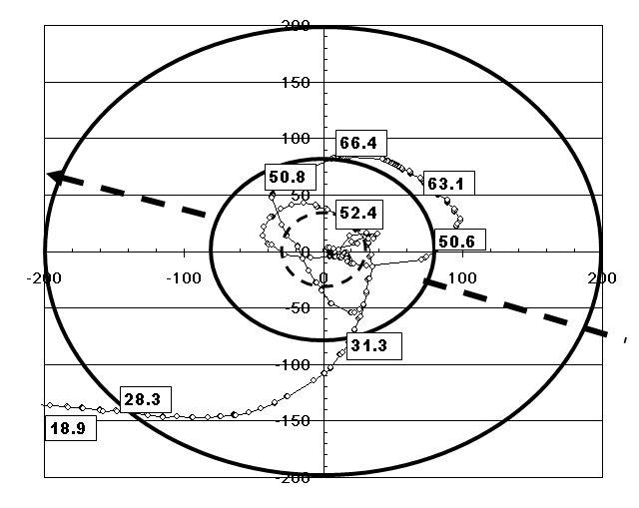
DR
UR
In-situ measurement of wind speed
by Aerosonde in Typhoon Longwang 2005
(Lin and Lee, 2008)
DL
UL

Slide 18
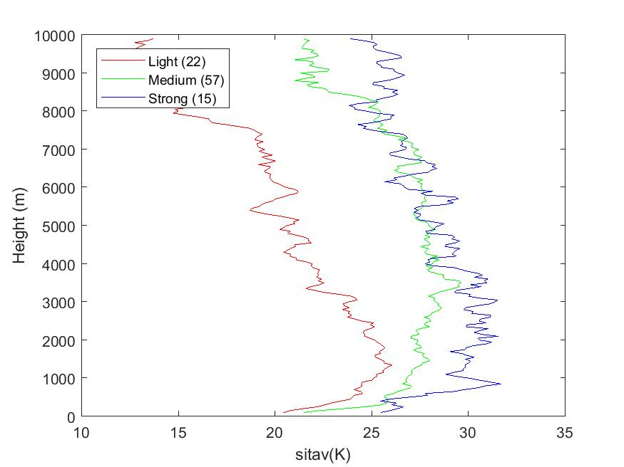
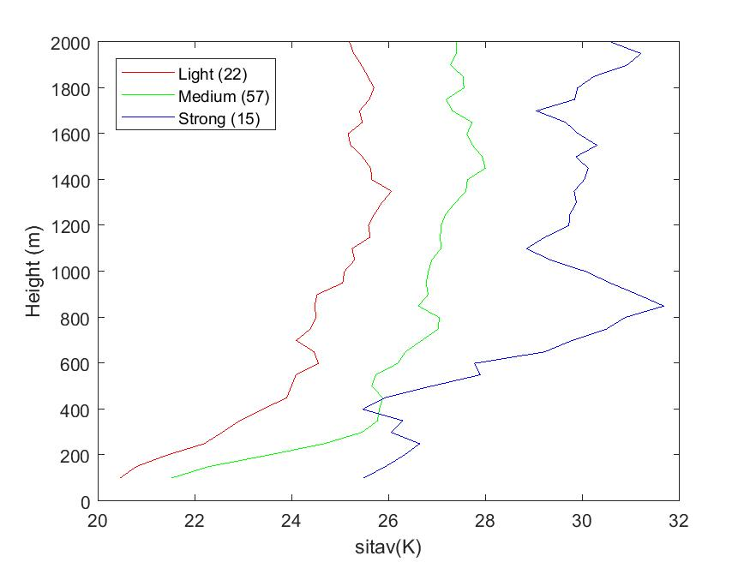
Characteristics of Typhoon Outer Core
Tangential velocity (UR)
DR
UR
DL
Three categories of Typhoon intensity (CWB)
UL
Tangential wind speed (m/s)
Tangential wind speed (m/s)
Difference of wind profile in three categories of typhoon intensity

Slide 19
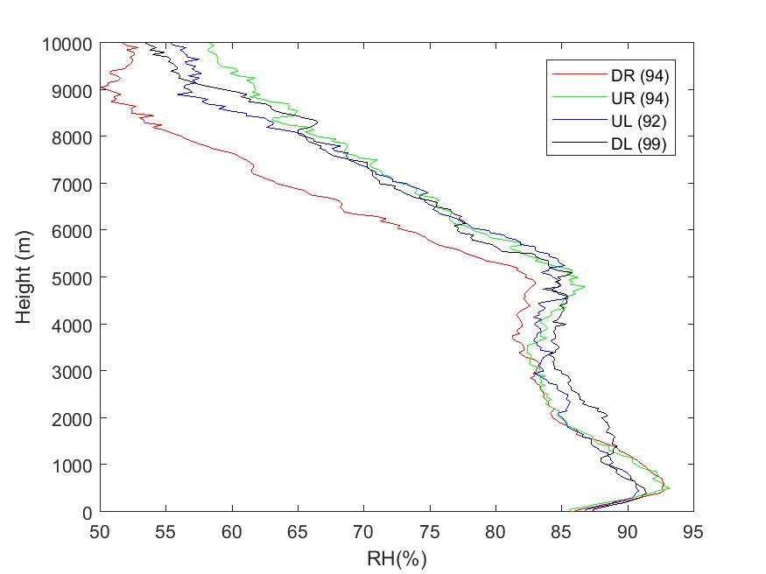
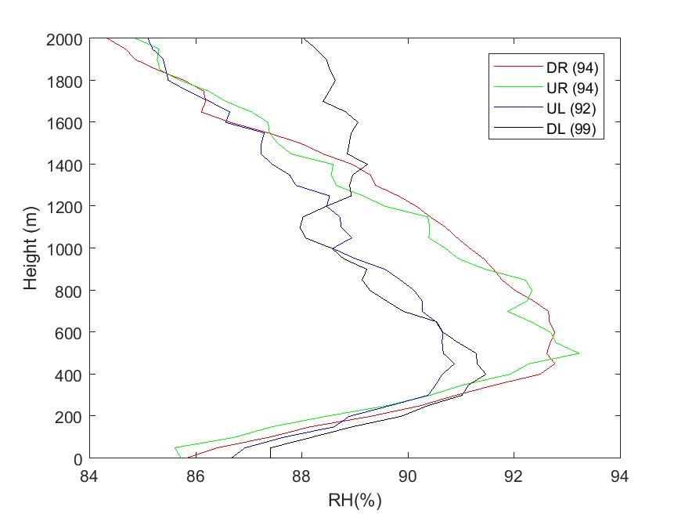
Characteristics of Typhoon Outer Core
Relative Humidity profile
DR
UR
DL
UL
500m
More symmetric in humidity field than wind field

Slide 20
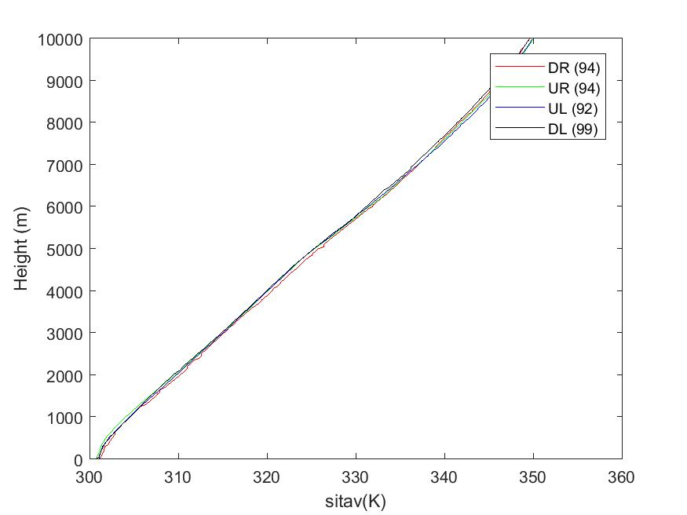
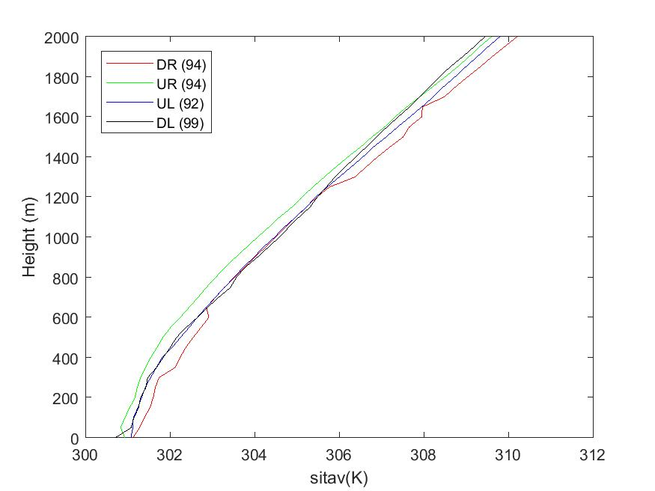
Characteristics of Typhoon Outer Core
Virtual Potential Temperature
DR
UR
DL
UL

Slide 21
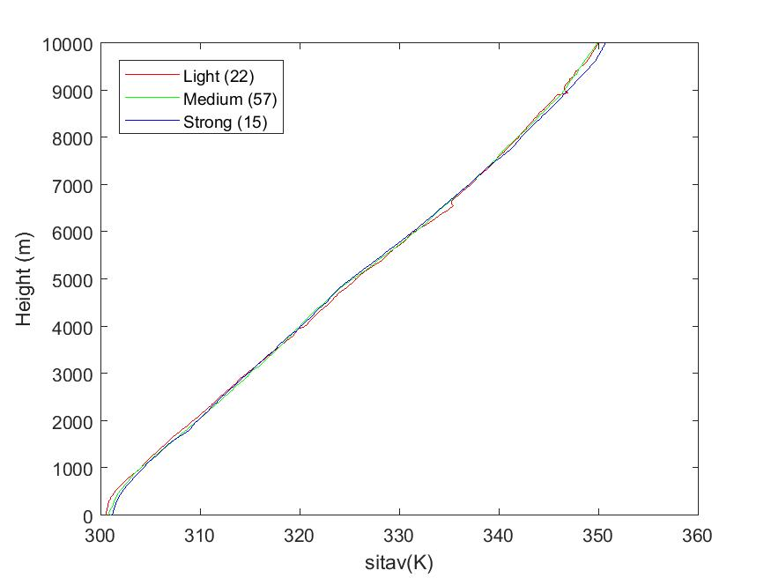
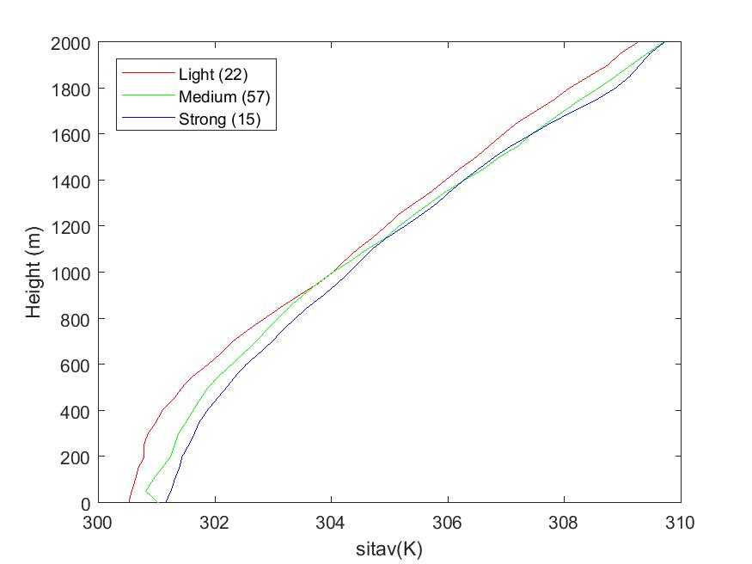
Characteristics of Typhoon Outer Core
Virtual Potential Temperature (UR)
DR
UR
DL
UL

Slide 22
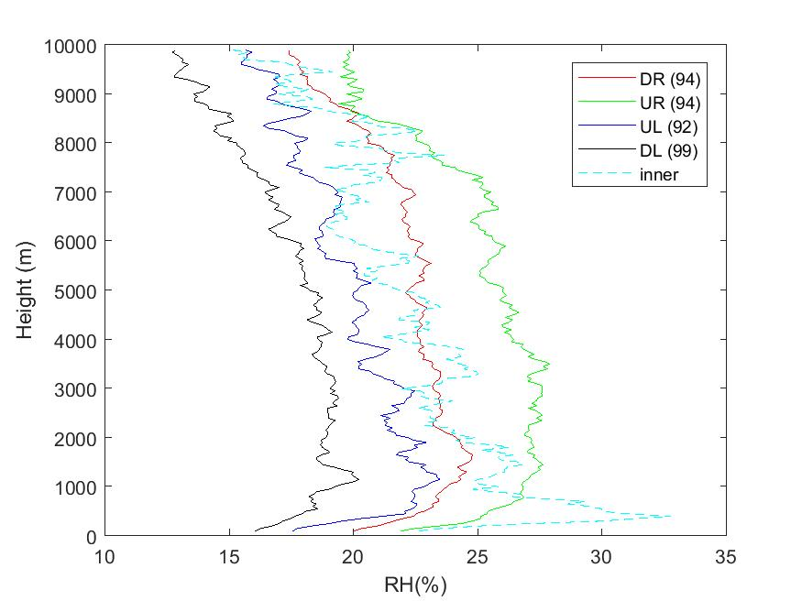
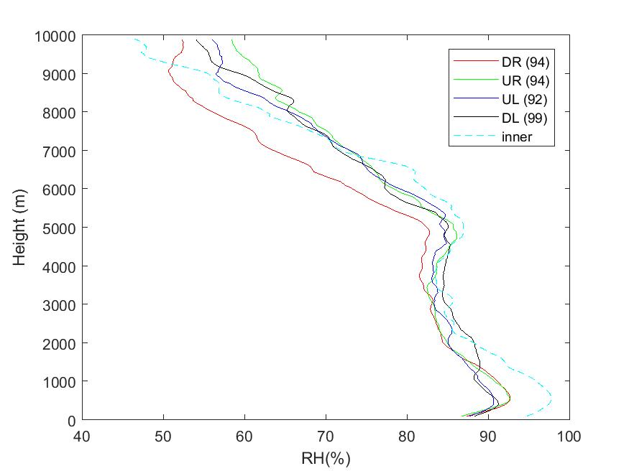
Comparison of vertical profiles between inner core (20 samples) and outer core (412 samples)
→lower and stronger windshear + more humid
Tangential wind speed (m/s)

Slide 23
Summaries
tangential wind profiles: maximum speed close to 1000m height and asymmetric in quadrants (stronger at UR, weaker at DL)
Humidity profiles : more symmetric than wind field
The profiles in different intensity of typhoons are under studied.
Forecast impact from models were done
More data from inner core should be collected
DR
UR
DL
UL

Slide 24
next ?
2018 mission ? _ possible cancel if AICD rental fee is no discounted and/or limited budget on flight hours
Phase 4 ? (TTFRI closes this year and NTU plans to replay the dropsonde mission after 2019)
Reconnaissance flights ? (NOAA P3 aircraft + AXBT, Coyote)

Slide 25
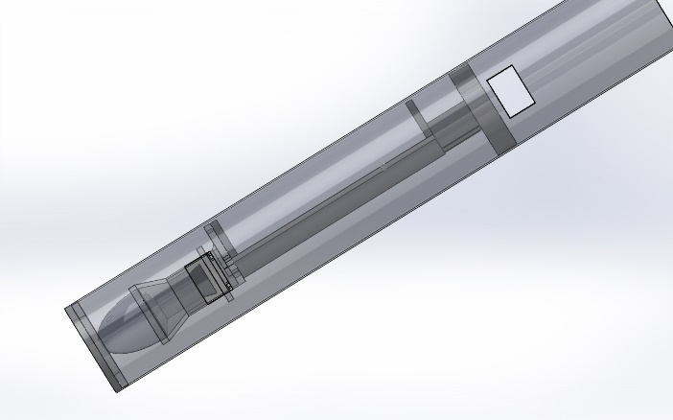
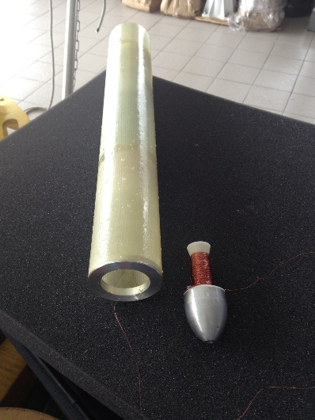
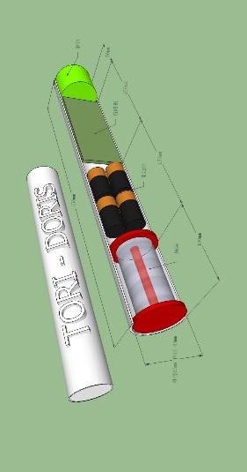
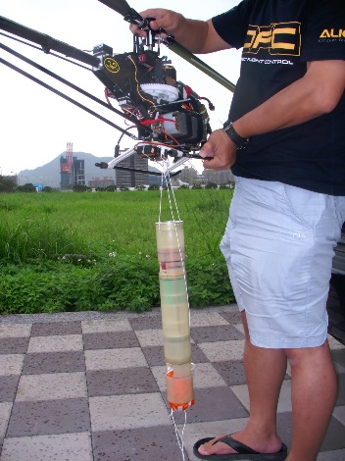
next step (1)
DORIS:
A mini AXBT in same size of RD94 dropsonde + iridium module
was under developed by NTU, TORI and TTFRI (2014-2015).
DORIS is expected to launch from ASTRA after RD94 to measure
OCPI (Ocean Coupling Potential Index) for typhoon intensity study
(First propotype was done except iridium module, postponed by funding)

Slide 26
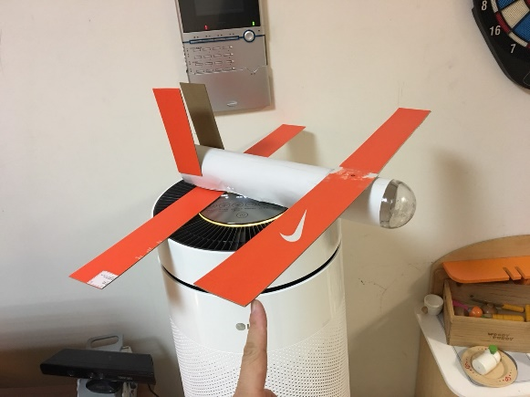
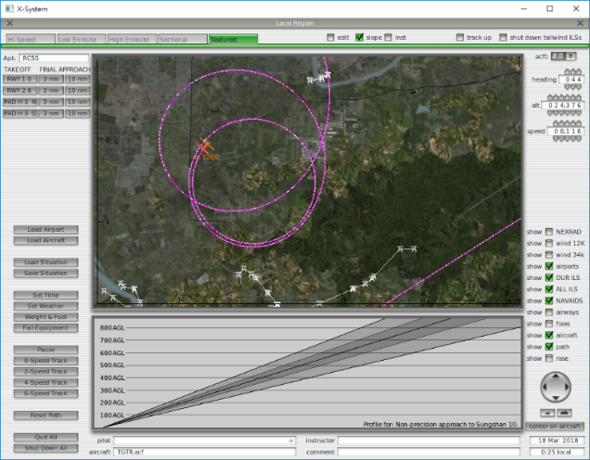
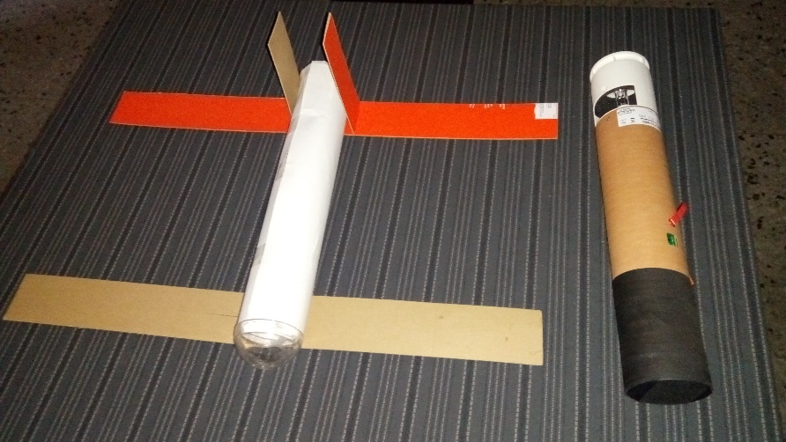
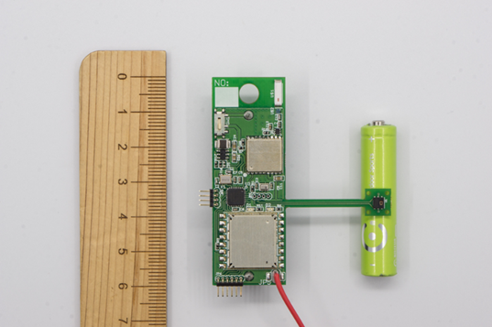
next step (2)
glider UAV dropsonde _same size of RD94 dropsonde
is developed by NTU. This wing-foldable glider (Pixhawk autopilot module, GPS, PTU sensors*) will be dropped from ASTRA to approach inner core (or eye) of typhoon (wing dropsonde). *NTU mini radiosonde (12 g) is done and used in 2017-2018.
NTU mini radiosonde

Slide 27
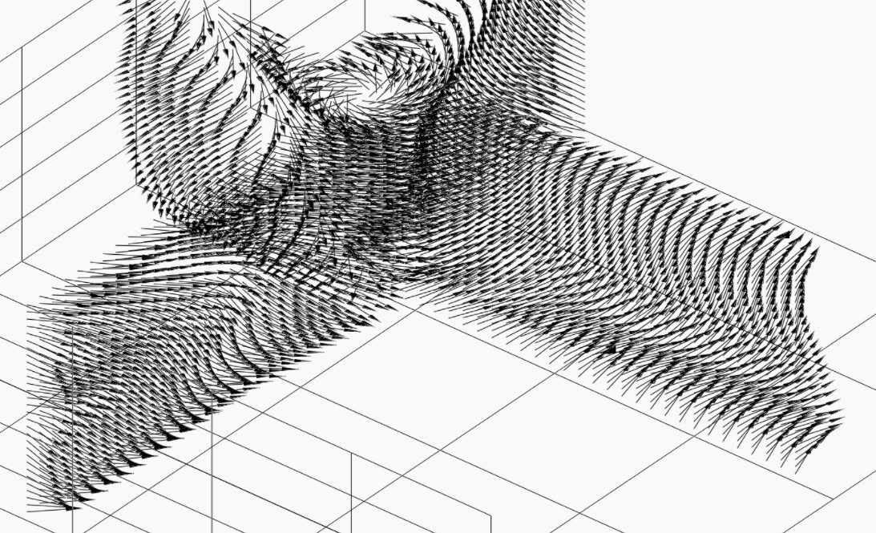
Slide-down ratio ~15 From ~150km distance (outer core) and 14 km cruise height slide into inner core and the center
glider frame/weight/battery/radio communication is developing currently. Flight performance is simulated through models (X-plane simulator + WRF simulation of TY Nepartak).
We hope to have first field test (balloon borne) in this year.

