Slide 1
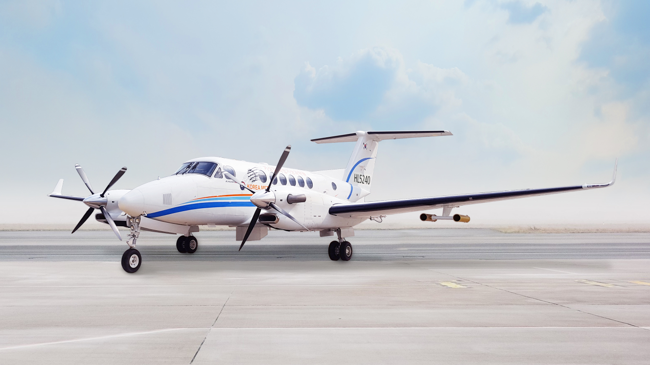
First results of dropsonde measurement from the KMA/NIMS atmospheric research aircraft in Korea
Soohyun Kwon¹, Chulkyu Lee¹, Jaeil Lee¹, Jonghwan Yoon¹, Sangwon Ju¹, Eunsil Jung²
¹National Institute of Meteorological Sciences(NIMS)
/Korea Meteorological Administration(KMA)
²Kyungpook National University
Notes:
Actually There no scientific results yet. I'll Introduce our aircraft and mission. I would like to present the drop situation of the dropsondes.

Slide 2
Introduction
KMA/NIMS introduced the research aircraft KingAir 350 in 2017.
Purposes of KMA/NIMS research aircraft in Korea
To detect the signals of severe weather : typhoon, heavy precipitation, and snow storm for better weather forecasting including NWP
To understand cloud physics to enhance the efficiency of the weather modification to mitigate water resource problems
To monitor the distribution and origin of aerosols including pollutant materials (i.e. yellow sand and fine dust)
To observe greenhouse gases in upper levels regularly over the West Sea together with the measurements at the AhnMyon-do ground station to monitor inflow from the continent
Notes:
In 2017, KMA introduced a weather research aircraft. A detailed explanation of this aircraft was given in the previous presentation.
We have four main purposes for research.
Our department focuses on research about severe weather.

Slide 3
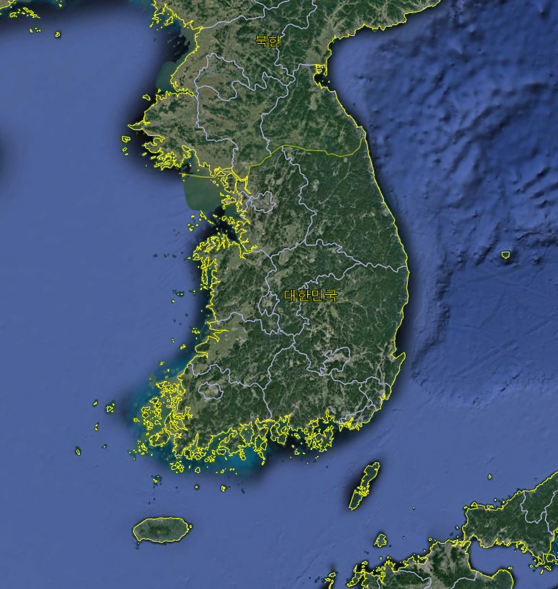
Severe weather missions
Vertical characteristics of atmospheric factor causing the heavy rain in the West sea
Thermo-dynamical structure of heavy snow in the West sea
Development of snow storm at east sea
Observation of terrain effect at microphysical process
Analysis of vertical weather structure for Typhoon predicted paths
Notes:
Severe weather mission studies four weather system as shown below.
The first and second purposes are to analyze the Vertical and themo-dynamucal characteristics of atmospheric factor for development of heavy rain and snow in west sea.
This region is a place where a lot of rain is generated due to the temperatures difference between land and sea surface.
In the winter, as shown in IR image, rolled cloud flows in and It causes the heavy snow.
The next is to Analysis of vertical weather structure for Typhoon predicted paths.
The Final purpose is to observe the vertical structure of snow developing in east sea.
I participated in the ice mission this winter and collected dropspnde observations.

Slide 4
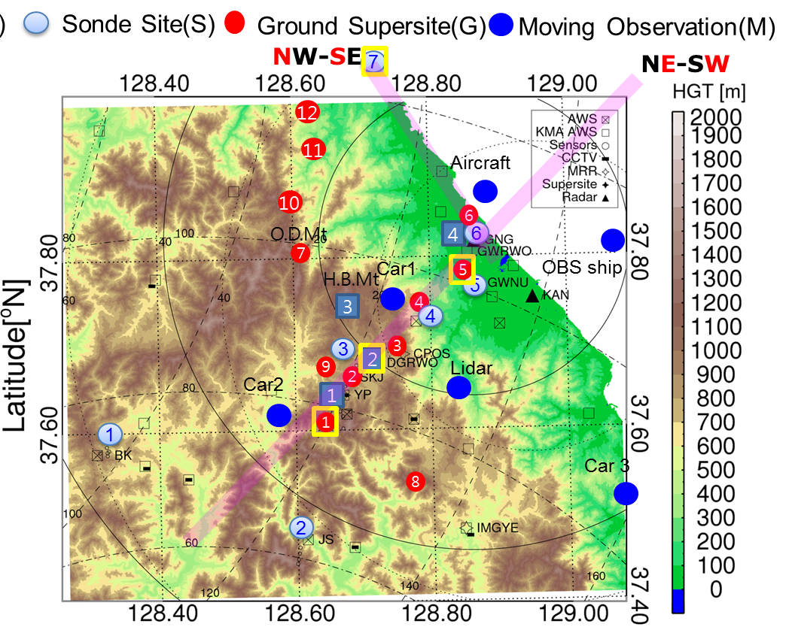
ICE-POP mission
ICE-POP 2018: International Collaborative Experiments for Pyeongchang 2018 Olympic & Paralympic winter game
Purpose :
→ Fill observation gaps of the current network with the airborne in situ measurements (e.g., over the Ocean and Pyeongchang area)
→ Provide the vertical structures of atmospheric conditions for pre-, during, and post-snow events by dropsonde for ocean & Pyeongchang
Observation area: Pyeongchang and east sea
Weather condition: Predicted heavy snow (before/after 1day)
Observation altitude: 1,000 ft(~ 500m) - 29,000 ft(8,839 m)
Instrument: Dropsonde, SFMR, GVR, CCN-200, CCP(CIP, CDP), PIP, WCM2000
Notes:
During this winter, we participated in the ICE-POP mission.
Ice pop 2018 is International Collaborative Experiments for Py 2018 Olypic and Paralympic winter game.
This mission is aimed at filling the observation gap of the
This figure show the ground observation site for ICE-POP mission.
Due to the complexity of the terrain, it exhibits highly fluctuating weather phenomena.
To surport the forcaster, We conducted the aircraft and dropsonde observation during the Olympics.
Observation area is

Slide 5
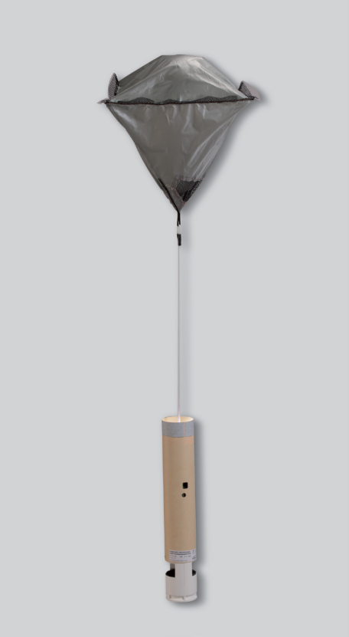
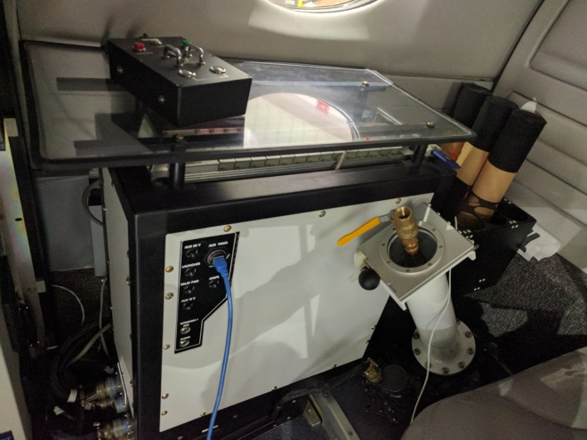
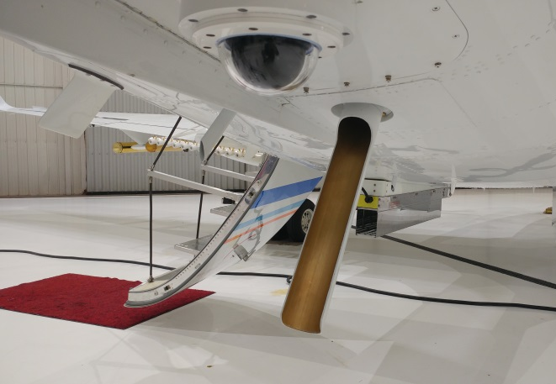
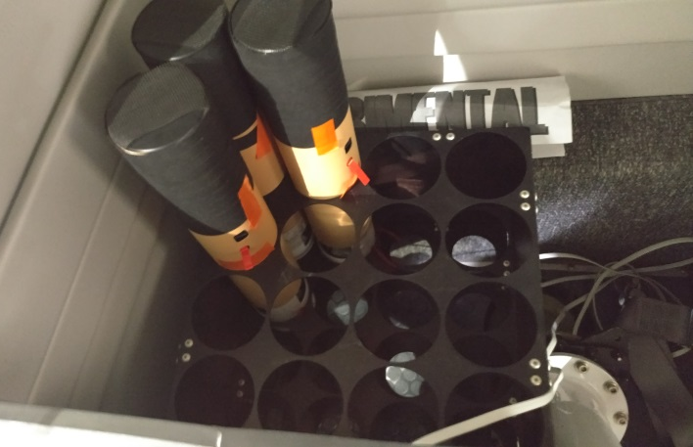
Dropsonde specification
Dropsonde RD94
- Descent speed
~ 11m/s at sea level
~ 21m/s at 12 km
- Descent time
From 14km ~ 15mins
From 7.5 km ~ 8min
AVAPS system
- receive 4 frequency channel simultaneously
EM122 Dropsonde Launcher
Measurements variables
- Horizontal wind speed
- Temperature profiles
- Relative humidity profiles
- Pressure
→ Release dropsondes at max. flight height(29,000ft)
AVAPS system
Hold 16 dropsondes
Notes:
We used the RD94 dorpsonde.
It has a descending speed of 11 m/s at sea level, 21 m/s at 12 km.
The descent time is 15min from 14km,
It can measure the horizontal wind speed and Temperature , RH, P
We used AVAPS system to set the dropsonde. The AVAPS system can set four drop sondes at the same time.
The dropsonde launcer used EM122.

Slide 6
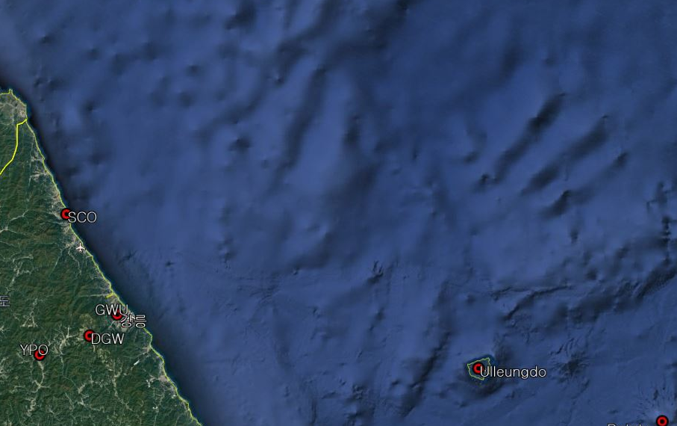
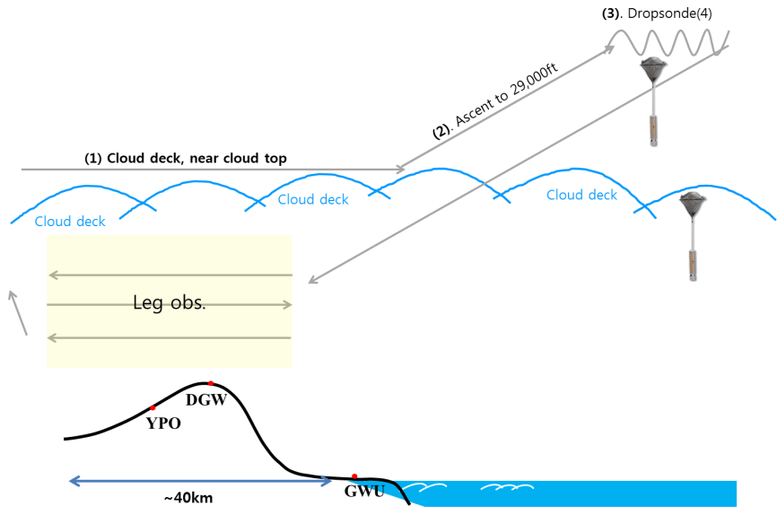
Measurement strategy
Target area: East sea
Observation altitude: 29,000ft (~9km) for the dropsonde 2,000-28,000ft for cloud physics and weather modification
Distance between each dropsondes: 20km
Number of sonde for 1 event : 6th Jan - 24th January (Olympic games) : Drop 16 dropsondes 28th Jan - 18th March (Paralympics): Drop 4 dropsondes
Cloud physics measurement
38.38N 131.18E
38.42N 130.17E
⑩
⑪
⑨
⑧
⑦
⑫
(16)
⑮
⑥
SCO
38.23N 131.17E
⑭
⑤
⑬
④
GWU
③
①
②
DGW
37.80N 130.16E
YPO
Notes:
The target area is the East sea area, which is an extension of the ground observation site.

Slide 7
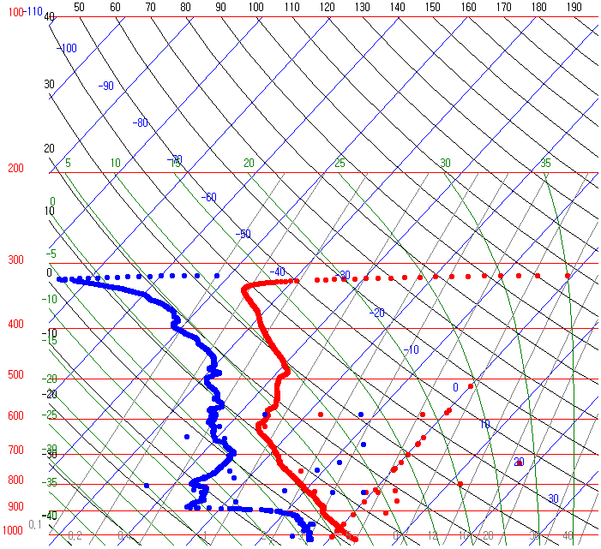
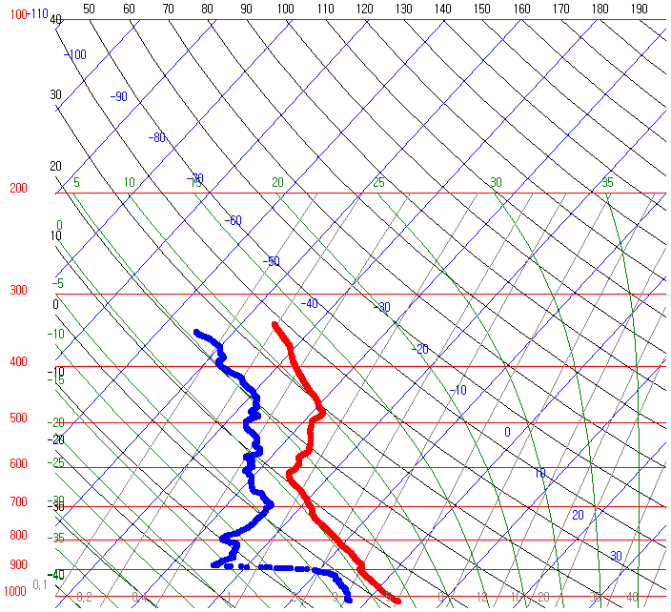
Results - Quality control using ASPEN
Measured raw files are post-processed using the ‘Atmospheric Sounding Processing ENvironment (ASPEN) V3.3’ program.
- D* file → Dyyyymmdd_hhmmssQC.eol
- Dew point temperature, U, V wind
Before QC
2018.02.23_0640
After QC
2018.02.23_0640
Notes:
Measured raw files are post-processed using the ‘Atmospheric Sounding Processing ENvironment (ASPEN) V3.3’ program.
In skew-T logP , The blue is dew point temp, and red is temperature,
Observation noise at high altitude is removed through the ASPEN

Slide 8
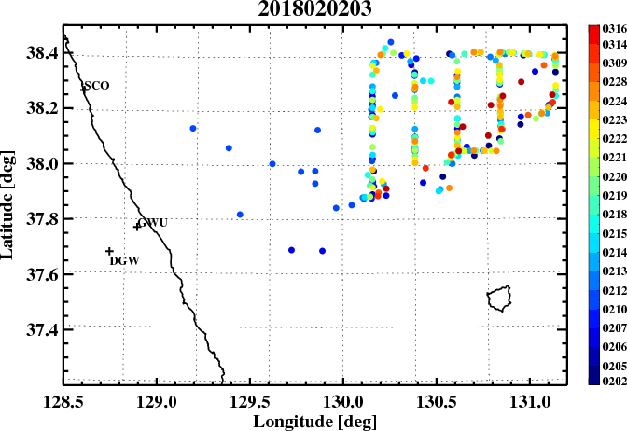
Results - Launched dropsonde status
Total flight(29th Feb.-16th Mar.) :
21 flights
launch 263 dropsondes, provide 200 sounding data
During ICE-POP
14 flights
launch 219 dropsondes, provide 174 sounding data
GPS error
Pre-lunched point
All dropsonde
Notes:
This is the launched dropsonde status.
During the test flight
We flew seven times, dropped 22 drop zones, and obtained 11 data.
This figure shows the launched location of dropsonde. Different colors represent the different day.

Slide 9
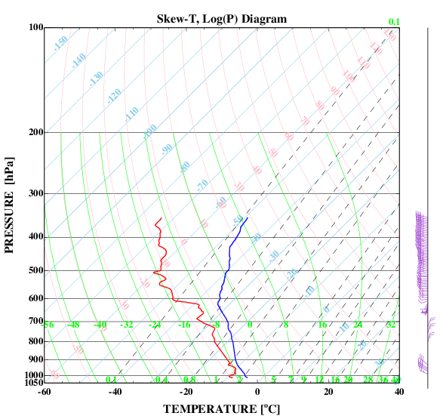
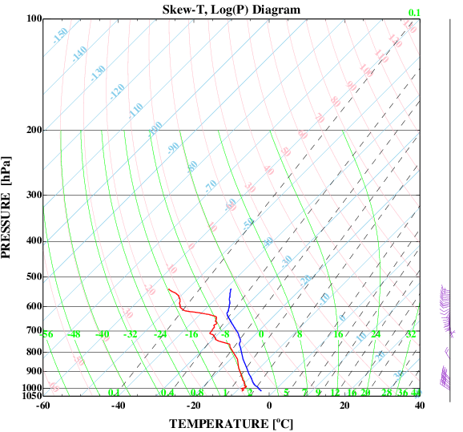
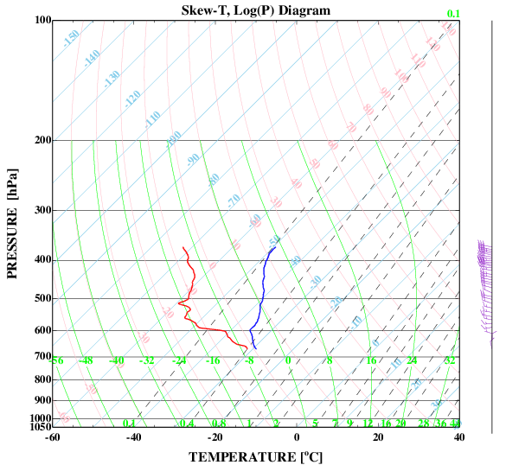
Results - Launched dropsonde status
73.8%
Normal
GPS error
Late GPS
Terminate early
Bad battery
Number of sondes
Normal : 200
GPS error : 38
Late GPS : 4
Terminate early : 21
Battery : 8
14.02%
7.75%
1.48%
2.95%
Normal
Late GPS (500hPa)
Terminate Early (1000hPa)
Notes:
We divided the state of sondes into five parts.
GPS error was classified when the wind direction and wind speed were not measured.
When the observation data was received from 500hPa or less after launch, It was classified as late GPS.
When the signal was disconnected before reaching the ground (1000hPa), it was classified as terminate early.
As a result, The normal observation was 73%, GPS error is 14%, late GPS is 1.48%, terminate early is 7.75%, and 2.95% of battery problem.

Slide 10
Results - Launched dropsonde status
 |  | Normal | GPS error | late GPS | Terminate Early | Battery | total
2016 | # of sonde | 145 | 35 | 4 | 16 | 8 | 208
 | Percentage | 69.71 | 16.83 | 1.92 | 7.69 | 3.85 | 100.00
2017 | # of sonde | 55 | 3 | 0 | 5 | 0 | 63
 | Percentage | 87.30 | 4.76 | 0.00 | 7.94 | 0.00 | 100.00
Notes:
More specifically, The failures were divided by using the year of manufacture represented in Drop id.
A total of 208 sondes were manufactured in 2016 and 63 sondes were manufactured in 2017.
As a result, in 2016, the percentage of normal observations was drastically lowered.
and the percentage of GPS errors was four times higher than in 2017.
Also, Battery failures also occurred eight times in 2016.

Slide 11
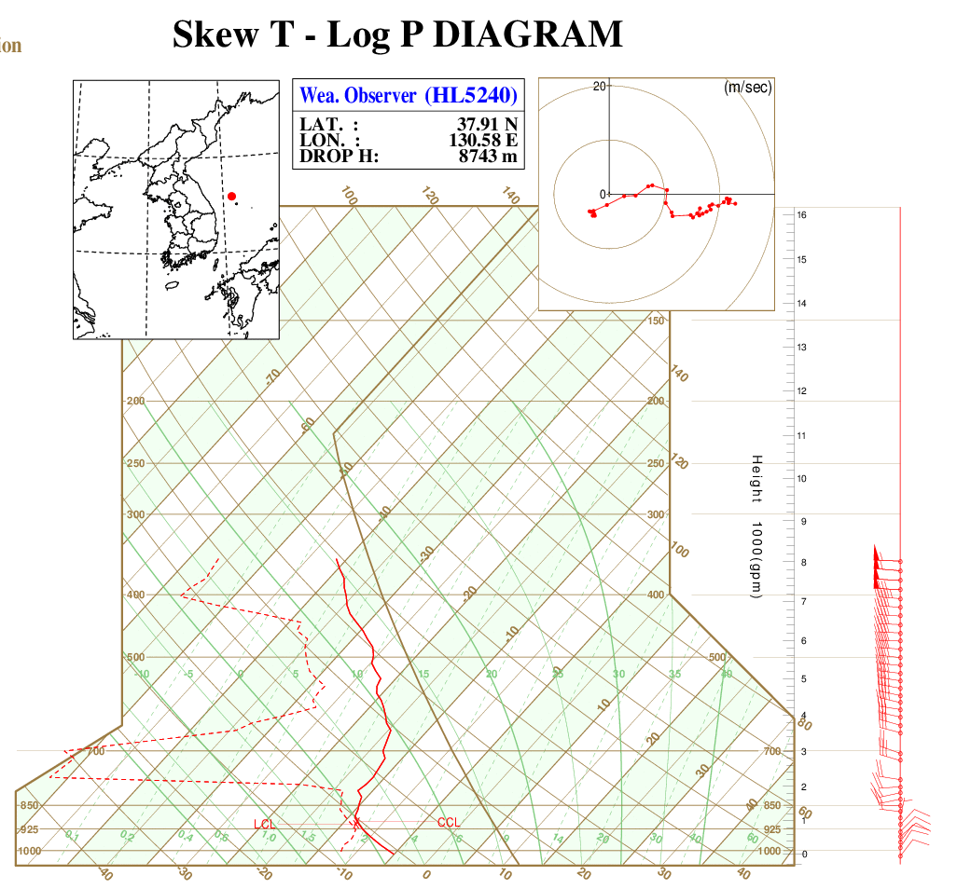
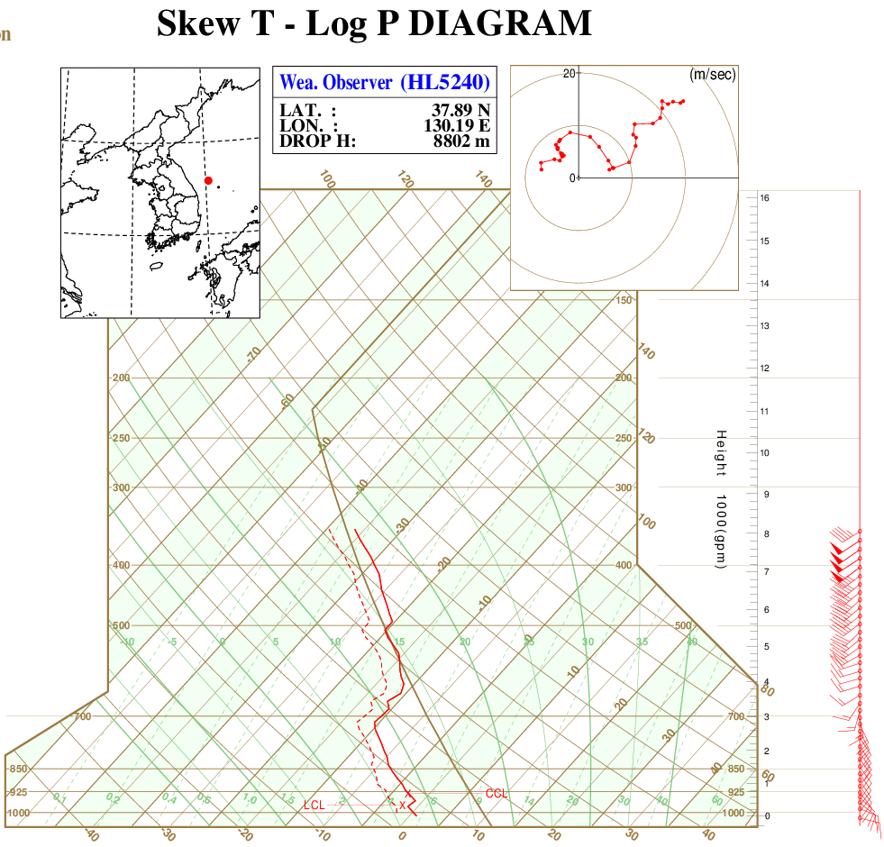
Result-Dropsonde observations
06UTC 24 February 2018
06UTC 28 February 2018 (Snow case)
When snow is not formed the low level cloud is observed around 925hPa and the easterly flow confined below the cloud top.
In snow case, however, the atmosphere is well saturated and easterly cold air dominates up to 700hPa.
Notes:
These are skew-T Log P Diagram of two different event.
The first case is an example of the non-snow case, and the second is the snow case.
When snow is not formed the low level cloud is observed around 925hPa and the easterly flow confined below the cloud top.
In snow case, however, the atmosphere is well saturated and easterly cold air dominates up to 700hPa.
mple that does not snow, and the right figure is an example of snowfall.

Slide 12
Summary and future plan
Summary
KMA/NIMS introduced the research aircraft KingAir 350 in 2017 for four mission (severe weather, cloud physics & weather modification, aerosol, and green house mission)
Participated in the ICE-POP mission to support forecasters.
14 flights, Drop 219, provide 174
Total : 271, Normal operation: 200
Failure rate of sonde manufactured in 2016 was higher than in 2017
Future plan
To find the optimized number of dropsonde and strategy for missions
To produce qualified ground truth data over land and upper levels to compare the performance of NWP models and share the results with forecasters to assist their decision making

