Slide 1
Multipurpose Above Surface/Below Surface Expendable Dropsonde (MASED)
NOAA sponsored Small Business Innovation Research (SBIR) Program
SBIR Data Rights Notice (Dec 2007)
These SBIR data are furnished with SBIR rights under Contract No. WC-133R-15-CN-0112. For a period of 4 years, unless extended in accordance with FAR 27.409(h), after acceptance of all items to be delivered under this contract, the Government will use these data for Government purposes only, and they shall not be disclosed outside the Government (including disclosure for procurement purposes) during such period without the permission of the Contractor, except that, subject to the foregoing use and disclosure prohibitions, these data may be disclosed for use by support Contractors. After the protection periods, the Government has a paid-up license to use, and to authorize others to use on its behalf, these data for Government purposes, but is relieved of all disclosure prohibitions and assumes no liability for unauthorized use of these data by third parties. This Notice shall be affixed to any reproductions of these data, in whole or in part.
(End of Notice)
Presenter: Andrew Keefe Technical Lead & Project Manager Advanced Systems Group Boston Engineering Corporation
05/01/2018

Slide 2
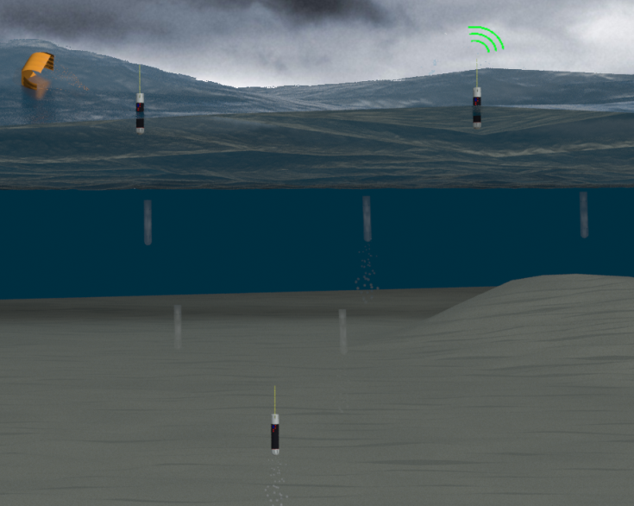
MASED Mission & CONOPS
The MASED project enables the collection of storm data above and below the ocean’s surface from a single device
Mission CONOPS
Deployed from AVAPS launch tube, and descends under a cruciform parachute, collecting data
On water impact the chute is discarded
Descends to a programmed mission subsea depth and then ascends to the surface, collecting data
At surface data is transmitted via Iridium
Time on surface is programmable
Subsea cycles are repeated
Funded as an SBIR Phase I ($94k) in 2014 (contract # WC-133R-14-CN-0068 )
Funded as an SBIR Phase II ($400k) in 2015 (contract # WC-133R-15-CN-0112 )
Final Report submitted to NOAA March 2018

Slide 3
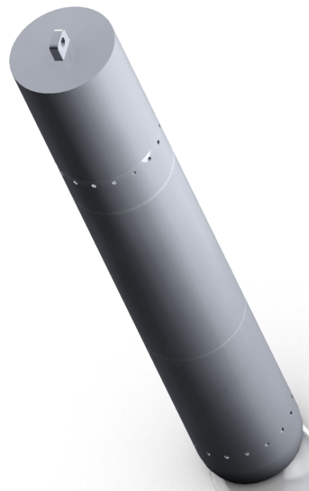
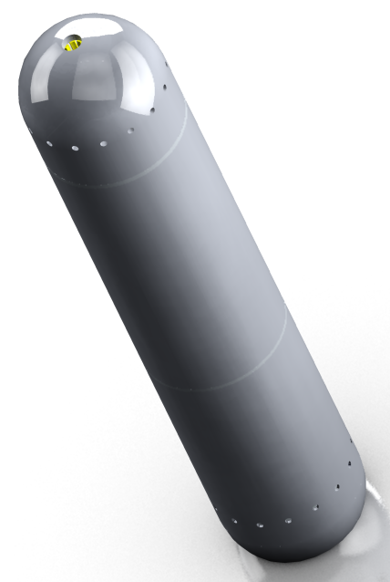
MASED Phase II of a NOAA SBIR Program
VBS: controlled descent/assent: rate ( 0.3 m/s max), up-down welling (100 mm/s), profiles (5 @ 200 m)
Subsea Sensors: conductivity, temperature, depth, ocean currents
Launch Package 16” x 2.75” Dia
Variable Buoyancy System proved feasible in the tank at UMass Dartmouth’s SMAST facility
Custom salinity sensor lab tested, shows accuracy around 1%
Custom PCBs are complete: power PCB, communications PCB, microcontroller PCB with IMU, salinity sensor PCB
Low altitude air drop testing and ocean impact testing conducted off the Jamestown Bridge in Rhode Island
4 prototypes test dropped from NOAA AOC for tube deployment through impact testing
First fully functioning prototype en-route to NOAA AOC, programmed for multiple shallow profiles with Iridium data offboarding, to be deployed at AOC’s next opportunity
Parachute Basket & Release system
Antennas
Electronics
pressure vessel
Variable buoyancy
system
Sensor nose
Marine Package 14.5” x 2.75” Dia. & 2.8 lbs.

Slide 4
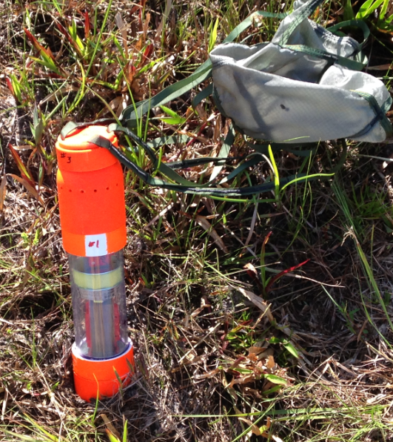
MASED Phase II of a NOAA SBIR Program

Slide 5
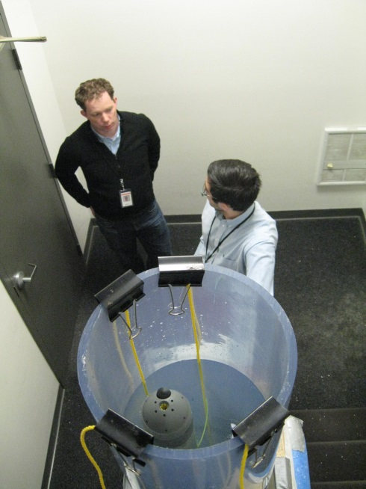
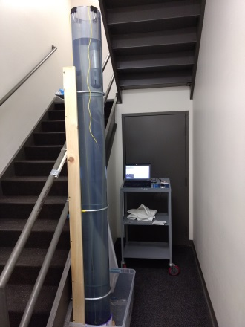
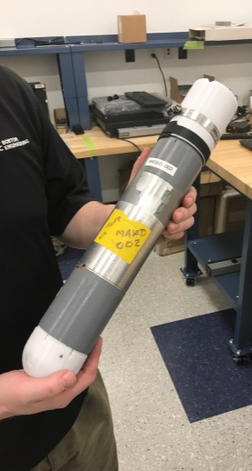
MASED Phase II of a NOAA SBIR Program

Slide 6
MASED Phase II of a NOAA SBIR Program

Slide 7
MASED Commercialization
One year from the completion of the NOAA SBIR Phase II we are to submit a marketing report to NOAA. This is intended to provide NOAA some feedback on how well the SBIR program incubates technology.
Boston Engineering needs to build additional prototypes and collect data, then assimilate data into white papers and a quad chart.
NOAA has requested a ROM for Boston Engineering to provide NOAA with 10-20 prototypes for testing purposes
ROM included some engineering updates for the software to refactor the Iridium messages to make them more compact and some low risk mechanical improvements for reliability purposes – but no major engineering updates
Boston Engineering would assemble the prototypes in-house and conduct initial unit testing before sending to NOAA
NOAA to determine who gets the prototypes and how they are tested
Boston Engineering to use the resulting data to refine the design
We submitted a proposal against NAVAIR SBIR N181-012 “Low Cost Persistent Environmental Measurement System” for an A-sized dropsonde capable of performing one profile a day for up to a year at the cost of $10s per profile. We call it Proteus. Different operational requirements, but some opportunity for common component cost reduction with MASED.

Slide 8
Andrew Keefe
781-314-0727 (Direct)
akeefe@boston-engineering.com

