Slide 1
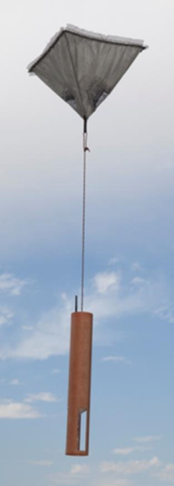
20th Annual Meeting of the AVAPS Users Group
1st Meeting December 7-9, 1998
2nd Meeting February 8-9, 2000 MacDill AFB
3rd Meeting March 11-12, 2001
4th Meeting April 10-11, 2002
.
.
.
20th Meeting April 24-25, 2018
Successful Collaboration of the NSF Research Community – NOAA Operations- NASA – International Research Community - Commercial Vaisala

Slide 2
