Slide 1
AVAPS at FAAM, Presentation for the 2018 AVAPS User Group Meeting
Stephen Devereau

Slide 2
Dropsonde Usage 2017/18

Slide 3
RD94 Usage
2017 - total 46 dropsondes
Test flights - 3
CLARIFY campaign (Ascension) - 43
2018 – total 40 dropsondes
MACCSIMIZE campaign (Alaska) – 34

Slide 4
Future Plans

Slide 5
Dropsonde Stock
Purchased the last RD94 dropsondes from Vaisala, aim was to use these dropsondes and then upgrade AVAPS
Current stock: 190 RD94
Low usage has been a problem:
Did not get permission to drop sondes over India (2016)
Fewer dropsondes used for CLARIFY campaign (Ascension), original plan was for 60 dropsondes. This was to save money due to increasing campaign costs as a result of transport issues at Ascension
Fewer dropsondes used for the MACSSIMIZE campaign (Alaska), original plan was for 80 dropsondes

Slide 6
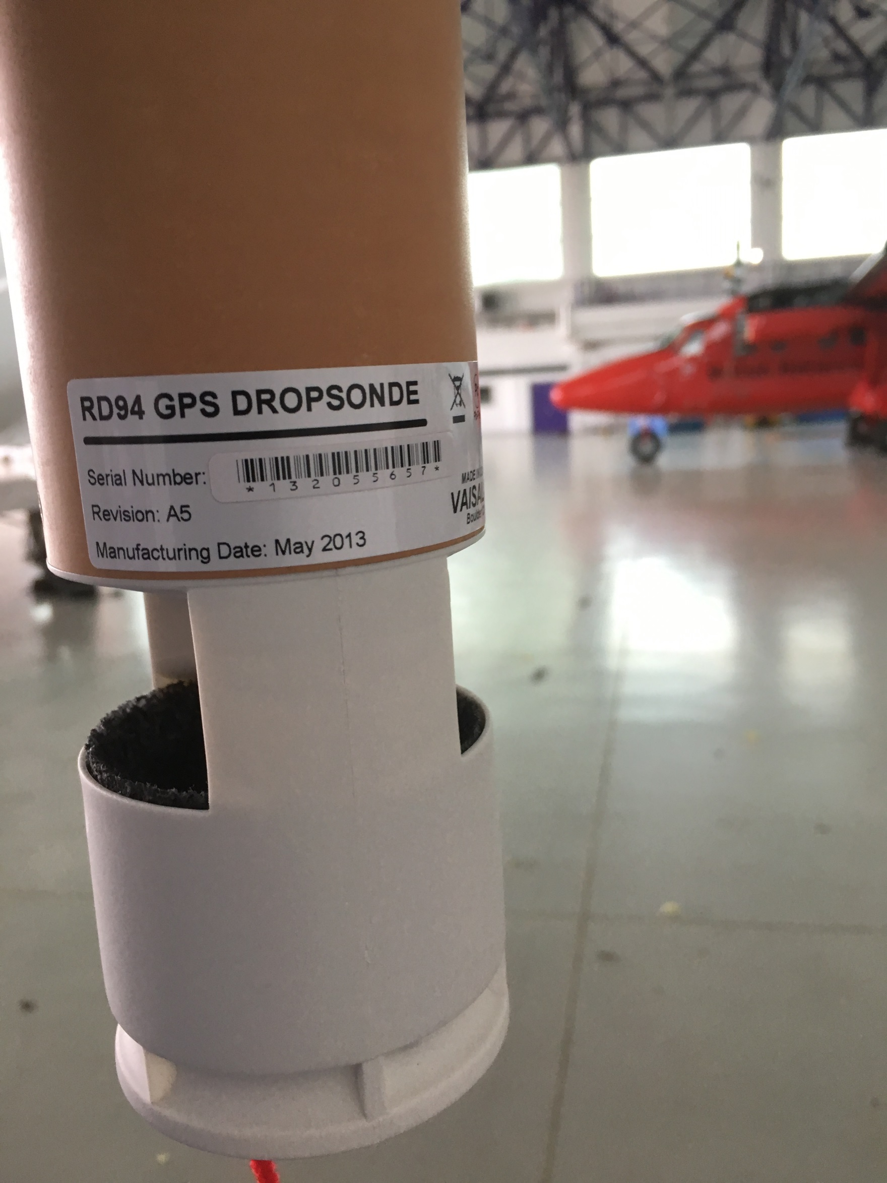
Dropsonde stock

Slide 7
AVAPS Upgrade
Planned for 2018, but did not get funded this year. Upgrade will be made in 2019, hopefully placing an order this summer
Aim was to use all the current RD94 stock prior to the upgrade
Move to an 8-channel system

Slide 8
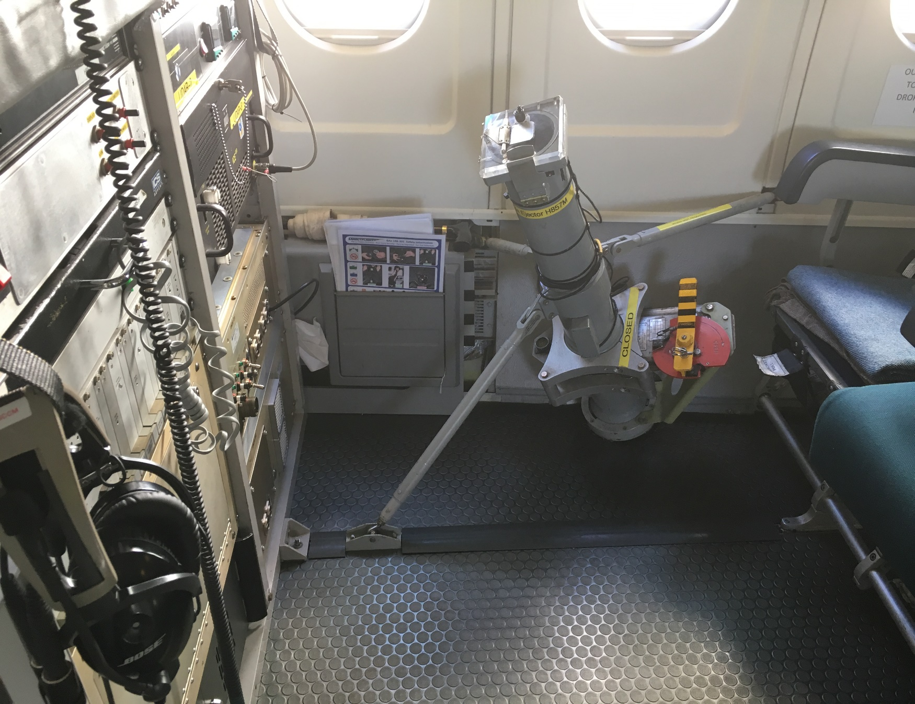
KiTsonde
Aircraft system has been installed, fitted next to AVAPS
No dropsondes yet: dropsondes will need clearance before we can start using them
Main interest: dust measurement

Slide 9
Issues

Slide 10
Flights B893 - B952, Sonde vs Aircraft
Aircraft profile ascent low to high level → dropsonde run → aircraft descent to low level
All within same operating area (~100 km)
Dropsonde data from latest version of Aspen

Slide 11
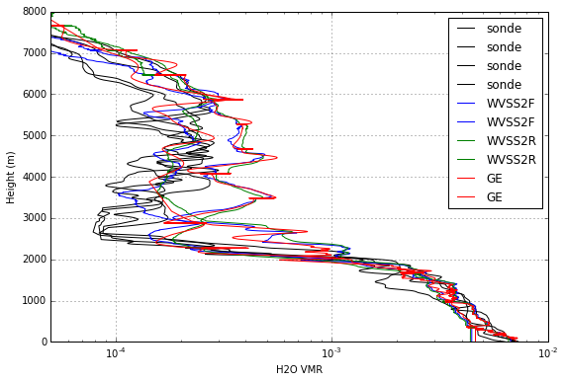
Flight B893 (10 Mar 2015, UK)

Slide 12
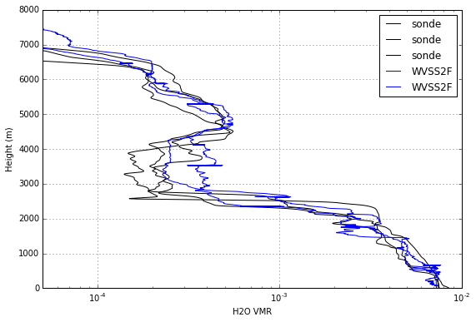
Flight B940 (10 Feb 2016, UK)

Slide 13
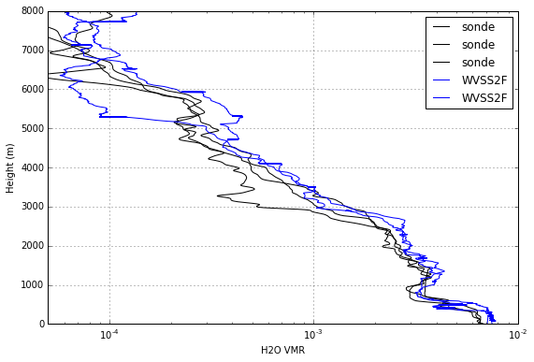
Flight B952 (17 Mar 2016, UK)

Slide 14
Flights B893 - B952, Sonde vs Aircraft
Tendency for the dropsondes to give lower humidities, particularly between approx. 2000 and 4000m.
Comparing radiative transfer simulations based on the dropsonde profiles with microwave measurements from MARSS at 183GHz which shows a consistent warm bias for the sondes (which implies too little water vapour), but not for the aircraft profiles.
Uncertainties in the spectroscopy used for the simulations cannot be ruled out for these cases, I think that on the whole the evidence points towards a dry bias in the sondes.
Stuart Fox, UK Met Office (Observation Based Research, Radiation Manager)

Slide 15
WVSS-II Instruments
WVSSII was designed for commercial air carriers by UCAR/SpectraSensors. A measurement is made just inside the aircraft with a TDL absorption technique using a single wavelength at 1.37µm and a 24 cm path length with 2nd harmonic detection.
Claimed sensitivity of 3ppm, and a range of +20 to –70 °CDP.
Currently two sensors fitted: one with a flush mounted inlet, the other with a Rosemount inlet

Slide 16
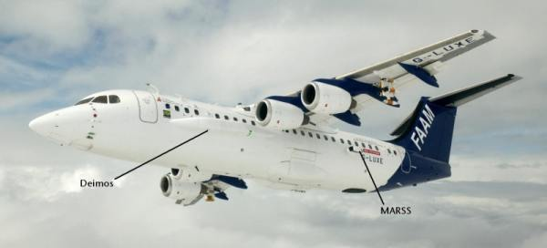
MARSS
MARSS (Microwave Airborne Radiometer Scanning System) is an along-track scanning, total power microwave radiometer which measures in five channels, two window channels at 89 and 157 GHz and three channels centred on the water vapour absorption line at 183.31 GHz.

Slide 17
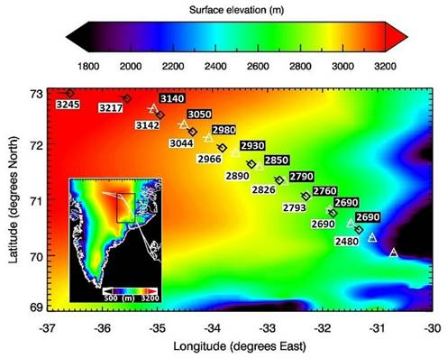
Tropospheric Airborne Fourier Transform Spectrometer (TAFTS)
COSMICS/CIRRCREX project, March 2015. 11 dropsondes released (white triangles)
TAFTS is an Imperial College instrument aimed at water vapour and cirrus cloud measurements and works in the far infra-red

Slide 18
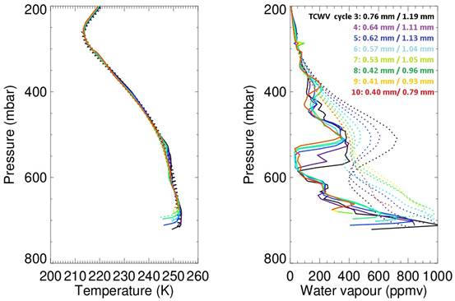
TAFTS
Dropsonde solid line, ERA-Interim dataset dotted line

Slide 19
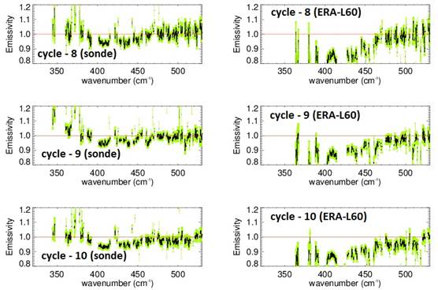
TAFTS
Retrieved emissivity, dropsonde left, ERA-Interim right

Slide 20
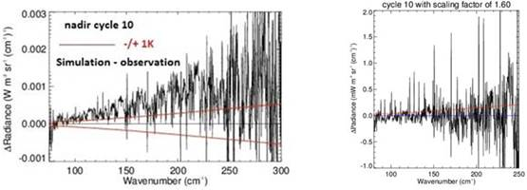
TAFTS
Looking at uncertainties in the dropsonde measurements
Looking for evidence for a bias in the 300 – 400 mbar region, based on the residuals between simulation and observation in the opaque region of the Far-IR.
Used a scaling factor of 1.6 to correct for this.

Slide 21
TAFTS
I’ve run off some weighting function calculations for selected narrow band wavenumber regions that helped me deduce the scaling and these show that the lower atmosphere still looks somewhat too dry in the 500 to 700 mbar layer.
Still the emissivities I get using the dropsondes are compatible with models for fine grain snow and is consistent with the Mid-IR measurements we have.
Jon Murray, Imperial College, London

Slide 22
Many thanks for the continued support!
Any questions?

