Slide 1


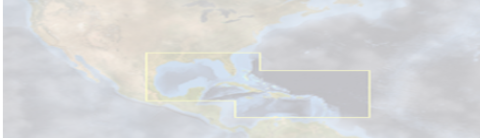

SAB/STAR Ocean Brief
Jun 1st 2010
OIL SPILL REPORT.
Caribbean and Gulf of Mexico Regional Node
Joaquin Angel Triñanes
University of Santiago de Compostela

Slide 2
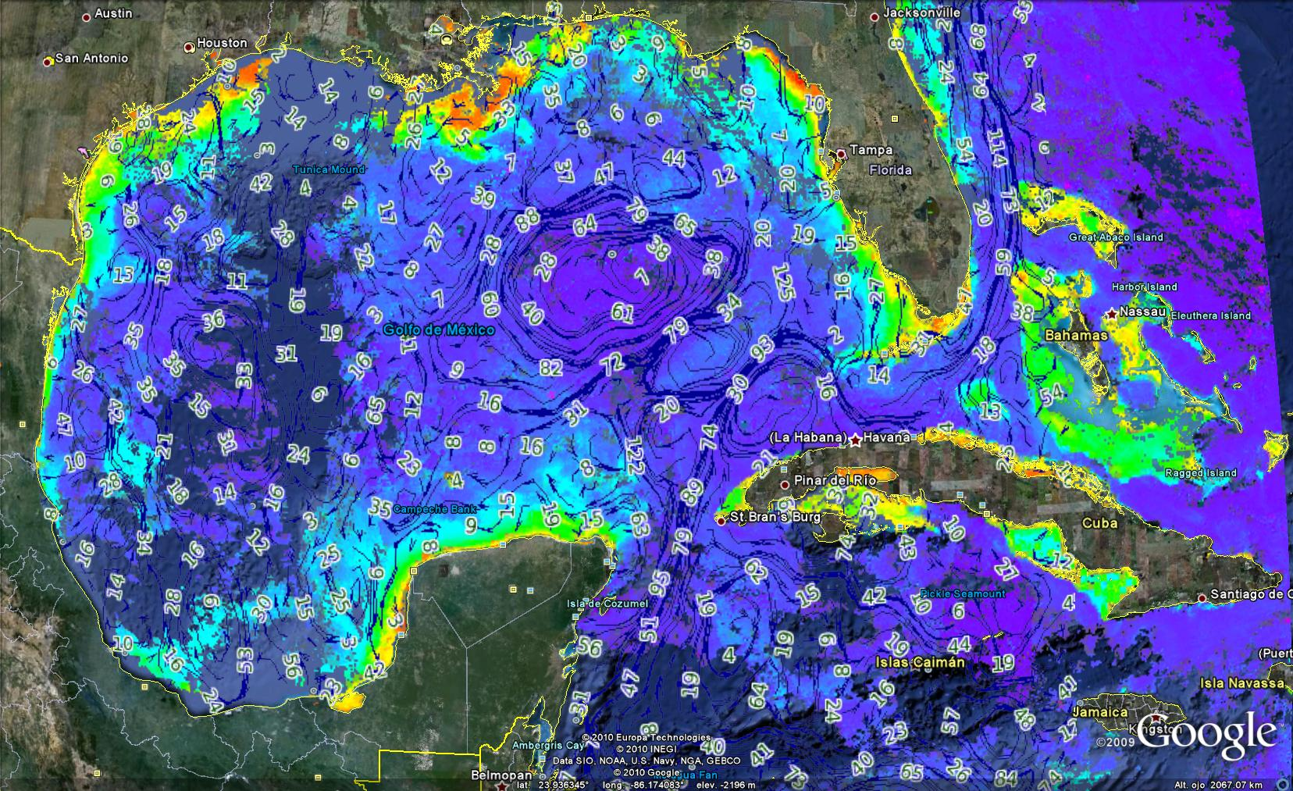

AQUA/MERIS 3D Chlor + Geostrophic currents

Slide 3
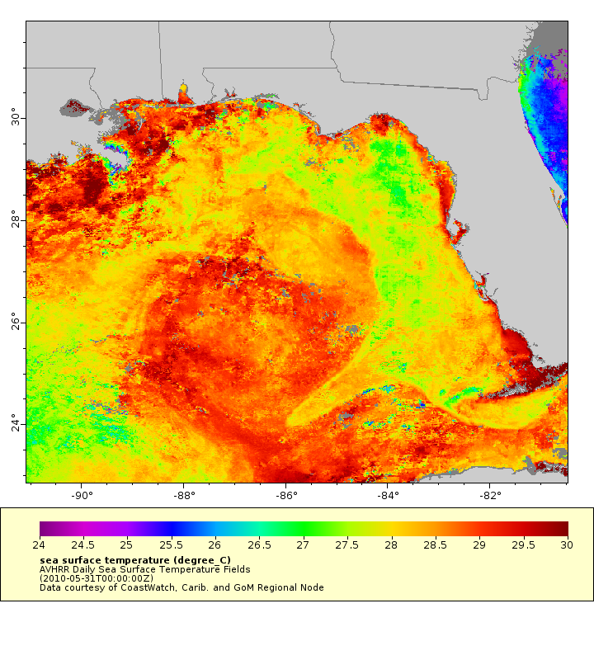
AVHRR SST

Slide 4
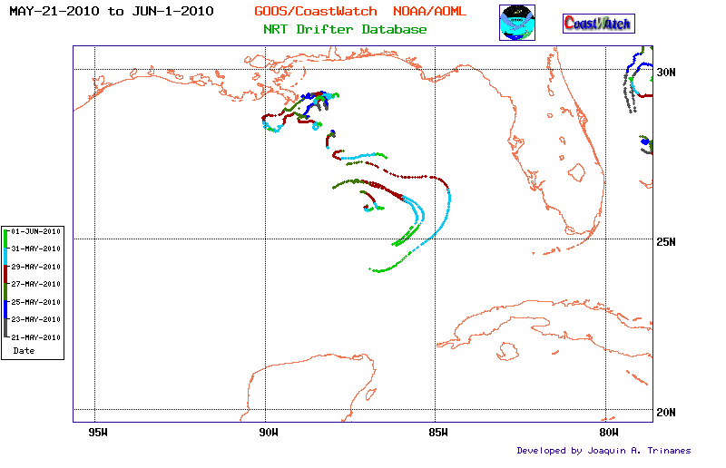
Drifters

Slide 5
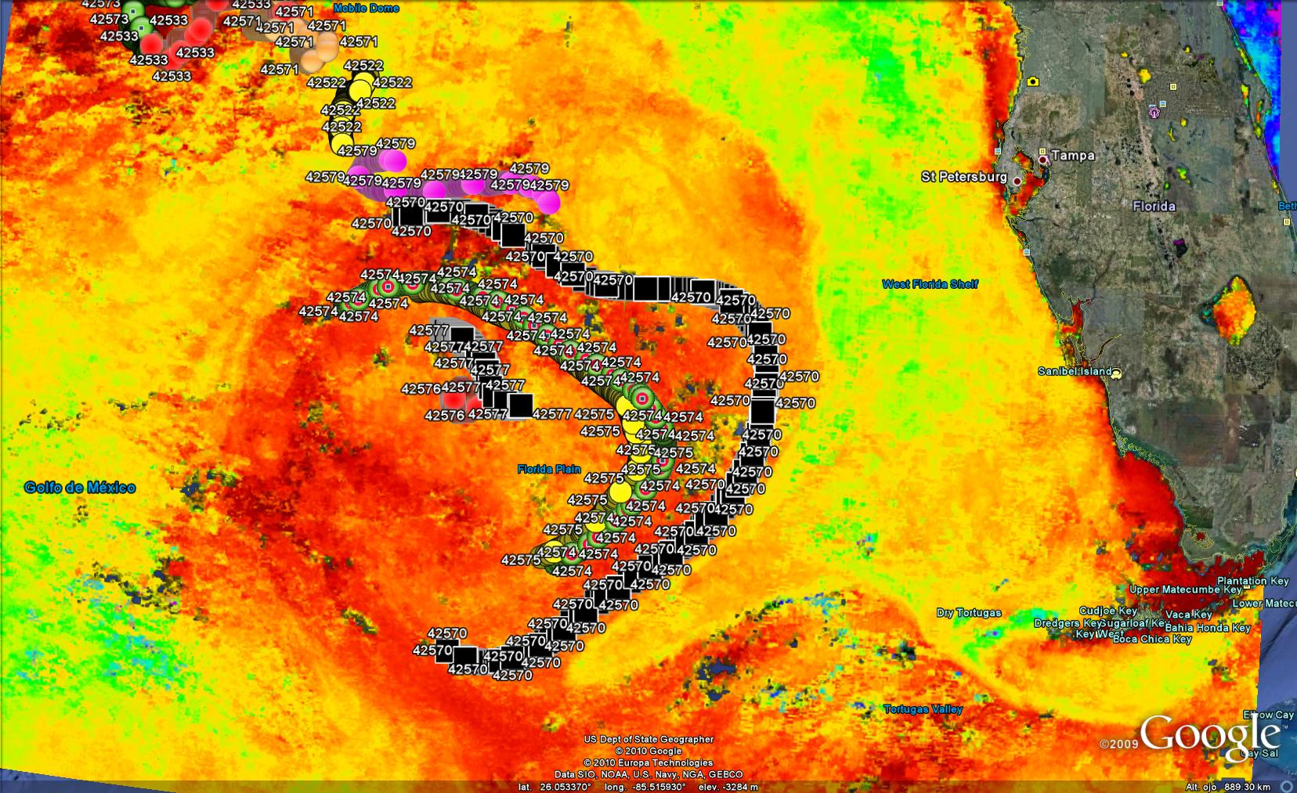
Drifters+SST

Slide 6
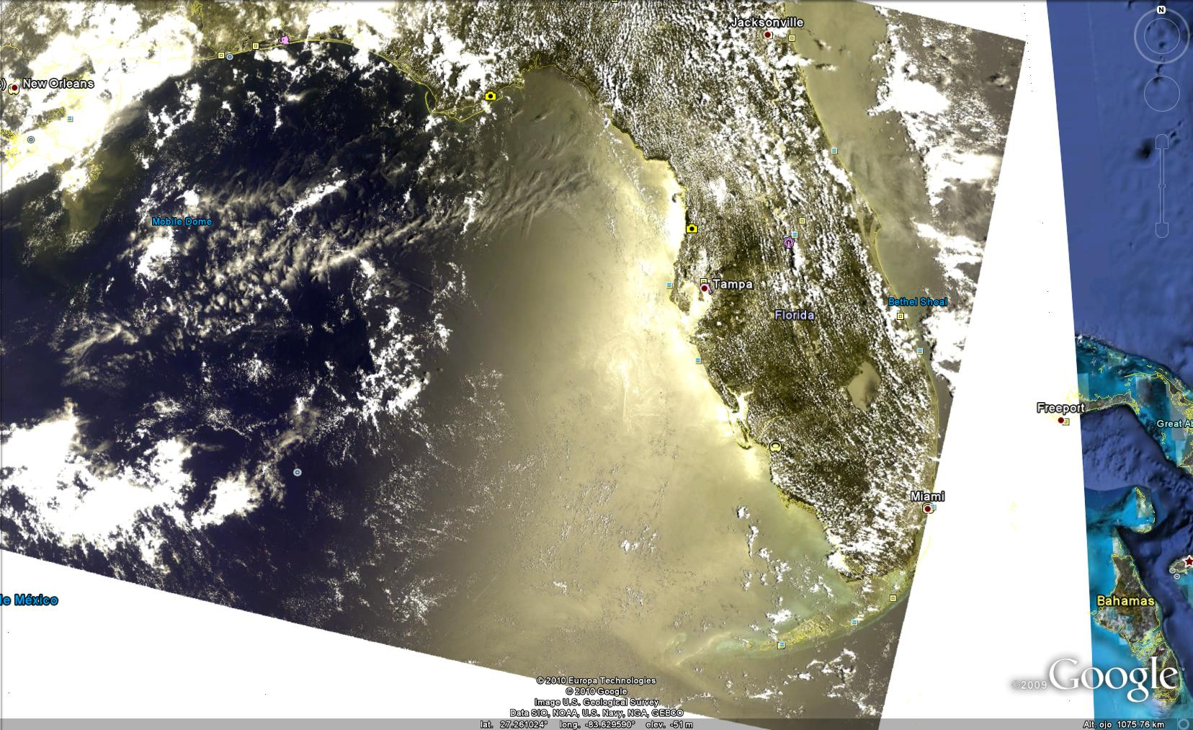
MERIS (May 31st 2010)

Slide 7
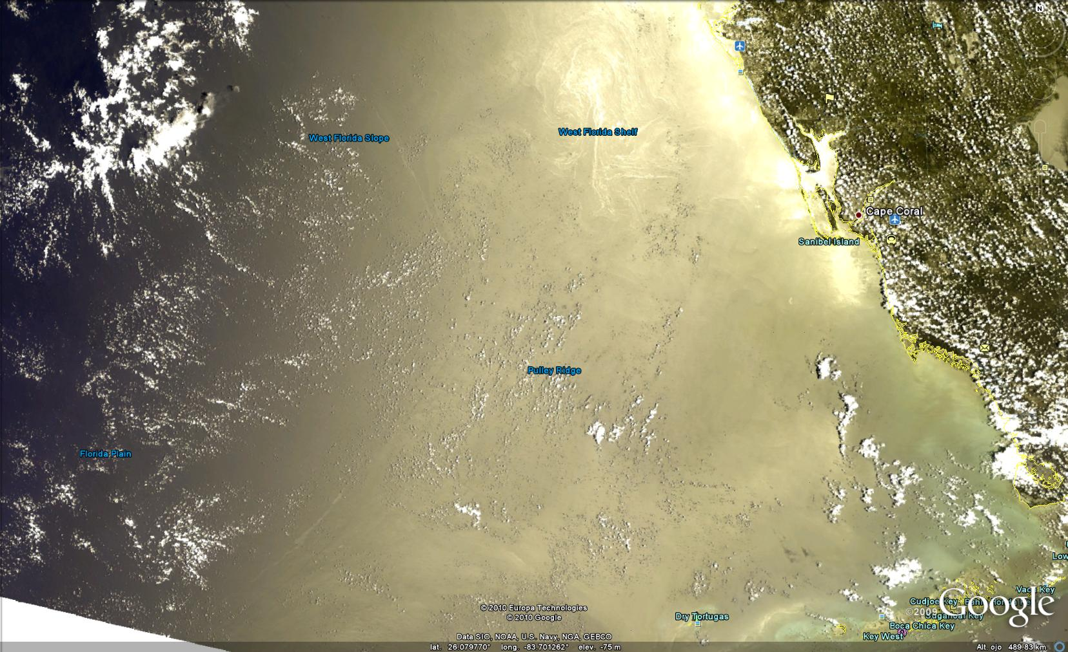
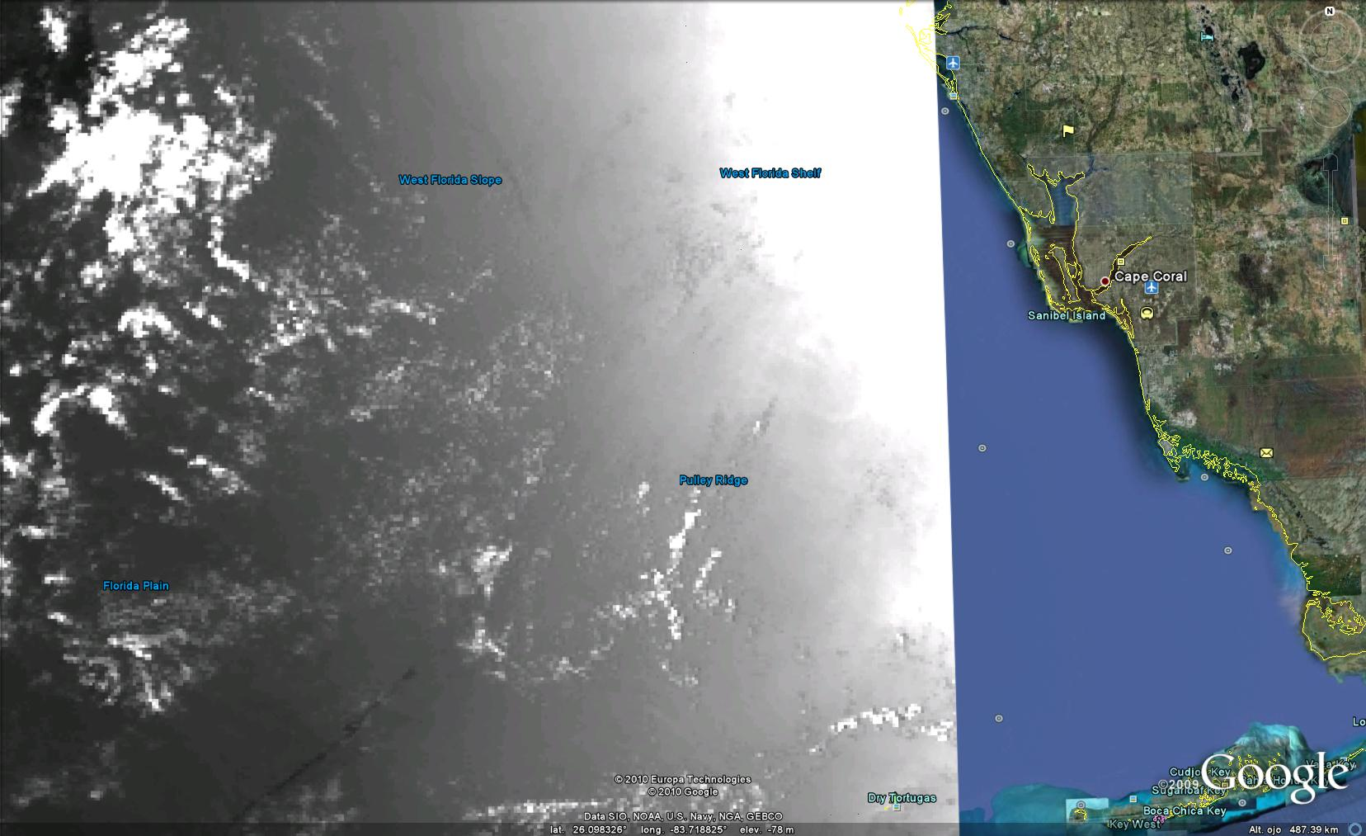
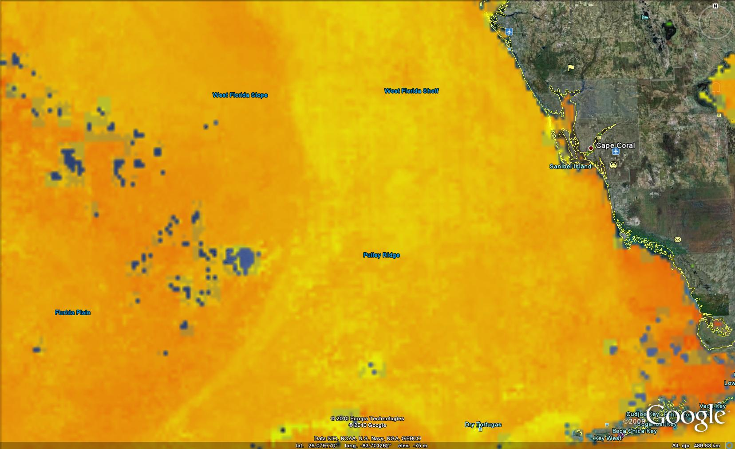
Oil Slicks?

Slide 8
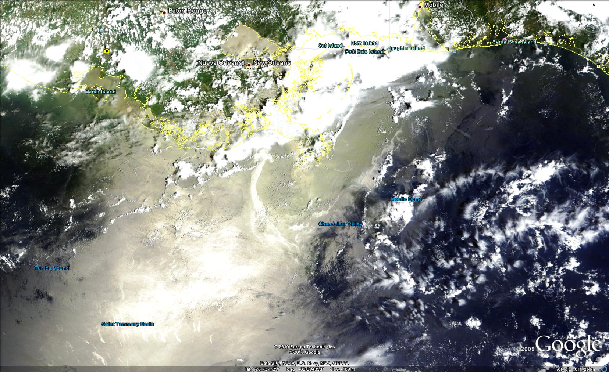
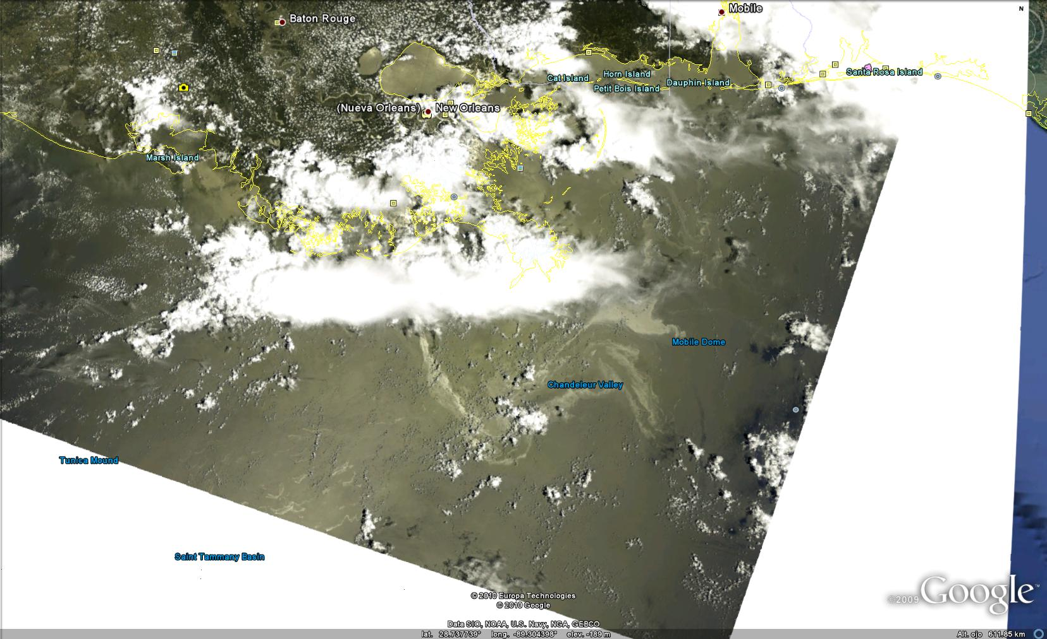
MERIS&TERRA May 31st 2010

Slide 9
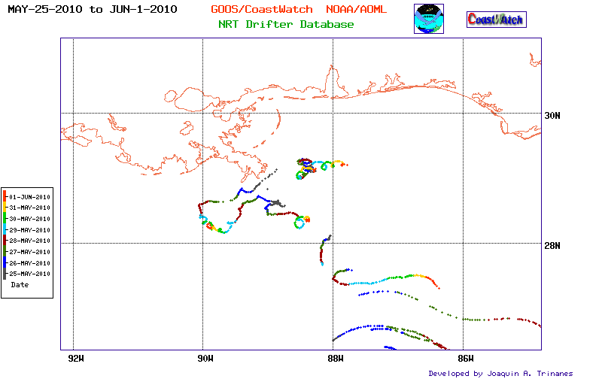
Drifters close up

Slide 10
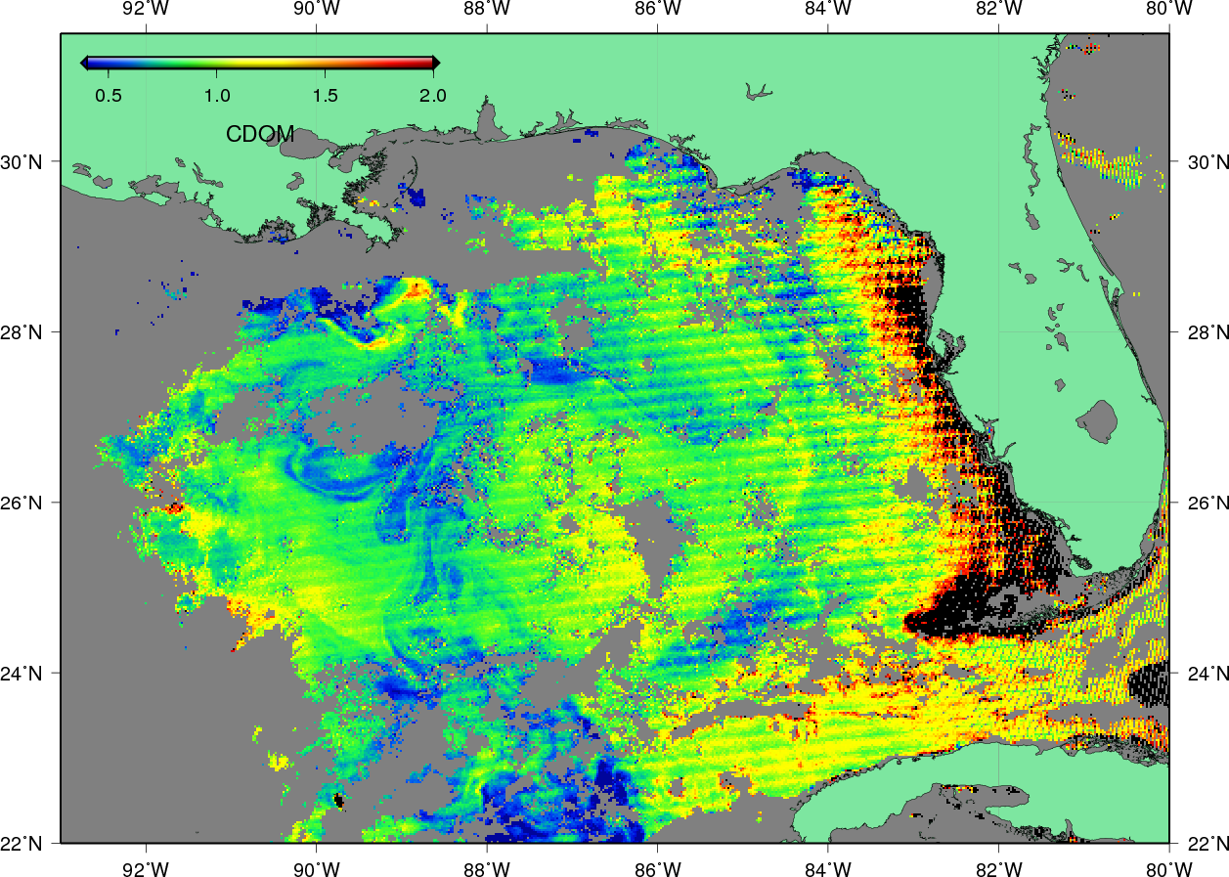
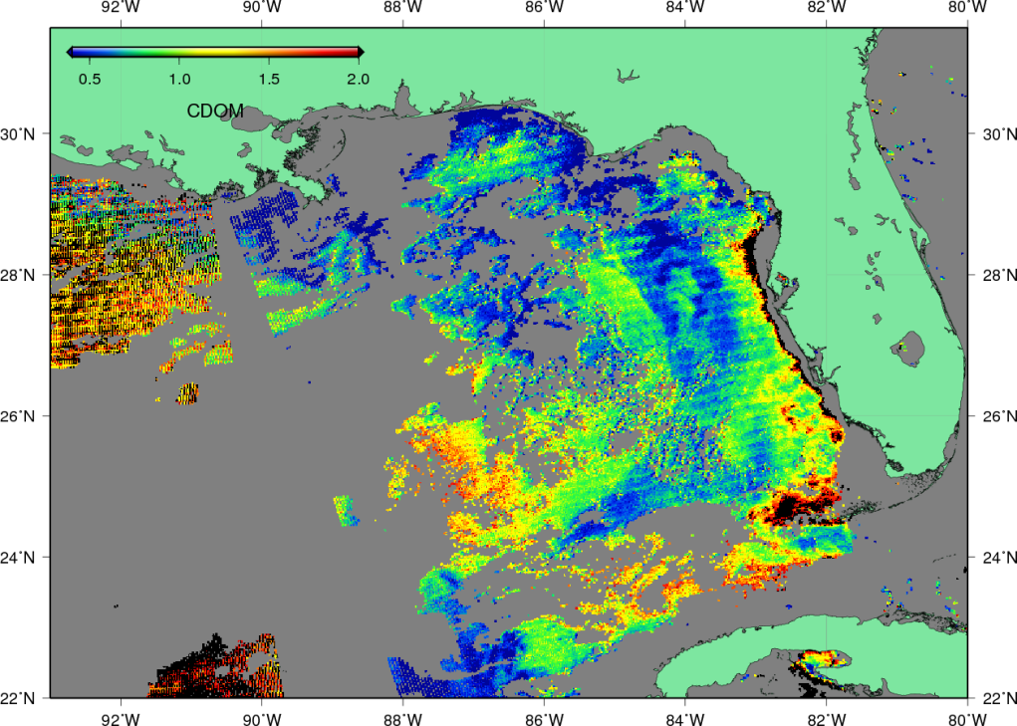
CDOM Aqua May 30th , May 31st 2010

Slide 11
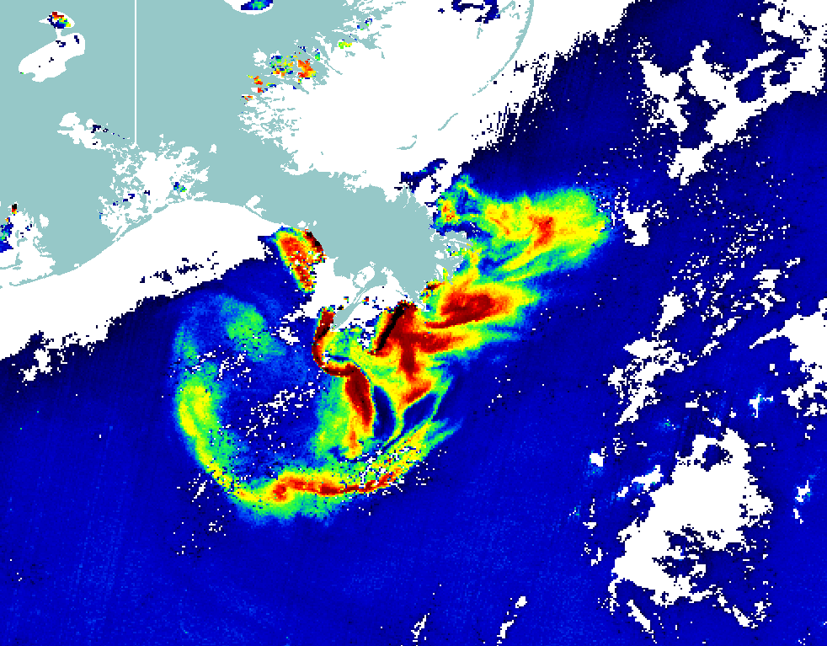
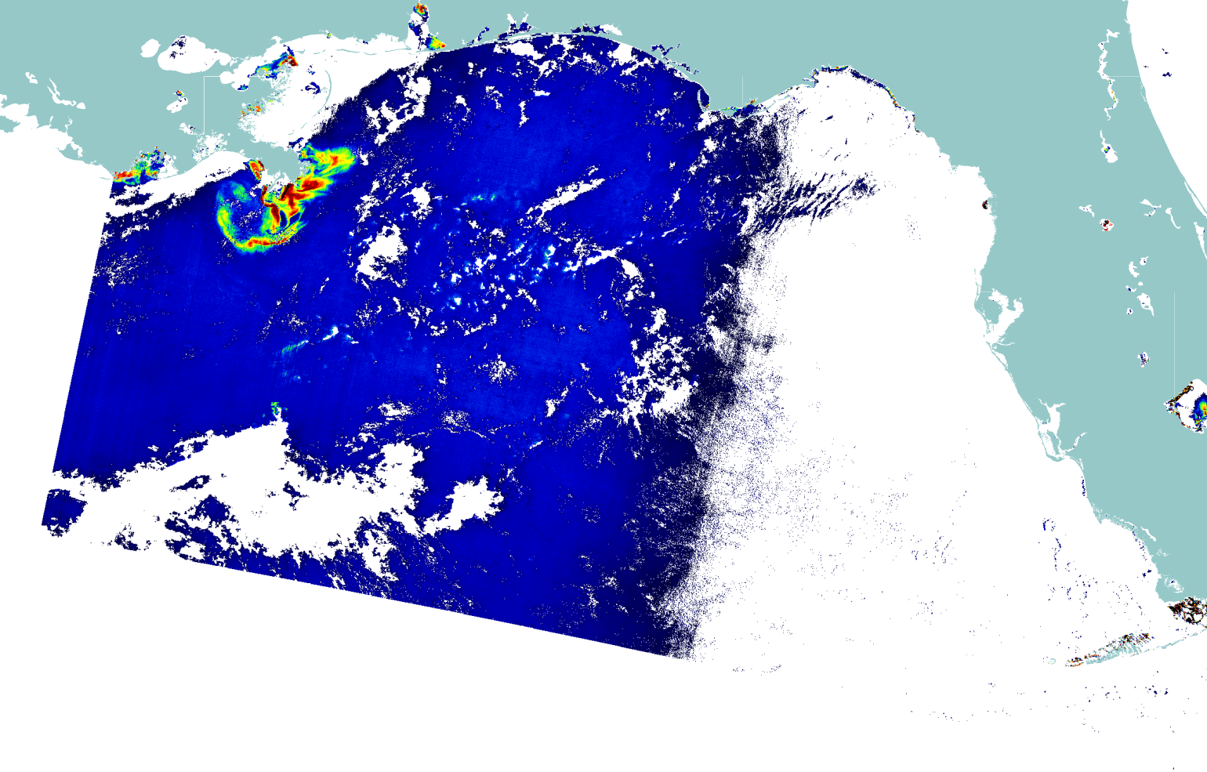
MCI MERIS May 31st 2010

Slide 12
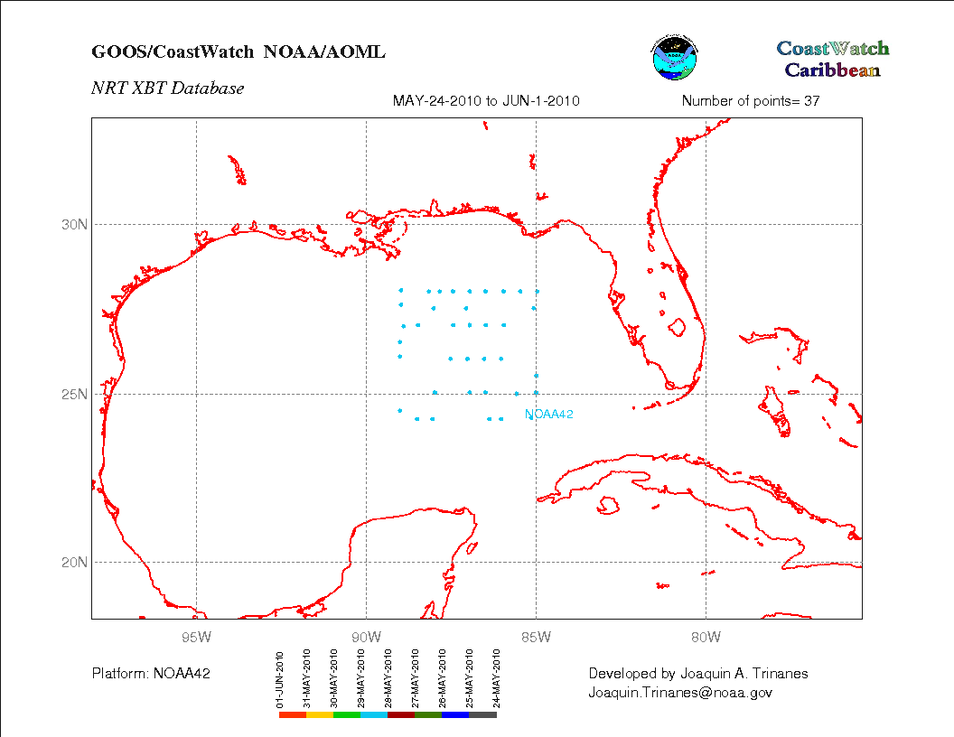
AXBTs

Slide 13
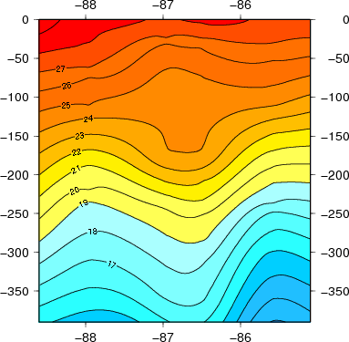
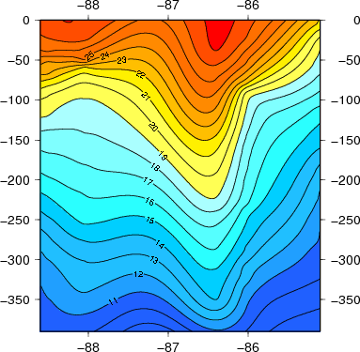
AXBTs
25N 24.25N

Slide 14
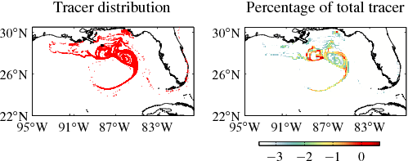
LCS (Surface)
Logarithmic Color Scale (10**)
(DISCLAIMER: "The products presented on this and related UM Oil Spill
Response web pages are only for research purposes and should only be used
for research guidance, not operational decisions.“)

Slide 15
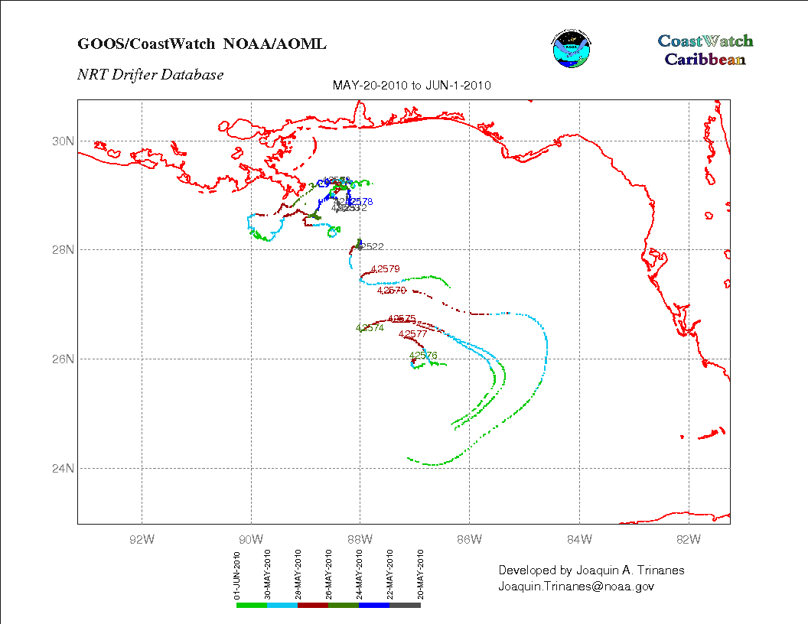
Latest News

