Slide 1
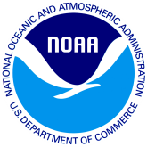

Atmosphere-Ocean Processes in the Intra-Americas Sea (IAS) and Their Impacts on Regional Climate Variability
Sang-Ki Lee (sang-ki.lee@noaa.gov)¹
Vasu Misra (vmisra@fsu.edu)²
¹National Oceanic and Atmospheric Administration, Atlantic Oceanographic and Meteorological Laboratory (AOML)
²Department of Earth, Ocean and Atmospheric Science, Florida State University
Outline
Atlantic warm pool (AWP) and its role in regional climate
Recent advances in IAS climate research
Current status of IAS modeling and observations
US CLIVAR PSMI Meeting (Coastal and Marginal Seas Processes, June 14 2016

Slide 2
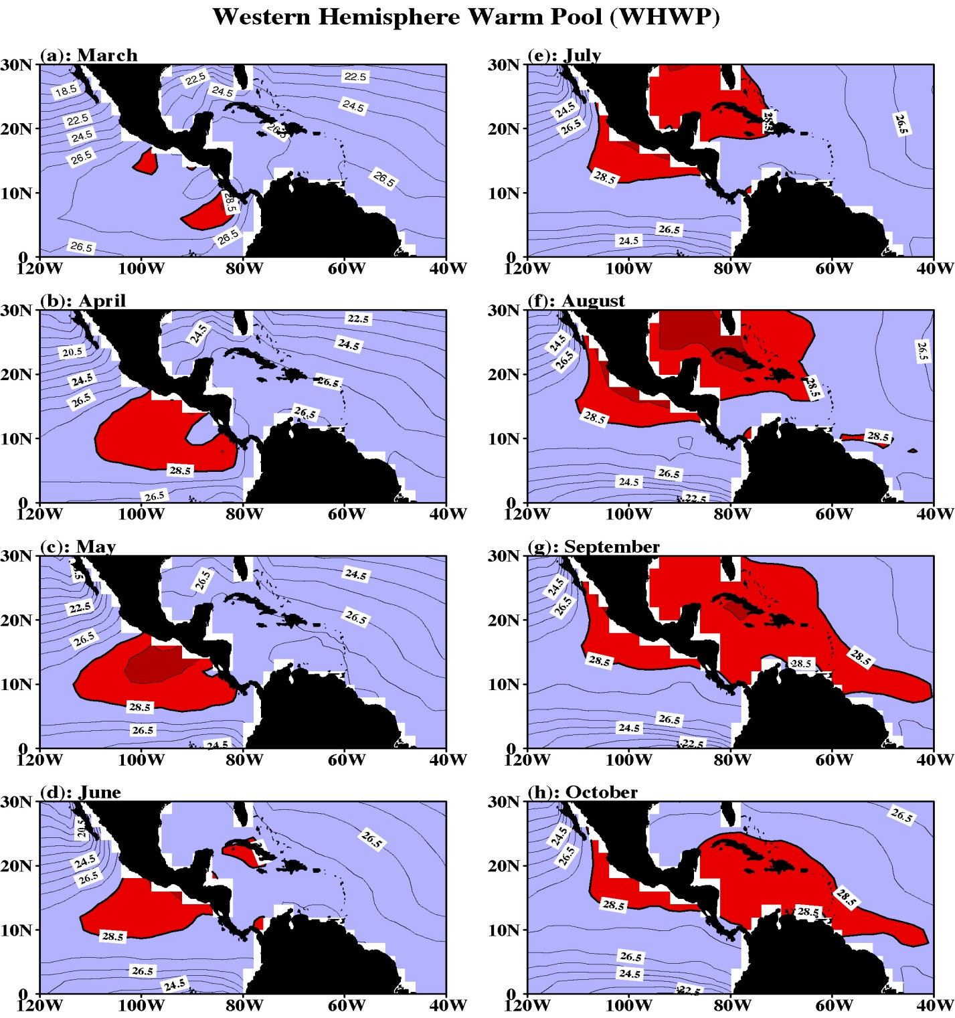
What is Atlantic warm pool (AWP)?
The area of surface water warmer than 28.5°C in the WH is defined as WHWP
WHWP first develops in the eastern North Pacific in spring
Then, it migrates to the Gulf of Mexico in summer then to the Caribbean Sea in fall
AWP is the Atlantic component of WHWP and is an important feature in the IAS
Wang and Enfield (2001, GRL)

Slide 3

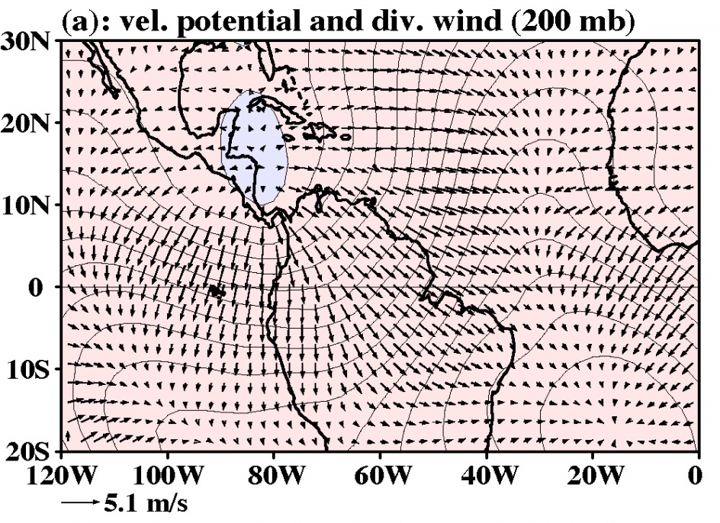


AWP is the tropical heating source in the WH
Wang and Enfield (2003); Wang (2005)

Slide 4
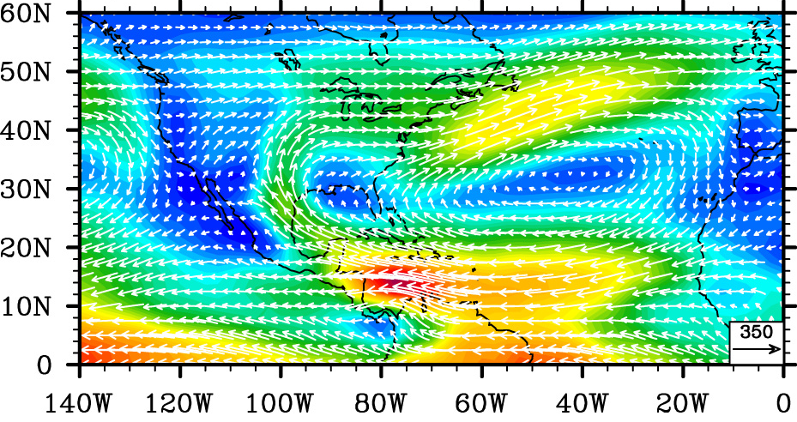
AWP is the major source of moisture in the WH
Moisture transport in summer (JJA)
Wang, Lee & Enfield (2007)
AWP is the major source of summer moisture in the WH
North American Low-Level (NALLJ) Jet carries the warm and humid air aloft the AWP to North America
Caribbean Low-Level Jet (CLLJ) carries the warm and humid air to the Central America and eastern North Pacific.

Slide 5
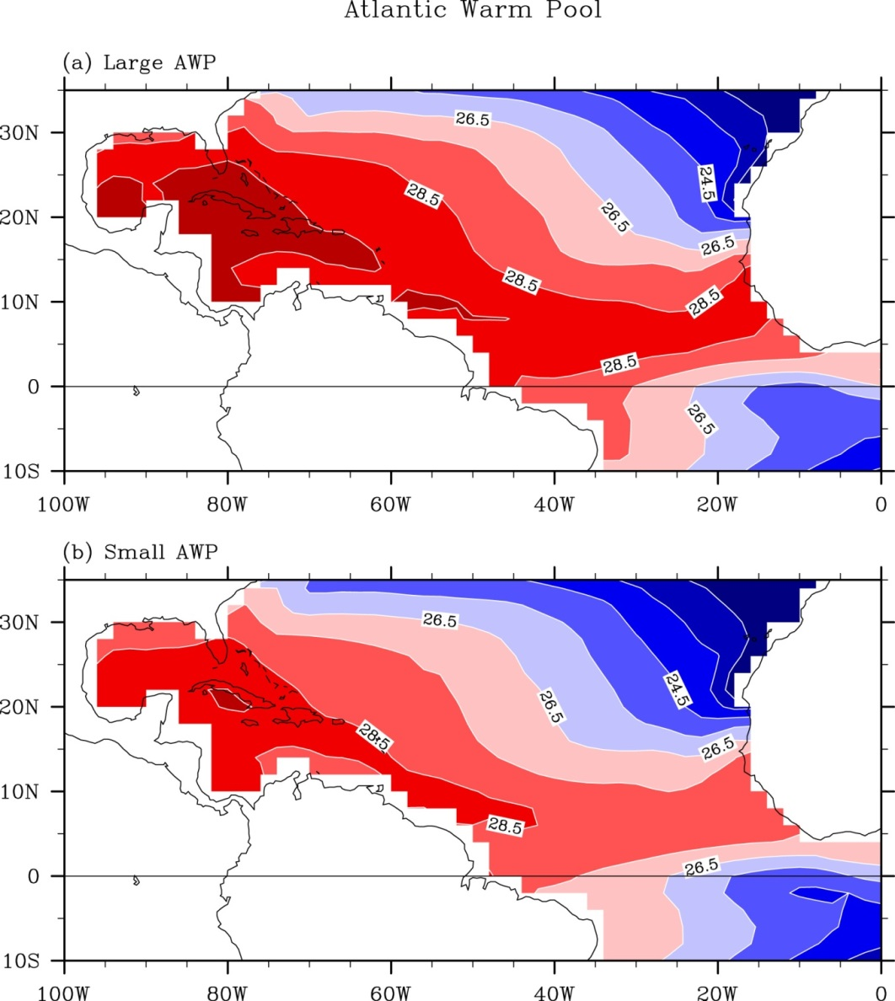
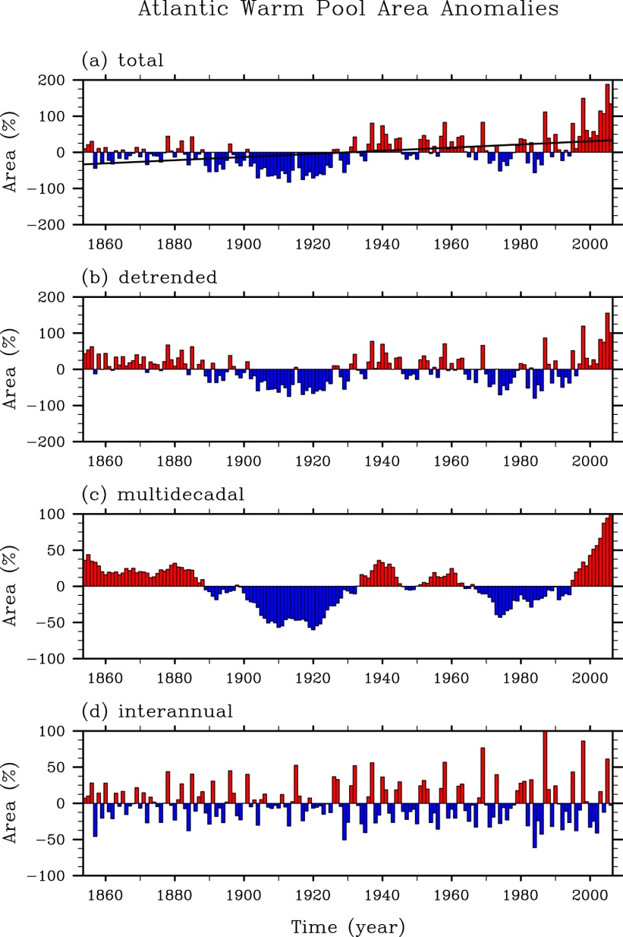
Multi-time scale variability of AWP
Wang, Lee & Enfield (2008,G³)
Large AWPs are almost three times larger than the small ones
AWP shows multi-time scale variability: (1) linear warming trend, (2) multidecadal and (3) interannual

Slide 6
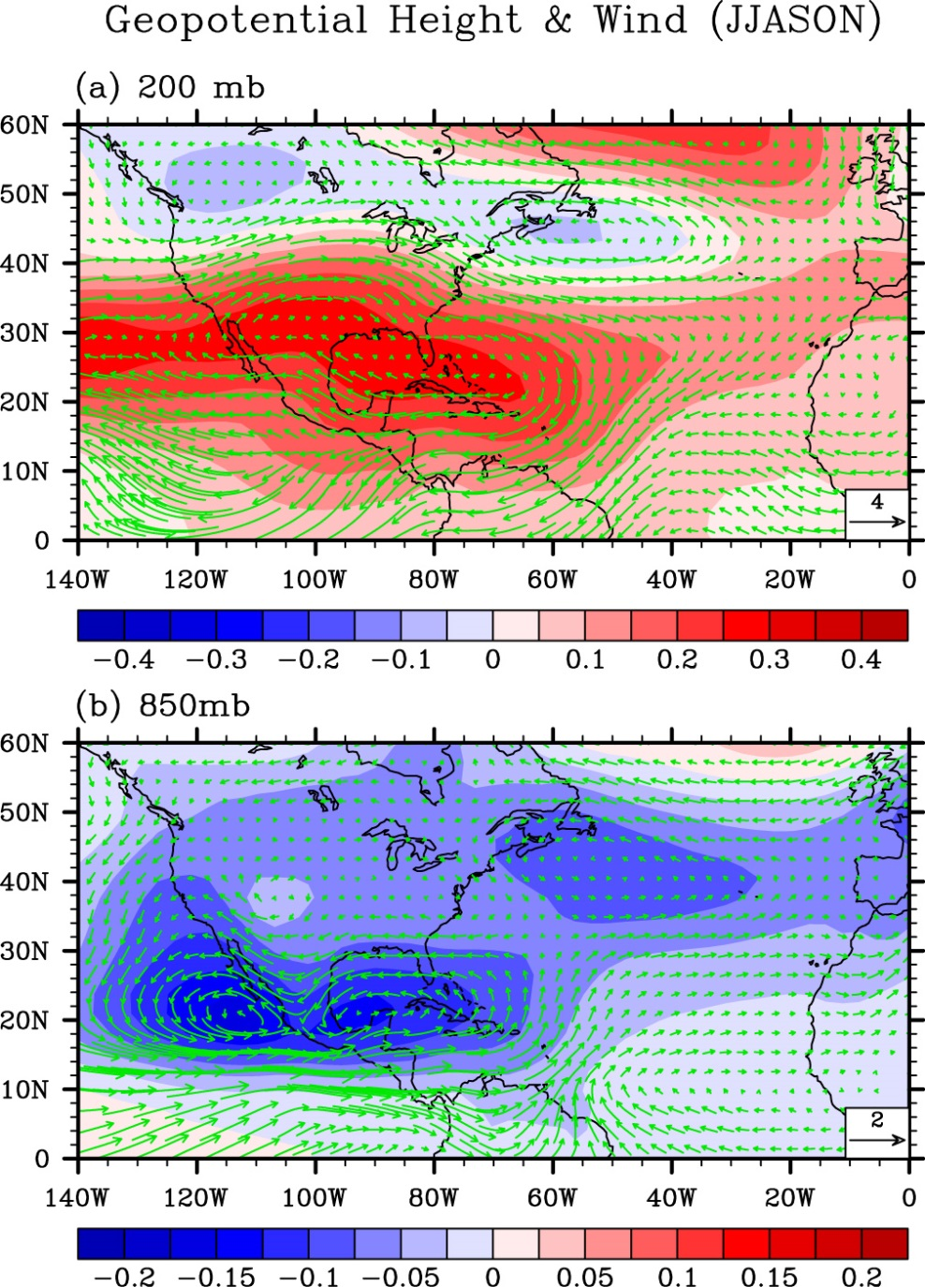
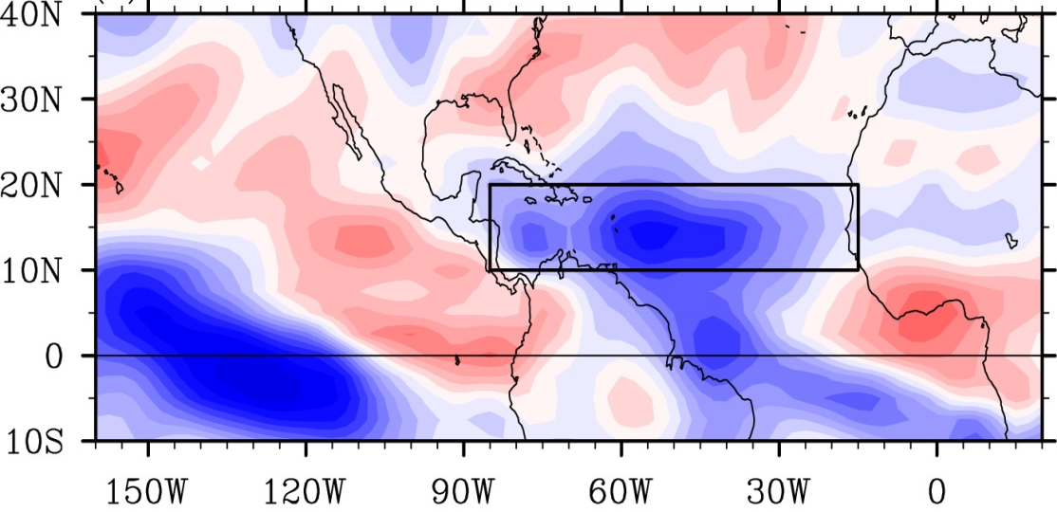
AWP and Atlantic hurricane activity
Geopotential Height and Winds (JJASON)
Vertical Wind Shear (JJASON)
Atmospheric response to AWP heating produces an anomalous anticyclone in the upper level and an anomalous cyclone in the lower level.
Reduced westerlies and easterlies lead to a large reduction in the vertical wind shear in the MDR.
Large (small) AWP increases (decreases) Atlantic hurricane activity
Wang, Lee & Enfield (2008, JCL)

Slide 7
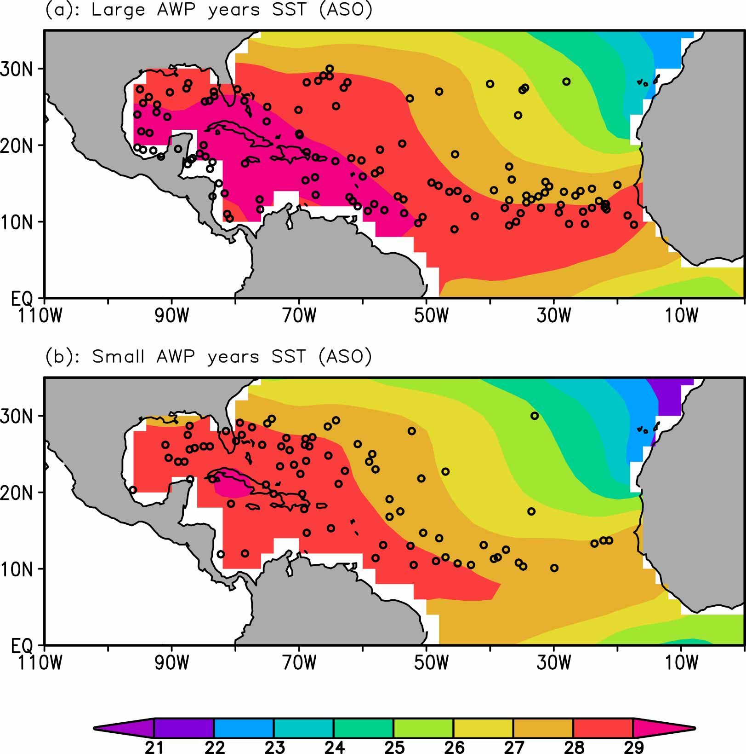
AWP and US Landfalling Hurricanes
10 Large AWPs (126 TCs)
In large AWP years, the AWP extends farther to the east promoting TC genesis east of 40W.
In small AWP years, the majority of TCs form west of 40W.
TCs formed east of 40W are less likely to make landfall on the US
10 Small AWPs (79 TCs)
Wang, Liu, Lee and Atlas (2011)

Slide 8
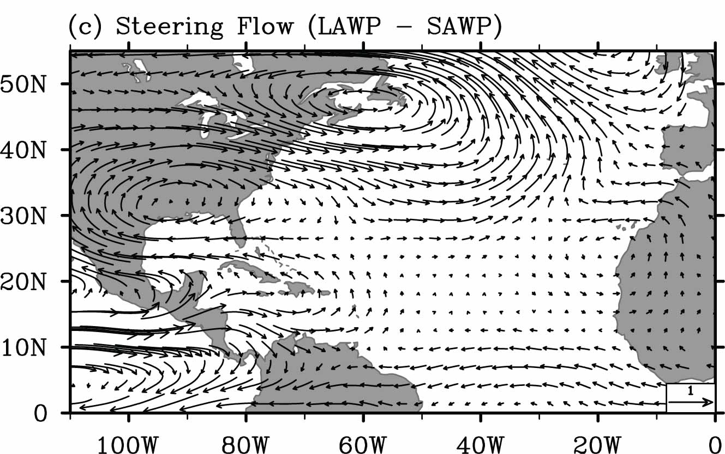
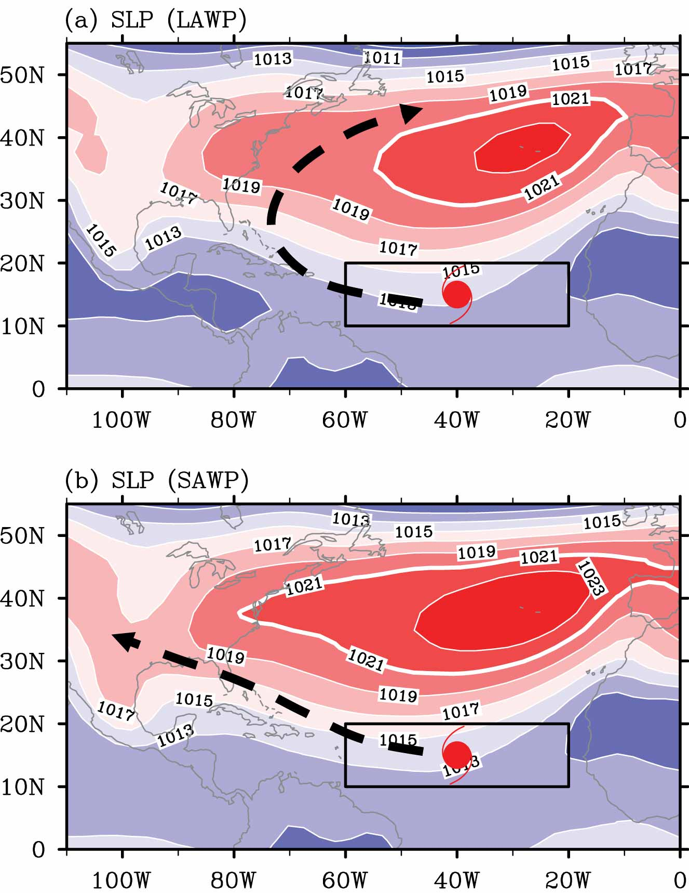
AWP and US Landfalling Hurricanes
Large AWP produces stationary Rossby waves (Lee et al., 2009) that enhances the upper-level westerlies in the 30N-45N band (i.e., hurricane steering flow).
The enhanced upper-level westerlies prevent the TCs to make landfall onto the US.
Wang et al. (2011)

Slide 9
AWP and US Landfalling Hurricanes
Hurricanes formed in the MDR during 1970-2009
 | Hurricanes | Landfalling Hurricanes | Ratio
10 Large AWPs | 31 | 7 | 23%
10 Small AWPs | 13 | 5 | 38%
Large AWP increases the number of hurricanes formed in the MDR
However, landfalling ratio (# of landfalling hurricanes /total # of hurricanes) reduces by 40% during large AWP years compared to small AWP years
The significant reduction of landfalling ratio during large AWP years is due to (1) eastward shift of the TC genesis location and (2) the enhanced upper-level westerlies that steer the TCs northeastward away from the US.

Slide 10
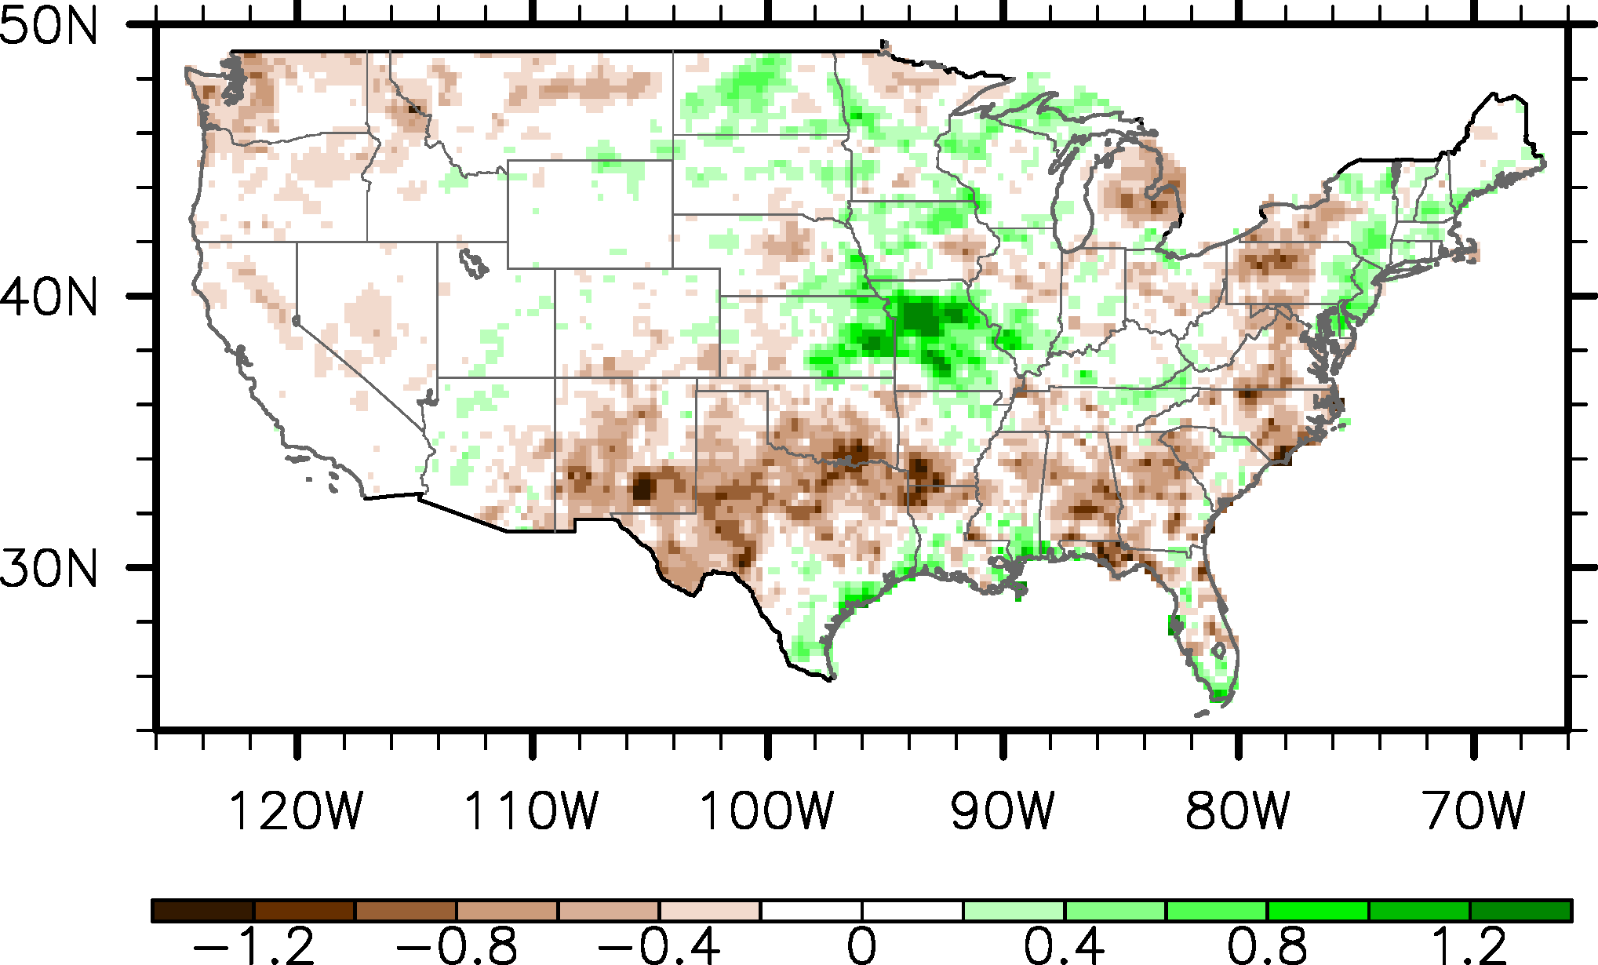
AWP and summer rainfall in the US
LAWP – SAWP: US Rainfall (JAS) – CPC gauge data
Large AWP decreases rainfall in the South and Southeast and increases rainfall in the Ohio Valley.
Since ENSO’s influence on US rainfall is much weaker in summer, AWP is an important predictor of US summer rainfall.

Slide 11
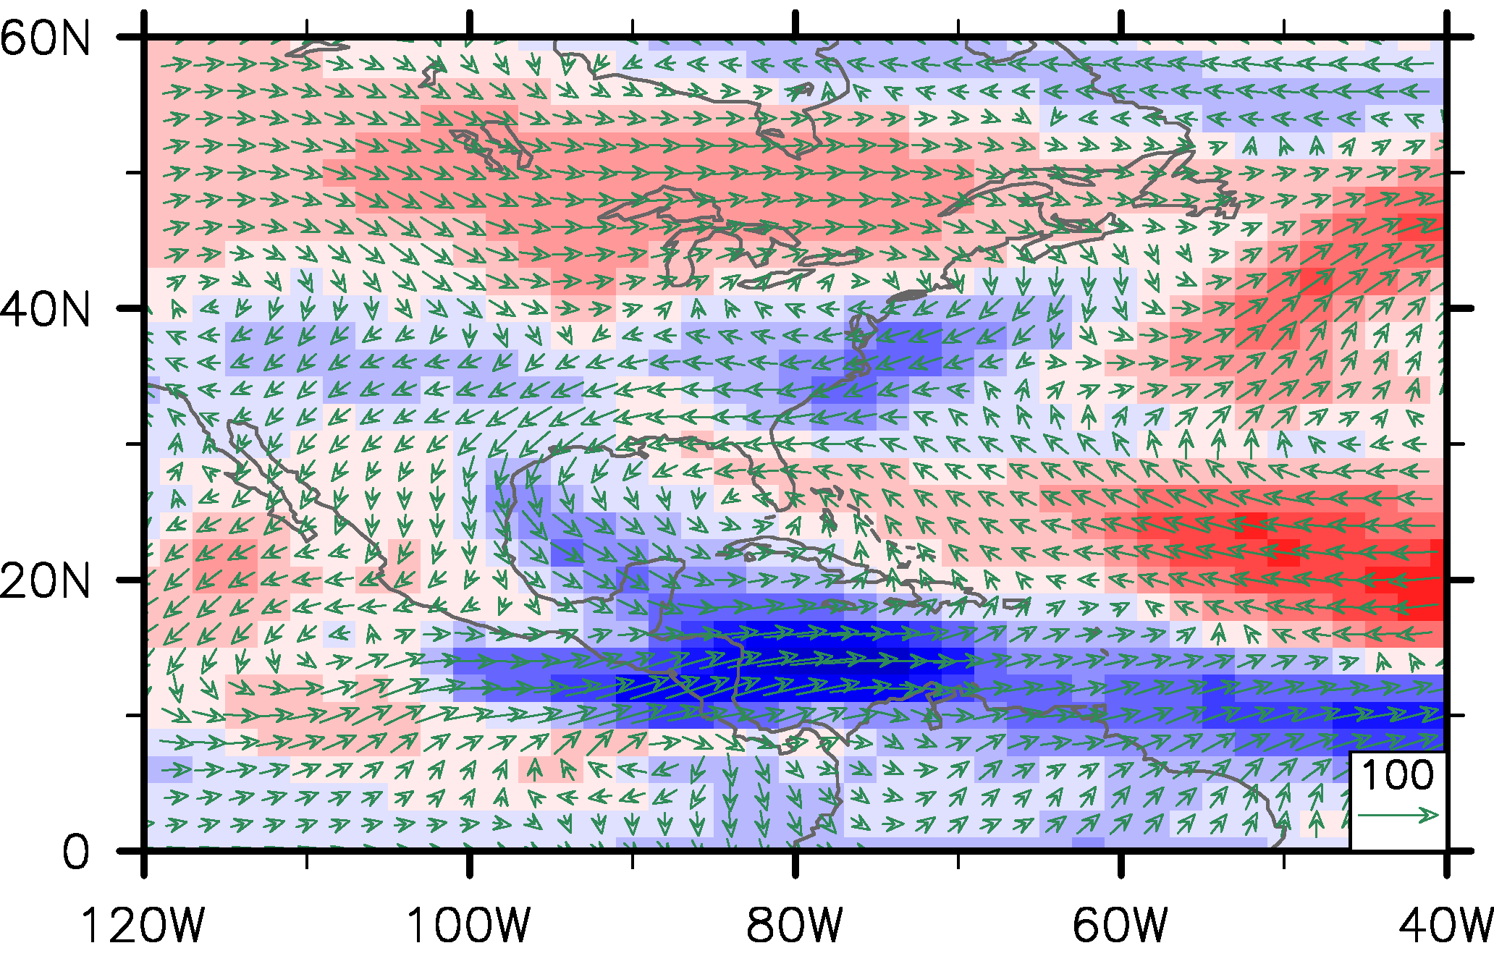
AWP and summer rainfall in the US
LAWP – SAWP: Moisture Flux (JAS) – 20CR
During large AWP years, the NALLJ tends to weaken over the South and Southeast and strengthen over the Ohio Valley
These regional changes in the NALLJ are linked to AWP-induced tropical and extra-tropical atmospheric anomalies

Slide 12
Recent advances in IAS climate research
Spring and early summer US tornado activity is linked atmosphere-ocean variability in the IAS (Munoz and Enfield, 2011; Lee et al. 2013; 2016; Jung and Kirtman, 2016)
High-resolution CGCM studies showed that IAS ocean mesoscale variability plays active role in driving climate variability in the US (Putrasahan et al., 2016)
Barrier layer in the IAS plays an important role for rapid hurricane intensification (e.g., Balaguru et al, 2012; Domingues et al., 2015).

Slide 13
Recent advances in IAS climate research
Projected weakening of the AMOC in the 21C will suppress the relative strength of the AWP, which will reduce rainfall in Central America and Atlantic hurricane activity in the 21C (Lee et al. 2011).
High-resolution downscaling simulations showed that due to the projected AMOC slowdown, the WBC system in the IAS will weaken, which will reduce coastal upwelling. This may result in rapid warming in the northern Gulf of Mexico and southern Caribbean Sea (Y. Liu et al, 2012; 2015; 2016).
Projected weakening of the AMOC may accelerate sea level rise in the east coast of South Florida (e.g., Park and Sweet, 2015; Wdowinski et al, 2016)

Slide 14
Current Status of IAS modeling & observations
Cold and dry bias in the IAS remain unresolved in both CMIP3 and CMIP5 (Misra et al. 2009; Kozar and Misra 2012; H. Liu et al. 2012, 2013; Martin and Schumacher, 2012; Ryu and Hayhoe 2014; Sheffield et al. 2013)
IAS region displays a highly heterogeneous distribution of rainfall. However, the rain gauge and radiosonde networks are sparse and temporally incomplete. This raises a challenge for observing and monitoring the climate of the region (Misra et al., 2015).
ARGO floats, which have the operating depth of about 2000m cannot pass the Lesser Antilles to reach the Caribbean Sea. As a result, the IAS is currently as poorly observed as the polar oceans (Misra et al., 2015).
NSF funded a GPS-based atmospheric sounding initiative: the Continuously Operating Caribbean Observation Network (COCONet) in 2011. COCONet is establishing a network of continuous GPS and meteorology stations over the Central America (http://coconet.unavco.org)
A pilot underwater glider project for the IAS started in 2014 (http://www.aoml.noaa.gov/phod/goos/glider)

Slide 15
Pathways to move forward
CMIP5 models continue to show large bias in the IAS. CMIP5 models do not resolve regional atmosphere-ocean processes in the IAS (e.g., regional convection processes and Loop Current). Fully-coupled high-resolution regional downscaling simulations could be useful.
Coordinated intensive field observations can be planned to provide high temporal and spatial resolution atmospheric and oceanic to better understand local and regional physical process and to provide high quality datasets for improving models.
High resolution modeling studies could be coordinated with intensive field programs to improve global model physical parameterizations.

Slide 16
For more information
Misra, V, C. Wang , Y. Serra, K. Karnauskas , E. M. Ellinor, J. Sheinbaum, P. Chang, S.-K. Lee, B. Rosenheim, B. Kirtman, D. Enfield, E. D. Maloney, A. Kumar, G. Poveda, R. Fu, J. Jouanno, S. Berthet, A. Mishra, M. Bourassa, J. Candela, and J. Ochoa, 2016: The Intra-Americas Sea: Challenges and Opportunities to Understand North American Climate Variability and Predictability (ftp://ftp.aoml.noaa.gov/phod/pub/sklee/iasclip/IASCLiP_White_Paper_2015.pdf)
2015 IASCLiP (Intra-Americas Study of Climate Processes) Virtual Workshop (https://usclivar.org/meetings/2015-iasclip-virtual-workshop)
US CLIVAR Variations 2016 winter issue “The Intra-Americas Seas: Vital to regional climate & extreme events” (https://usclivar.org/sites/default/files/documents/2016/Variations2016Winter_0.pdf)
IASCLiP website: http://www.eol.ucar.edu/field_projects/iasclip
Contact Vasu Misra (vmisra@fsu.edu) or Sang-Ki Lee (sang-ki.lee@noaa.gov)

Slide 17
References
Balaguru, K., Chang, P., Saravanan, R., Leung, L. R., Xu, Z., Li, M., & Hsieh, J. S., 2012: Ocean barrier layers’ effect on tropical cyclone intensification. Proceedings of the National Academy of Sciences, 109 (36), 14343-14347.
Domingues, R., G. Goni, F. Bringas, S.-K. Lee, H.-S. Kim, G. Halliwell, J. Dong, J. Morell and L. Pomales, 2015: Upper-ocean response to Hurricane Gonzalo (2014): salinity effects revealed by sustained and targeted observations from underwater gliders. Geophys. Res. Lett., 42, 7131-7138, doi:10.1002/2015GL065378.
Jung, E. and B. Kirtman, 2016: Can we predict seasonal changes in high impact weather in the United States? Environment Research Letter, In-revision
Kozar, M. and V. Misra, 2012: Evaluation of twentieth-century Atlantic Warm Pool simulations in historical CMIP5 runs Clim. Dyn., 41(9-10), 2375-2391.
Lee, S.-K., C. Wang and B. E. Mapes, 2009: A simple atmospheric model of the local and teleconnection responses to tropical heating anomalies. J. Climate, 22, 272-284.
Lee, S.-K., D. B. Enfield and C. Wang, 2011: Future impact of differential inter-basin ocean warming on Atlantic hurricanes. J. Climate, 24, 1264-1275.
Lee, S.-K., R. Atlas, D. B. Enfield, C. Wang and H. Liu, 2013: Is there an optimal ENSO pattern that enhances large-scale atmospheric processes conducive to major tornado outbreaks in the U.S.? J. Climate, 26, 1626-1642.

Slide 18
References
Lee, S.-K., A. T. Wittenberg, D. B. Enfield, S. J. Weaver, C. Wang and R. Atlas, 2016: Springtime U.S. regional tornado outbreaks and their links to ENSO flavors and North Atlantic SST variability. Environ. Res. Lett., 11, 044008.
Liu, H., C. Wang, S.-K. Lee and D. B. Enfield, 2012: Atlantic warm pool variability in the IPCC twentieth-century climate simulations. J. Climate, 25, 5612-5628.
Liu, H., C. Wang, S.-K. Lee and D. B. Enfield, 2013: Atlantic warm pool variability in the CMIP5 simulations. J. Climate, 26, 5315-5336.
Liu, Y., S.-K. Lee, B. A. Muhling, J. T. Lamkin and D.B. Enfield, 2012: Significant reduction of the Loop Current in the 21st century and its impact on the Gulf of Mexico. J. Geophys. Res., 117, C05039.
Liu, Y., S.-K. Lee, D. B. Enfield, B. A. Muhling, J. T. Lamkin, F. Muller-Karger and M. A. Roffer, 2015: Potential impact of climate change on the Intra-Americas Seas: Part-1. A dynamic downscaling of the CMIP5 model projections. J. Marine Syst., 148, 56-69, doi:10.1016/j.jmarsys.2015.01.007.
Liu, Y., S.-K. Lee, D. B. Enfield, B. A. Muhling, J. T. Lamkin, F. E. Muller-Karger, and M. A. Roffer, 2016: Past and future climate variability in the Intra-Americas Sea and its impact on the marine ecosystem and fisheries, US CLIVAR Variations, Vol. 14, No. 1, 27-32.

Slide 19
References
Martin, E.R., and C. Schumacher, 2011: Modulation of Caribbean precipitation by the Madden–Julian oscillation. J. Climate, 24, 813–824.
Misra, V., S. Chan, R. Wu, and E. Chassignet, 2009: Air-sea interaction over the Atlantic warm pool in the NCEP CFS. Geophys. Res. Lett., 36, L15702.
Muñoz, E., and D. Enfield, 2011: The boreal spring variability of the Intra-Americas low-level jet and its relation with precipitation and tornadoes in the eastern United States. Climate Dyn., 36, 247–259.
Park, J., and W. Sweet, 2015: Accelerated sea level rise and Florida Current transport. Ocean Science 11(4), 607-615.
Putrasahan, D. I. Kamenkovich, B. Kirtman and L. K. Shay, 2016: Ocean mesoscale variability in the Gulf of Mexico, US CLIVAR Variations, Vol. 14, No. 1, 10-14.
Ryu, J.-H. and K. Hayhoe, 2014: Understanding the sources of Caribbean precipitation biases in CMIP3 and CMIP5 simulations. Climate Dynamics 42.11-12, 3233-3252.
Sheffield, J., A. Barrett, B. Colle, R. Fu, K. L. Geil, Q. Hu, J. Kinter, S. Kumar, B. Langenbrunner, K. Lombardo, L. N. Long, E. Maloney, A. Mariotti, J. E. Meyerson, K. C. Mo, J. D. Neelin, Z. Pan, A. Ruiz-Barradas, Y. L. Serra, A. Seth, J. M. Thibeault, J. C. Stroeve, 2013: North American climate in CMIP5 experiments. Part I: Evaluation of 20th Century continental and regional climatology. J. Climate, 26, 9209-9245.

Slide 20
References
Wang, C., and D.B. Enfield, 2001: The tropical Western Hemisphere warm pool. Geophysical Research Letters, 28:1635-1638
Wang, C., and D.B. Enfield, 2003: A further study of the tropical Western Hemisphere warm pool. Journal of Climate, 16:1476-1493
Wang, C., 2005: ENSO, Atlantic climate variability, and the Walker and Hadley circulations. In: The Hadley Circulation: Present, Past, and Future. H. F. Diaz and R. S. Bradley, Eds., Kluwer Academic Publishers, 173-202
Wang, C., S.-K. Lee, and D. B. Enfield, 2007: Impact of the Atlantic warm pool on the summer climate of the Western Hemisphere. Journal of Climate, 20:5021-5040
Wang, C., S.-K. Lee, and D. B. Enfield, 2008: Atlantic warm pool acting as a link between Atlantic multidecadal oscillation and Atlantic tropical cyclone activity. Geochem. Geophys. Geosyst., 9, Q05V03.
Wang, C., H. Liu, S.-K. Lee, and R. Atlas, 2011: Impact of the Atlantic warm pool on United States landfalling hurricanes. Geophysical Research Letters, 38, L19702.
Wdowinski, S., R. Braya, B. P. Kirtmana and Z. Wub, 2016: Increasing flooding hazard in coastal communities due to rising sea level: Case study of Miami Beach, Florida. Ocean & Coastal Management 126, 1-8.

