Slide 1
Argo and SOOP XBT Recent Activities and Results
Frederick Bingham
Kyla Drushka
Information for this presentation obtained from D. Roemmich and G. Goni (via R. Perez!)

Slide 2
Argo: Basic Facts
US Argo supported by NOAA, includes a 5-institution consortium and a data assembly center
US Argo activities include tech development, commercial acquisition, deployment and logistics, comms, data management, data analysis, international coordination and outreach
US operates 1890 of 3854 currently deployed floats

Slide 3
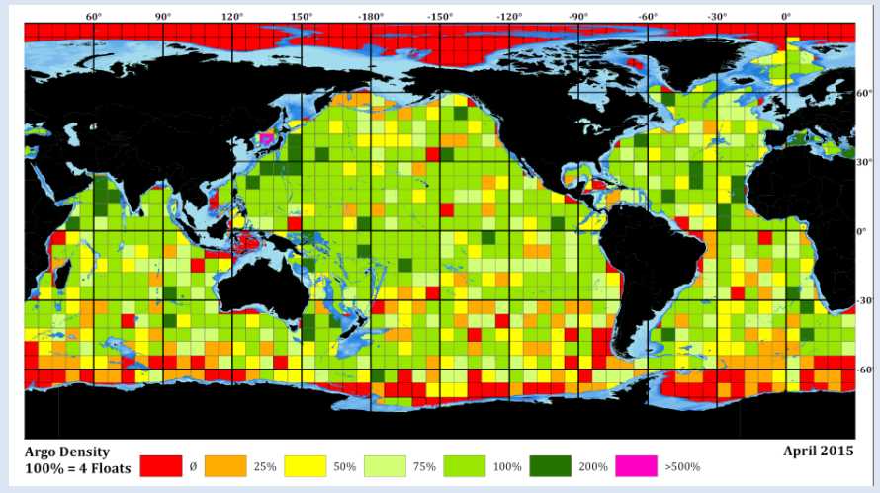
Argo: Basic Facts
Present coverage

Slide 4
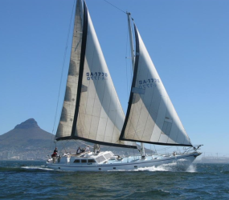
Argo: Recent Advances
Development and early deployment of Deep Argo (see Renellys’ talk)
More biogeochemical sensors
Major format change to Argo netCDF files to accommodate different types of sensors
Several gridded Argo products are available (MOAA GPV, Roemmich and Gilson, MIMOC, etc.)
More use of iridium communications (minimizes surface time, allows two-way control of float missions)
Deployment from non-traditional platforms (e.g. sailboats)
Schooner Lady Amber
>100 floats

Slide 5
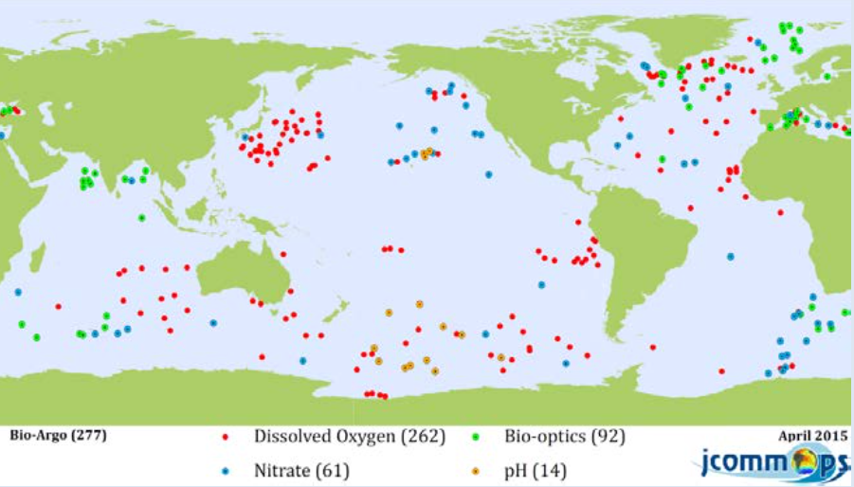
Argo: Future Plans
Enhanced spatial coverage in marginal seas, WBCs, equatorial regions, high latitudes (~4135 floats)
Implementation of Deep Argo
Continued development and deployment of BGC sensors

Slide 6
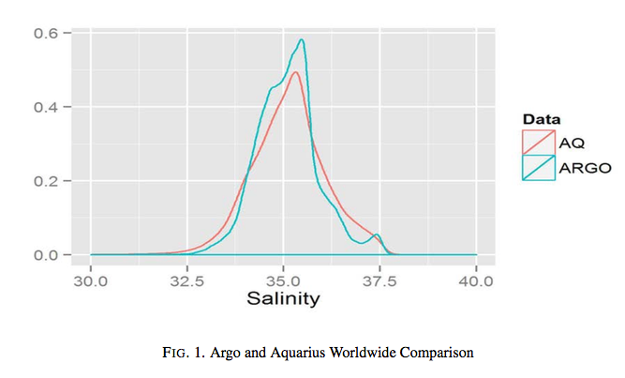
Argo: Synergies between Argo and other observing system elements
SSH and altimetry
Repeat hydrography. Complementary sampling and cross-calibration
Drifter network. Complementary estimates of dynamic topography
Tropical moored array. Estimates of subsurface variability
SSS – ground truth
SST
Mannshardt et al., 2015

Slide 7
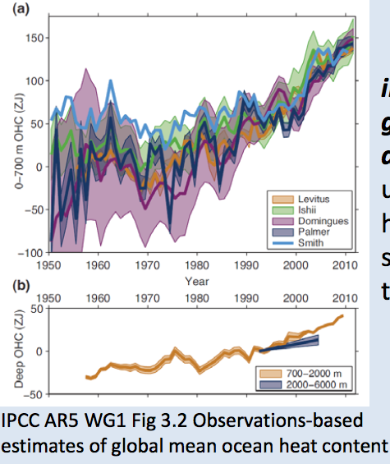
Argo: Accomplishments
2038 Research papers based on Argo
Global change assessment
Use in data assimilation models
Education

Slide 8
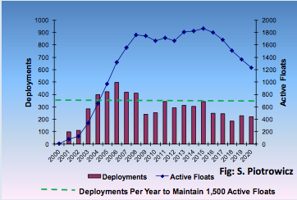
Argo: Challenges
Sustaining core array under level or decreasing budgets
Deployment inside EEZs and other restricted areas
Deployment priorities. Polar oceans? Regional seas?

Slide 9
XBT Network: Basic Facts
The XBT Network is an international program dedicated to the implementation, maintenance, enhancement, and data management of upper ocean measurements from XBTs
Science objectives: meridional heat transport, current variability (esp. WBCs), upper ocean heat content, model initialization and validation

Slide 10
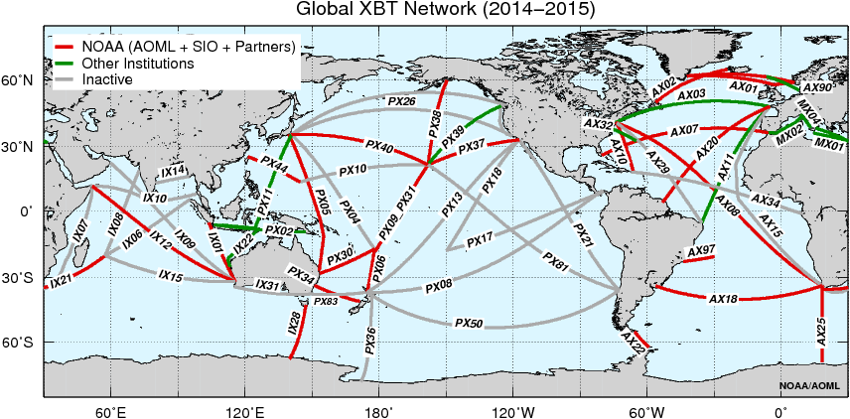
XBT Network: Distribution
28 active transects
Red = Active US

Slide 11
XBT Network: Boundary, surface and subsurface currents
: Boundary currents sampled by the XBT Network
XBT transects are sampling:
Western Boundary Currents:
Kuroshio (3 transects)
Gulf Stream (3 transects)
Agulhas Current, rings
Brazil Current, rings (2 transects)
East Australian Current (2 transects)
East Auckland Current and Tasman Outflow
Eastern boundary currents: California Current, Alaska Current, Leeuwin Current, …
Low latitude WBCs: Solomon Sea, Indonesian Throughflow
Equatorial System: NECC, NEUC (2 transects)
High latitude: Antarctic Circumpolar Current (3 transects)
Multiple transects across one current provide critical information on spatial changes in the structure

Slide 12
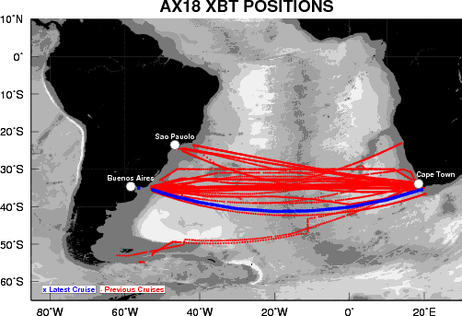
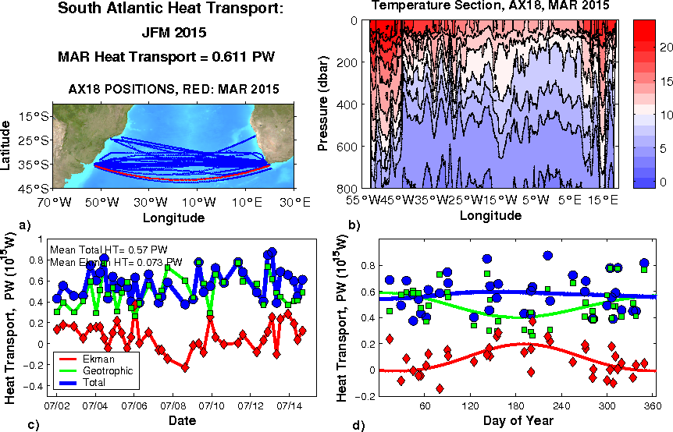
South and North Atlantic Meridional Overturning and
Meridional Heat Transport
AX07 (North Atlantic): Started in 1994 (21 years)
AX18 (South Atlantic): Started in 2002 (13 years):
42 Realizations
11,000 XBTs deployed
First sustained observations in the South Atlantic to monitor MOC/MHT, and Brazil-Agulhas Currents
Quarterly reports of MOC/MHT
Carried out ocean experiments to determine optimal sampling
http://www.aoml.noaa.gov/phod/soto/mht/reports

Slide 13
XBT Network: Recent Developments
Transition to Iridium communications
Redesign of autolaunchers, new data acquisition software
Program managed with international cooperation (US, Germany, France, Japan, …) by the SOOPIP
Important long-term datasets (10+ years)
Are the current transects the best ones to do?

Slide 14
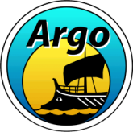
Deep Argo: Basic Facts
Systematic ocean observations > 2000 m are limited to ship-borne measurements sparse in time and deep moored arrays of confine spatial coverage
Coverage is not sufficient to describe the mean ocean circulation in many regions or the decadal property variations
Deep Argo Workshop
May 5-7th, 2015 in Hobart, Tasmania
30 participants, 6 countries
U.S., France, U.K., Australia, New Zealand, Japan
Information for this presentation obtained from N. Zilbermann and the Deep Argo workshop steering committee (Dean Roemmich, Susan Wijffels, Nathalie Zilberman, Guillaume Maze, Steve Riser, Toshio Suga, Katsuro Katsumata, Breck Owens, Greg Johnson, Brian King, Bernadette Sloyan)

Slide 15
Deep Argo: Motivation
50% of the ocean volume is at depth > 2000 m
12% of the ocean
volume is at depth > 4000 m
Deep ocean warming > 2000 m
intensified
below 4000 m
Purkey and Johnson, 2010
Purkey and Johnson, 2010
Deep ocean > 4000 m heat uptake equivalent to 0.027 Wm⁻² (~5 ZJ decade⁻¹), about half of the ocean below 2000 m
Regional signals > 4000 m are much larger

Slide 16
Deep Argo: Value
Operational application
Improve global ocean reanalysis and coupled ocean-atmosphere forecasting systems below 2000 m (assimilation, constraint, OSSEs, removal of deep bias)
2. Basic research
Significant progress in global heat budget and freshwater storage
Improve knowledge of regional distribution of regional sea level budget, and quantification of the causes of sea level change
Provide basin coverage of deep ocean circulation
Resolve abyssal decadal signal changes locally not just globally
Many other research topics (mixing, ice melting, TS structure, ...)
3. Mutidecadal climate change assessment
IPCC AR5, BAMS state of the climate reports, ...
4. Education (as demonstrated for Argo)

Slide 17
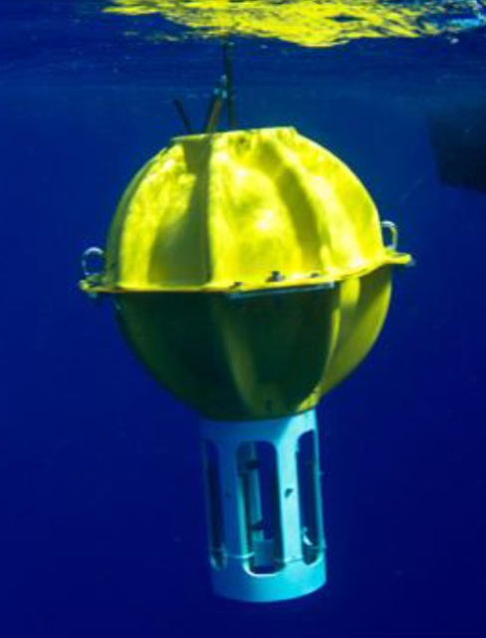
Deep Argo: Float models
Deep NINJA
TSK Co LTD, JAMSTEC
0 – 4000 m
SBE-41 CTD
50 kg
15 deployed so far
Deep APEX
TWR, UW
0 – 6000 m
SBE-61 CTD
43 cm glass sphere
2 Prototypes deployed
Deep ARVOR
NKE, CNRS, IFREMER
0 – 4000 m
SBE-41 CTD
26 kg
4 Prototypes deployed
Deep SOLO
SIO
0 – 6000 m
SBE-61 CTD
25 kg
33 cm glass sphere
3 Prototypes deployed

Slide 18
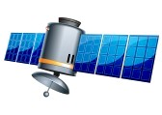
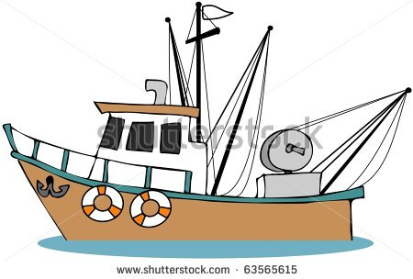
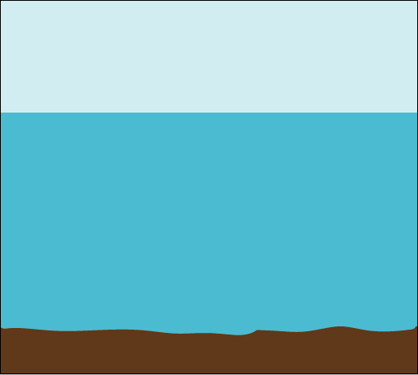
Technical aspects of Deep Argo floats under discussion
Deep NINJA
Deep Apex
Deep SOLO
Deep
Arvor
Deep Argo float cycle
Cycle time
Parking depth at 1000 m
Cycle time – aim for array refresh time of 5 years (15-day cycle)
Collect data during ascent or descent
Parking depth. Bottom landing
Vertical resolution of profile
CTD accuracy requirements: ±0.001°C, ±0.002 salinity, ±3 dbar)
Meeting temperature accuracy goal, working towards salinity and pressure goal.
Measure temperature and salinity during descent or ascent
Descend to 4000-6000 m or near bottom if shallower
Parking depth at 3000-5500 m
Deep Arvor Deep NINJA
Deep SOLO
Deep Apex

Slide 19
Deep Argo: Recent Developments
A Workshop was held to discuss technology developments for Deep Argo, scientific and operational rationales, and plans for future work
4 designs of Deep Argo floats have been developed and tested with depth ranges of 4000 m and 6000 m
A Deep Argo CTD has been developed by SBE in collaboration with NZ/US/Aus. Argo and deployed in shipboard casts and float profiling, with encouraging results.
Regional pilot arrays of Deep Argo floats have begun and will continue in 2015-2016 in the Southern Ocean, SW Pacific, and North Atlantic
Core Argo
2000 m
Deep Argo
4000 m

Slide 20
Southwest Pacific Ocean
2 Deep SOLO in 2014
8 Deep SOLO, 2 Deep Apex in 2015
Deployment opportunity in 2016 (R/V Investigator, CSIRO, P15S)
Flat abyssal plain w/ substantial deep warming, limited eddy activity
North Pacific Ocean and Southern Ocean
North Atlantic Ocean
2 early (3500m) Deep Arvor in 2012-2013
2 Deep Arvor prototypes (4000 m) in 2014
9 Deep Arvor in 2015
North Atlantic deep water formation rates and characteristics
15 Deep NINJA deployed in 2012-2014
3 Deep NINJA in 2015
Engineering test (3,Pacific Ocean), water mass formation and deep MOC (12,Southern Ocean)

Slide 21
Deep Argo: Straw Plan
Greg Johnson
Plan: 2-3 year pilot arrays before global implementation
Sample to the ocean bottom (up to 6000 m)
5° x 5° spacing: ~1200 floats, based on decorrelation statistics
Start at high latitudes (deep-ocean warming signal) -> equator -> global
Challenges: Funding, CTD technical challenges, float endurance, leverage international collaboration between partners

